Slide 1
Project 23Bis: Text Categorization – ACM Classification

Slide 2
Group Members

Slide 3
Abstract
In this project I’ll be extracting information from various ACM Library articles with the objective of learning patterns in them and finally be able to make a information retrieval system. These articles are COVID-19 related and the data extracted is composed of: the article’s title, the article’s abstract, the article’s author tags and finally the article’s CCS Concepts.

Slide 4
Topics
Webscraping
Text retrieval systems
Data interpretation

Slide 5
Previous works / Resources used
https://www.analyticsvidhya.com/blog/2018/04/a-comprehensive-guide-to-understand-and-implement-text-classification-in-python/
https://www.acm.org/publications/class-2012

Slide 6
Technologies and tools used
Project is done in python
Libraries used:
  Requests
  BeautifulSoup
  Pickle
  Matplotlib
Jupyter notebooks

Slide 7
Technologies and tools that will be used
Thesaurus API
Word2Vec
Nltk library for tf-idf calculation among others
Might use other languages for task 10’s interface

Slide 8
Implementation details: Webscraping
Objective: extract the data from the 30 first articles that show as a result of searching “COVID-19” for each month since Dec-2020 to Sep-2021.
In order to “search” COVID-19 in each month I simply manipulated the url of the first search (December 2019) to fit one by one the rest of the months.
Then from each search I extract the urls of the first 30 results using BeautifulSoup
Finally I loop through these links to get the articles’ urls and extract the information from them (using BeautifulSoup again).

Slide 9
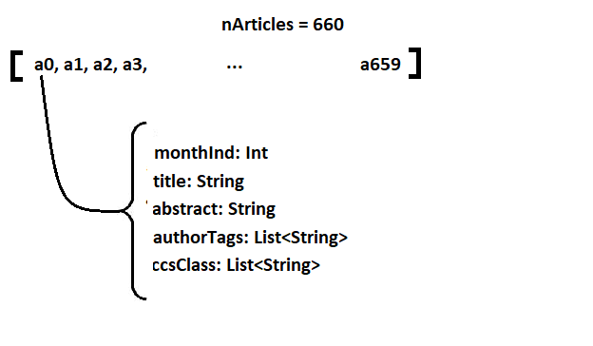
To extract different parts of the website with BeautifulSoup custom filters were used to find each type of tag.
The data was stored using pickle in a python list with the following structure:

Slide 10
Implementation: Processing of related data
Number of search results:
  Every month, apart from the articles, the amount of results the search gave was saved and later visualized using matplotlib in a jupyter notebook
Most popular author tags
Most populat CCS Concepts
  First in a dictionary, for every CCS Concept/Keyword, each time it appeared the month it appeared in was saved.
  Then they were sorted according to the number of appearances (length of the list)
  Finally, for the top CCS Concepts/Keywords, A list was made where every item represented one month and the item’s value represented the ammount of times that CCS Concept/Keyword appeared that month.
These results are stored in QuickData

Slide 11
Implementation: Future Tasks
Most other tasks have similar nature to the ones already made in the sense that they simply process the data webscraped in a certain way to produce new data and it’s then represented in some way.
The only task that can change the tools used significantly is the last one as it requires an interface. For the rest of them the use of a new library should be enough.

Slide 12
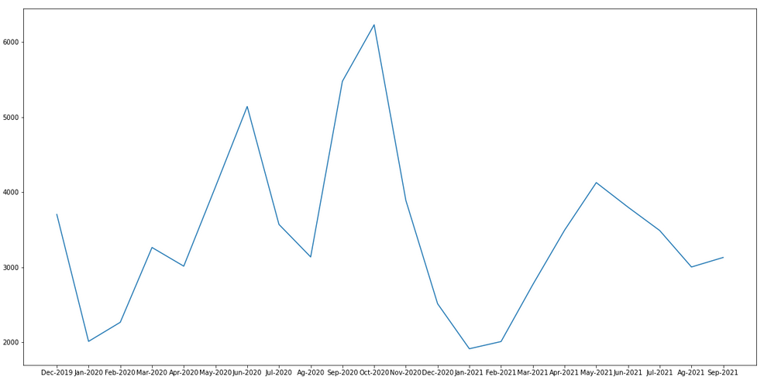
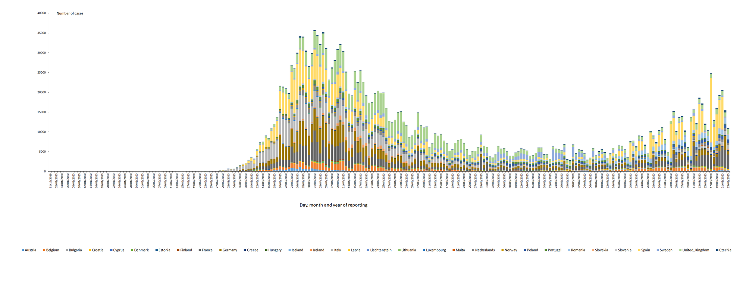
Current Results so Far
Tasks done: 1,2,3,4

Slide 13
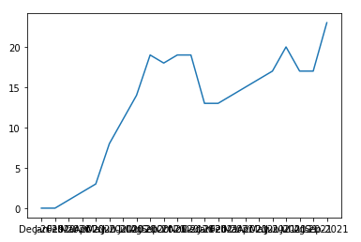
Current Results so Far
Covid Keyword:

Slide 14
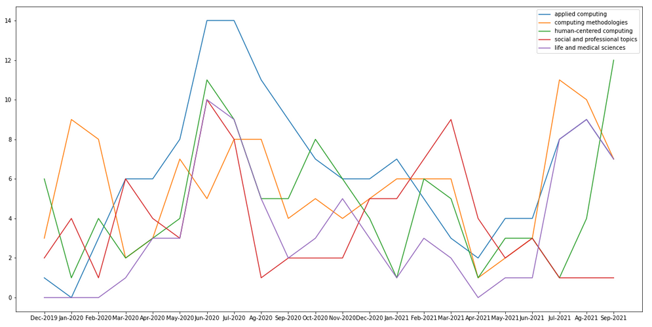
Current Results so Far

Slide 15
Plan until final submission
Thursday: task 5 and 6
Friday: start of task 7
Saturday and Sunday: Work in the project is not planned
Monday: task7, 8 and 9
Tuesday: report writing
Wednesday: Finishing touches. Report revision, code cleanup and submission.

