Slide 1
UE20CS334 – NLP Project Approval
Project title : Poetic/Literary Device Detection and Meaning Extraction
Project ID : 3
Project Team Students Names:
Ajay Anil Kumar
C V Eswar Sai Reddy
Rudra Narayan Samanta

Slide 2
Outline
Problem Statement
Scope and Application of the problem
Feasibility Study
High level design

Slide 3
Problem Statement
Automating the process of identifying and categorizing literary devices such as metaphor, simile, alliteration, rhyme, and imagery in a given text, which can be time-consuming and subject to human error.

Slide 4
Scope and Application of the problem
The application developed can be used by students to understand the poem better. Whether the student is improving his/her writing skills or studying for an English exam, literary devices are important to know.
The model can also be used by teachers as a way of teaching poems to students.
The model can be used to create datasets for literary/poetic devices (like WordNet) which can be used to train wide range of models

Slide 5
Feasibility Study
Purpose:
To recognise literary/poetic devices in written material / poems and to determine their meanings.

Slide 6
Feasibility Study
Requirements:
NLP tools and libraries
Text/Poetic data to train and test the model(s)
ML model(s) which can perform NLP and semantic analysis
Resources to identify the correctness of the model (for testing)

Slide 7
Feasibility Study
Challenges:
There aren't many annotated text corpora available.
Difficult to identify and extract literary/poetic devices' meaning
Overcoming the diversity of writing types and styles.

Slide 8
Feasibility Study
Method of approach:
There are datasets which can be used to complete the project, like dataset of words, their meaning and usage of the word in sentences
These datasets allow us to extract required data related to literary/poetic devices and helps to complete the project

Slide 9
Abstract
Poetic/Literary Device Detection and Meaning Extraction: Batch 3
This project aims to develop a machine learning approach for the detection and extraction of poetic and literary devices in text. The proposed approach will use natural language processing techniques to automatically identify various devices such as similes, metaphors, personification, and alliteration. The model will also extract the intended meaning of these devices in context, providing insights into the author's use of language and the underlying themes and emotions conveyed in the text. The project has potential applications in various fields such as literary analysis, sentiment analysis, and content generation. The ability to automatically detect and extract literary devices from text can help in deeper understanding and interpretation of literary works, improve language-based applications and aid in the creation of more engaging and impactful content.

Slide 10
Motivation and Scope of the Project
Poetic/Literary Device Detection and Meaning Extraction: Batch 3
The motivation behind the project "Poetic/Literary Device Detection and Meaning Extraction" is to develop a machine learning approach for the automatic identification and extraction of various poetic and literary devices in text.
The scope of the project includes the development of a model that can detect devices such as similes, metaphors, personification, alliteration, and others. The model will also extract the intended meaning of these devices in context. The project will leverage natural language processing techniques such as part-of-speech tagging, named entity recognition, and sentiment analysis to achieve its objectives.

Slide 11
Suggestions from Review - 1
Poetic/Literary Device Detection and Meaning Extraction: Batch 3
Take a deeper dive into various techniques and models

Slide 12
Individual Information on Literature Survey
Poetic/Literary Device Detection and Meaning Extraction: Batch 3
S.N. | Name of the Student | SRN | Paper | Paper Title
1 | Ajay Anil Kumar | PES2UG20CS028 | 1 | Deep Learning Metaphor Detection with Emotion-Cognition Association
 |  |  | 2 | A Knowledge Graph Embedding Approach for Metaphor Processing
 |  |  | 3 | Metaphor Detection in a Poetry Corpus
 |  |  | 4 | DeepMet: A Reading Comprehension Paradigm for Token-level Metaphor Detection
2 | C V Eswar Sai Reddy | PES2UG20CS096 | 5 | Detecting oxymoron in a single statement (Oxymoron)
 |  |  | 6 | The Enrichment of Arabic WordNet Antonym Relations (Oxymoron)
 |  |  | 7 | Personifying INanimate Entities by Acquiring Parallel Personification Data for Learning Enhanced Generation (Personification)
 |  |  | 8 | Part-Of-Speech Tagging for Social Media Texts (Both)
3 | Rudra Narayan Samantha | PES2UG20CS286 | 9 | Neural Simile Recognition with Cyclic Multitask Learning and Local Attention
 |  |  | 10 | Neural Multitask Learning for Simile Recognition
 |  |  | 11 | Combining Part-of-Speech Tags and Self-Attention Mechanism for Simile Recognition
 |  |  | 12 | Automatic Recognition of Simile Based on Sequential Model

Slide 13
Literature Survey – 1: Paper 1, 2, 3, 4
Poetic/Literary Device Detection and Meaning Extraction: Batch 3
Paper Details (Citation) | Objective of paper, Techniques/Methods | Detailed Explanation along with results | Limitations
Deep Learning Metaphor Detection ... (IEEE 2022) | 4 types of features are extracted – deep feature, emotional feature, cognitive feature and hidden feature. | In comparison with all the other existing works in the same domain, the method proposed in this paper shows better performance. (0.83 F1) | For future work, the process of finding the contextual features through the right understanding of metaphor could be further explored.
A Knowledge Graph … (IEEE 2020) | The proposed method consists of two main components: a knowledge graph construction module and a metaphor detection module. | We combine our embeddings with Tencent embeddings by concatenating them together for classification, and the combination can lead to the best performance. | Should investigate methods to incorporate the learned embeddings for other types of metaphors such as token level contextual metaphor detection.
Metaphor Detection in a Poetry Corpus. (2017 Association for Computational Linguistics) | -Building and annotating the corpus -Rule based Metaphor detection -Statistical based Metaphor detection | the recall of the non-metaphor class is lower at 0.670 than for the class metaphor at 0.804. | deep-learning classifiers such as CNN, so as to improve precision further.
DeepMet (2020 Association for Computational Linguistics) | The approach encodes the global text, local text and question information as well as incorporating the POS features on two granularity. | The experimental results show that FGPOS features have a greater impact on the model than POS features | Through error analysis, we find that the multiple words trigger metaphor will affect the performance of the metaphor detection model.

Slide 14
Literature Survey – 2: Paper 5, 6, 7, 8
Poetic/Literary Device Detection and Meaning Extraction: Batch 3
Paper Details (Citation) | Objective of paper, Techniques/Methods | Detailed Explanation along with results | Limitations
Detecting oxymoron in a single statement – IEEE 2017 | Propose a novel evaluation scheme for word vector representation using oxymoron Offset vectors and deterministic algorithm are used to check if pair of words are contradictory or not | Highest accuracy of 67 percent is observed in this paper. Word pairs are taken and lemmatization is performed. The relation between the words is obtained from the results of lemmatization | The proposed method resulted in less accuracy even after multiple improvements and very less research work is done in this field
The Enrichment of Arabic WordNet Antonym Relations – Springer 2017 | Propose a pattern-based approach to extend the relations using arabic corpus and a corpus analysis tool | The paper demonstrated a way to group words from the given sentence – hence extracting oxymorons from the given sentences. There is no accuracy associated with this paper as the paper. | Fine-tuning of the model is required and Arabic WordNet has very less support which is a downside
Personifying INanimate....Learning Enhanced Generation - COLING 2022 | Create a corpus of personifications and personify literal sentences. Seq2seq model is used to literal input. | The paper obtained 97 percent accuracy in human validation. They identified topic – attribute (object - action) from the dataset and used them to personify the literal input | Dependency on parallel data, focuses on personification of unanimated objects, limited evaluation
Part-Of-Speech Tagging for Social Media Texts - Springer 2013 | Identify different parts of speech from social media text corpus | Different taggers like TreeTagger, TnT, etc are used to perform the POS tagging. It is observed that TreeTagger got highest accuracy – 93.72% | Input data should be collected from vast range of sources for better real-world accuracy

Slide 15
Literature Survey – 3: Paper 9, 10, 11, 12
Poetic/Literary Device Detection and Meaning Extraction: Batch 3
Paper Details (Citation) | Objective of paper, Techniques/Methods | Detailed Explanation along with results | Limitations
Neural Simile Recognition with Cyclic Multitask Learning and Local Attention(IEEE-2020) | Novel cyclic multitask learning method for simile detection | Uses a Bi-LSTM based Sentence Encoder , classifies by Local Attention based Simile Sentence method and CRF based Component Extractor to find the components of the sentence. the cyclic multitask learning approach improves performance by better capturing the interdependence between the simile sentence classification and simile component extraction subtasks | model is trained on a limited set of simile types and may not perform well on other simile types,and lacks generalization.
Neural Multitask Learning for Simile Recognition(ACL 2018) | neural multitask learning framework jointly optimizing three tasks: simile sentence classification, simile compo- nent extraction and language modeling. | Uses a simile sentence classification and a simile component extractor . A component is judged to be correct only if both the boundary and the tag exactly match the gold answer. | the framework assumes that the two subtasks (simile sentence classification and simile component extraction) have a linear relationship the proposed model relies on the availability of large amounts of labeled data, which may not be feasible for all applications
Combining Part-of-Speech Tags and Self-Attention Mechanism for Simile Recognition(IEEE 2019) | improve the accuracy of simile recognition using a combination of part-of-speech (POS) tags and self-attention mechanisms | combining both POS tags and a self-attention mechanism allows the model to capture both syntactic and semantic information in simile sentences, leading to improved performance. | it may struggle with particularly complex or subtle simile expressions that are not well-represented in the training data.
Automatic Recognition of Simile Based on Sequential Model(IEEE 2017) | sequential model to capture the sequential dependencies between words in a sentence. | The model consists of a discriminant part ,labelling part and a feature selection part result shows that the use of sequential model containing both classifier and sequence labeler can effectively identify the phenomenon of simile in Chinese | the proposed model only uses simple features such as word embeddings and part-of-speech tags, which may not be sufficient to capture the complex semantic and syntactic relationships between words in simile expressions.

Slide 16
Summary: Learning from Literature Survey
Poetic/Literary Device Detection and Meaning Extraction: Batch 3
The papers we have referred to, tell us the methods in which we can detect a few of these literary devices. We can improve some of these detection algorithms and can also create our own algorithms.
The methods used in these papers haven't been tested with poetry.

Slide 17
Personification – Definition
Poetic/Literary Device Detection and Meaning Extraction: Batch 3
Personification is a literary device which is used to attribute human (animate) characteristics to something that is not human (inanimate).
Examples:
The sun smiled down on us.
The story jumped off the page.
The light danced on the surface of the water.

Slide 18
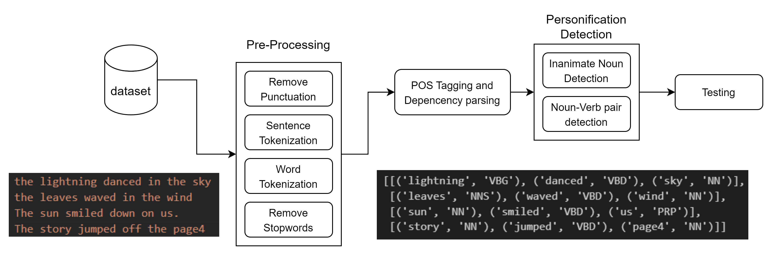
High Level Architecture Diagram - Personification
Poetic/Literary Device Detection and Meaning Extraction: Batch 3

Slide 19
Metaphor – Definition
Poetic/Literary Device Detection and Meaning Extraction: Batch 3
Metaphor is a literary device that describes something by saying it’s something else. It pulls comparisons between two unrelated ideas.
Examples:
Life is a highway.
Her eyes were diamonds.
He is a shining star.

Slide 20
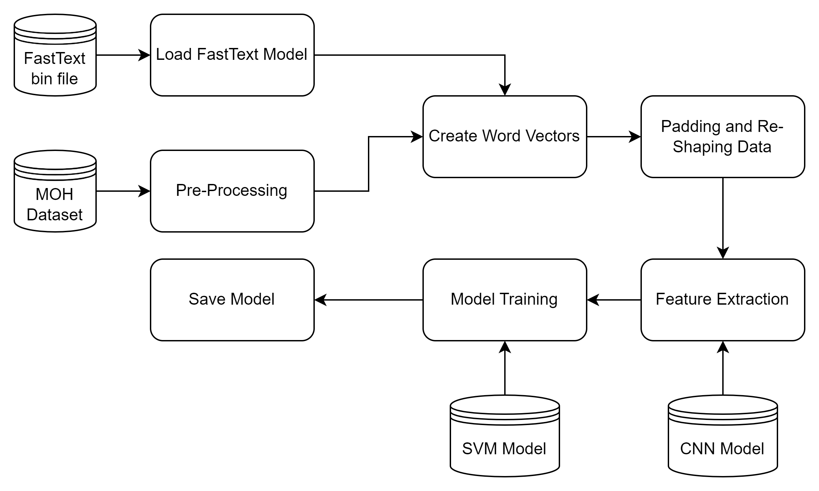
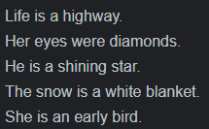
High Level Architecture Diagram - Metaphor
Poetic/Literary Device Detection and Meaning Extraction: Batch 3

Slide 21
Oxymoron – Definition
Poetic/Literary Device Detection and Meaning Extraction: Batch 3
Oxymoron is a literary device in which two words with opposite meanings are used together to create a new meaning.
Examples:
My work desk is an organized mess.
This is just the false truth.
My sister and I had a friendly fight.

Slide 22
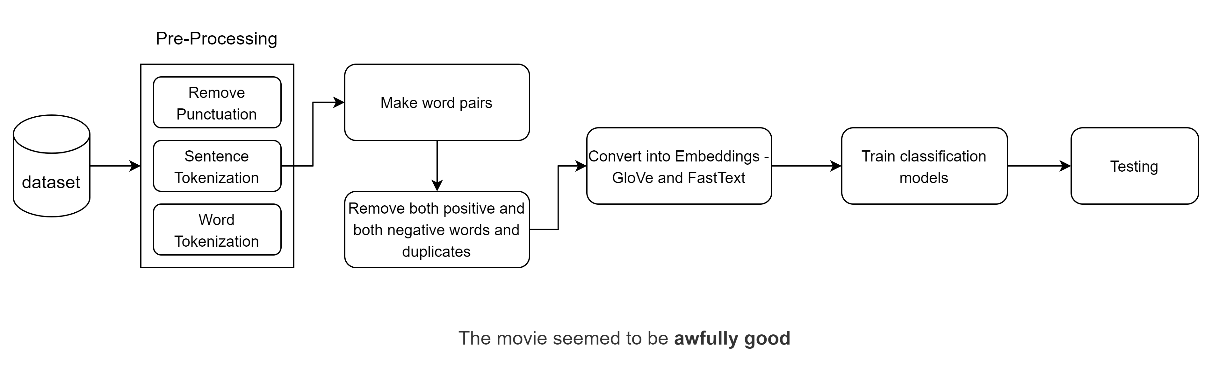
High Level Architecture Diagram - Oxymoron
Poetic/Literary Device Detection and Meaning Extraction: Batch 3

Slide 23
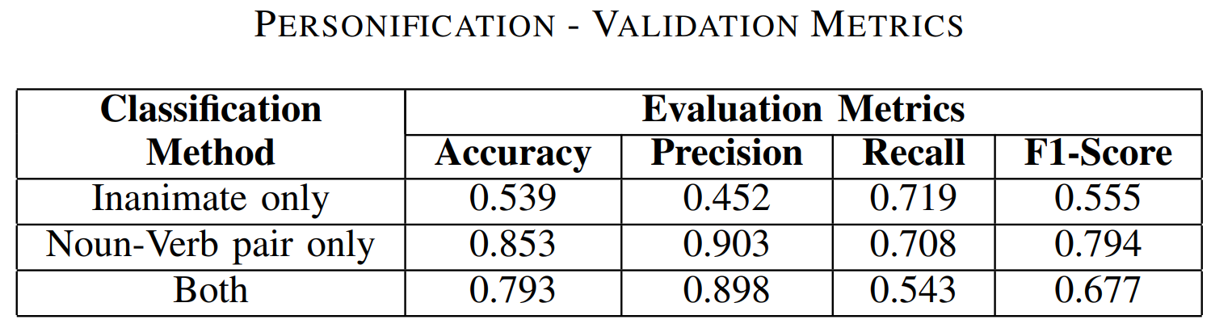
Results - Personification
Poetic/Literary Device Detection and Meaning Extraction: Batch 3

Slide 24
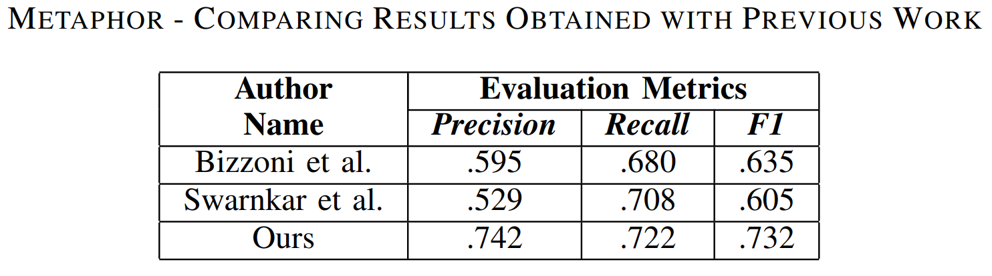
Results - Metaphor
Poetic/Literary Device Detection and Meaning Extraction: Batch 3

Slide 25
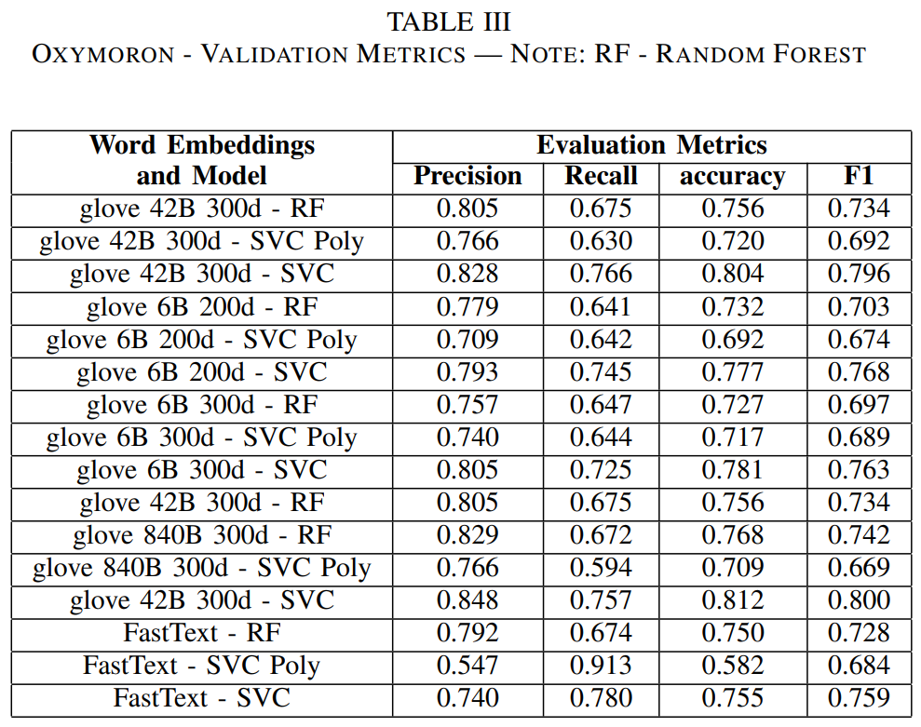
Results - Oxymoron
Poetic/Literary Device Detection and Meaning Extraction: Batch 3

Slide 26
Novel Component
Poetic/Literary Device Detection and Meaning Extraction: Batch 3
The method proposed to identify personification using word embeddings created using Word Synsets and their types is not done before.
Usage of classification models for detecting oxymorons (or) antonyms by using the difference vector of word embeddings of two words as input to the models is not done before.
Our method to identify metaphor doesn’t involve using hand-crafted features and custom embeddings where as previous deep learning models used custom embeddings and hand-crafted features.

Slide 27
Conclusion
Poetic/Literary Device Detection and Meaning Extraction: Batch 3
An approach of identifying three different literary devices, namely Personification, Metaphor and Oxymoron is proposed through this project. The main drawback which we faced for our project is not having enough data. Collecting more amount of data related to each literary device will surely help to get better results. Our approaches gave better results than some of the papers which we referred. As having less data is one of the major drawback of the project collecting more data should help to make the models better. This project helped us to explore different concepts and get hands-on experience in Natural Language Processing.

Slide 28
Future Work
Poetic/Literary Device Detection and Meaning Extraction: Batch 3
More data should be collected to make the literary device identification better.
References to a noun are not being considered when identifying personification and this is making the model miss some occurrences of personificaiton. Performing NER and mapping pronouns with their respective nouns should help to increase the model’s performance.
Identifying the parts of embeddings which are affecting the outcome of models should be identified and models should be refined to get better results in oxymoron detection.

