Slide 1


AI-Based Crop Recommendation System
KPR Institute of Engineering and Technology, Coimbatore 641 407
Department of Electronics and Communication Engineering
Review 1
Batch Number: [Enter Batch Number]
Team Members:
  Kiruthika Devi M D [23EC057]
  Hari Prakash M [23EC035]
  Eswar V [23EC026]
Guided By
  Dr.Kalamani M
  EC/Professor

Slide 2
Introduction/ Problem Statement/ Objective
Reliance on traditional intuition leads to suboptimal crop selection, without data-driven guidance on soil or climate suitability.
Soil degradation is worsened by improper fertilizer application, causing Nitrogen, Phosphorus and Potassium (N-P-K) imbalance.
Crops unsuited to regional climate conditions cause severe financial losses and reduced yield for farmers.
Objective: Build a data-driven decision support system that recommends the optimal crop using real-time soil nutrient and atmospheric parameters.

Slide 3
Literature Survey
S. No | Title of the Article and Year | Authors | Key Findings | Limitations
1. | [Base Paper — Crop Recommendation using ML]
2. | [Ref — Random Forest for Agri Prediction]
3. | [Ref — Soil Nutrient Analysis Systems]

Slide 4
Literature Survey
S. No | Title of the Article and Year | Authors | Key Findings | Limitations
4. | [Ref — IoT-based Precision Agriculture]
5. | [Ref — Full-Stack Agri-Tech Dashboards]
6. | [Ref — Weather-Integrated Crop Advisory]

Slide 5
Hardware Components and Software Requirements
Hardware Components
Development Laptop/PC — 1 — ML training & full-stack dev — Available
Raspberry Pi Zero 2 W — 1 — IoT telemetry gateway — To be Purchased
RS485 Modbus Soil NPK Sensor — 1 — measures N, P, K — To be Purchased
DHT22 Sensor — 1 — air temperature & humidity — To be Purchased
Analog Soil pH & Moisture Probe — 1 — soil pH/moisture — To be Purchased
Software Components
Frontend: React.js + Vite + CSS3 (SPA dashboard)
Backend API: Node.js & Express.js (REST API, JWT auth, PostgreSQL)
ML Engine: Python + Flask + Scikit-Learn (Random Forest API)
Database: PostgreSQL (Users, Predictions, History)
IDE/Tools: VS Code, Postman, Git & GitHub

Slide 6
Current Implementation / Progress
Dataset of 2,200 agricultural samples across 22 crop categories collected and preprocessed. Random Forest Classifier (100 trees, max depth 15) trained and validated, achieving 99.3% accuracy. Flask ML inference API built and tested locally. React frontend and Express/PostgreSQL backend scaffolded, with JWT authentication and core prediction form implemented.

Slide 7
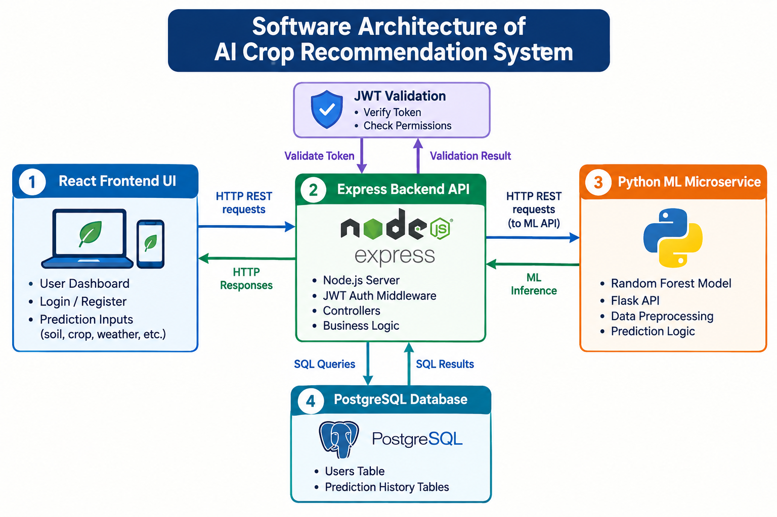
Block Diagram / Flow Diagram/ Circuit Diagram
System data flow from user input to prediction and back, with the IoT sensor extension shown below.

Slide 8
Initial Results / Evidence
Model validation results: 99.3% prediction accuracy on the held-out test set across all 22 crop categories. [Insert confusion matrix, accuracy graph, or dashboard screenshots here]

Slide 9
Work Plan
Complete JWT-protected /api/predict and /api/history endpoints; build History Table and User Profile Modal; integrate Weather API for auto-fetched rainfall/temperature; begin Raspberry Pi + sensor hardware integration; conduct end-to-end system testing.
Month 1: Backend endpoints, History & Profile UI, Weather API integration. Month 2: Hardware sensor integration, end-to-end testing, deployment & documentation.

Slide 10
Conclusion
At this stage, the core ML model (Random Forest, 99.3% accuracy) has been trained on 2,200 samples across 22 crops, and the foundational full-stack architecture (React + Express + PostgreSQL + Flask) is operational. The system empowers farmers and agronomists with data-backed crop choices to maximize yield and preserve soil health, with authentication, IoT sensor integration, and mobile support planned as future enhancements.

Slide 11
References
[Author(s)], "[Base paper title on crop recommendation systems]," [Journal/Conference], [Year]. (Insert IEEE citation)
[Author(s)], "[Reference on Random Forest for agriculture]," [Journal/Conference], [Year].
[Author(s)], "[Reference on soil nutrient / NPK sensing]," [Journal/Conference], [Year].
[Author(s)], "[Reference on PERN/MERN stack agri-tech systems]," [Journal/Conference], [Year].
[Author(s)], "[Reference on IoT-based precision agriculture]," [Journal/Conference], [Year].
[All References should be in IEEE Reference Format]

