Slide 1
MACHINE LEARNING USING PYTHON
SUBMITTED BY
S.S.V.SUBRAMANYESWARA RAO
Y20ACS554

Slide 2
CONTENTS
ABSTRACT
EXISTING SYSTEM
PROPOSED SYSTEM
HIGH LEVEL DESIGN
CODE
SCREENSHOTS
REFERENCES

Slide 3
ABSTRACT
Heart disease is a major cause of death throughout the world. It is difficult to predict by medical practitioners as it requires expertise and higher knowledge of prediction.
An automated system will enhance medical efficiency and reduce cost and time.
The objective is to extract the hidden patterns by applying data mining techniques on the dataset and to predict the presence value on a scale.
The prediction of heart disease requires a huge size of data which is too massive and complex to process and analyse by conventional technique.
Our aim is to find out an suitable technique that is efficient and accurate for prediction of cardiac disease.
Keywords- prediction, heart disease, machine learning, algorithms, analysis

Slide 4
EXISTING SYSTEM
LINEAR REGRESSION
LOGISTIC REGRESSION
NAIVE BAYES
K – NEAREST NEIGHBOUR
RANDOM FOREST
SUPPORT VECTOR MACHINES
DECISION TREE

Slide 5
PROPOSED SYSTEM
LOGISTIC REGRESSION :
DATA PREPARATION
DATA EXPLORATION
DATA PREPROCESSING
FEATURE SELECTION
MODEL SELECTION AND TRAINING
MODEL INTERPRETABILITY

Slide 6
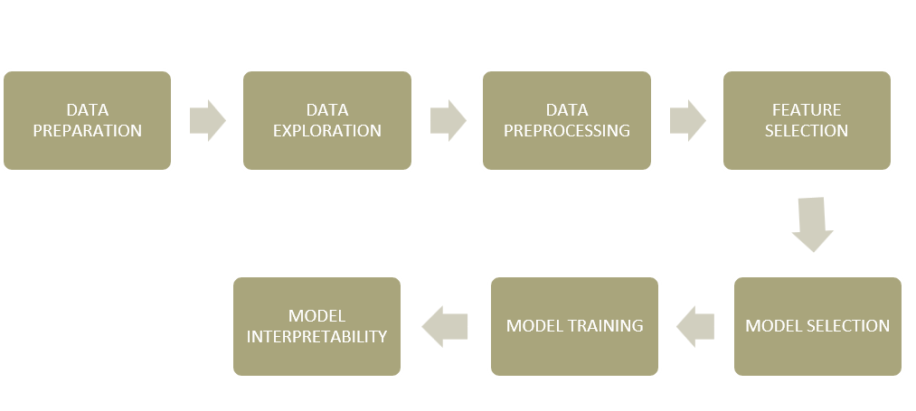
FLOW CHART

Slide 7
CODE
import pandas as pd
import numpy as np
import seaborn as sns
import matplotlib.pyplot as plt
# IMPORTING DATA SET
import pandas as pd
import io
df=pd.read_csv('heart.csv')
print(df)
# DATA EXPLORATION AND PREPROCESSING
df.head()
df.info()
df.describe()
df.isnull().sum()
# Replace missing values with the mean of each column
df.fillna(df.mean(), inplace=True)
from sklearn.preprocessing import StandardScaler
scaler = StandardScaler()
df[['age', 'thalachh']] = scaler.fit_transform(df[['age', 'thalachh’]])

Slide 8
plt.hist(df['age'], bins=20)
plt.xlabel('Age')
plt.ylabel('Frequency')
plt.title('Distribution of Age')
plt.show()
# FEATURE SELECTION
X = df.drop('output', axis=1) # Features
y = df['output'] # Target variable
from sklearn.ensemble import ExtraTreesClassifier model = ExtraTreesClassifier()
model.fit(X, y) # Print feature importances
feature_importances = pd.Series(model.feature_importances_, index=X.columns)
feature_importances.sort_values(ascending=False, inplace=True)
print(feature_importances)
# Select top k features (e.g., top 5 features)
k = 5
selected_features = feature_importances.index[:k].tolist()
print(selected_features)

Slide 9
# MODEL SELECTION AND TRAINING
from sklearn.linear_model import LogisticRegression
from sklearn.model_selection import train_test_split
from sklearn.metrics import accuracy_score, precision_score, recall_score, f1_score
# Split the data into training and testing sets
X_train, X_test, y_train, y_test = train_test_split(X, y,
test_size=0.2, random_state=42)
# Train the Logistic Regression model
logistic_model = LogisticRegression()
logistic_model.fit(X_train, y_train)
# Predict on the test set
y_pred = logistic_model.predict(X_test)
# Evaluate the model
accuracy = accuracy_score(y_test, y_pred)
precision = precision_score(y_test, y_pred)
recall = recall_score(y_test, y_pred)
f1 = f1_score(y_test, y_pred)
print("Logistic Regression:")
print("Accuracy:", accuracy)
print("Precision:", precision)
print("Recall:", recall)
print("F1 Score:", f1)

Slide 10
# MODEL INTERPRETABILITY
from sklearn.tree import DecisionTreeClassifier
from sklearn import tree
# Train the Decision Tree model
tree_model = DecisionTreeClassifier()
tree_model.fit(X_train, y_train)
# Plot the decision tree
plt.figure(figsize=(12, 8))
tree.plot_tree(tree_model, feature_names=X.columns, class_names=['No Heart Disease', 'Heart Disease'], filled=True)
plt.show()

Slide 11
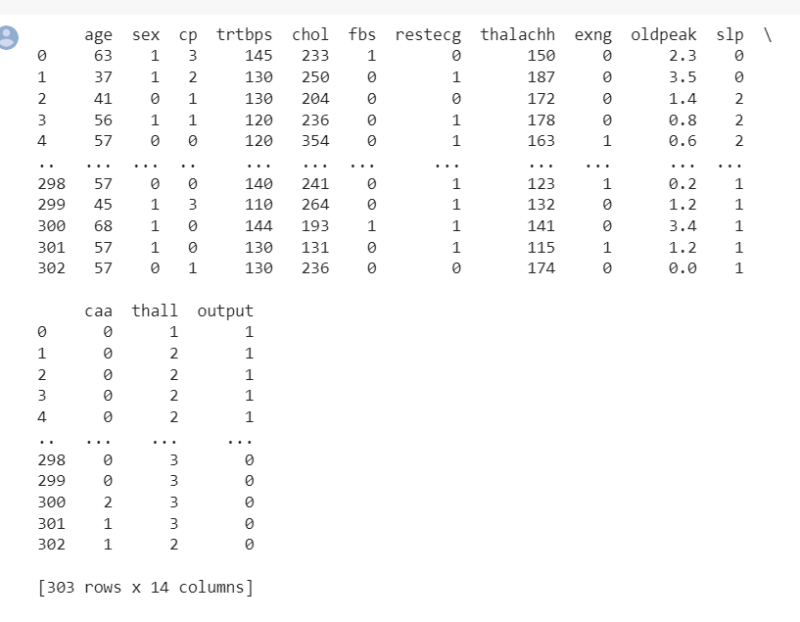
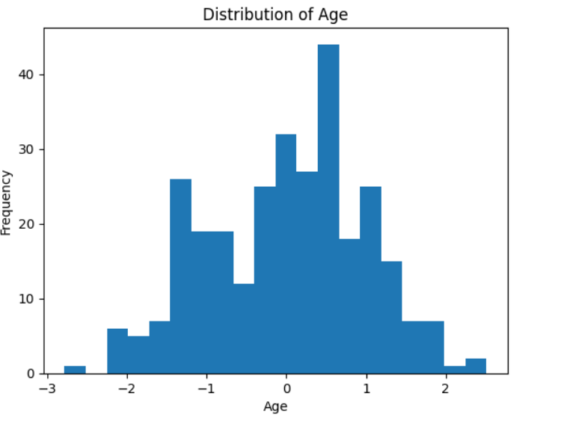
SCREEN SHOTS

Slide 12
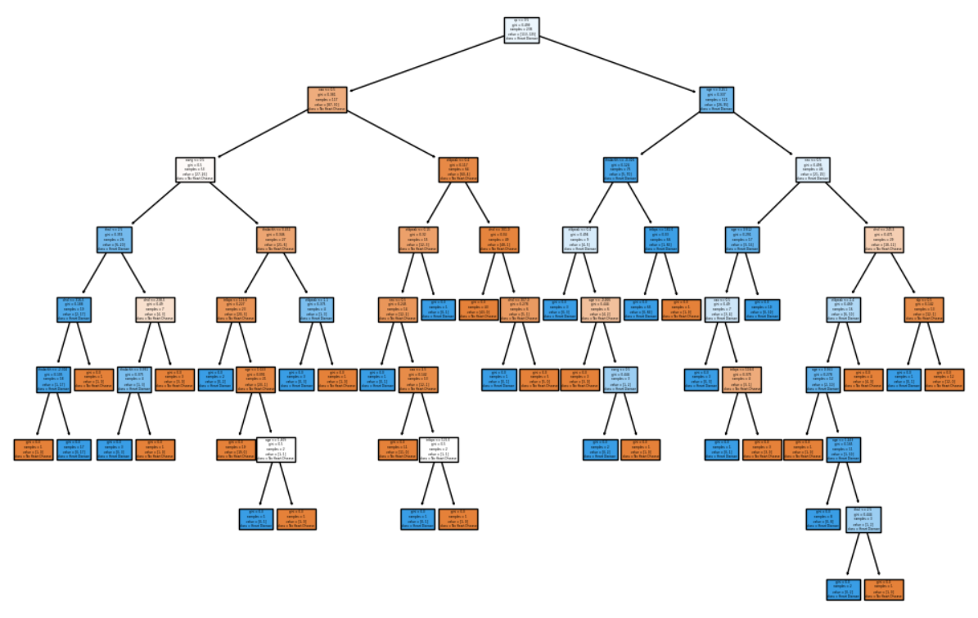

Slide 13
REFERENCES
DataSet is available at :
https://drive.google.com/file/d/1pXHQXXYBh4DmDcabvHdvxAoe53QwxoCc/view?usp=drive_link
Decision Trees and random forests:
https://docs.google.com/presentation/d/1AjWgQUUlM1Te45v9sAtrr_wVMMY3y6hnqmMff1u4M/edit?usp=
https://colab.research.google.com/drive/1V3ofuUj6LubyZ6tAm6w27AQiB-u6VxqE?usp=
K-means:
https://colab.research.google.com/drive/110Uf8PfnR3MnxPyVN-7zHTpqkkT0P-4V?usp=sharing

Slide 14
THANK YOU

