Slide 1
Probability and Related Concepts

Slide 2
Experiment: An experiment is a test, trial, or procedure for the purpose of discovering something unknown.
Simply, an activity that produces a result or an outcome is called an experiment.
For example,
Toss the coin repeatedly and note the outcomes. There are two possible outcomes – Head(H) or Tails(T).
Driving from Delhi to Bangalore and measuring the distance between the two cities.

Slide 3
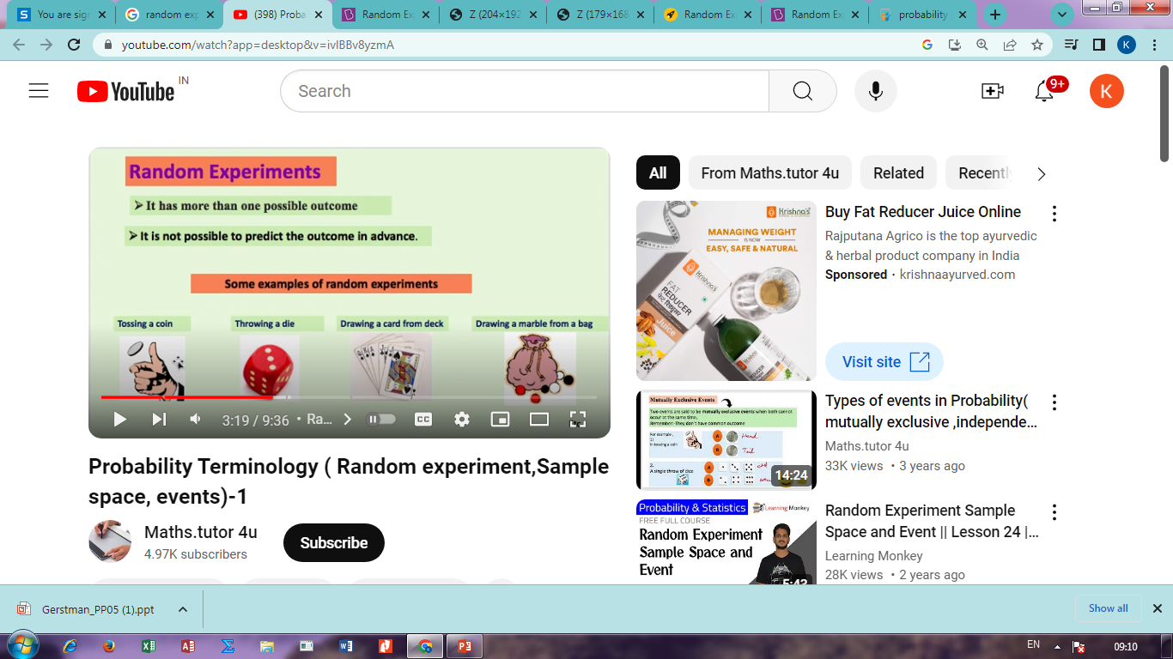
Random experiment: A random experiment is defined as an experiment whose outcome cannot be predicted with certainty.
(i) It has more than one possible outcome.
(ii) It is not possible to predict the outcome in advance.

Slide 4
Trial: When a random experiment is repeated many times each one is known as a trial.
Outcome: An outcome is a possible result of the random experiment.
      HH, HT, TH, TT
Sample space: A sample space can be defined as the list of all possible outcomes of a random experiment.
If you toss a coin twice W = {HH,HT,TH,TT}
Event: An event is a possible outcome of an experiment and forms a subset of the sample space. Simply, A simple event is one outcome or a collection of outcomes.
{HH}, {HT,TH}

Slide 5
TYPES OF EVENTS
1. Simple or Elementary event: It has only one sample point of sample space.
The possibility of 2 appearing on the die is a simple event and is given by E = {2}.
Compound or Composite event: It has more than one sample point of sample space.
The possibility of an even number appearing is a compound event, as there is more than one possibility, there are three possibilities i.e. E = {2,4,6}.

Slide 6
3. Certain event: It is sure to occur in an experiment.
The possibility of occurring any performance of throwing a die.
The earth revolving around the sun
4. Impossible event: It never occurs in an experiment.
The possibility of occurring 7
Sunrise in the west
5. Equally Likely Events: When the events are equally likely to happen in an experiment.
The possibility of occurring of 1,2,…6 is same

Slide 7
Complementary Events: For an event E non-occurrence of event E is complementary event.
Then the sample space S ={1,2,3,4,5,6}.
Now, let us consider that , E1 represents all the outcomes greater than 4.
Then, E₁= {5,6} and E₁' = {1,2,3,4}.

Slide 8
7. Mutually Exclusive Events: When two events do not occur at the same time.
Let A is even number and B is odd number, the possibility of occurring A and B is impossible. Then A and B are Mutually Exclusive Events.
A union B is equal to null or impossible events.
8. Exhaustive events: A set of events out of which at least one is sure to occur when the experiment is performed are exhaustive events.
The outcome of an exam is either passing or failing

Slide 9

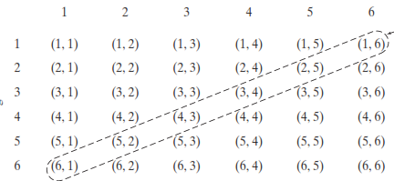
Examples of Sample Space
1. Consider the experiment of ﬂipping a coin three times
2. Rolling two dice

Slide 10


3. A local TV station advertises Two news casting positions. If three women (W1, w2, w3)and two men (M1, M2) apply, the “experiment” of hiring two co-anchors
4. Suppose that a coin is tossed until the ﬁrst tail appears.
5. A computer programmer is running a subroutine that solves a general quadratic equation, ax2+ bx + c =0.

Slide 11
There are three basic interpretations of probability:
Classical probability
Empirical or relative frequency probability
Subjective probability

Slide 12
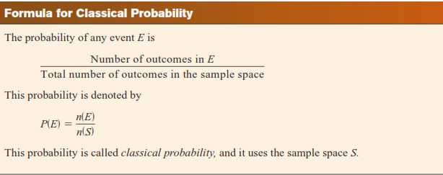
Classical probability:
It uses sample spaces to determine the numerical probability that an event will happen and certain outcomes are equally likely.
Example: The outcomes when a die is rolled

Slide 13
2. Empirical or relative frequency probability:
It uses the number of occurrences of a given outcome within a sample set as a basis for determining the probability of that outcome occurring again.
For example, that a researcher for the American Automobile Association (AAA) asked 50 people who plan to travel over the Thanksgiving holiday how they will get to their destination.

Slide 14
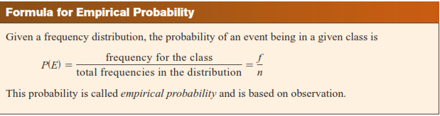
Method Frequency
Drive 41
Fly 6
Train or bus 3
Total 50
The probability of selecting a person who is driving is 41/50

Slide 15
3. Subjective probability:
It uses a probability value based on an educated guess or estimate, employing opinions and inexact information.
For example, A seismologist might say there is an 80% probability that an earthquake will occur in a certain area

Slide 16
Quantifying Uncertainty
Probability is used to quantify levels of belief:
Probability | Expression
0.00 | Never
0.05 | Seldom
0.20 | Infrequent
0.50 | As often as not
0.80 | Very frequent
0.95 | Highly likely
1.00 | Always
Basic Biostat
5: Probability Concepts

Slide 17
Probability Review
Example: Flip of a Coin
2 outcomes (Heads or Tails)
P(Heads) = ½ or .5 or 50%
P(Tails) = ½ or .5 or 50%

Slide 18
Example: Roll of a Number Cube
6 outcomes (1,2,3,4,5,6)
P(0) = 0/6 0%
P(1) = 1/6 or .17 or 17%
P(2,3,or 4) = 3/6 or .5 or 50%
P(1,2,3,4,5,6) = 6/6 or 100%
Complement P(not a 6) = 5/6 or 83%

Slide 19
Axioms of Probability
Defined over (Ω,S) s.t.
  P(α) >= 0 for all α in S
  P(Ω) = 1
  If α, β are disjoint, then
    P(α U β) = p(α) + p(β)
We can deduce other axioms from the above ones
      Ex: P(α U β) for non-disjoint event
      P(α U β) = p(α) + p(β) – p(α ∩ β)

Slide 20
The Addition Rules for Probability
Rule 1: When two events A and B are mutually exclusive, the probability that A or B will occur is
P(A or B) =P(A∪B)= P(A) + P(B)
Rule 2: If A and B are not mutually exclusive, then
P(A or B) = P(A∪B)=P(A) + P(B) - P(A ∩ B)

Slide 21
Independent Vs Dependent events
Two events A and B are independent events if the fact that A occurs does not affect the probability of B occurring. Otherwise A and B are dependent events.
When the outcome or occurrence of the ﬁrst event affects the outcome or occurrence of the second event in such a way that the probability is changed, the events are said to be
dependent events or conditional events.

Slide 22
The Multiplication Rules and Conditional Probability
Multiplication Rule 1: When A and B are two independent events, the probability of both occurring is
P(A and B)=P(A ∩ B)=P(A)P(B)
Multiplication Rule 2: When A and B are two dependent events, the probability of both occurring is
P(A and B)=P(A ∩ B)=P(A/B)P(B)
P(A and B)=P(A ∩ B)=P(B/A)P(A)

Slide 23
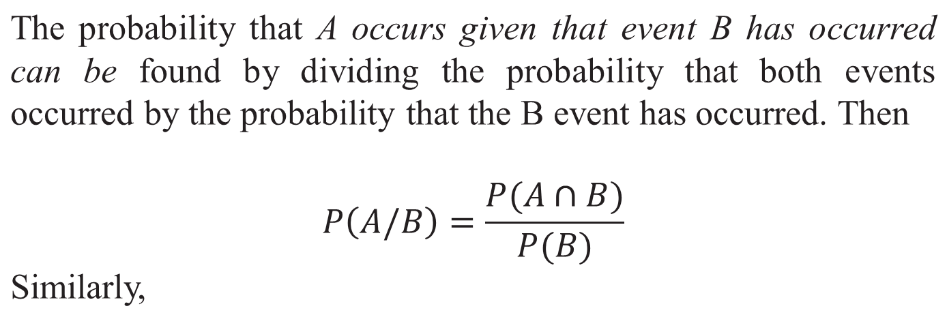
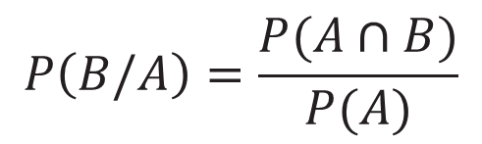
Conditional Probability

Slide 24
