Slide 1
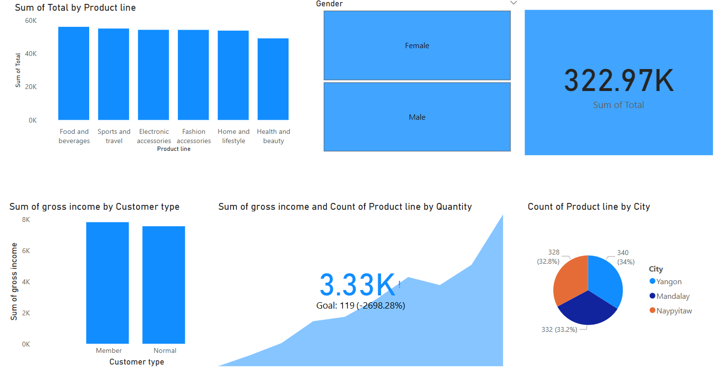
Supermarket Sales Report Summary
Power BI Dashboard Overview

Slide 2
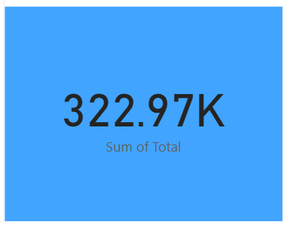
Sales Overview
Total revenue, number of transactions, and sales trends over time.

Slide 3
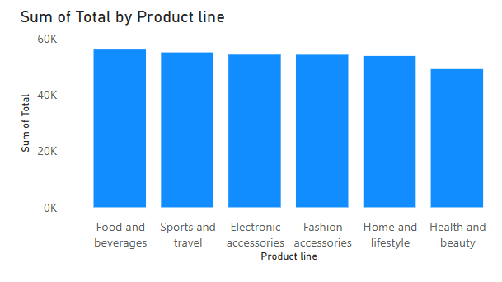
Customer Insights
Demographics, repeat purchases, and customer segmentation.

Slide 4
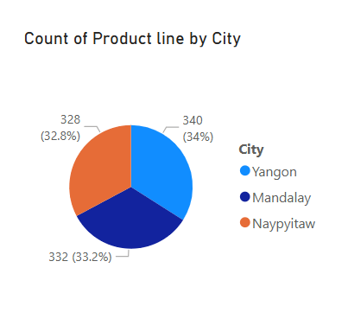
Store Performance
Comparison of store locations by sales and profit.

