Slide 1


SHOPEZ E- COMMERCE APP
A Modern MERN Stack Solution

Slide 2




Introduction to ShopEZ e-commerce platform

Slide 3
TEAM ID:-LTVIP2025TMID55631
PRESENTED BY:-
G.ESWAR
G.PRAVEEN
E.NANDA KUMAR
G.HARINI

Slide 4
Key features of the ShopEZ e- commerce app
User-friendly interface
The intuitive design enhances the shopping experience for all users.
Secure payment options
Multiple secure payment methods ensure safe transactions for customers.
Real-time order tracking
Customers can easily track their orders from purchase to delivery.

Slide 5


Understanding the use case through storyboards
User experience journey
Illustrates how customers interact with the app seamlessly.
Order fulfillment process
Shows the steps taken from order to delivery confirmation.

Slide 6
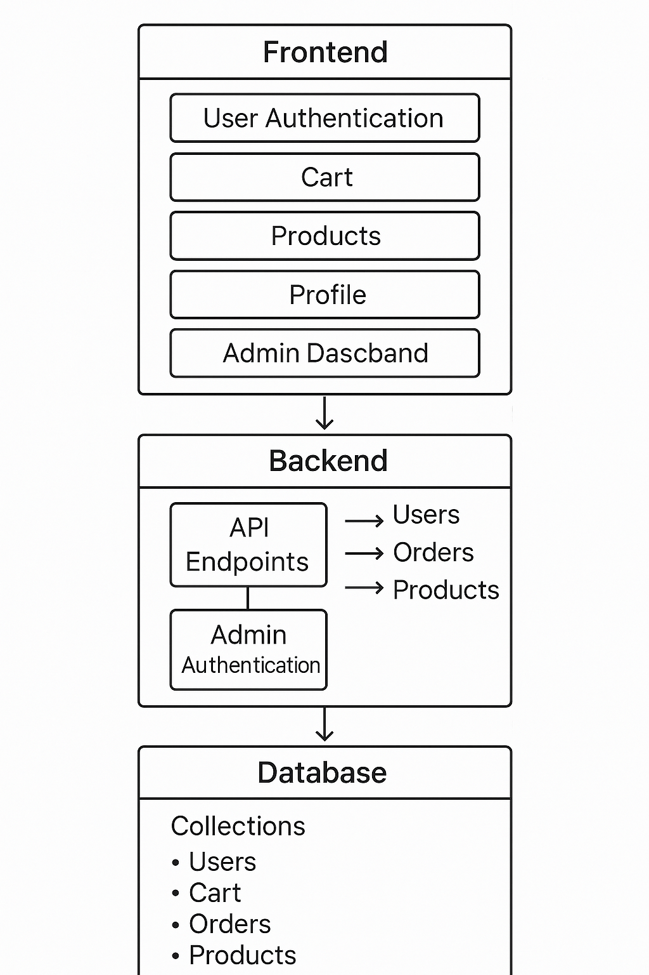
Technical Architecture
g
Heading
Heading

Slide 7
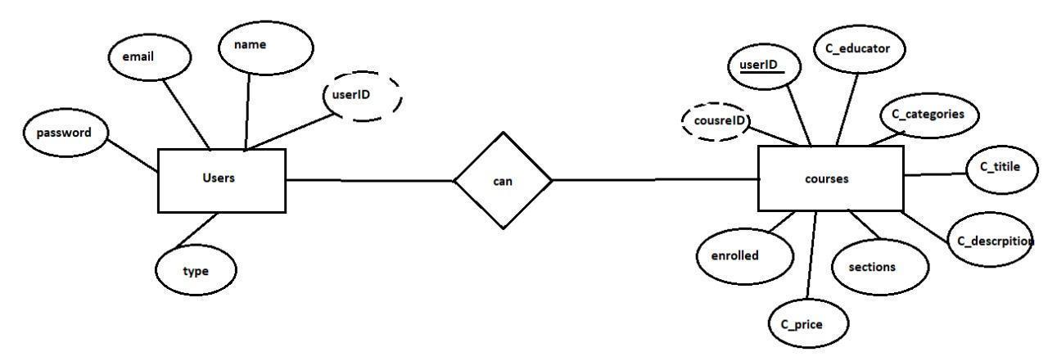
ER Diagram
Heading
Heading
Heading
Heading

Slide 8

Prerequisites for the ShopEZ App
MongoDB database technology
MongoDB is a NoSQL database that provides flexible data storage solutions.
01
02 Express.js framework
Express.js simplifies the development of robust web applications with Node.js.
React.js for frontend
React.js allows for dynamic user interfaces to enhance user experience effortlessly.
03
Node.js for server-side
Node.js enables efficient server-side scripting and improves performance for web apps.
04

Slide 9

Understanding user and admin flow in ShopEZ
This flowchart illustrates the clear paths for both users and admins to enhance the shopping experience seamlessly.

Slide 10
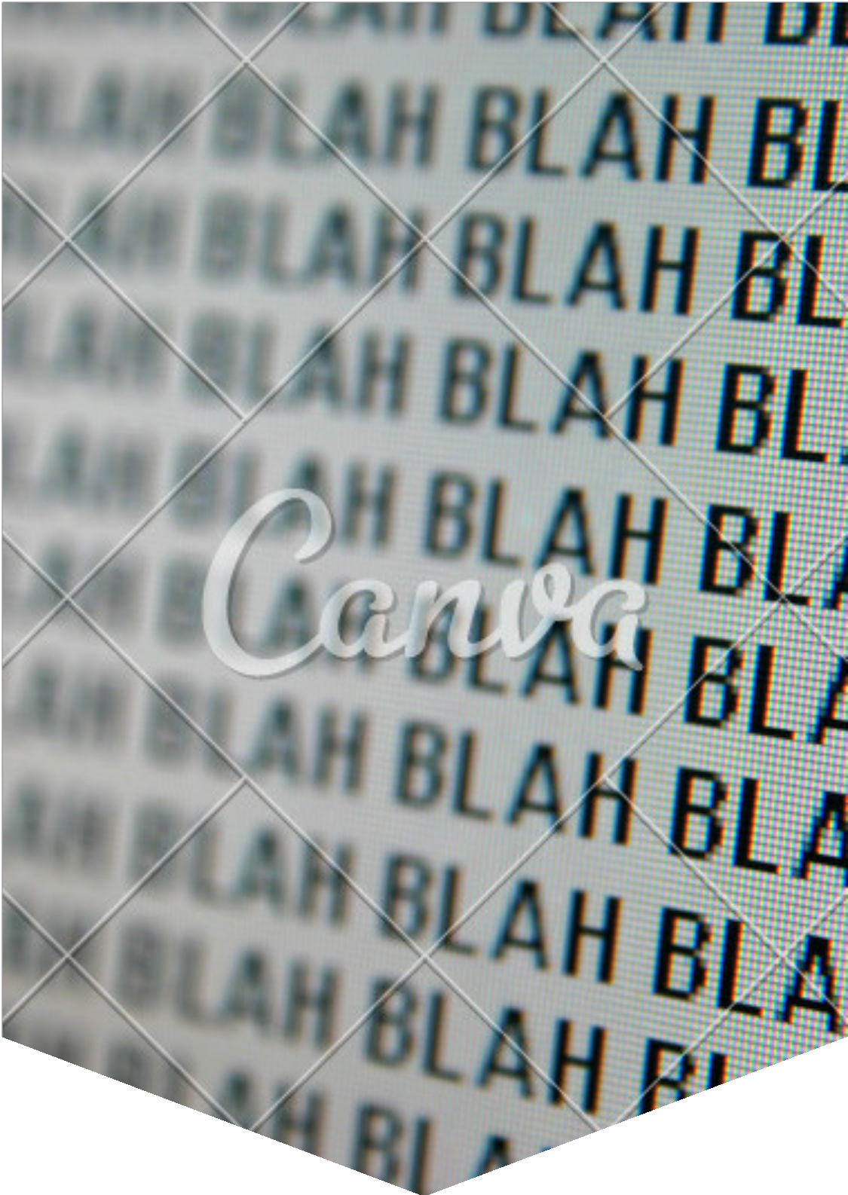
Project structure of the ShopEZ application
This slide illustrates the organized project structure of the ShopEZ MERN Stack application for efficient development.

Slide 11

Backend development with APIs and server code
Explore how API integration enhances functionality and optimizes performance for the ShopEZ application.

Slide 12
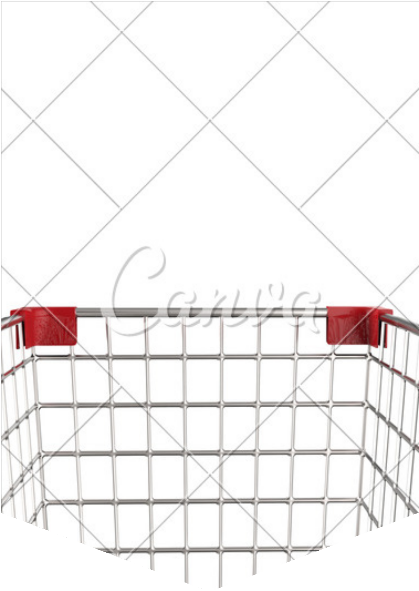
Frontend development with engaging UI screenshots
Explore the intuitive user interface designed for seamless navigation and enhanced shopping experiences.

Slide 13
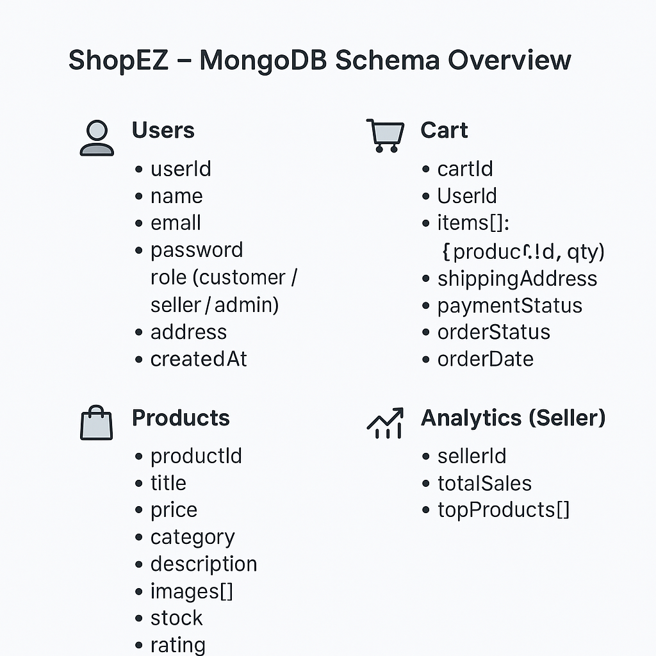
Schemas Overview
Heading
Heading
Heading
Heading

Slide 14
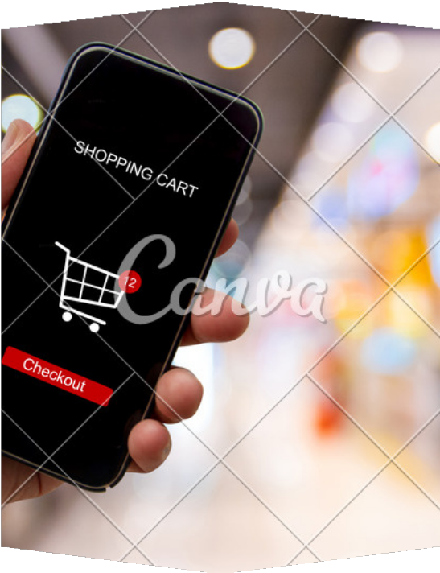

Demo screens showcasing user-friendly interface
Streamlined checkout experience
Simplified steps ensure quicker purchase completions for users.
Intuitive product navigation
Users can easily find and explore products they love.

Slide 15
Access our project and demo links here https://github.com/eswar877/shopEZ-main

Slide 16
Thank you for your attention and questions
Engagement opportunity
We welcome your questions and feedback to enhance our discussion.
Future steps
Let’s explore the implementation and growth of the ShopEZ app together.
Collaboration
Partnering will help us achieve greater success in this endeavor.

