Slide 1
BURGHUB

Slide 2
INTRODUCTION
This project aims to develop a web-based application that depicts online food ordering.
With our user-friendly platform, you can easily browse, order, and track your food in real-time, ensuring a piping hot meal ready to enjoy.
Our innovative app and efficient delivery network make satisfying your cravings a breeze, with delicious eats arriving at your doorstep in 25 minutes or less.

Slide 3
Technologies used:
Mongo DB compass (backend-database)
Visual studio code

Slide 4
Database Design & Model
Customer collection consists of customer_id, name, phone_num, email_id, password and house address.
Admin collection consists of details such as id, name, password, and username.
Item collection consists of item_id, item_name, category_id, topping_choice[]( topping_id), description, price and picture.
Topping collection consists of topping_id, topping_price and topping_description.
Item_Category collection contains category_id, category_name.
Delivery collection consists of delivery_id, name, phone_num, email_id, password.
Order collection consists of order_id, order_date, customer_id, order_status, delivery_type, delivery_fee,payment_type,refund_status,delivery_id,items[](item_id,selected_toppings[](topping_id)).
Payment collection consists of payment_id, order_id, amount, card_number, expiry_date, card_holder, card_type, cvv.

Slide 5
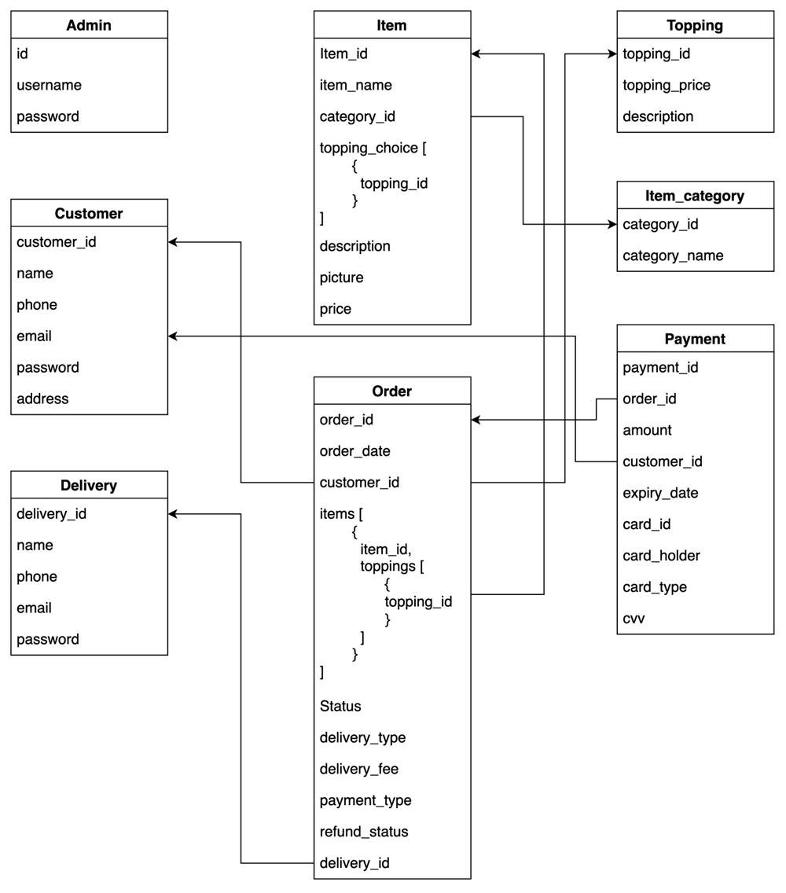

Slide 6
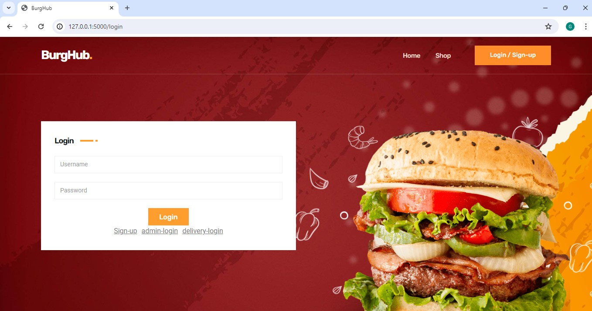
Functionality – Login/Sign-up

Slide 7
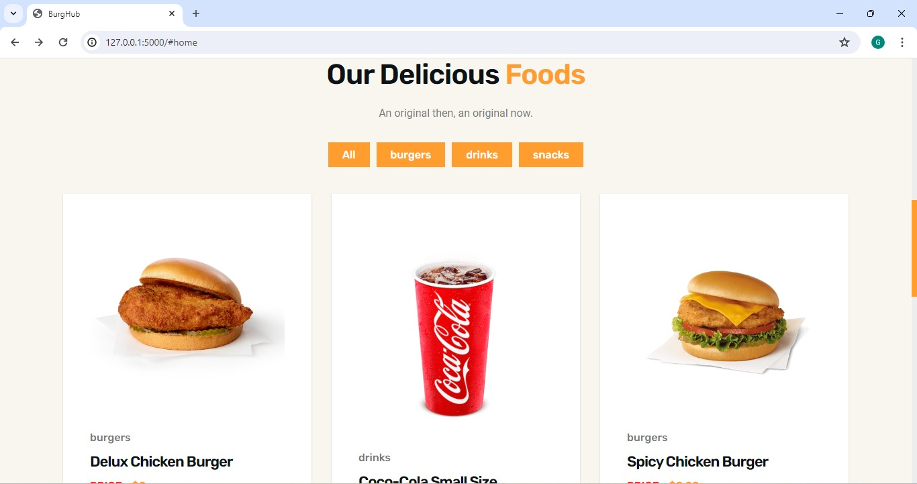
Functionality-Menu

Slide 8
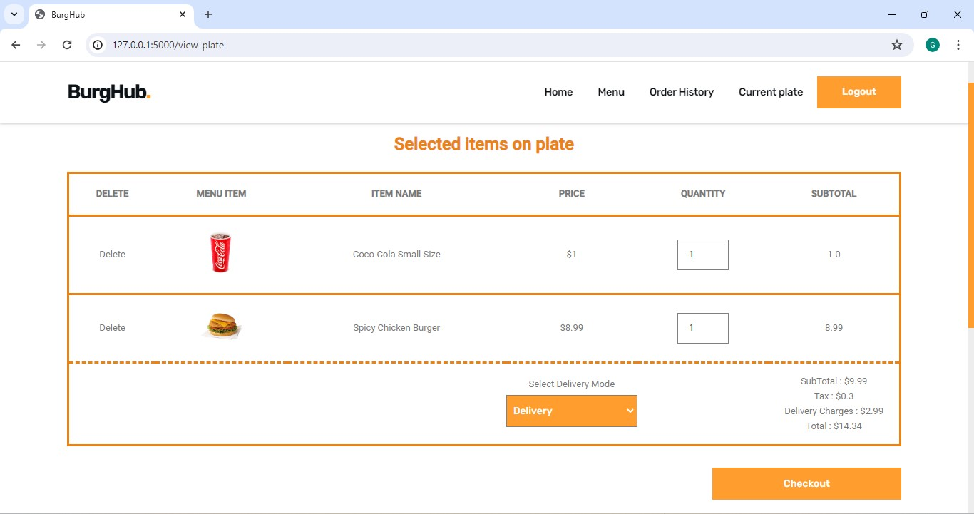
Orders

Slide 9
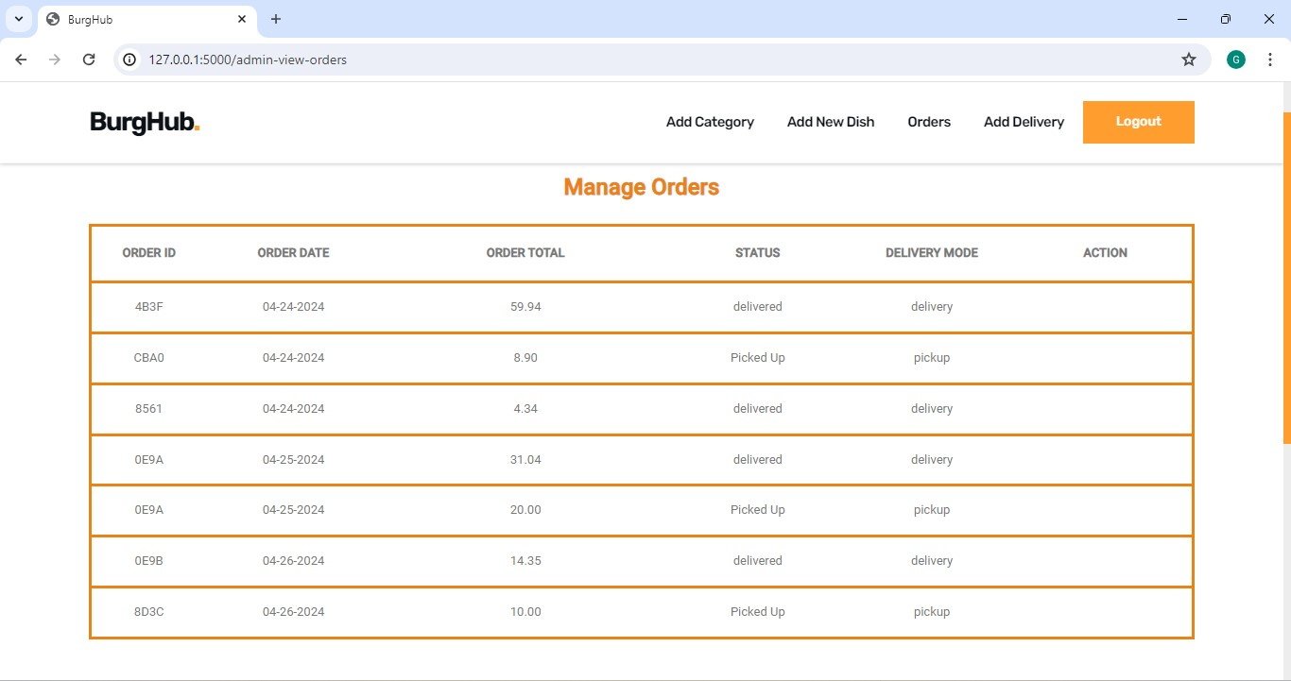
Order History

Slide 10
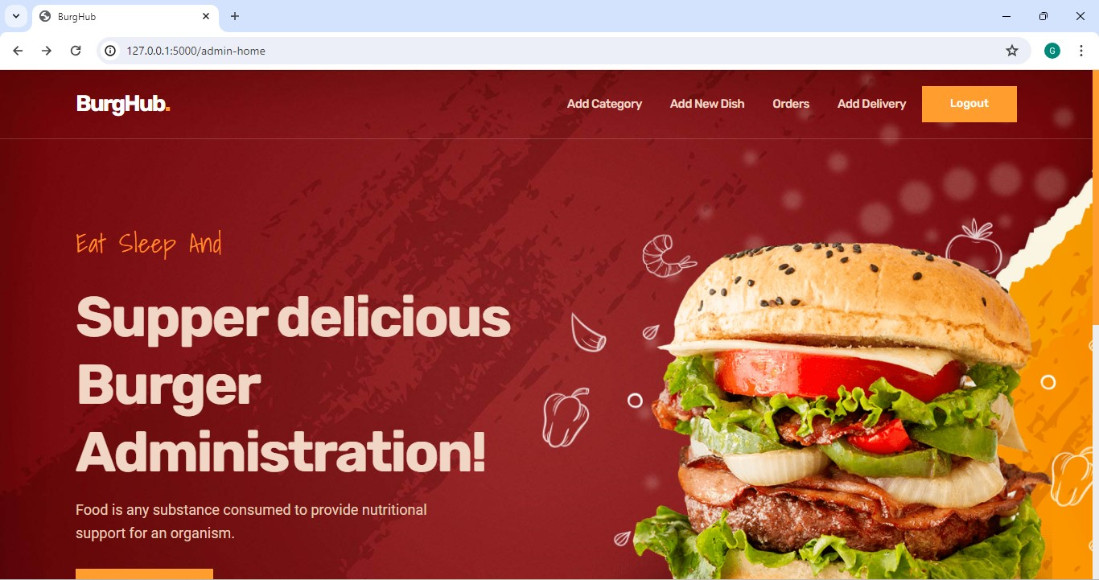
Admin dashboard

Slide 11
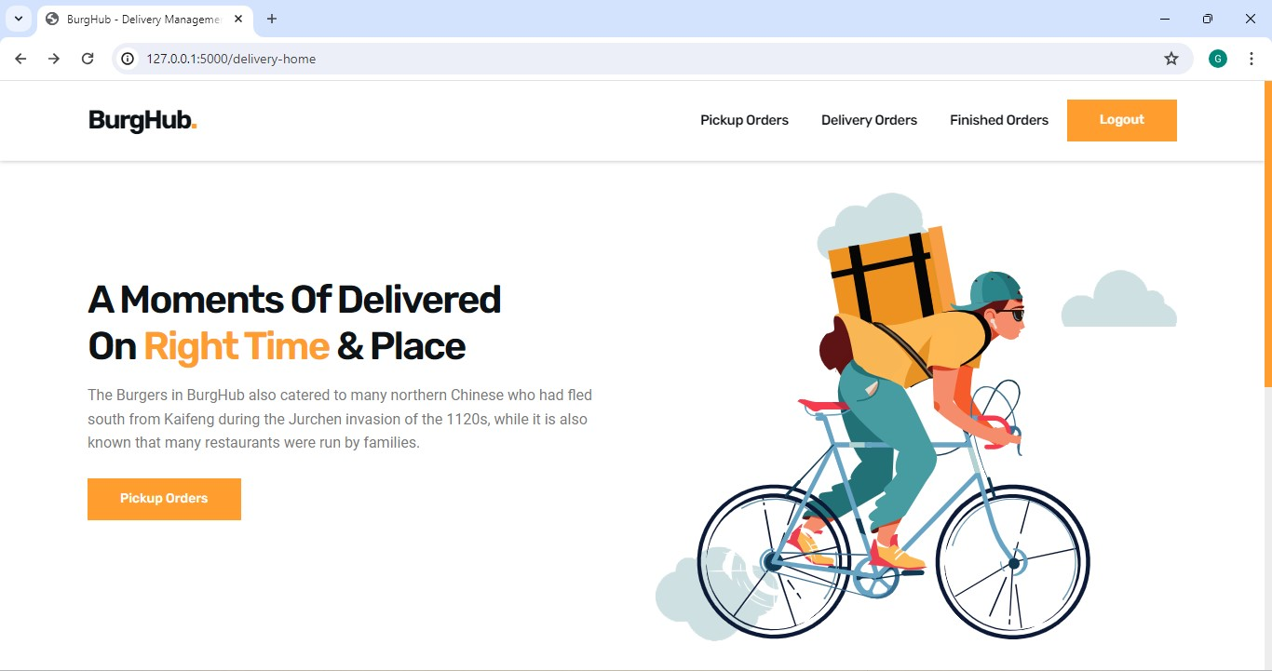
Delivery Dashboard

Slide 12
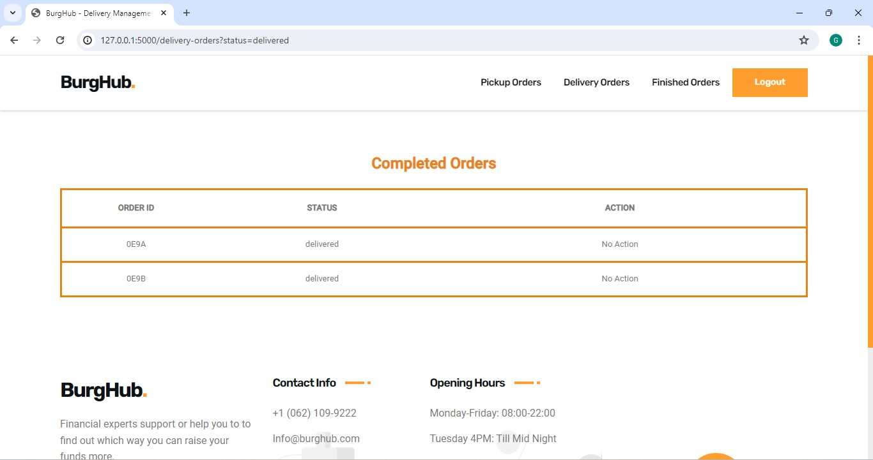

Slide 13
Conclusion
In conclusion, BurgerHub is more than just a food delivery service—a culinary experience designed to delight and satisfy. With our diverse menu, efficient delivery, and commitment to quality, we're redefining how you enjoy your favorite eats. Whether you're craving a classic burger, crispy fries, refreshing drinks, or indulgent desserts, BurgerHub delivers it with speed, convenience, and a dash of flavor.

