Slide 1
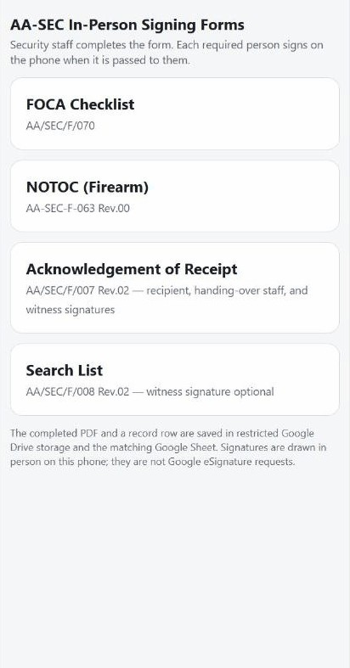
STAFF GUIDE
AA-SEC Signing Forms
Fill the form. Pass the phone. Each person signs for themselves.
FOCA · NOTOC (Firearm) · Acknowledgement of Receipt · Search List

Slide 2
BEFORE YOU START
3 simple rules
1
Use your AirAsia (@airasia.com) account
2
Each person signs for themselves. Never sign for anyone else
3
One case = one new form. Never reuse an old one

Slide 3
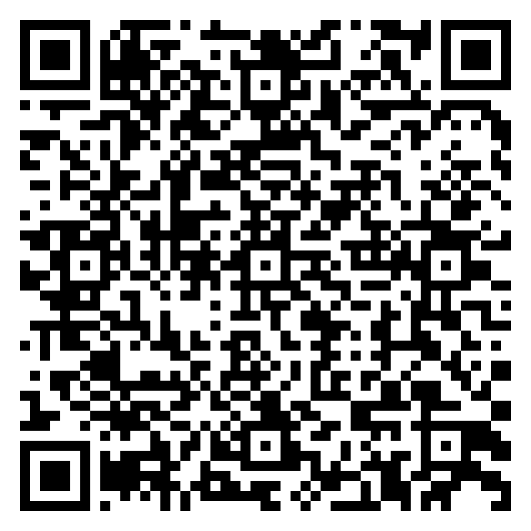
STEP 1
Get the app link
Ask your supervisor for the link,
or scan this code with your phone camera.
The link only works for AirAsia Google accounts.
Scan to open the app

Slide 4
STEP 1
Open it in Chrome on your phone
1
Open the Chrome app
2
Paste the link, or scan the code
3
If asked, sign in with your @airasia.com account
4
Wait for the list of 4 forms
Tip: in Chrome tap ⋮ → Add to Home screen, so the app is one tap away next time.

Slide 5
THE HOME SCREEN
You see 4 forms
This is the first screen.
Pick the form for your job.

Slide 6
STEP 2
Tap the correct form
FOCA
Flight security checklist
NOTOC (Firearm)
Firearm loading, Captain signs
Acknowledgement
Items handed over
Search List
Person / vehicle / locker search

Slide 7
AA/SEC/F/070
FOCA Checklist
Who does what
1
Security staff fills the form
2
Airline Representative: name, ID, sign
3
Security Representative: name, ID, sign, save

Slide 8
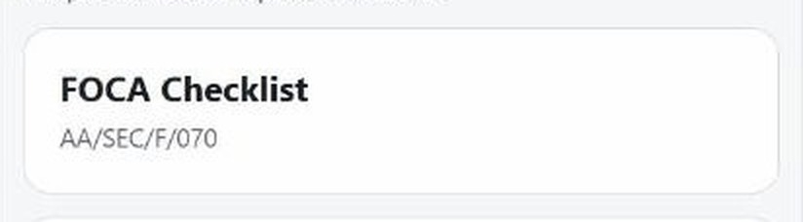
FOCA · STEP 1
SECURITY STAFF
Tap FOCA
CLOSE-UP

Slide 9
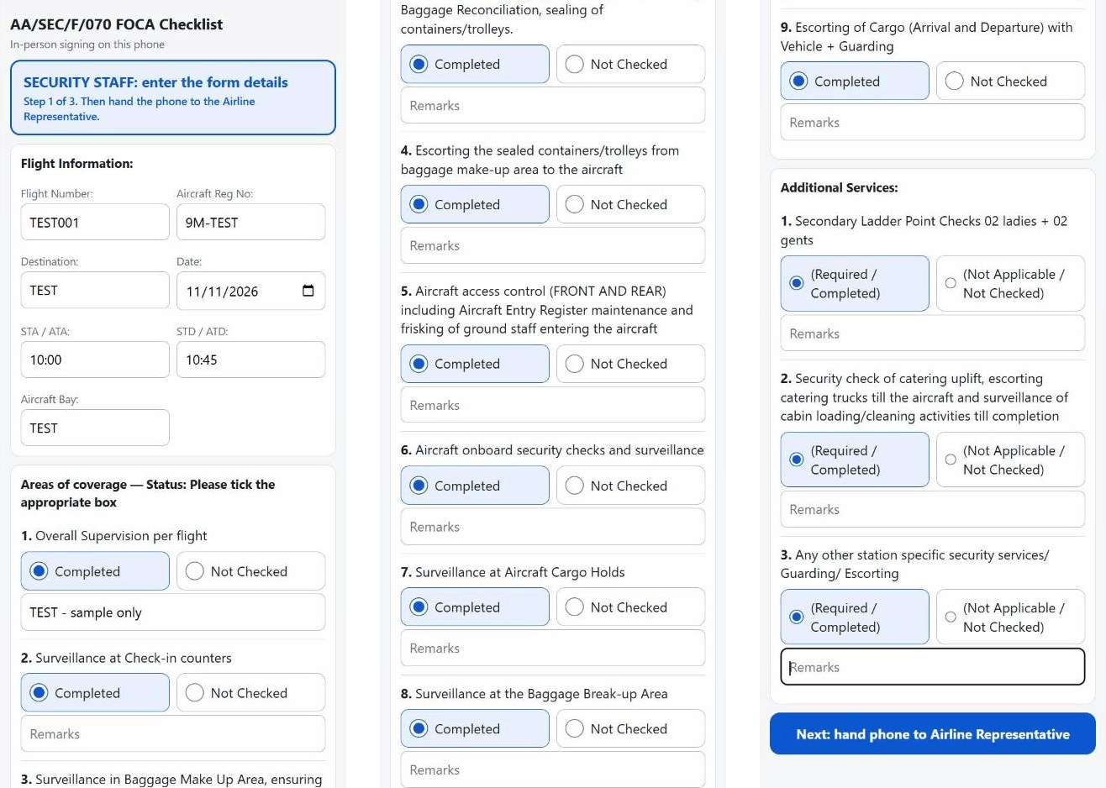
FOCA · THE WHOLE FORM
Scroll down to see it all
Top: flight details.
Middle: tick each line.
Bottom: blue Next button.

Slide 10
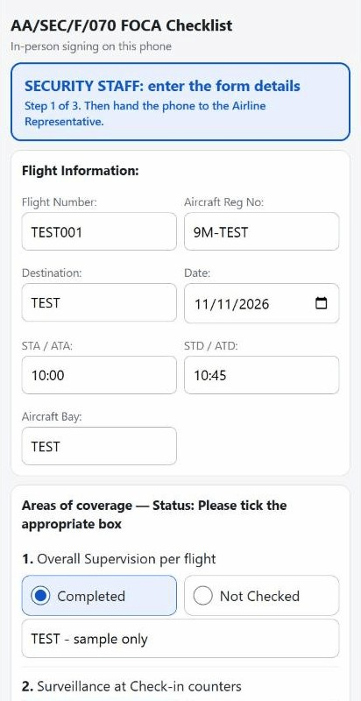
FOCA · STEP 2
SECURITY STAFF
Fill the boxes
Flight number, reg, destination, date, times and bay.
Flight number and date are a must.
Sample shown: TEST data only.

Slide 11
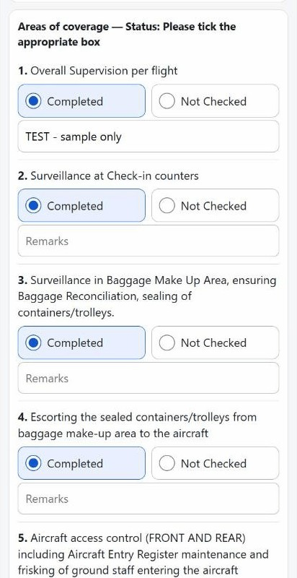
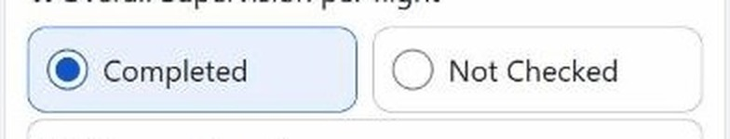
FOCA · STEP 3
SECURITY STAFF
Tick one box on every line
Completed or Not Checked.
Add remarks if needed.
CLOSE-UP

Slide 12
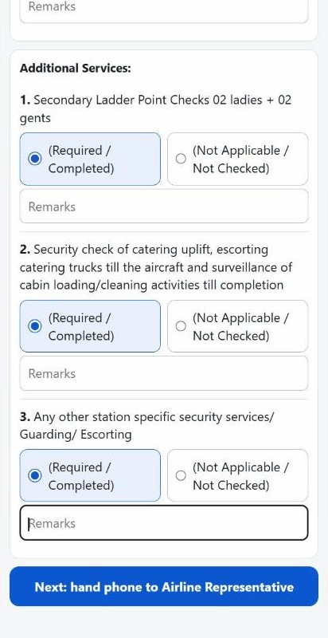
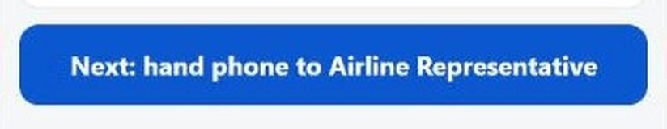
FOCA · STEP 4
SECURITY STAFF
Check, then tap Next
Read every line again before you tap.
CLOSE-UP

Slide 13
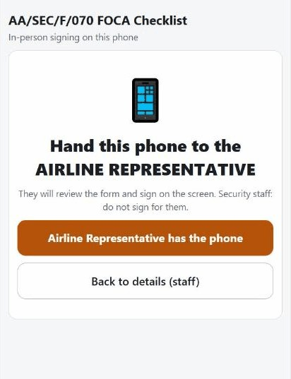
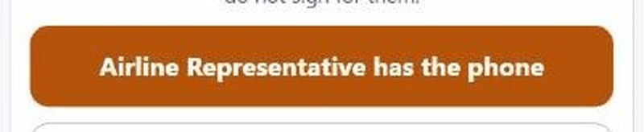
FOCA · STEP 5
AIRLINE REPRESENTATIVE
Give the phone to the Airline Rep
They tap the orange button:
“Airline Representative has the phone”.
CLOSE-UP

Slide 14
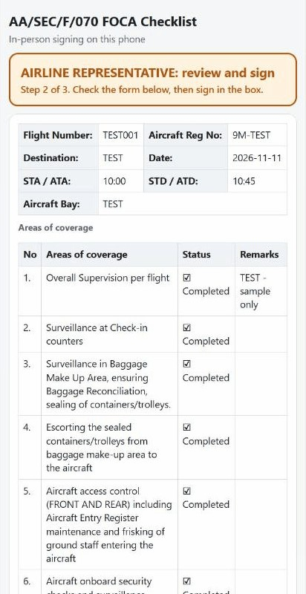
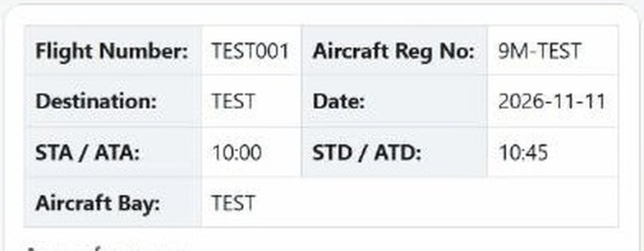
FOCA · STEP 6
AIRLINE REPRESENTATIVE
Check the form
Airline Rep reads every detail.
Wrong? Tap “Something is wrong”.
CLOSE-UP

Slide 15
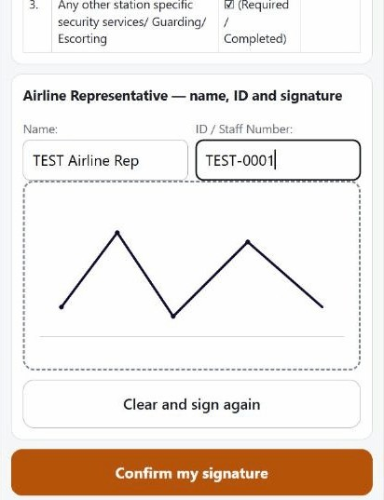
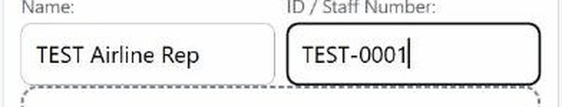
FOCA · STEP 7
AIRLINE REPRESENTATIVE
Type own name and ID
Airline Rep types their own name and ID / staff number.
CLOSE-UP

Slide 16
FOCA · STEP 8
AIRLINE REPRESENTATIVE
Sign in the box
Use a finger or stylus.
Security staff: do not sign for them.

Slide 17
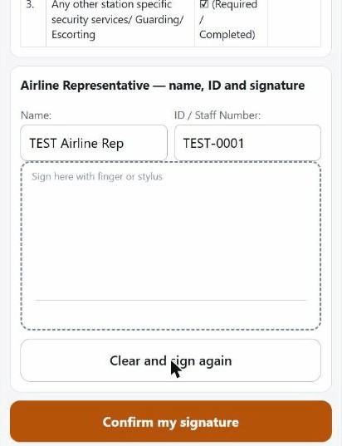
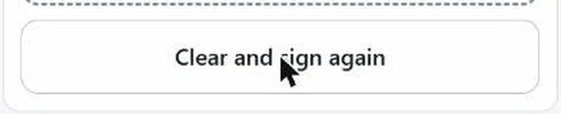
MISTAKE IN THE SIGNATURE?
AIRLINE REPRESENTATIVE
Tap Clear and sign again
Works the same on every signature box.
CLOSE-UP

Slide 18
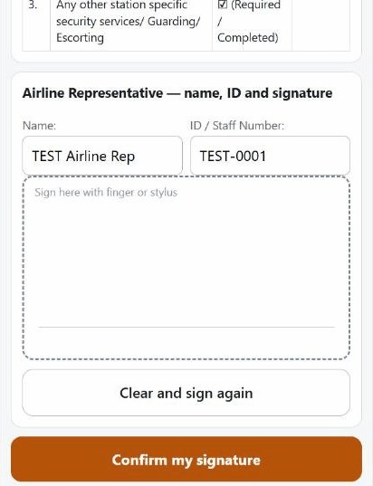
MISTAKE IN THE SIGNATURE?
AIRLINE REPRESENTATIVE
Box is empty. Sign again
Draw the signature one more time.

Slide 19
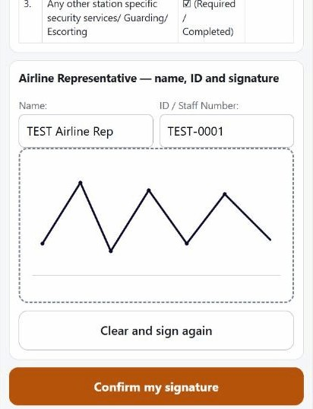
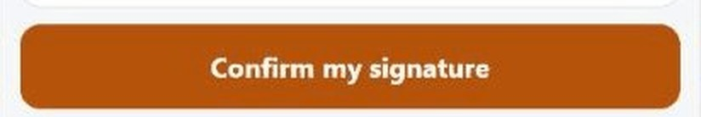
FOCA · STEP 9
AIRLINE REPRESENTATIVE
Tap Confirm my signature
Then give the phone back to Security staff.
CLOSE-UP

Slide 20
FOCA · STEP 10
SECURITY REPRESENTATIVE
Phone back to Security
1
Screen says: “Hand the phone back to SECURITY STAFF”
2
Tap the blue button: “Security staff has the phone”

Slide 21
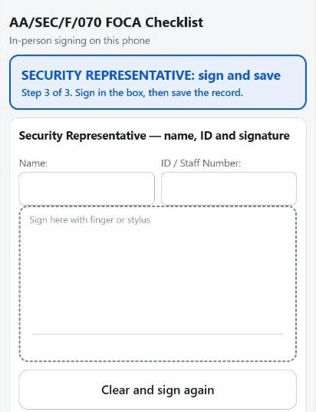
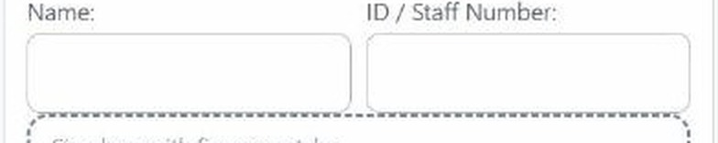
FOCA · STEP 11
SECURITY REPRESENTATIVE
Type own name and ID
Security Representative types their own name and ID / staff number.
CLOSE-UP

Slide 22
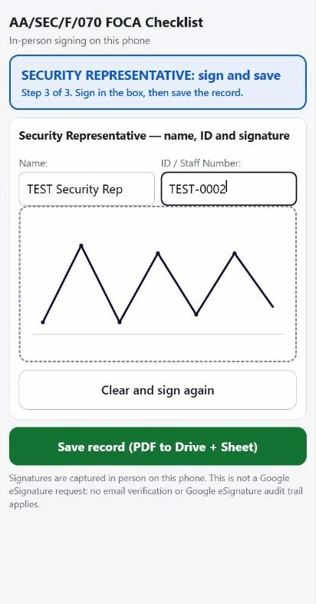
FOCA · STEP 12
SECURITY REPRESENTATIVE
Sign in the box
Mistake? Tap Clear and sign again.

Slide 23
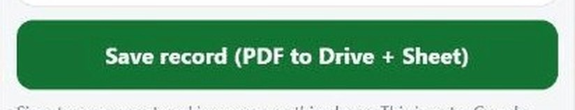
FOCA · STEP 13
SECURITY REPRESENTATIVE
Tap Save record
Tap once only. The button turns to “Saving...”.
CLOSE-UP

Slide 24
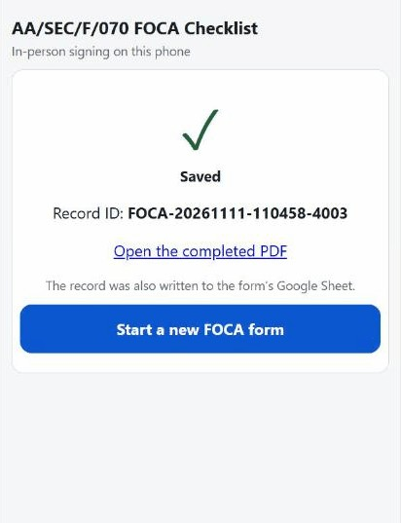
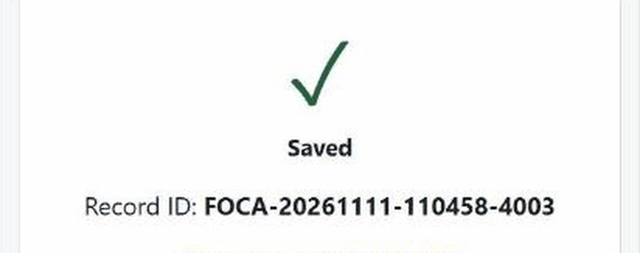
FOCA · STEP 14
SECURITY REPRESENTATIVE
Wait for “Saved”
You see a tick and a Record ID.
Do not close the app before this.
CLOSE-UP
Shown: TEST record FOCA-20261111-110458-4003.

Slide 25
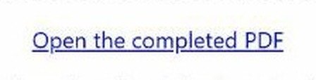
AFTER SAVING · ALL FORMS
SECURITY STAFF
Tap Open the completed PDF
The signed PDF opens in Google Drive.
CLOSE-UP

Slide 26
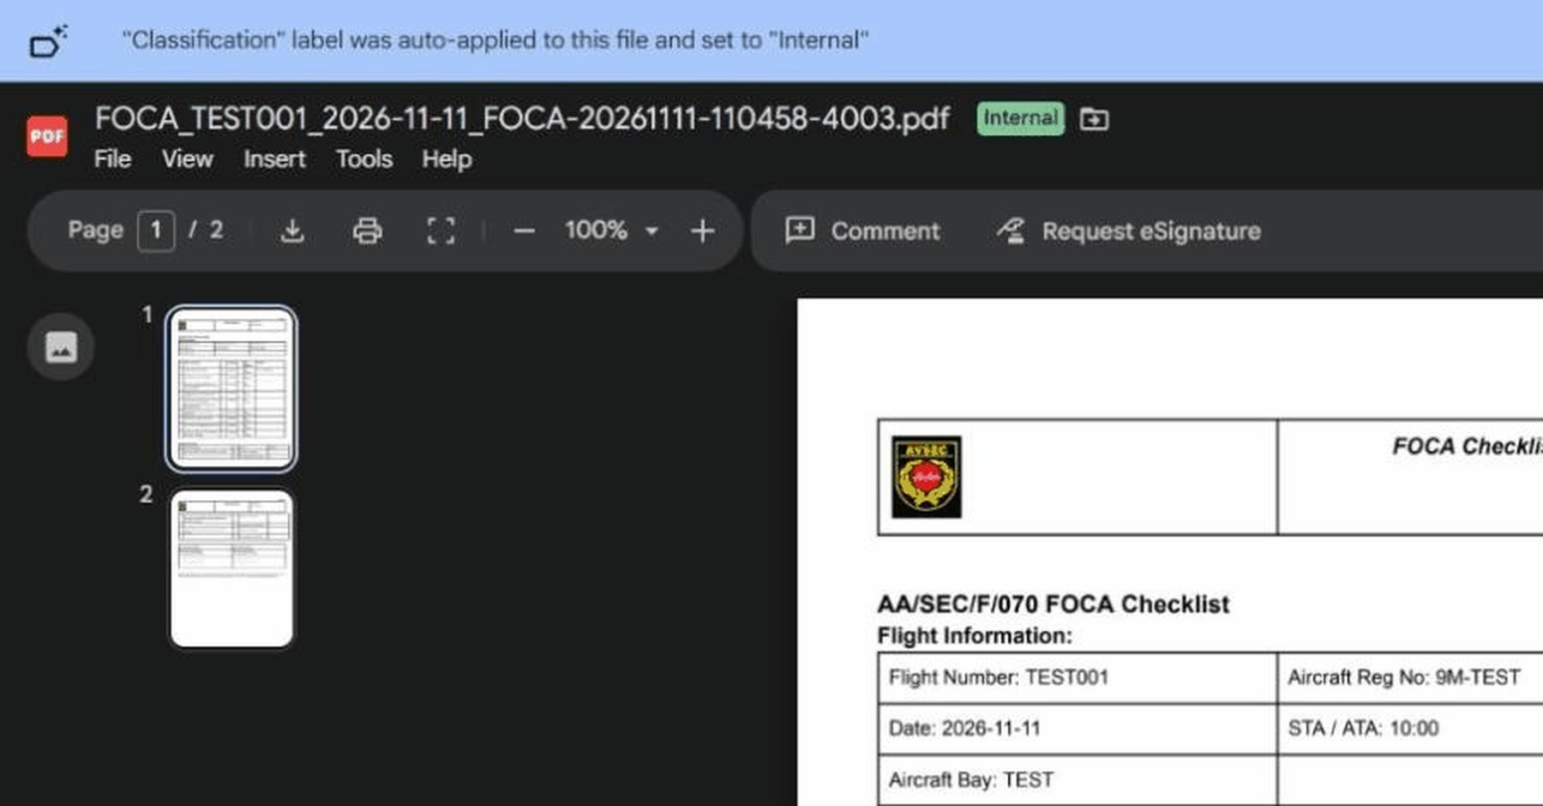
AFTER SAVING
The PDF opens in Google Drive
Check the file name: form, flight, date and Record ID.

Slide 27
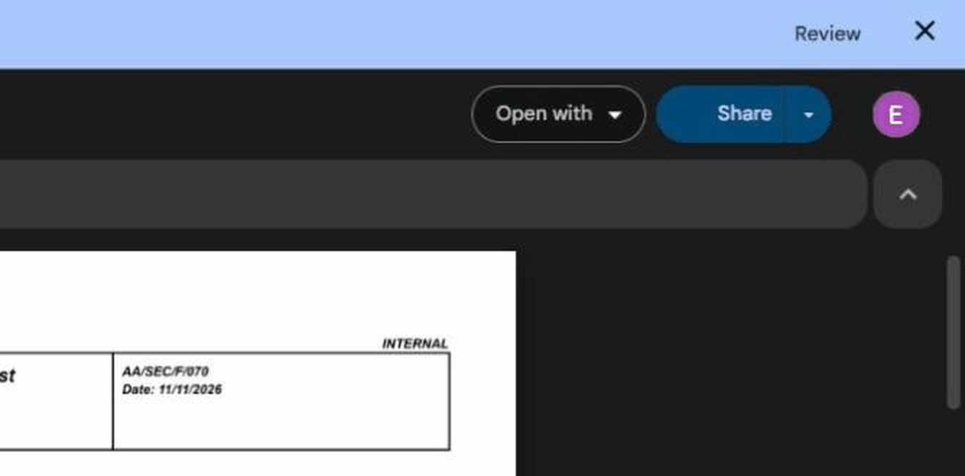
SHARE THE PDF
Tap Share
The blue Share button is at the top right.

Slide 28
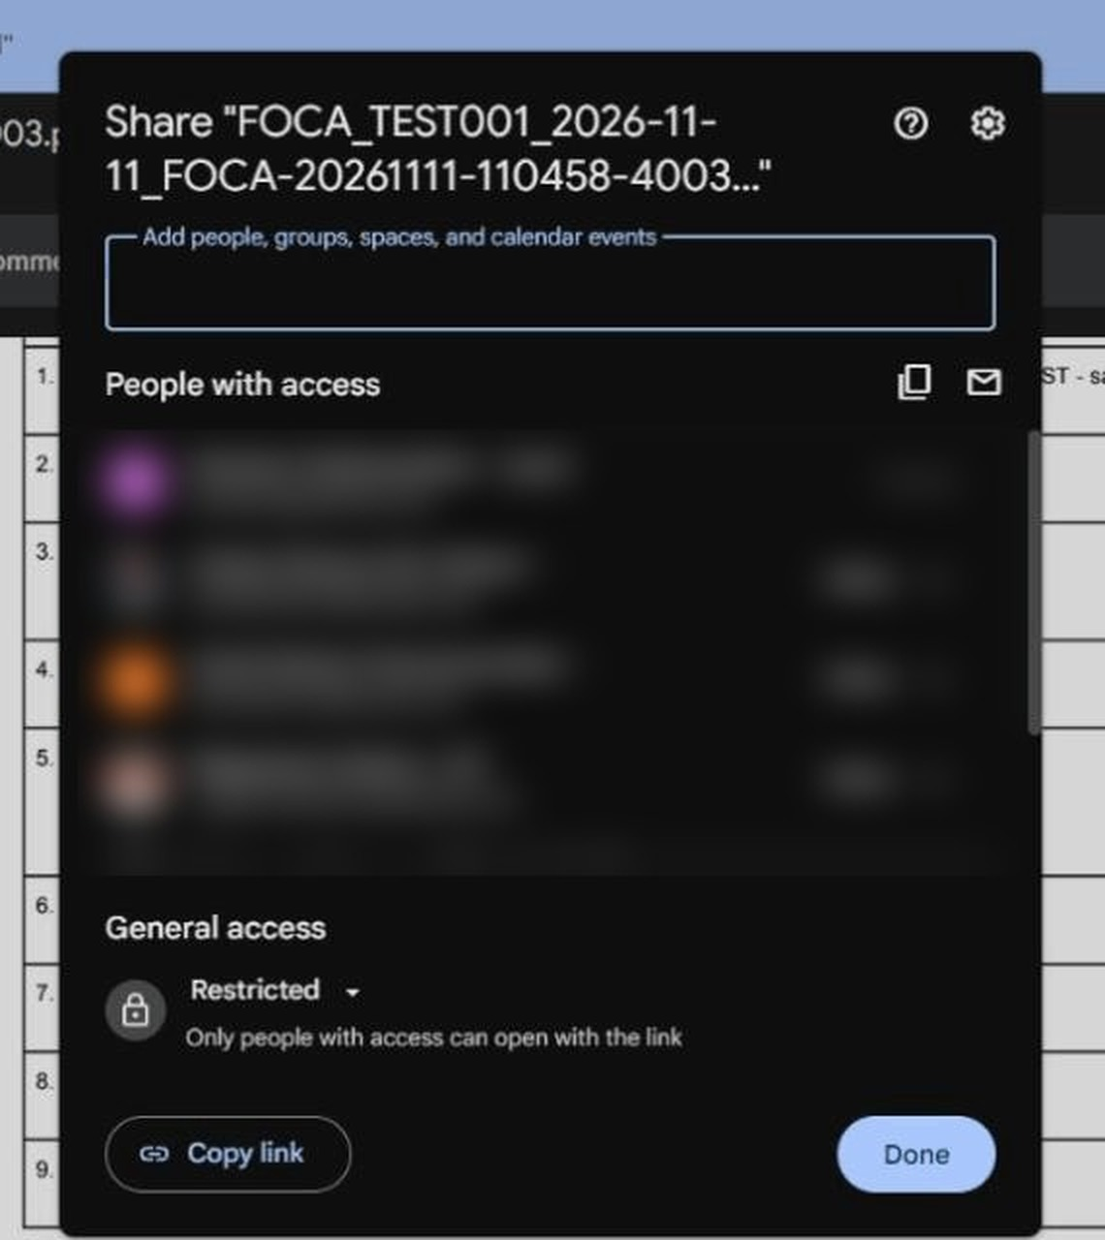
SHARE THE PDF
Tap Copy link
Send it only to an authorised person.
Keep access “Restricted”. Do not change it to “Anyone with the link”.

Slide 29
AA-SEC-F-063 Rev.00
NOTOC (Firearm)
Who does what
1
Security staff fills the form
2
Captain: checks, then signs
3
Security staff (“Loaded by”): signs and saves

Slide 30
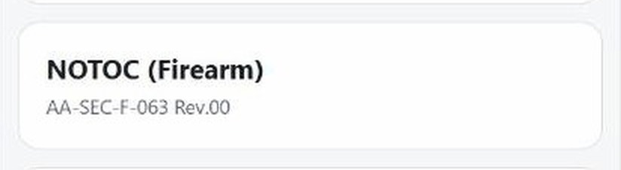
NOTOC · STEP 1
SECURITY STAFF
Tap NOTOC (Firearm)
CLOSE-UP

Slide 31
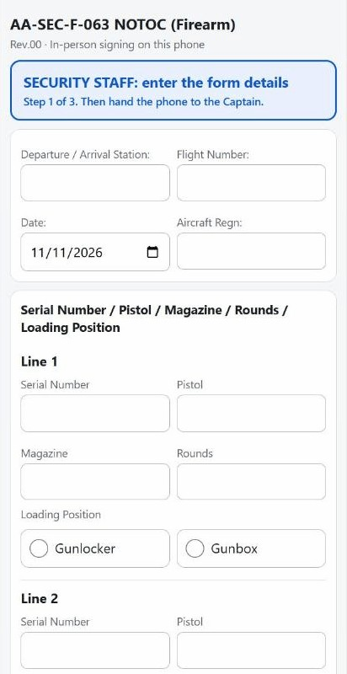
NOTOC · STEP 2
SECURITY STAFF
Fill the flight boxes
Station, flight number, date and aircraft regn.

Slide 32
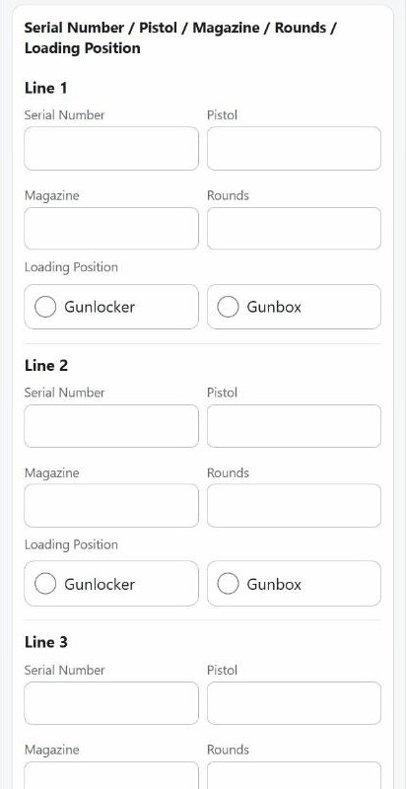
NOTOC · STEP 3
SECURITY STAFF
One line for each firearm
Serial number, pistol, magazine, rounds.
Tick Gunlocker or Gunbox.

Slide 33
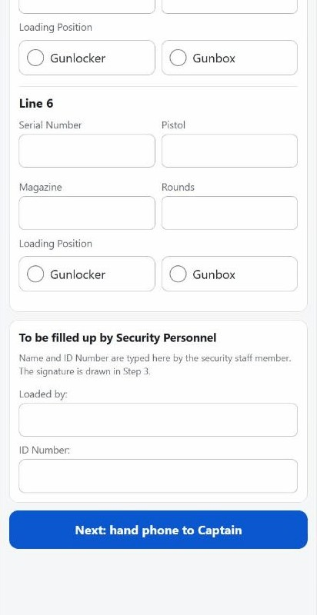
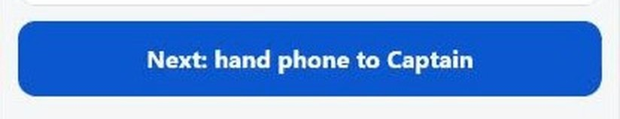
NOTOC · STEP 4
SECURITY STAFF
Fill “Loaded by”, tap Next
Then give the phone to the Captain.
CLOSE-UP

Slide 34
NOTOC · STEPS 5–7
Signing works like FOCA
1
Captain checks the form and signs
2
Phone goes back to Security staff
3
Security staff signs, taps Save, waits for “Saved”
Mistake in a signature? Tap Clear and sign again.

Slide 35
AA/SEC/F/007 Rev.02
Acknowledgement of Receipt
Who does what
1
Security staff fills the details
2
Recipient, handing-over staff and witness
3
Each named person signs for themselves

Slide 36
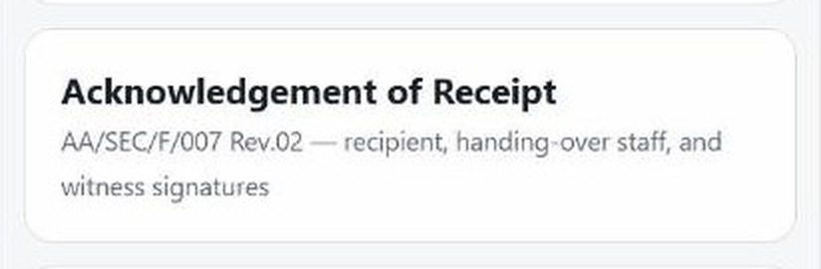
ACKNOWLEDGEMENT · STEP 1
SECURITY STAFF
Tap Acknowledgement of Receipt
CLOSE-UP

Slide 37
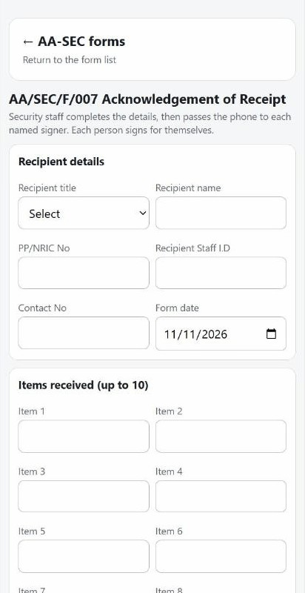
ACKNOWLEDGEMENT · STEP 2
SECURITY STAFF
Fill the recipient details
Title, name, PP/NRIC, staff ID, contact, date.

Slide 38
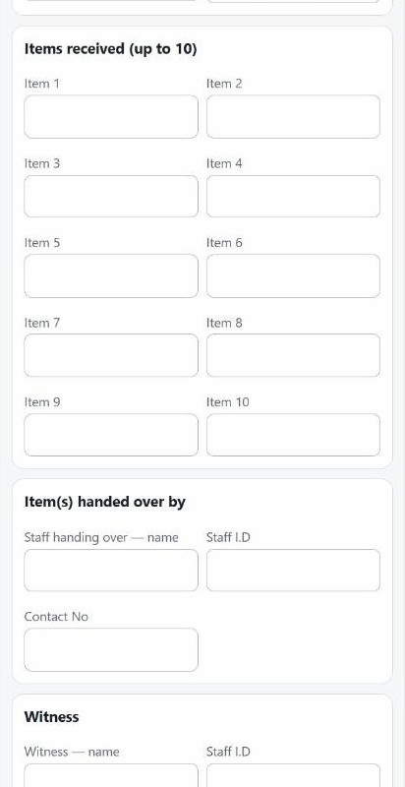
ACKNOWLEDGEMENT · STEP 3
SECURITY STAFF
List the items received
Up to 10 items. One item per box.

Slide 39
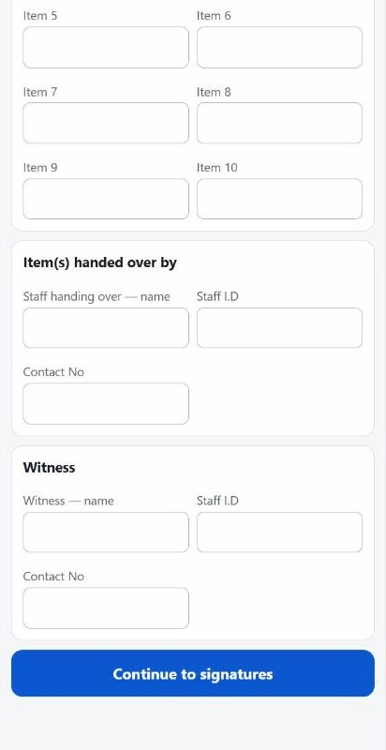
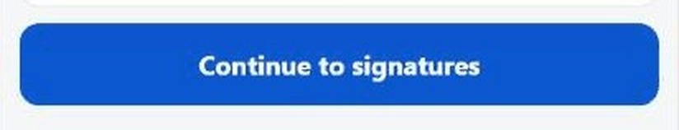
ACKNOWLEDGEMENT · STEP 4
SECURITY STAFF
Last boxes, then tap Continue
Handing-over staff and witness details. Then pass the phone to each named person.
CLOSE-UP

Slide 40
ACKNOWLEDGEMENT · SIGNING
EACH SIGNER
Pass the phone to each person
1
Recipient signs
2
Handing-over staff signs
3
Witness signs
4
Save, then wait for “Saved”
Each person signs on the phone themselves. Mistake? Tap Clear and sign again.

Slide 41
AA/SEC/F/008 Rev.02
Search List
Who does what
1
Security staff fills the details
2
Each named signer signs for themselves
3
Witness signature is optional

Slide 42
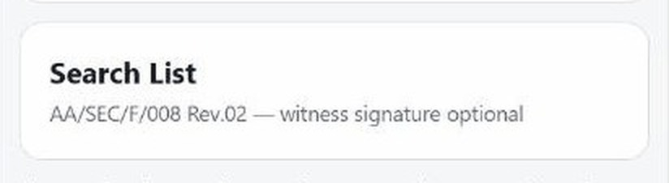
SEARCH LIST · STEP 1
SECURITY STAFF
Tap Search List
CLOSE-UP

Slide 43
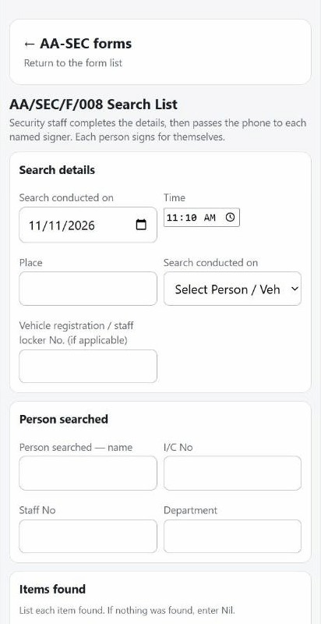
SEARCH LIST · STEP 2
SECURITY STAFF
Fill the search details
Date, time, place, and what was searched: person, vehicle or locker.

Slide 44
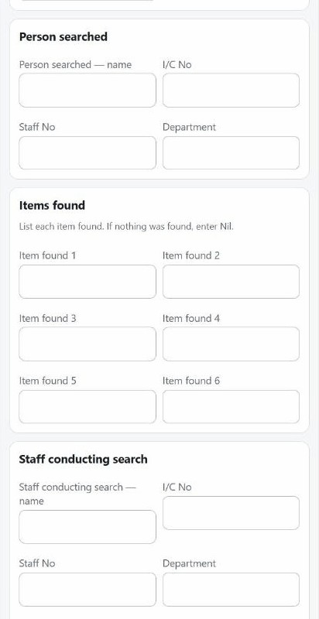
SEARCH LIST · STEP 3
SECURITY STAFF
Person searched and items found
Nothing found? Type “Nil”.

Slide 45
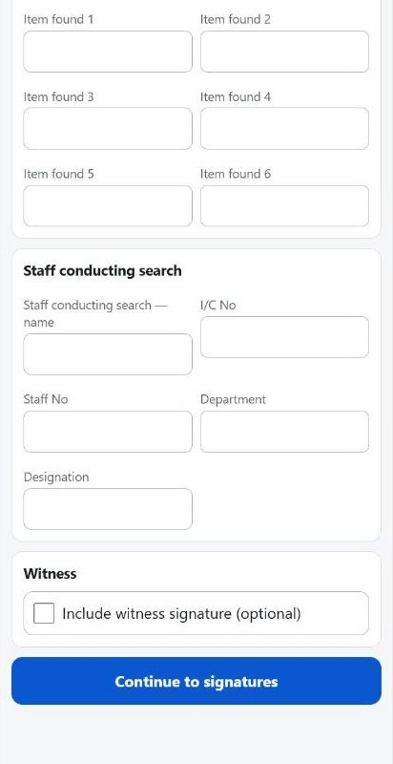
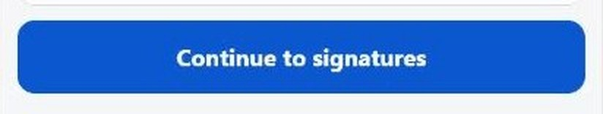
SEARCH LIST · STEP 4
SECURITY STAFF
Staff details, then tap Continue
Tick the witness box only if a witness will sign.
CLOSE-UP

Slide 46
SEARCH LIST · SIGNING
EACH SIGNER
Pass the phone to each signer
1
Each named person signs for themselves
2
Witness signs only if the box was ticked
3
Save, then wait for “Saved”

Slide 47
WHERE THE PDFs GO
Google Drive: one folder per form
AA-SEC Signed Forms (RESTRICTED)
Inside each folder:
• the signed PDFs
• the form’s records Sheet
File name shows form, flight, date and Record ID.
FOCA
NOTOC
AA-SEC-F-007 Acknowledgement
AA-SEC-F-008 Search Lists
Checked in eswaranp@airasia.com Drive, 11 Nov 2026. Only authorised people should open this folder.

Slide 48
WHERE THE RECORDS GO
Google Sheets: one row per save
FOCA Records
NOTOC Records
AA-SEC-F-007 Acknowledgement Records
AA-SEC-F-008 Search List Records
Example: the TEST row in FOCA Records
Record ID | Saved at (MYT) | Flight Number | Airline Rep | Security Rep | PDF file
FOCA-20261111-110458-4003 | 2026-11-11 11:04:58 | TEST001 | TEST Airline Rep | TEST Security Rep | link to the PDF
Read from the live FOCA Records Sheet on 11 Nov 2026.

Slide 49
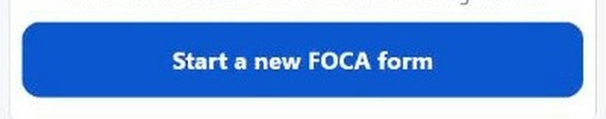
NEW CASE?
SECURITY STAFF
Start a new form
Every save makes its own PDF and its own record row.
New case = tap “Start a new … form”.
CLOSE-UP

Slide 50
QUICK CHECK
Every time
1
Correct form tapped
2
All boxes filled and checked
3
Each person typed own name, ID and signed
4
Saved screen seen, PDF opened
5
Link shared only with an authorised person

