Slide 1
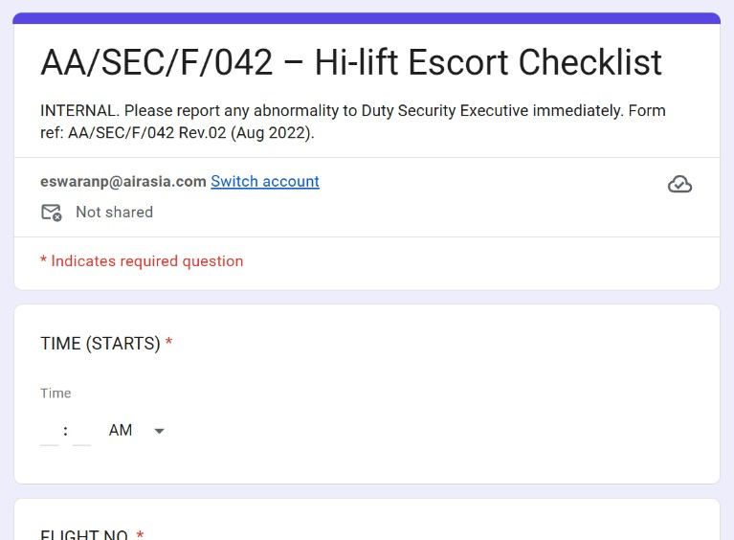
STAFF GUIDE
High-Lift Escort eForm
AA/SEC/F/042 – Hi-lift Escort Checklist
How to fill it in on your phone, one step at a time
Notes:
Guide for AVSEC staff completing the AA/SEC/F/042 Hi-lift Escort Checklist Google Form. All screenshots come from the live form. Sample entries are marked TEST.

Slide 2
ABOUT THIS FORM
What is this form for?
1
Record one hi-lift escort
Flight number, ETD, sector and start time.
From the form:
“Please report any abnormality to Duty Security Executive immediately.”
2
Checks at the catering facility
Prohibited-item check in the truck / hi-lift cabin, seal and lock, truck number, seal number.
3
Two security sign-offs
Catering facility security, then aircraft security.
Fill in one form for each escort, as you do the checks.
Notes:
Purpose and timing are taken from the form's own sections: flight details, checks at the catering facility, then two sign-offs (catering facility security and aircraft security). Confirm local SOP timing with your supervisor.

Slide 3
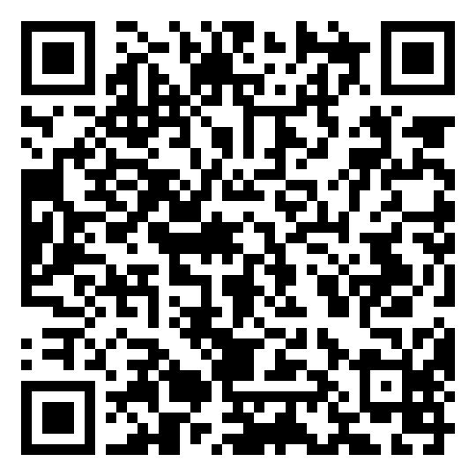
STEP 1 · OPEN THE FORM
Open the form on your phone
1
Get the form link from your supervisor.
2
Tap the link, or scan this code with your phone camera.
3
The form opens in your browser. No app needed.
Scan to open the form
docs.google.com/forms/d/e/1FAIpQLSdvRbvLoDAUtwm8XPoAqVZGMPkAjgAHXka_e8h5XoG_oo-enQ/viewform
Notes:
The QR code and link point to the live form. If your team shares the link another way (for example a group chat), tell staff where to find it.

Slide 4
THE FORM OPENS
Check you have the right form
The title says AA/SEC/F/042 – Hi-lift Escort Checklist.
Notes:
First screen staff see after opening the link.

Slide 5
GOOD TO KNOW
Red * means you must answer
You cannot go to the next page until every * box is filled.

Slide 6
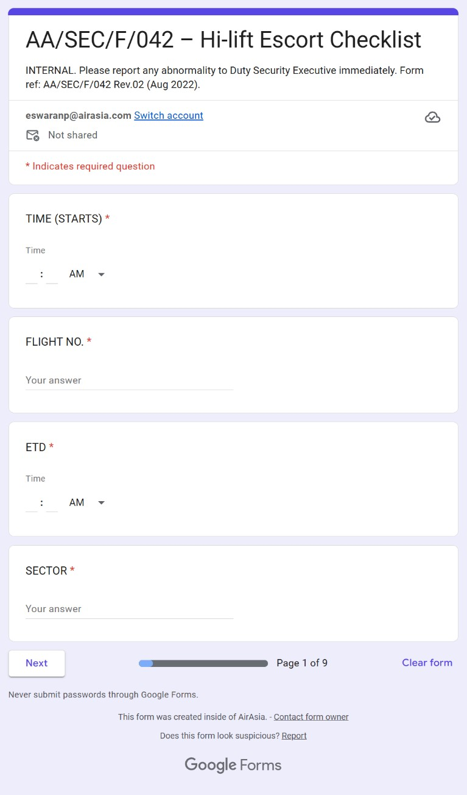
PAGE 1 OF 9
Flight details
This page has 4 boxes:
Time (starts), Flight No., ETD, Sector.
Scroll down to see them all.
Notes:
Full view of page 1 before anything is filled in.

Slide 7
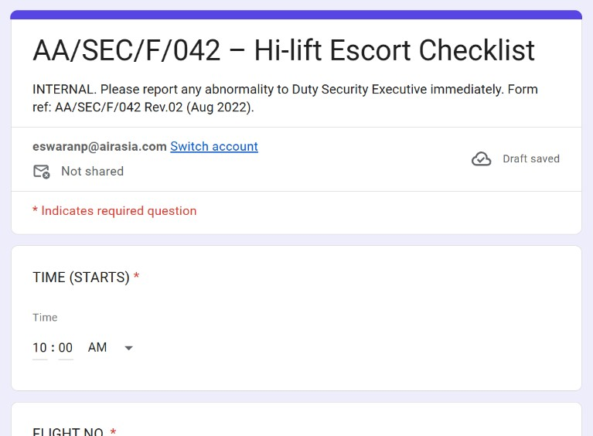
PAGE 1 OF 9
TEST / SAMPLE DATA
2
Tap the box. Type the start time.
Type the hour, then the minutes.
Sample: 10 : 00

Slide 8
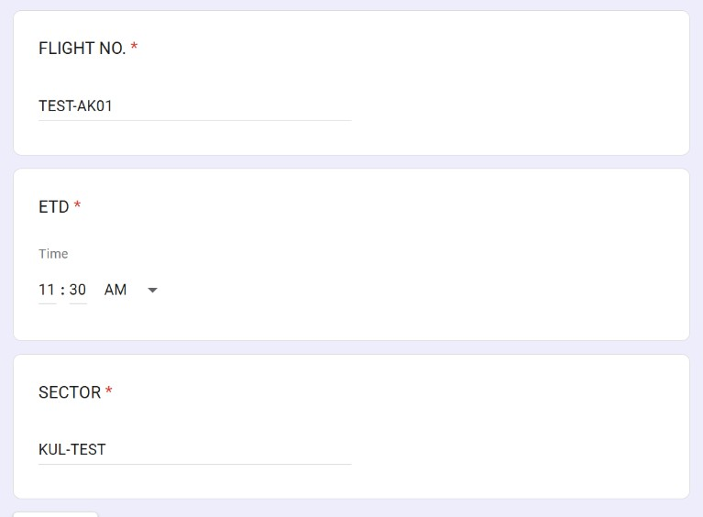
PAGE 1 OF 9
TEST / SAMPLE DATA
3
Tap the box. Type the flight number.
Sample: TEST-AK01

Slide 9
PAGE 1 OF 9
TEST / SAMPLE DATA
4
Type the ETD
Hour, then minutes.
Sample: 11 : 30

Slide 10
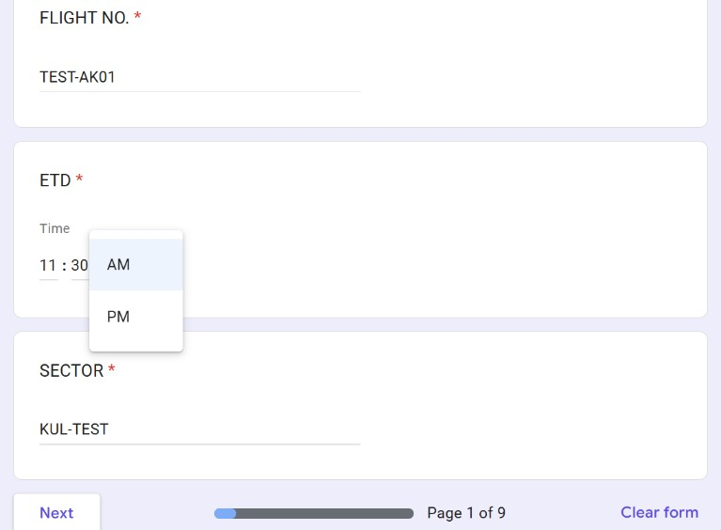
PAGE 1 OF 9
TEST / SAMPLE DATA
5
Choose AM or PM
Tap AM to open the list. Choose PM for afternoon or night times.
Do this for every time box.

Slide 11
PAGE 1 OF 9
TEST / SAMPLE DATA
6
Tap the box. Type the sector.
Sample: KUL-TEST

Slide 12
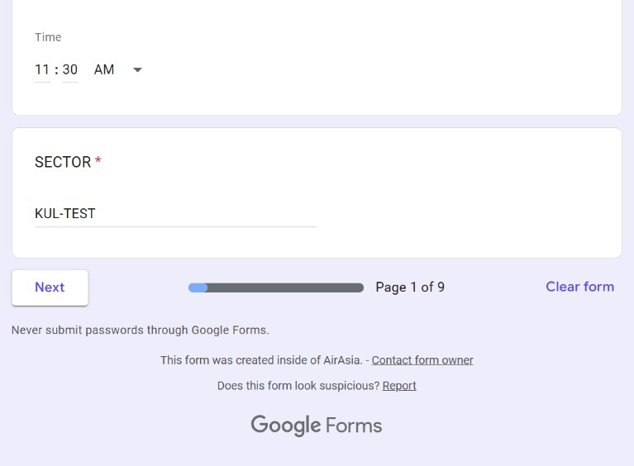
PAGE 1 OF 9
TEST / SAMPLE DATA
7
Tap Next
The bar shows which page you are on.

Slide 13
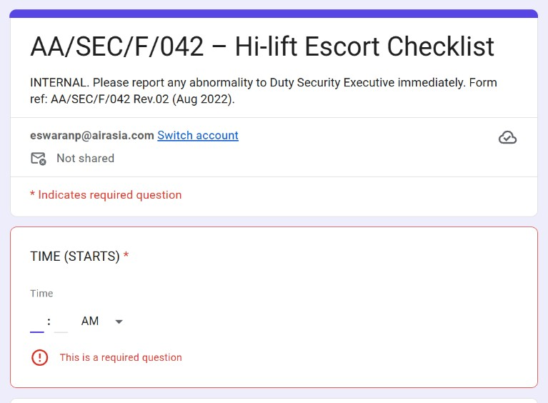
IF YOU MISS A BOX
Red message? Fill in that box.
“This is a required question” means the box is empty. Fill it in, then tap Next again.

Slide 14
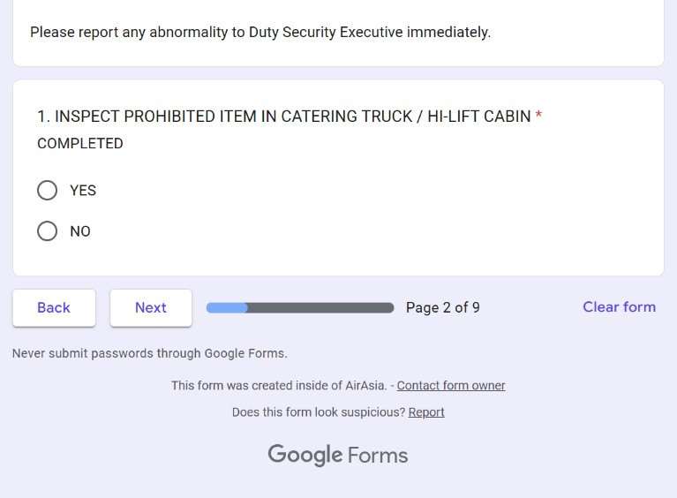
PAGE 2 OF 9
Item 1: prohibited-item check
Inspect the catering truck / hi-lift cabin for prohibited items.
Notes:
Full view of page 2 before an answer is chosen.

Slide 15
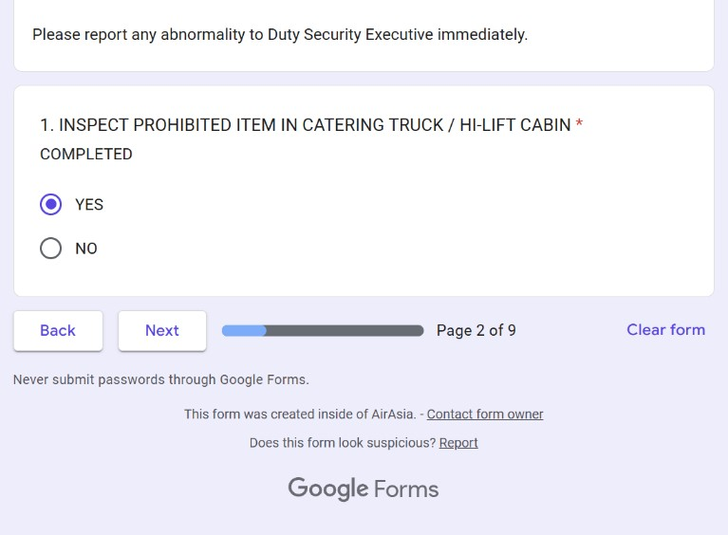
PAGE 2 OF 9
8
Choose your answer
Tap YES when the check is completed.
Then tap Next

Slide 16
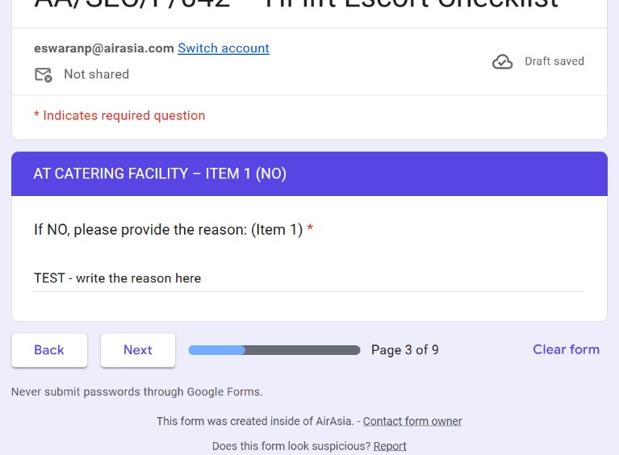
ONLY IF YOU CHOSE NO
TEST / SAMPLE DATA
9
Type the reason
Choosing NO opens this page. The reason is required.
Then tap Next

Slide 17
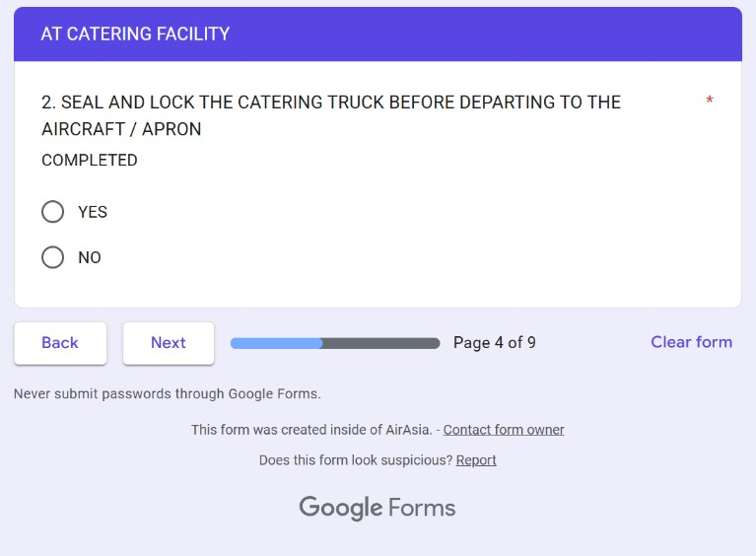
PAGE 4 OF 9
Item 2: seal and lock
Seal and lock the catering truck before departing to the aircraft / apron.
Notes:
Full view of page 4 before an answer is chosen.

Slide 18
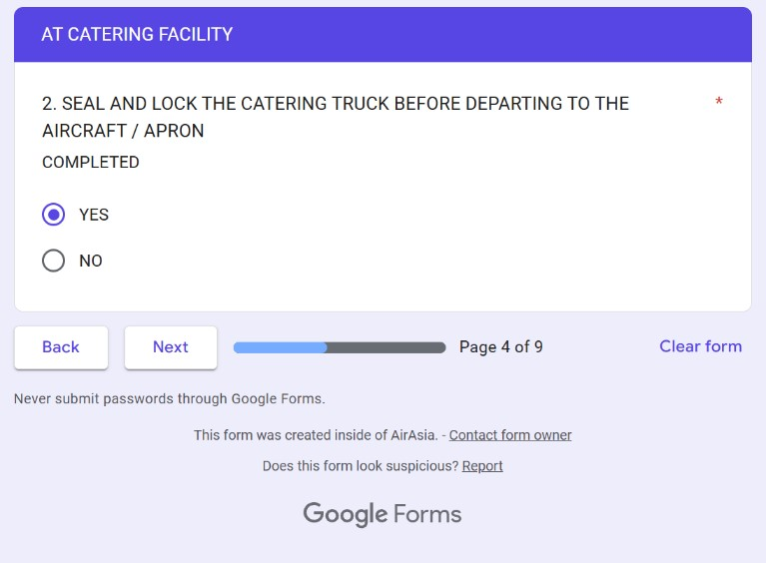
PAGE 4 OF 9
10
Choose your answer
Tap YES when the truck is sealed and locked.
Then tap Next

Slide 19
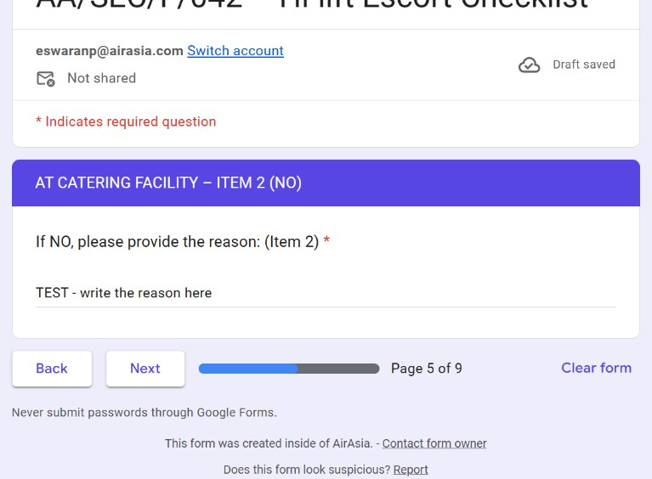
ONLY IF YOU CHOSE NO
TEST / SAMPLE DATA
11
Type the reason
Choosing NO opens this page. The reason is required.
Then tap Next

Slide 20
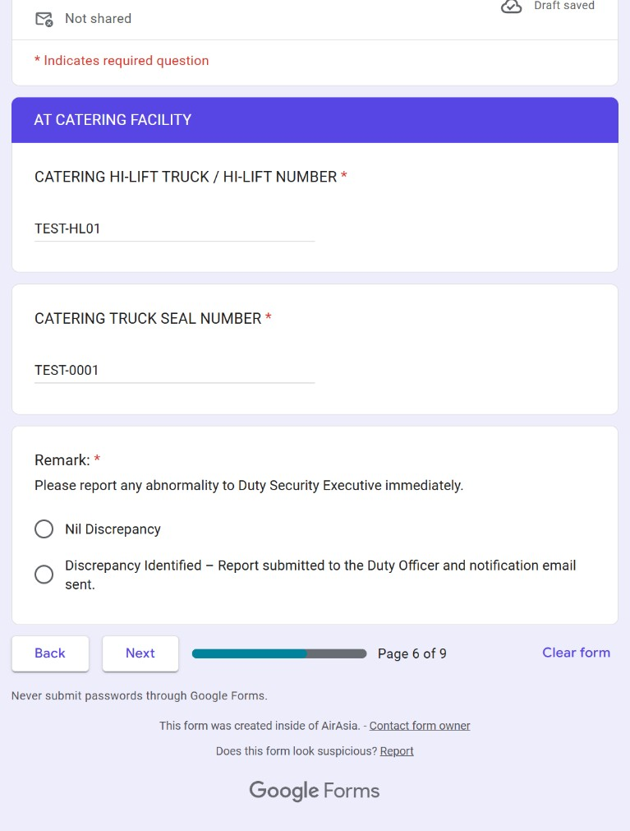
TEST / SAMPLE DATA
PAGE 6 OF 9
Truck, seal and remark
Two boxes to type in, then one answer to choose.
Notes:
Full view of page 6 (sample truck and seal numbers already typed).

Slide 21
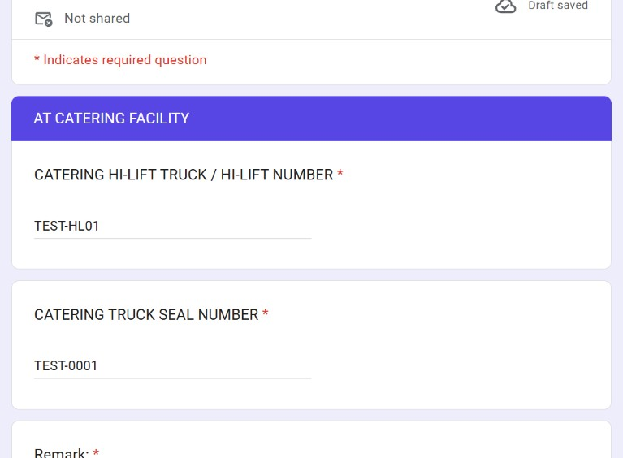
PAGE 6 OF 9
TEST / SAMPLE DATA
12
Type the hi-lift number
Catering hi-lift truck / hi-lift number.
Sample: TEST-HL01

Slide 22
PAGE 6 OF 9
TEST / SAMPLE DATA
13
Type the seal number
Catering truck seal number.
Sample: TEST-0001

Slide 23
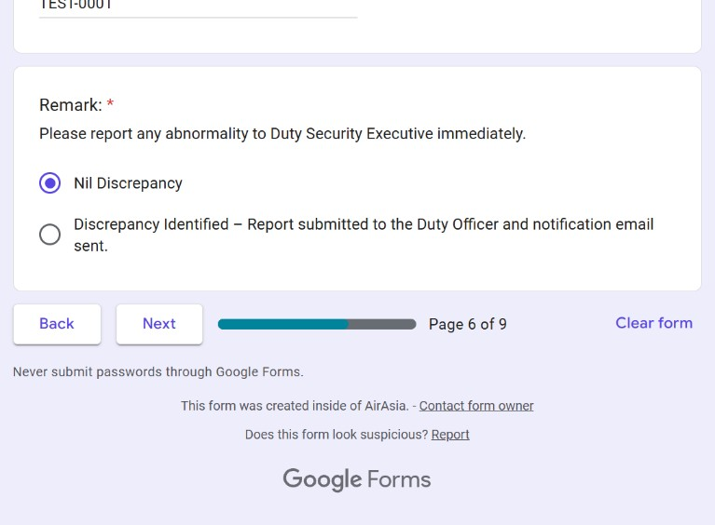
PAGE 6 OF 9
14
Choose the remark
Nil Discrepancy = nothing wrong found.
Then tap Next

Slide 24
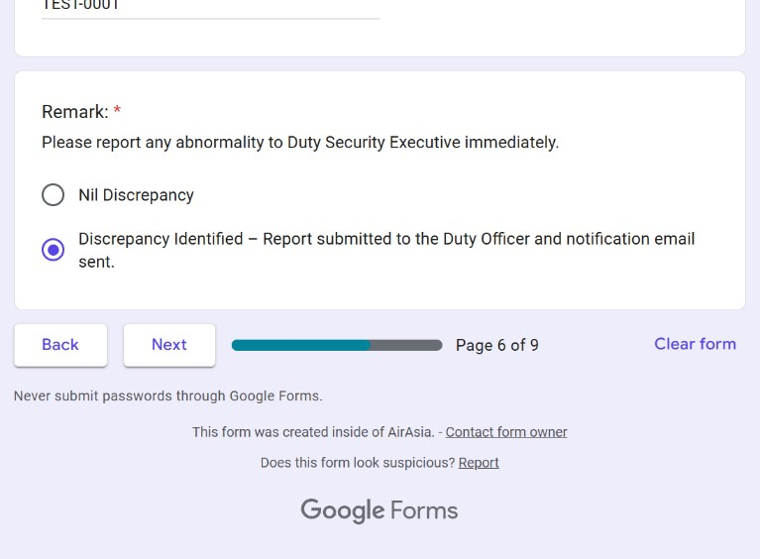
ONLY IF THERE IS A PROBLEM
15
Choose Discrepancy Identified
Only after the report is submitted to the Duty Officer and the notification email is sent.
Then tap Next

Slide 25
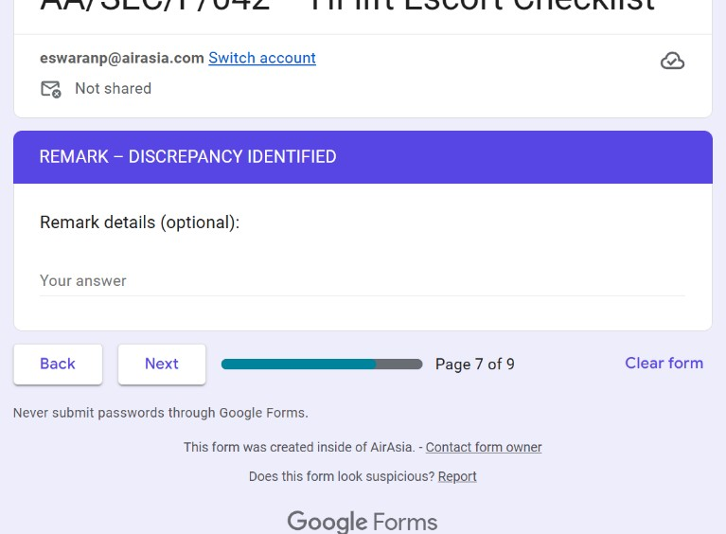
PAGE 7 · DISCREPANCY ONLY
16
Add details if needed
This box is optional. You can leave it empty and tap Next.

Slide 26
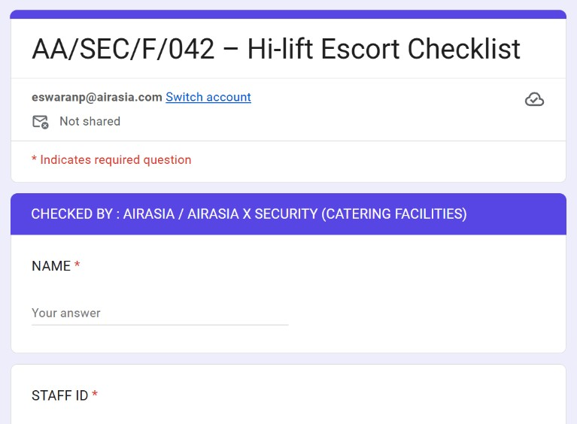
PAGE 8 OF 9
Sign-off: catering facility
Checked by AirAsia / AirAsia X Security at the catering facility.
Notes:
Full view of page 8 before anything is filled in.

Slide 27
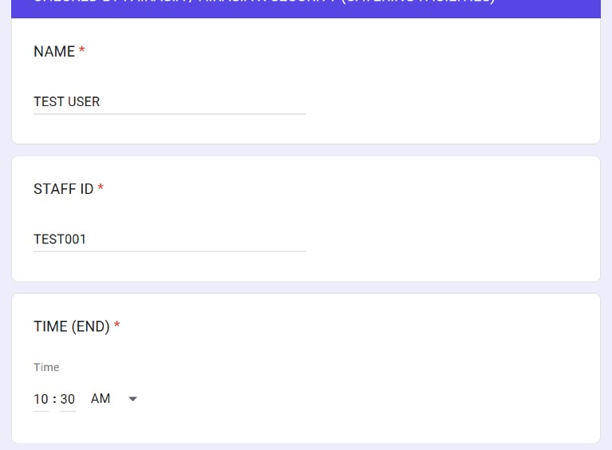
PAGE 8 OF 9
TEST / SAMPLE DATA
17
Type your name
Sample: TEST USER

Slide 28
PAGE 8 OF 9
TEST / SAMPLE DATA
18
Type your staff ID
Sample: TEST001

Slide 29
PAGE 8 OF 9
TEST / SAMPLE DATA
19
Type the end time
Hour, minutes, then check AM / PM.
Sample: 10 : 30 AM

Slide 30
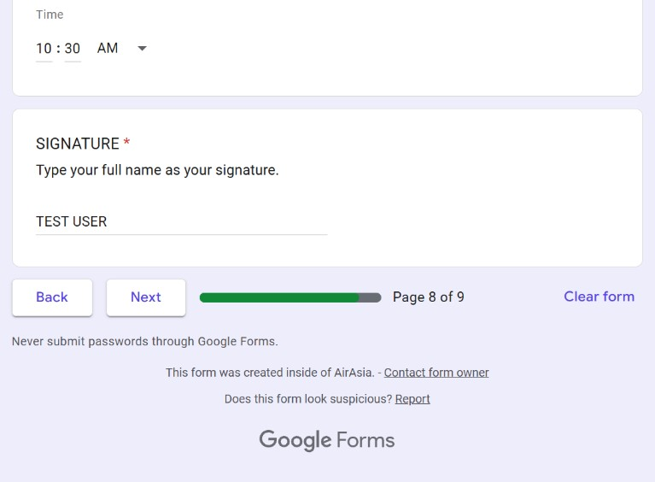
PAGE 8 OF 9
TEST / SAMPLE DATA
20
Sign: type your full name
The signature is your full name, typed.
Then tap Next

Slide 31
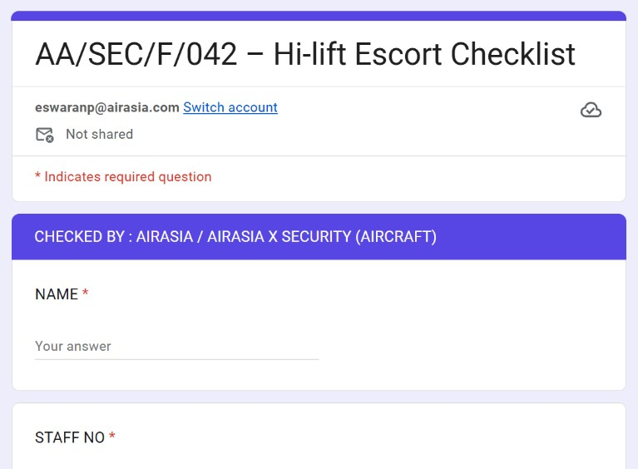
PAGE 9 OF 9
Sign-off: aircraft
Checked by AirAsia / AirAsia X Security at the aircraft. Same 4 boxes as page 8.
Notes:
Full view of page 9 before anything is filled in.

Slide 32
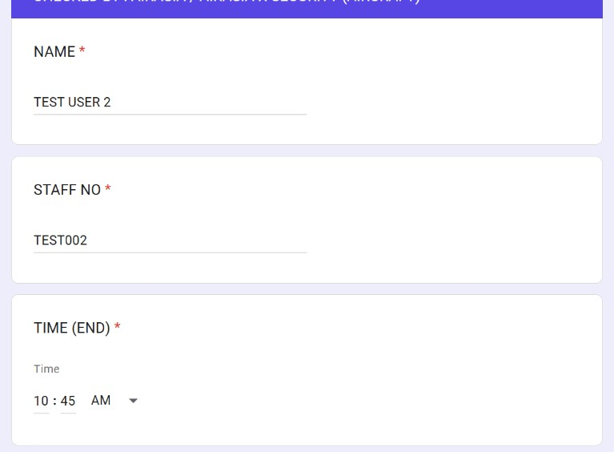
PAGE 9 OF 9
TEST / SAMPLE DATA
21
Fill in name, staff no. and end time
Same as page 8. This page says STAFF NO.
Sample: TEST USER 2, TEST002, 10 : 45

Slide 33
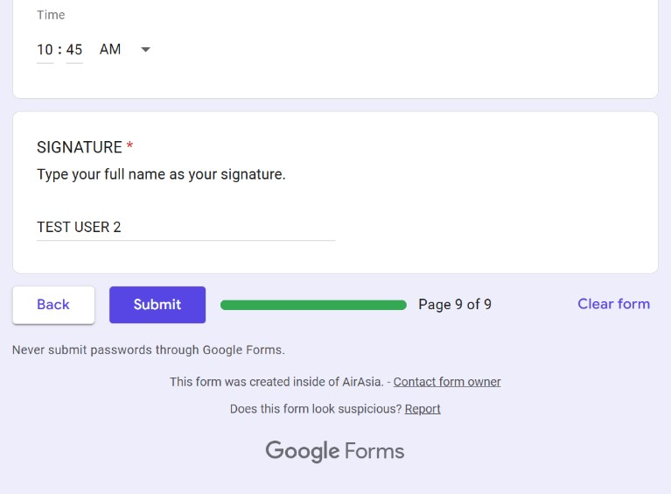
PAGE 9 OF 9
TEST / SAMPLE DATA
22
Check your details
Tap Back to look at earlier pages. Your answers stay filled in.
Fix anything wrong, then come back with Next.

Slide 34
PAGE 9 OF 9
TEST / SAMPLE DATA
23
Tap Submit
Submit is only on the last page.

Slide 35
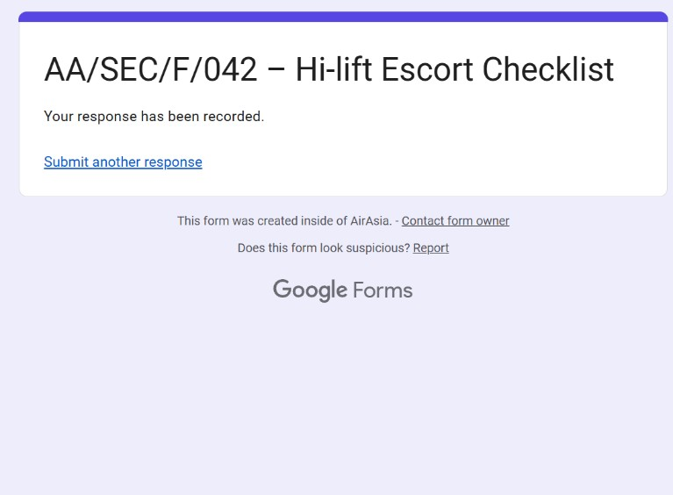
DONE
24
Look for this message
“Your response has been recorded.” means it was sent.
Use “Submit another response” only for a new escort.
Notes:
This confirmation screen came from one TEST submission made on 11 Nov 2026 at 10:36 (Flight No. TEST-AK01).

Slide 36
AFTER YOU SUBMIT
You cannot change it after Submit
✕
No edit link
Editing after submitting is turned off for this form.
✕
No copy sent to you
The form does not collect email or send copies.
!
Made a mistake?
Tell your supervisor straight away.
So: check every page before you tap Submit.
Notes:
Checked in the live form settings on 11 Nov 2026: Collect email addresses = Do not collect; Send responders a copy = Off; Allow response editing = Off. The confirmation screen shows no 'Edit your response' link.

Slide 37
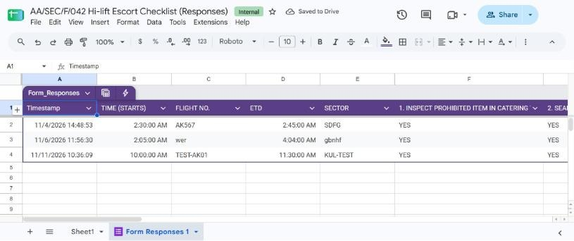
WHERE ANSWERS GO
Every Submit adds one row to a Google Sheet
Sheet: AA/SEC/F/042 Hi-lift Escort Checklist (Responses).
Row 4 is the TEST response made for this guide.
Notes:
Linked response Sheet verified on 11 Nov 2026: tab 'Form Responses 1'. The TEST row (Timestamp 11/11/2026 10:36:09, Flight No. TEST-AK01) can be deleted by the Sheet owner.

Slide 38
WHO DOES WHAT
You submit. Supervisors review.
Staff
Fill in the form on your phone and tap Submit.
Response Sheet
Each submission is saved as a new row.
Authorised supervisors
Review the records in the Sheet.
Staff do not need to open the Sheet.

Slide 39
Need help?
1
Form will not open?
Check the link. Use the link or QR code from your supervisor.
2
Page will not load or submit?
Check your internet connection (data or Wi-Fi), then try again.
3
Not sure what to type?
Ask your supervisor before you submit.

