Slide 1
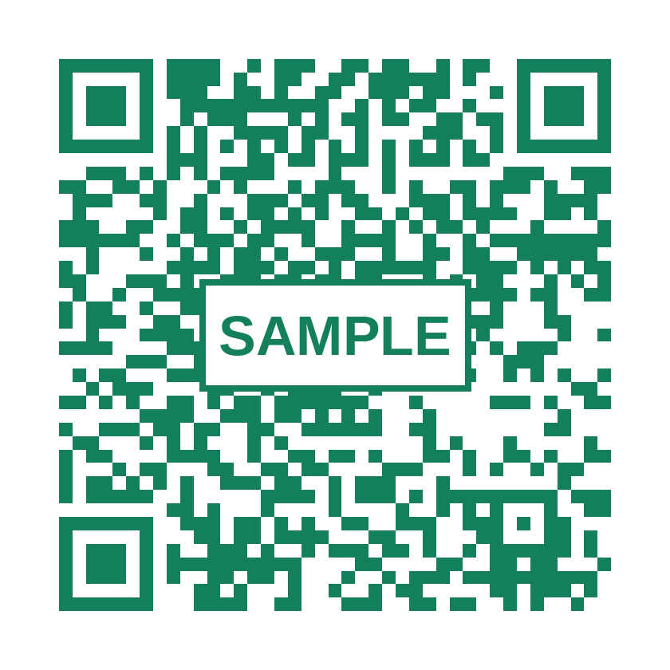
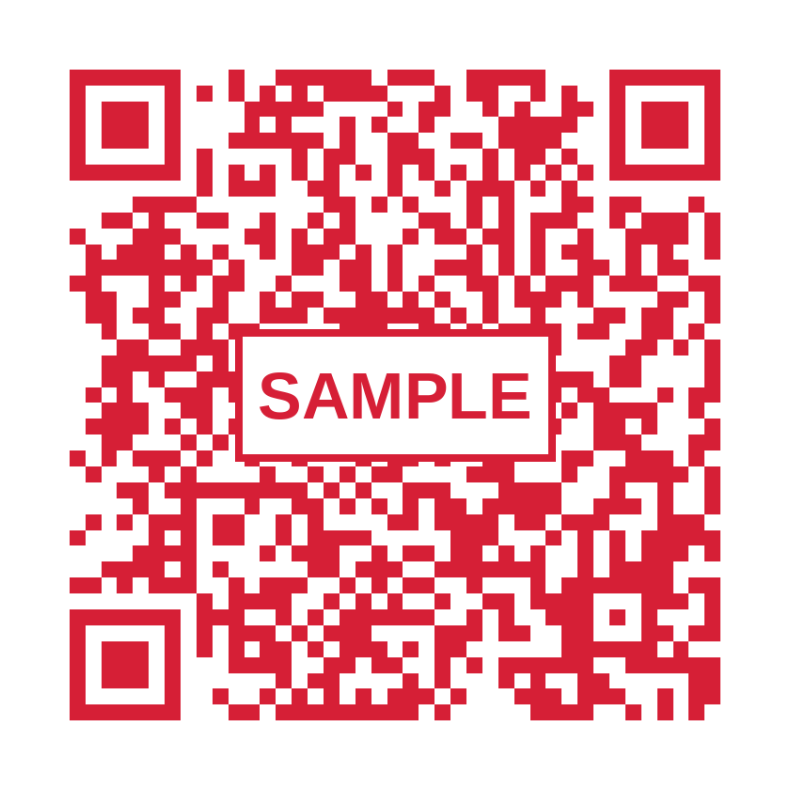
How to Check In and Check Out
AA/SEC/F/077 ATTENDANCE RECORD
CHECK-IN
CHECK-OUT
Staff training briefing
Scan, fill in, submit, recorded
Start of shift
End of shift
Notes:
Welcome everyone. This briefing covers the AA/SEC/F/077 Attendance Record. There are two QR codes: one for check-in at the start of the shift, one for check-out at the end. Today we walk through each step using the real forms.

Slide 2
Two QR codes. Two moments.
CHECK-IN
CHECK-OUT
START of shift
END of shift
Scan to open the Check-in form
Scan to open the Check-out form
1 Scan
2 Fill in form
3 Submit
4 Recorded
Never swap them: Check-in at the start, Check-out at the end.
Notes:
Two separate QR codes open two separate forms. Check-in is green, check-out is red throughout this deck so they cannot be confused. The flow is the same every time: scan, fill in the form, submit, recorded.

Slide 3
Start of shift: scan the Check-in QR
1
a
Scan at the START of your shift
CHECK-IN QR
b
Sign in with your AirAsia Google account
c
Title must say Check-in
Wrong QR = wrong form. At the end of the shift use the Check-out QR.
Notes:
Step 1. At the start of your shift, scan the Check-in QR. Use your AirAsia Google account. Confirm the form title says Check-in before you type anything.

Slide 4
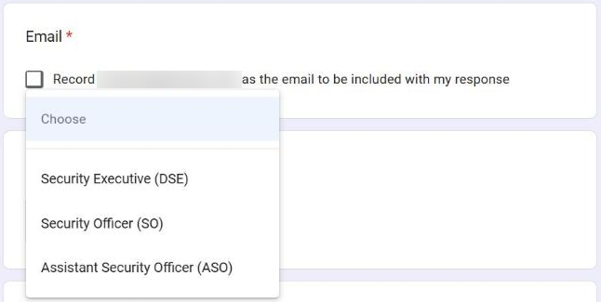
Fill in the Check-in form
2
What the form asks
Email
tick the Record email box
Designation
choose yours (left)
Shift start date
the date your shift starts
Team
Alpha, Bravo, Charlie or Delta
Choose your designation
Name
your name
DSE
SO
ASO
Security Executive
Security Officer
Assistant Security Officer
Staff ID
your Staff ID
Notes:
Step 2. The form asks for Email, Designation, Shift start date, Team, Name and Staff ID. Tick the box that records your Google email. Choose your own designation: Security Executive (DSE), Security Officer (SO) or Assistant Security Officer (ASO).

Slide 5
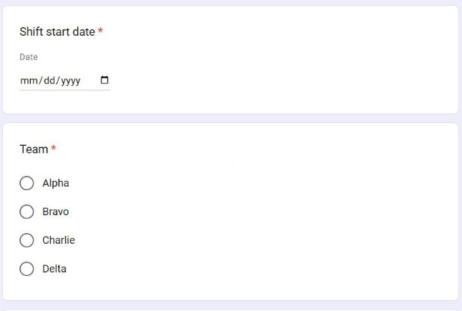
Select your team
3
ALPHA
BRAVO
CHARLIE
DELTA
Tap ONE circle: your own team.
Your team decides which tab of the attendance Sheet holds your record.
Notes:
Step 3. Choose the team you belong to: Alpha, Bravo, Charlie or Delta. This decides which team tab your record appears under in the Google Sheet.

Slide 6
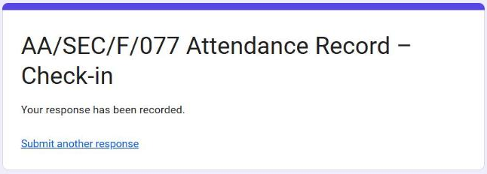
Review, press Submit, check the confirmation
4
Check every field
YOU SHOULD SEE THIS
1
Email ticked, designation, date, team, name, Staff ID
2
Press Submit once
One check-in per shift
3
Wait for the confirmation
No confirmation screen? Your check-in was not sent. Check the fields and press Submit again.
The screen on the right
Notes:
Step 4. Review each field, press Submit once, and wait for the page that says Your response has been recorded. The check-in time is saved automatically at that moment.

Slide 7
End of shift: scan the Check-out QR
5
a
Scan at the END of your shift
CHECK-OUT QR
b
Use your AirAsia Google account
c
Title must say Check-out
This is a different QR from the Check-in one. Do not scan the Check-in QR again.
Notes:
Step 5. At the end of the shift, scan the separate Check-out QR with the same company Google account you used to check in.

Slide 8
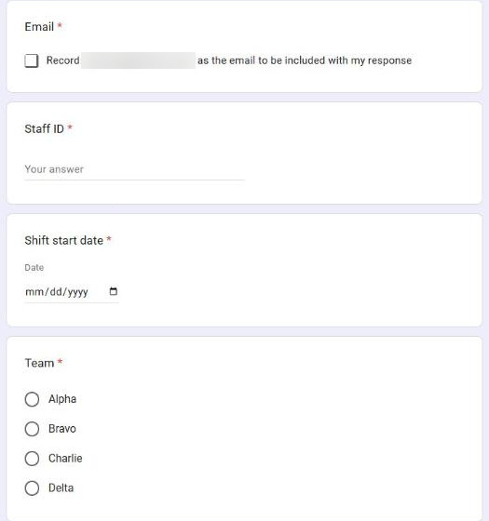
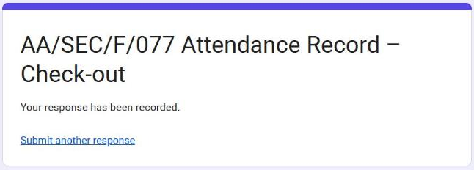
Complete the Check-out form and submit
6
Same details as check-in
Email: tick the Record email box
Staff ID: the same Staff ID
Shift start date: the date your shift started
Team: the same team
This form has no Designation or Name field.
THEN SUBMIT: YOU SHOULD SEE THIS
Notes:
Step 6. The check-out form is shorter: Email, Staff ID, Shift start date and Team. It does not ask for designation or name. Use the same Staff ID, the date your shift started, and your team. Press Submit and wait for the confirmation.

Slide 9
Times are recorded automatically
7
CHECK-IN TIME
CHECK-OUT TIME
Saved when you press Submit on the Check-in form
Saved when you press Submit on the Check-out form
Never type or edit your own time
The forms have no time field. The Google Sheet records the submission time for you, and authorised supervisors review it there.
Notes:
Step 7. You never enter a time. The submission time is recorded automatically in the Google Sheet when you press Submit. Staff must not type or edit their own check-in or check-out time.

Slide 10
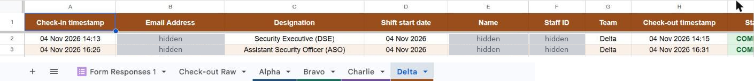
Where your attendance goes
Staff scans QR
Submits the form
Google Sheet records the time
Appears under your team
Check-in or Check-out
Check-in or Check-out form
automatically
Alpha, Bravo, Charlie or Delta
Check-in time
Check-out time
Your team's tab (Delta shown)
Sample view: staff details hidden. The Sheet is for authorised supervisors to review. Staff only use the QR codes and forms.
Notes:
This is what happens behind the scenes. You scan, submit, and the Google Sheet records the submission time automatically. Your record then appears under your team's tab with a check-in time and a check-out time. The Sheet is for authorised supervisors to review. Staff only need the QR codes and forms. Personal details are hidden in this screenshot.

Slide 11
Common mistakes to avoid
X
Scanned the wrong QR
OK
Check-in QR at the start, Check-out QR at the end
X
Picked the wrong team
OK
Tap your own team: Alpha, Bravo, Charlie or Delta
X
Wrong shift start date
OK
Enter the date your shift started, at check-in and check-out
X
Used a personal Google account
OK
Use your AirAsia Google account, the same one both times
X
Forgot to check out
OK
Scan the Check-out QR at shift end. Both scans give a COMPLETE record
Notes:
Five mistakes to avoid: scanning the wrong QR, choosing the wrong team, entering the wrong shift start date, using a personal Google account, and forgetting to check out.

Slide 12
Quick reference: save this to your phone
CHECK-IN: START of shift
CHECK-OUT: END of shift
1
Scan the Check-in QR
1
Scan the Check-out QR
2
Pick Designation and Team
2
Enter Staff ID and date
3
Enter date, Name, Staff ID
3
Pick your Team
4
Submit: see "recorded"
4
Submit: see "recorded"
AirAsia Google account | Never type a time | Submit once per shift
Notes:
Quick reference. Staff can screenshot this slide. Three rules: use your AirAsia Google account, never type a time, and submit once per shift.

