Slide 1
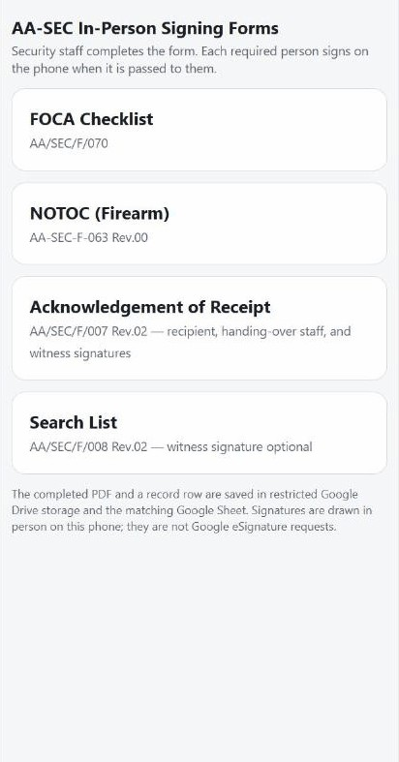
STAFF GUIDE · AA/SEC/F/070
FOCA Checklist
Security fills the checklist. Airline Rep and Security Rep each sign on the same phone.
AA-SEC In-Person Signing Forms app

Slide 2
AA/SEC/F/070
Who does what
Who does what
1
Security staff fills the checklist
2
Airline Representative: name, ID, sign
3
Security Representative: name, ID, sign, save

Slide 3
BEFORE YOU START
Rules for every FOCA
1
Use your AirAsia (@airasia.com) Google account
2
Each person types their own name and ID, and signs for themselves
3
Never sign for anyone else
4
One case = one new form. Never reuse an old one

Slide 4
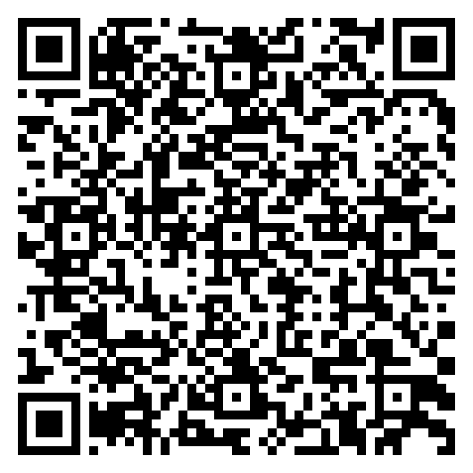
STEP 1
Get the app link
Ask your supervisor for the link,
or scan this code with your phone camera.
The link only works for AirAsia Google accounts.
Scan to open the app

Slide 5
STEP 2
Open it in Chrome on your phone
1
Open the Chrome app on the phone
2
Paste the link, or scan the code
3
If asked, sign in with your @airasia.com account
4
Wait for the list of 4 forms
Tip: in Chrome tap ⋮ → Add to Home screen, so the app is one tap away next time.

Slide 6
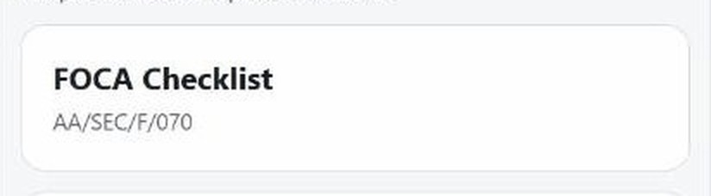
STEP 3
SECURITY STAFF
Tap FOCA
Check the form code on the card:
AA/SEC/F/070.
CLOSE-UP

Slide 7
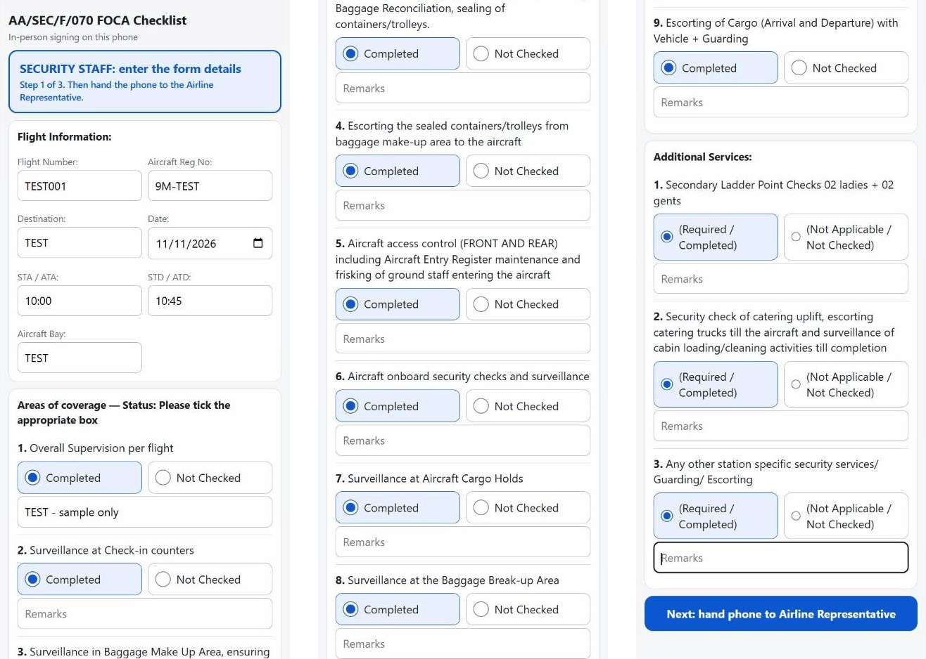
THE WHOLE FORM
Scroll down to see it all
Top: flight details.
Middle: tick each line.
Bottom: blue Next button.

Slide 8
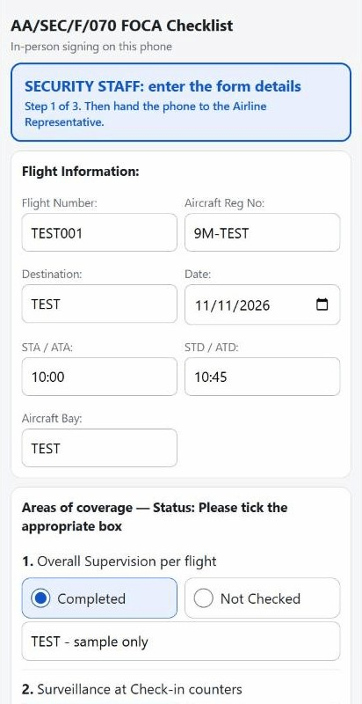
STEP 4
SECURITY STAFF
Fill the flight boxes
Flight number, aircraft reg, destination, date, STA/ATA, STD/ATD, bay.
Flight number and date are a must.
Sample shown: TEST data only.

Slide 9
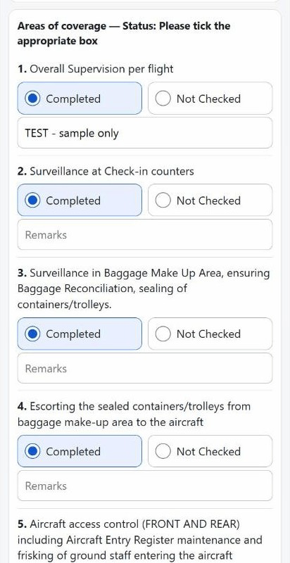
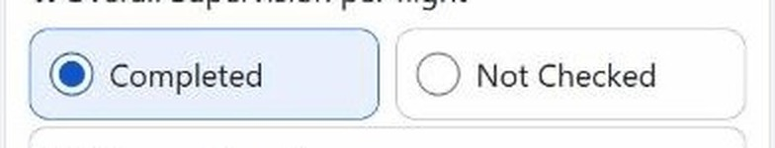
STEP 5
SECURITY STAFF
Tick one box on every line
Areas of coverage: Completed or Not Checked.
Type a remark if needed.
CLOSE-UP

Slide 10
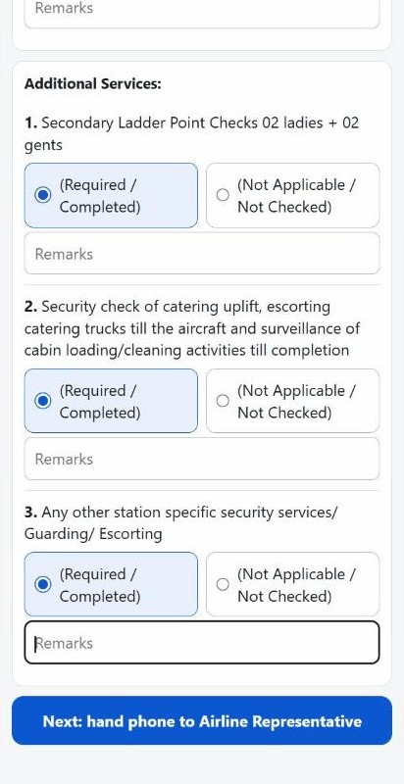
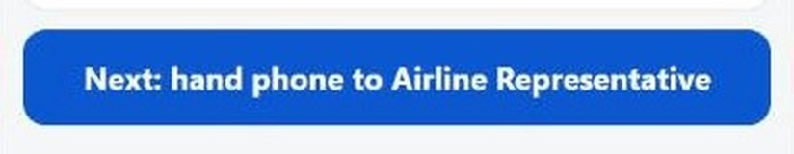
STEP 6
SECURITY STAFF
Additional Services, then tap Next
Tick Required/Completed or Not Applicable.
Read every line before you tap.
CLOSE-UP

Slide 11
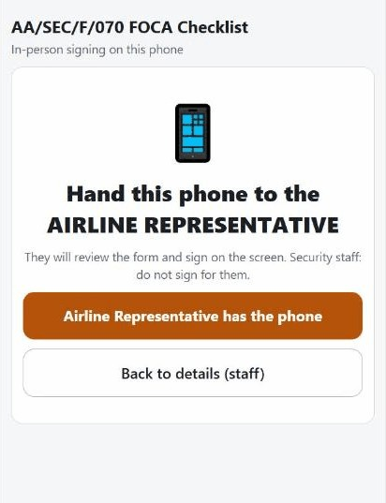
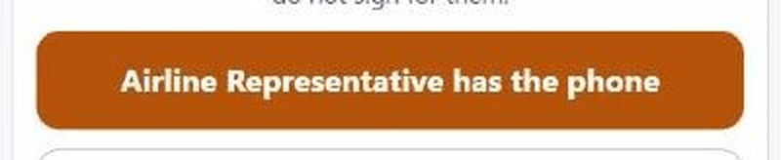
STEP 7
AIRLINE REPRESENTATIVE
Give the phone to the Airline Rep
They tap the orange button:
“Airline Representative has the phone”.
CLOSE-UP

Slide 12
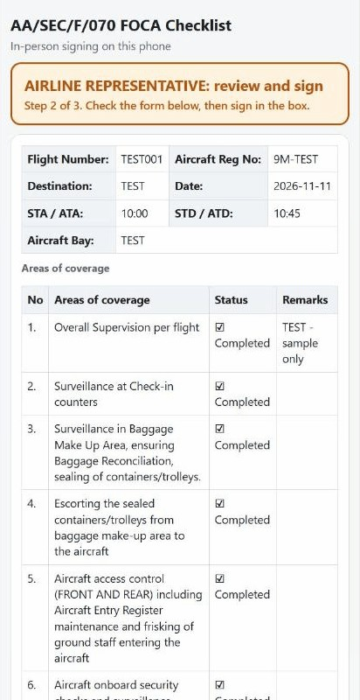
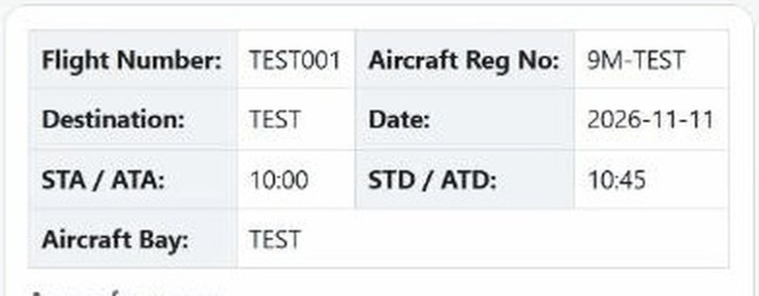
STEP 8
AIRLINE REPRESENTATIVE
Airline Rep checks the form
They read every detail.
Wrong? They tap “Something is wrong” and the phone goes back to Security.
CLOSE-UP

Slide 13
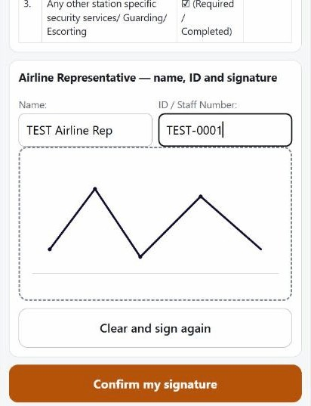
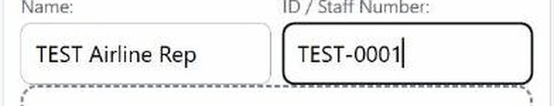
STEP 9
AIRLINE REPRESENTATIVE
Type own name and ID
Name and ID / staff number of the Airline Rep.
CLOSE-UP

Slide 14
STEP 10
AIRLINE REPRESENTATIVE
Sign in the box
Use a finger or stylus.
Security staff: do not sign for them.

Slide 15
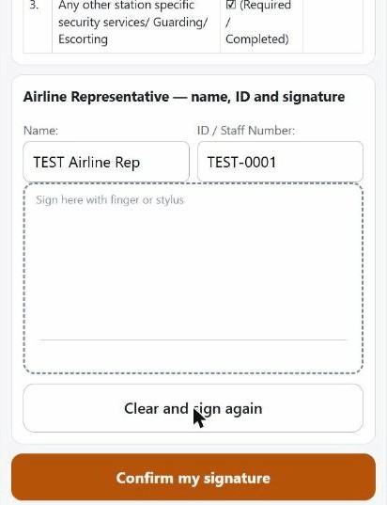
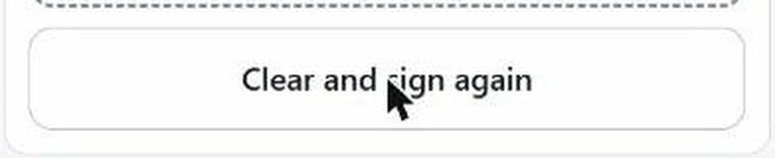
MISTAKE IN THE SIGNATURE?
AIRLINE REPRESENTATIVE
Tap Clear and sign again
The box empties. Sign one more time.
CLOSE-UP

Slide 16
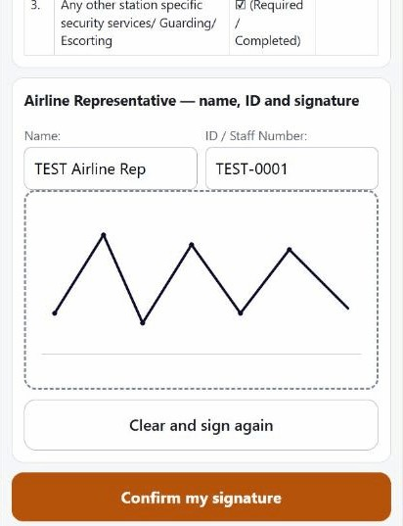
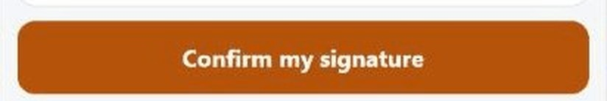
STEP 11
AIRLINE REPRESENTATIVE
Tap Confirm my signature
Then the screen asks to hand the phone back to Security.
CLOSE-UP

Slide 17
STEP 12
SECURITY REPRESENTATIVE
Phone back to Security
1
Screen says: “Hand the phone back to SECURITY STAFF”
2
Tap the blue button: “Security staff has the phone”

Slide 18
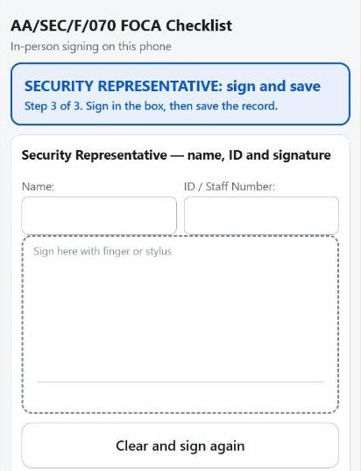
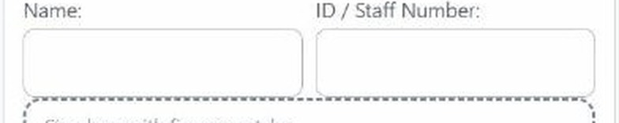
STEP 13
SECURITY REPRESENTATIVE
Type own name and ID
Name and ID / staff number of the Security Rep.
CLOSE-UP

Slide 19
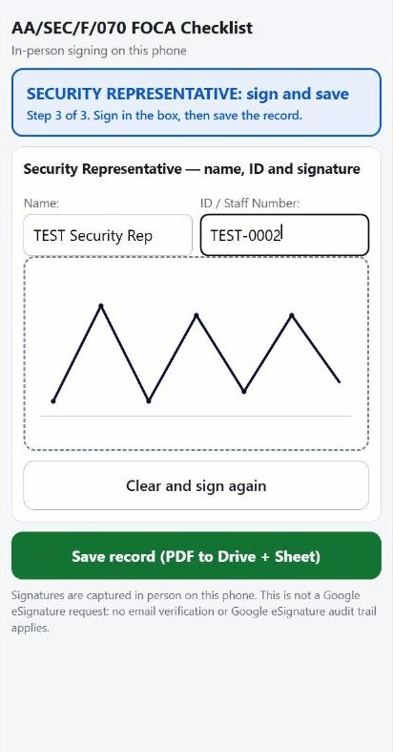
STEP 14
SECURITY REPRESENTATIVE
Sign in the box
Mistake? Tap Clear and sign again.

Slide 20
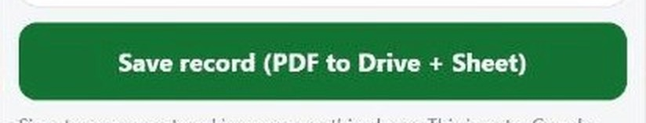
STEP 15 · SAVE
SECURITY REPRESENTATIVE
Tap Save record
Green button: “Save record (PDF to Drive + Sheet)”.
Tap once only. It turns to “Saving...”.
CLOSE-UP

Slide 21
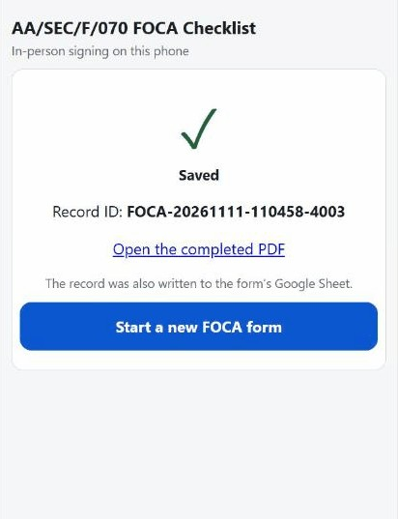
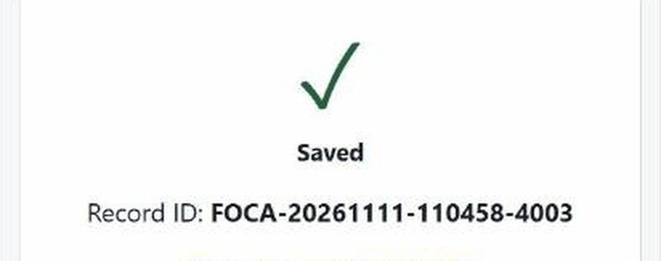
STEP 16 · SAVED
SECURITY REPRESENTATIVE
Wait for “Saved”
You see a tick and a Record ID.
Do not close the app before this.
CLOSE-UP
Shown: TEST record FOCA-20261111-110458-4003.

Slide 22
IF IT SAYS “NOT SAVED”
Do not start again
1
Your entries and signatures stay on the screen
2
Check the phone has internet
3
Tap Save again

Slide 23
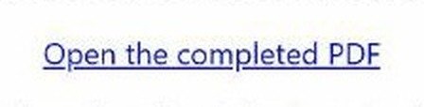
AFTER SAVING
SECURITY STAFF
Tap Open the completed PDF
The signed PDF opens in Google Drive.
CLOSE-UP

Slide 24
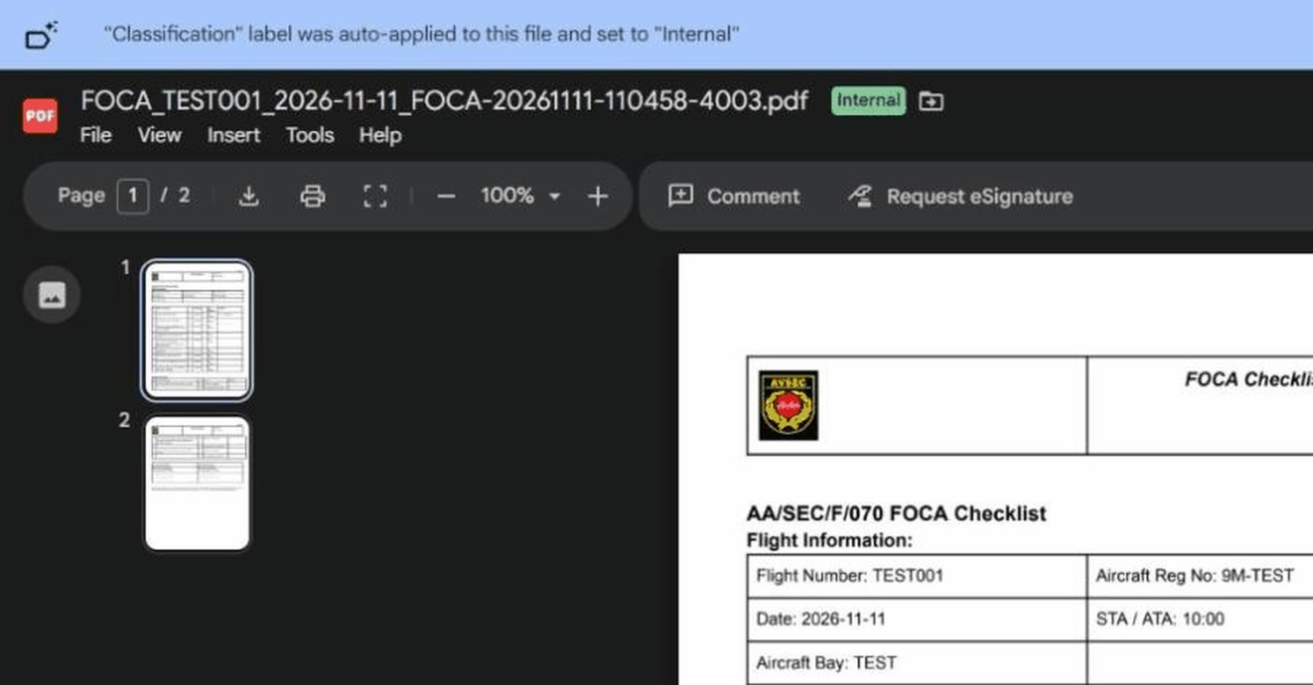
AFTER SAVING
Check the PDF
Check the file name: form, date and Record ID.
Scroll to check every page and each signature.

Slide 25
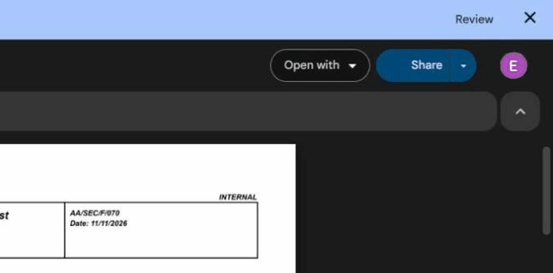
SHARE THE PDF
Tap Share
The blue Share button is at the top right.

Slide 26
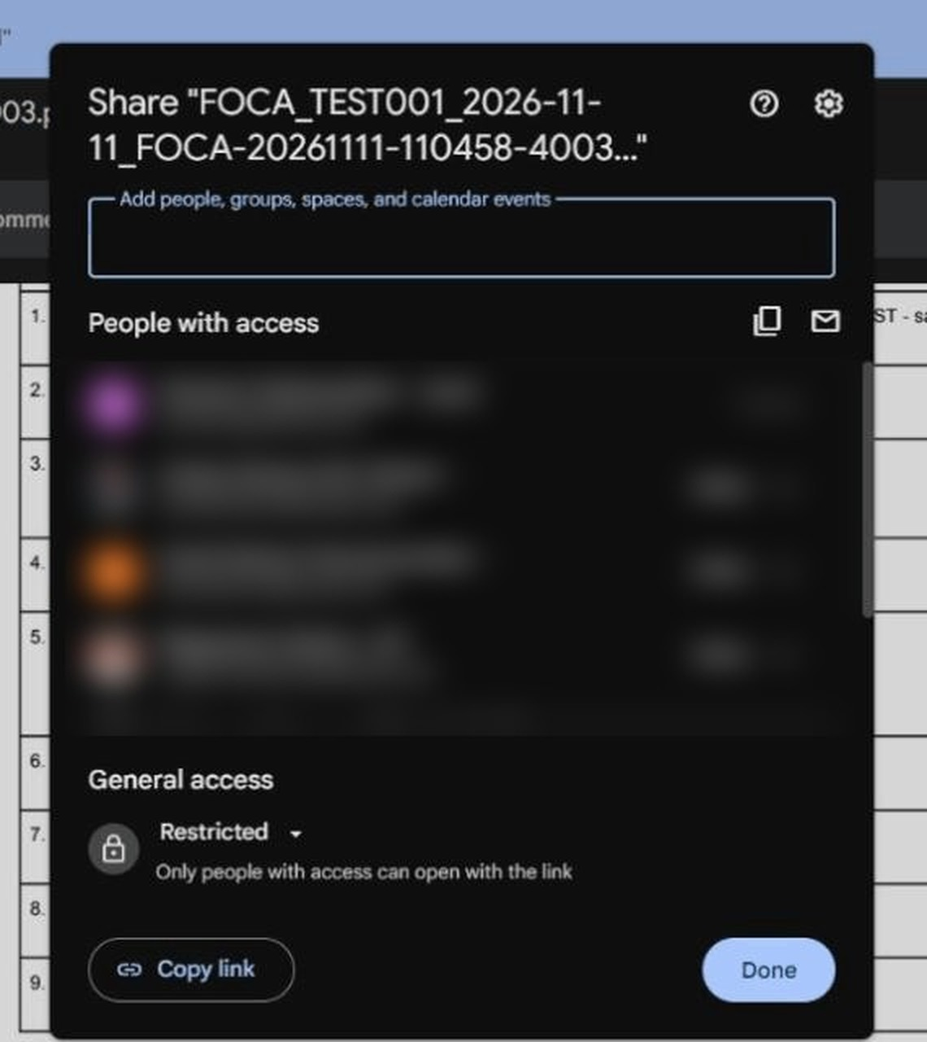
SHARE THE PDF
Tap Copy link
Send the link only to an authorised person.
Keep access “Restricted”. Never change it to “Anyone with the link”.

Slide 27
WHERE THE PDF IS SAVED
Google Drive
My Drive
Every save adds:
• 1 new signed PDF in this folder
• 1 new row in the records Sheet
Only authorised people open this folder.
AA-SEC Signed Forms (RESTRICTED)
FOCA
PDF: FOCA_<flight>_<date>_<Record ID>.pdf
Locations checked in eswaranp@airasia.com Drive, 12 Nov 2026.

Slide 28
WHERE THE RECORD IS SAVED
Google Sheets: one row per save
Sheet: FOCA Records
Same folder as the PDFs: FOCA
Example: the TEST row
Record ID | Saved at (MYT) | Flight Number | Airline Rep | Security Rep | PDF file
FOCA-20261111-110458-4003 | 2026-11-11 11:04:58 | TEST001 | TEST Airline Rep | TEST Security Rep | link to the PDF
Records are written by the app. Do not edit or delete rows.

Slide 29
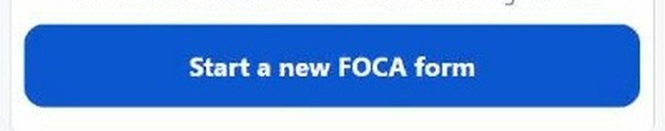
NEW CASE?
SECURITY STAFF
Start a new form
Each save = its own PDF and record.
New case: tap “Start a new FOCA form”.
CLOSE-UP

Slide 30
FOCA · QUICK CHECK
Every time
1
Flight details and date correct
2
One box ticked on every line
3
Airline Rep typed own name, ID and signed
4
Security Rep typed own name, ID and signed
5
Saved screen seen, PDF checked

