Slide 1
MVC4
Parameswari.E

Slide 2
Introduction
The Model-View-Controller (MVC) architectural pattern separates an application into three main components:
Model
View and
Controller.
The ASP.NET MVC framework provides an alternative to the ASP.NET Web Forms pattern for creating Web applications.
The ASP.NET MVC framework is a lightweight, highly testable presentation framework that (as with Web Forms-based applications) is integrated with existing ASP.NET features, such as master pages and membership-based authentication.

Slide 3
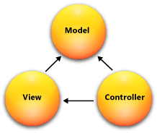
MVC Pattern

Slide 4
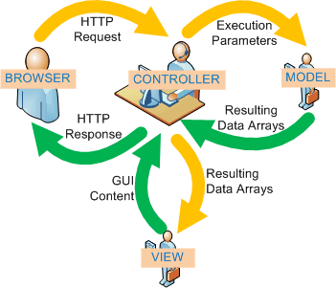

Slide 5



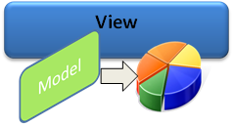
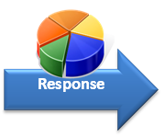
Step 1: Incoming request directed to Controller.
Step 2: Controller processes request and forms a data Model.
Step 3: Model is passed to View.
Step 4: View transforms Model into appropriate output format
Step 5: Response is rendered.

Slide 6
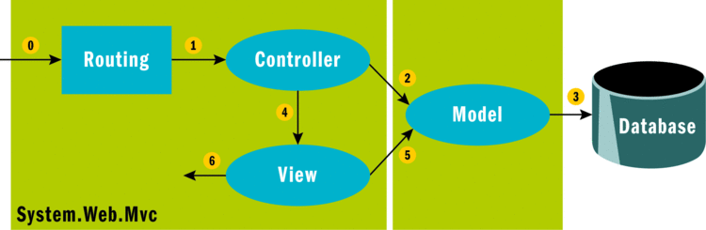

Slide 7
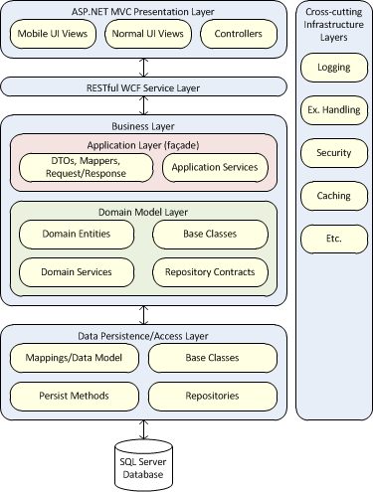

Slide 8
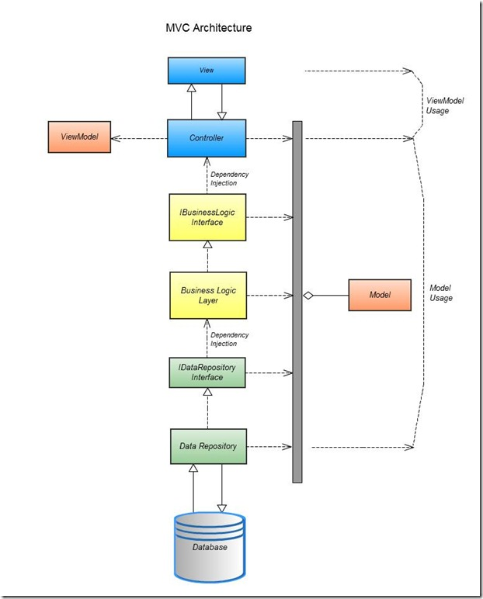

Slide 9
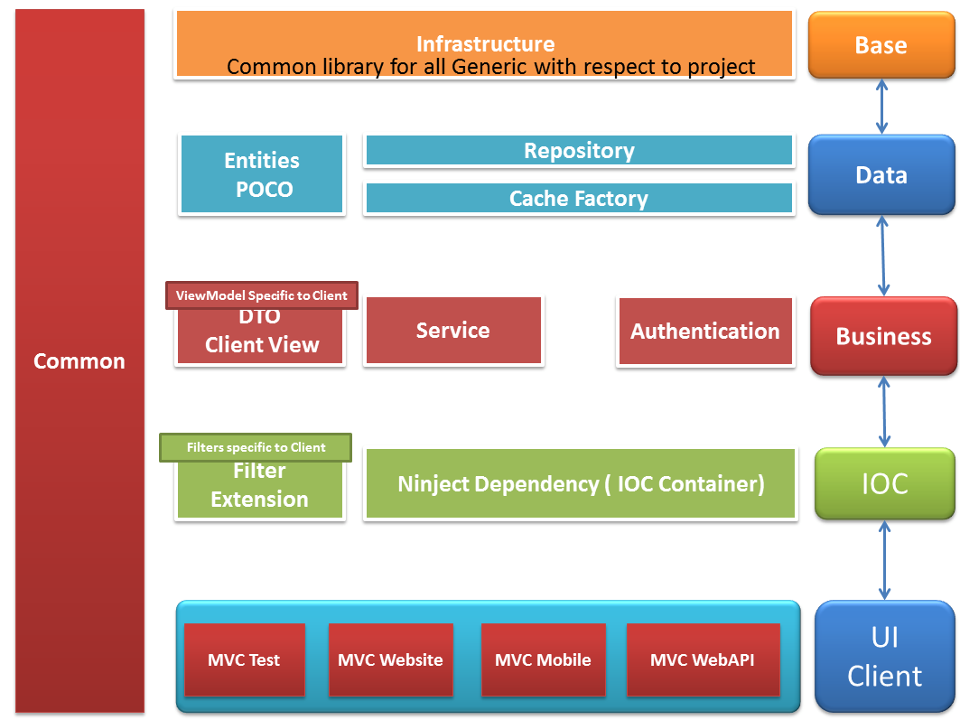

Slide 10
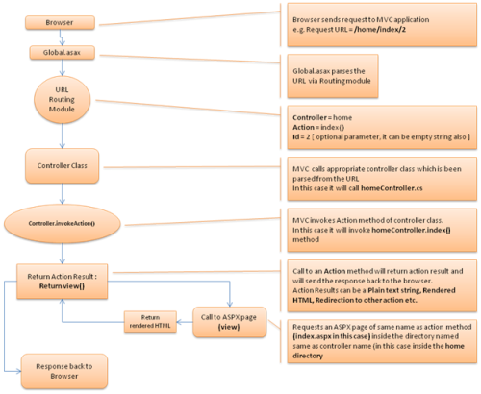

Slide 11
MVC Framework Overview
The MVC framework is defined in the System.Web.Mvc assembly.
Models –
Model objects are the parts of the application that implement the logic for the application's data domain.
Often, model objects retrieve and store model state in a database.
For example, a Product object might retrieve information from a database, operate on it, and then write updated information back to a Products table in a SQL Server database.
In small applications, the model is often a conceptual separation instead of a physical one.
For example, if the application only reads a dataset and sends it to the view, the application does not have a physical model layer and associated classes.
In that case, the dataset takes on the role of a model object.

Slide 12
MVC Framework Overview
Views
Views are the components that display the application's user interface (UI).
Typically, this UI is created from the model data.
An example would be an edit view of a Products table that displays text boxes, drop-down lists, and check boxes based on the current state of a Product object.
Controllers
Controllers are the components that handle user interaction, work with the model, and ultimately select a view to render that displays UI.
In an MVC application, the view only displays information; the controller handles and responds to user input and interaction.
For example, the controller handles query-string values, and passes these values to the model, which in turn might use these values to query the database.

Slide 13
MVC Architecture

Slide 14
When to choose MVC App
Scenarios | What to choose?? | Remarks
Your developers love drag and drop control from the tool box and raw HTML is a nightmare for them | Web forms | Classic ASP.NET controls are abstractions of HTML, with “runat” server attribute.

Slide 15
When to choose MVC App
Your Application demands fancy visual controls to display data. Even if it requires something like Gridview | Web froms | MVC only has HTML helpers. Some of those are: ActionLink — Links to an action method BeginForm — Marks the start of a form and links to the action method that renders the form CheckBox * — Renders a check box DropDownList * — Renders a drop-down list Hidden — Embeds information in the form that is not rendered for the user to see ListBox — Renders a list box RadioButton * — Renders a radio button TextArea — Renders a text area (multi-line text box) TextBox * — Renders a text box And you don’t have much choice. We never want a for loop around HTML controls to achieve the gridview functionality.

Slide 16
When to choose MVC App
You want to achieve Separation of Controls build into the system/framework and you don’t need to bother | MVC | SOC is in the architecture of this framework. With web forms, you can achieve SOC but you need to do that on your own with some best practices while writing your code.
You want to test each and every component of your application right from the beginning, without connecting to databases | MVC | MVC was designed by keeping testability in mind.
Let me know if I missed any major one. |  | Web forms is mature and MVC is young which lacks component model. But needless to say it leads you towards a good code design.

Slide 17
MVC1
ASP.NET MVC 1 Overview In February 2007, Scott Guthrie (“ScottGu”) of Microsoft sketched out the core of ASP.NET MVC while flying on a plane to a conference on the East Coast of the United States.

Slide 18
MVC2
ASP.NET MVC 2 was released just one year later, in March 2010. Some of the main features in MVC 2 included:
UI helpers with automatic scaffolding with customizable templates
Attribute-based model validation on both client and server
Strongly typed HTML helpers
Improved Visual Studio tooling

Slide 19
ASP.NET MVC 3 Overview
ASP.NET MVC 3 shipped just 10 months after MVC 2, driven by the release date for Web Matrix.
The Razor view engine
Support for .NET 4 Data Annotations
Improved model validation
Greater control and flexibility with support for dependency resolution and global action filters
Better JavaScript support with unobtrusive JavaScript, jQuery Validation, and JSON binding
Use of NuGet to deliver software and manage dependencies throughout the platform

Slide 20
MVC 4 Overview
The MVC 4 release is building on a pretty mature base and is able to focus on some more advanced scenarios.
ASP.NET Web API
Enhancements to default project templates
Mobile project template using jQuery Mobile
Display Modes
Task support for Asynchronous Controllers
Bundling and minification

Slide 21
ASP.NET Web API
ASP.NET Web API (referred to as Web API), a framework that offers the ASP.NET MVC development style but is tailored to writing HTTP services.
This includes both modifying some ASP.NET MVC concepts to the HTTP service domain and supplying some new service-oriented features.

Slide 22
Web API features that are similar to MVC
Routing
Model binding and validation
Filters
Scaffolding
Easy unit testability

Slide 23
Web API new concepts and features specific to HTTP service development
HTTP programming model
Action dispatching based on HTTP verbs
Content negotiation
Code-based confi guration

Slide 24
Creating Model
The .NET platform has had ADO.NET as its data access layer from the beginning.
ADO.NET provided simple abstractions over existing Databases or promoted the Database first design philosophy.
But as the development scenarios changed with Domain Driven Development, the Model first design came into prevalence where the Database Schema was based upon the Model.

Slide 25
Creating Model
To support such a scenario, Microsoft introduced Entity Framework which could generate Model based upon the Database Schema.
Entity Framework also supported the Model First approach.
In this approach, developers can design the Model using ADO.NET EF designer in Visual Studio and then from this design, Database Schema could be designed.
The advantage of this approach is that developers can focus on the Domain model and get started quickly.

Slide 26
Creating Model
In Entity Framework 4.1, a new approach was introduced where Plain Old CLR Objects (POCO) could serve as Domain objects and they need not inherit from EntityObject anymore.
In this case EF, provided an implementation of what’s referred to as DBContext having capability to track changes to these objects in memory.

Slide 27
Creating Model
Entity Framework Code-First makes use of POCOs.
In this case, a developer has complete control over the classes being written or Implemented.
The developer can completely concentrate on the Business Domain.
This supports Attributed based Mapping from class to Table.
One could also use the Fluent API for configuration of Schema and domain relationships.

Slide 28
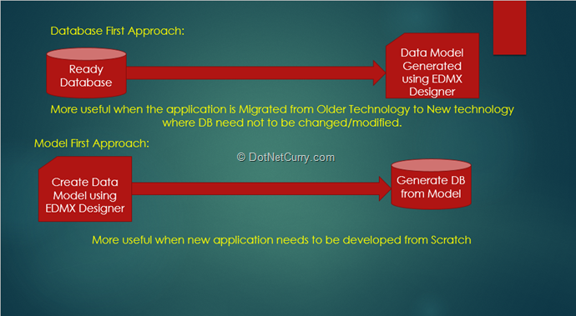

Slide 29
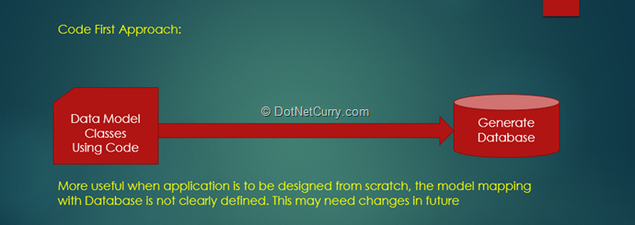

Slide 31
ViewData and ViewBag
Data is passed from the controllers to the views via a ViewDataDictionary – View Data.
ViewData["CurrentTime"] = DateTime.Now;
The ViewBag is a dynamic wrapper around ViewData.
It allows you to set values as follows:
ViewBag.CurrentTime = DateTime.Now;
Thus, ViewBag.CurrentTime is equivalent to ViewData["CurrentTime"].

Slide 32
STRONGLY TYPED VIEWS
public ActionResult List() {
var albums = new List<Album>();
for (int i = 0; i < 10; i++) {
albums.Add(new Album {Title = "Album " + i});
}
return View(albums);
}
@model IEnumerable<MvcApplication1.Models.Album>
<ul>
@foreach (Album p in Model) {
<li>@p.Title</li>
}
</ul>

Slide 33
THE RAZOR VIEW ENGINE
The Razor view engine was introduced with ASP.NET MVC 3 and is the default view engine moving forward.
Razor provides a streamlined syntax for expressing views that minimizes the amount of syntax and extra characters.

Slide 34
Razor Syntax Samples
Implicit Code Expression
Razor <span>@model.Message</span>
Web Forms <span><%: model.Message %></span>
Explicit Code Expression
RAZOR <span>ISBN@(isbn)</span>
Web Forms <span>ISBN<%: isbn %></span>

Slide 35
Razor Syntax Samples
Unencoded Code Expression
Razor <span>@Html.Raw(model.Message)</span>
Web Forms <span><%: Html.Raw(model.Message) %></span>
or
<span><%= model.Message %></span>

Slide 36
Razor Syntax Samples
Code Block
Razor @{
int x = 123;
string y = ˝because.˝;
}
Web Forms <%
int x = 123;
string y = "because.";
%>

Slide 37
Razor Syntax Samples
Combining Text and Markup
Razor @foreach (var item in items) {
<span>Item @item.Name.</span>
}
Web Forms <% foreach (var item in items) { %>
<span>Item <%: item.Name %>.</span>
<% } %>

Slide 38
Razor Syntax Samples
Mixing Code and Plain Text
Razor @if (showMessage) {
<text>This is plain text</text>
}
or
@if (showMessage) {
@:This is plain text.
}
Web Forms <% if (showMessage) { %>
This is plain text.
<% } %>

Slide 39
Razor Syntax Samples
Escaping the Code Delimiter
Razor My Twitter Handle is &#64;haacked
or
My Twitter Handle is @@haacked
Web Forms &lt;% expression %&gt; marks a code nugget.

Slide 40
Razor Syntax Samples
Server-Side Comment
Razor @*
This is a multiline server side comment.
@if (showMessage) {
<h1>@ViewBag.Message</h1>
}
All of this is commented out.
*@
Web Forms <%--
This is a multiline server side comment.
<% if (showMessage) { %>
<h1><%: ViewBag.Message %></h1>
<% } %>
All of this is commented out.
--%>

Slide 41
Razor Syntax Samples
Calling a Generic Method
Razor @(Html.SomeMethod<AType>())
Web Forms <%: Html.SomeMethod<AType>() %>
URL Helpers
<span>
@Url.Action("Browse", "Store", new { genre = "Jazz" }, null)
</span>
The result will be the following HTML:
<span>
/Store/Browse?genre=Jazz
</span>

Slide 42
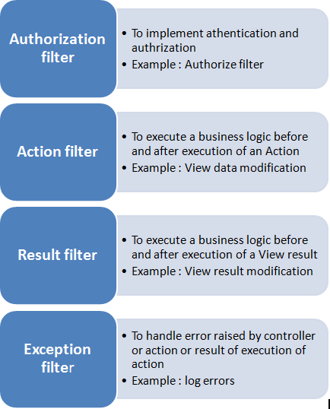
MVC Filters

Slide 43
Action Method
//OutPutTest Action Method [OutputCache(Duration=10)] public ActionResult OutPutTest() { ViewBag.Date = DateTime.Now.ToString("T"); return View(); }

Slide 44
Authorize Filter
public class CustAuthFilter : AuthorizeAttribute { public override void OnAuthorization(AuthorizationContext filterContext) { filterContext.Controller.ViewBag.AutherizationMessage = "Custom Authorization: Message from OnAuthorization method."; } }

Slide 45
Action Filter
OnActionExecuting - Runs before execution of Action method.
OnActionExecuted - Runs after execution of Action method.
OnResultExecuting - Runs before content is rendered to View.
OnResultExecuted - Runs after content is rendered to view.

Slide 46
Exception Filter
public class CustExceptionFilter : FilterAttribute, IExceptionFilter { public void OnException(ExceptionContext filterContext) { filterContext.Controller.ViewBag.ExceptionMessage = "Custom Exception: Message from OnException method."; } }

