Slide 1
Using ERWin to model your data
Supplied by Computer Associates as part of AllFusion

Slide 2
ERWin
To open, choose the following path:
  Program files > CA Associates > AllFusion > ERWin Data Modeler > ERWin

Slide 3
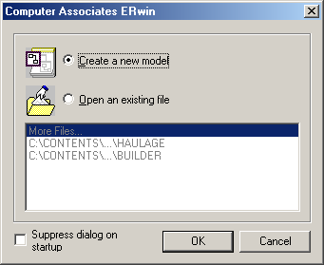
Starting ERWin

Slide 4
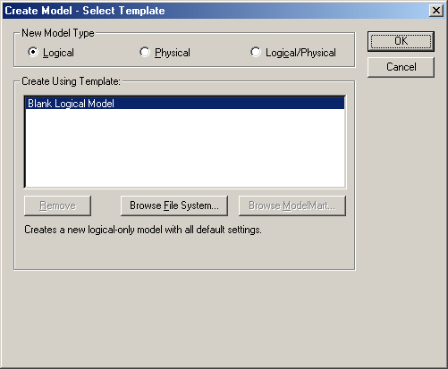
Use the logical/physical type

Slide 5
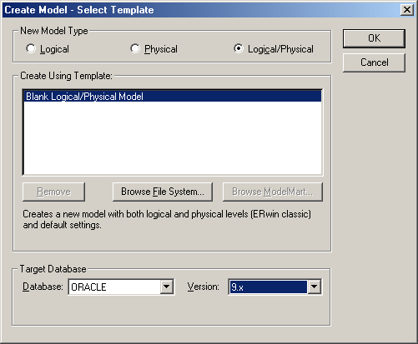
Pick your model type…

Slide 6
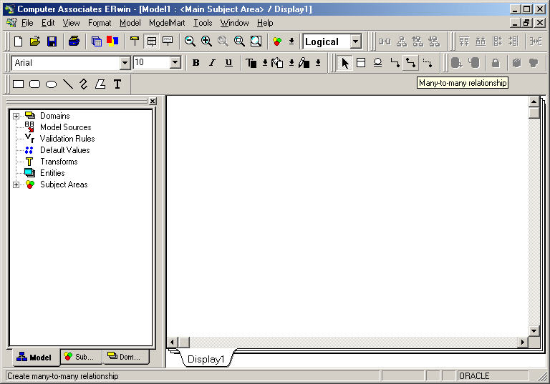
Blank model

Slide 7
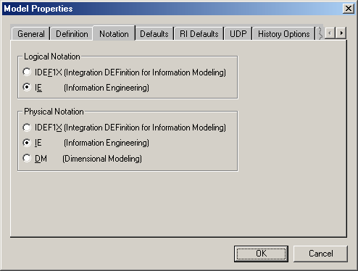
Change the model properties
The model properties can be changed by choosing ‘model’ from the menu across the top, and then model properties.
Click the NOTATION tab and select the IE notation for both logical and physical models.

Slide 8
Customise the tool bar
Choose view, toolbars and toolbox.
This will give icons to allow you to add entities and relationships from the toolbar.

Slide 9
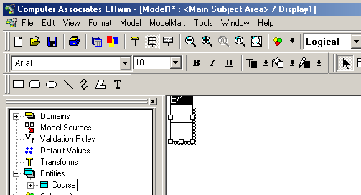
Alternately, to add…
Entities
  Right click on the entity icon in the browser
    The browser is the left panel on the screen

Slide 10
To add attributes…
Expand the entity icon.
Right click on the attributes icon and add an attribute.
Right click on the attribute, to open the properties.
  Here, primary keys can be set and data types can be allocated.

Slide 11
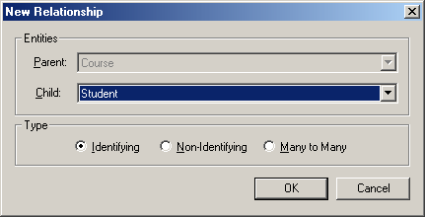
Adding foreign keys

Slide 12
How to
Open the ‘parent relationship’ from the course.
Choose the student as child entity.
  Note, if you tick ‘identifying’, the key will become part of the primary key of the child entity. You may NOT WANT THAT!

Slide 13
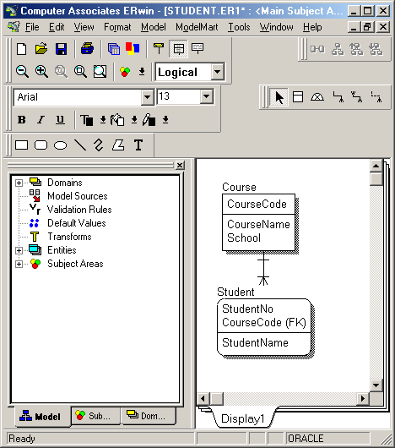
Result of ‘identifying’

Slide 14
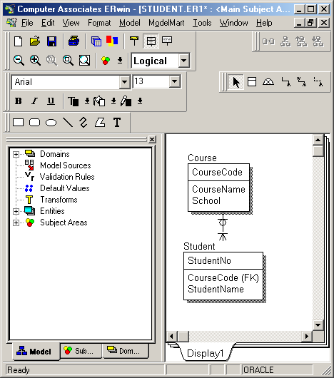
Non-identifying…

Slide 15
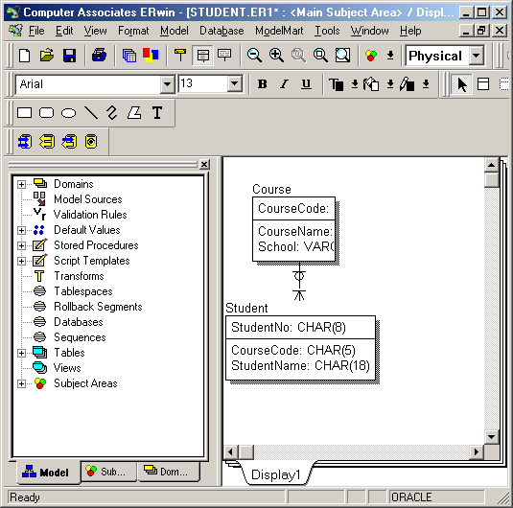
To get ‘physical’…
Drop down the ‘logical’ box to get ‘physical’.

Slide 16
To generate a schema…
Use the physical model
Choose the database as Oracle 9.x
  There’s no 10g available.
Choose Forward Engineer / Schema generation
Ensure that you go through each of the generated items, and set the ticks correctly, as shown in next slides.

Slide 17
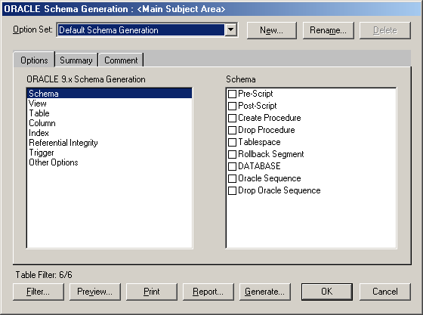
Schema options

Slide 18
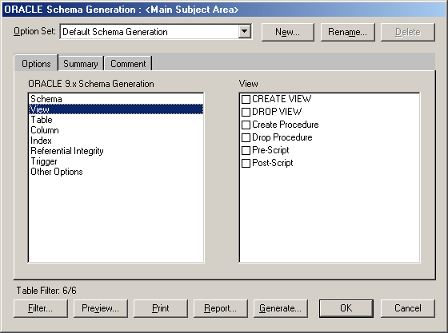
View options

Slide 19
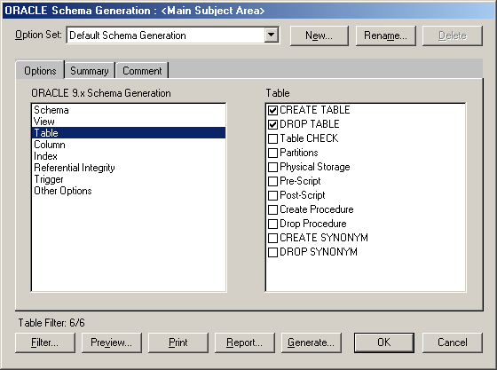
Table options

Slide 20
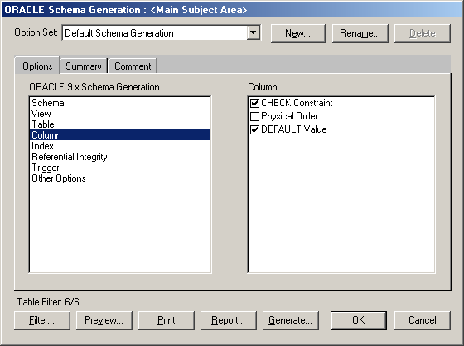
Column options

Slide 21
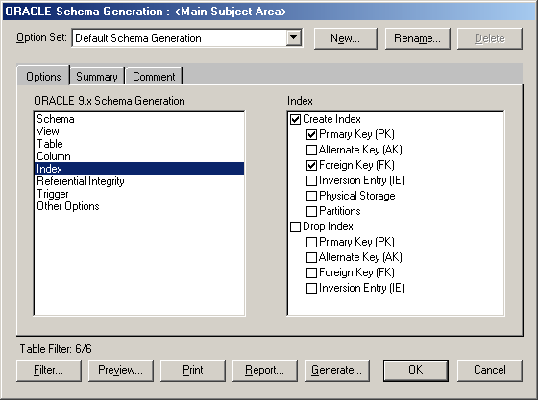
Index options

Slide 22
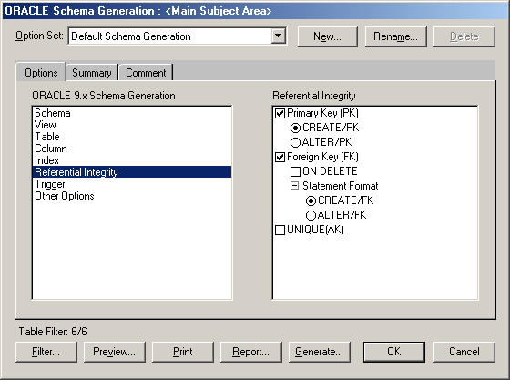
Referential Integrity

Slide 23
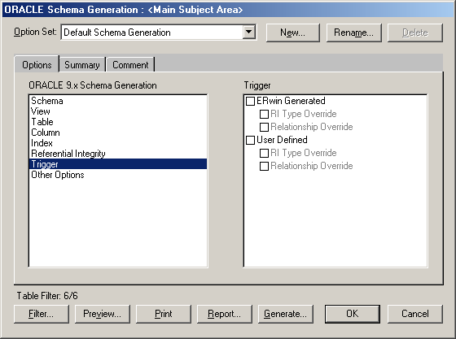
Trigger

Slide 24
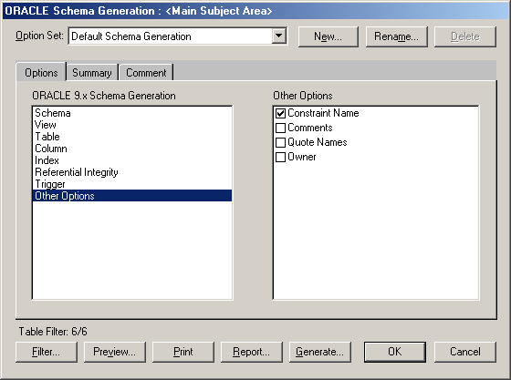
Other options

Slide 25
When all parameters chosen…
Click Generate, if you can connect to your schema, otherwise,
Click Preview
  This gives you the SQL you need to run to set up your schema in the way you have configured it.
  You can save that SQL in a file and run it.

Slide 26
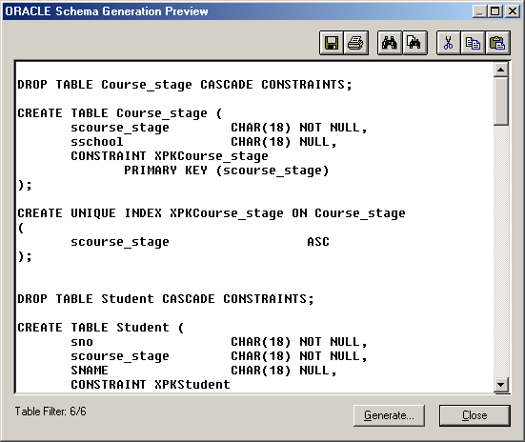
Preview

