Slide 1
Hive: A data warehouse on Hadoop

Slide 3
Motivation
Yahoo worked on Pig to facilitate application deployment on Hadoop.
  Their need mainly was focused on unstructured data
Simultaneously Facebook started working on deploying warehouse solutions on Hadoop that resulted in Hive.
  The size of data being collected and analyzed in industry for business intelligence (BI) is growing rapidly making traditional warehousing solution prohibitively expensive.

Slide 4
Hadoop MR
MR is very low level and requires customers to write custom programs.
HIVE supports queries expressed in SQL-like language called HiveQL which are compiled into MR jobs that are executed on Hadoop.
Hive also allows MR scripts
It also includes MetaStore that contains schemas and statistics that are useful for data explorations, query optimization and query compilation.
At Facebook Hive warehouse contains tens of thousands of tables, stores over 700TB and is used for reporting and ad-hoc analyses by 200 Fb users.

Slide 5
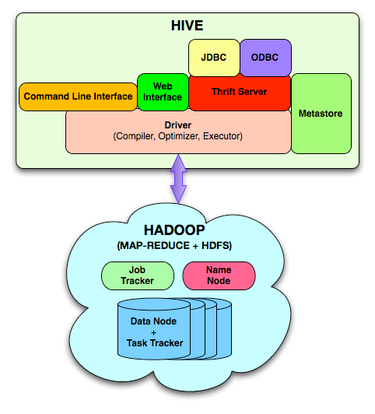
Hive architecture (from the paper)

Slide 6
Data model
Hive structures data into well-understood database concepts such as: tables, rows, cols, partitions
It supports primitive types: integers, floats, doubles, and strings
Hive also supports:
  associative arrays: map<key-type, value-type>
  Lists: list<element type>
  Structs: struct<file name: file type…>
SerDe: serialize and deserialized API is used to move data in and out of tables

Slide 7
Query Language (HiveQL)
Subset of SQL
Meta-data queries
Limited equality and join predicates
No inserts on existing tables (to preserve worm property)
  Can overwrite an entire table

Slide 8
Wordcount in Hive
FROM (
MAP doctext USING 'python wc_mapper.py' AS (word, cnt)
FROM docs
CLUSTER BY word
) a
REDUCE word, cnt USING 'pythonwc_reduce.py';

Slide 9
Session/tmstamp example
FROM (
FROM session_table
SELECT sessionid, tstamp, data
DISTRIBUTE BY sessionid SORT BY tstamp
) a
REDUCE sessionid, tstamp, data USING 'session_reducer.sh';

Slide 10
Data Storage
Tables are logical data units; table metadata associates the data in the table to hdfs directories.
Hdfs namespace: tables (hdfs directory), partition (hdfs subdirectory), buckets (subdirectories within partition)
/user/hive/warehouse/test_table is a hdfs directory

Slide 11
Hive architecture (from the paper)

Slide 12
Architecture
Metastore: stores system catalog
Driver: manages life cycle of HiveQL query as it moves thru’ HIVE; also manages session handle and session statistics
Query compiler: Compiles HiveQL into a directed acyclic graph of map/reduce tasks
Execution engines: The component executes the tasks in proper dependency order; interacts with Hadoop
HiveServer: provides Thrift interface and JDBC/ODBC for integrating other applications.
Client components: CLI, web interface, jdbc/odbc inteface
Extensibility interface include SerDe, User Defined Functions and User Defined Aggregate Function.

Slide 13
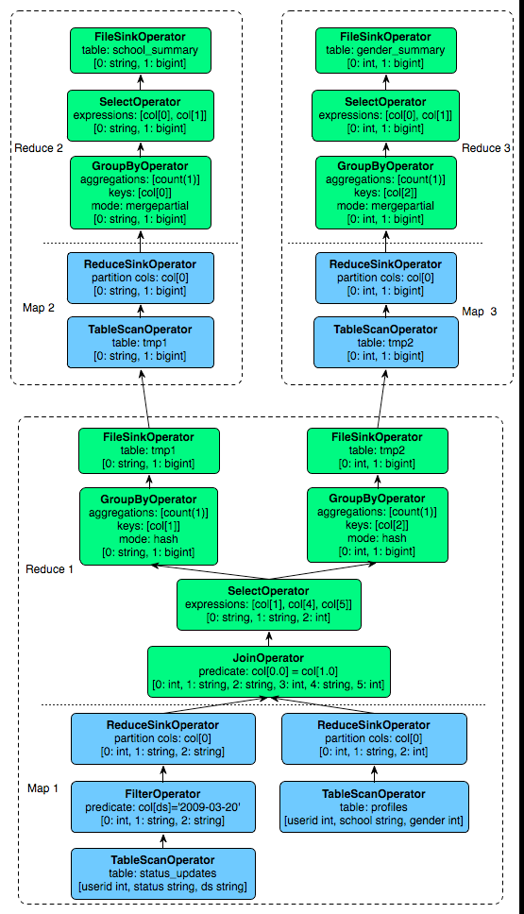
Sample Query Plan

Slide 14
Hive Usage in Facebook
Hive and Hadoop are extensively used in Facbook for different kinds of operations.
700 TB = 2.1Petabyte after replication!
Think of other application model that can leverage Hadoop MR.

