Slide 1
NoSQL
W2013
CSCI 2141

Slide 2
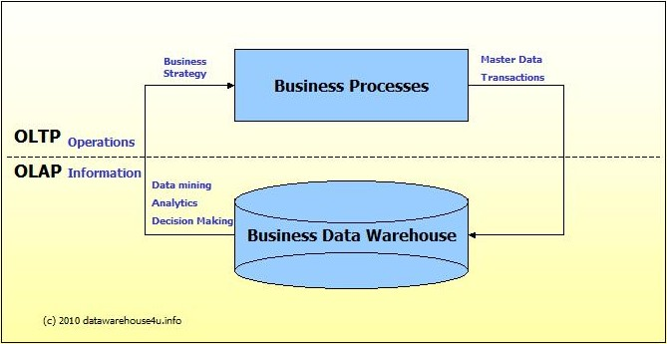
OLTP vs. OLAP
We can divide IT systems into transactional (OLTP) and analytical (OLAP). In general we can assume that OLTP systems provide source data to data warehouses, whereas OLAP systems help to analyze it
.

Slide 3
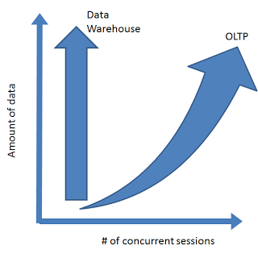
Challenges of Scale Differ

Slide 4
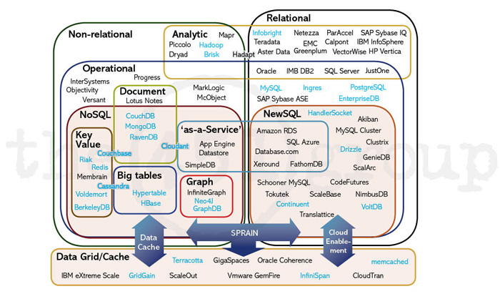

Slide 5
A Comparison of SQL and NoSQL Databases
Slides from: Keith W. Hare
Metadata Open Forum
More reading: http://martinfowler.com/articles/nosqlKeyPoints.html
Metadata Open Forum

Slide 6
Abstract
NoSQL databases (either no-SQL or Not Only SQL) are currently a hot topic in some parts of computing. In fact, one website lists over a hundred different NoSQL databases.
This presentation reviews the features common to the NoSQL databases and compares those features to the features and capabilities of SQL databases.
BIG DATA!

Slide 7
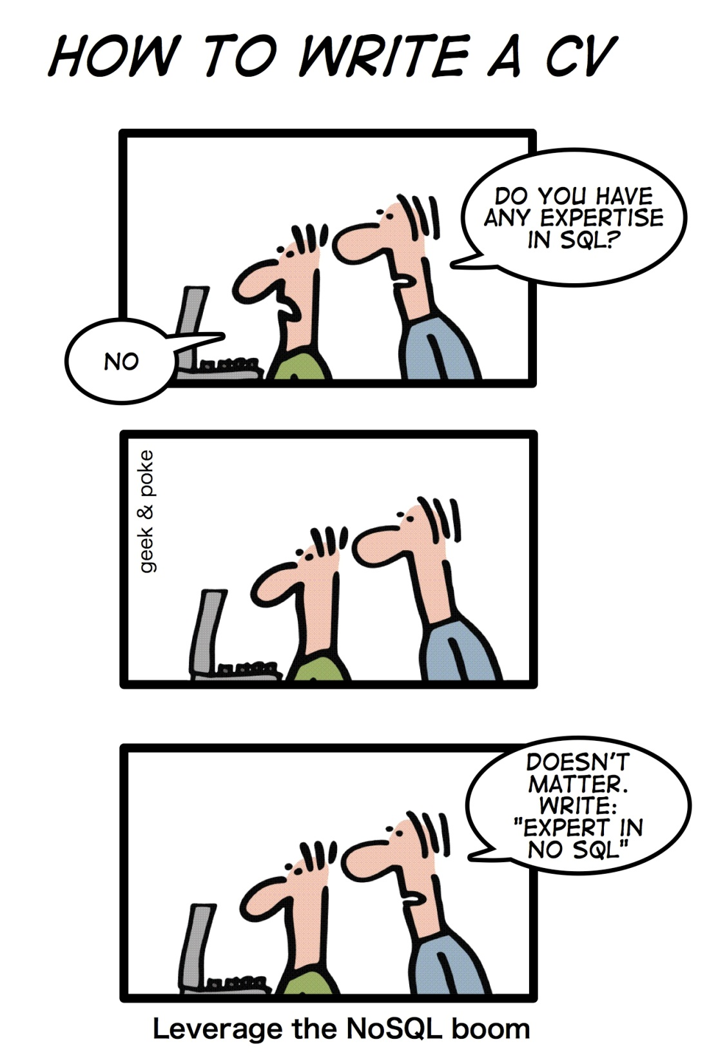

Slide 8
SQL Characteristics
Data stored in columns and tables
Relationships represented by data
Data Manipulation Language
Data Definition Language
Transactions
Abstraction from physical layer

Slide 9
SQL Physical Layer Abstraction
Applications specify what, not how
Query optimization engine
Physical layer can change without modifying applications
  Create indexes to support queries
  In Memory databases

Slide 10
Data Manipulation Language (DML)
Data manipulated with Select, Insert, Update, & Delete statements
  Select T1.Column1, T2.Column2 …
  From Table1, Table2 …
  Where T1.Column1 = T2.Column1 …
Data Aggregation
Compound statements
Functions and Procedures
Explicit transaction control

Slide 11
Data Definition Language
Schema defined at the start
Create Table (Column1 Datatype1, Column2 Datatype 2, …)
Constraints to define and enforce relationships
  Primary Key
  Foreign Key
  Etc.
Triggers to respond to Insert, Update , & Delete
Stored Modules
Alter …
Drop …
Security and Access Control

Slide 12
Transactions – ACID Properties
Atomic – All of the work in a transaction completes (commit) or none of it completes
Consistent – A transaction transforms the database from one consistent state to another consistent state. Consistency is defined in terms of constraints.
Isolated – The results of any changes made during a transaction are not visible until the transaction has committed.
Durable – The results of a committed transaction survive failures

Slide 13
NewSQL: more OLTP throughput, real-time analytics
) SQL as the primary mechanism for application interaction
2) ACID support for transactions
3) A non-locking concurrency control mechanism so real-time reads will not conflict with writes, and thereby cause them to stall.
4) An architecture providing much higher per-node performance than available from the traditional "elephants”
5) A scale-out, shared-nothing architecture, capable of running on a large number of nodes without bottlenecking

Slide 14
NoSQL Definition
From www.nosql-database.org:
  Next Generation Databases mostly addressing some of the points: being non-relational, distributed, open-source and horizontal scalable. The original intention has been modern web-scale databases. The movement began early 2009 and is growing rapidly. Often more characteristics apply as: schema-free, easy replication support, simple API, eventually consistent / BASE (not ACID), a huge data amount, and more.

Slide 15
NoSQL Products/Projects
http://www.nosql-database.org/ lists 122 NoSQL Databases
Cassandra
CouchDB
Hadoop & Hbase
MongoDB
StupidDB
Etc.

Slide 16
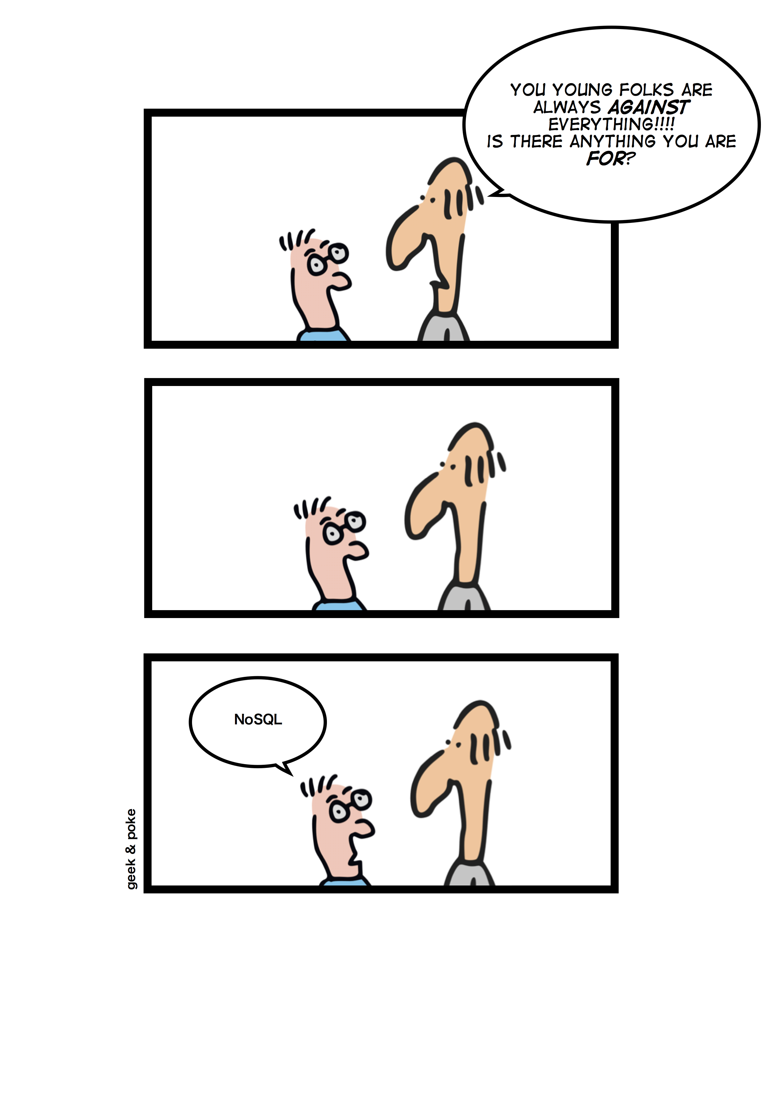
NoSQL Products/Projects
http://www.nosql-database.org/ lists 122 NoSQL Databases
Cassandra
CouchDB
Hadoop & Hbase
MongoDB
StupidDB
Etc.

Slide 17
NoSQL Distinguishing Characteristics
Large data volumes
  Google’s “big data”
Scalable replication and distribution
  Potentially thousands of machines
  Potentially distributed around the world
Queries need to return answers quickly
Mostly query, few updates
Asynchronous Inserts & Updates
Schema-less
ACID transaction properties are not needed – BASE
CAP Theorem
Open source development

Slide 18
BASE Transactions
Acronym contrived to be the opposite of ACID
  Basically Available,
  Soft state,
  Eventually Consistent
Characteristics
  Weak consistency – stale data OK
  Availability first
  Best effort
  Approximate answers OK
  Aggressive (optimistic)
  Simpler and faster

Slide 19
Brewer’s CAP Theorem
A distributed system can support only two of the following characteristics:
Consistency
Availability
Partition tolerance

Slide 20
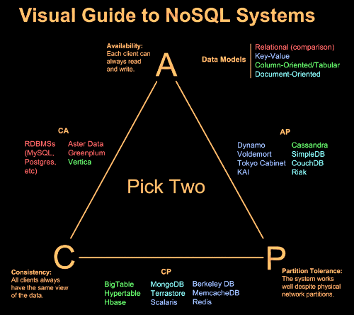

Slide 21
NoSQL Database Types
Discussing NoSQL databases is complicated because there are a variety of types:
Column Store – Each storage block contains data from only one column
Document Store – stores documents made up of tagged elements
Key-Value Store – Hash table of keys

Slide 22
Other Non-SQL Databases
XML Databases
Graph Databases
Codasyl Databases
Object Oriented Databases
Etc…
Will not address these today

Slide 23
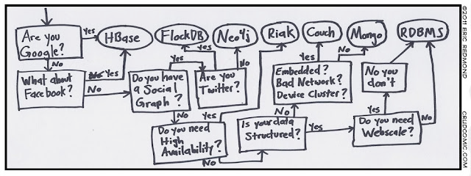

Slide 24
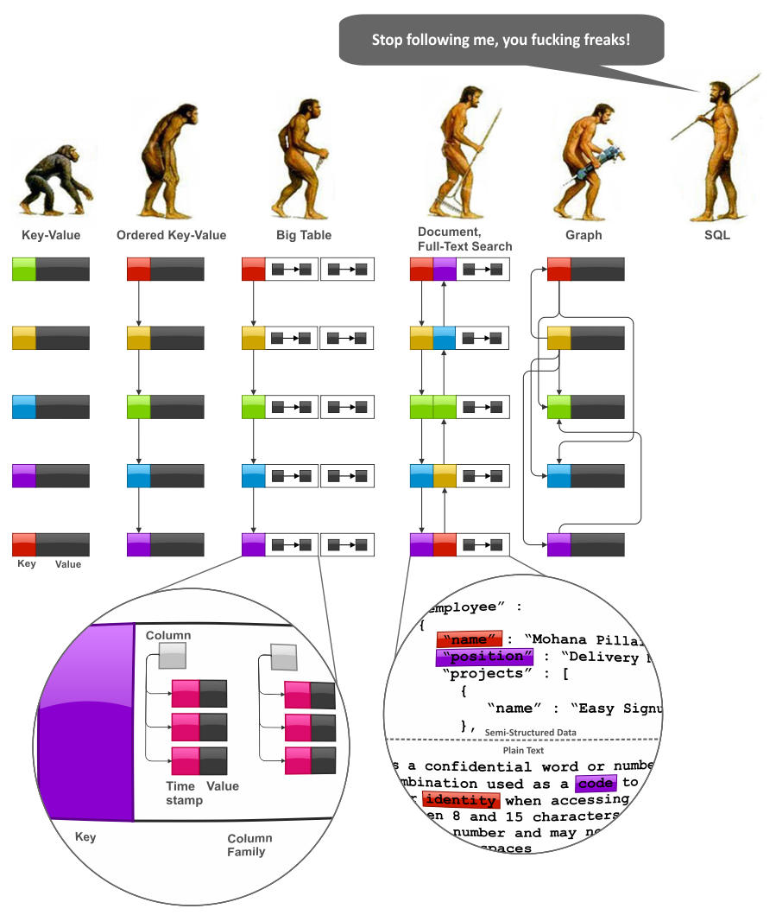

Slide 25
Storing and Modifying Data
Syntax varies
  HTML
  Java Script
  Etc.
Asynchronous – Inserts and updates do not wait for confirmation
Versioned
Optimistic Concurrency

Slide 26
Retrieving Data
Syntax Varies
  No set-based query language
  Procedural program languages such as Java, C, etc.
Application specifies retrieval path
No query optimizer
Quick answer is important
May not be a single “right” answer

Slide 27
Open Source
Small upfront software costs
Suitable for large scale distribution on commodity hardware

Slide 28
NoSQL Summary
NoSQL databases reject:
  Overhead of ACID transactions
  “Complexity” of SQL
  Burden of up-front schema design
  Declarative query expression
  Yesterday’s technology
Programmer responsible for
  Step-by-step procedural language
  Navigating access path

