Slide 1











































Tech Stack
Backend
Frontend
DevOps
Cloud
Testing

Slide 2
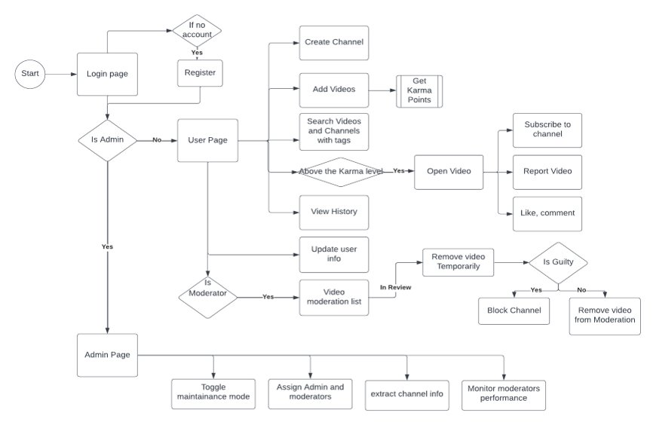
Workflow Diagram

Slide 3
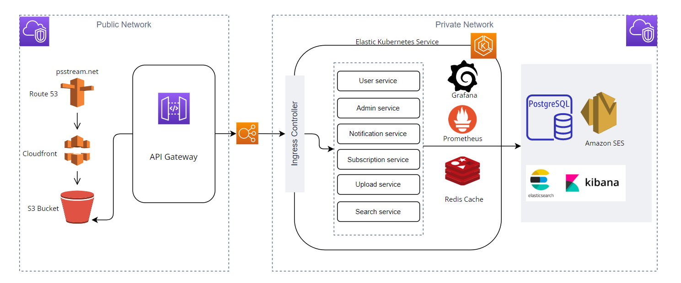

Cloud Architecture
Notes:
Cloud architecture - terraform

Slide 4
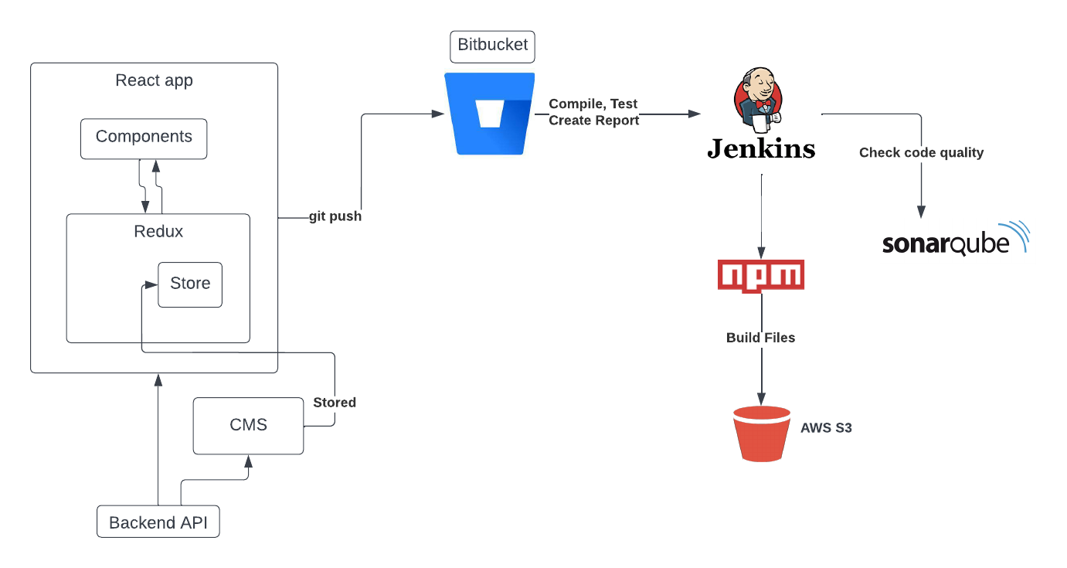


CI/CD Pipeline For Frontend
Stage fail
Stage fail
Cloud Front

Slide 5







CI/CD Pipeline For Backend
Unit test cases
SonarQube analysis
Maven build
Docker build
Jenkins
Stage Fail
Stage Fail
Stage Fail

Slide 6
NFR and SLA
Design documentation
Microservice response time < 200 ms-Partially(Jmeter Reports)
Secure access over HTTPS/TLS (Encryption over wire)
AWS security
Application security
Secure data store for PII information (Encryption at rest)
Page view times < 2s
Latency < 15s
Throughput - 100 req/s
Availability - 99.999
Quality of video – 480p/720p- Future scope
Concurrent user session/ API – 5000
Concurrent user on video – 1000
Responsive web design - supported view port 767px (Mobile and Desktop)
Data Metrics and Logging
CI&CD Pipelines to be deployed via Jenkins | Docker.
Release wise pipeline configuration for hot fixes and feature releases
Proper Error page should be displayed
Test Data preparation, management and data cleanup should be there.
Continuous failures shall be communicated at priority via alerts to the support teams to be acted upon.
Proper error handling should be there for microservice.
Test Data preparation, management and data cleanup should be there.
Continuous failures shall be communicated at priority via alerts to the support teams to be acted upon.
Proper error handling should be there for microservice.
Email notification to admin in case server is down for particular amount of time
Accessibility
Notes:
Change arrow direction

Slide 7


Engineering POVs and Testing
01
100% method coverage
95% block/line coverage
02
Unit Testing and Regression
01
03
Code Quality
Code Complexity
Unit Test coverage FE > 70%
04
02
05
Memory profiling
03
Unit Test Coverage – microservices > 95
03
Unit Test Reports
06
07
Monitoring & Alerting
Release cadence
08

Slide 8
Testing and Engineering POVs
100% method coverage
01
95% block/line coverage
02
Unit Testing and Regression
Code Quality
01
03
03
Code Complexity
04
Unit Test coverage FE > 70%
Unit Test coverage FE > 70%
02
02
05
Memory profiling
03
Unit Test Coverage – microservices > 95
03
Unit Test Coverage – microservices > 95
03
03
Unit Test Reports
06
07
Monitoring & Alerting
03
8
Release cadence
08
8

