Slide 1
JDBC
Java Database Connectivity

Slide 2
JDBC API
JDBC 4.0 (part of JSE 6) is an API that provides standard for connectivity to variety of data sources like SQL databases, spreadsheets and flat.
JDBC provides call-level API for SQL databases meaning, API defines a set of interfaces and abstract methods. The database vendors (like Oracle, MySQL) must implement the JDBC API.
Therefore before writing JDBC code we must make sure that we have the library with respect to the data source that we intend to use.
JDBC is based on the X/Open SQL Call Level Interface (CLI). JDBC 4.0 complies with the SQL 2003 standard.
JDBC 4.0
java.sql
javax.sql
JDBC core API
JDBC Optional Package API
Notes:
1.

Slide 3
Steps to write database code
Load the driver
Obtain connection
Create and execute statements
[Use result sets to navigate the results]
Close the connection

Slide 4
Load the driver
java.sql.DriverManager class is used to get drivers and get connection to the database.
To register (Load) the driver with the application explicitly:
  Class.forName(“<driver class name>");
  Or
  DriverManager.registerDriver( new <driver class name>());
  Both of these registers the given driver with the DriverManager.. Static block of the <Driver class> calls DriverManager.registerDriver() method!
With JDBC 4.0, this class also provides a mechanism to automatically load the database drivers (provided they are packaged in the specified way) → later

Slide 5
Get Connected
Getting Connection:
  static Connection getConnection(String url) throws SQLException
  static Connection getConnection(String url, Properties info) throws SQLException
  static Connection getConnection(String url, String user, String password) throws SQLException

Slide 6
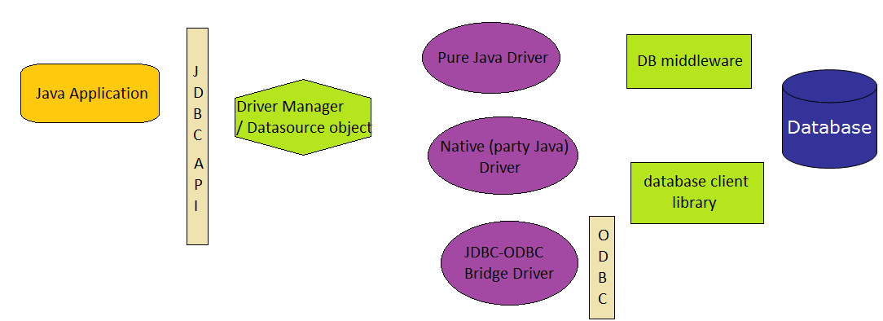
JDBC Architecture
4 Ways to connect to database – through 4 types of driver

Slide 7
Driver Types
JDBC driver are classes used to translate JDBC calls either to vendor-specific database calls or may be directly invoke database commands.
Types of driver
  Type 1- JDBC-ODBC Bridge
  Type 2- Part Java, Part Native Driver
  Type 3- Intermediate Database Access Server
  Type 4- Pure Java Drivers

Slide 8
JDBC-ODBC Bridge
Database
Java
application
JDBC
API
ODBC
API
ODBC
Layer
JDBC-ODBC
Bridge
Drivers classes that implement the JDBC API as a mapping to ODBC (Open Database Connectivity) API.
ODBC Microsoft's interface for accessing data in a heterogeneous database management systems.
ODBC binary code and in many cases, database client code -- must be loaded on each client machine that uses a JDBC-ODBC Bridge

Slide 9
Example using JDBC-ODBC Bridge
We will write code to establish connection with JDBC-ODBC Bridge.
Before we write code there are 2 things we need to do
  Create a database in MS-Access with any name.
  Configure the DSN for ODBC Driver as specified in the next slides

Slide 10
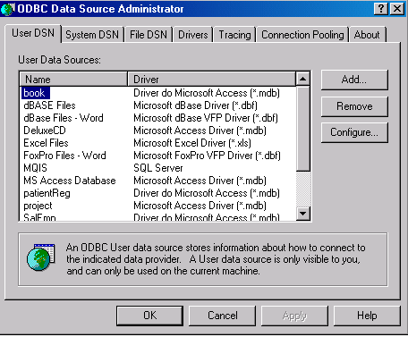
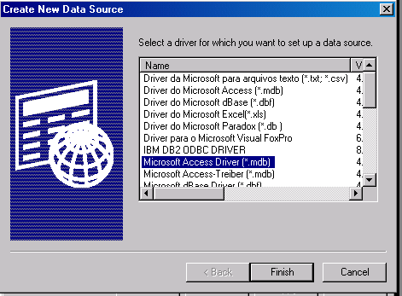
Configure the DSN for ODBC Driver for MS-Access
In control panel locate “Data Sources (ODBC)” icon (inside Administrative Tools)
Double-click the icon and click on “Add” button in the “User DSN” tab.
Select “Microsoft Access Driver” and click “Finish”

Slide 11
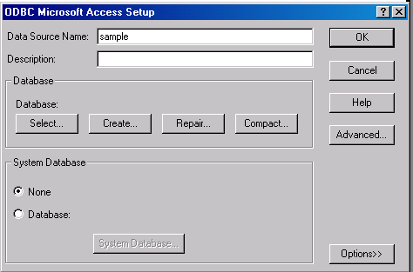
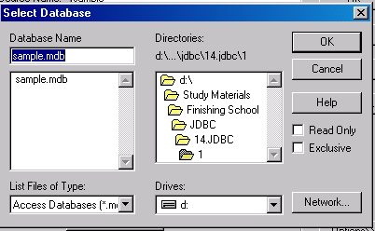
Enter DSN name as “sample” (we will use this name in the code) and click “Select”.
Browse through and get the access file and click “OK”.
Click “OK” on next two screens and come out of the control panel.

Slide 12
Code to get JDBC-ODBC connection
import java.sql.*;
public class ODBCMain{
Connection con;
public ODBCMain() {
try {
//sample is data source name (DSN)
String url = "jdbc:odbc:sample";
//Load the JDBC-ODBC bridge driver
Class.forName("sun.jdbc.odbc.JdbcOdbcDriver");
//Obtain the connection to the database
con = DriverManager.getConnection(url);
System.out.println (“JDBC-ODBC connection established");
con.close();
}
catch(Exception e){
e.printStackTrace();
} }
public static void main(String str[]){new ODBCMain();}}

Slide 13
Disadvantages
ODBC uses a C. Calls from Java to native C code have a number of drawbacks in the security, robustness, and automatic portability of applications.
Multiple layers of indirection leads to inefficiency.

Slide 14
Type2- Part Java, Part Native Driver
Database
Java
application
Vendor
Specific
API
JDBC
API
JDBC Driver
Much like the bridge driver, this style of driver also requires that some binary code be loaded on each client machine. Therefore this also shares the same disadvantages. This driver is very rarely now a days.

Slide 15
Preferred Database Drivers
Type 3 and Type 4 drivers are preferred database drivers for Java.
Each of these drivers are used in different architectural situations.
Type 4 Drivers
  Used in 2-tier architecture
  Direct to database connection from java application
  Pure Java Driver
Type 3
  Three-tier
  Connection to database happens through a middleware. The middleware provides connectivity to many different databases.
  JDBC-Net pure Java Driver
We will be using Type 4 driver in this session.

Slide 16
Java application
JDBC Driver Manager or Data Source Object
Pure Java Driver
JDBC-Net Pure Java Driver
TYPE 3
TYPE 4
Database middleware
Database

Slide 17
Connecting using type 4 driver
There are two ways in which we can write this code to connect to a database using Type 4 driver
  By specifying class explicitly in the code using Class.forName() or DriverManager.registerDriver().
  By using JDBC 4.0 way where we can avoid hard coding the class name in the code.
MySQL database using type 4 driver name is com.mysql.jdbc.Driver .
But before we write code to connect to MySQL databse
  we must have database. Create a database called test in MySQL.
  set the classpath to the jar file with respect to MySQL in the classpath. Download Connector/J driver for mysql-connector-java-5.0.4-bin.jar.

Slide 18
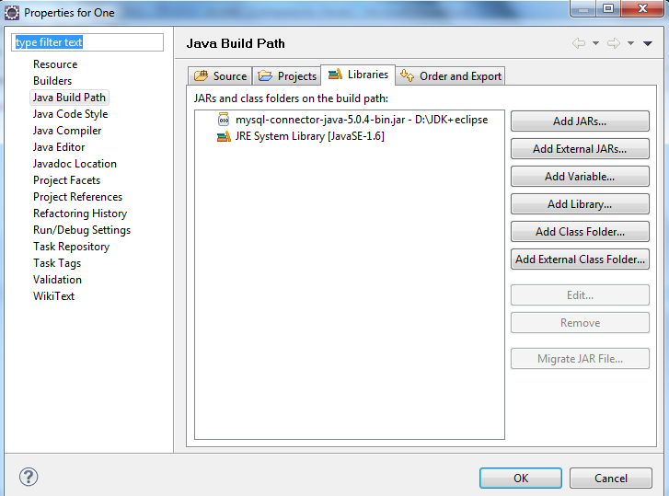
Setting classpath to MySQL driver in eclipse
Select your project, Go to Project menu and select Properties.
Move to “Java Build Path” on the left panel. Click on “Add External JARs”, browse and locate the jar file for MySQL.
Click on Open. This will add the jar file to the Properties Box as shown in the diagram.

Slide 19
Example: Connecting to MySQL – older way
import java.sql.*;
import java.util.Properties;
public class Connect {
public static void main (String[] args) {
Connection conn = null;
try {
String userName = "root";
String password = "root";
String url = "jdbc:mysql://localhost/test";
Class.forName ("com.mysql.jdbc.Driver");
Properties connectionProps = new Properties();
connectionProps.put("user", userName);
connectionProps.put("password",password);
conn = DriverManager.getConnection(url,connectionProps);
System.out.println ("Database connection successful");}

Slide 20
catch (Exception e){
System.err.println ("Failed to connect to database" +e);
}
finally{
if (conn != null) {
try { conn.close ();}
catch (SQLException e) { }
}
}
}
}
Result:
Database connection successful

Slide 21
JDBC 4.0 way to connect to database
A JDBC 4-compliant Type 4 Driver JAR is identified using the Java service provider mechanism. It contains a text a file named “META-INF/services/java.sql.Driver”, which contains the name of the class(es) of the Drivers which exist in that JAR.
Extract the mysql-connector-java-5.0.4-bin.jar to check if there is a file called java.sql.Driver in the folder “META-INF/services” folder.
If you don’t have then to make it JDBC 4-compliant , follow simple steps
  Create a folder say MySQLJar. Copy the mysql-connector-java-5.0.4-bin.jar file inside it.
  Create a folder called META-INF and then services inside META-INF.

Slide 22
  Create a file named java.sql.Driver (without any extension)
  Enter the driver name in the file:
  com.mysql.jdbc.Driver # Class name of the Driver
  Update the jar file by executing the command
  jar -uf mysql-connector-java-5.0.4-bin.jar META-INF/services/java.sql.Driver

Slide 23
Example: Connecting using JDBC 4.0 way
With JDBC 4.0 the Java service provider mechanism, applications no longer need to explicitly load JDBC drivers using Class.forName().
When the getConnection() is called, the DriverManager will attempt to locate a suitable driver from amongst specified in the classpath. (If there are more than one, the first one is used.)
The code is fundamentally same as the previous example- only line eliminated is Class.forName ("com.mysql.jdbc.Driver");
import java.sql.*;
import java.util.Properties;
public class Connect {
public static void main (String[] args) {
Connection conn = null;
try {
String userName = "root";
String password = "root";
String url = "jdbc:mysql://localhost/test";

Slide 24
Properties connectionProps = new Properties();
connectionProps.put("user", userName);
connectionProps.put("password",password);
conn = DriverManager.getConnection (url,connectionProps);
System.out.println ("Database connection successful");
}
catch (SQLException e) {
System.err.println ("Failed to connect to database" +e);
}
finally
{
if (conn != null) {
try { conn.close ();}
catch (SQLException e) { }
}
}
} }

Slide 25
java.sql.Connection
Connection is an interface.
getConnection()method of DriverManager returns the object that implements this interface.
Connection class can be used to do a variety of tasks
  Obtain Statement object
  To work with transactions
  To get meta-data about the database
For executing a static SQL statement and returning the results it produces, an object that implements Statement interface is used.

Slide 26
Obtaining Statement
Connection class methods to obtain Statement and its subclasses:
  Statement createStatement() throws SQLException
  PreparedStatement prepareStatement(String sql) throws SQLException
  CallableStatement prepareCall(String sql) throws SQLException
Statement
PreparedStatement
CallableStatement

Slide 27
SQLException
Most methods in the java.sql and javax.sql packages throw SQLException.
This object can be used to get message describing the error ,SQL state, error code specific to the database and a reference to any chained exceptions
  int getErrorCode()
  int getErrorCode()
  SQLException getNextException()

Slide 28
Statement
The object of this type is used for executing a static SQL statement and returning the results it produces.
The result of the query statement is returned in the form of ResultSet object .
Only one ResultSet object per Statement object can be open at the same time.
Therefore, reading data 2 or more ResultSet objects would require obtaining ResultSets from different Statement objects.
On calling execute methods on Statement object, the ResultSet object obtained from this Statement object (if there are any) is automatically closed.

Slide 29
Statement members
ResultSet executeQuery(String sql) throws SQLException
  sql is typically a static SQL SELECT statement. a ResultSet object that contains the data produced by the given query; never null
int executeUpdate(String sql) throws SQLException
  sql is typically a SQL DML (INSERT, UPDATE, or DELETE statement) or DDL like (CREATE, DROP statements)
  Returns the row count as number of rows affected for DML statements or 0 for SQL DDL statement.
int executeUpdate(String sql, int autoGeneratedKeys) throws SQLException
  Executes the Sql statement. If auto-generated keys has value Statement.RETURN_GENERATED_KEYS, then auto-generated keys produced by this object will be made available for retrieval.
  Statement.NO_GENERATED_KEYS will not make the auto-generated keys available
  Return value is same as the above method

Slide 30
ResultSet getGeneratedKeys() throws SQLException
  Retrieves any auto-generated keys created as a result of executing this Statement object.
int executeUpdate(String sql, int[] columnIndexes) throws SQLException
  Executes the SQL statement.
  columnIndexes array contains the indexes of the columns in the target table that contain the auto-generated keys. These keys are made available for retrieval.
int executeUpdate(String sql, String[] columnNames) throws SQLException
  This is same as the above method except that instead of array containing indexes of column it contains column names.

Slide 31
boolean execute(String sql) throws SQLException
  Used to execute stored procedure
  Used to execute sql that many return multiple result set or update counts
  To get the results - methods getResultSet or getUpdateCount to retrieve the first result, and getMoreResults to move to any subsequent result(s).
    ResultSet getResultSet() throws SQLException
    int getUpdateCount() throws SQLException
    boolean getMoreResults() throws SQLException

Slide 32
Batch execution methods: Multiple updates can be sent to the database for execution as a batch.
  void addBatch(String sql) throws SQLException
  used to add the given SQL command to be executed as batch.
  int[] executeBatch() throws SQLException
  submits a batch of commands to the database for execution and if all commands execute successfully, returns an array of update counts

Slide 33
ResultSet methods (default)
ResultSet is an interface representing table of data that is retrieved from a database
It maintains a cursor initially pointing to the first row. The next method moves the cursor to the next row until returns false when there are no rows to read.
A default ResultSet object is not updatable and has a cursor that moves forward only.
boolean next() throws SQLException
void close() throws SQLException
XXX getXXX(int colndex)throws SQLException
XXX getXXX(String colname)throws SQLException
where XXX is any primitive type, String, java.sql.Date (subclass of java.util.Date), Object
colIndex begins from 1
colname as specified with the SQL AS clause

Slide 34
Example :Code to insert and fetch records
Assuming a table in MYSQL named Student with regNo(int(11)), name(varchar(45)), degree(name(varchar(45)) and semester((int(11))
import java.sql.*;
import java.util.Properties;
public class Connect {
public static void main (String[] args) {
Connection conn = null;
try
{
String userName = "root";
String password = "root";
String url = "jdbc:mysql://localhost/test";
Properties props = new Properties();
props.put("user", userName);
props.put("password",password);
conn = DriverManager.getConnection(url,props);
Statement s= conn.createStatement();

Slide 35
s.executeUpdate("INSERT INTO STUDENT VALUES (1,'Rama','M.C.A.', 1)");
s.executeUpdate("INSERT INTO STUDENT VALUES (2,'Sita','B.Tech', 2)");
ResultSet rs=s.executeQuery("SELECT * FROM STUDENT");
System.out.println("ID Name Degree Semester");
while (rs.next() ) {
System.out.println( rs.getInt(1) +" "+rs.getString(2)+" "+rs.getString(3)+" "+rs.getInt(4)); }
} catch (SQLException e){
System.err.println ("Failed to connect to database" +e);
}
finally {
if (conn != null) {
try { conn.close ();}catch (SQLException e) { }
} } } }

Slide 36
Advanced ResultSet
A default ResultSet object is not updatable and has a cursor that moves forward only.
In order to have ResultSet which are scrollable and updatable a different createStatement() method has to be used.
public Statement createStatement(int resSetType,int resSetConcurrency) throws SQLException
resSetType :
ResultSet.TYPE_FORWARD_ONLY
cursor may move only forward (default)
ResultSet.TYPE_SCROLL_INSENSITIVE
scrollable but not sensitive to changes to the underlying data in the database that happens outside the purview of this object
ResultSet.TYPE_SCROLL_SENSITIVE
scrollable but not sensitive to changes to the underlying data

Slide 37
resSetConcurrency :
ResultSet.CONCUR_READ_ONLY
makes the result set read only
ResultSet.CONCUR_UPDATABLE
makes the result set updateable. Using this object, rows can be inserted, updated and deleted in the object itself which automatically synchronizes with the database.

Slide 38
More ResultSet methods
void afterLast() throws SQLException
void beforeFirst() throws SQLException
boolean first() throws SQLException
boolean last() throws SQLException
boolean isAfterLast()
boolean isBeforeFirst()
boolean isFirst()
boolean isLast()
boolean rowUpdated() throws SQLException
boolean rowInserted() throws SQLException
boolean rowDeleted() throws SQLException

Slide 39
void updateXXX(int columnIndex, byte x) throws SQLException
Where XXX is primitives or String, java.sql.Date, Object
void insertRow() throws SQLException
void updateRow() throws SQLException
void deleteRow() throws SQLException
void refreshRow() throws SQLException
void moveToInsertRow() throws SQLException
How these methods work is better understood by an example ahead.

Slide 40
Example: using advanced ResultSet
import java.sql.*;
import java.util.Properties;
public class AdvRS {
public static void main (String[] args) {
Connection conn = null;
try
{
String userName = "root";
String password = "root";
String url = "jdbc:mysql://localhost/test";
Properties props = new Properties();
props.put("user", userName);
props.put("password",password);
conn = DriverManager.getConnection (url,props);
Statement stmt = conn.createStatement(ResultSet.TYPE_SCROLL_INSENSITIVE, ResultSet.CONCUR_UPDATABLE);

Slide 41
ResultSet rs = stmt.executeQuery("SELECT * FROM STUDENT");
System.out.println("Before...");
System.out.println("ID Name Degree Semester");
while (rs.next() ) {
System.out.println( rs.getInt(1) +" "+rs.getString(2)+" "+rs.getString(3)+" "+rs.getInt(4));
}
//inserting a new row
rs.moveToInsertRow();
rs.updateInt("RegNo", 3);
rs.updateString("name", "Geeta");
rs.updateString("degree", "B.E.");
rs.updateInt("semester", 3);
rs.insertRow();

Slide 42
//updating 2nd row – changing name to Seetha
rs.absolute(2);
rs.updateString(2,"Seetha");
rs.updateRow();
rs.beforeFirst();
System.out.println("After...");
System.out.println("ID Name Degree Semester");
while (rs.next() ) {
System.out.println( rs.getInt(1) +" "+rs.getString(2)+" "+rs.getString(3)+" "+rs.getInt(4)); }}
catch (SQLException e) { System.err.println ("Failed to connect to database" +e);
}
finally {if (conn != null) {
try {conn.close ();} catch (SQLException e) { } } } } }

Slide 43
Result of execution of the code
Before...
ID Name Degree Semester
1 Rama M.C.A. 1
2 Sita B.Tech 2
After...
ID Name Degree Semester
1 Rama M.C.A. 1
2 Seetha B.Tech 2
3 Geeta B.E. 3

Slide 44
PreparedStatement
Interface that inherits from Statement
If the same sql statement is executed many times it is more efficient to use a prepared statement.
It enables a SQL statement to contain parameters like functions. So same statement can be executed for different set of values.

Slide 45
Methods
public void clearParameters() throws SQLException
void setXxx(int parameterIndex, XXX x) All methods throws SQLException
XXX are all primitives, String, java.sql.Date, Object
For a very large binary or UNICODE value which is in a file
  void setBinaryStream(int parameterIndex, InputStream x, [long length]) throws SQLException
  the driver has to determine whether the parameter data should be sent to the server as a LONGVARBINARY or a BLOB
  void setCharacterStream(int parameterIndex, Reader reader) throws SQLException
  the driver has to determine whether the parameter data should be sent to the server as a LONGVARCHAR or a CLOB
  void setBlob(int parameterIndex, InputStream inputStream, [long length]) ) throws SQLException
  void setClob(int parameterIndex, Reader reader) throws SQLException

Slide 46
Example: Inserting large objects in the database
Example demonstrating insertion of a picture in a database. Assuming that we have table Photo(id integer(110, name varchar(45), pho blob).
import java.sql.*;
import java.io.*;
public class InsertPhoto{
public static void main(String[] args) {
System.out.println("Insert Image Example!");
String driverName = "com.mysql.jdbc.Driver";
String userName = "root";
String password = "root";
String url = "jdbc:mysql://localhost/test";
Connection con = null;
try{
Class.forName(driverName);
con = DriverManager.getConnection(url,userName,password);

Slide 47
File imgfile = new File("D:\\image.jpg");
FileInputStream fin = new FileInputStream(imgfile);
PreparedStatement pre = con.prepareStatement("insert into Photo values(?,?,?)");
pre.setInt(1,5);
pre.setString(2,"Durga");
pre.setBinaryStream(3,fin,(int)imgfile.length());
pre.executeUpdate();
System.out.println("Inserting Successfully!");
pre.close();
con.close();
}
catch (Exception e){
System.out.println(e.getMessage());}
}
}

Slide 48
PreparedStatement for batch updates
Apart from the batch related methods added by the Statement interface, PreparedStatement adds one more
void addBatch() throws SQLException
is used to add batch of commands
But since most of the batch operations are executed using same sql statement, it is usually used with PreparedStatement since it allows parameterized statements and hence they can be cached to give better performance.

Slide 49
Example: Batch updates
import java.sql.*;
public class BatchEx {
public static void main (String[] args) throws SQLException {
Connection conn = null;
String userName = "root";
String password = "root";
String url ="jdbc:mysql://localhost/test";
java.util.Calendar c=java.util.Calendar.getInstance();
conn = DriverManager.getConnection(url,userName,password);
PreparedStatement stmt = conn.prepareStatement("INSERT INTO BookIssue VALUES(?,?,?,?)");
stmt.setInt(1,15);
stmt.setInt(2,1);
c.clear(); c.set(2011,9,25);
stmt.setDate(3, new java.sql.Date((c.getTime()).getTime()));

Slide 50
c.set(2011,9,27);
stmt.setDate(4,new java.sql.Date((c.getTime()).getTime()));
stmt.addBatch();
stmt.setInt(1,16);
stmt.setInt(2,2);
c.clear();
c.set(2011,10,12);
stmt.setDate(3,new java.sql.Date((c.getTime()).getTime()));
c.set(2011,10,27);
stmt.setDate(4,new java.sql.Date((c.getTime()).getTime()));
stmt.addBatch();
stmt.executeBatch();
conn.close();
}}

Slide 51
CallableStatement
Interface that inherits from PreparedStatement that is used to execute stored-procedure.
In Connection.prepareCall(String s)is used to create a CallableStatement.
The string parameter is of the form
{[?=] call <procedure-name>[<arg1>,<arg2>, ...]}
The arguments IN parameter values are set using the set methods inherited from PreparedStatement.
All OUT parameters must be registered before a stored procedure is executed.
void registerOutParameter(int parameterIndex, int sqlType) throws SQLException
java.sql.Types has all the parameters that can be sent as sqlType. (Please refer to <docfolder>\docs\api\java\sql\Types.html)

Slide 52
Java Code to call the stored procedure
PROCEDURE GETSTUD(IN id1 INT,OUT nm VARCHAR(45))
BEGIN
SELECT NAME INTO nm FROM STUDENT WHERE REGNO=id1;
END
import java.sql.*;
public class CallSPMySQL {
public static void main(String[] args) {
String userName = "root";
String password = "root";
String url = "jdbc:mysql://localhost/test";
Connection conn = null;
try{
conn = DriverManager.getConnection(url,userName,password);
CallableStatement c=conn.prepareCall("{call GETSTUD(?,?)}");

Slide 53
String name=null;
c.setInt(1,2);
c.registerOutParameter(2,java.sql.Types.VARCHAR);
c.executeUpdate();
name=c.getString(2);
System.out.println("Name retrieved: "+ name);
}
catch (SQLException e) {
System.err.println ("Failed to connect to database" +e); }
finally {
if (conn != null)
try { conn.close ();} catch (SQLException e) { }
}
}
}

Slide 54
Example: Get ResultSet from stored procedure
Using execute(), getResultSet() and getMoreResults() methods of the Statement, multiple results can be retrieved from stored procedure.
PROCEDURE AllStudents()
BEGIN
Select * from Student;
END
import java.sql.*;
public class CallableSQLRS {
public static void main(String[] args) {
String userName = "root";
String password = "root";
String url = "jdbc:mysql://localhost/test";
Connection conn = null;
try{
conn = DriverManager.getConnection(url,userName,password);

Slide 55
CallableStatement c=conn.prepareCall("{call AllStudents()}");
boolean res = c.execute();
while (res) {
ResultSet rs = c.getResultSet();
System.out.println("ID Name Degree Semester");
while (rs.next() ) {
System.out.printf( "%2s %10s %10s %7s\n",rs.getInt(1),rs.getString(2),rs.getString(3),rs.getInt(4));
}
res = c.getMoreResults();
}}
catch (SQLException e) { System.err.println(e);}
finally { if (conn != null)
try {conn.close ();} catch (SQLException e) { } } }}

Slide 56
Transaction support
Methods in Connection class helps to demarcate the set of statements into a transaction.
public void setAutoCommit(boolean autoCommit) throws SQLException
public void rollback() throws SQLException
public void commit() throws SQLException

Slide 57
Example: Transaction support
To understand transactions we will use two tables Login ( id, login, password) and Student (regno, name,degree,semester). Insertion of student data will require us to insert data either into both the tables or in none of them in case there is an error. Login will be same as regno.
import java.sql.*;
class Trans{
public static void insert(String login, String pass,int id, String name){
String userName = "root";
String password = "root";
String url = "jdbc:mysql://localhost/test";
Connection con = null;
try{
con = DriverManager.getConnection(url,userName,password);
Statement st=con.createStatement();
con.setAutoCommit(false);

Slide 58
st.executeUpdate("INSERT INTO Login VALUES("+ id+ ",'"+login+"','"+pass+"')");
st.executeUpdate("INSERT INTO Student VALUES("+login+",'" + name + "','B.E.',1)");
con.commit();
con.close();
} catch(Exception e) {
try{
System.out.println("Rolling back Exception :" + e.toString());
con.rollback();
e.printStackTrace();}
catch(Exception e1){} }
}
public static void main(String[] s){
insert("1111", "danger", 1,"Emily"); } }
Test the application by giving duplicate login values
without transaction statements
with transaction statements

Slide 59
JDBC Transaction Isolation Levels
Connection interface defines a method to set isolation level
void setTransactionIsolation(int level) throws SQLException
Level can have following static constants define in Connection
  TRANSACTION_READ_UNCOMMITTED :Allows dirty reads, non-repeatable reads, and phantom reads to occur.
  TRANSACTION_READ_COMMITTED :Ensures only committed data can be read.
  TRANSACTION_REPEATABLE_READ: Is close to being serializable, however, phantom reads are possible.
  TRANSACTION_SERIALIZABLE: Dirty reads, non-repeatable reads, and phantom reads are prevented.

Slide 60
DatabaseMetaData & Isolation Levels support
To check if transaction isolation Levels are supported
DatabaseMetaData md = conn.getMetaData();
if md.supportsTransactionIsolationLevel(Connection.TRANSACTION_REPEATABLE_READ)) {
System.out.println("TRANSACTION_REPEATABLE_READ is supported.");
conn.setTransactionIsolation(Connection.TRANSACTION_READ_COMMITTED);}
MySQL supports this

Slide 61
SavePoint
This interface can be used to commit changes up to certain point.
When a transaction is rolled back to a SavePoint all changes made after that SavePoint are undone.
import java.sql.*;
public class SavePointEx {
public static void main(String[] args) {
String userName = "root";
String password = "root";
String url = "jdbc:mysql://localhost/test";
Connection conn = null;
try{
conn = DriverManager.getConnection(url,userName,password);
conn.setAutoCommit(false);
Statement st=conn.createStatement();

Slide 62
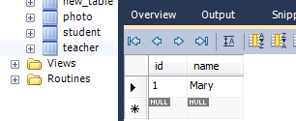
st.executeUpdate(" CREATE TABLE teacher (id INT NOT NULL ,name VARCHAR(45) NULL , PRIMARY KEY (id) )");
st.executeUpdate("insert into teacher values (1,'Mary')");
Savepoint mySavepoint=conn.setSavepoint();
st.executeUpdate("insert into teacher(id) values(2)");
conn.rollback(mySavepoint);
conn.commit();
st.close();
conn.close();
}
catch (SQLException e) { System.err.println ("Failed to connect to database" +e); }
finally {if (conn != null)
try { conn.close ();} catch (SQLException e) { }} }}

Slide 63
Introduction to javax.sql.RowSet
JDBC Rowset is like ResultSet but more simpler and flexible than ResultSet
Rowset is an interface subclass of ResultSet interface.
A rowset can be used as a JavaBeans component and can be created and configured at design time and executed at run time.
Since it is designed like a JavaBean, there are setter and getter methods to retrieve datasource, usename, password etc.
The RowSet interface also supports JavaBeans events.
Events allow RowSet to notify other components in an application to when a change happens in the rowset .
Like all the other JDBC classes, JDBC driver vendors or database vendors have to provide a RowSet implementation as part of their JDBC products.

Slide 64
Overview of Java Bean
“A Java Bean is a reusable software component that can be manipulated visually in a builder tool”.
It is a specification for how Java classes should be coded so that they can be introspected by various tools like IDEs( for drag and drop), application servers and other Java applications.
Properties/ attributes/data members in a Java Bean are exposed using accessor and mutators. They must be written like how we defined them for Student class.
Beans can also have other methods apart from accessor and mutators.
Beans also have what are called Events. Using events one bean can notify other bean in case of a change.
We are already aware of points1 and 2. We will understand point 3 through RowSet.
The full specs can be obtained from
http://download.oracle.com/otndocs/jcp/7224-javabeans-1.01-fr-spec-oth-JSpec/

Slide 65
RowSet accessors and mutators
String getCommand()
void setCommand(String cmd) throws SQLException
String getDataSourceName()
void setDataSourceName(String name) throws SQLException
String getUsername()
void setUsername(String name) throws SQLException
String getPassword()
void setPassword(String password) throws SQLException

Slide 66
String getUrl() throws SQLException
void setUrl(String url) throws SQLException
int getTransactionIsolation()
void setTransactionIsolation(int level) throws SQLException
boolean isReadOnly()
void setReadOnly(boolean value) throws SQLException
XXX getXXX()
void setReadXXX(XXX x) where XXX are primitive, String, Object and java.sql.Date

Slide 67
Events
RowSet has fundamentally 3 events:
  RowSet has changed
  Rows have been added or deleted or updated
  Cursor has movement while scrolling through RowSet.
A class which is interested in events of the RowSet must register itself with the RowSet using the method
void addRowSetListener(RowSetListener listener)
This class must also implement methods of the interface RowSetListener.
This allows the RowSet to call back the methods of RowSetListener when the event fires.

Slide 68
RowSetListener
void rowSetChanged(RowSetEvent event)
  Called when RowSet has changed
void rowChanged(RowSetEvent event)
  Called when rows have been added or deleted or updated
void cursorMoved(RowSetEvent event)
  Called when Cursor has movement while scrolling through RowSet

Slide 69
Interfaces inheriting from RowSet
JdbcRowSet
CachedRowSet
WebRowSet
JoinRowSet
FilteredRowSet
In this session we will look at the basic usage of JdbcRowSet and CachedRowSet

Slide 70
Connected and disconnected RowSet
There are two ways in which a RowSet can connect to database.
Connected RowSet:
  A RowSet object uses a JDBC driver to make a connection and maintain that connection throughout its life cycle
  Only JdbcRowSet interface is connected.
Disconnected RowSet:
  A RowSet object makes a connection with a data source, gets data from it, and then close the connection.
  A disconnected rowset may make changes to its data while it is disconnected and then send the changes back to the original source of the data, but it must reestablish a connection to do so.
  All RowSet interface except JdbcRowSet disconnected

Slide 71
JdbcRowSet
The class that implements this interface called com.sun.rowset.JdbcRowSetImpl can be obtained from http://www.java2s.com/Code/Jar/c/Downloadcomsunrowsetjar.htm.
Java SE 7 has a class RowSetFactor which also can be used to create a JdbcRowSet object.
We will be using com.sun.rowset.JdbcRowSetImp since we are working with Java 6.
Example in the next slide has two classes-
  class that uses RowSet
  Class that implements RowSetListener.

Slide 72
Example : using JdbcRowSet
This examples deletes a row and displays the rows in Student table. When these events happen, the JdbcRowSetListener is notified.
import java.sql.*;
import javax.sql.*;
import javax.sql.rowset.JdbcRowSet;
import com.sun.rowset.JdbcRowSetImpl;
public class RowSetEx {
public static void main(String[] args) throws Exception {
String userName = "root";
String password = "root";
String url = "jdbc:mysql://localhost/test";
Connection con = DriverManager.getConnection(url,userName,password);

Slide 73
JdbcRowSet rowSet = new JdbcRowSetImpl(con);
rowSet.setType(ResultSet.TYPE_SCROLL_INSENSITIVE);
String queryString = "SELECT * FROM student";
rowSet.setCommand(queryString);
rowSet.execute();
rowSet.addRowSetListener(new JdbcRowSetListener());
rowSet.next();
if(rowSet.getInt(1)==1) rowSet.deleteRow();
while (rowSet.next()) {
System.out.println("Reg Number: " + rowSet.getInt(1)); System.out.println("Name: " + rowSet.getString(2));
}
con.close();
}}

Slide 74
class JdbcRowSetListener implements RowSetListener {
public void cursorMoved(RowSetEvent event) {
System.out.println("Cursor Moved");
}
public void rowChanged(RowSetEvent event) {
System.out.println("Row Changed ");
}
public void rowSetChanged(RowSetEvent event){}
}
Cursor Moved
Row Changed
Cursor Moved
Reg Number: 3
Name: Geeta
Cursor Moved
Reg Number: 1111
Name: Emily
Cursor Moved
Result of execution

Slide 75
CachedRowSet
The CachedRowSet interface is the super interface for all disconnected RowSet - WebRowSet, JoinRowSet, and FilteredRowSet objects.
This can also be created using CachedRowSetImpl. This constructor does not take Connection object as argument. It stores with it the database connection related information.
acceptChanges() method is used to synchronizing the CachedRowSet back to the database.

Slide 76
Example using CachedRowSet
import java.sql.*;
import com.sun.rowset.CachedRowSetImpl;
public class CRowSetEx {
public static void main(String[] args) throws Exception {
String userName = "root";
String password = "root";
String url = "jdbc:mysql://localhost/test";
Connection con = DriverManager.getConnection(url,userName,password);
con.setAutoCommit(false);
CachedRowSetImpl crowSet = new CachedRowSetImpl();
crowSet.setUsername(userName);
crowSet.setPassword(password);
crowSet.setUrl(url);

Slide 77
crowSet.setType(ResultSet.TYPE_SCROLL_INSENSITIVE);
String queryString = "SELECT * FROM student";
crowSet.setCommand(queryString);
crowSet.execute();
crowSet.addRowSetListener(new JdbcRowSetListener());
crowSet.next();
if(crowSet.getInt(1)==2) crowSet.updateString("name","Reema");
crowSet.updateRow();
crowSet.acceptChanges(con);
crowSet.moveToCurrentRow();
while (crowSet.next()) {
System.out.println("Reg Number: " + crowSet.getInt(1));
System.out.println("Name: " + crowSet.getString(2));
} }}

Slide 78
Overview of other disconnected RowSet
A JoinRowSet implementation is used to create a SQL JOIN between RowSet objects when they are not connected to a data source.
FilteredRowSet allows filtering of data in the result set and provides us only those rows that we want to work on. Select queries where clause does the same. But since FilteredRowSet is disconnected this feature is provided to filter without having to execute SQL query. This avoids having to get a connected to the database and sending queries to it.
A WebRowSet in addition to offering all of the capabilities of a CachedRowSet object can also be used to work with XML document.

