Slide 1
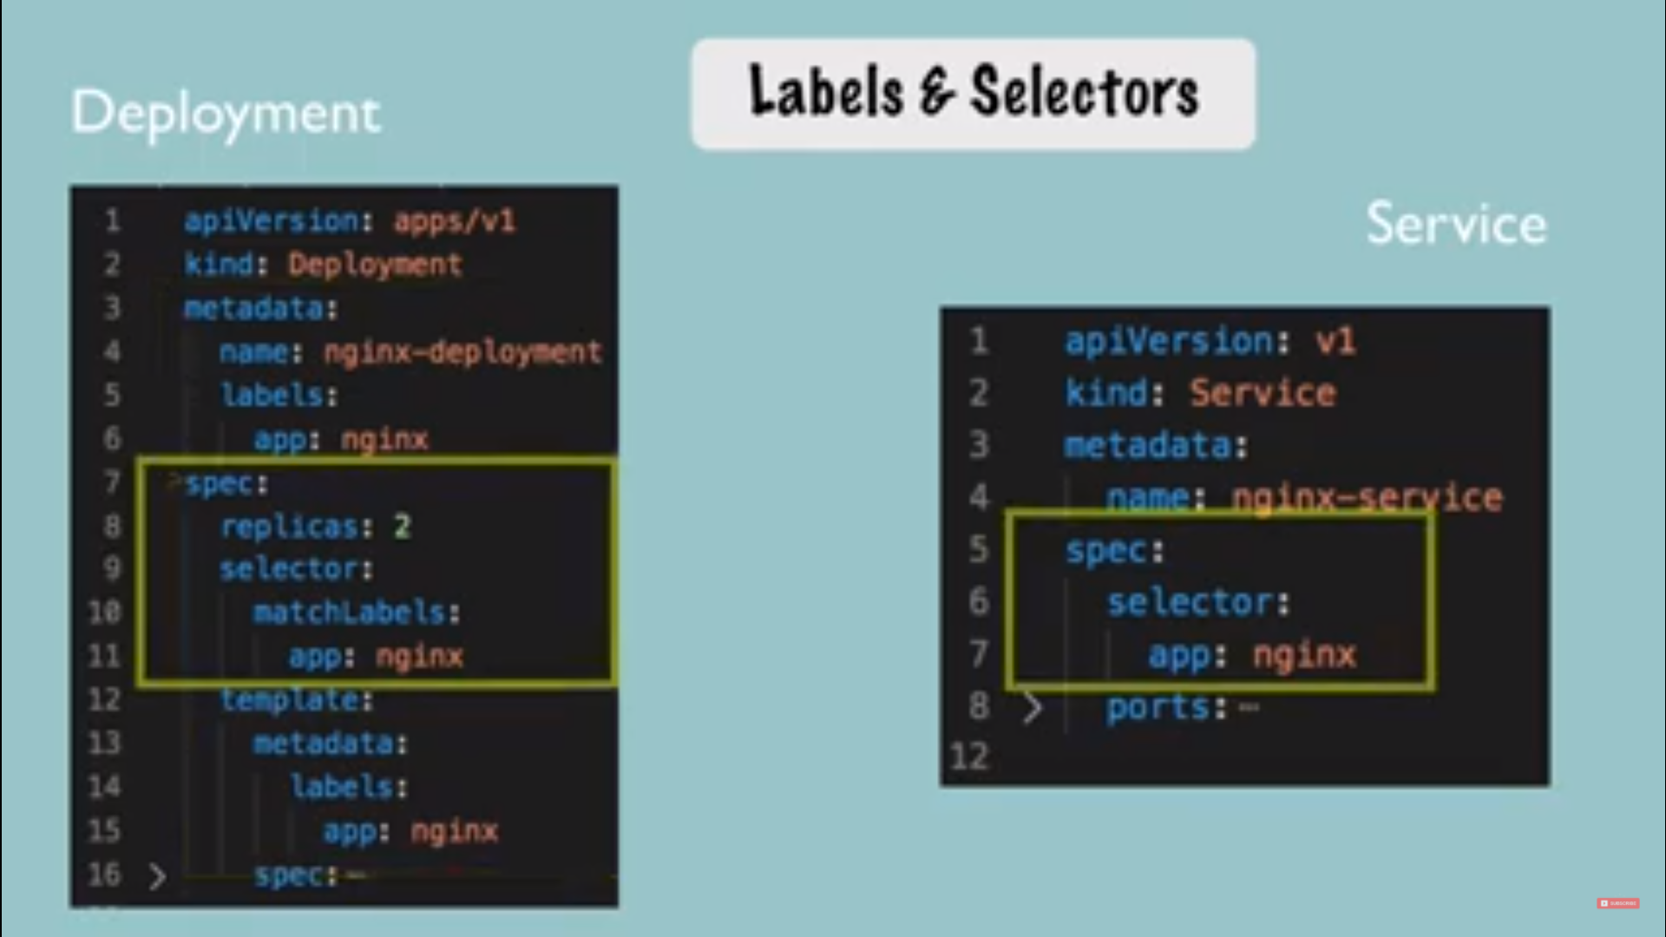
Deployment file

Slide 2
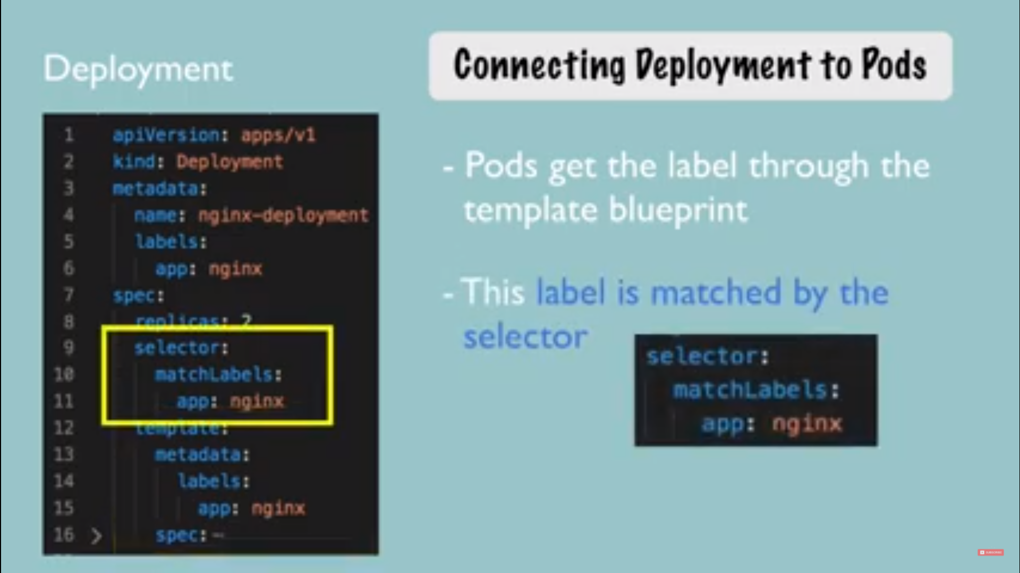
Deployment file

Slide 3
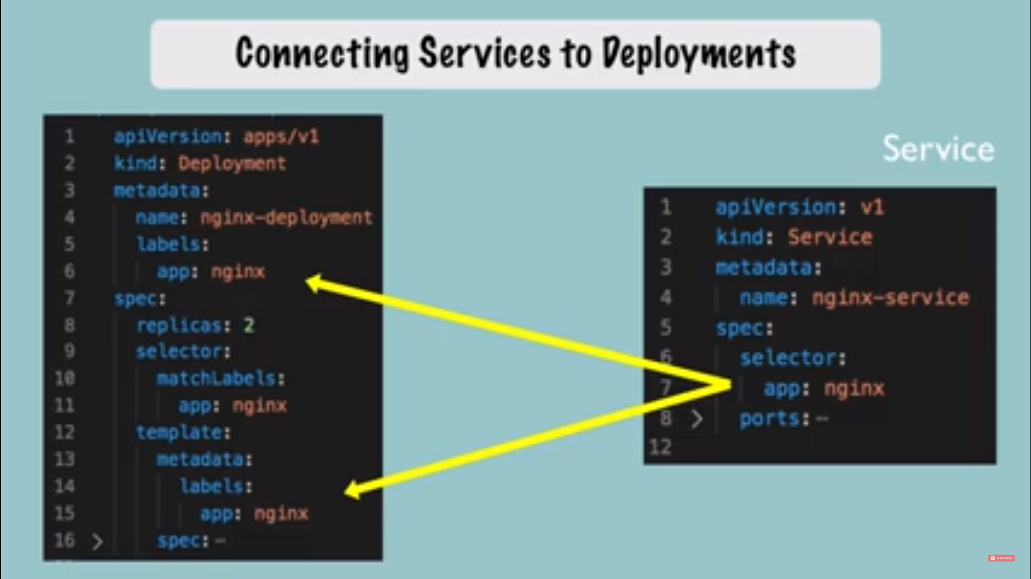
Deployment file

Slide 4
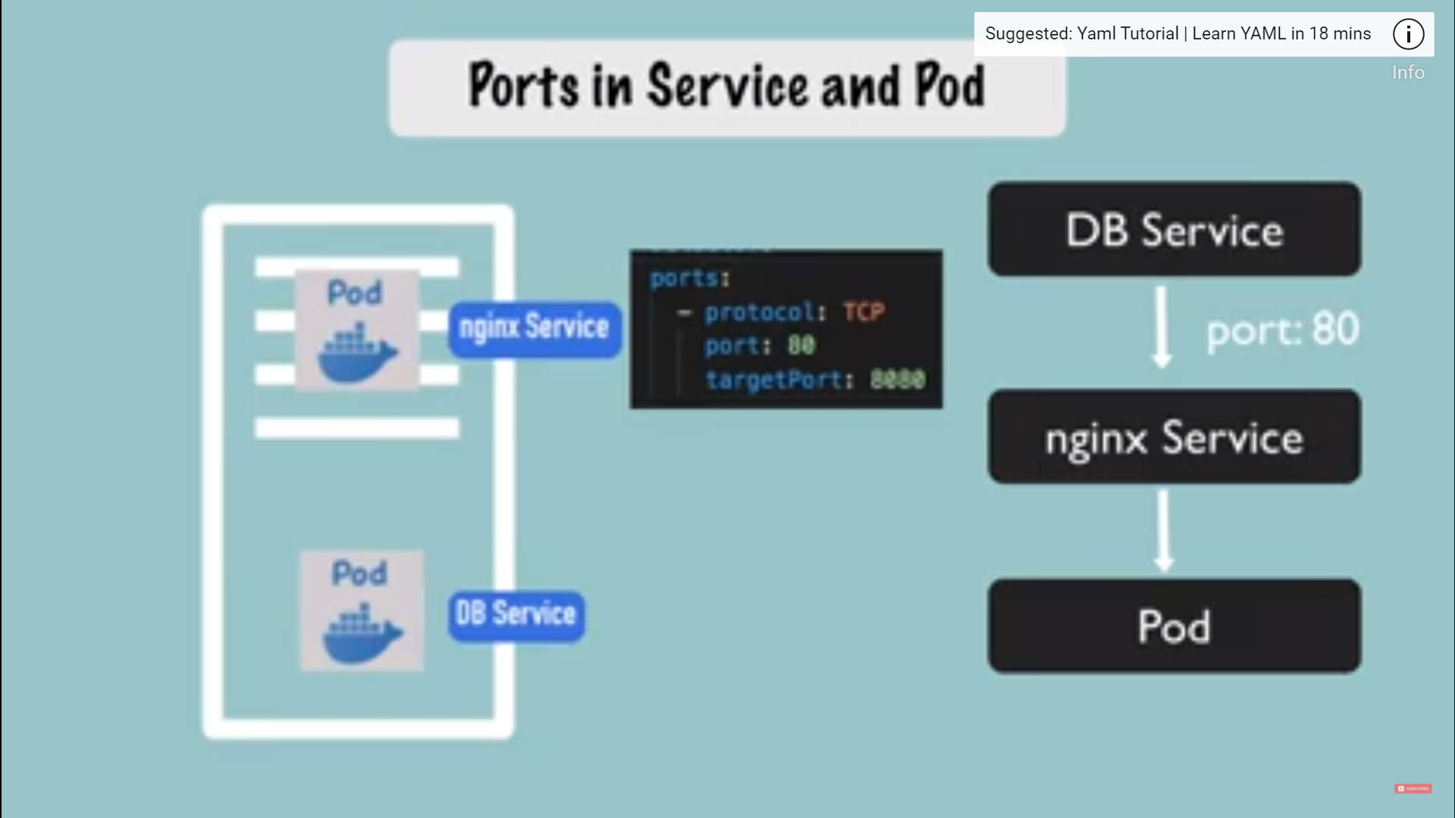
Deployment file

Slide 5
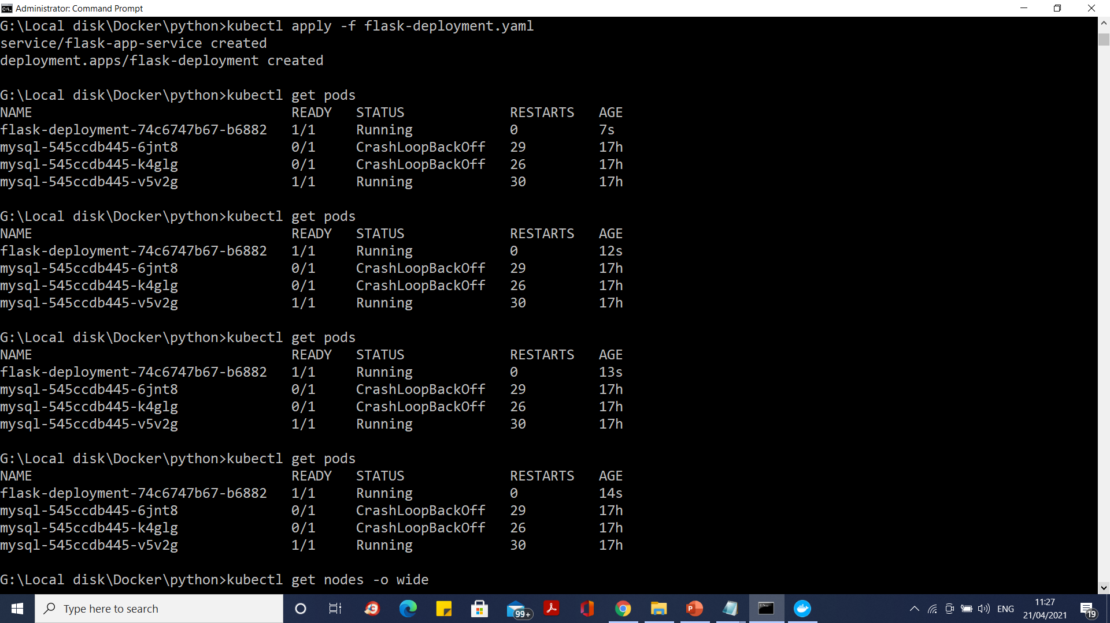
Docker and Kubernetes - Python

Slide 6
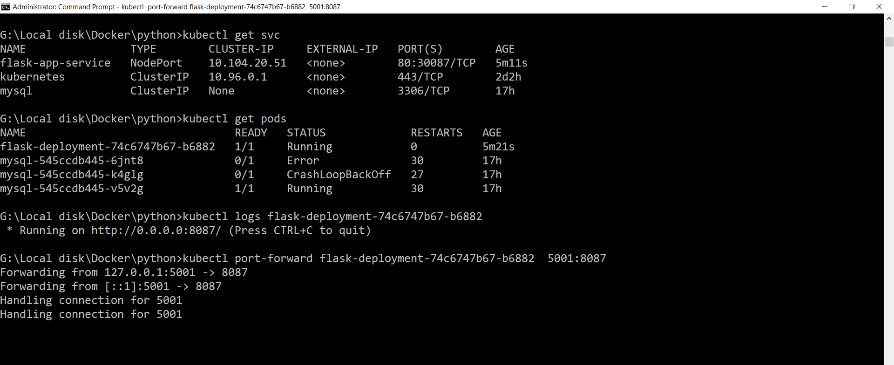

Docker and Kubernetes - Python

Slide 7
Expose Service using External IP
kubectl expose deployment cgi-flask-deployment --type=LoadBalancer --name=flask-app-service-v1
Access service using service without port forwarding
http://localhost:8087

Slide 8
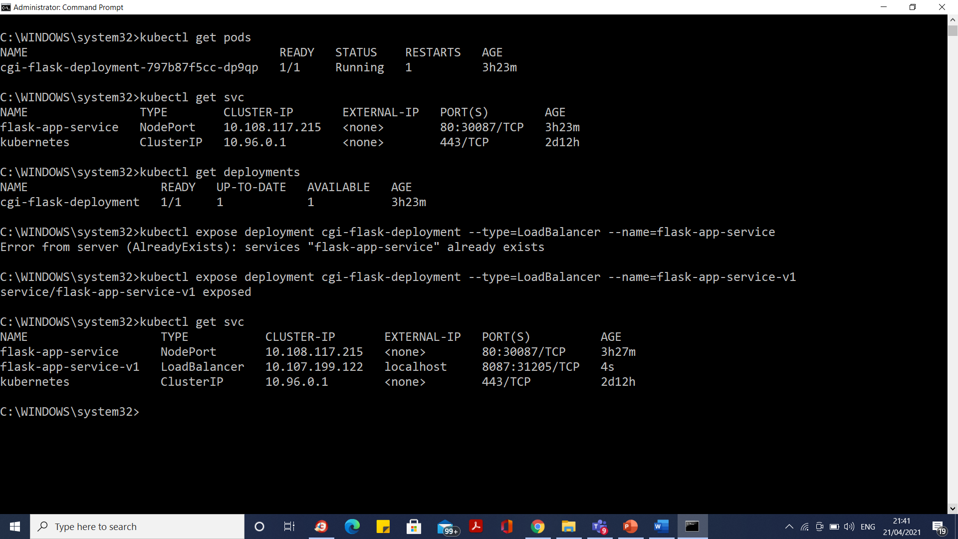
Expose Service using External IP

Slide 9

Expose Service using External IP

Slide 10
What is an Ingress?
In Kubernetes, an Ingress is an object that allows access to Kubernetes services from outside the Kubernetes cluster.
We configure access by creating a collection of rules that define which inbound connections reach which services.

Slide 11
What is an Ingress?
For example, you might want to send requests to example.com/api/v1/ to an api-v1 service, and requests to example.com/api/v2/ to the api-v2 service.
With an Ingress, we can easily set this up without creating a bunch of LoadBalancers or exposing each service on the Node.

Slide 12
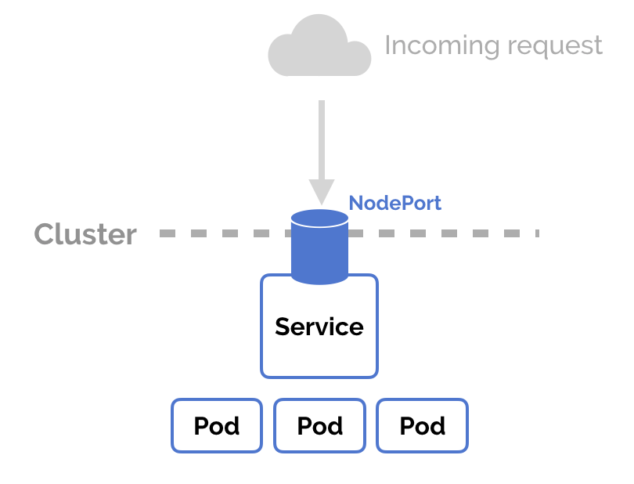
Kubernetes Ingress vs LoadBalancer vs NodePort

Slide 13
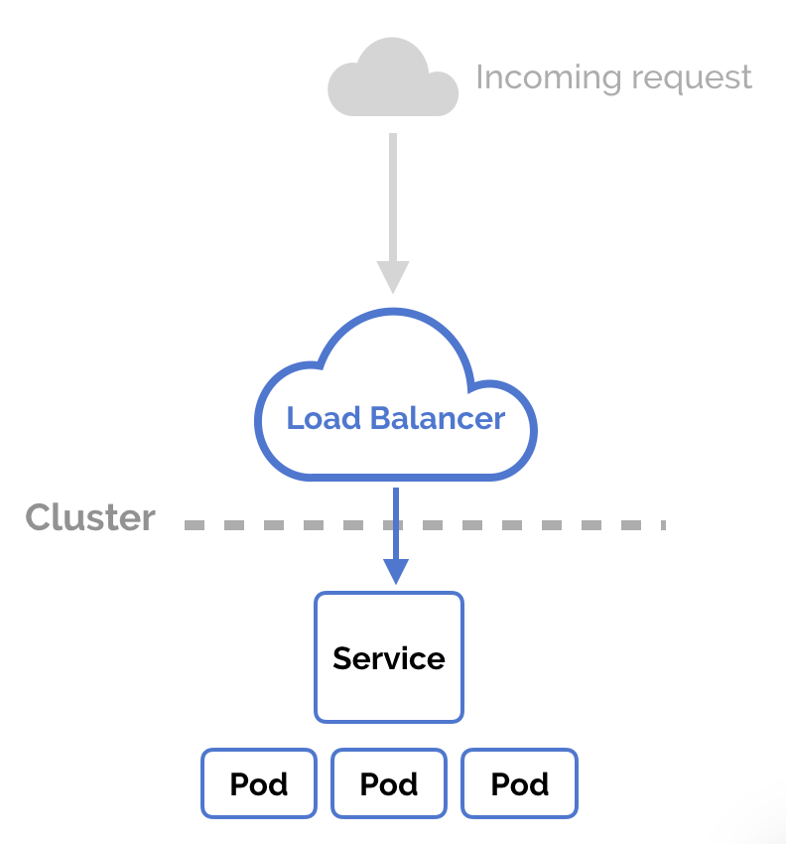
Kubernetes Ingress vs LoadBalancer vs NodePort

Slide 14
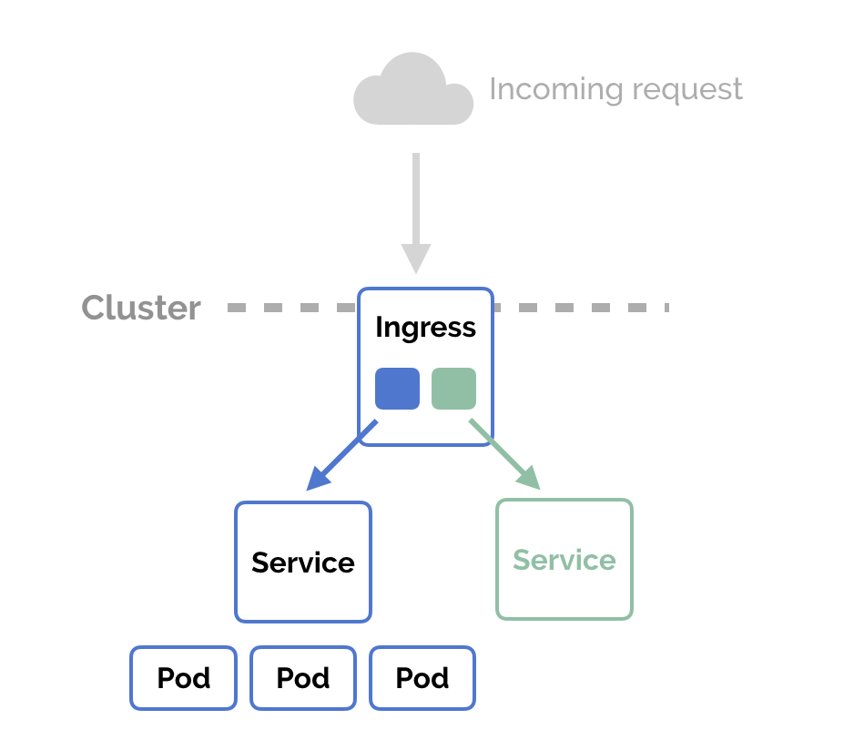
Kubernetes Ingress vs LoadBalancer vs NodePort

Slide 15
Loadbalance and Routing - Ingress
ingress installation
kubectl apply -f https://raw.githubusercontent.com/kubernetes/ingress-nginx/controller-v0.41.2/deploy/static/provider/cloud/deploy.yaml
verify installation
kubectl get pods -n ingress-nginx -l app.kubernetes.io/name=ingress-nginx --watch

Slide 16
Loadbalance and Routing - Ingress
kubectl apply -f apple.yaml
kubectl apply -f banana.yaml
kubectl apply -f ingress.yaml
curl -kL http://localhost/apple
curl -kL http://localhost/banana

Slide 17
What is helm
In simple terms, Helm is a package manager for Kubernetes.
Helm is the K8s equivalent of yum or apt.
Helm deploys charts, which you can think of as a packaged application.
It is a collection of all your versioned, pre-configured application resources which can be deployed as one unit.
You can then deploy another version of the chart with a different set of configuration.

Slide 18
What is helm
Helm helps in three key ways:
Improves productivity
Reduces the complexity of deployments of microservices
Enables the adaptation of cloud native applications

Slide 19
What are Helm charts?
Helm Charts are simply Kubernetes YAML manifests combined into a single package that can be advertised to your Kubernetes clusters.
Once packaged, installing a Helm Chart into your cluster is as easy as running a single helm install, which really simplifies the deployment of containerized applications.

Slide 20
Helm Install
choco install kubernetes-helm
Or
https://github.com/helm/helm/releases
Unzip
Initialize helm using the helm init command.
Finally, add the repo of the helm chart using the below-given command.
helm repo add stable https://kubernetes-charts.storage.googleapis.com/
helm repo list

Slide 21
Deploy an Apache webserver using Helm
Location to search
helm repo add bitnami https://charts.bitnami.com/bitnami
Download apache
helm install my-apache bitnami/apache --version 8.0.2

Slide 22
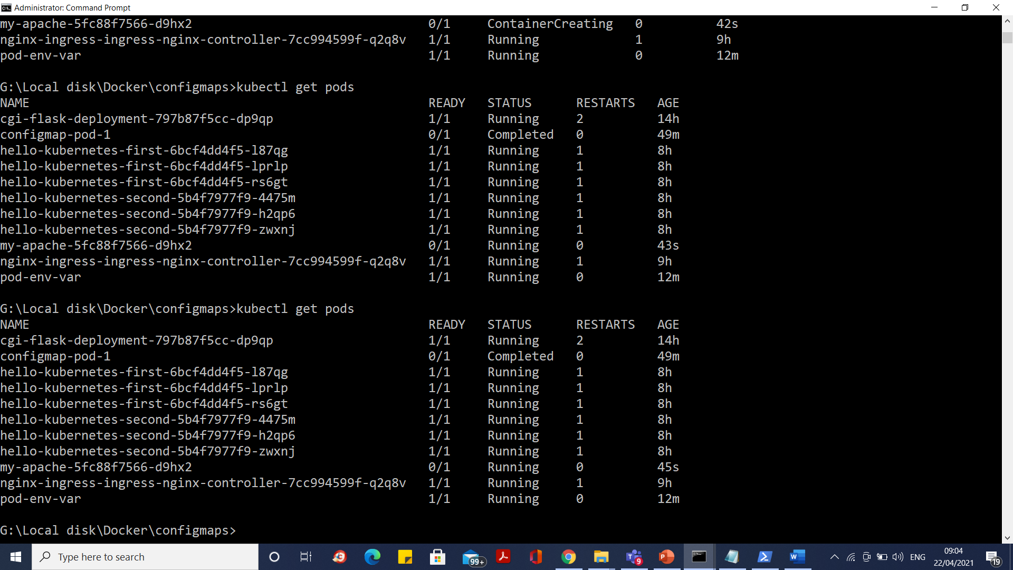
Deploy an Apache webserver using Helm

Slide 23
Deploy an Apache webserver using Helm
helm list
helm upgrade my-apache bitnami/apache --version 8.0.3
Rollback
helm rollback my-apache 1
helm delete my-apache

Slide 24
How to Access Production-Ready Helm Charts
We can search public hubs for Charts that enable you to quickly deploy your desired application with a customizable configuration.
A Helm Chart doesn't just contain a static set of definitions.
Helm comes with capabilities to hook into any lifecycle state of a Kubernetes deployment.
This means during the installation or upgrade of an application, various actions can be executed like creating a database update before updating the actual database.

Slide 25
How to Access Production-Ready Helm Charts
Helm might be heavy for a simple container like a single node web server, but it’s very useful for more complex applications.
For example it works great for a distributed system like Kafka or Cassandra that usually runs on multiple distributed nodes on different datacenters.

Slide 26
Production-ready WordPress application
Containers that serve WordPress,
Instances of MariaDB for persistence and
Prometheus sidecar containers for each WordPress container to expose health metrics.

Slide 27
How to Deploy WordPress and MariaDB
helm repo add bitnami https://charts.bitnami.com/bitnami
helm install my-wordpress bitnami/wordpress --version 10.1.4

Slide 28
Loadbalance and Routing - Ingress
1. create first-app.yaml
2. create second-app.yaml
3. deploy them
4. helm repo add ingress-nginx https://kubernetes.github.io/ingress-nginx
5.helm repo update
6.helm install nginx-ingress ingress-nginx/ingress-nginx --set controller.publishService.enabled=true
7.watch the load balancer by running
kubectl --namespace default get services -o wide -w nginx-ingress-ingress-nginx-controller

Slide 29
Loadbalance and Routing - Ingress
Kubectl apply –f app-ingress.yaml
kubectl get ingress hello-kubernetes-ingress
kubectl describe ingress hello-kubernetes-ingress

Slide 30
What is a ConfigMap in Kubernetes?
A ConfigMap is a dictionary of configuration settings.
This dictionary consists of key-value pairs of strings.
Kubernetes provides these values to your containers.
Like with other dictionaries (maps, hashes, ...) the key lets you get and set the configuration value.

Slide 31
Why would you use a ConfigMap in Kubernetes?
Use a ConfigMap to keep your application code separate from your configuration.
It is an important part of creating a Twelve-Factor Application.
A ConfigMap stores configuration settings for your code. Store connection strings, public credentials, hostnames, and URLs in your ConfigMap.

Slide 32
How does a ConfigMap work?

Slide 33
ConfigMaps
ConfigMaps can be used to:
Populate the values of environment variables
Set command-line arguments in a container
Populate config files in a volume

Slide 34
Creating ConfigMaps from file
kubectl create configmap command to create configmaps easily from literal values, files, or directories.
kubectl create configmap configmap-example-1 --from-file=./config-map-data.txt
kubectl describe configmap/configmap-example-1
kubectl delete configmap/configmap-example-1

Slide 35
Create ConfigMaps from Literal Values
kubectl create configmap literal-config-1 --from-literal=literal-key1=value1 --from-literal=literal-key2=22
kubectl create configmap literal-config-mysql --from-literal=literal-port=3306 --from-literal=literal-host=127.0.0.1 --from-literal=literal-user=root --from-literal=liter-password=password

Slide 36
Create ConfigMaps from-literal
kubectl create configmap literal-config-1 --from-literal=city=London --from-literal=population=millions

Slide 37
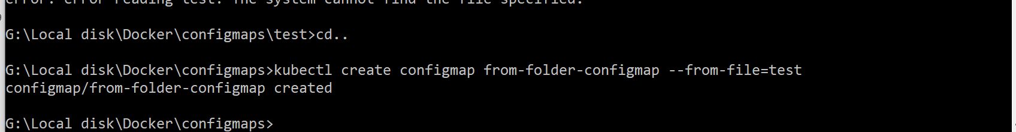
Create ConfigMaps from Directories
kubectl create configmap from-folder-configmap --from-file=test
kubectl describe configmap/from-folder-configmap

Slide 38
Use Configmap as Env variable
kubectl get configmaps literal-config-1 -o yaml
kubectl create -f Config-Map-demo1.yaml

Slide 39
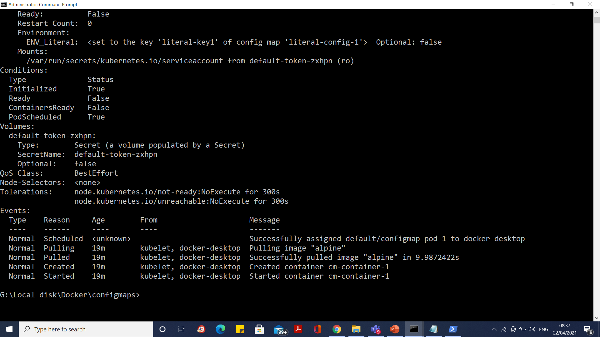
Use Configmap as Env variable

Slide 41
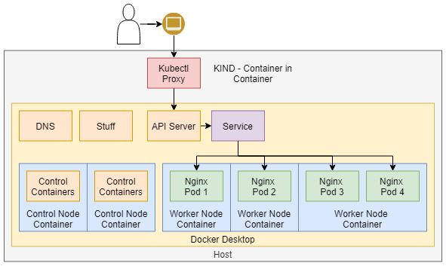
Docker-Desktop wsl2 Multinode cluster

Slide 42
Docker-Desktop wsl2 Multinode cluster
curl.exe -Lo kind-windows-amd64.exe https://kind.sigs.k8s.io/dl/v0.10.0/kind-windows-amd64
copy .\kind-windows-amd64.exe d:\kube\kind.exe
Go to d:\kube
kind create cluster # Default cluster context name is `kind`.
kind create cluster --name kind-2

Slide 43
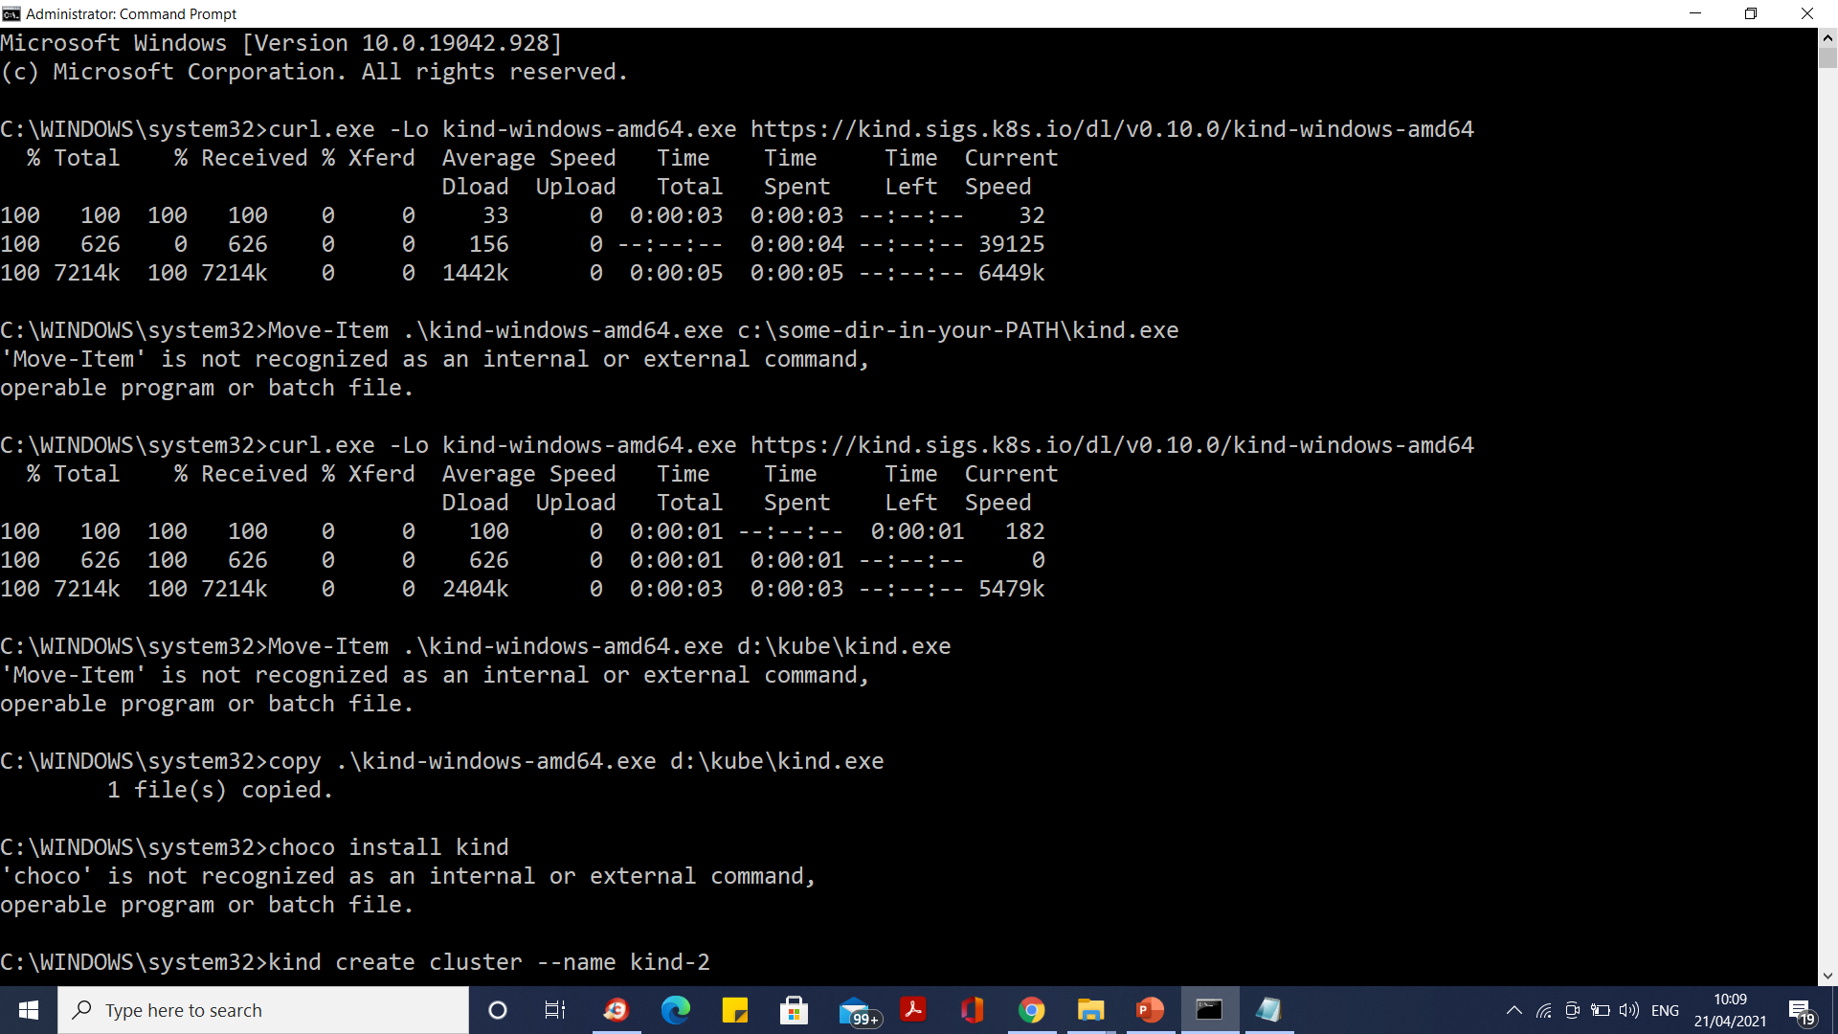
Docker-Desktop wsl2 Multinode cluster

Slide 44
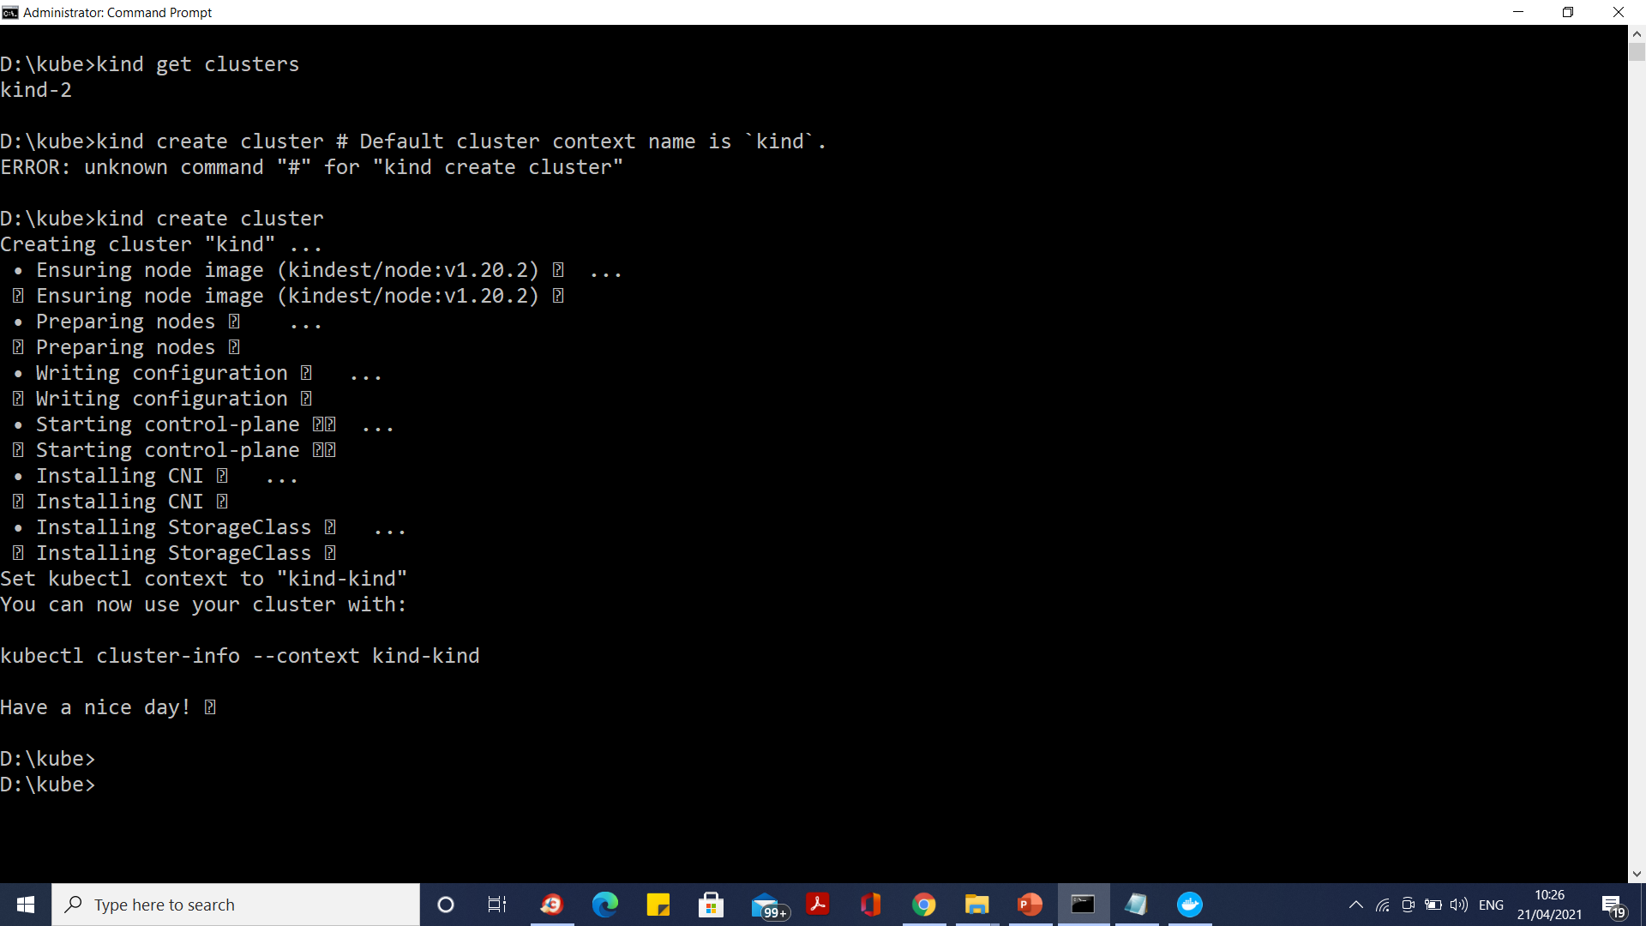
Docker-Desktop wsl2 Multinode cluster

Slide 45
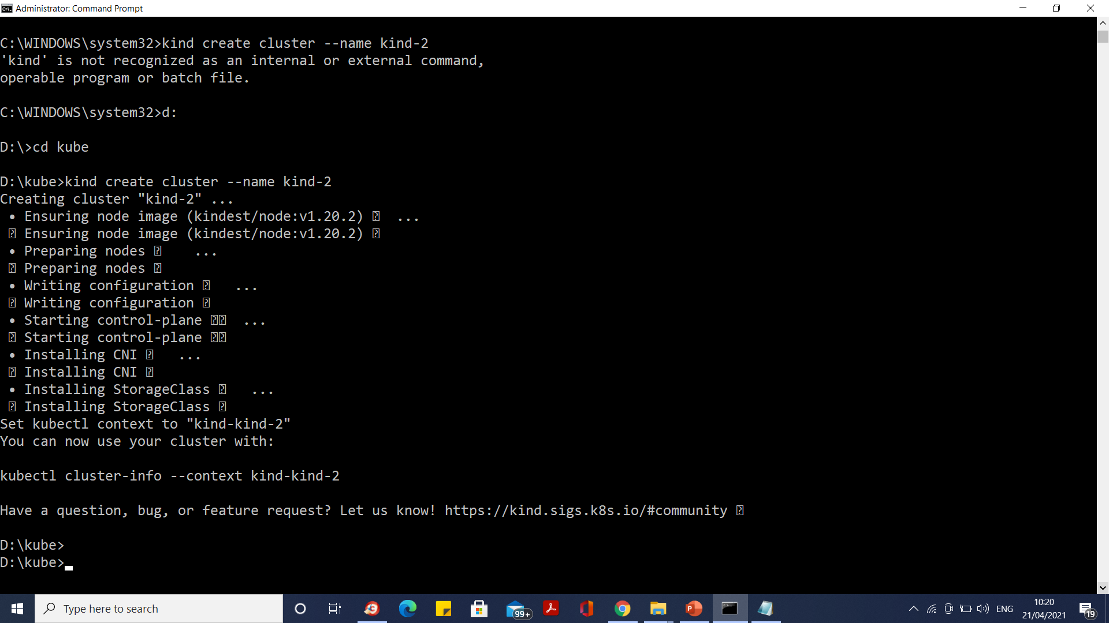
Docker-Desktop wsl2 Multinode cluster

Slide 46
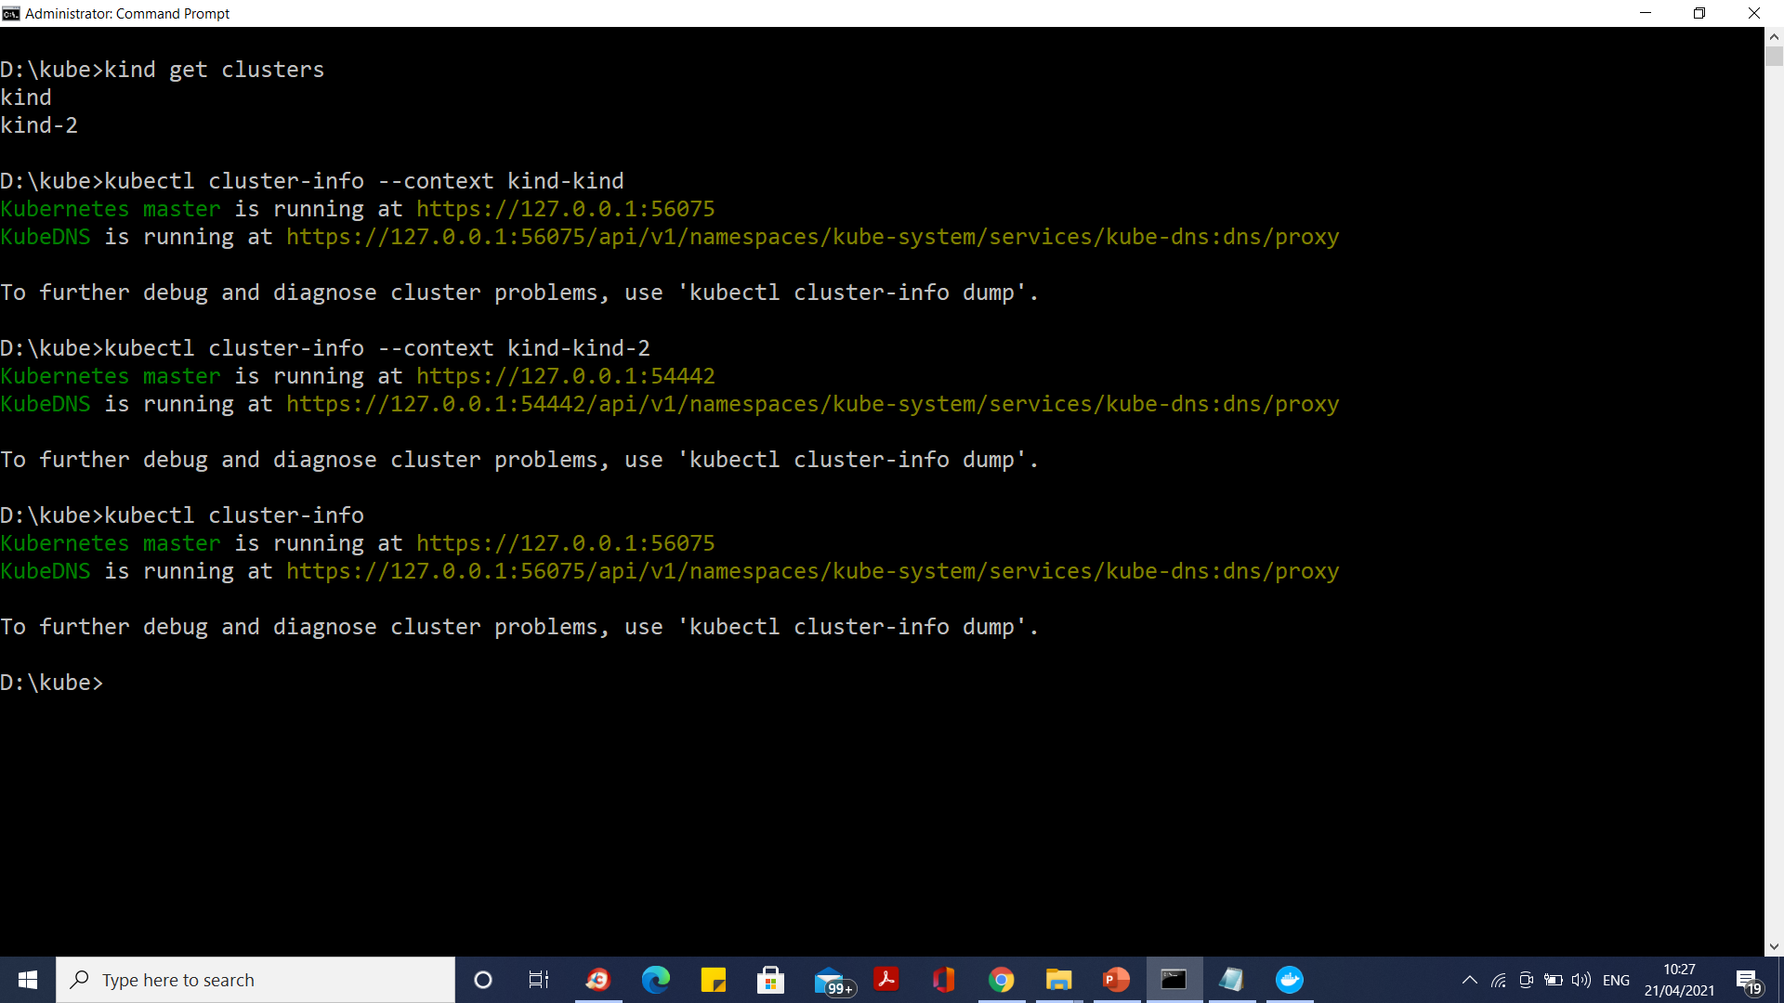
Docker-Desktop wsl2 Multinode cluster

Slide 47
Kubernetes multiple control planes
# a cluster with 3 control-plane nodes and 3 workers
kind: Cluster
apiVersion: kind.x-k8s.io/v1alpha4
nodes:
- role: control-plane
- role: control-plane
- role: control-plane
- role: worker
- role: worker
- role: worker

Slide 48
Kubernetes multiple control planes
kind: Cluster
apiVersion: kind.x-k8s.io/v1alpha4
nodes:
- role: control-plane
extraPortMappings:
- containerPort: 80
hostPort: 80
listenAddress: "0.0.0.0" # Optional, defaults to "0.0.0.0"
protocol: udp # Optional, defaults to tcp

Slide 49
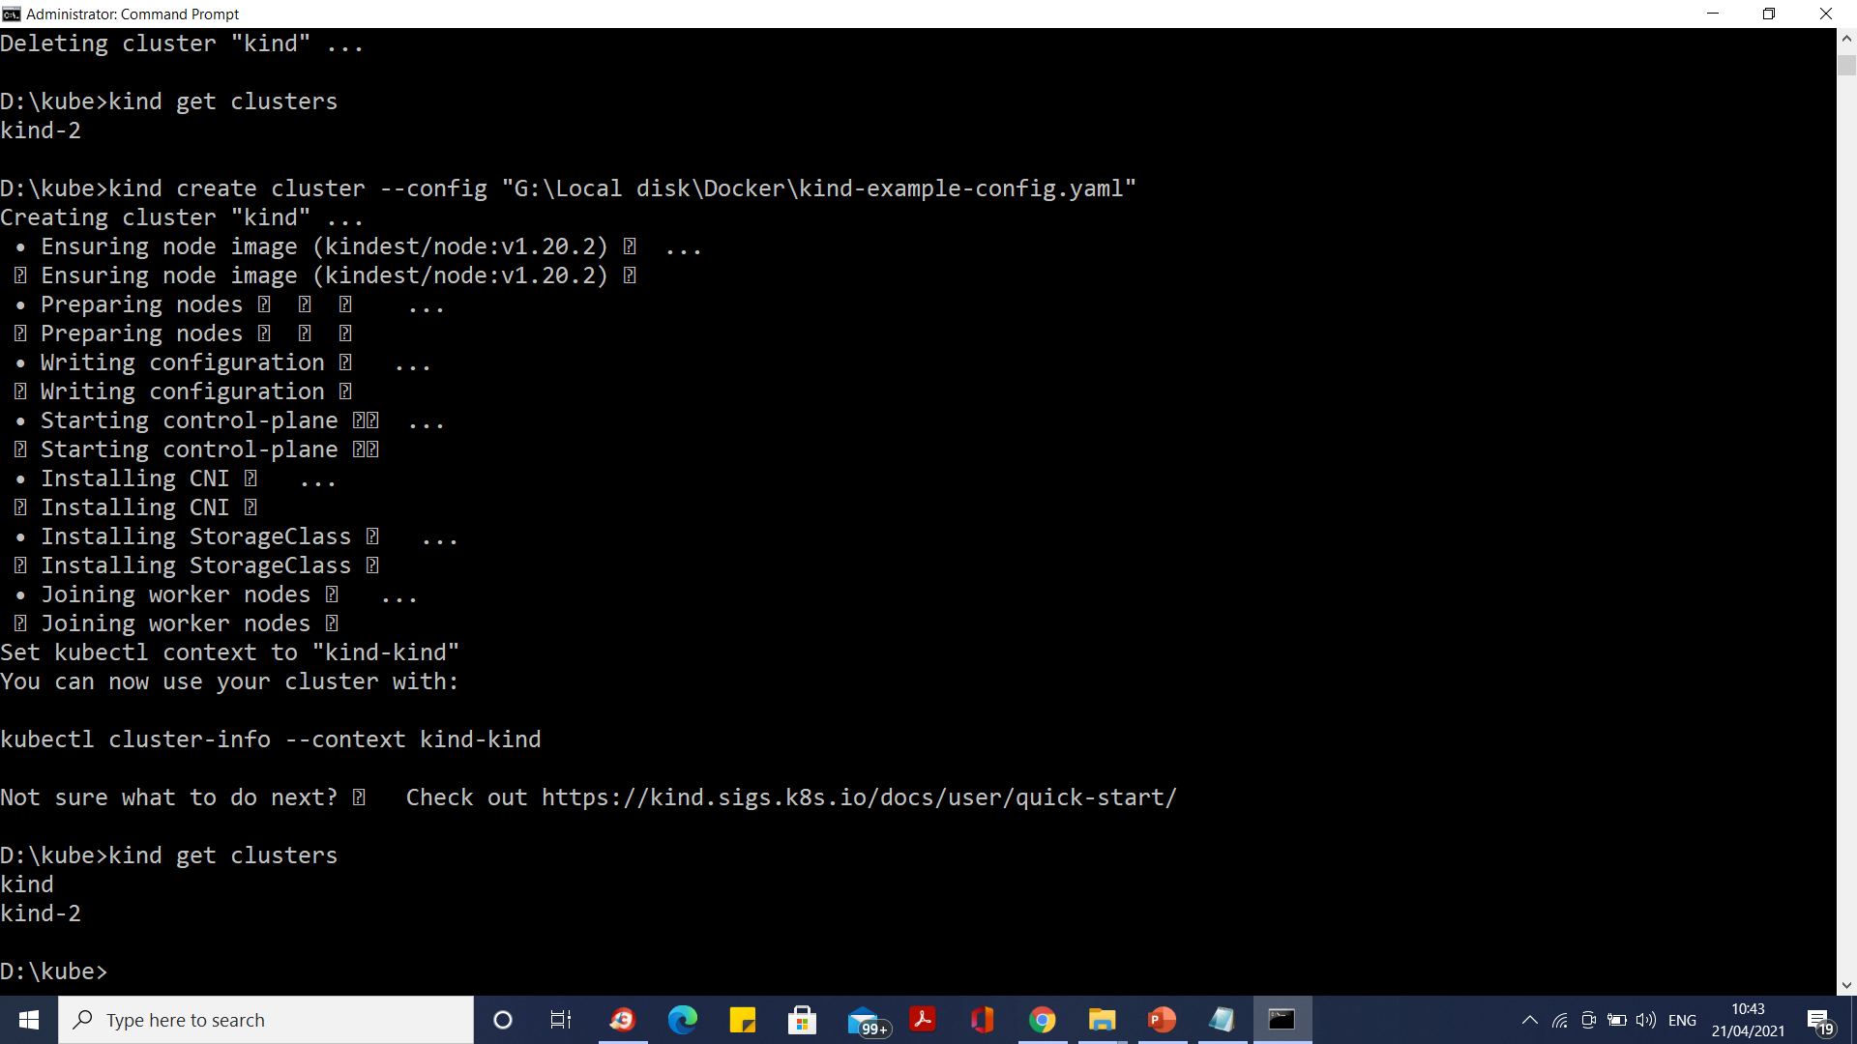
Kubernetes multiple control planes

Slide 50
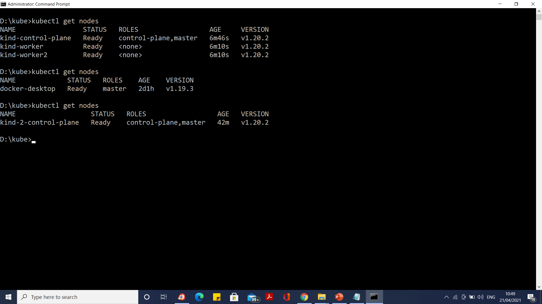
Kubernetes multiple control planes

Slide 51
Multi node cluster dashboard
Repeat dashboard installation steps for every cluster

Slide 52
Kubernetes Deployment Policies
recreate: terminate the old version and release the new one
ramped: release a new version on a rolling update fashion, one after the other
blue/green: release a new version alongside the old version then switch traffic
canary: release a new version to a subset of users, then proceed to a full rollout
a/b testing: release a new version to a subset of users in a precise way (HTTP headers, cookie, weight, etc.).
A/B testing is really a technique for making business decisions based on statistics but we will briefly describe the process.
This doesn’t come out of the box with Kubernetes, it implies extra work to setup a more advanced infrastructure (Istio, Linkerd, Traefik, custom nginx/haproxy, etc).

Slide 53
Recreate - best for development environment
spec:
replicas: 3
strategy:
type: Recreate

Slide 54
Recreate - best for development environment
The recreate strategy is a dummy deployment which consists of shutting down version A then deploying version B after version A is turned off.
This technique implies downtime of the service that depends on both shutdown and boot duration of the application.

Slide 55
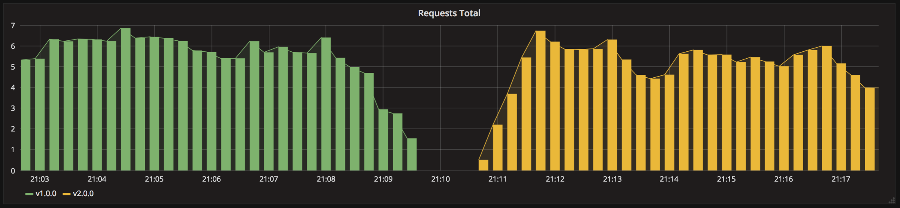
Recreate - best for development environment

Slide 56
Recreate - best for development environment
Deploy the first application
$ kubectl apply -f app-v1.yaml
# Test if the deployment was successful
Kubectl logs deploy/my-app
# Then deploy version 2 of the application
$ kubectl apply -f app-v2.yaml
Kubectl logs deploy/my-app

Slide 57
Recreate - best for development environment
Pro:
application state entirely renewed
Cons:
downtime that depends on both shutdown and boot duration of the application

Slide 58
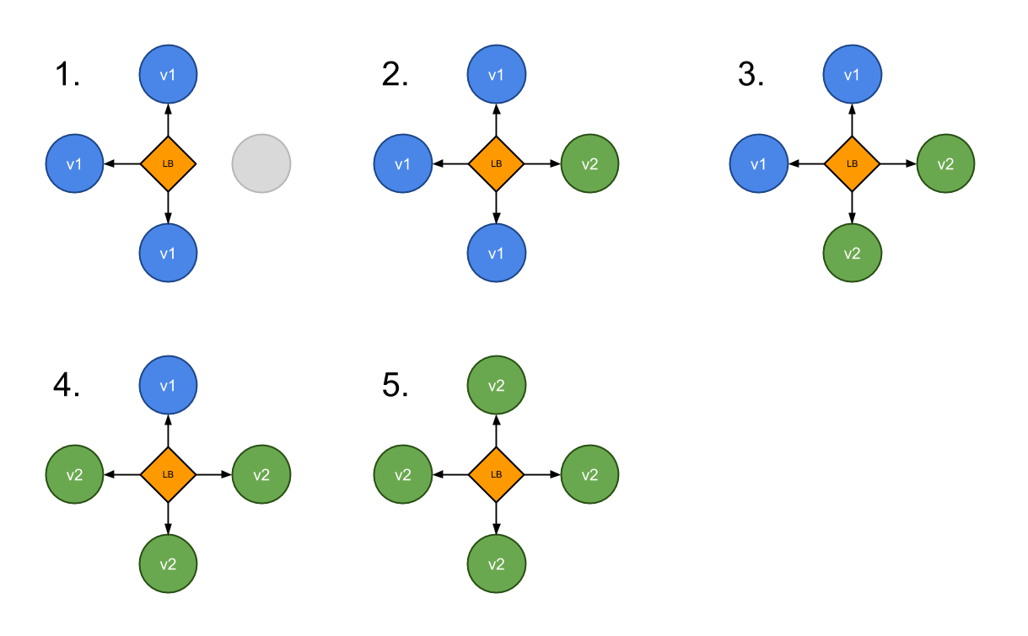
Ramped - slow rollout
A ramped deployment updates pods in a rolling update fashion, a secondary ReplicaSet is created with the new version of the application, then the number of replicas of the old version is decreased and the new version is increased until the correct number of replicas is reached.

Slide 59
Ramped – Slow Rollout
spec:
replicas: 3
strategy:
type: RollingUpdate
rollingUpdate:
maxSurge: 2 # how many pods we can add at a time
maxUnavailable: 0 # maxUnavailable define how many pods can be unavailable
# during the rolling update

Slide 60
Ramped- best for development environment
Deploy the first application
$ kubectl apply -f app-v1.yaml
# Test if the deployment was successful
Kubectl logs deploy/my-app
# Then deploy version 2 of the application
$ kubectl apply -f app-v2.yaml
Kubectl logs deploy/my-app

Slide 61
Ramped- best for development environment
# In case you discover some issue with the new version, you can undo the
# rollout
$ kubectl rollout undo deploy my-app
# If you can also pause the rollout if you want to run the application for a
# subset of users
$ kubectl rollout pause deploy my-app
# Then if you are satisfy with the result, rollout
$ kubectl rollout resume deploy my-app

Slide 62
Ramped- best for development environment
When setup together with horizontal pod autoscaling it can be handy to use a percentage based value instead of a number for maxSurge and maxUnavailable.
If you trigger a deployment while an existing rollout is in progress, the deployment will pause the rollout and proceed to a new release by overriding the rollout.

Slide 63
Ramped- best for development environment
Pro:
version is slowly released across instances
convenient for stateful applications that can handle rebalancing of the data
Cons:
rollout/rollback can take time
supporting multiple APIs is hard
no control over traffic

Slide 64
Blue/Green - best to avoid API versioning issues
A blue/green deployment differs from a ramped deployment because the "green" version of the application is deployed alongside the "blue" version.
After testing that the new version meets the requirements, we update the Kubernetes Service object that plays the role of load balancer to send traffic to the new version by replacing the version label in the selector field.

Slide 65
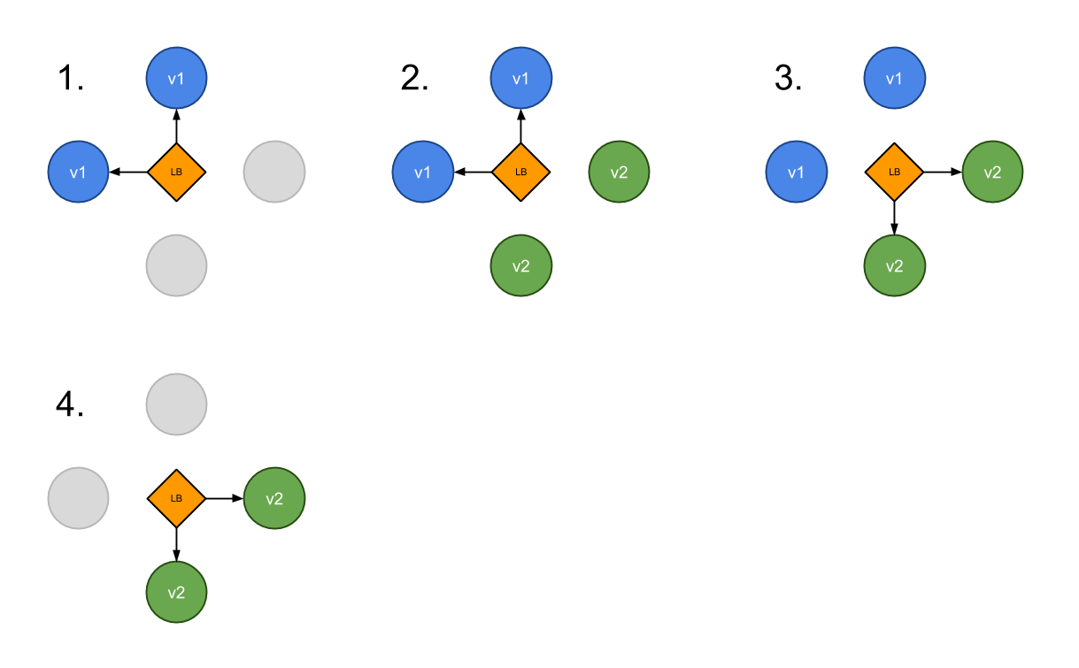
Blue/Green - best to avoid API versioning issues

Slide 66
ReplicaSet
A ReplicaSet's purpose is to maintain a stable set of replica Pods running at any given time.
As such, it is often used to guarantee the availability of a specified number of identical Pods.

Slide 67
ReplicaSet
A ReplicaSet is defined with fields, including a selector that specifies how to identify Pods it can acquire, a number of replicas indicating how many Pods it should be maintaining, and a pod template specifying the data of new Pods it should create to meet the number of replicas criteria.
A ReplicaSet then fulfills its purpose by creating and deleting Pods as needed to reach the desired number.
When a ReplicaSet needs to create new Pods, it uses its Pod template.

Slide 68
ReplicaSet
When to use a ReplicaSet
A ReplicaSet ensures that a specified number of pod replicas are running at any given time.
However, a Deployment is a higher-level concept that manages ReplicaSets and provides declarative updates to Pods along with a lot of other useful features.
Therefore, we recommend using Deployments instead of directly using ReplicaSets, unless you require custom update orchestration or don't require updates at all.

Slide 69
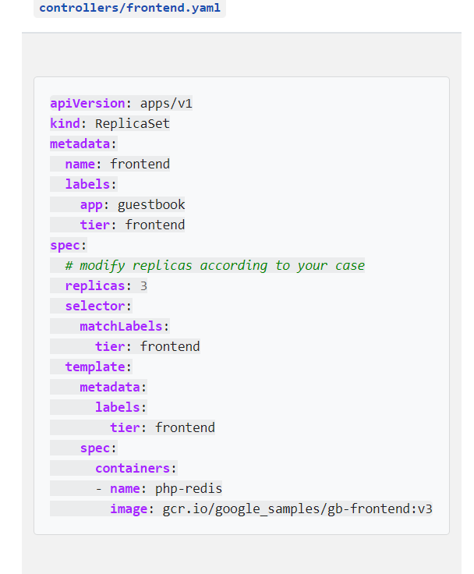
kubectl get rs

Slide 70
What is a Deployment?
A Deployment provides declarative updates for Pods and Replica Sets (the next-generation Replication Controller).
You only need to describe the desired state in a Deployment object, and the Deployment controller will change the actual state to the desired state at a controlled rate for you.
You can define Deployments to create new resources, or replace existing ones by new ones.

Slide 71
What is a Deployment?
A typical use case is:
Create a Deployment to bring up a Replica Set and Pods.
Check the status of a Deployment to see if it succeeds or not.
Later, update that Deployment to recreate the Pods (for example, to use a new image).
Rollback to an earlier Deployment revision if the current Deployment isn't stable.
Pause and resume a Deployment.

Slide 72
Creating a Deployment
Here is an example Deployment. It creates a Replica Set to bring up 3 nginx Pods.
{% include code.html language="yaml" file="nginx-deployment.yaml" ghlink="/docs/concepts/workloads/controllers/nginx-deployment.yaml" %}
Run the example by downloading the example file and then running this command:
$ kubectl create -f docs/user-guide/nginx-deployment.yaml --record
deployment "nginx-deployment" created

Slide 73
Creating a Deployment
$ kubectl get deployments
NAME DESIRED CURRENT UP-TO-DATE AVAILABLE AGE
nginx-deployment 3 0 0 0 1s
$ kubectl get rs
NAME DESIRED CURRENT READY AGE
nginx-deployment-2035384211 3 3 0 18s

Slide 74
Creating a Deployment
$ kubectl get pods --show-labels

Slide 75
Rolling Back a Deployment
Sometimes you may want to rollback a Deployment; for example, when the Deployment is not stable, such as crash looping.
By default, two previous Deployment's rollout history are kept in the system so that you can rollback anytime you want.

Slide 76
Rolling Back a Deployment
Note: a Deployment's revision is created when a Deployment's rollout is triggered.
This means that the new revision is created if and only if the Deployment's pod template (i.e. .spec.template) is changed, e.g. updating labels or container images of the template.
Other updates, such as scaling the Deployment, will not create a Deployment revision -- so that we can facilitate simultaneous manual- or auto-scaling.
This implies that when you rollback to an earlier revision, only the Deployment's pod template part will be rolled back.

Slide 77
Rolling Back a Deployment
kubectl set image deployment/nginx-deployment nginx=nginx:1.91
kubectl rollout status deployments nginx-deployment
kubectl rollout history deployment/nginx-deployment
kubectl rollout history deployment/nginx-deployment --revision=2

Slide 78
Scaling a Deployment
kubectl scale deployment nginx-deployment --replicas 10
kubectl get deploy
kubectl set image deploy/nginx-deployment nginx=nginx:sometag

Slide 79
Working with Kubernetes Objects
Kubernetes objects are persistent entities in the Kubernetes system.
Kubernetes uses these entities to represent the state of your cluster.
Specifically, they can describe:
What containerized applications are running (and on which nodes)
The resources available to those applications
The policies around how those applications behave, such as restart policies, upgrades, and fault-tolerance

Slide 80
Init containers
A Pod can have multiple containers running apps within it, but it can also have one or more init containers, which are run before the app containers are started.
Init containers are exactly like regular containers, except:
Init containers always run to completion.
Each init container must complete successfully before the next one starts.
If a Pod's init container fails, Kubernetes repeatedly restarts the Pod until the init container succeeds.
However, if the Pod has a restartPolicy of Never, Kubernetes does not restart the Pod.

Slide 81
Differences from regular containers
Init containers support all the fields and features of app containers, including resource limits, volumes, and security settings.
However, the resource requests and limits for an init container are handled differently, as documented in Resources.
Also, init containers do not support lifecycle, livenessProbe, readinessProbe, or startupProbe because they must run to completion before the Pod can be ready.

Slide 82
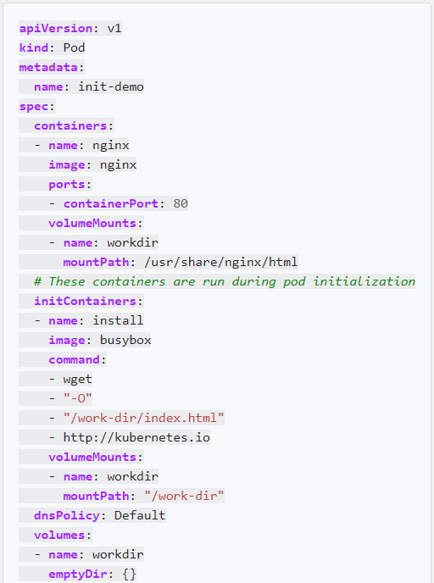
Create a Pod that has an Init Container

Slide 83
Working with Kubernetes Objects
To work with Kubernetes objects--whether to create, modify, or delete them--you'll need to use the Kubernetes API.
When you use the kubectl command-line interface, for example, the CLI makes the necessary Kubernetes API calls for you.

Slide 84
Object Spec and Status
Almost every Kubernetes object includes two nested object fields that govern the object's configuration: the object spec and the object status.
For objects that have a spec, you have to set this when you create the object, providing a description of the characteristics you want the resource to have: its desired state.
The status describes the current state of the object, supplied and updated by the Kubernetes system and its components.
The Kubernetes control plane continually and actively manages every object's actual state to match the desired state you supplied.

Slide 85
Object Spec and Status
For example: in Kubernetes, a Deployment is an object that can represent an application running on your cluster.
When you create the Deployment, you might set the Deployment spec to specify that you want three replicas of the application to be running.
The Kubernetes system reads the Deployment spec and starts three instances of your desired application--updating the status to match your spec.
If any of those instances should fail (a status change), the Kubernetes system responds to the difference between spec and status by making a correction--in this case, starting a replacement instance.

Slide 86
Describing a Kubernetes object
Deployment.yaml
apiVersion - Which version of the Kubernetes API you're using to create this object
kind - What kind of object you want to create
metadata - Data that helps uniquely identify the object, including a name string, UID, and optional namespace
spec - What state you desire for the object

Slide 87
Network Terms
Layer 2 Networking
Layer 2 is the data link layer providing Node-to-Node data transfer.
It defines the protocol to establish and terminate a connection between two physically connected devices. It also defines the protocol for flow control between them.

Slide 88
Network Terms
Layer 4 Networking
The transport layer controls the reliability of a given link through flow control. In TCP/IP, this layer refers to the TCP protocol for exchanging data over an unreliable network.

Slide 89
Network Terms
Layer 7 Networking
The application layer is the layer closest to the end user, which means both the application layer and the user interact directly with the software application.
This layer interacts with software applications that implement a communicating component. Typically, Layer 7 Networking refers to HTTP.

Slide 90
Network Terms
NAT — Network Address Translation
NAT or network address translation is an IP-level remapping of one address space into another. The mapping happens by modifying network address information in the IP header of packets while they are in transit across a traffic routing device.

Slide 91
Network Terms
SNAT — Source Network Address Translation
SNAT simply refers to a NAT procedure that modifies the source address of an IP packet. This is the typical behaviour for the NAT described above.
DNAT — Destination Network Address Translation
DNAT refers to a NAT procedure that modifies the destination address of an IP packet. DNAT is used to publish a service resting in a private network to a publicly addressable IP address.

Slide 92
Network Terms
Network Namespace
In networking, each machine (real or virtual) has an Ethernet device (that we will refer to as eth0).
All traffic flowing in and out of the machine is associated with that device.
In truth, Linux associates each Ethernet device with a network namespace — a logical copy of the entire network stack, with its own routes, firewall rules, and network devices.
Initially, all the processes share the same default network namespace from the init process, called the root namespace.
By default, a process inherits its network namespace from its parent and so, if you don’t make any changes, all network traffic flows through the Ethernet device specified for the root network namespace.

Slide 93
Network Terms
veth — Virtual Ethernet Device Pairs
Computer systems typically consist of one or more networking devices — eth0, eth1, etc — that are associated with a physical network adapter which is responsible for placing packets onto the physical wire.
Veth devices are virtual network devices that are always created in interconnected pairs.
They can act as tunnels between network namespaces to create a bridge to a physical network device in another namespace, but can also be used as standalone network devices.

Slide 94
Network Terms
bridge — Network Bridge
A network bridge is a device that creates a single aggregate network from multiple communication networks or network segments.
Bridging connects two separate networks as if they were a single network.
Bridging uses an internal data structure to record the location that each packet is sent to as a performance optimization.

Slide 95
Network Terms
iptables — Packet Mangling Tool
iptables is a program that allows a Linux system administrator to configure the netfilter and the chains and rules it stores.
Each rule within an IP table consists of a number of classifiers (iptables matches) and one connected action (iptables target).

Slide 96
Network Terms
IPVS — IP Virtual Server
IPVS implements transport-layer load balancing as part of the Linux kernel.
IPVS is a tool similar to iptables. It is based on the Linux kernel’s netfilter hook function, but uses a hash table as the underlying data structure.
That means, when compared to iptables, IPVS redirects traffic much faster, has much better performance when syncing proxy rules, and provides more load balancing algorithms.

Slide 97
Network Terms
DNS — The Domain Name System
The Domain Name System (DNS) is a decentralized naming system for associating system names with IP addresses.
It translates domain names to numerical IP addresses for locating computer services.

Slide 98
The Kubernetes Networking Model
Kubernetes makes opinionated choices about how Pods are networked. In particular, Kubernetes dictates the following requirements on any networking implementation:
all Pods can communicate with all other Pods without using network address translation (NAT).
all Nodes can communicate with all Pods without NAT.
the IP that a Pod sees itself as is the same IP that others see it as.

Slide 99
The Kubernetes Networking Model
Given these constraints, we are left with four distinct networking problems to solve:
Container-to-Container networking
Pod-to-Pod networking
Pod-to-Service networking
Internet-to-Service networking

Slide 100
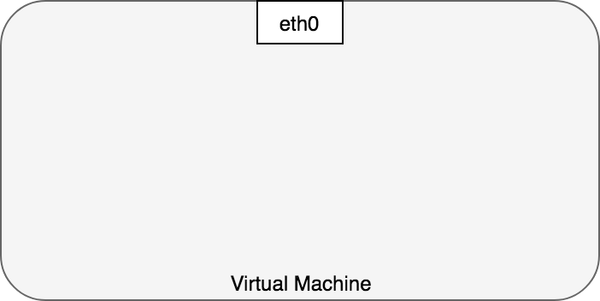
Container-to-Container Networking
Typically, we view network communication in a virtual machine as interacting directly with an Ethernet device,

Slide 101
Container-to-Container Networking
Linux, each running process communicates within a network namespace that provides a logical networking stack with its own routes, firewall rules, and network devices.
In essence, a network namespace provides a brand new network stack for all the processes within the namespace.
As a Linux user, network namespaces can be created using the ip command.
For example, the following command will create a new network namespace called ns1.
ip netns add ns1

Slide 102
Container-to-Container Networking
When the namespace is created, a mount point for it is created under /var/run/netns, allowing the namespace to persist even if there is no process attached to it.
You can list available namespaces by listing all the mount points under /var/run/netns, or by using the ip command.
$ ls /var/run/netns
ns1
$ ip netns
ns1

Slide 103
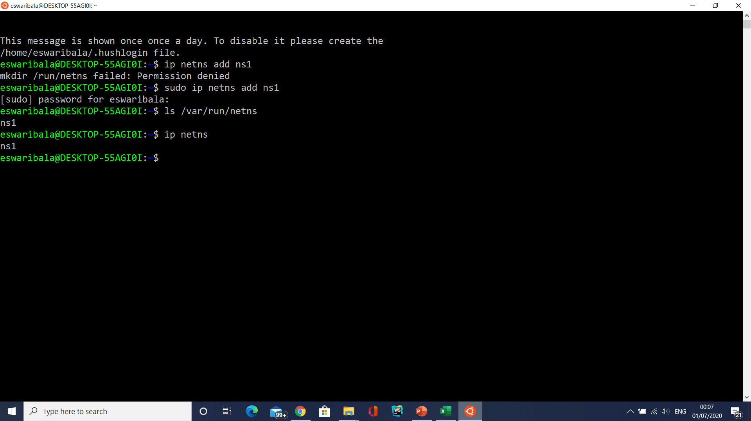

Slide 104
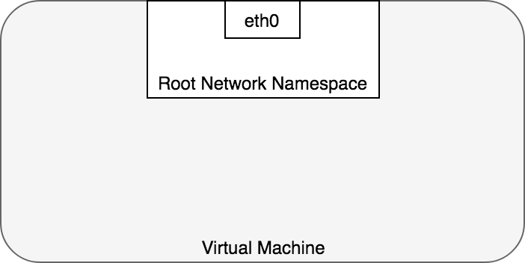
Root Network Namespace
By default, Linux assigns every process to the root network namespace to provide access to the external world

Slide 105
Network Namespace/pod
In terms of Docker constructs, a Pod is modelled as a group of Docker containers that share a network namespace.
Containers within a Pod all have the same IP address and port space assigned through the network namespace assigned to the Pod, and can find each other via localhost since they reside in the same namespace.
We can create a network namespace for each Pod on a virtual machine.
This is implemented, using Docker, as a “Pod container” which holds the network namespace open while “app containers” (the things the user specified) join that namespace with Docker’s –net=container: function.

Slide 106
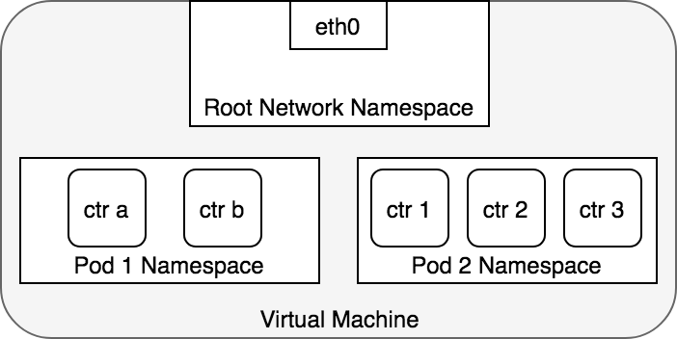
Network Namespace/pod
Applications within a Pod also have access to shared volumes, which are defined as part of a Pod and are made available to be mounted into each application’s filesystem.

Slide 107
Pod-to-Pod Networking
In Kubernetes, every Pod has a real IP address and each Pod communicates with other Pods using that IP address.
The task at hand is to understand how Kubernetes enables Pod-to-Pod communication using real IPs, whether the Pod is deployed on the same physical Node or different Node in the cluster.
We are considering that pods reside on the same machine to avoid the complications of going over the internal network to communicate across Nodes.

Slide 108
Pod-to-Pod Networking
From the Pod’s perspective, it exists in its own Ethernet namespace that needs to communicate with other network namespaces on the same Node.
Namespaces can be connected using a Linux Virtual Ethernet Device or veth pair consisting of two virtual interfaces that can be spread over multiple namespaces.
To connect Pod namespaces, we can assign one side of the veth pair to the root network namespace, and the other side to the Pod’s network namespace.
Each veth pair works like a patch cable, connecting the two sides and allowing traffic to flow between them.
This setup can be replicated for as many Pods as we have on the machine.

Slide 109
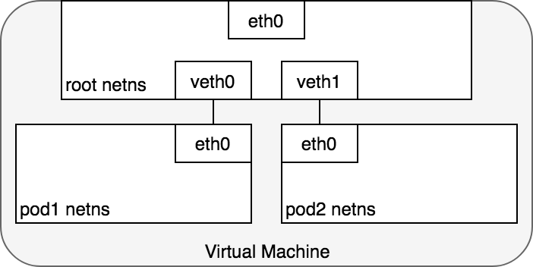
Pod-to-Pod Networking

Slide 110
Pod-to-Pod Networking
At this point, we’ve set up the Pods to each have their one network namespace so that they believe they have their own Ethernet device and IP address, and they are connected to the root namespace for the Node.
Now, we want the Pods to talk to each other through the root namespace, and for this we use a network bridge.

Slide 111
Pod-to-Pod Networking
A Linux Ethernet bridge is a virtual Layer 2 networking device used to unite two or more network segments, working transparently to connect two networks together.
The bridge operates by maintaining a forwarding table between sources and destinations by examining the destination of the data packets that travel through it and deciding whether or not to pass the packets to other network segments connected to the bridge.
The bridging code decides whether to bridge data or to drop it by looking at the MAC-address unique to each Ethernet device in the network.

Slide 112
Pod-to-Pod Networking
Bridges implement the ARP protocol to discover the link-layer MAC address associated with a given IP address.
When a data frame is received at the bridge, the bridge broadcasts the frame out to all connected devices (except the original sender) and the device that responds to the frame is stored in a lookup table.
Future traffic with the same IP address uses the lookup table to discover the correct MAC address to forward the packet to.

Slide 113
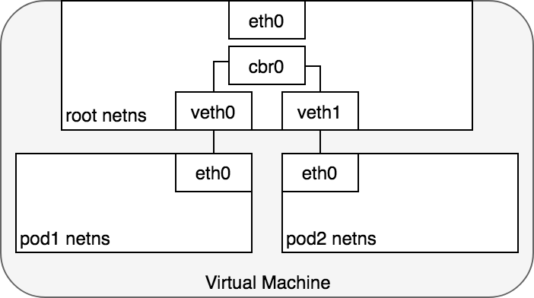
Pod-to-Pod Networking

Slide 114
Life of a Packet

Slide 115
Life of a Packet
Pod 1 sends a packet to its own Ethernet device eth0 which is available as the default device for the Pod.
For Pod 1, eth0 is connected via a virtual Ethernet device to the root namespace, veth0 (1).
The bridge cbr0 is configured with veth0 a network segment attached to it.
Once the packet reaches the bridge, the bridge resolves the correct network segment to send the packet to — veth1 using the ARP protocol (3).

Slide 116
Life of a Packet
When the packet reaches the virtual device veth1, it is forwarded directly to Pod 2’s namespace and the eth0 device within that namespace (4).
Throughout this traffic flow, each Pod is communicating only with eth0 on localhost and the traffic is routed to the correct Pod.
The development experience for using the network is the default behaviour that a developer would expect.

Slide 117
Life of a Packet
Kubernetes’ networking model dictates that Pods must be reachable by their IP address across Nodes.
That is, the IP address of a Pod is always visible to other Pods in the network, and each Pod views its own IP address as the same as how other Pods see it.
We now turn to the problem of routing traffic between Pods on different Nodes.

Slide 118
Life of a packet: Pod-to-Pod, across Nodes

Slide 119
Pod-to-Service Networking
A Kubernetes Service manages the state of a set of Pods, allowing you to track a set of Pod IP addresses that are dynamically changing over time.
Services act as an abstraction over Pods and assign a single virtual IP address to a group of Pod IP addresses.
Any traffic addressed to the virtual IP of the Service will be routed to the set of Pods that are associated with the virtual IP.
This allows the set of Pods associated with a Service to change at any time — clients only need to know the Service’s virtual IP, which does not change.

Slide 120
Pod-to-Service Networking
When creating a new Kubernetes Service, a new virtual IP (also known as a cluster IP) is created on your behalf.
Anywhere within the cluster, traffic addressed to the virtual IP will be load-balanced to the set of backing Pods associated with the Service.
In effect, Kubernetes automatically creates and maintains a distributed in-cluster load balancer that distributes traffic to a Service’s associated healthy Pods.

Slide 121
Pod to Service

Slide 122
Pod to Service
The packet first leaves the Pod through the eth0 interface attached to the Pod’s network namespace (1).
Then it travels through the virtual Ethernet device to the bridge (2).
The ARP protocol running on the bridge does not know about the Service and so it transfers the packet out through the default route — eth0 (3).
Here, something different happens. Before being accepted at eth0, the packet is filtered through iptables.
After receiving the packet, iptables uses the rules installed on the Node by kube-proxy in response to Service or Pod events to rewrite the destination of the packet from the Service IP to a specific Pod IP (4).

Slide 123
Pod to Service
The packet is now destined to reach Pod 4 rather than the Service’s virtual IP.
The Linux kernel’s conntrack utility is leveraged by iptables to remember the Pod choice that was made so future traffic is routed to the same Pod (barring any scaling events).
In essence, iptables has done in-cluster load balancing directly on the Node. Traffic then flows to the Pod using the Pod-to-Pod routing we’ve already examined (5).

Slide 124
Service to POD

Slide 125
Using DNS
Kubernetes can optionally use DNS to avoid having to hard-code a Service’s cluster IP address into your application.
Kubernetes DNS runs as a regular Kubernetes Service that is scheduled on the cluster.
It configures the kubelets running on each Node so that containers use the DNS Service’s IP to resolve DNS names.
Every Service defined in the cluster (including the DNS server itself) is assigned a DNS name.
DNS records resolve DNS names to the cluster IP of the Service or the IP of a POD, depending on your needs.
SRV records are used to specify particular named ports for running Services.

Slide 126
Using DNS
A DNS Pod consists of three separate containers:
kubedns: watches the Kubernetes master for changes in Services and Endpoints, and maintains in-memory lookup structures to serve DNS requests.
dnsmasq: adds DNS caching to improve performance.
sidecar: provides a single health check endpoint to perform healthchecks for dnsmasq and kubedns.

Slide 127
Ingress — Routing Internet traffic to Kubernetes
Ingress — getting traffic into your cluster — is a problem to solve.
Again, this is specific to the network you are running, but in general, Ingress is divided into two solutions that work on different parts of the network stack:
(1) a Service LoadBalancer and
(2) an Ingress controller.

Slide 128
Layer 4 Ingress: LoadBalancer
When you create a Kubernetes Service you can optionally specify a LoadBalancer to go with it.
The implementation of the LoadBalancer is provided by a cloud controller that knows how to create a load balancer for your service.
Once your Service is created, it will advertise the IP address for the load balancer.
As an end user, you can start directing traffic to the load balancer to begin communicating with your Service

Slide 130
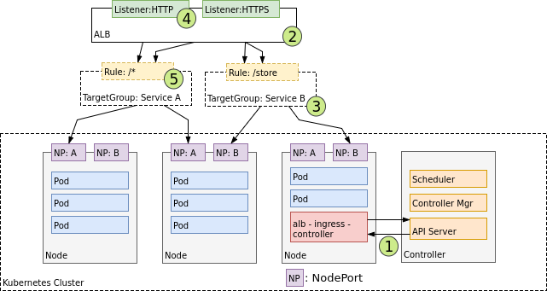
Ingress Controller

Slide 131
Docker Security
Docker container security is more complicated, largely because a typical Docker environment has many more moving parts. Those parts include:
Your containers. You probably have multiple Docker container images, each hosting individual microservices. You probably also have multiple instances of each image running at a given time. Each of those images and instances needs to be secured and monitored separately.
The Docker daemon, which needs to be secured to keep the containers it hosts safe.
The host server, which could be bare metal or a virtual machine.
If you host your containers in the cloud using a service like ECS, that is another layer to secure.
Overlay networks and APIs that facilitate communication between containers.
Data volumes or other storage systems that exist externally from your containers

Slide 132

Docker Security

Slide 133
Docker Security
Whether image comes from an official one, such as NGINX, Redis, Ubuntu, or Alpine Linux; or one from a total stranger.
USE PRIVATE OR TRUSTED REPOSITORIES
In Docker Hub, the images are always scanned and reviewed by Docker’s Security Scanning Service.
Docker Cloud and Docker Hub can scan images in private repositories to verify that they are free from known security vulnerabilities or exposures, and report the results of the scan for each image tag.

Slide 134
Docker Security
USE DOCKER CONTENT TRUST
Before a publisher pushes an image to a remote registry, Docker Engine signs the image locally with the publisher’s private key.
When you later pull this image, Docker Engine uses the publisher’s public key to verify that the image you are about to run is exactly what the publisher created, has not been tampered with and is up to date.

Slide 135
Docker Security
Docker Bench Security
The tool was based on the recommendations in the CIS Docker 1.13 Benchmark, and run checks against the following six areas:
Host configuration
Docker daemon configuration
Docker daemon configuration files
Container images and build files
Container runtime
Docker security operations

Slide 136
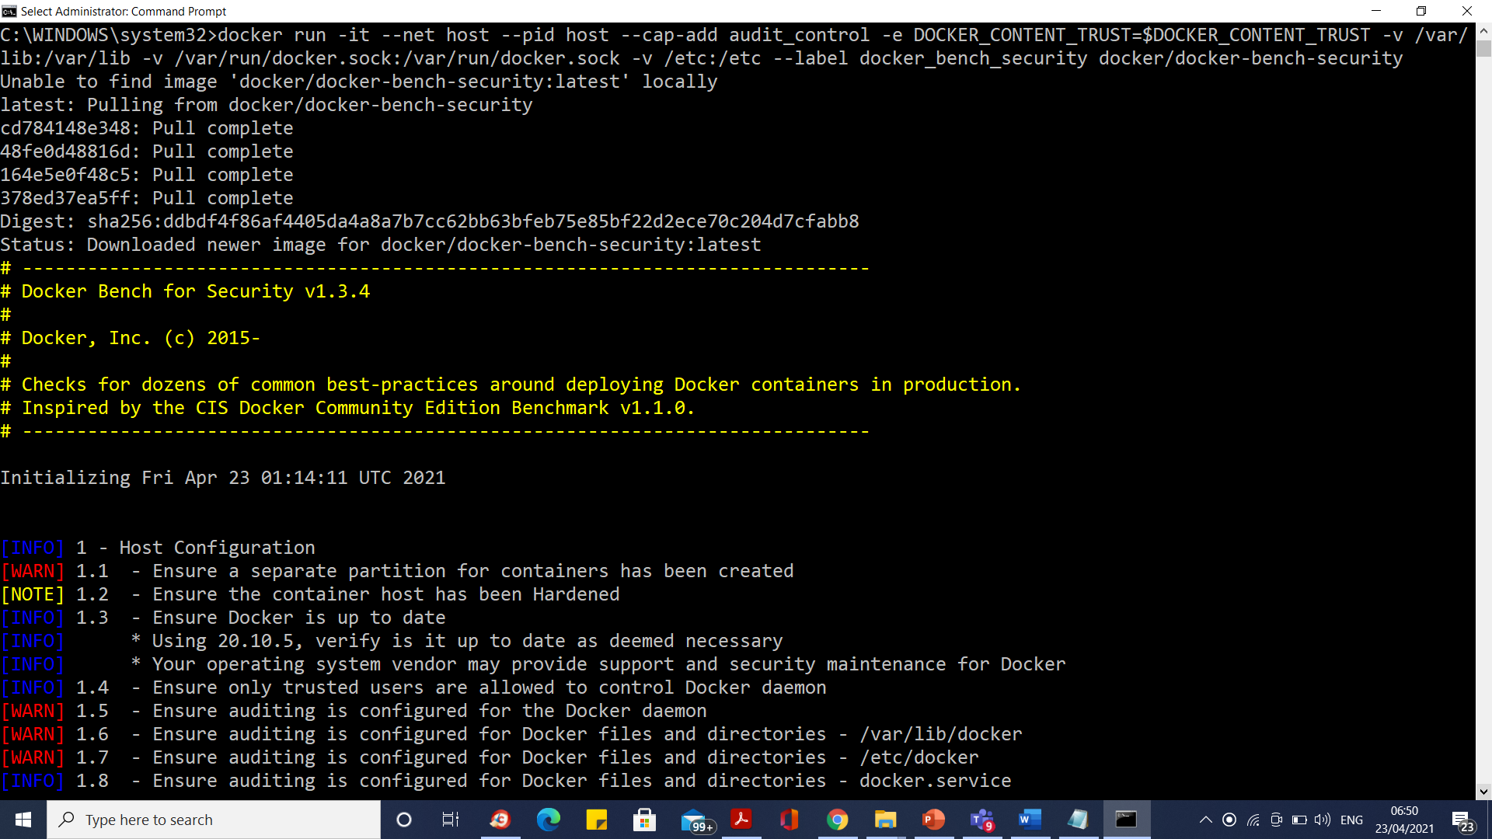
Docker Security

Slide 137
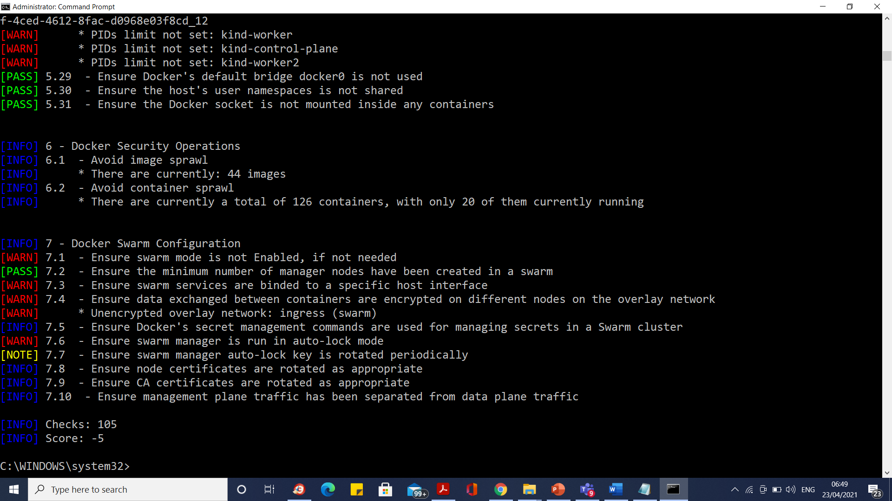
Docker Security

Slide 138
Docker Security
With respect to Docker focus on two points:
Containers running in privileged mode
Excess privileges used by containers
Starting with the first point, you can run a Docker container with the --privileged switch.
What this does is give extended privileges to this container.
It gives all capabilities to the container, and it also lifts all the limitations enforced by the device cgroup controller.
In other words, the container can then do almost everything that the host can do.
This flag exists to allow special use-cases, like running Docker within Docker.

Slide 139
Docker Security
DROP UNNECESSARY PRIVILEGES AND CAPABILITIES.
Consider these questions:
What kind of network connectivity does your application need?
Does it need raw socket access?
Does it need to send and receive UDP requests? If not, then deny it those capabilities.
If not, then deny it those capabilities.
To do so, make use of the --cap-drop and --cap-add switches.

Slide 140
Docker Security
docker run \
--cap-drop SETPCAP \
--cap-drop NET_BIND_SERVICE \
--cap-add SYS_MODULE \
-ti /bin/sh

Slide 141
Docker Security
System Security
While Docker is increasingly very safe by default, thanks to having namespaces and cgroups as its foundation, you don’t need to only rely on these features.
You can go further and make use of other Linux security options, such as AppArmor, SELinux, grsecurity and Seccomp.

Slide 142
Docker Security
App Armor is a Linux kernel security module that allows the system administrator to restrict programs’ capabilities with per-program profiles.
Profiles can allow capabilities like network access, raw socket access, and the permission to read, write, or execute files on matching paths.

Slide 143
Docker Security
Limit Available Resource Consumption
What does your application need?
Is it a quite light application, requiring no more than
50MB of memory?
Then why let it access more?
Does it perform more intensive processing, requiring 4+ CPUs?
Then allow it to have access to that.

Slide 144
Docker Security
Assuming that analysis, profiling, and benchmarking are part of your continuous development processes, then this information will be readily available.
As a result, when deploying your containers, ensure that they only have the resources that they need.

Slide 145
Docker Security
To do so, use the applicable docker run switches, such as the following:
-m / --memory: Set a memory limit --memory-reservation: Set a soft memory limit
--kernel-memory: Set a kernel memory limit
--cpus: Limit the number of CPUs
--device-read-bps: Limit the read rate from a device

Slide 146
Docker Security
Large Attack Surfaces
As Docker allows you to create and deploy applications so quickly — as well as to destroy them with equal ease — it can be difficult to know exactly what applications your organization has deployed.
Given that, the potential of a large attack surface grows. Not sure about the deployment statistics of your organization?
To help you out, ask yourself the following questions:
What applications are currently deployed by your organization?
Who deployed them?

Slide 147
Docker Security
When were they deployed?
Why were they deployed?
How long are they to be deployed for?
Who’s responsible for them?
When was a security scan last run on them?

Slide 148
Docker Security
IMPLEMENT AN AUDIT TRAIL WITH PROPER LOGGING
As with audit trails within applications, such as when a user created their account when it was activated, and when the user last updated their password, and those more widely within organizations, consider implementing an audit trail around every container that your organization creates and deploys.

Slide 149
Configuring Certificate-Based Mutual Authentication with Kubernetes Ingress-Nginx
Mutual Authentication
Mutual authentication is also known as 2-way authentication. It is a process in which both the client and server verify each others identity via a Certificate Authority.
Mutual SSL authentication or certificate based mutual authentication refers to two parties authenticating each other through verifying the provided digital certificate so that both parties are assured of the others’ identity.

Slide 150
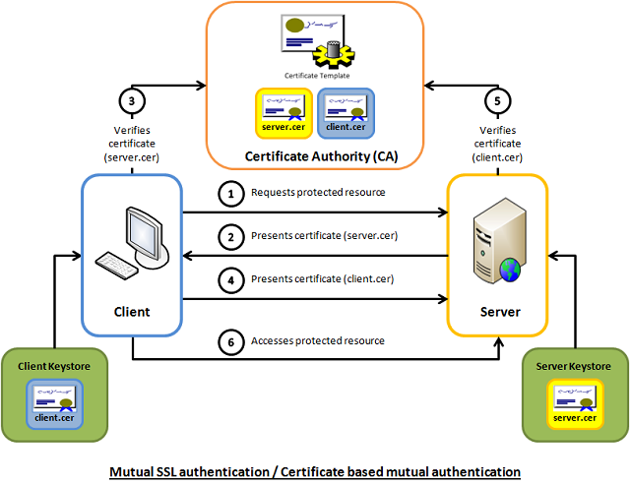
Configuring Certificate-Based Mutual Authentication with Kubernetes Ingress-Nginx

Slide 151
Setting Up Mutual Authentication
Creating the Certificates
CommonName(CN): Identifies the hostname or owner associated with the certificate.
Certificate Authority(CA): A trusted 3rd party that issues Certificates. Usually you would obtain this from a trusted source, but for this example we will just create one. The CN is usually the name of the issuer.
Server Certificate: A Certificate used to identify the server. The CN here is the hostname of the server. The Server Certificate is valid only if it is installed on a server where the hostname matches the CN.
Client Certificate: A Certificate used to identify a client/user. The CN here is usually the name of the client/user.

Slide 152
Setting Up Mutual Authentication
Generate the CA Key and Certificate
$ openssl req -x509 -sha256 -newkey rsa:4096 -keyout ca.key -out ca.crt -days 356 -nodes -subj '/CN=Fern Cert Authority'
# Generate the Server Key, and Certificate and Sign with the CA Certificate
$ openssl req -new -newkey rsa:4096 -keyout server.key -out server.csr -nodes -subj '/CN=meow.com'
$ openssl x509 -req -sha256 -days 365 -in server.csr -CA ca.crt -CAkey ca.key -set_serial 01 -out server.crt
# Generate the Client Key, and Certificate and Sign with the CA Certificate
$ openssl req -new -newkey rsa:4096 -keyout client.key -out client.csr -nodes -subj '/CN=Fern'
$ openssl x509 -req -sha256 -days 365 -in client.csr -CA ca.crt -CAkey ca.key -set_serial 02 -out client.crt

Slide 153
Setting Up Mutual Authentication
Creating the Kubernetes Secrets
$ kubectl create secret generic my-certs --from-file=tls.crt=server.crt --from-file=tls.key=server.key --from-file=ca.crt=ca.crt
$ kubectl get secret my-certs
NAME TYPE DATA AGE
my-certs Opaque 3 1m

Slide 154
Deploying an Application with Mutual Authentication
Refer docker commands.txt

Slide 155
TLS and mutual authentication
https://kubernetes.io/docs/tasks/tls/managing-tls-in-a-cluster/

Slide 156
Create Secret
https://kubernetes.io/docs/tasks/administer-cluster/encrypt-data/

Slide 157
Overview of RBAC concepts in Kubernetes
The RBAC model in Kubernetes is based on three elements:
Roles: definition of the permissions for each Kubernetes resource type
Subjects: users (human or machine users) or groups of users
RoleBindings: definition of what Subjects have which Roles

Slide 158
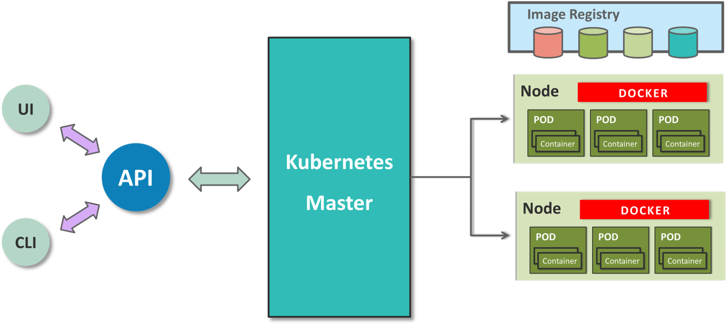
Pod has group of containers that are run on the same host. So, if we regularly deploy single containers, then our container and the pod will be one and the same.

Slide 159
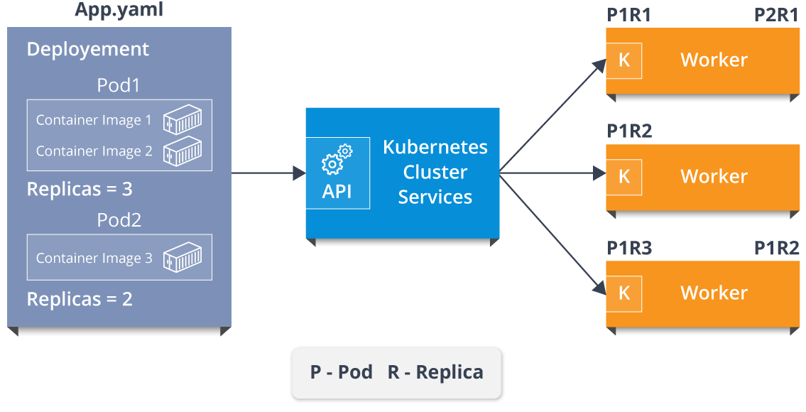
Representation Of Kubernetes Cluster

Slide 160
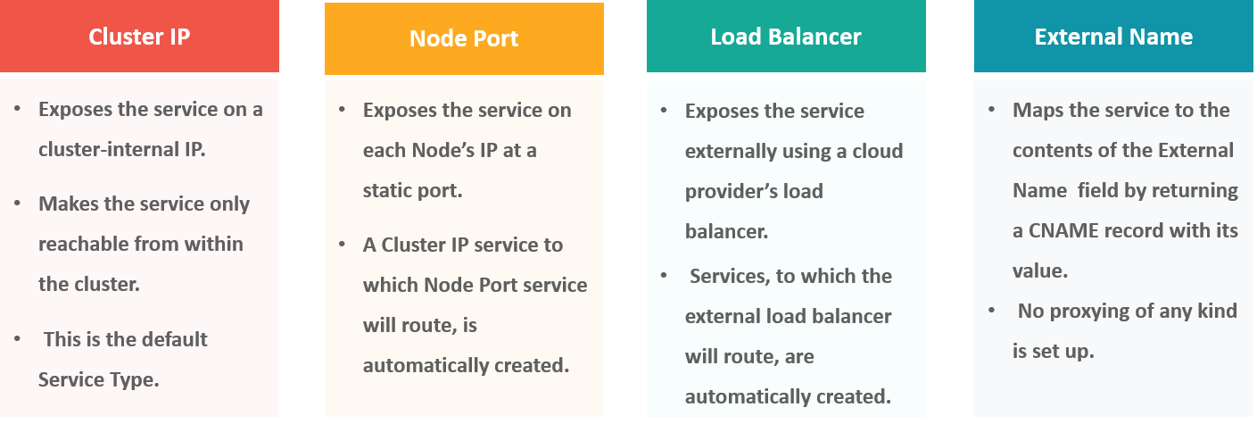
Different types of services in Kubernetes

Slide 161
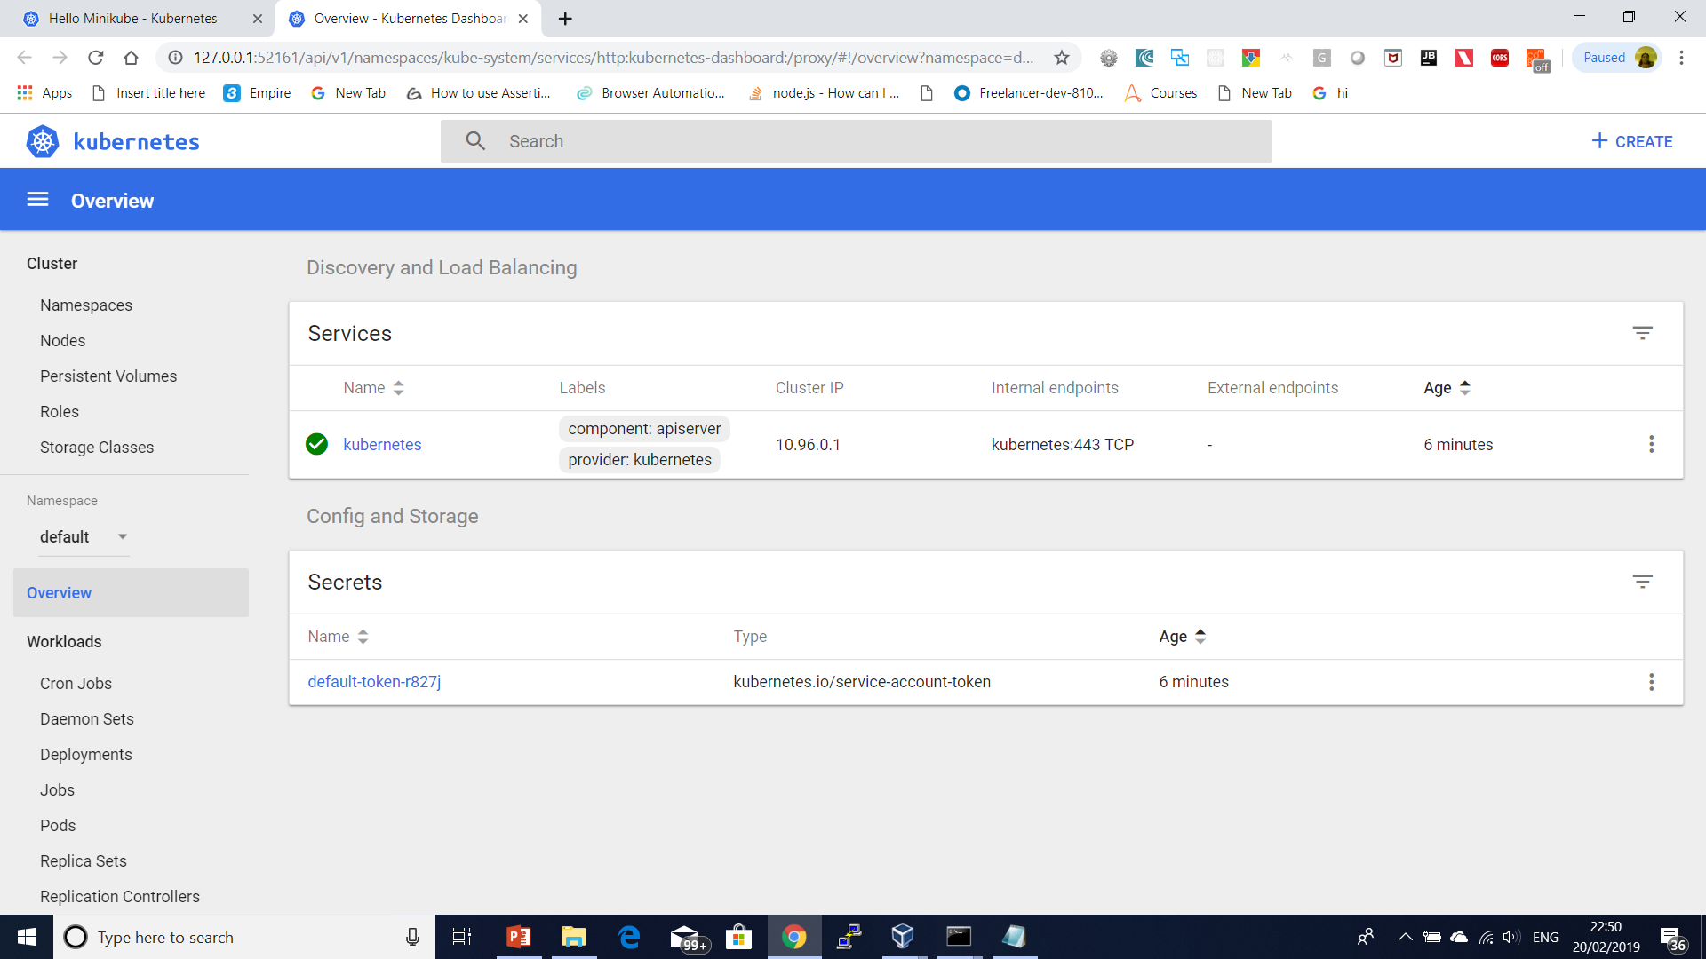
Minikube –p cluster1 dashboard

Slide 162
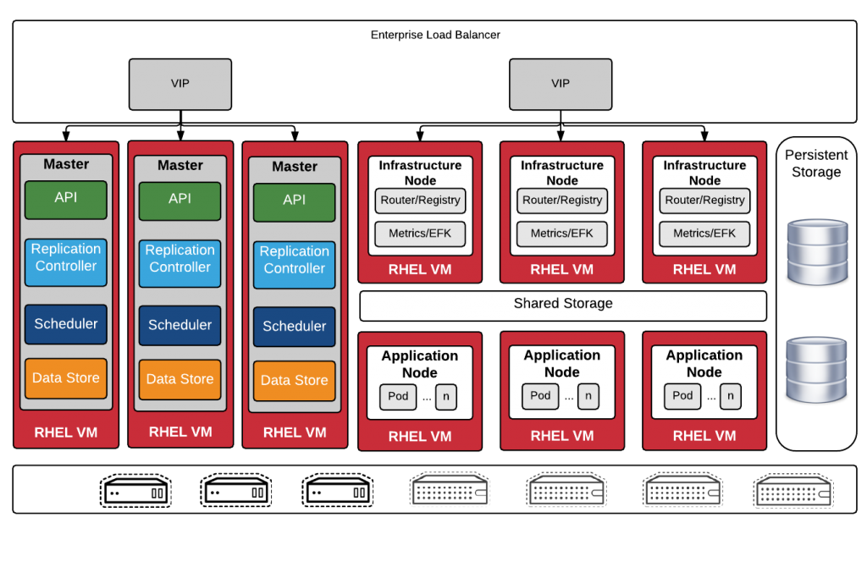
Openshift
Openshift is built on top of kubernetes. Openshift project is maintained by Redhat. It has both open source (openshift orgin) and enterprise version (openshift container platform).
Along with core Kubernetes features, it offers out of the box components for container management and orchestration.

Slide 163
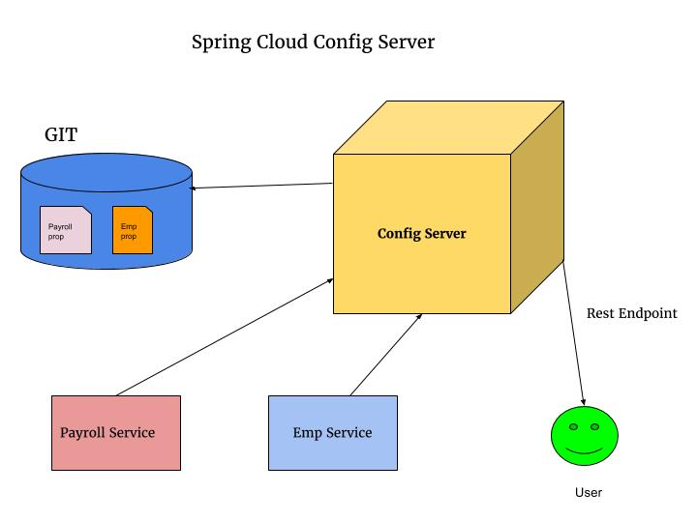
Spring Cloud Config Server with git

Slide 164
AWS Lambda Serverless Environment
What is AWS Lambda?
Amazon explains, AWS Lambda (λ) as a ‘serverless’ compute service, meaning the developers, don’t have to worry about which AWS resources to launch, or how will they manage them, they just put the code on lambda and it runs, it’s that simple! It helps you to focus on core-competency i.e. App Building or the code.

Slide 165
AWS Lambda Serverless Environment
Where will I use AWS Lambda?
AWS Lambda executes your backend code, by automatically managing the AWS resources. When we say ‘manage’, it includes launching or terminating instances, health checkups, auto scaling, updating or patching new updates etc.

Slide 166
AWS Lambda Serverless Environment
So, how does it work?
The code that you want Lambda to run is known as a Lambda function. Now, as we know a function runs only when it is called, right? Here, Event Source is the entity which triggers a Lambda Function, and then the task is executed.

Slide 167
AWS Lambda Serverless Environment
Let’s take an example to understand it more clearly.
Suppose you have an app for image uploading. Now when you upload an image, there are a lot of tasks involved before storing it, such as resizing, applying filters, compression etc.
So, this task of uploading of an image can be defined as an Event Source or the ‘trigger’ that will call the Lambda Function, and then all these tasks can be executed via the Lambda function.

Slide 168
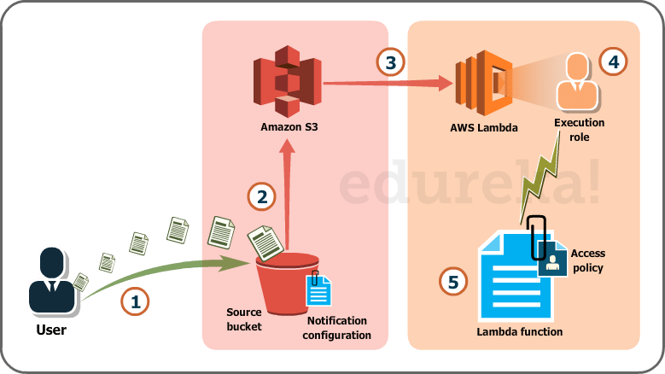

Slide 169
AWS Lambda Serverless Environment
The whole process, as you can see in the diagram, is divided into 5 steps, let’s understand each one of them.
User uploads an image (object) to a source bucket in S3 which has notification attached to it, for Lambda.
The notification is read by S3 and it decides where to send that notification.
S3 sends the notification to Lambda, this notification acts as an invoke call of the lambda function.
Execution role in Lambda can be defined by using IAM (Identity and Access Management) to give access permission for the AWS resources, for this example here it would be S3.
Finally, it invokes the desired lambda function which works on the object which has been uploaded to the S3 bucket.

Slide 170
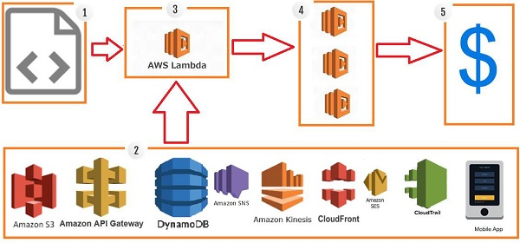
How AWS Lambda Works?

Slide 171
AWS Lambda Steps
Step 1 − Upload AWS lambda code in any of languages AWS lambda supports, that is NodeJS, Java, Python, C# and Go.
Step 2 − These are few AWS services on which AWS lambda can be triggered.
Step 3 − AWS Lambda which has the upload code and the event details on which the trigger has occurred. For example, event from Amazon S3, Amazon API Gateway, Dynamo dB, Amazon SNS, Amazon Kinesis, CloudFront, Amazon SES, CloudTrail, mobile app etc.

Slide 172
AWS Lambda Steps
Step 4 − Executes AWS Lambda Code only when triggered by AWS services under the scenarios such as −
User uploads files in S3 bucket
http get/post endpoint URL is hit
data is added/updated/deleted in dynamo dB tables
push notification
data streams collection
hosting of website
email sending
mobile app, etc.
Step 5 − Remember that AWS charges only when the AWS lambda code executes, and not otherwise.

Slide 173
Advantages of using AWS Lambda
Ease of working with code(Infrastructure Burden Free)
Log Provision
Billing based on Usage
Multi Language Support
Ease of code authoring and deploying

Slide 174
Disadvantages of using AWS Lambda
It is not suitable for small projects.
You need to carefully analyze your code and decide the memory and timeout. Incase if your function needs more time than what is allocated, it will get terminated as per the timeout specified on it and the code will not be fully executed.
Since AWS Lambda relies completely on AWS for the infrastructure, you cannot install anything additional software if your code demands it.

Slide 175
Events that Trigger AWS Lambda
Entry into a S3 object
Insertion, updation and deletion of data in Dynamo DB table
Push notifications from SNS
GET/POST calls to API Gateway
Headers modification at viewer or origin request/response in CloudFront
Log entries in AWS Kinesis data stream
Log history in CloudTrail

Slide 176
Use Cases of AWS Lambda
S3 Object and AWS Lambda
Amazon S3 passes the event details to AWS Lambda when there is any file upload in S3. The details of the file upload or deletion of file or moving of file is passed to the AWS Lambda.
The code in AWS Lambda can take the necessary step for when it receives the event details. For Example creating thumbnail of the image inserted into S3.

Slide 177
Use Cases of AWS Lambda
DynamoDB and AWS Lambda
DynamoDB can trigger AWS Lambda when there is data added, updated and deleted in the table. AWS Lambda event has all the details of the AWS DynamoDB table about the insert /update or delete.
API Gateway and AWS Lambda
API Gateway can trigger AWS Lambda on GET/POST methods. We can create a form and share details with API Gateway endpoint and use it with AWS Lambda for further processing, for Example, making an entry of the data in DynamoDB table.

Slide 178
Use Cases of AWS Lambda
SNS and AWS Lambda
SNS is used for push notification, sending SMS etc. We can trigger AWS lambda when there is any push notification happening in SNS. We can also send SMS to the phone number from AWS Lambda when it receives the trigger.

Slide 179
Use Cases of AWS Lambda
Scheduled Events and AWS Lambda
Scheduled Events can be used for cron jobs. It can trigger AWS Lambda to carry out the task at regular time pattern.
CloudTrail and AWS Lambda
CloudTrail can be helpful in monitoring the logs on the account. We can use AWS Lambda to further process the CloudTrail logs .

Slide 180
Use Cases of AWS Lambda
Kinesis and AWS Lambda
Kinesis is used to capture/store real time tracking data coming from website clicks, logs, social media feeds and a trigger to AWS Lambda can do additional processing on this logs.

Slide 181
Zipkin server
Download from
download the latest Zipkin server from maven repository and run the executable jar file using below command.
java -jar zipkin-server-2.12.1-exec.jar
Once Zipkin is started, we can see the Web UI at http://localhost:9411/zipkin/

Slide 182
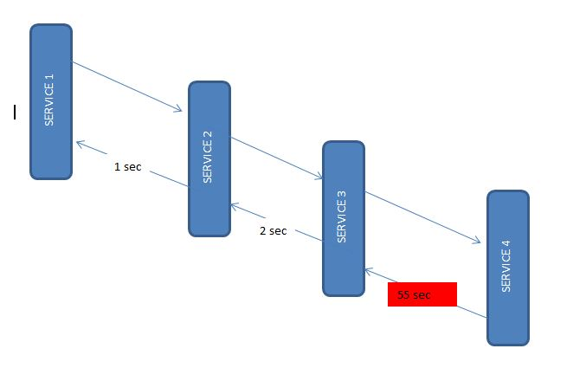
Microservices Interactions

Slide 183
Micrometer Prometheus
Micrometer provides a simple facade over the instrumentation clients for the most popular monitoring systems, allowing you to instrument your JVM-based application code without vendor lock-in.
Micrometer is an open-source project and provides a metric facade that exposes metric data in a vendor-neutral format that a monitoring system can understand.

Slide 184
Micrometer Prometheus
These monitoring systems are supported:
AppOptics
Azure Monitor
Netflix Atlas
CloudWatch
Datadog
Dynatrace
Elastic
Ganglia
Graphite
Humio
Influx/Telegraf
JMX
KairosDB
New Relic
Prometheus
SignalFx
Google Stackdriver
StatsD
Wavefront

Slide 185
Micrometer Prometheus
Micrometer is not part of the Spring ecosystem and needs to be added as a dependency.
In our demo application, this was already done in the Spring Initializr configuration.
Prometheus metrics in application.properties:
management.endpoints.web.exposure.include=
prometheus,health,info,metric

Slide 186
Prometheus and grafana
prometheus.exe --config.file="prometheus.yml" --web.listen-address=:9092
Refer project
D:\git\ericmay2021repo\productdockerapi

Slide 187
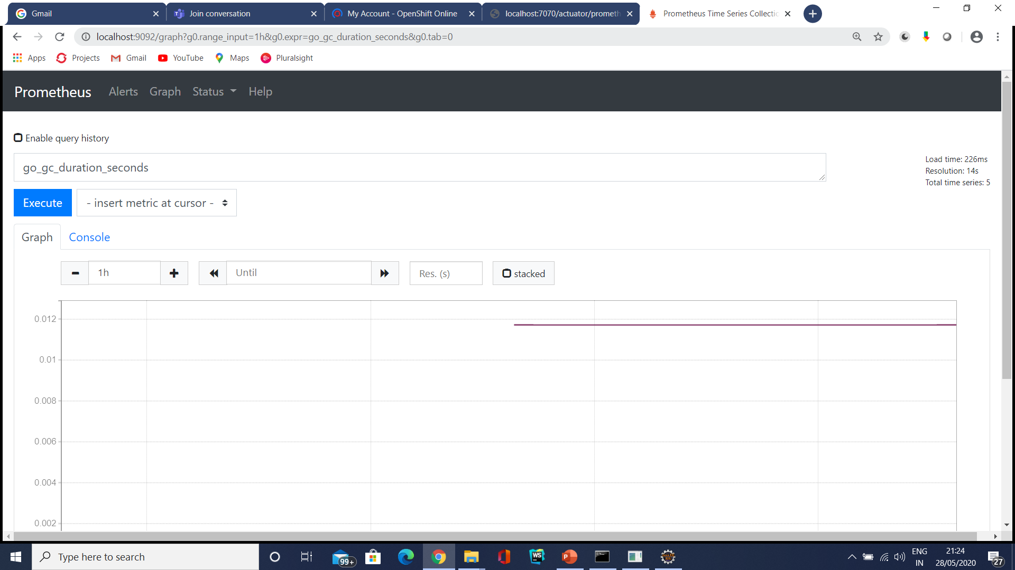
Prometheus

Slide 188
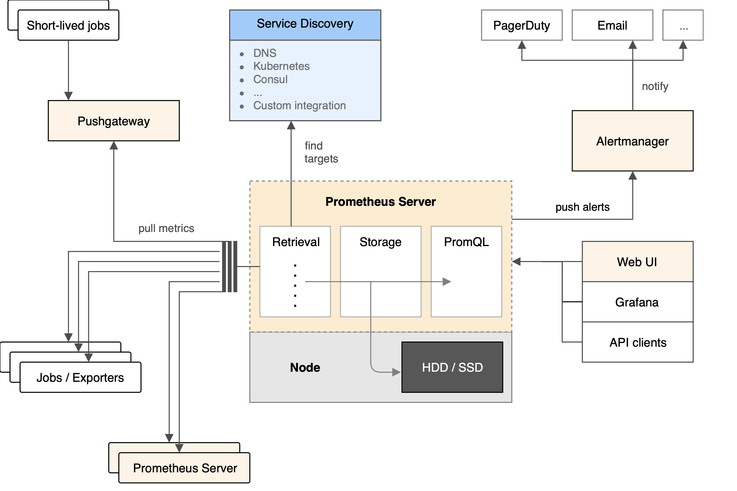
Prometheus

Slide 189
Custom Metrics
We can also define some custom metrics.
The demo contains a Scheduler class which periodically runs the included schedulingTask method.
To be able to send custom metrics we need to import MeterRegistry from the Micrometer library and inject it into our class.

Slide 190
Custom Metrics
It is possible to instantiate these types of meters from MeterRegistry:
Counter: reports merely a count over a specified property of an application
Gauge: shows the current value of a meter
Timers: measures latencies or frequency of events
DistributionSummary: provides distribution of events and a simple summary
Refer implementation of a counter and a gauge for demonstration purposes

Slide 191
Grafana

Slide 192

Spring Data Flow

Slide 193
Spring Data Flow
Spring Cloud Data Flow is a toolkit to build real-time data integration and data processing pipelines by establishing message flows between Spring Boot applications that could be deployed on top of different runtimes.
Long lived applications require Stream Applications while Short lived applications require Task Applications.
In this example we make use of Stream Applications. Previously we had already developed Spring Cloud Stream applications to understand the concept of Spring Cloud Stream Source and Spring Cloud Sink and their benefit.

Slide 194
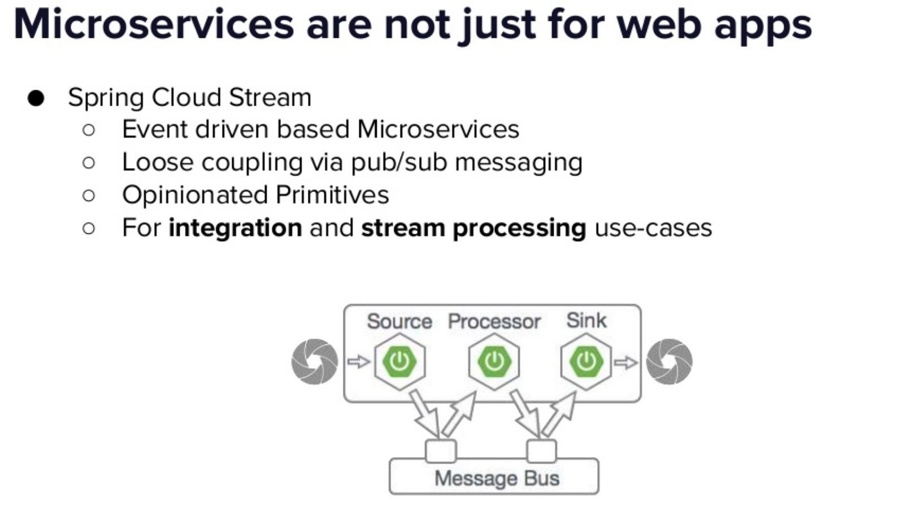

Slide 195
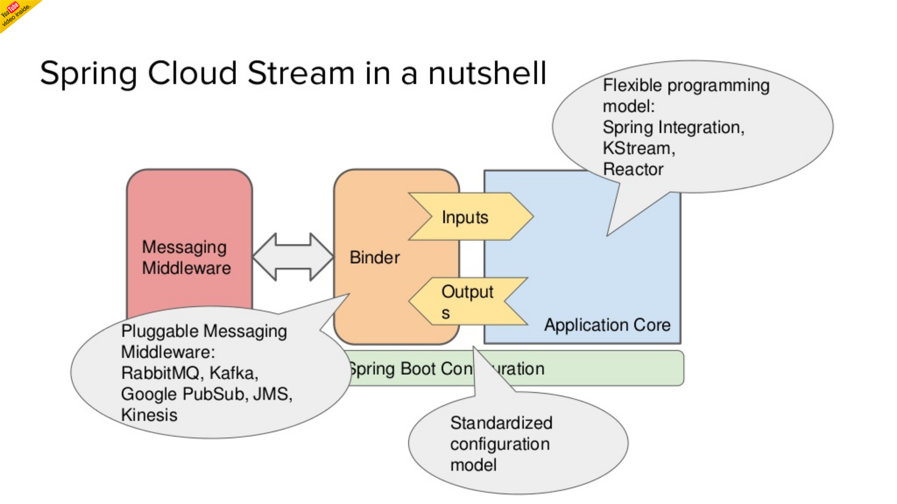

Slide 196
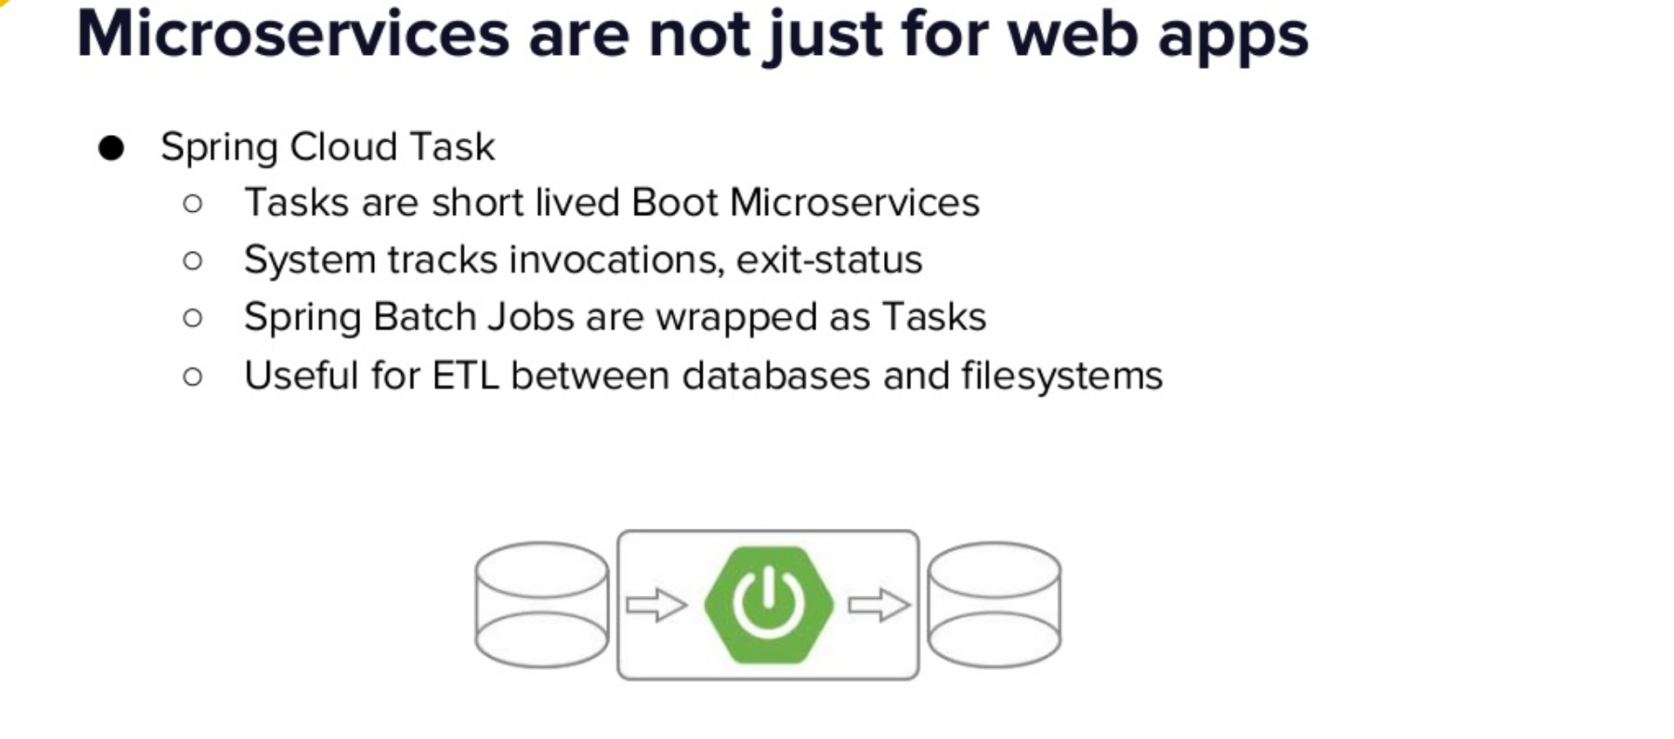

Slide 197
Spring Data Flow
1) Applications:
Applications will be of two types.
A. Short lived applications:
this type of applications can be run for short amount of time and then it will terminate. Example: Spring Cloud Task, it will for whenever we try to execute the task it will launched and then it terminate after the task, same for batch applications.

Slide 198
Spring Data Flow
1) Applications:
B. Long lived applications:
this type of applications will be run for unbounded amount of time, majorly these applications are message based applications.
Example:
Spring Cloud Stream, this type of applications will consume messages and produce messages to data flow server configured message broker.

Slide 199
Spring Data Flow
2) Application packaging:
the target run time will be of two types.
A. Spring boot jar file:
we can specify either spring boot jar or any http URL pointing to spring boot jar file or maven artifact.
B. Docker Image:
we can also specify the docker image url for micro service applications.

Slide 200
Spring Data Flow
3) Runtime:
the target system run time where our applications will be executed. The list of supported run times are:
Cloud Foundry Apache YARN Kubernetes Apache Mesos Local Server for development.

Slide 201
Spring Data Flow
Microservice based Streaming and Batch data processing for Cloud Foundry and Kubernetes.
Spring Cloud Data Flow provides tools to create complex topologies for streaming and batch data pipelines.
The data pipelines consist of Spring Boot apps, built using the Spring Cloud Stream or Spring Cloud Task microservice frameworks.
Spring Cloud Data Flow supports a range of data processing use cases, from ETL to import/export, event streaming, and predictive analytics.

Slide 202
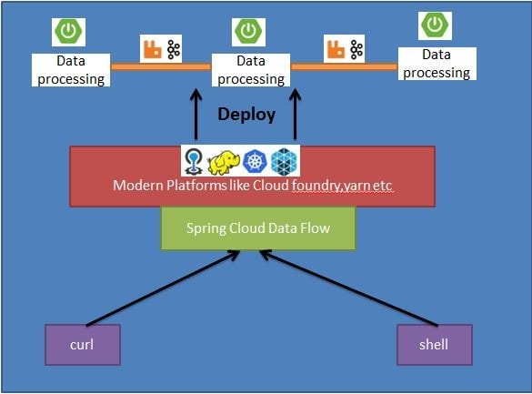
Spring Data Flow

Slide 203
Source | Processor | Sink
file | aggregator | aggregate-counter
ftp | bridge | cassandra
gemfire | filter | counter
gemfire-cq | groovy-filter | field-value-counter
http | groovy-transform | file
jdbc | header-enricher | ftp
jms | httpclient | gemfire
load-generator | pmml | gpfdist
loggregator | python-http | hdfs
mail | python-jython | hdfs-dataset
mongodb | scriptable-transform | jdbc
Mqtt | splitter | log

Slide 204
Rabbit | tasklaunchrequest-transform | mongodb
S3 | tcp-client | mqtt
sftp | tensorflow | pgcopy
syslog | transform | rabbit
tcp | twitter-sentiment | redis-pubsub
tcp-client |  | router
time |  | s3
trigger |  | sftp
triggertask |  | task-launcher-cloudfoundry
twitterstream |  | task-launcher-local
 |  | task-launcher-yarn
 |  | tcp
 |  | throughput
 |  | websocket

Slide 205
Spring Data Flow
The Spring Cloud Data Flow server uses Spring Cloud Deployer, to deploy data pipelines made of Spring Cloud Stream or Spring Cloud Task applications onto modern platforms such as Cloud Foundry and Kubernetes.
Custom stream and task applications, targeting different middleware or data services, can be built using the familiar Spring Boot style programming model.

Slide 206
Spring Data Flow
Pipelines consist of Spring Boot apps, built using the Spring Cloud Stream or Spring Cloud Task microservice frameworks.
SCDF can be accessed using the REST API exposed by it or the web UI console.
We can make use of metrics, health checks, and the remote management of each microservice application .
Also we can scale stream and batch pipelines without interrupting data flows.
With SCDF we build data pipelines for use cases like data ingestion, real-time analytics, and data import and export.

Slide 207

Spring Data Flow
SCDF is composed of the following Spring Projects-

Slide 208
Spring Data Flow
java -jar spring-cloud-dataflow-server-local-1.3.0.M1.jar
java -jar spring-cloud-dataflow-shell-1.3.0.M1.jar

Slide 209
Spring data flow
app register --name myprocessor --type processor --uri file:///F:/virtusa_microservices_oct2019/source-0.0.1-SNAPSHOT.jar

Slide 210


Slide 211


Slide 212


Slide 213


Slide 214
stream create --name log-data --definition 'source-app | processor-app| sink-app‘
stream deploy --name log-data
Go to Spring Cloud Data Flow UI Console - http://localhost:9393/dashboard

Slide 215
Splunk
Splunk is a one-stop solution as it automatically pulls data from various sources and accepts data in any format such as .csv, json, config files, etc.
Splunk is the easiest tool to install and allows functionality like: searching, analyzing, reporting as well as visualizing machine data.
It has a huge market in the IT infrastructure and business.
Many big players in the industry are using Splunk such as Dominos, Adobe, Bosch, Vodafone, Coca-Cola etc.

Slide 216

Splunk

Slide 217
Splunk
Splunk collects data in real-time from multiple systems.
It accepts data in any form, example- log file, .csv, json, config etc.
Splunk can pull data from database, cloud and any other OS
It analyze and visualize the data for better performance.
Splunk give alerts/ event notifications.
Provides real-time visibility.
It satisfies industry needs like horizontal scalability (using many systems in parallel)

Slide 218

Splunk Architecture

Slide 219
Splunk Architecture
Splunk CLI/ splunk web interface or any other interface interacts with the search head.
This communication happens via Rest API.
It can be used to search head to make distributed searches, setup knowledge objects for operational intelligence, perform scheduling/ alerting and create reports or dashboards for visualization.
It can also be used to run scripts for automating data forwarding from remote Splunk forwarders to pre-defined network ports.
After that you can monitor the files that are coming at real time and analyze if there are any anomalies and set alert/ reminders accordingly.
It can be used to perform routing, cloning and load balancing of the data that is coming in from the forwarder, before they are stored in an indexer.
It can also be used to create multiple users to perform various operations on the indexed data.

Slide 220

Splunk Users

Slide 221

Splunk vs Other Tools

Slide 222

Case: Domino’s

Slide 223

Case: Domino’s

Slide 224

Splunk Components

Slide 225


Slide 226


Slide 227


Slide 228


Slide 229

Indexer for Data Storage and Processing

