Slide 1
Threads

Slide 2
What is a thread?
Sun defines a thread as a single sequential flow of control within a program.
A threads is a sequence of lines of code that execute within a process.
It is sometimes referred to as an execution context or a lightweight process.
Thread based multitasking environments allow a single program to perform two or more tasks simultaneously.
The thread in java is a realization of OS level thread. In other words, the thread in java is created using native methods which in turn create threads based on the OS.

Slide 3
Test your knowledge
Can you distinguish between a Thread and a Process at OS level?

Slide 4
Uses of threads in application
In client-server based systems, the server program creates threads that allows it to respond to multiple users at the same time.
GUI programs have a separate thread to gather user’s interface events from the host OS.
Do other things while waiting for slow I/O operations.
Animations

Slide 5
java.lang.Thread class
So far programs that we created used just one thread.
Java SE provides 2 classes for working with thread called Thread and ThreadGroup.
When a Java Virtual Machine starts up, that is when an application starts to execute, there is usually a single thread called main.
The main threads continues to execute until
  exit() method is called
  all threads (non-daemon threads) have died
A deamon thread is a special type of thread that runs in background. When JVM exits, only remaining thread which will be running are daemon threads. By default all the threads that are created in java are non-daemon threads. More on this later

Slide 6
Printing main thread
public class ThreadTest{
public static void main(String s[])
{
System.out.println(“Hello”);
System.out.println(
Thread.currentThread().getName());
}
}
Prints : main
currentThread() is a ______ method of _______class.
getName() is _____________ method of _________ class

Slide 7
Thread class constructors
There are two ways to create threads
  By extending Thread class
    Constructors that will be called in such case could be
      Thread()
      Thread(String name)
  By creating Thread object and passing Runnable instance.
    Constructors that will be called in such case could be
      Thread(Runnable target)
      Thread(Runnable target, String name)

Slide 8
Creating Threads by extending
class SimpleThread extends Thread {
public void run(){
/* code that is executed when
thread executes */
}}
Creating the SimpleThread object
SimpleThread t= new SimpleThread();
t.start(); // Calls run() method of SimpleThread
We override the run() method and put the code that needs to be executed when the thread runs, in the run() method.
To call run method we call start() !

Slide 9
Starting a thread
Since SimpleThread inherits from the Thread class, start() method of the Thread class gets inherited into the SimpleThread class.
The start() method of the Thread class creates OS level thread.
After this it calls the run() method.
Since the run() method is overriden , run() method of the SimpleThread is called.

Slide 10
Starting a thread
JSE
public class Thread{…
public void start(){
// create OS level thread
// calls run();
}
public void run(){…}}
1
class SimpleThread extends Thread{
…
public void run(){}}
SimpleThread t= new SimpleThread();
t.start();

Slide 11
Example : create Thread through inheritance
The code below tests if the given number is prime or non-prime, even or odd.
Thread no. 1 : user created thread that tests for prime or non-prime.
Thread no. 2 : main thread that tests for even or odd.
import java.util.*;
class PrimeOddThread extends Thread {
int num;
public static void main(String str[]){
PrimeOddThread c= new PrimeOddThread ();
Scanner scan= new Scanner(System.in);
int i=scan.nextInt();
c.num=i;
c.start();
if(c.odd())
System.out.println("Odd");
else System.out.println("Even");
}

Slide 12
public void run() {
if( prime())
System.out.println("Prime");
else System.out.println("Non-Prime");
}
public boolean prime(){
for(int i=2;i<num/2;i++){
if(num%i==0) return false;}
return true;}
public boolean odd(){
if(num%2==0) return false;
else return true;
}}
The code is likely to print : Even first and then Prime (if prime and even number like 2 is entered)
But strictly speaking, one can never guarantee whether Even will be printed or Prime first. It is totally up to the OS thread scheduler to choose which thread to execute first.

Slide 13
Test your understanding
What will happen if you call run() method instead of start() method in the previous example?

Slide 14
Problem with the first way – Using Runnable
The way the thread was created (in the previous example) thread requires your class to inherit from Thread class.
This means that this class cannot inherit from any other class.
Another way to program threads is by implementing Runnable interface.
Runnable interface has one method
  public void run()
Second way to create thread is by
  Creating a class that implements Runnable interface- that is overriding the run()
  Creating a Thread class instance and passing Runnable instance. Recall the 2nd set of constructors of Thread

Slide 15
Understanding working with Runnable
class SimpleThreadR implements Runnable{
public void run(){…}
}
//Creation of thread – using a constructor that expects a Runnable object
Thread t= new Thread(new SimpleThreadR() );
t.start(); // calls the run method of SimpleThreadR
Thread class has a member called target which is of type Runnable.
When the Thread constructor as above is invoked, the target member is assigned to the instance that is passed via constructor.
When start() is called on the thread instance OS level thread gets created and then run() of Thread is called.
run() of Thread in turn calls run() of target member.

Slide 16
Callback working behind the scene
class Thread implements Runnable{…
private Runnable target;
public Thread(Runnable target){
this.target=target;
…
}
public void start(){
// create OS level thread
run();
}
public void run(){
if (target != null){target.run(); }}
1
2
3
Runnable
Thread t=new Thread(new SimpleThreadR() );
t.start();}
class SimpleThreadR implements Runnable{…
public void run(){}}

Slide 17
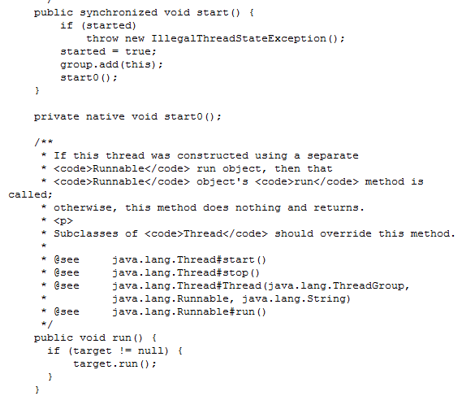
Code snippet of Thread class

Slide 18
Example :create Thread using Runnable
import java.util.*;
class PrimeOddThread implements Runnable {
int num;
public static void main(String str[]){
  PrimeOddThread x=new PrimeOddThread();
  Thread c= new Thread (x );
  Scanner scan= new Scanner(System.in);
  int i=scan.nextInt();
  x.num=i;
  c.start();
  if(x.odd())
  System.out.println("Odd");
  else
  System.out.println("Even");
}

Slide 19
public void run() {
if( prime())
System.out.println("Prime");
else System.out.println("Non-Prime");
}
public boolean prime(){
  for(int i=2;i<num/2;i++){
  if(num%i==0)return false;}
  return true;}
  public boolean odd(){
  if(num%2==0) return false;
  else return true;
}
}

Slide 20
Naming Threads
Every thread is given a name. If you don’t specify a name, a default name will be created.
For example the main thread is named ‘main’.
The default name of a user defined thread is ‘Thread-0’ for the first thread created, ‘Thread-1’ for the second and so on.
To explicitly name the thread
  Use constructor
    Thread(Runnable target, String name) or
    Thread(String name)
  Or instance method
    final void setName(String name)
  What is the method used to get the name? What is the method used to get the current thread?

Slide 21
Lifecycle of a thread
Thread life cycle begins when a new thread instance is created.
Then start() method on thread is called. Calling the start() method does not mean that the thread runs immediately. There may be many threads waiting to run. It is up to Thread scheduler of the OS to decide which thread will run first. We can’t control the scheduler from the java program! So when we have several threads (of same priority), we cannot determine which thread will run when.
Also, just because a series of threads are started in a particular order doesn’t mean they’ll run in that order.
When start() method is called a new thread of execution starts (with a new call stack).The thread moves from the new state to the ready state.
When the thread gets a chance to execute, its run() method will be called.
A thread may be blocked - waiting for a resource (like printer etc). Once the thread gets the resource, it again moves to ready state.

Slide 22
Lifecycle
When a thread completes its run() method, the thread is considered dead.
final boolean isAlive() can be used to check if the thread is alive or dead.
An attempt to start a dead thread throws IllegalThreadStateException
yield()
After run() method completes
new
start()
ready
running
dead
run()
sleep(), wait()
Waiting for IO device
Waiting /
Blocked
Up to the thread scheduler to pick a thread for execution from ready state.

Slide 23
Putting a thread to sleep
sleep() causes the currently executing thread to sleep (temporarily cease execution) for the minimum of specified number of milliseconds.
static void sleep(long millis) throws InterruptedException
static void sleep(long millis, int nanos) throws InterruptedException
Note that sleep() is static method.
InterruptedException is a checked exception. A sleeping thread can be interrupted so that it’s sleep can be broken. This can be done using interrupt()
Coming up!

Slide 24
Example for sleep
public class Appear implements Runnable{
char c[]={‘H',‘E',‘L',‘L‘,’O’};
public void run() {
  int i=0;
  try{
  while (i<5){
  System.out.print(c[i++]);
  /* will sleep for at least a second */
  Thread.sleep(1000);
  }
  }catch(InterruptedException e){}
  }
public static void main(String str[]){
Thread t =new Thread(new Appear());
t.start(); }}
  Can you guess what this code does?

Slide 25
Interruption
A thread can be interrupted while it is sleeping or waiting. This can be done by calling interrupt() on it. In other words, when the thread is calling sleep(), join() or wait() methods, it can be interrupted .
When interrupt() is called, an InterruptedException exception will be thrown..So the catch handler block will be executed. sleep(), join() or wait() methods throw InterruptedException
The interrupt status will be reset before the InterruptedException exception is thrown.
Methods that can be used to test if the current thread has been interrupted
  static boolean interrupted() : interrupted status of the thread is cleared by this method
  boolean isInterrupted(): interrupted status of the thread is unaffected
join() and wait() coming up!

Slide 26
Example : interrupt
The code prints “Have a nice day” every 1 sec until user presses an a key.
When user presses a key, an InterruptedException is thrown and catch handler is called. The break in catch handler makes the thread come out of while loop and hence run() method returns
import java.util.*;
public class Doll extends Thread {
public void run() {
while(true){
try {
System.out.println("Have a nice day");
Thread.sleep(1000);
} catch(InterruptedException e) { break; } }}
public static void main(String args[]) {
Doll d = new Doll();
d.start();
Scanner scan = new Scanner(System.in);
String s=scan.nextLine();
if(s!=null) d.interrupt();
} }

Slide 27
join()
When a thread calls join( ) on another thread instance, the caller thread will wait till the called thread finishes execution.
final void join() throws InterruptedException
join() can also be specified with some timeout , in which case the thread waits at most milliseconds for this thread to die.
If timeout specified as 0 means the thread will wait forever
final void join(long millis) throws InterruptedException
final void join(long millis, int nanos) throws InterruptedException
A thread waiting because of join() can also be interrupted. Hence the method throws a InterruptedException

Slide 28
Example: join()
If we want to guarantee that Prime (or Non-Prime) is printed before Even( or Odd) then the thread printing Even(or Odd), that is main thread, can wait till the prime thread finishes the execution.
class Join implements Runnable{
int num;
public void run() {
if( prime()) System.out.print("Prime");
else System.out.print("Non-Prime"); }
public boolean prime(){
  for(int i=2;i<num/2;i++){
  if(num%i==0)return false;
  }
  return true; }
public boolean odd(){
  if(num%2==0)return false;
  else return true; }

Slide 29
public static void main(String str[]){
  Join s=new Join();
  Thread t= new Thread(s);
  s.num=55;
  t.start();
  try{ t.join();} //main thread waits for t to finish
  catch(InterruptedException e){}
  boolean b=s.odd();
  if(b)
  System.out.print(" and Odd");
  else System.out.print("and Even");
}}

Slide 30
Thread priorities
A thread is always associated with a priority based on the OS
For simplicity Java assigns priority as a number between 1 and 10, inclusive of 10. 10 is the highest priority and 1 is the lowest.
This is the only way to influence the scheduler’s decision as to the thread execution sequence to some extent.
At any given time, the highest-priority thread will be chosen to run. However, this is not guaranteed. The thread scheduler may choose to run a lower-priority thread to avoid starvation.
Threads that were created so far were created with a default priority of 5.
The new threads inherit the priority from the thread that created it.

Slide 31
Methods for thread priorities
Setting and getting priority
  final void setPriority(int newPriority) throws IllegalArgumentException
  final int getPriority()
  Note that setPriority() throws IllegalArgumentException if number passed to the method is not between 1 and 10 (inclusive of 10).
  Also the priority cannot be greater than maximum permitted priority of the thread's thread group (even if the newPriority specifies a number greater than the thread's thread group priority)
static constants to set priorities:
  Thread.MIN_PRIORITY (1)
  Thread.NORM_PRIORITY (5)→ default
  Thread.MAX_PRIORITY (10)

Slide 32
Selfish threads
In non-pre-emptive OS, if a thread that executes with high priority and has long execution time does not voluntarily leave the CPU to give a chance for other threads with similar priority to execute, such a thread is called a selfish thread.
It is recommended that threads with high priority (be unselfish)
They must either call Thread.sleep() or Thread. yield() method.
  static void yield()
yield() method causes the currently executing thread object to temporarily pause and allow other threads to execute.

Slide 33
Why threads synchronization?
Let us say we have an Account class which has withdraw and deposit methods.
For each transaction (deposit or withdraw) a thread is created.
Let us visualize what happens when two people simultaneously withdraw from the same account object .
Let us assume that there is Rs. 1000 in the account
Account
Rs.1000
Thread A calls withdraw(500)
Thread B calls withdraw(750)
Thread A waits for the transaction to complete
Thread B waits for the transaction to complete
Rs.500
Thread A updates the money to (1000-500)=500
Rs.-250
Thread B updates the money to 500-750=-250
Code demonstrating the same…

Slide 34
Code without synchronization
class Account{
  private int money;
  Account(int amt){
  //get amt from database
  money=amt;}
  void withdraw(int amt){
    if(amt<money){
    try{
      /*
      sleep() here is used to simulating time to connect to other systems and performing IO operation
      */
    Thread.sleep(1000);
    money=money-amt;
    }catch(Exception e){}

Slide 35
  System.out.println("Received "+ amt +" by " + Thread.currentThread().getName());
}
  else
  System.out.println("Sorry "+ Thread.currentThread().getName()+ "Requested amt ("+ amt +") is not available.");
  System.out.println("Balance "+ money);
}
}
public class ThreadTest implements Runnable
{
  Account a;
  int amt;

Slide 36
public static void main(String str[]){
Account lb= new Account(1000);
new ThreadTest(lb,"A",500);
new ThreadTest(lb,"B",750);
}
public ThreadTest(Account a,String name,int amt){
this.a=a;
this.amt=amt;
new Thread(this,name).start();
}
public void run(){ a.withdraw(amt);}
}

Slide 37
Result:
Received 500 by A
Balance 500
Received 750 by B
Balance -250

Slide 38
Terms
If two threads access the same object and each calls a method that changes the state of that object then data corruption could result. This is called race condition.
Monitor is a block of code guarded by a mutual-exclusion semaphore (mutex or intrinsic lock or monitor lock ). A thread that wants to enter the monitor must have mutex.
Only one thread can own the mutex at a time. Other threads which wants to enter the critical code must wait till the thread that acquired mutex releases it.
In Java, every object has one and only one monitor and mutex associated with it.

Slide 39

Solution to the Account problem
Thread A acquires mutex for the Account object and calls withdraw(500)
Thread B waits for A to release the mutex
Thread A waits for the transaction to complete
Thread A updates the money to (1000-500)=500 and releases the mutex
Thread B acquires mutex for the object and calls withdraw(750)
Thread B gets the message that it cannot withdraw the requested amount
Thread B releases the mutex
Account
Rs.1000
Rs 500
Account
Rs.500

Slide 40
synchronized
Java implements this concept by using synchronized keyword.
synchronized can be used in 2 ways
  A method can be marked synchronized
  A block of code can be marked synchronized→ synchronized statements
A thread enters a synchronized code only if no other thread is executing any other a synchronized code on that object. Therefore, two invocations of synchronized methods on the same object cannot interleave.
Once a thread enters a synchronized code, it acquires a mutex. It is released only when the thread leaves the synchronized code.

Slide 41
Correcting code using synchronized
If an object is visible to more than one thread, all reads or writes to that object's non final attributes should be done through synchronized methods.
Approach 1: Add synchronized keyword to withdraw and other critical methods of the Account object.
synchronized void withdraw(int amt)
Approach 2: Use synchronized statements by explicitly locking the object before calling critical methods of the Account object.
  public void run(){
  synchronized(a) {
  a.withdraw(amt); }
  }

Slide 42
Tell me how?
How does static synchronized method work?
When they are invoked, since a static method is associated with a class, the thread acquires the monitor lock for the Class object associated with the class.
Thus access to class's static fields is controlled by this lock. Note that a lock on static method has no effect on any instances of that class.
But what is Class?
Every class loaded in Java has a corresponding instance of java.lang.Class representing that class. This object contains all static members of the class X
This Class object is in the method area (that is logically part of the heap).
The heap contains a pointer to the location of the object’s class in the Method Area

Slide 43
Deadlock
A deadlock occurs when two or more threads wait for each other to release the lock on a particular object.
Scenario:
  A needs to transfer money from Account 1 to Account 2.
  B needs to transfer money from Account 2 to Account 1.
  Thread A acquires intrinsic lock on Account 1
  Thread B acquires intrinsic lock on Account 2
  Thread A waits for intrinsic lock for Account 2 to be released
  Thread B waits for intrinsic lock of Account 1 to be released
  Ends up in a DEADLOCK

Slide 44
Code leading to deadlock
public class Lock{
public static void main(String[] args) {
final Account resource1 = new Account(2000);
final Account resource2 = = new Account(2000);
// t1 tries to lock resource1 then resource2
Thread t1 = new Thread() {
public void run() {
// Lock resource 1
synchronized (resource1) {
System.out.println("Thread 1:locked resource 1. updating the balance”);
try {
Thread.sleep(50);
} catch (InterruptedException e) { }

Slide 45
// Lock resource 2
synchronized (resource2) {
System.out.println("Thread 1: locked resource 2. updating the balance "); }
}
} };
// t2 tries to lock resource2 then resource1
Thread t2 = new Thread() {
public void run() {
// Lock resource 2
synchronized (resource2) {
System.out.println("Thread 2: locked resource. updating the balance ");
try {
Thread.sleep(50);
} catch (InterruptedException e) {
}

Slide 46

// Lock resource 1
synchronized (resource1) {
System.out.println("Thread 2: locked resource.updating the balance ");
}
}
}};
t1.start();
t2.start();
}
}
If all goes as planned, deadlock will occur, and the program will never exit.

Slide 47
Some ways to prevent deadlock
Avoid deadlock by first locking all the resources in some predefined sequence at the start itself before starting on any thing critical.
void method1(){
synchronized(resource1){
synchronized(resource2){
…}}
}
void method2(){
synchronized(resource1){
synchronized(resource2){
…}}
}

Slide 48
Sequencing locking
The predefined sequence must be carefully thought out.
Will this code always work?
public void transferMoney(Account fromAccount,
Account toAccount, double amt) {
synchronized (fromAccount) {
synchronized (toAccount) {
if (fromAccount.bal>amt) {
fromAccount.debit(amt);
toAccount.credit(amt);
}
} } }
What if a transfer of money happens from account 111 to account 222 and at the same time a transfer of money happens from account 222 to account 111? Do see the deadlock occurring?
One solution to this is by locking the accounts in the increasing order. That is first lock 111 and then 222.

Slide 49
Few more points
Synchronized methods of super class can be overridden to be unsynchronized.
Constructors cannot be declared as synchronized because only the thread that creates an object should have access to it while it is being constructed
A non-static inner class can lock it’s containing class using a synchronized block.
Methods in the interface cannot be declared as synchronized.
The locking does not prevent threads from accessing unsynchronized methods.
Synchronized methods are also called thread-safe methods.

Slide 50
Daemon threads
So far the threads that we have been creating are called foreground threads. A program continues to execute as long as it has at least one foreground (non-daemon) thread that is alive.
The daemon threads are also called service threads. They are used for background processes that will continue only as long as the active threads of the program are alive.
Daemon threads cease to execute when there are no non-daemon threads alive because when VM detects that the only remaining threads are daemon threads, it exits.
The threads we have seen so far are non-daemon.
Example: garbage collector thread is a daemon thread that runs with a low priority.
final void setDaemon(boolean on) : must be called before the thread is started.
boolean isDaemon()

Slide 51
Example for daemon threads
The code prints “"Have a nice day“ for as long as main methods runs. The main method finishes execution after printing the last letter O.
public class Doll extends Thread {
public void run() {
while(true) {
try {
System.out.println("Have a nice day");
Thread.sleep(1000);
} catch(InterruptedException e) { break; }
}
}
public static void main(String args[]) {
Doll d = new Doll();
d.setDaemon(true);
d.start();
char c[]={'H','E','L','L','O'};

Slide 52
int i=0;
try{
while (i<5){
System.out.print(c[i++]+" ");
Thread.sleep(1000);
}
}catch(InterruptedException e){}
System.out.println("End of main method");
}
}

Slide 53
ThreadGroup
ThreadGroups object have collection of threads.
This helps in manipulating a group of threads all at a time instead of manipulating each of them individually . For instance all the threads in a collection can be started together.
Every Java thread is a member of some thread group. When a thread is created, unless it is explicitly put in a thread group, the runtime system automatically places the new thread in the same group as the thread that created it.
When a Java application first starts up, the Java runtime system creates a ThreadGroup named "main".

Slide 54
ThreadGroup Members
Constructors
  ThreadGroup(String name)
  ThreadGroup(ThreadGroup parent, String name)
final ThreadGroup getThreadGroup()
Is a method of Thread class that returns the thread group the calling thread belongs to
Methods to enumerate:
  int enumerate(Thread[] list)
  int enumerate(Thread[] list, boolean recurse)
Methods with respect to the group
  int activeCount()
  ThreadGroup getParent()
  String getName()
  boolean parentOf(ThreadGroup g)

Slide 55
Thread constructors with ThreadGroup
Thread(ThreadGroup group, Runnable target)
Thread(ThreadGroup group, Runnable target, String name)
Thread(ThreadGroup group, Runnable target, String name, long stackSize)
Thread(ThreadGroup group, String name)

Slide 56
Methods :threads as a group
int getMaxPriority()
void setMaxPriority(int pri)
void interrupt()
void destroy()
boolean isDaemon()
void setDaemon(boolean daemon )
  void list() (Prints information about this thread group to the standard output. )

Slide 57
class ThreadGroupDemo{
public static void main (String [] args){
  ThreadGroup tg = new ThreadGroup ("group 1");
  Thread t1 = new Thread (tg, "thread 1");
  Thread t2 = new Thread (tg, "thread 2");
  Thread t3 = new Thread (tg, "thread 3");
  tg = new ThreadGroup ("group 2");
  Thread t4 = new Thread (tg, "thread 4");
  tg = Thread.currentThread ().getThreadGroup ();
  int agc = tg.activeGroupCount ();
  System.out.println ("Active thread groups in " + tg.getName () +" thread group: " + agc);
  tg.list (); }}
Active thread groups in main thread group: 2
java.lang.ThreadGroup[name=main,maxpri=10]
Thread[main,5,main]
java.lang.ThreadGroup[name=group 1,maxpri=10]
java.lang.ThreadGroup[name=group 2,maxpri=10]

Slide 58



Inter-thread communication
Inter-thread communication is required when execution of one thread depends on another thread’s task.
In such case, the second thread intimates or notifies the first thread when it has finished some task that the first thread is waiting for.
The best suited situation to understand this is a producer-consumer problem.
A producer thread produces something which consumer thread consumes. A producer and consumer thread can run independently.
What we need to ensure however is that producer makes sure that it has produced enough for consumer to consume. If producer has not produced then consumer will have to wait till producer finishes.
Worm:
consumer
Tree:
Producer

Slide 59
wait()
Consumer thread needs to check if the item to be consumed is there. Otherwise it has to wait. So a method is required to wait on the object where is item produced (object that is consumed is member of the object that is going to be consumed).
Therefore some wait method has to be in the Object class.
  final void wait() throws InterruptedException
  final void wait(long timeout) throws InterruptedException
  public final void wait(long timeout, int nanos) throws InterruptedException
The first methods causes current thread to wait until either another thread invokes the notify() or the notifyAll() for this object,
The second method waits for notify() or the notifyAll() for this object or waits for a specified amount of time which ever happens first.

Slide 60
notify()
After the production of item, the Producer thread has to intimate the thread or threads which are waiting for the production. The production happens for a member of the an object.
But the producer instead of directly notifying all the threads, just notifies the object. Since object has list of all waiting (consumer) threads with it ( as a result of the wait calls), object awakens all the consumer threads.
  final void notify()
  →Wakes up a single thread that is waiting on this object's lock. The choice is arbitrary .
  final void notifyAll()
  →Wakes up all threads that are waiting on this object's lock.

Slide 61
Monitor
Now one every important thing to bear in mind is that both producer and consumer thread have to own a monitor before producing or consuming.
When wait() is called, the thread releases ownership of this monitor and waits until another thread notifies. Therefore the waiting threads has to wait until can re-obtain ownership of the monitor and resume execution
When the thread that calls notify() the lock is not released.
Therefore the producer thread after producing calls wait() to relinquishes the lock on the object to allow consumer to consume.
Similarly the consumer thread must notify the producer that it has finished consuming by calling notify(). This awakens the producer thread which is on wait().

Slide 62
Exceptions thrown by wait and notify
Overloaded wait() methods throw a checked exception which is InterruptedException.
So what does it mean when a method throws InterruptedException?
Overloaded wait() and notify() methods also throw an uncheck exception which is IllegalMonitorStateException.
(Please note that generally when method is defined only checked exceptions are listed in the exception list.)
IllegalMonitorStateException is thrown if these methods are not called from a synchronized context.

Slide 63
Example: Producer/Consumer
Example has one producer thread (tree) and one consumer threads (earthworm).
Producer produces random amount apples if the apple count is less than 100 and notifies the consumer. It then waits until apple count is <100.
Consumer consumes random amount of apples if apple count is equal to or above the count needed and then notifies the producer. If the required apples are not available it waits until producer notifies it.
(int)(Math.random()*100)+1 produces a double number between 0 and 100.
public class ProducerConsumer implements Runnable{
int apples; // mainatins the count of the apples
public static void main(String s[]){
// Creating 3 threads
  ProducerConsumer pc = new ProducerConsumer();
  Thread producer= new Thread(pc, "Tree");
  Thread consumer1= new Thread(pc, “Worm");

Slide 64
// Starting 3 threads
  producer.start();
  consumer1.start();
  consumer2.start();
}
//Producer calls this method
synchronized void produce(){
  while(true){
  //produce apples only if there are <=100 apples
  if(apples>100)
  try{
  System.out.println("Waiting for apples to be eaten");
  wait();
  }
  catch(InterruptedException e){}

Slide 65
try{
  int i=(int)(Math.random()*100)+1;
  Thread.sleep(i*10); // time taken to produce apples
  apples=apples+i;
  System.out.println("Produced apples ="+ apples);
  }catch(InterruptedException e){}
  notifyAll();
}}
//Consumers calls this method
synchronized void consume(){
  while(true){
  int i=(int)(Math.random()*100)+1;
  // consume only if there are enough apples
  if(apples>0 && apples<i)
  try{ System.out.println(Thread.currentThread().getName() +" waiting for "+ (i-apples) +“ more apples");
  wait();}catch(InterruptedException e){}

Slide 66
try{
  System.out.println(Thread.currentThread().getName()+ " busy eating "+ i +" apples");
  Thread.sleep(i); // time taken to consume apples
  apples=apples-i;}
  catch(InterruptedException e){}
  notify();}
}
public void run(){
  if(Thread.currentThread().getName().equals("Tree"))
  produce();
  else consume();
}}

Slide 67
Sample output
Produced apples =91
Produced apples =164
Waiting for apples to be eaten
Worm busy eating 42 apples
Worm busy eating 27 apples
Worm busy eating 73 apples
Worm busy eating 17 apples
Worm waiting for 54 more apples
Produced apples =88

Slide 68
Test your understanding
Will the code work if we had another consumer, say man?
notify() arbitrary selects a single thread which has called wait().
Let us analyze the code for consume() method. If man is on wait() and earthworm calls notify() then what happens if man awakens and gets a change to execute.

Slide 69
Test your understanding
if(apples>0 && apples<i)
try{
  int j=(i-apples);
  System.out.println(Thread.currentThread().getName() + " waiting for "+j+" more apples");
  wait();}catch(InterruptedException e){}}
try{
  System.out.println(Thread.currentThread().getName()+ " busy eating "+ i +" apples");
  Thread.sleep(i);
  apples=apples-i;}
  catch(InterruptedException e){}
  notify();}}
Man wakes up but does not check if apples are there before eating

Slide 70
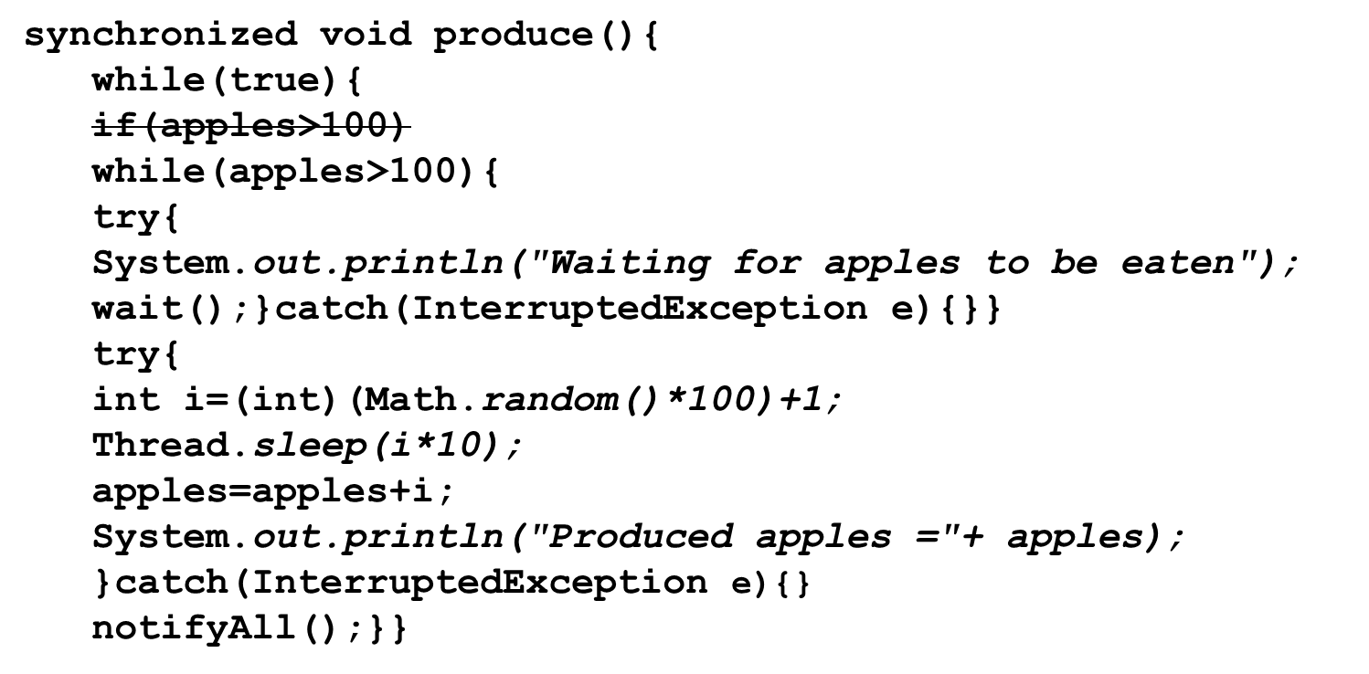
Multiple producer and consumers
Similar to the problem in the previous case, even in case of multiple producers we have similar problem.
Cases where there could be multiple consumer and producer, while loops are used instead of if for verifying the condition.
Corrected code to allow multiple producer and consumer:

Slide 71
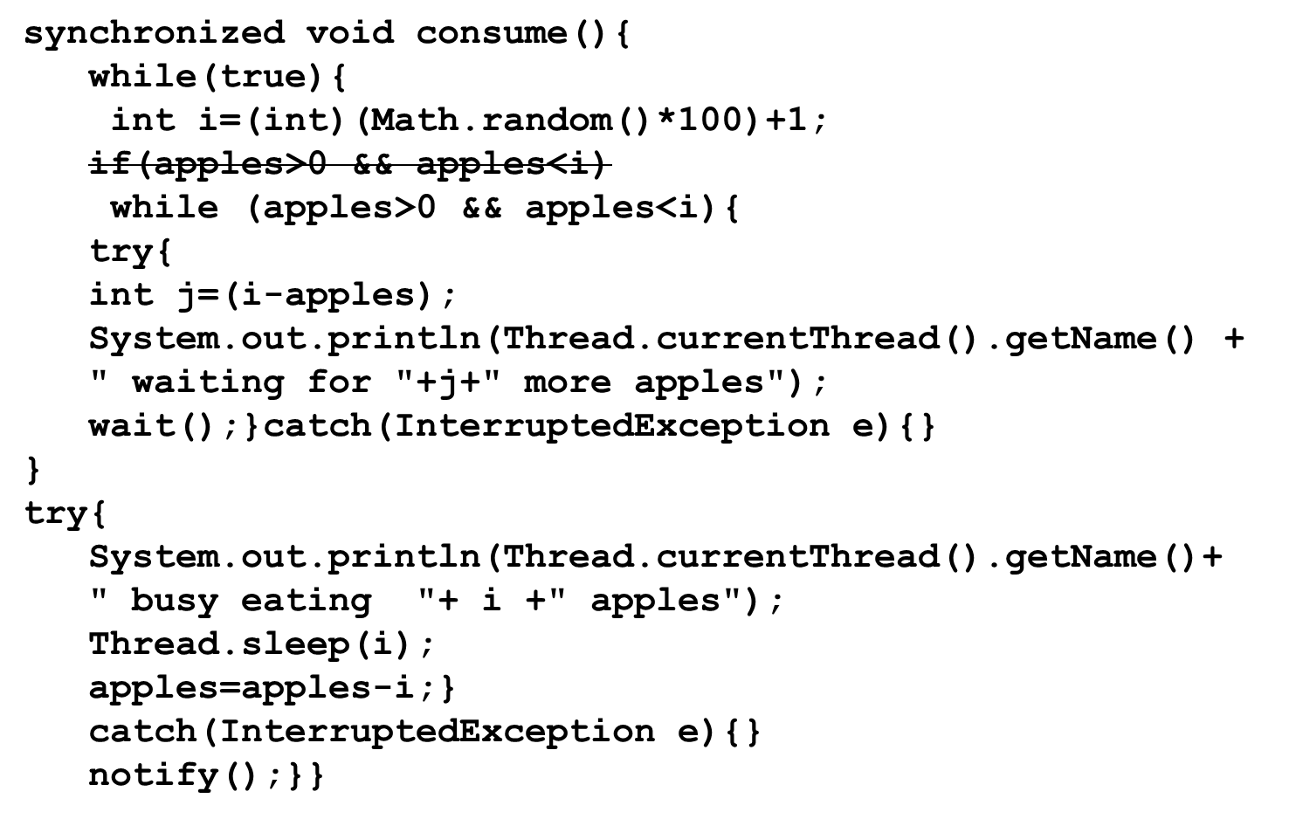

Slide 72
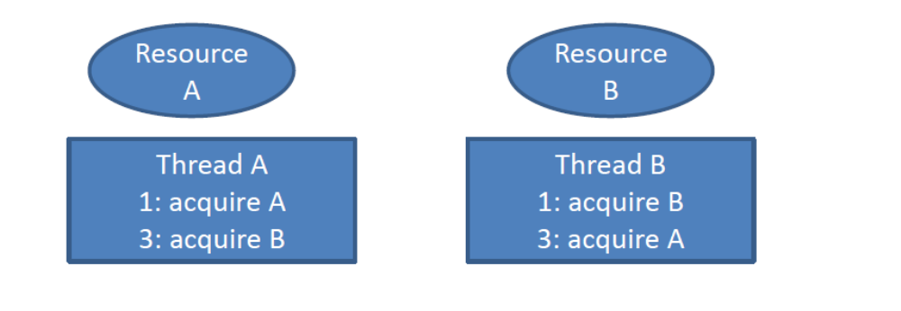
Concurrency Issues
Deadlock: Two or more threads waiting for each other to release a resource

Slide 73
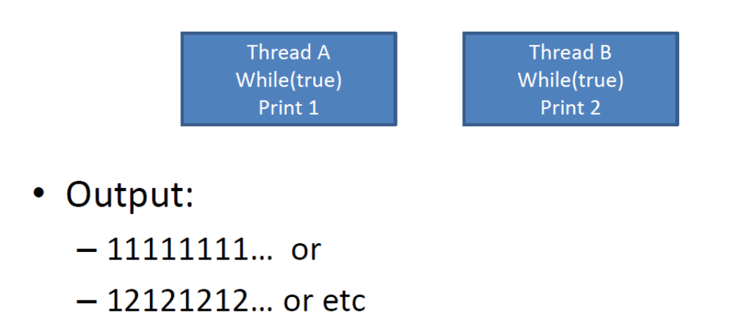
Concurrency Issues
Race Conditions: Non deterministic output, that depends on the order of thread execution

Slide 74

Concurrency Issues
Starvation: A slow thread being starved of a resource by a fast thread
This brings us to thread safe classes
–A class that guarantees the internal state of the class as well as returned values from methods are correct while invoked concurrently from multiple thread

Slide 75
Framework Overview
The Concurrency utilities includes the following:
1.Task Scheduling Framework: The Executor is a framework for handling the invocation, scheduling and execution of tasks
2.Concurrent Collection: Concurrent implementations of commonly used classes like map, list and queue (no more reinventing the wheel ).
3.Atomic Variables: classes for atomic manipulation of single variables, provides higher performance than simply using synchronization primitives

Slide 76
Framework Overview
4.Locks: High performance implementation of locks with the same semantics as the synchronized keyword, with additional functionality like timeouts.
5.Timers: Provides access to a nanosecond timer for making fine grained timing measurements, useful for methods that accept timeouts.

Slide 77
What is Executor Framework?
The executor is a framework helps you in creating and managing threads in an application. The executor framework helps you in the following tasks.
Thread Creation: It provides a variety of methods for the creation of threads that helps in running your applications concurrently.
Thread Management: It also manages the thread life cycle. You need not worry if the thread is active, busy or dead before submitting the task for execution.
Task Submission And Execution: Executor framework provides methods for task submission in the thread pool, It also gives the power to decide if the thread will be executed or not.

Slide 78
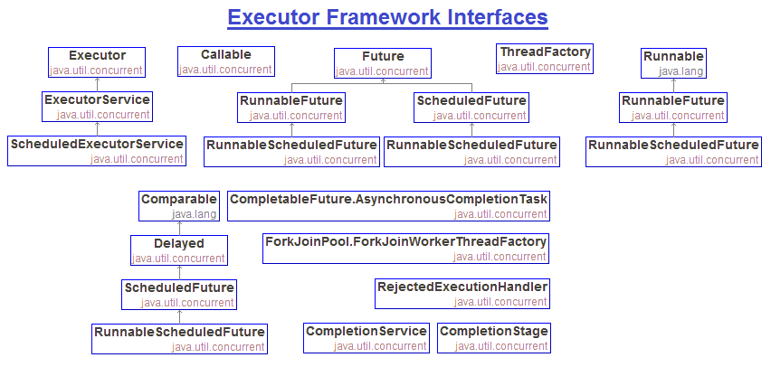
What is Executor Framework?

Slide 79
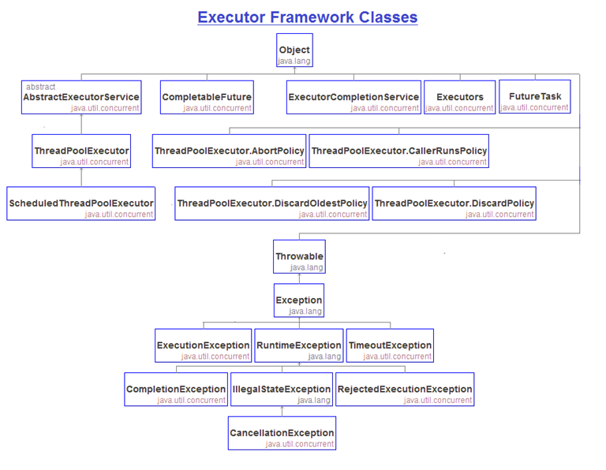
What is Executor Framework?

Slide 80
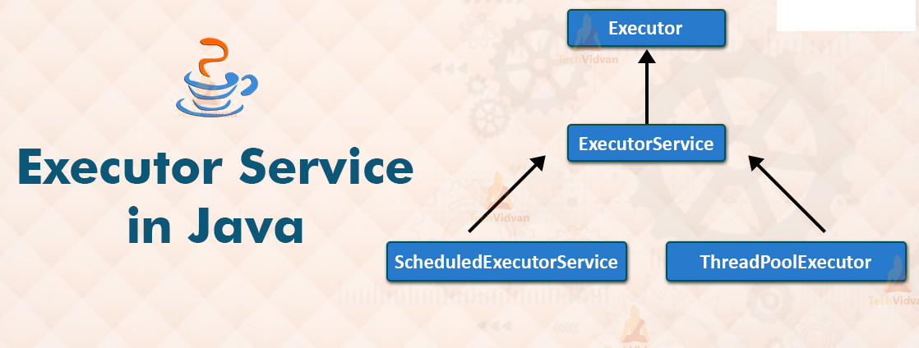
What is Executor Framework?

Slide 81
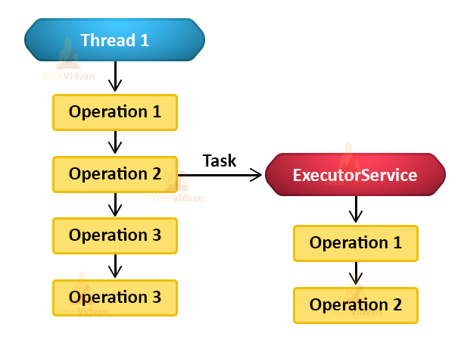
Task Delegation

Slide 82
Executor Service
The Java ExecutorService is the interface which allows us to execute tasks on threads asynchronously.
The Java ExecutorService interface is present in the java.util.concurrent package.
The ExecutorService helps in maintaining a pool of threads and assigns them tasks.
It also provides the facility to queue up tasks until there is a free thread available if the number of tasks is more than the threads available.

Slide 83
Executor Service
The Java ExecutorService is the interface which allows us to execute tasks on threads asynchronously.
The Java ExecutorService interface is present in the java.util.concurrent package.
The ExecutorService helps in maintaining a pool of threads and assigns them tasks.
It also provides the facility to queue up tasks until there is a free thread available if the number of tasks is more than the threads available.

Slide 84
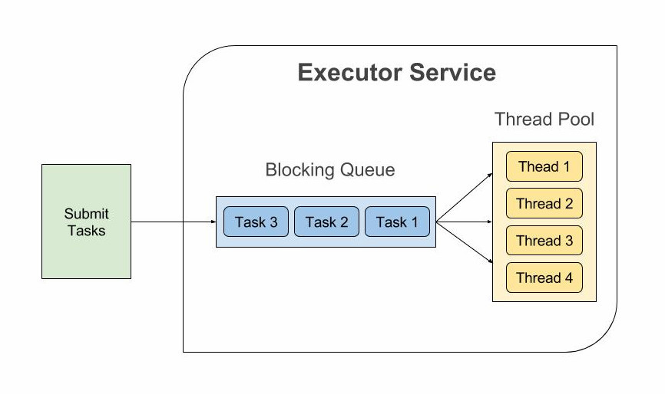
Executor Service

Slide 85
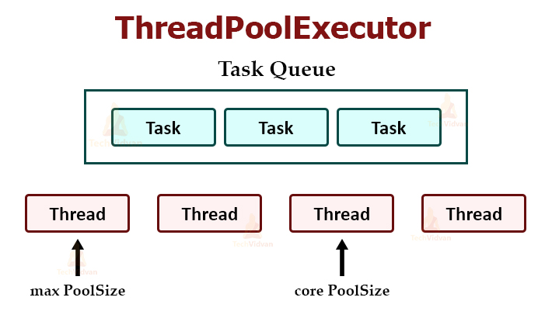

Slide 86
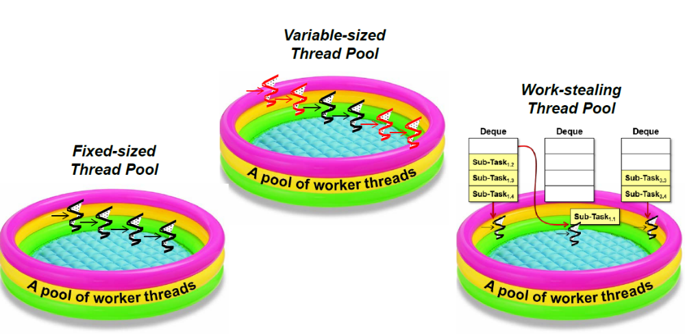
Types of Thread Pool

Slide 87
Executor Service several thread pools
Thread Pool | effect
CachedThreadPool | An infinitely expandable cacheable thread pool. If the thread pool length exceeds the processing requirements, the idle thread can be flexibly reclaimed. If there is no reclaimable, the thread is newly created. More suitable for processing a large number of short-term small tasks.
FixedThreadPool | Create a fixed-length thread pool that controls the maximum number of concurrent threads, and the excess threads wait in the queue.
ScheduledThreadPool | Create a fixed-length thread pool that supports scheduled and periodic task execution. A thread pool that can be started in a delayed manner and started periodically. It is suitable for scenarios where multiple background threads are required to execute periodic tasks.

Slide 88
Executor Service several thread pools
Thread Pool | effect
SingleThreadExecutor | A single-threaded thread pool can be used for scenarios that require sequential execution, and only one thread is executing.
WorkStealingPool | Threads are dynamically created and closed based on the required level of parallelism. By using multiple queues to reduce competition, the underlying implementation uses ForkJoinPool. Can make full use of the advantages of multi-cpu, multi-core cpu, split a task into multiple "small tasks", put multiple "small tasks" on multiple processor cores in parallel; when multiple "small tasks" are executed Once you're done, combine the results of these executions. A thread pool with multiple task queues can reduce the number of connections and create threads of the current number of available CPUs to execute in parallel.

Slide 89
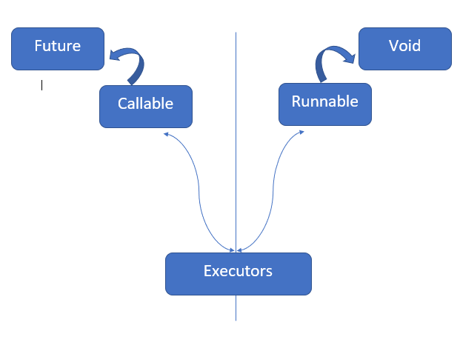
Runnable, Callable and Future
ExecutorService service = Executors.newSingleThreadExecutor();
Future<> submit = executorService.submit(callable);

Slide 90
Runnable, Callable and Future
As Callable return result, there has to be something that holds the result.
So Java Introduced Future.
Which doesn’t contain the result immediately, but will contain the result once the thread completes the operation.
You can get the result by calling the get method of the future object.
(It is a blocking operation)

Slide 91
Runnable, Callable and Future
Problems with Future
  You cannot perform further operation on the result without blocking it.
  You cannot chain multiple Future together.
  You cannot combine multiple Future together.
  No support for Exception Handling.

Slide 92
What’s a CompletableFuture?
Completable Future is used for asynchronous programming in Java.
Asynchronous programming is a means of writing non-blocking code by running a task on a separate thread than the main application thread and notifying the main thread about its progress, completion or failure.

Slide 93
What’s a CompletableFuture?
Java CompletableFuture inherits CompletionStage and Future interfaces.
CompletableFuture.thenApply is inherited from CompletionStage.
The thenApply returns a new CompletionStage that, when this stage completes normally, is executed with this stage's result as the argument to the supplied function.
Find the method declaration of thenApply from Java doc.

Slide 94
Runnable and Callable
 | Runnable | Callable
method | run() | call()
return value | void | Incoming generics, it is recommended to use the get method with a timeout parameter to get
abnormal | Internal processing | Can be thrown up
use | new Thread(Runnable target) | With the submit method of ExecutorService

Slide 95
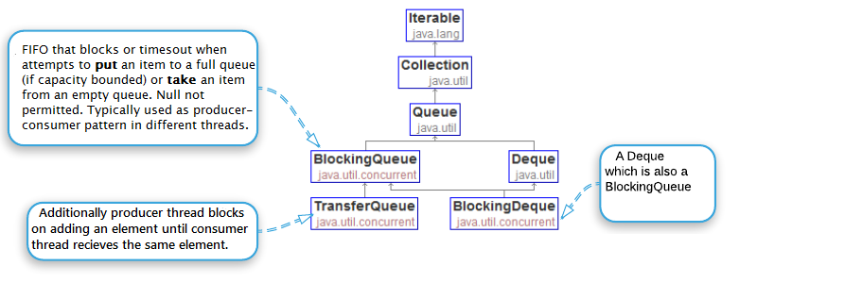
Concurrent Collections

Slide 96
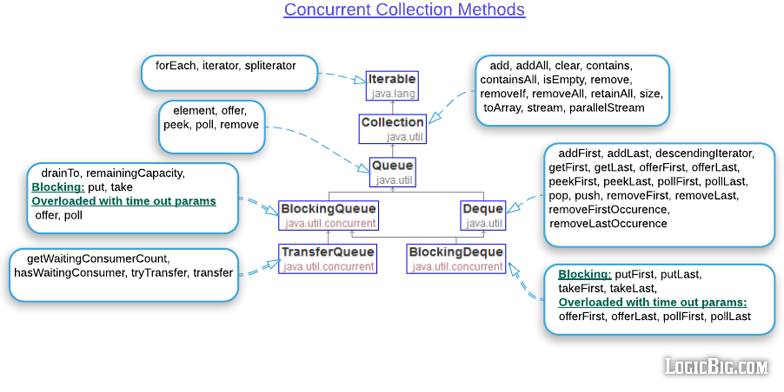
Concurrent Collections

Slide 97
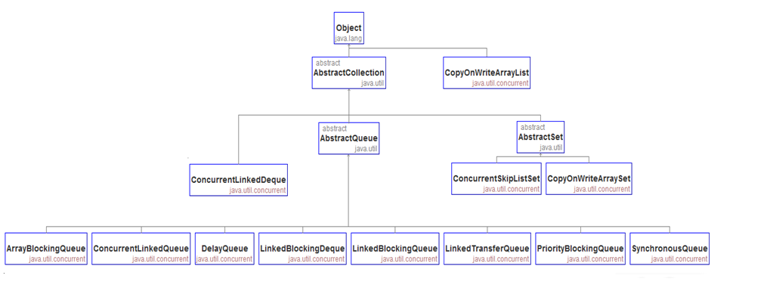
Concurrent Collections

Slide 98
ConcurrentHashMap
You should use ConcurrentHashMap when you need very high concurrency in your project.
It is thread safe without synchronizing the whole map.
Reads can happen very fast while write is done with a lock.
There is no locking at the object level.
The locking is at a much finer granularity at a hashmap bucket level.
ConcurrentHashMap doesn’t throw a ConcurrentModificationException if one thread tries to modify it while another is iterating over it.
ConcurrentHashMap uses multitude of locks.

Slide 99
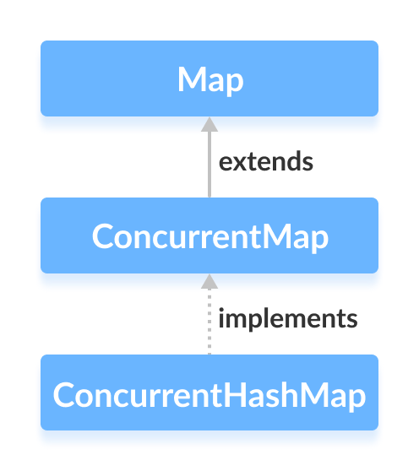
ConcurrentHashMap

Slide 100
ConcurrentHashMap
It uses re-entrant lock for this purpose. Similar to HashMap, ConcurrentHashMap has 16 buckets i.e segments, to create ConcurrentHashMap with more than 16 buckets it has different constructors.

Slide 101
ConcurrentHashMap
ConcurrentHashMap: This map allows concurrent thread access. Only part of the map called segment i.e underlying data structure is getting locked while adding or updating the map. It allows concurrent thread access to read the data without locking. It was introduced to improve performance.
Concurrency-Level: It is a number which is an estimated number of concurrently updating threads.
Load-Factor: It is a value which is used to control the resizing factor.
Initial Capacity: It is a property which creates a Map with the size provided.

Slide 102
Concurrent hash map
ConcurrentHashMap
You should use ConcurrentHashMap when you need very high concurrency in your project.
It is thread safe without synchronizing the whole map.
Reads can happen very fast while write is done with a lock.
There is no locking at the object level.
The locking is at a much finer granularity at a hashmap bucket level.
ConcurrentHashMap doesn’t throw a ConcurrentModificationException if one thread tries to modify it while another is iterating over it.
ConcurrentHashMap uses multitude of locks.

Slide 103
Synchronized hash map
SynchronizedHashMap
Synchronization at Object level.
Every read/write operation needs to acquire lock.
Locking the entire collection is a performance overhead.
This essentially gives access to only one thread to the entire map & blocks all the other threads.
It may cause contention.
SynchronizedHashMap returns Iterator, which fails-fast on concurrent modification.

Slide 104
Java Locks and Concurrency
Locks
Implicit Locks
Or synchronized methods and synchronized blocks.
Each object in java has a intrinsic lock associated with it.
Synchronized methods use the lock of method owner object; Synchronized blocks, if you don’t pass in any object in, same as sychronized methods, otherwise, it use the object you passed in as the lock.
Synchronized methods and blocks are reentrant.

Slide 105
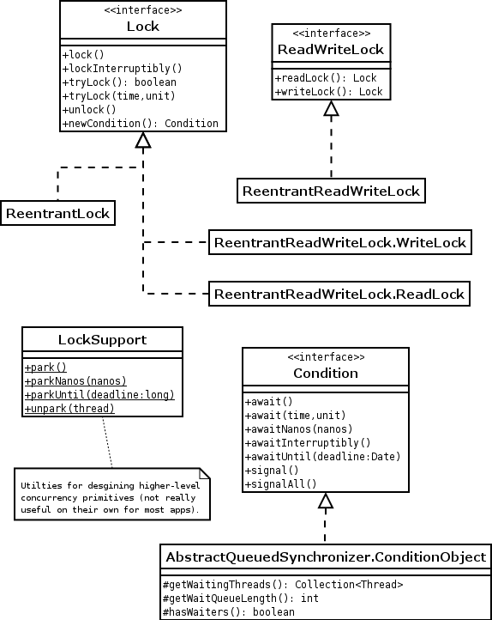
Java Locks and Concurrency

Slide 106
Reentrant Locks
ReentrantLock is a mutually exclusive lock with the same behavior as the intrinsic/implicit lock accessed via the synchronized keyword.
ReentrantLock, as the name suggests, possesses reentrant characteristics. That means a thread that currently owns the lock can acquire it more than once without any problem.

Slide 107
ReadWriteLock
ReadWriteLock consists of a pair of locks - one for read access and one for write access. The read lock may be held by multiple threads simultaneously as long as the write lock is not held by any thread.
ReadWriteLock allows for an increased level of concurrency. It performs better compared to other locks in applications where there are fewer writes than reads.

Slide 108
Mutexes
Special case of the semaphore
Stands for mutual exclusion semaphore
A Semaphore with a single permit
Used to gain exclusive access to a resource
•Similar to a lock with one key difference: can be released by a thread other then the one holding the mutex

Slide 109
Cyclic Barriers
A synchronization aid that allows a set of threads to all reach a common point before proceeding
Useful in programs that involve a fixed number of threads that must wait for each other at some point
Called cyclic because barrier can be reused
A thread signals it has reached the barrier by calling CyclicBarrier.await()
The threads blocks until all other threads have reached the barrier (which signal this the same way)
Can specify a timeout at which time the thread will stop blocking

Slide 110
Latches
Similar to a Cyclic Barrier, used to synchronize a set of threads that have a task divided amongst themselves
The CountDownLatchis intializedwith a given count
On reaching the synchronization point a thread can invoke the countdown() method which decrements the internal count
Threads that call the await() method will block until the count has reached zero
At this point all waiting threads are released

Slide 111
Latches
Calling await() after count has reached zero, has no effect ( the thread will continue executing)
Threads that call countdown() are not required to call await() ( and can proceed executing)
This is useful when the main thread has split execution between a number of worker threads
The worker threads call countdown() on completing their task, the main thread blocks on await() until count has reached zero

Slide 112
Exchangers
A synchronization point at which two threads can exchange objects
•Can be thought of as a CyclicBarrierwith a count of two plus allowing an exchange of state at the barrier
•On calling the exchange() method the thread provides some object as input
•The exhange() methods returns the object entered as input by the second thread to the calling thread
•Useful for example in the case where one thread is filling a buffer (filler thread) and the other emptying (emptying thread)
•On calling exchange() the filler thread is passed an empty buffer
•The emptying thread obtain the newly full buffer from the filler thread

Slide 113
Atomic Variables
To share an updateable variable among threads, synchronization is used.
Synchronization among multiple threads used to be achieved using the synchronized keyword and it was based on an object’s monitor.
If a thread is not able to acquire an object’s monitor, that thread is suspended and it has to be resumed later.
This way of synchronization (suspending and resuming) uses a great deal of system resources.
The problem is not in the locking and unlocking mechanism of the monitor lock; rather it is in suspending and resuming the threads.
If there is no contention for acquiring a lock, using the keyword synchronized to synchronize threads does not hurt much.

Slide 114
Atomic Variables
An atomic variable uses a lock-free synchronization of a single variable.
If program needs to synchronize on more than one shared variable, you still need to use the old synchronization methods.
By lock-free synchronization, multiple threads can access a shared variable safely using no object monitor lock.
JDK takes advantage of a hardware instruction called “compare-and-swap" (CAS) to implement the lock-free synchronization for one variable.

Slide 115
Atomic Variables
CAS is based on three operands: a memory location M, an expected old value O, and a new value N.
If the memory location M contains a value O, CAS updates it atomically to N; otherwise, it does not do anything.
CAS always returns the current value at the location M that existed before the CAS operation started.

Slide 116
Atomic Variables
CAS(M, O, N) {
currentValueAtM = get the value at Location M;
if (currentValueAtM == O) {
set value at M to N;
}
return currentValueAtM;
}

Slide 117
Atomic Variables
CAS takes an optimistic approach by assuming that there are no other threads updating the value at location M; if the location M contains value O, update it to N;
if the value at location M is not O, do not do anything.
Therefore, if multiple threads attempt to update the value at location M
to different values simultaneously, only one thread will succeed and others will fail.
The synchronization using locks takes a pessimistic approach by assuming that other threads may be working with location M and acquires a lock before it starts working at location M, so that other threads will not access location M while one is working with it.

Slide 118
Atomic Variables
Atomic variable classes are named like AtomicXxx, and can be used to execute multiple instructions on a single variable atomically without using any lock.
Here, Xxx is replaced with different words to indicate different classes that are used for different purposes; for example, the AtomicInteger class is used to represent an int variable, which is supposed to be manipulated atomically.
Twelve classes in the Java class library support read-modify-write operations on a single variable atomically.
They are in the java.util.concurrent.atomic package.

Slide 119
Atomic Variables
They can be classified into
1. Scalar
2. Array Classes
3. Field Updater
4.Compound Variable Classes

Slide 120
Atomic Variables
Scalar Variables
The AtomicInteger, AtomicLong, and AtomicBoolean classes support operations on primitive data types int, long, and boolean, respectively.
If you need to work with other primitive data types, use the AtomicInteger class.
You can use it directly to work with byte and short data types.
Atomic Arrays Classes
There are three classes called AtomicIntegerArray, AtomicLongArray, and AtomicReferenceArray that represent an array of int, long, and reference types whose elements can be updated atomically.

Slide 121
Atomic Variables
Atomic Field Updater Classes
There areThere are three classes called AtomicLongFieldUpdater, tomicIntegerFieldUpdater, and AtomicReferenceFieldUpdater that can be used to update a volatile field of a class atomically using reflection.
These classes have no constructors. To get a reference to an object of these classes, you need to use their factory method called newUpdater().
Atomic Compound Variable Classes
CAS works by asking “Is the value at location M still O?” If the answer is yes, it updates the value at location M from O to N. In a typical scenario, one thread may read the value from location M as O. By the time this thread tries to update the value from O to N, another thread has changed the value at location M from O to P, and back from P to O.

Slide 122
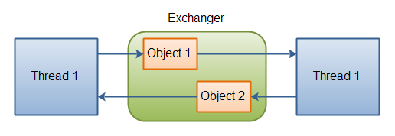
Exchanger

Slide 123
Volatile Keyword in Java
Volatile keyword is used to modify the value of a variable by different threads.
It is also used to make classes thread safe.
It means that multiple threads can use a method and instance of the classes at the same time without any problem.
The volatile keyword can be used either with primitive type or objects.

Slide 124
Volatile Keyword in Java
The volatile keyword does not cache the value of the variable and always read the variable from the main memory.
The volatile keyword cannot be used with classes or methods. However, it is used with variables. It also guarantees visibility and ordering. It prevents the compiler from the reordering of code.
The contents of the particular device register could change at any time, so you need the volatile keyword to ensure that such accesses are not optimized away by the compiler.

Slide 125
Volatile Keyword in Java
You can use a volatile variable if you want to read and write long and double variable automatically.
It can be used as an alternative way of achieving synchronization in Java.
All reader threads will see the updated value of the volatile variable after completing the write operation. If you are not using the volatile keyword, different reader thread may see different values.
It is used to inform the compiler that multiple threads will access a particular statement. It prevents the compiler from doing any reordering or any optimization.

Slide 126
Volatile Keyword in Java
If you do not use volatile variable compiler can reorder the code, free to write in cache value of volatile variable instead of reading from the main memory.

Slide 127
Volatile Keyword in Java
Volatile Keyword | Synchronization Keyword
Volatile keyword is a field modifier. | Synchronized keyword modifies code blocks and methods.
The thread cannot be blocked for waiting in case of volatile. | Threads can be blocked for waiting in case of synchronized.
It improves thread performance. | Synchronized methods degrade the thread performance.
It synchronizes the value of one variable at a time between thread memory and main memory. | It synchronizes the value of all variables between thread memory and main memory.
Volatile fields are not subject to compiler optimization. | Synchronize is subject to compiler optimization.

