Slide 1
Application Delivery Fundamentals 2.0 B: Java
Junit and Mockito

Slide 2
Goals
Mockito
Mocking Introduction
The Order Processor Usecase
Create the DAO Layer
Create the BO Layer
Add the Mockito Dependency
Stubbing and Setting Expectations

Slide 3
Goals
Verify the results
Test a negative scenario
Mocking Exceptions
Test Cancel Order
Cancel Order Negative Scenario
Cancel Order Exception Scenario
Cancel Order Exception On Update
Mock testing with PowerMock

Slide 4
Goals
Getting and installing PowerMock
Mocking static methods
Verifying method invocation
Mocking final classes or methods
Mocking constructors
Mocking private methods
Partial mocking using spy
Test Spring Framework application with JUnit 5 and Mockito

Slide 5
Junit
JUnit is an open source Unit Testing Framework for JAVA.
It is useful for Java Developers to write and run repeatable tests.
Erich Gamma and Kent Beck initially develop it.
It is an instance of xUnit architecture. As the name implies, it is used for Unit Testing of a small chunk of code.
Developers who are following test-driven methodology must write and execute unit test first before any code.

Slide 6
Junit
JUnit 5 = JUnit Platform + JUnit Jupiter + JUnit Vintage
The JUnit Platform serves as a foundation for launching testing frameworks on the JVM.
It also defines the TestEngine API for developing a testing framework that runs on the platform.
JUnit Jupiter is the combination of the new programming model and extension model for writing tests and extensions in JUnit 5.
The Jupiter sub-project provides a TestEngine for running Jupiter based tests on the platform.

Slide 7
Junit
JUnit Vintage provides a TestEngine for running JUnit 3 and JUnit 4 based tests on the platform.

Slide 8
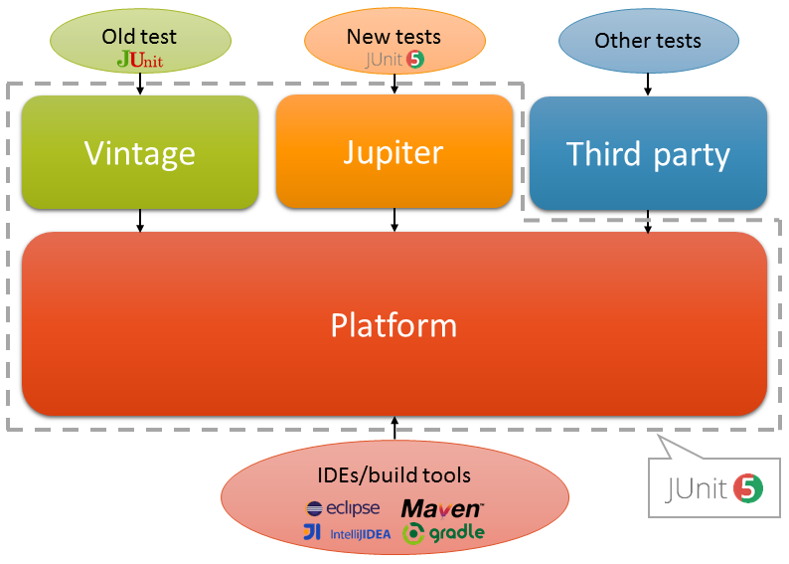
Junit

Slide 9
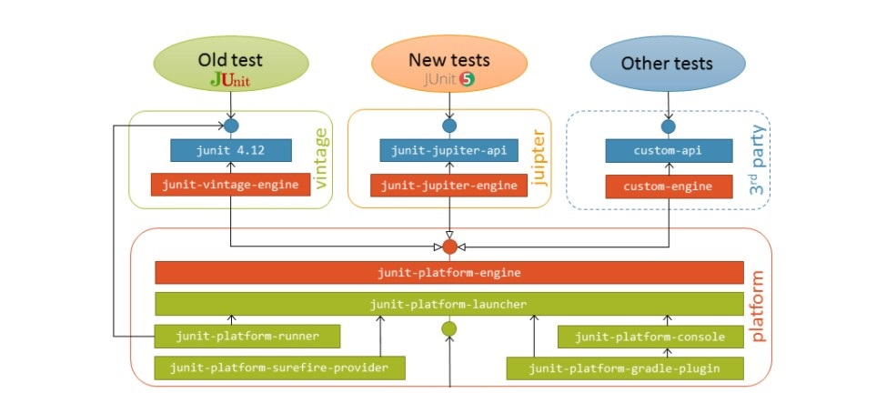
Junit

Slide 10
JUnit 5 Features
Writing Tests in JUnit Jupiter
Migrating from JUnit 4 to JUnit Jupiter
Running Tests
Extension Model for JUnit Jupiter
Advanced Topics
JUnit Platform Launcher API
JUnit Platform Test Kit

Slide 11
Annotations
Annotation | Description
@Test | Denotes that a method is a test method. Unlike JUnit 4’s @Test annotation, this annotation does not declare any attributes, since test extensions in JUnit Jupiter operate based on their own dedicated annotations. Such methods are inherited unless they are overridden.
@ParameterizedTest | Denotes that a method is a parameterized test. Such methods are inherited unless they are overridden.
@RepeatedTest | Denotes that a method is a test template for a repeated test. Such methods are inherited unless they are overridden.

Slide 12
Annotations
Annotation | Description
@TestFactory | Denotes that a method is a test factory for dynamic tests. Such methods are inherited unless they are overridden.
@TestTemplate | Denotes that a method is a template for test cases designed to be invoked multiple times depending on the number of invocation contexts returned by the registered providers. Such methods are inherited unless they are overridden.
@TestMethodOrder | Used to configure the test method execution order for the annotated test class; similar to JUnit 4’s @FixMethodOrder. Such annotations are inherited.

Slide 13
Annotations
Annotation | Description
@TestInstance | Used to configure the test instance lifecycle for the annotated test class. Such annotations are inherited.
@DisplayName | Declares a custom display name for the test class or test method. Such annotations are not inherited.
@DisplayNameGeneration | Declares a custom display name generator for the test class. Such annotations are inherited.

Slide 14
Annotations
Annotation | Description
@TestInstance | Used to configure the test instance lifecycle for the annotated test class. Such annotations are inherited.
@DisplayName | Declares a custom display name for the test class or test method. Such annotations are not inherited.
@DisplayNameGeneration | Declares a custom display name generator for the test class. Such annotations are inherited.

Slide 15
Annotations
Annotation | Description
AfterEach | Denotes that the annotated method should be executed after each @Test, @RepeatedTest, @ParameterizedTest, or @TestFactory method in the current class; analogous to JUnit 4’s @After. Such methods are inherited unless they are overridden.
@BeforeAll | Denotes that the annotated method should be executed before all @Test, @RepeatedTest, @ParameterizedTest, and @TestFactory methods in the current class; analogous to JUnit 4’s @BeforeClass. Such methods are inherited (unless they are hidden or overridden) and must be static (unless the "per-class“ test instance lifecycle is used).
AfterEach | Denotes that the annotated method should be executed after each @Test, @RepeatedTest, @ParameterizedTest, or @TestFactory method in the current class; analogous to JUnit 4’s @After. Such methods are inherited unless they are overridden.

Slide 16
Annotations
Annotation | Description
@AfterAll | Denotes that the annotated method should be executed after all @Test, @RepeatedTest, @ParameterizedTest, and @TestFactory methods in the current class; analogous to JUnit 4’s @AfterClass. Such methods are inherited (unless they are hidden or overridden) and must be static (unless the "per-class" test instance lifecycle is used).
@Nested | Denotes that the annotated class is a non-static nested test class. @BeforeAll and @AfterAll methods cannot be used directly in a @Nested test class unless the "per-class" test instance lifecycle is used. Such annotations are not inherited.
@Tag | Used to declare tags for filtering tests, either at the class or method level; analogous to test groups in TestNG or Categories in JUnit 4. Such annotations are inherited at the class level but not at the method level.

Slide 17
Annotations
Annotation | Description
@Disabled | Used to disable a test class or test method; analogous to JUnit 4’s @Ignore. Such annotations are not inherited.
@Timeout | Used to fail a test, test factory, test template, or lifecycle method if its execution exceeds a given duration. Such annotations are inherited.
@ExtendWith | Used to register extensions declaratively. Such annotations are inherited.

Slide 18
Annotations
Annotation | Description
@RegisterExtension | Used to register extensions programmatically via fields. Such fields are inherited unless they are shadowed.
@TempDir | Used to supply a temporary directory via field injection or parameter injection in a lifecycle method or test method; located in the org.junit.jupiter.api.io package.
@RegisterExtension | Used to register extensions programmatically via fields. Such fields are inherited unless they are shadowed.

Slide 19
Assertions

Slide 20
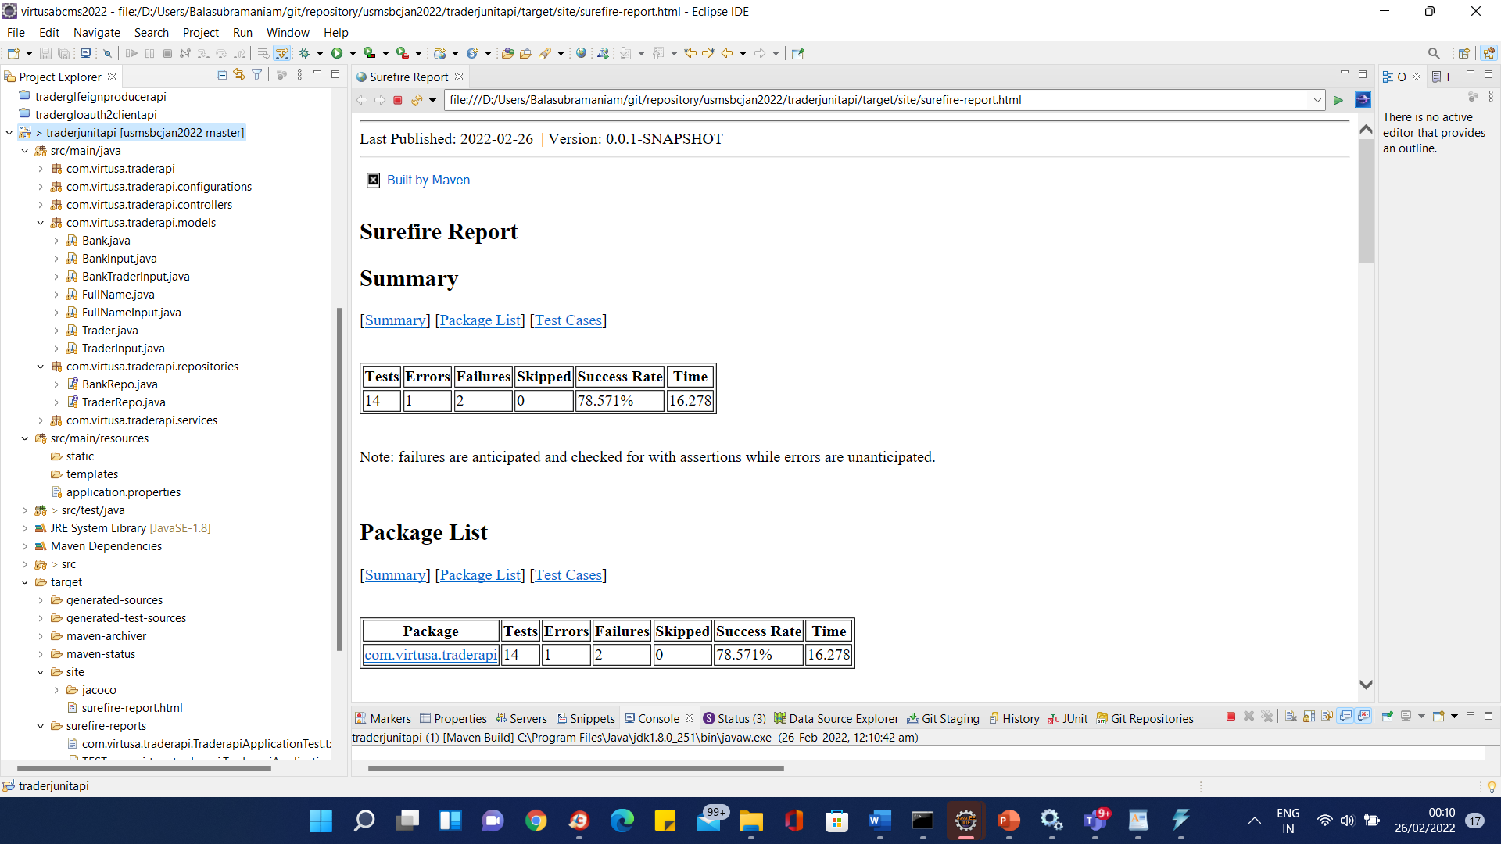
Surefire Report
mvn surefire-report:report

Slide 21
Surefire Report
Gradle does not require sure fire plugin in intellij.
Reports autogenerated

Slide 22
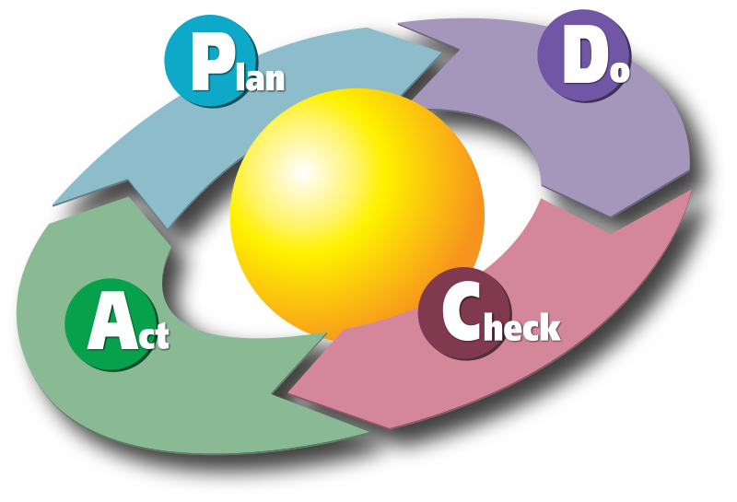
Test Driven Development:
Java

Slide 23
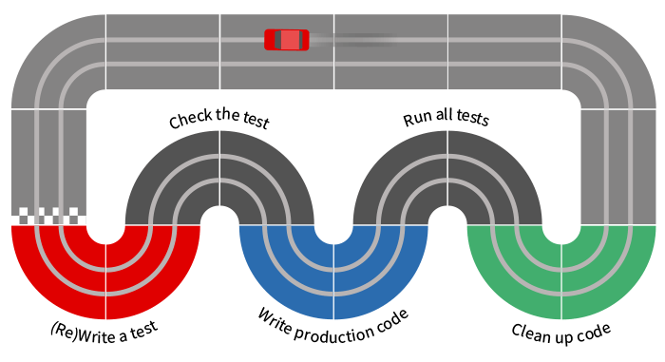
TDD

Slide 24
TDD Goals
What Is Test-driven Development
How Do I Adopt TDD?
Testing Concepts
Test-driven Development Concepts
Testing Tools
Setting Up Testing Infrastructure
Installing Java SDK and Eclipse IDE
Unit Testing Java code with jUnit

Slide 25
TDD Goals
JUnit in Action
Testing for Exceptions
@Before and @After
Decoupling
Mock Objects
Mockito in Action
Add the Mockito Dependency
Stubbing and Setting Expectations
Verify the results

Slide 26
TDD Goals
Test a negative scenario
Mocking Exceptions
Verification Mode
Add the Mockito Dependency
Stub Void Methods Implicitly
Stub Void Methods Explicitly
say doNothing to test Consecutive calls
The F.I.R.S.T Principle
Test Doubles Introduction
Test Doubles In Mockito
Refactoring

Slide 27
TDD Goals
Web Tier Testing
Middle Tier Testing
Testing Legacy Code
Continuous Integration Testing

Slide 28
What is TDD
Test-Driven Development (TDD) is a technique for building software that guides software development by writing tests. (Martin Fowler’s definition)
“Test Driven Development” is NOT primarily about testing or development (i.e., coding)
It is rather about design - where design is evolved through refactoring
Developers write unit tests (NOT testers) and then code

Slide 29
What is TDD
The primary goal of TDD is to make the code clearer, simple and bug-free.
Test-Driven Development starts with designing and developing tests for every small functionality of an application.
In TDD approach, first, the test is developed which specifies and validates what the code will do.

Slide 30
Old Approach

Slide 31
New Approach

Slide 32
TDD? But I already write unit tests!
The simple concept of TDD is to write and correct the failed tests before writing new code (before development).
This helps to avoid duplication of code as we write a small amount of code at a time in order to pass tests. (Tests are nothing but requirement conditions that we need to test to fulfill them).
Test-Driven development is a process of developing and running automated test before actual development of the application.
Hence, TDD sometimes also called as Test First Development.

Slide 33
Why TDD
TDD as a technique for specifying your requirements and design before writing the actual program code.
The second view takes a more pragmatic approach and sees TDD as a technique that helps programmers write better code.
Regardless of the view one takes, what TDD practitioners all agree on is that TDD will not only improve your code, but it will also improve the overall design and implementation of your software system.

Slide 34
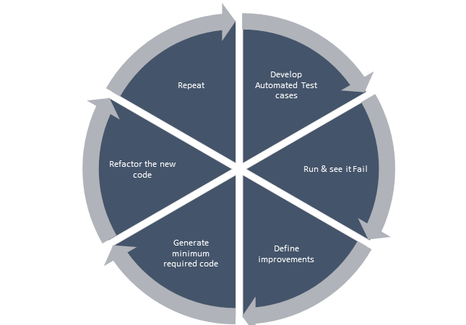
Why TDD

Slide 35
Why TDD
Reduce development costs
Cut down time to market in the development process
Improve programmer’s productivity
Develop a neat code that is well-defined
Cut down turnaround time
Generates proof that the developed code works as expected
Boosts the process of generating quality code

Slide 36
Why TDD
A significant advantage of TDD is that it enables you to take small steps when writing software.
This is a practice that I have promoted for years because it is far more productive than attempting to code in large steps.
For example, assume you add some new functional code, compile, and test it.
Chances are pretty good that your tests will be broken by defects that exist in the new code.
It is much easier to find, and then fix, those defects if you've written two new lines of code than two thousand.
The implication is that the faster your compiler and regression test suite, the more attractive it is to proceed in smaller and smaller steps.
I generally prefer to add a few new lines of functional code, typically less than ten, before I recompile and rerun my tests.

Slide 37
TDD mantra

Slide 38
TDD mantra
Red—write a little test that doesn’t work, perhaps doesn’t even compile at first
Green—make the test work quickly, committing whatever sins necessary in the process
Refactor—eliminate all the duplication and smells created in just getting the test to work

Slide 39
3 laws of TDD
Law 1: You may not write production code unless you’ve first written a failing unit test.
Law 2: You may not write more of a unit test than is sufficient to fail.
Law 3: You may not write more production code than is sufficient to make the failing unit test pass.

Slide 40
TDD Benefits
Early bug notification
Developers test their code but in the database world, this often consists of manual tests or one-off scripts.
Using TDD you build up, over time, a suite of automated tests that you and any other developer can rerun at will.
Better Designed, cleaner and more extensible code.
It helps to understand how the code will be used and how it interacts with other modules.
It results in better design decision and more maintainable code.
TDD allows writing smaller code having single responsibility rather than monolithic procedures with multiple responsibilities. This makes the code simpler to understand.
TDD also forces to write only production code to pass tests based on user requirements.

Slide 41
TDD Benefits
Confidence to Refactor
If you refactor code, there can be possibilities of breaks in the code. So having a set of automated tests you can fix those breaks before release. Proper warning will be given if breaks found when automated tests are used.
Using TDD, should results in faster, more extensible code with fewer bugs that can be updated with minimal risks.
Good for teamworkIn the absence of any team member, other team members can easily pick up and work on the code. It also aids knowledge sharing, thereby making the team more effective overall.
Good for DevelopersThough developers have to spend more time in writing TDD test cases, it takes a lot less time for debugging and developing new features. You will write cleaner, less complicated code.

Slide 42
TDD Benefits

Slide 43
Impact of Adopting TDD
Using TDD to produce code means that developers begin by setting out exactly what the code should do rather than beginning with how the code should satisfy the requirement.
The advantage of this is that the developer is focused on what the code needs to achieve from the outset rather than writing code in a more generalised way.
At Boost found that continuous testing quite naturally results in fewer defects and TTD results in a greater understanding of what the code should achieve as well as cleaner code.

Slide 44
How Do I Adopt TDD
Add a test.
Run all tests and see if any new test fails.
Write some code.
Run tests and Refactor code.
Repeat.

Slide 45
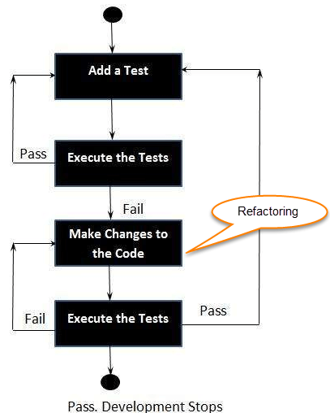
How Do I Adopt TDD

Slide 46
Extreme Programming Practise

Slide 47
What is acceptance TDD and Developer TDD
Acceptance TDD (ATDD):
With ATDD you write a single acceptance test.
This test fulfills the requirement of the specification or satisfies the behavior of the system.
After that write just enough production/functionality code to fulfill that acceptance test.
Acceptance test focuses on the overall behavior of the system.
ATDD also was known as Behavioral Driven Development (BDD).

Slide 48
What is acceptance TDD and Developer TDD
Developer TDD
With Developer TDD you write single developer test i.e. unit test and then just enough production code to fulfill that test.
The unit test focuses on every small functionality of the system.
Developer TDD is simply called as TDD.
The main goal of ATDD and TDD is to specify detailed, executable requirements for your solution on a just in time (JIT) basis.
JIT means taking only those requirements in consideration that are needed in the system. So increase efficiency.

Slide 49
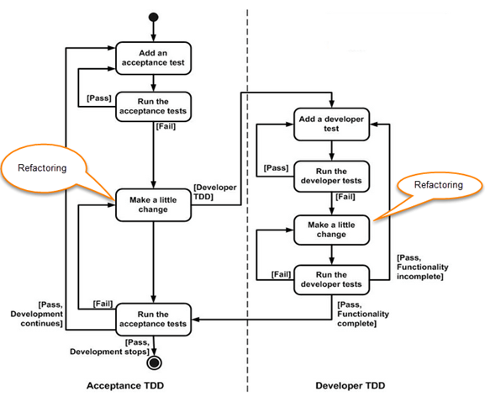
What is acceptance TDD and Developer TDD

Slide 50
Scaling TDD via Agile Model Driven Development (AMDD)
TDD is very good at detailed specification and validation.
It fails at thinking through bigger issues such as overall design, use of the system, or UI.
AMDD addresses the Agile scaling issues that TDD does not.
Thus AMDD used for bigger issues.

Slide 51
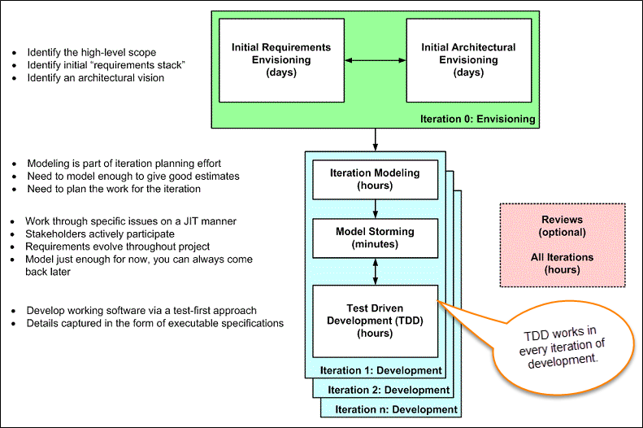
Scaling TDD via Agile Model Driven Development (AMDD)

Slide 52
Scaling TDD via Agile Model Driven Development (AMDD)
Iteration 0: Envisioning
There are two main sub-activates.
Initial requirements envisioning.It may take several days to identify high-level requirements and scope of the system. The main focus is to explore usage model, Initial domain model, and user interface model (UI).
Initial Architectural envisioning.It also takes several days to identify architecture of the system. It allows setting technical directions for the project. The main focus is to explore technology diagrams, User Interface (UI) flow, domain models, and Change cases.

Slide 53
Scaling TDD via Agile Model Driven Development (AMDD)
Iteration modeling:Here team must plan the work that will be done for each iteration.
Agile process is used for each iteration, i.e. during each iteration, new work item will be added with priority.
First higher prioritized work will be taken into consideration. Work items added may be reprioritized or removed from items stack any time.
The team discusses how they are going to implement each requirement. Modeling is used for this purpose.
Modeling analysis and design is done for each requirement which is going to implement for that iteration.

Slide 54
Scaling TDD via Agile Model Driven Development (AMDD)
Model storming:
This is also known as Just in time Modeling.
Here modeling session involves a team of 2/3 members who discuss issues on paper or whiteboard.
One team member will ask another to model with them. This modeling session will take approximately 5 to 10 minutes. Where team members gather together to share whiteboard/paper.
They explore issues until they don't find the main cause of the problem. Just in time, if one team member identifies the issue which he/she wants to resolve then he/she will take quick help of other team members.
Other group members then explore the issue and then everyone continues on as before. It is also called as stand-up modeling or customer QA sessions.

Slide 55
Scaling TDD via Agile Model Driven Development (AMDD)
Test Driven Development (TDD).
It promotes confirmatory testing of your application code and detailed specification.
Both acceptance test (detailed requirements) and developer tests (unit test) are inputs for TDD.
TDD makes the code simpler and clear. It allows the developer to maintain less documentation.

Slide 56
Scaling TDD via Agile Model Driven Development (AMDD)
Reviews.
This is optional. It includes code inspections and model reviews.
This can be done for each iteration or for the whole project.
This is a good option to give feedback for the project.

Slide 57
TDD vs AMDD
TDD | AMDD
TDD shortens the programming feedback loop | AMDD shortens modeling feedback loop.
TDD is detailed specification | AMDD works for bigger issues
TDD promotes the development of high-quality code | AMDD promotes high-quality communication with stakeholders and developers.
TDD speaks to programmers | AMDD talks to business analyst, stakeholders, and data professionals.
TDD non-visually oriented | AMDD visually oriented
TDD has limited scope to software works | AMDD has a broad scope including stakeholders. It involves working towards a common understanding
Both support evolutionary development | --------------------------------------------

Slide 58
How Do I Adopt TDD

Slide 59
Adoption Stages
The developer also notices that when they return to some code that they haven't seen for a while, the tests serve to document how the code works.
A point of revelation occurs when the developer realizes that writing tests in this way helps them to "discover" the API to their code. TDD has now become a design process.
Expertise in TDD begins to be drawn at the point where the developer realizes that TDD is not about testing, it is about defining behavior.
Behavior is about the interactions between components of the system and so the use of mocking is a fundamental to advanced TDD.

Slide 60
Adoption Stages
1. The developer starts writing unit tests around their code using a test framework like JUnit or TestNG.
2. As the body of tests increases the developer begins to enjoy a strongly increased sense of confidence in their work.
3. At some point the developer has the insight (or are shown) that writing the tests before writing the code, helps them focus on only writing the code that they need.

Slide 61
Measuring and Monitoring Adoption
Time of running and manually testing your application - measure the time it takes to run your application and test it manually. With TDD it will decrease.
Object-oriented design quality
Cohesion (increase)
Method’s length (decrease)
Cyclomatic complexity (decrease)
install Sonar or another tool for static code analysis. Observe key design metrics.

Slide 62
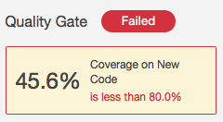
Measuring and Monitoring Adoption
Code coverage
This metric defines the percentage of your production code that is exercised (run) by the tests. With TDD you can expect it to increase, of course.
monitor Code Coverage for new code. Expect it to rise after adopting TDD.

Slide 63
Measuring and Monitoring Adoption
Bug fixing time
Automated developer tests will catch whole classes of defects.
You’ll stop wasting time on simple calculation mistakes, rounding errors or simple regression bugs.
For the whole team, expect a significant reduction of the time spent identifying, tracking and fixing bugs.
monitor the time your team reports on identifying, managing and fixing defects. Expect it to reduce after adopting TDD.

Slide 64
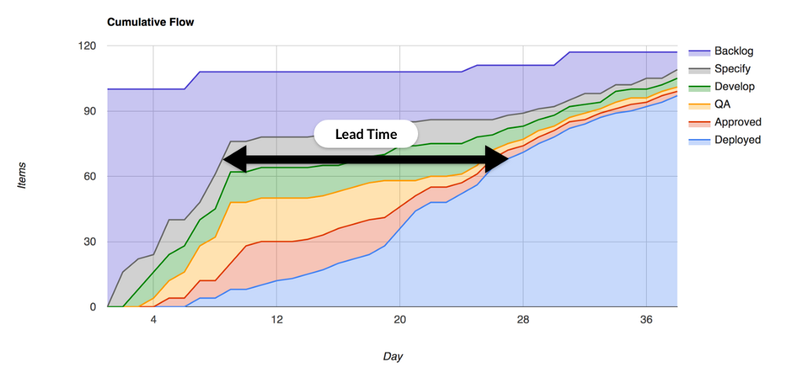
Measuring and Monitoring Adoption
Average Lead Time
Lead Time is the time elapsed between starting work on a certain feature and delivering it to production environment.
You can monitor Lead Times for each particular feature or just take the average.

Slide 65
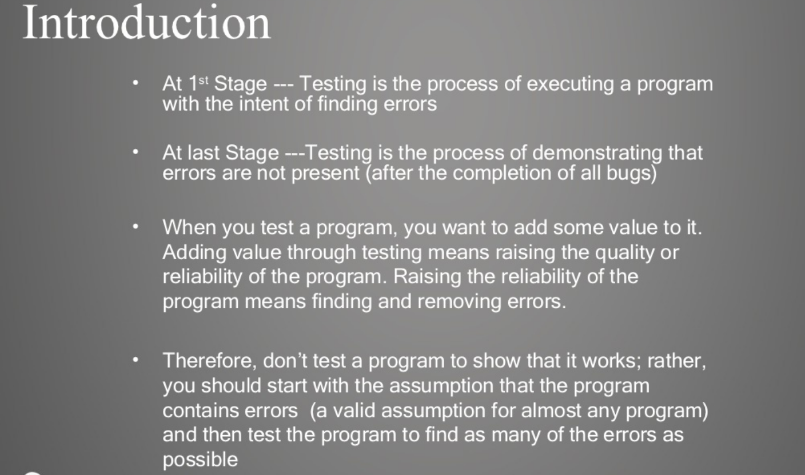
Testing Concepts

Slide 66
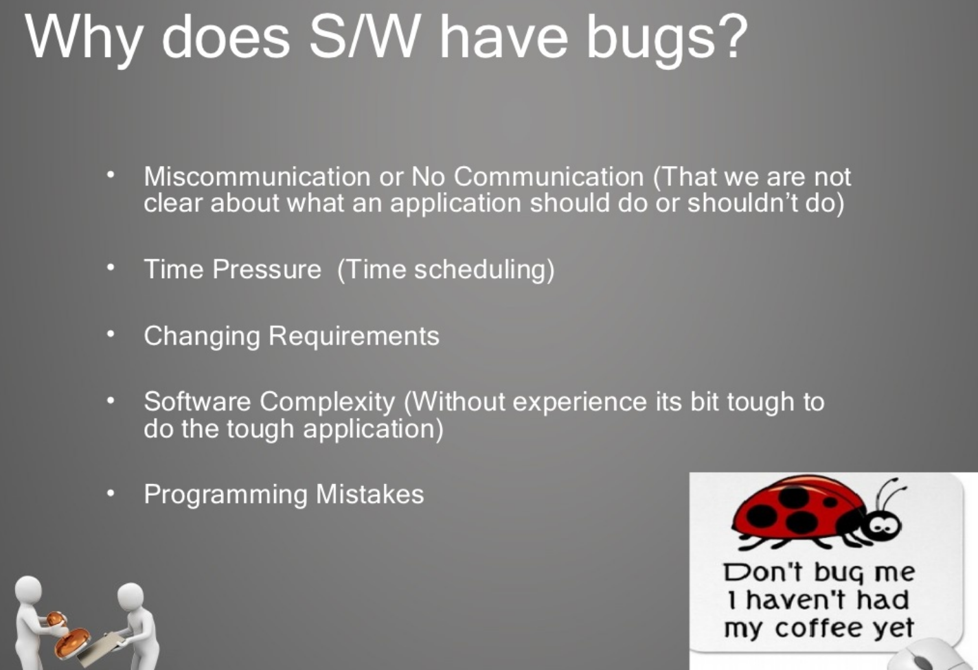
Testing Concepts

Slide 67
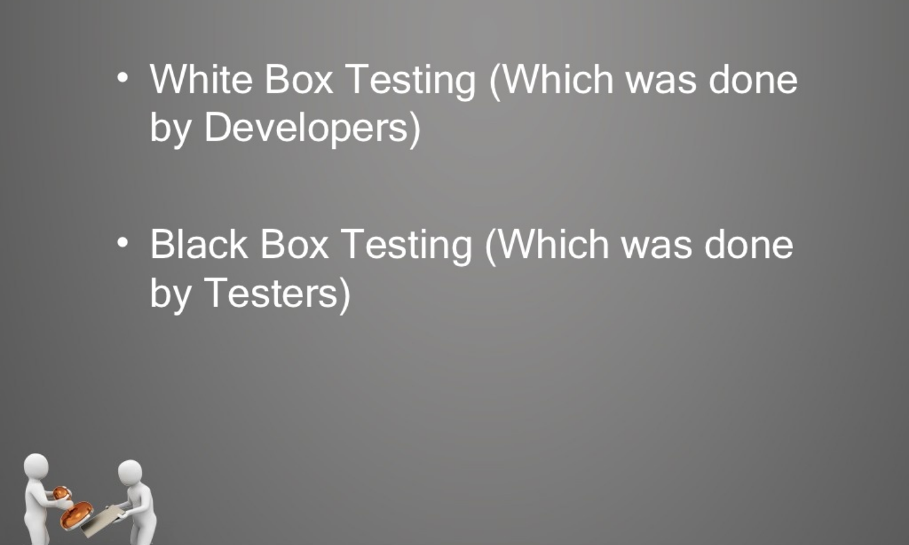
Testing Concepts
Testing Techniques

Slide 68
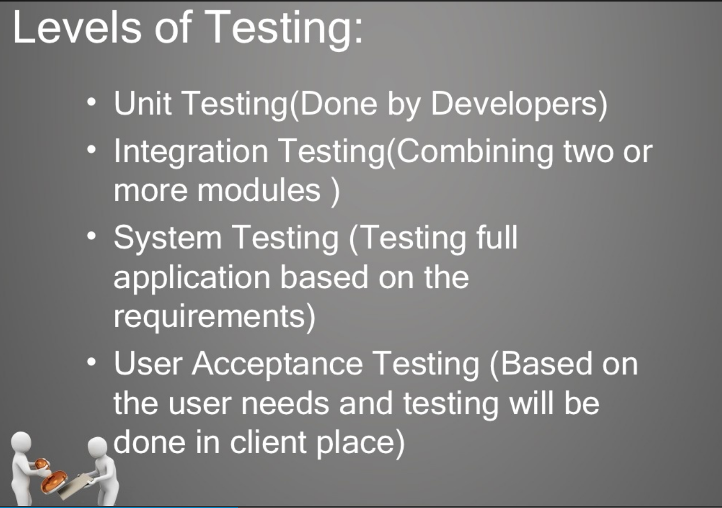
Testing Concepts

Slide 69
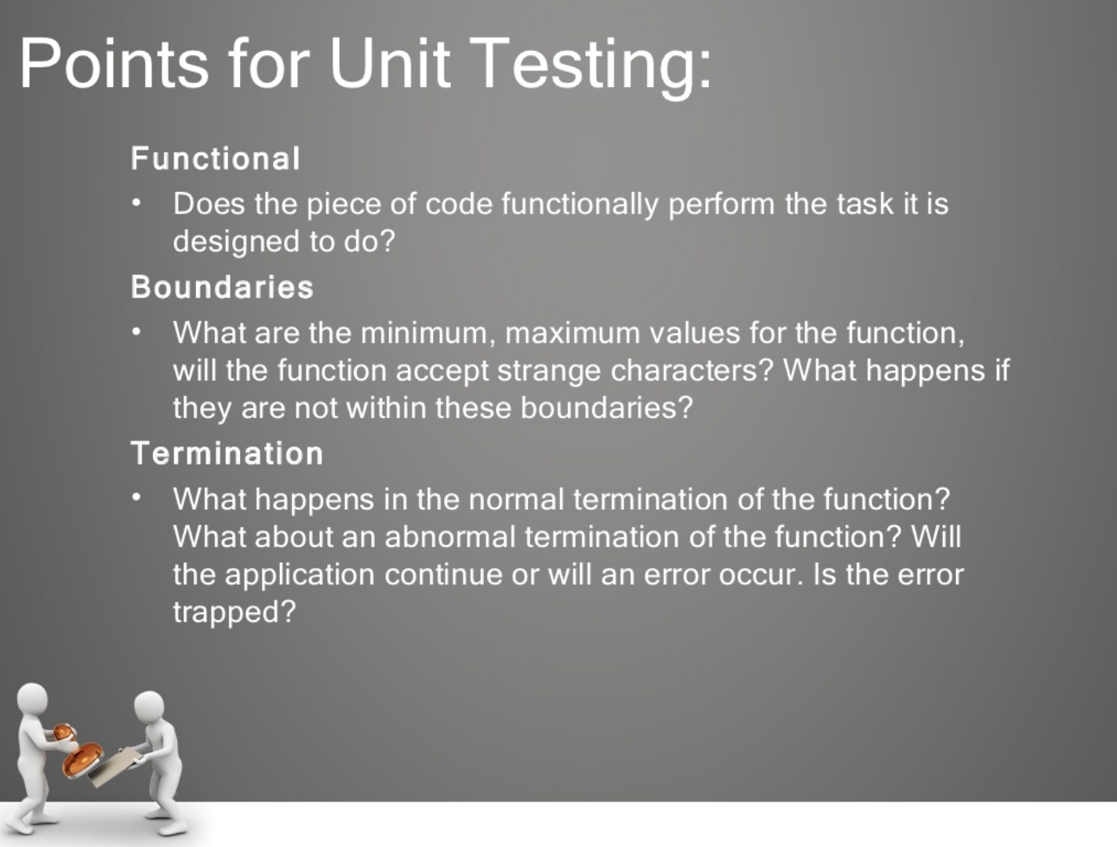
Testing Concepts

Slide 70
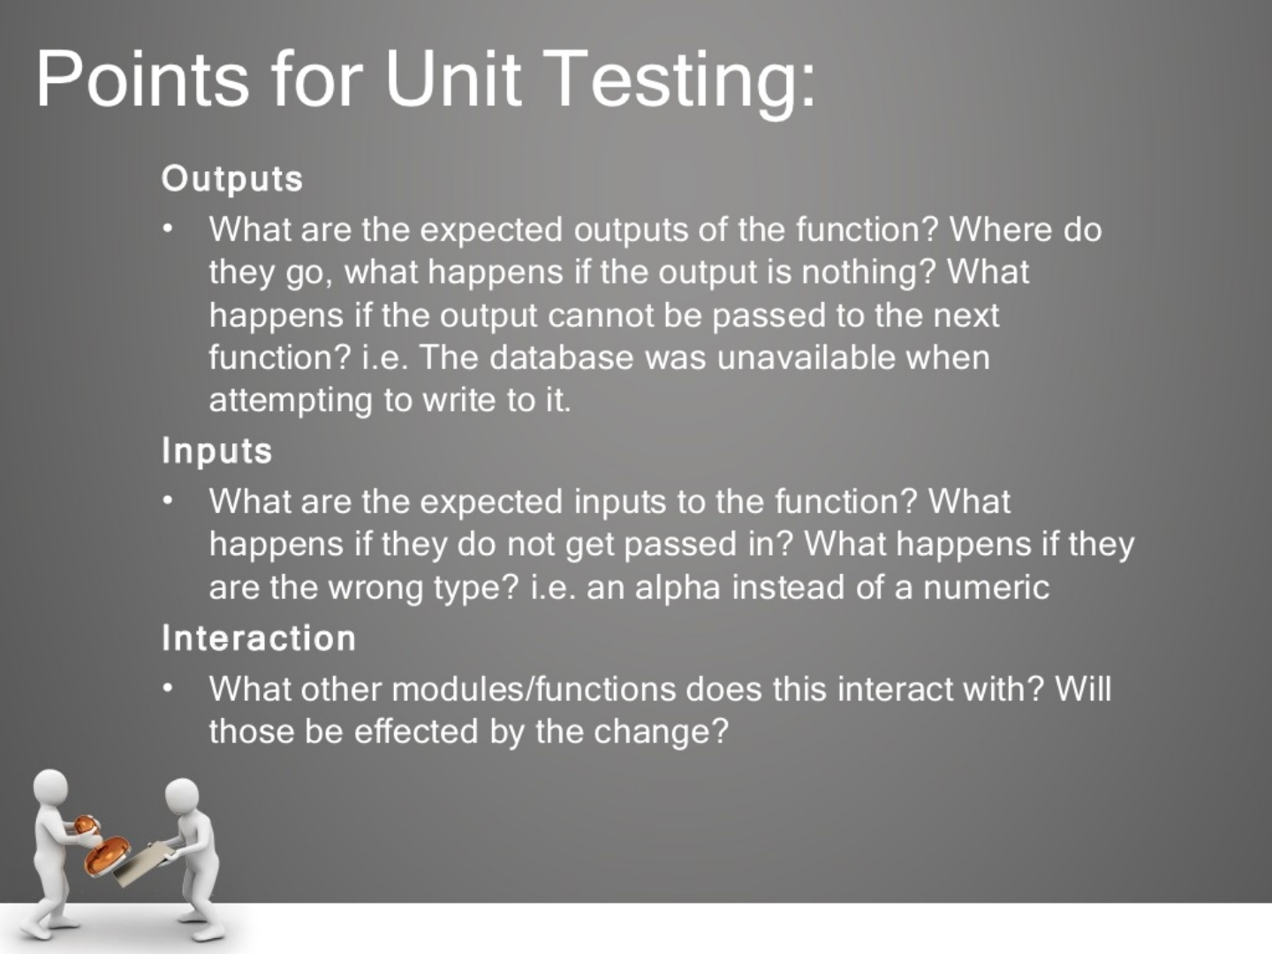
Testing Concepts

Slide 71
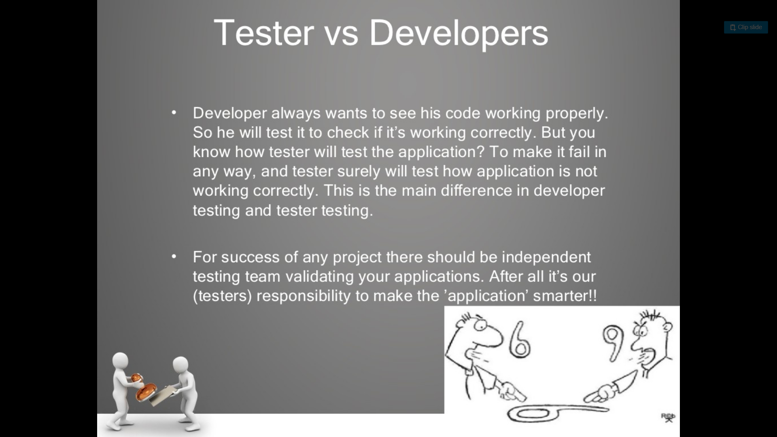
Testing Concepts

Slide 72
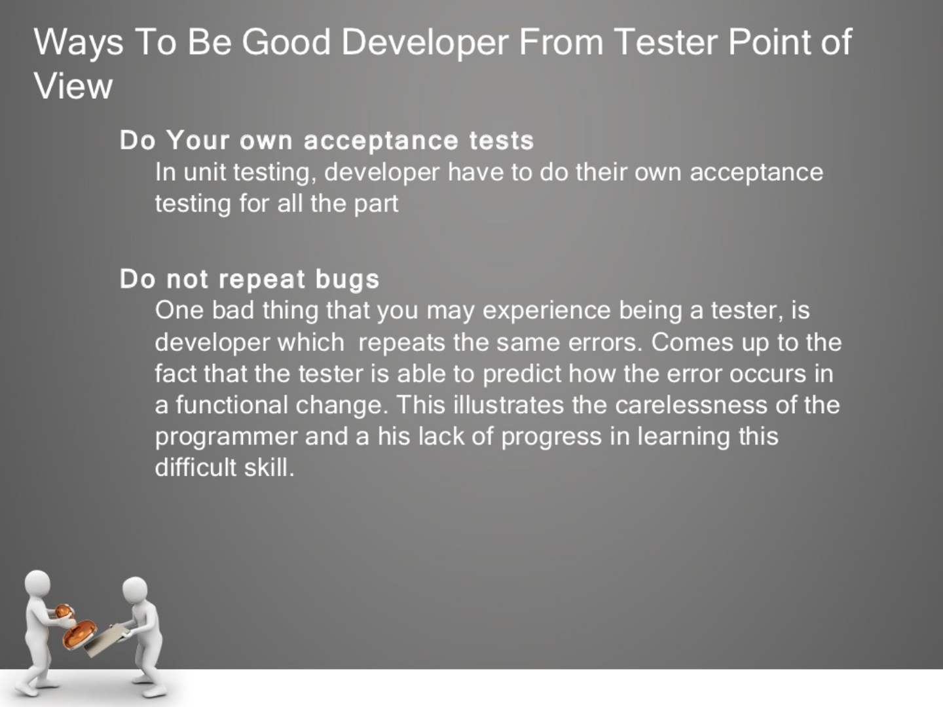
Testing Concepts

Slide 73
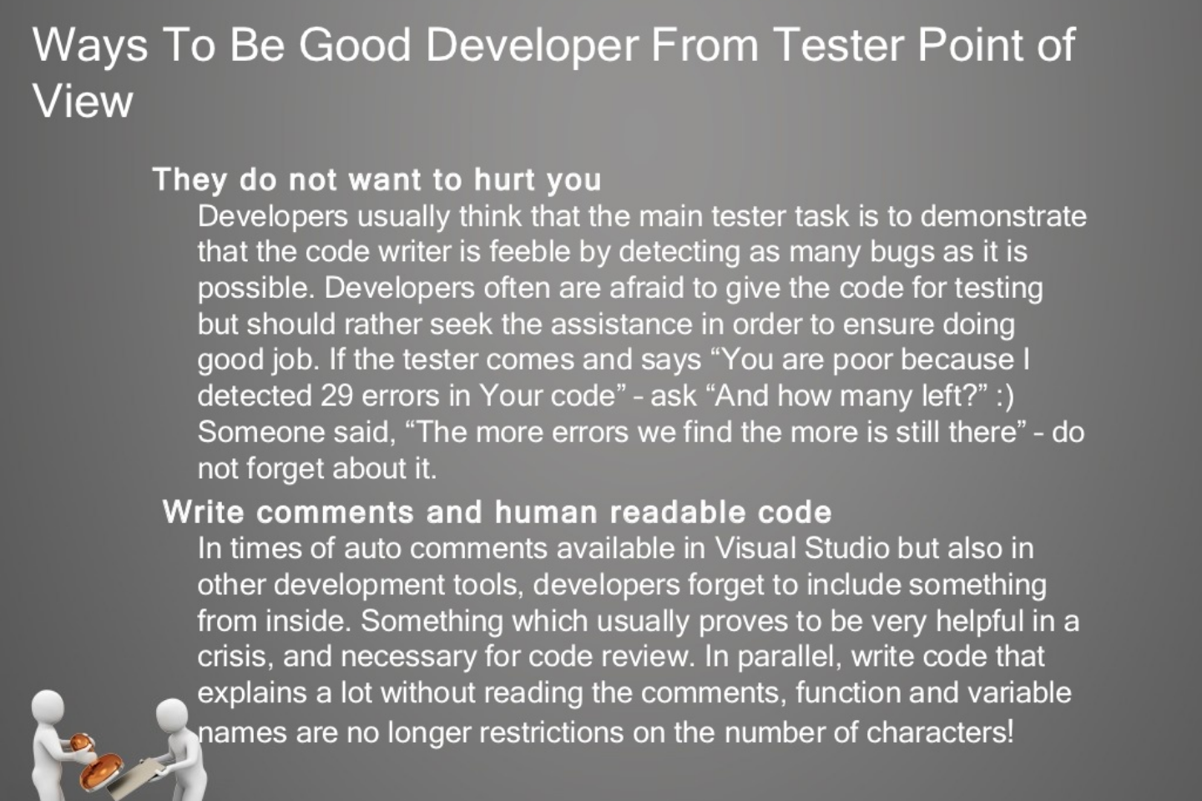
Testing Concepts

Slide 74
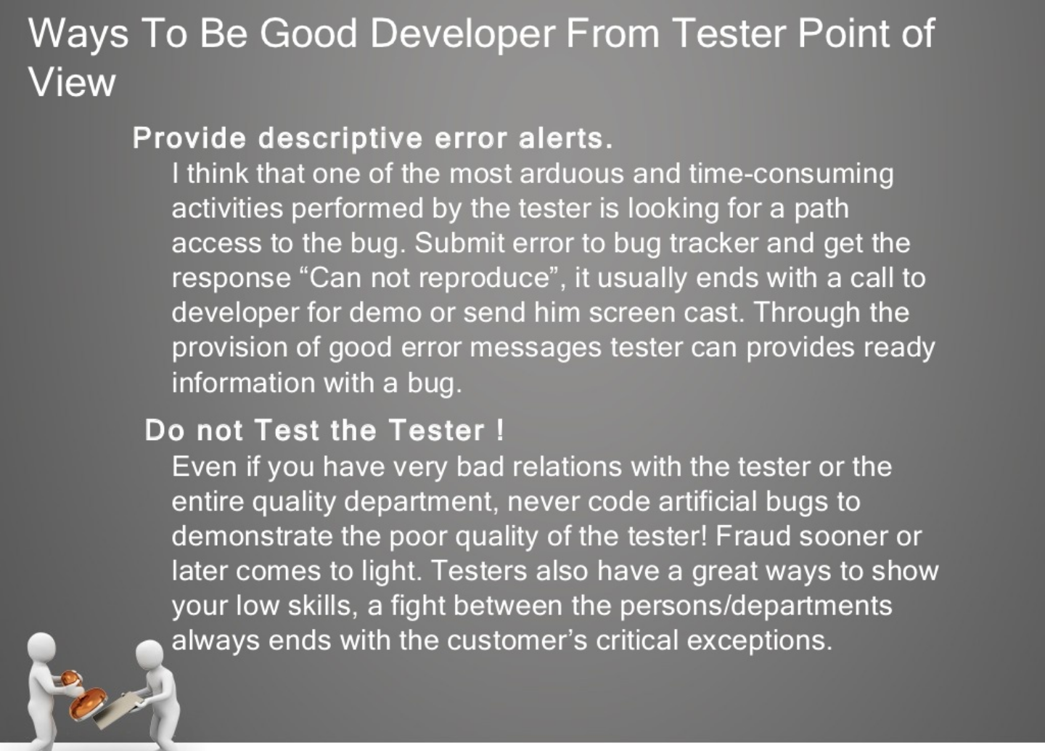
Testing Concepts

Slide 75
Good Testing Practices
A good test case is one that has a high probability of detecting an undiscovered defect, not one that shows that the program works correctly
It is impossible to test your own program
A necessary part of every test case is a description of the expected result

Slide 76
Good Testing Practices (cont’d)
Avoid non reproducible or on-the-fly testing
Write test cases for valid as well as invalid input conditions.
Thoroughly inspect the results of each test
As the number of detected defects in a piece of software increases, the probability of the existence of more undetected defects also increases

Slide 77
Good Testing Practices (cont’d)
Assign your best people to testing
Ensure that testability is a key objective in your software design
Never alter the program to make testing easier
Testing, like almost every other activity, must start with objectives

Slide 78
Levels of Testing
Unit Testing
Integration Testing
Validation Testing
Regression Testing
Alpha Testing
Beta Testing
Acceptance Testing

Slide 79
Unit Testing
Algorithms and logic
Data structures (global and local)
Interfaces
Independent paths
Boundary conditions
Error handling

Slide 80
Why Integration Testing Is Necessary
One module can have an adverse effect on another
Sub functions, when combined, may not produce the desired major function
Individually acceptable imprecision in calculations may be magnified to unacceptable levels

Slide 81
Why Integration Testing Is Necessary (cont’d)
Interfacing errors not detected in unit testing may appear
Timing problems (in real-time systems) are not detectable by unit testing
Resource contention problems are not detectable by unit testing

Slide 82
Top-Down Integration
The main control module is used as a driver, and stubs are substituted for all modules directly subordinate to the main module.
Depending on the integration approach selected (depth or breadth first), subordinate stubs are replaced by modules one at a time.

Slide 83
Top-Down Integration (cont’d)
Tests are run as each individual module is integrated.
On the successful completion of a set of tests, another stub is replaced with a real module
Regression testing is performed to ensure that errors have not developed as result of integrating new modules

Slide 84
Problems with Top-Down Integration
Many times, calculations are performed in the modules at the bottom of the hierarchy
Stubs typically do not pass data up to the higher modules
Delaying testing until lower-level modules are ready usually results in integrating many modules at the same time rather than one at a time
Developing stubs that can pass data up is almost as much work as developing the actual module

Slide 85
Bottom-Up Integration
Integration begins with the lowest-level modules, which are combined into clusters, or builds, that perform a specific software sub function
Drivers (control programs developed as stubs) are written to coordinate test case input and output
The cluster is tested
Drivers are removed and clusters are combined moving upward in the program structure

Slide 86
Problems with Bottom-Up Integration
The whole program does not exist until the last module is integrated
Timing and resource contention problems are not found until late in the process

Slide 87
Validation Testing
Determine if the software meets all of the requirements defined in the SRS
Having written requirements is essential
Regression testing is performed to determine if the software still meets all of its requirements in light of changes and modifications to the software
Regression testing involves selectively repeating existing validation tests, not developing new tests

Slide 88
Alpha and Beta Testing
It’s best to provide customers with an outline of the things that you would like them to focus on and specific test scenarios for them to execute.
Provide with customers who are actively involved with a commitment to fix defects that they discover.

Slide 89
Acceptance Testing
Similar to validation testing except that customers are present or directly involved.
Usually the tests are developed by the customer

Slide 90
Test Methods
White box or glass box testing
Black box testing
Top-down and bottom-up for performing incremental integration
ALAC (Act-like-a-customer)

Slide 91
Test Types
Functional tests
Algorithmic tests
Positive tests
Negative tests
Usability tests
Boundary tests
Startup/shutdown tests
Platform tests
Load/stress tests

Slide 92
Concurrent Development/ Validation Testing Model
Conduct informal validation while development is still going on
Provides an opportunity for validation tests to be developed and debugged early in the software development process
Provides early feedback to software engineers
Results in formal validation being less eventful, since most of the problems have already been found and fixed

Slide 93
Validation Readiness Review
During informal validation developers can make any changes needed in order to comply with the SRS.
During informal validation QA runs tests and makes changes as necessary in order for tests to comply with the SRS.

Slide 94
Validation Readiness Review (cont’d)
During formal validation the only changes that can be made are bug fixes in response to bugs reported during formal validation testing. No new features can be added at this time.
During formal validation the same set of tests run during informal validation is run again. No new tests are added.

Slide 95
Entrance Criteria for Formal Validation Testing
Software development is completed (a precise definition of “completed” is required.
The test plan has been reviewed, approved and is under document control.
A requirements inspection has been performed on the SRS.
Design inspections have been performed on the SDDs (Software Design Descriptions).

Slide 96
Entrance Criteria for Formal Validation Testing (cont’d)
Code inspections have been performed on all “critical modules”.
All test scripts are completed and the software validation test procedure document has been reviewed, approved, and placed under document control.
Selected test scripts have been reviewed, approved and placed under document control.

Slide 97
Entrance Criteria for Formal Validation Testing (cont’d)
All test scripts have been executed at least once.
CM tools are in place and all source code is under configuration control.
Software problem reporting procedures are in place.
Validation testing completion criteria have been developed, reviewed, and approved.

Slide 98
Formal Validation
The same tests that were run during informal validation are executed again and the results recorded.
Software Problem Reports (SPRs) are submitted for each test that fails.
SPR tracking is performed and includes the status of all SPRs ( i.e., open, fixed, verified, deferred, not a bug)

Slide 99
Formal Validation (cont’d)
For each bug fixed, the SPR identifies the modules that were changed to fix the bug.
Baseline change assessment is used to ensure only modules that should have changed have changed and no new features have slipped in.
Informal code reviews are selectively conducted on changed modules to ensure that new bugs are not being introduced.

Slide 100
Formal Validation (cont’d)
Time required to find and fix bugs (find-fix cycle time) is tracked.
Regression testing is performed using the following guidelines:
Use complexity measures to help determine which modules may need additional testing
Use judgment to decide which tests to be rerun
Base decision on knowledge of software design and past history

Slide 101
Formal Validation (cont’d)
Track test status (i.e., passed, failed, or not run).
Record cumulative test time (cumulative hours of actual testing) for software reliability growth tracking.

Slide 102
Exit Criteria for Validation Testing
All test scripts have been executed.
All SPRs have been satisfactorily resolved. (Resolution could include bugs being fixed, deferred to a later release, determined not to be bugs, etc.) All parties must agree to the resolution. This criterion could be further defined to state that all high-priority bugs must be fixed while lower-priority bugs can be handled on a case-by-case basis.

Slide 103
Exit Criteria for Validation Testing (cont’d)
All changes made as a result of SPRs have been tested.
All documentation associated with the software (such as SRS, SDD, test documents) have been updated to reflect changes made during validation testing.
The test report has been reviewed and approved.

Slide 104
Test Planning
The Test Plan – defines the scope of the work to be performed
The Test Procedure – a container document that holds all of the individual tests (test scripts) that are to be executed
The Test Report – documents what occurred when the test scripts were run

Slide 105
Test Plan
Questions to be answered:
How many tests are needed?
How long will it take to develop those tests?
How long will it take to execute those tests?
Topics to be addressed:
Test estimation
Test development and informal validation
Validation readiness review and formal validation
Test completion criteria

Slide 106
Test Estimation
Number of test cases required is based on:
Testing all functions and features in the SRS
Including an appropriate number of ALAC (Act Like A Customer) tests including:
Do it wrong
Use wrong or illegal combination of inputs
Don’t do enough
Do nothing
Do too much
Achieving some test coverage goal
Achieving a software reliability goal

Slide 107
Considerations in Test Estimation
Test Complexity – It is better to have many small tests that a few large ones.
Different Platforms – Does testing need to be modified for different platforms, operating systems, etc.
Automated or Manual Tests – Will automated tests be developed? Automated tests take more time to create but do not require human intervention to run.

Slide 108
Estimating Tests Required
SRS Reference | Estimated Number of Tests Required | Notes
4.1.1 | 3 | 2 positive and 1 negative test
4.1.2 | 2 | 2 automated tests
4.1.3 | 4 | 4 manual tests
4.1.4 | 5 | 1 boundary condition, 2 error conditions, 2 usability tests
…
Total | 165

Slide 109
Estimated Test Development Time
Estimated Number of Tests: 165
Average Test Development Time: 3.5
(person-hours/test)
Estimated Test Development Time: 577.5
(person-hours)

Slide 110
Estimated Test Execution Time
Estimated Number of Tests: 165
Average Test Execution Time: 1.5
(person-hours/test)
Estimated Test Execution Time: 247.5
(person-hours)
Estimated Regression Testing (50%): 123.75
(person-hours)
Total Estimated Test Execution Time: 371.25
(person-hours)

Slide 111
Test Procedure
Collection of test scripts
An integral part of each test script is the expected results
The Test Procedure document should contain an unexecuted, clean copy of every test so that the tests may be more easily reused

Slide 112
TDD Design Patterns
Pass/Fail Patterns
These patterns are your first line of defence (or attack, depending on your perspective) to guarantee good code.
But be warned, they are deceptive in what they tell you about the code.
The Simple-Test Pattern
The Code-Path Pattern
The Parameter-Range Pattern

Slide 113
TDD Design Patterns
Data Transaction Patterns
Data transaction patterns are a start at embracing the issues of data persistence and communication.
These patterns intentionally omit stress testing, for example, loading on the server
The Simple-Data-I/O Pattern
The Constraint-Data Pattern
The Rollback Pattern

Slide 114
TDD Design Patterns
Collection Management Patterns
A lot of what applications do is manage collections of information. While there are a variety of collections available to the programmer, it is important to verify that the code is using the correct collection.
This affects ordering and constraints.
The Collection-Order Pattern
The Enumeration Pattern The
Collection-Constraint Pattern
The Collection-Indexing Pattern

Slide 115
TDD Design Patterns
Performance Patterns
Unit testing should not just be concerned with function but also with form.
How efficiently does the code under test perform its function? How fast? How much memory does it use?
Does it trade off data insertion for data retrieval effectively? Does it free up resources correctly?
These are all things that are under the purview of unit testing.
By including performance patterns in the unit test, the implementer has a goal to reach, which results in better code, a better application, and a happier customer.
The Performance-Test Pattern

Slide 116
TDD Design Patterns
Process Patterns
Unit testing is intended to test, well, units...the basic functions of the application.
It can be argued that testing processes should be relegated to the acceptance test procedures, however I don't buy into this argument.
A process is just a different type of unit. Testing processes with a unit tester provide the same advantages as other unit testing--it documents the way the process is intended to work and the unit tester can aid the implementer by also testing the process out of sequence, rapidly identifying potential user interface issues as well.
The term "process" also includes state transitions and business rules, both of which must be validated.
The Process-Sequence Pattern
The Process-State Pattern
The Process-Rule Pattern

Slide 117
TDD Design Patterns
Simulation Patterns
Data transactions are difficult to test because they often require a preset configuration, an open connection, and/or an online device (to name a few).
Mock objects can come to the rescue by simulating the database, web service, user event, connection, and/or hardware with which the code is transacting.
Mock objects also have the ability to create failure conditions that are very difficult to reproduce in the real world--a lossy connection, a slow server, a failed network hub, etc.
Mock-Object Pattern
The Service-Simulation Pattern
The Bit-Error-Simulation Pattern
The Component-Simulation Pattern

Slide 118
TDD Design Patterns
Multithreading Patterns
Unit testing multithreaded applications is probably one of the most difficult things to do because you have to set up a condition that by its very nature is intended to be asynchronous and therefore non-deterministic.
Furthermore, to perform many threading tests correctly, the unit tester application must itself execute tests as separate threads so that the unit tester isn't disabled when one thread ends up in a wait state
The Signalled Pattern
The Deadlock-Resolution Pattern

Slide 119
TDD Design Patterns
Stress-Test Patterns
Most applications are tested in ideal environments--the programmer is using a fast machine with little network traffic, using small datasets.
The real world is very different. Before something completely breaks, the application may suffer degradation and respond poorly or with errors to the user.
Unit tests that verify the code's performance under stress should be met with equal fervor (if not more) than unit tests in an ideal environment.
The Bulk-Data-Stress-Test Pattern
The Resource-Stress-Test Pattern
The Loading-Test Pattern

Slide 120
TDD Design Patterns
Presentation Layer Patterns
One of the most challenging aspects of unit testing is verifying that information is getting to the user right at the presentation layer itself and that the internal workings of the application are correctly setting presentation layer state.
Often, presentation layers are entangled with business objects, data objects, and control logic. If you're planning on unit testing the presentation layer, you have to realize that a clean separation of concerns is mandatory. Part of the solution involves developing an appropriate Model-View-Controller (MVC) architecture. The MVC architecture provides a means to develop good design practices when working with the presentation layer. However, it is easily abused. A certain amount of discipline is required to ensure that you are, in fact, implementing the MVC architecture correctly, rather than just in word alone.
The View-State Test Pattern
The Model-State Test Pattern

Slide 121
TDD Tools
Eclipse Oxygen
Git or bitbucket
Junit
TestNG
Hamcrest
AssertJ
Java Code Coverage (JaCoCo)
Mockito
Easy Mock
Power Mock
Selenium

Slide 122
TDD Best Practises
Naming Conventions
Separate the implementation from the test code
Name test classes in a similar fashion as classes they test
Use descriptive names for test methods
Write the test before writing the implementation code
Only write new code when test is failing
Rerun all tests every time implementation code changes

Slide 123
TDD Best Practises
All tests should pass before new test is written
Refactor only after all tests are passing
Write the simplest code to pass the test
Write assertions first, act later
Minimize assertions in each test
Do not introduce dependencies between tests
Use mocks(reduce dependency)
Use setup and tear-down methods
Do not use base classes

Slide 124
Mocking in Unit testing
In simple English, Mocking is make a replica or imitation of something.
We use mocking in unit testing. A object that you want to test may have dependencies on other complex objects.
To isolate the behavior of the object you want to test you replace the other objects by mocks that simulate the behavior of the real objects.
So in simple words, mocking is creating objects that simulate the behavior of real objects.

Slide 125
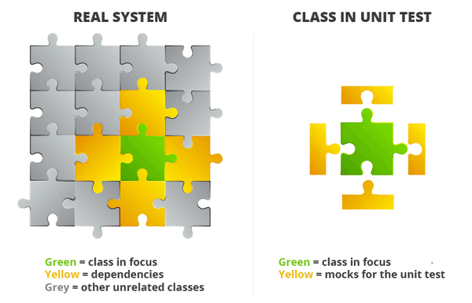

Slide 126
Mocking in Unit testing
In simple terms, providing a controlled instance or implementation of dependency that the code under test depends on in order to test its core logic.
A controlled instance is that the behavior of the dependency can be programmed or controlled as desired for the method or system under test.
let’s take an example of any Business or Ecommerce Application.
Almost every such type of application primarily has 3 layers i.e. User Interface, Business Layer & Data Access layer (which talks to the underlying data store)

Slide 127
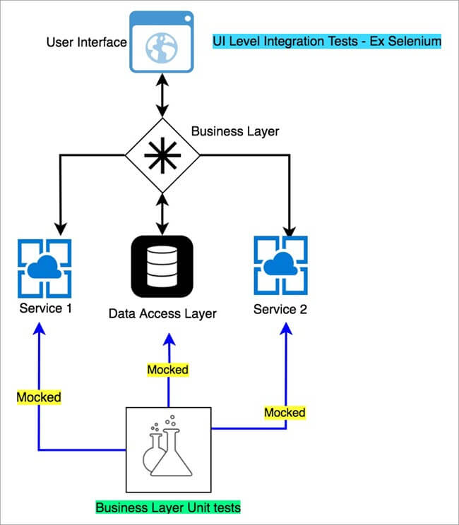

Slide 128
Mocking in Unit testing
Look at it this way – An app like google maps can have dependencies on an
Actual data stores like MySQL or any other no SQL database which stores Map data.
An external service like Coordinate Service which provides latitudes and longitudes of a location.
An external service like traffic service which provides real-time traffic information for a given Coordinate pair.

Slide 129
Mocking in Unit testing
So, if someone is trying to validate the core business logic using unit test, until and unless they have working implementations of these dependencies, the tests could not be run.
Mocks come to rescue in these situations, where no matter your dependency is up and running or not, you are always guaranteed to run your business logic with a programmed response for the dependency that’s being getting called from the code under test.

Slide 130
Types/Categories of Test Doubles
Mock is essentially a type of “Test Double” – it’s a tech jargon.
“Test Double” essentially means an object which is replaced by equivalent real object instance or dependency.
There are different types of Test doubles as mentioned below:
Fakes
Stubs
Spies
Mocks

Slide 131
Fakes:
A fake is a working implementation similar to a real dependency, except the fact that it is local to the system under test.
A Fake is more powerful than Stub.
Fake classes can change the behavior based on input.
Fake class functions can return different output for different inputs unlike that of stub.
Fakes can help us to mimic all the possible behavior of the interfaces.
Example: Instead of hitting a real production DB, the test uses a simple collection/in-memory to store data.

Slide 132
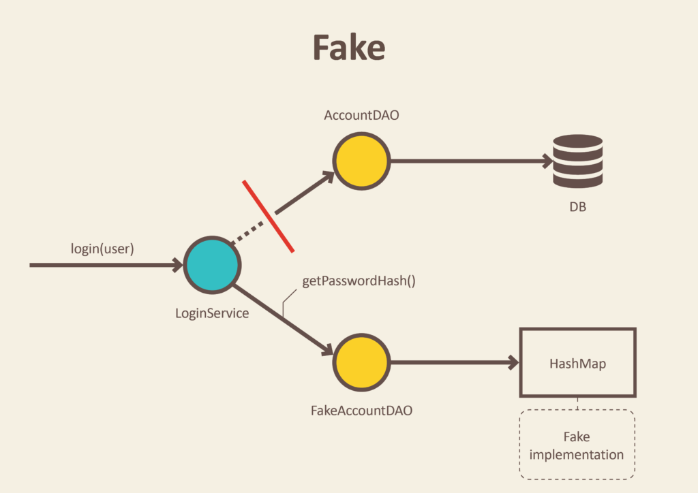

Slide 133
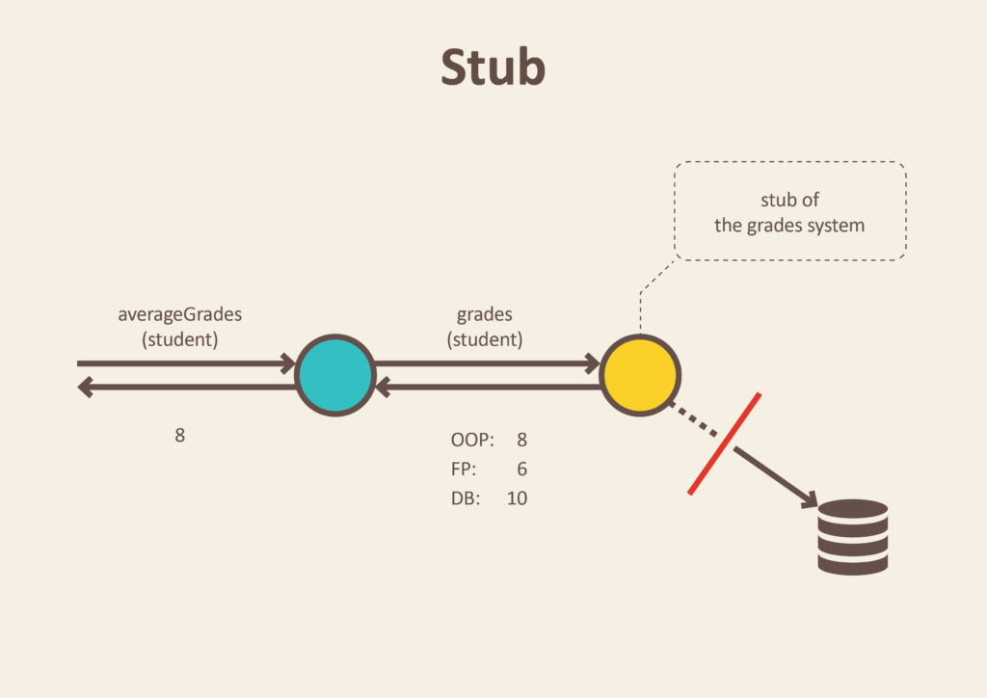
Stubs:
Stubs are pre-configured responses when a dependency is called from the system under test.

Slide 134
Stubs:
A Stub is the lightest and most static version of this chain.
Stub always returns the predefined output regardless of the input.
We can't control the behavior of the stub.
A stub can be useful to mimic the database objects (as shown below).

Slide 135
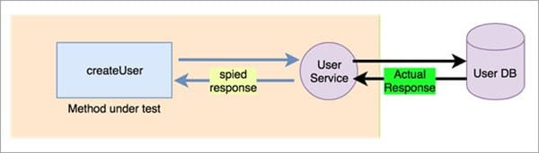
Spies:
As the name suggests, its actually the real function (dependency) call with some watching mechanism. Post the call, it can be verified whether the call was actually triggered or not along with the parameters.

Slide 136
Spies:
Spy is an advanced version of the Fake which can store the previous state of the object.
The spy can be useful to mimic the retry services or to check scenarios like 'if the function called at least once'.
You can also create a spy for loggers to store and validate all the logs logged while running the test case.

Slide 137
Mocks:
Mocks are special instances of objects, on which Stubbed/pre-configured responses can be specified. The fact that the mock got called can be verified as an assert in the test.
There is a report generator function which sends an email to a specified address during execution.
As we don’t want to send actual email, again and again, during testing, the Email Service is mocked (and the email method which sends the email is configured to do nothing when it’s called).
At the end of the test, we can just verify that the email sending method of the email service got called through the mocked object.

Slide 138
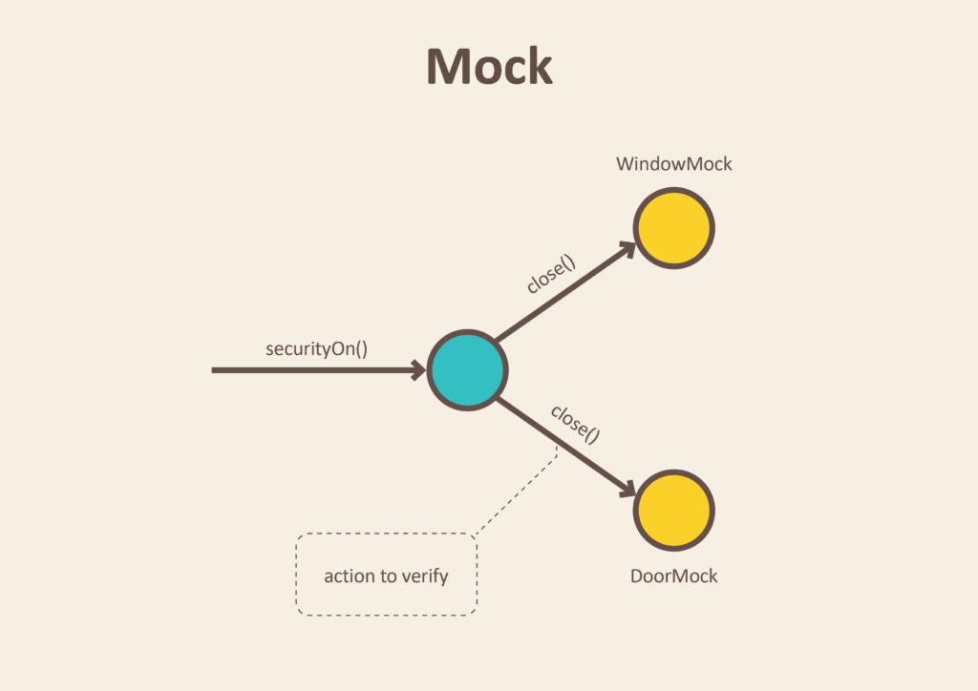

Slide 139
Mocks
A Mock is the most powerful and flexible version in the chain.
The behavior of the mocked interface can be changed dynamically based on scenarios.
We can apply a variety of assertions by creating Mocked objects using mock frameworks, for example - Mockito.
Mock gives the full control over the behavior of mocked objects.

Slide 140
What are the benefits of mocking?
You can create tests in advance; TDD
Teams can work in parallel
You can create proof of concepts or demos.
You can write test for resource not accessible
Mock can be delivered to the customer
You can isolate systems

Slide 141
What are the key mocking concepts?
When it comes to mocking, there are only 3 things you really need to worry about;
Stubbing
setting expectations
verifying.

Slide 142
Stubbing
Stubbing is the process of telling your fake how to behave when it is interacted with.
You can generally stub public properties (those with getters and/or setters) and public functions.
When it comes to stubbing functions, you have a lot of choices typically.
You may wish to return a specific value, throw an error or dispatch an event.
Further, you may wish to indicate that the function behave differently depending upon how it is invoked (i.e. by matching the types or values of the parameters passed to the function).

Slide 143
Stubbing
One great feature of many of the mocking frameworks is that you need not stub void functions.
Nor do you have to stub any functions that are not invoked or properties that are not consulted during the execution of your tests.

Slide 144
Setting Expectations
One of the key features of a fake is the ability to tell the fake what you expect when your test runs.
For example, you may expect that a specific function be invoked exactly 3 times.
You may expect that it never be invoked.
You may expect that it be invoked at least twice, but not more than 5 times.
You may expect that it be invoked with specific types of arguments or specific values or any combination of the above.
The possibilities are endless.

Slide 145
Setting Expectations
Setting expectations is the process of telling your fake what you expect to happen to it.
Remember that since it’s a fake, nothing actually happens.
But, your class under test is none the wiser.
From its perspective, it invoked the function and expects that it did whatever it was supposed to do.

Slide 146
Verifying
Setting expectations and verification go hand in hand.
Setting expectations is done prior to invoking the function(s) on the class under test.
Verification is done after. So, first you set expectations, then you verify that your expectations were met.
From a unit testing perspective, if your expectations were not met, the unit test fails.
For example, if you set the expectation that the ILoginService.login function should be invoked exactly once with a specific username and password, but it was never invoked during the execution of your test, then the fake would not verify and the test should fail.

Slide 147
Mockito framework
Mockito is an open source testing framework for Java released under the MIT License.
Mockito distinguishes itself from other mocking frameworks by allowing developers to verify the behavior of the system under test (SUT) without establishing expectations beforehand.
One of the criticisms of mock objects is that there is a tighter coupling of the test code to the system under test.
Since Mockito attempts to eliminate the expect-run-verify pattern by removing the specification of expectations, the coupling is reduced or minimized.
The result of this distinguishing feature is simpler test code that should be easier to read and modify

Slide 148
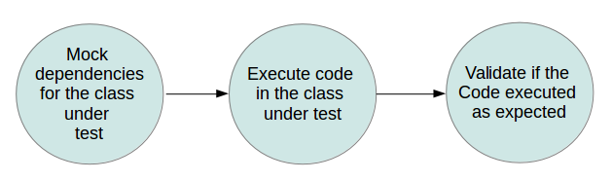
Mockito

Slide 149
Adding Mockito as dependencies to a project
If you use Maven, add the following dependency to the POM.xml.
<!-- https://mvnrepository.com/artifact/org.mockito/mockito-all -->
<dependency>
<groupId>org.mockito</groupId>
<artifactId>mockito-all</artifactId>
<version>1.10.19</version>
</dependency>

Slide 150
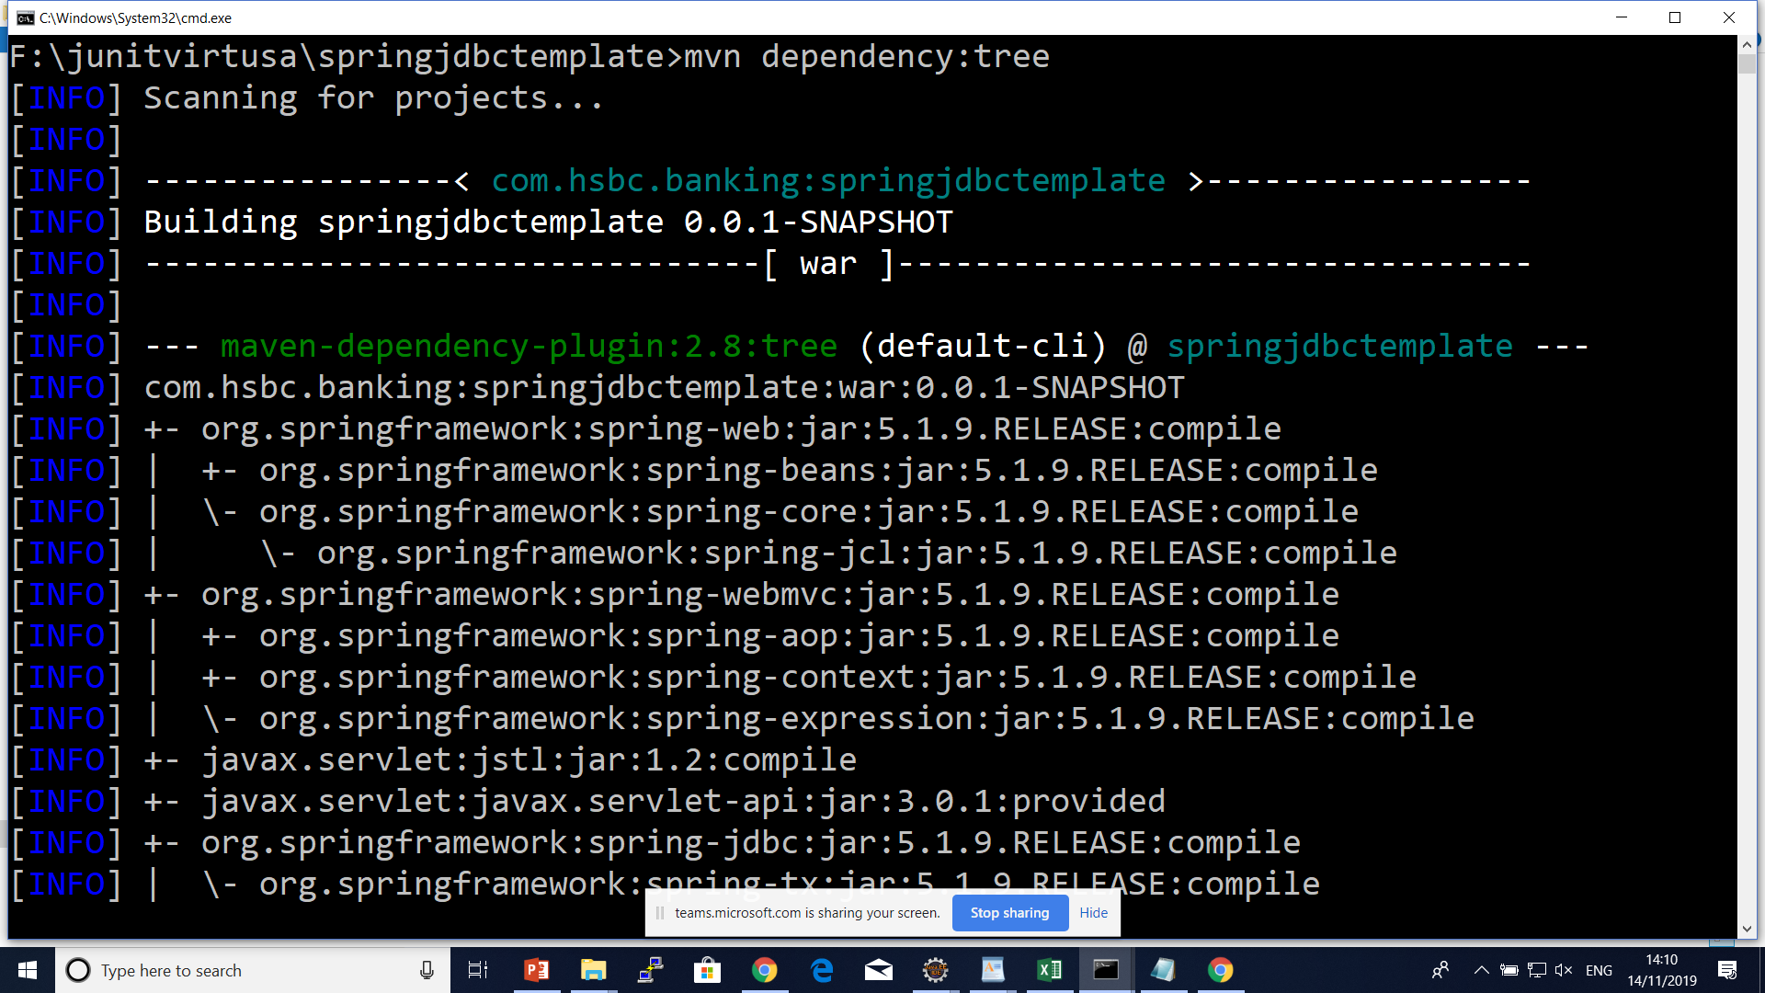

Slide 151
Mockito Annotations
@Mock
@Mock to create and inject mocked instances without having to call Mockito.mock manually.
@Spy
@Captor
@InjectMocks

Slide 152
PowerMock– Mocking the Impossible
PowerMockito is a PowerMock's extension API to support Mockito.
It provides capabilities to work with the Java Reflection API in a simple way to overcome the problems of Mockito, such as the lack of ability to mock final, static or private methods.

Slide 153
PowerMock– Mocking the Impossible
With PowerMockito it is possible to mock all the hard cases that Mockito does not support.
Most of the time this means mocking of static methods.
But it is also possible to mock private methods and constructor calls.
Anyway most of time the use case is mocking static methods calls.
PowerMockito is using byte code manipulation and thus it comes with its own JUnit runner.

Slide 154
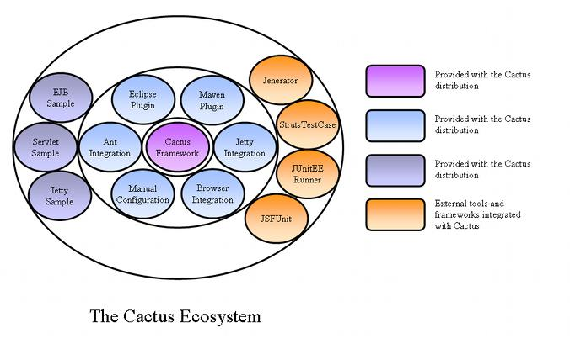
Apache Cactus

Slide 155
Apache Cactus
The Cactus Ecosystem is made of several components:
The Cactus Framework: This is the heart of Cactus. It is the engine that provides the API to write Cactus tests.
The Cactus Integration Modules: They are front ends and frameworks that provide easy ways of using the Cactus Framework (Ant scripts, Eclipse plugin, Maven plugin, ...).
The Cactus Samples: They are simple projects that demonstrate how to write Cactus tests and how to use some of the Integration Modules.

Slide 156
Apache Cactus
Cactus is a simple test framework for unit testing server-side java code (Servlets, EJBs, Tag Libs, Filters).
The intent of Cactus is to lower the cost of writing tests for server-side code.
It uses JUnit and extends it. Cactus implements an in-container strategy that executes the tests inside a container.

Slide 157
Different kinds of unit tests
There are several kinds of unit testing frameworks. We categorize them in 3 types:
Type 1: code logic unit testing. Probably the best strategy for these tests is to use a Mock Objects type framework.
Type 2: integration unit testing. Cactus is typically in this category (we'll let you judge if it is the best or not :)). These tests will exercise the interactions with the container.
Type 3: functional unit testing. These unit tests will let you test the returned values from your server code.
This is for example HttpUnit (Note that HttpUnit also performs standard functional testing - as opposed to functional unit testing -, which let you test full use cases - a login use case for example, which is comprised of several requests/responses).

Slide 158
Questions

Slide 159
Module Summary
Junit and mockito

