Slide 1
Tailwind CSS
Parameswari E

Slide 2
Goals
1️⃣ What is Tailwind CSS?
2️⃣ Utility-First Philosophy (Core Concept)
3️⃣ Why Tailwind is Popular
4️⃣ Tailwind Installation (Vite + React)
5️⃣ Core Tailwind Building Blocks
6️⃣ Colors System
7️⃣ Responsive Design (VERY IMPORTANT)
8️⃣ Hover, Focus, Active States
9️⃣ Dark Mode

Slide 3
Goals
🔟 Reusing Styles (@apply)
1️⃣1️⃣ Tailwind in React (Best Practices)
1️⃣2️⃣ Tailwind vs Bootstrap
1️⃣3️⃣ When to Use Tailwind
1️⃣4️⃣ Real-World Example

Slide 4
1️⃣ What is Tailwind CSS?
Tailwind CSS is a utility-first CSS framework.
Instead of writing custom CSS files like:
    .btn {
    background: blue;
    color: white;
    padding: 8px 16px;
    border-radius: 6px;
    }
You write styles directly in HTML/JSX using utility classes:
  <button className="bg-blue-500 text-white px-4 py-2 rounded">
  Click Me
  </button>

Slide 5
2️⃣ Utility-First Philosophy (Core Concept)
Utility | Meaning
p-4 | padding: 1rem
m-2 | margin: 0.5rem
text-xl | font-size
bg-red-500 | background color
flex | display: flex

Slide 6
3️⃣ Why Tailwind is Popular
✅ Advantages
No CSS naming headache
  No .header-container-wrapper
Fast UI development
Consistent spacing & colors
Dead CSS removed automatically
Perfect for React, Vue, Angular

Slide 7
3️⃣ Tailwind Concerns
Concern | Solution
HTML looks long | Components solve this
Hard to read | Use formatting & grouping
Reuse styles | Use @apply or components

Slide 8
4️⃣ Tailwind Installation (Vite + React)
Step 1: Install Tailwind
npm install -D tailwindcss postcss autoprefixer

Slide 9
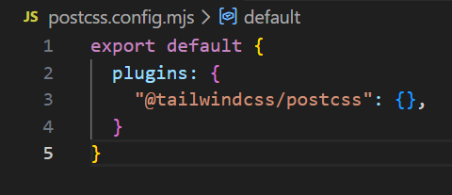
4️⃣ Tailwind Installation (Vite + React)
Step 2: Configure postcss.config.mjs
export default {
plugins: {
"@tailwindcss/postcss": {},
}
}

Slide 10
4️⃣ Tailwind Installation (Vite + React)
Step3: Add @import "tailwindcss"; in root css file

Slide 11
5️⃣ Core Tailwind Building Blocks
<div class="p-4 m-2 w-64 h-32 border rounded-lg"></div>
Class | Purpose
p-* | padding
m-* | margin
w-* | width
h-* | height
border | border

Slide 12
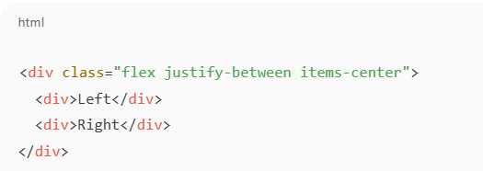
5️⃣ Core Tailwind Building Blocks
🔹 Flexbox
Utility | Meaning
flex | display flex
justify-center | horizontal
items-center | vertical
gap-4 | spacing

Slide 13
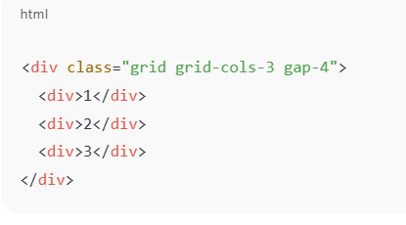
5️⃣ Core Tailwind Building Blocks
🔹 Grid

Slide 14
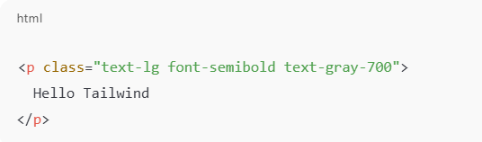
5️⃣ Core Tailwind Building Blocks
🔹 Typography
Utility | Meaning
text-sm/xl | font size
font-bold | weight
text-center | alignment

Slide 15
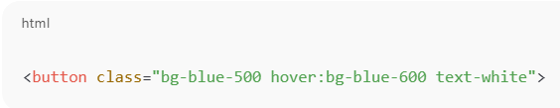
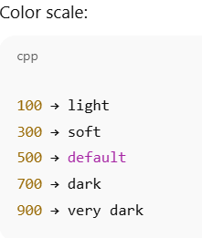
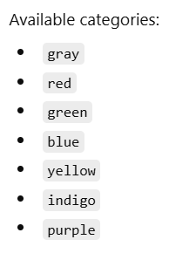
6️⃣ Colors System

Slide 16

7️⃣ Responsive Design (VERY IMPORTANT)
Tailwind uses mobile-first breakpoints.
Prefix | Screen
sm: | ≥640px
md: | ≥768px
lg: | ≥1024px
xl: | ≥1280px

Slide 17
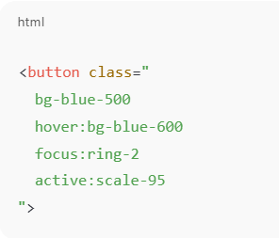
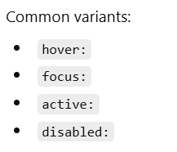
8️⃣ Hover, Focus, Active States

Slide 18
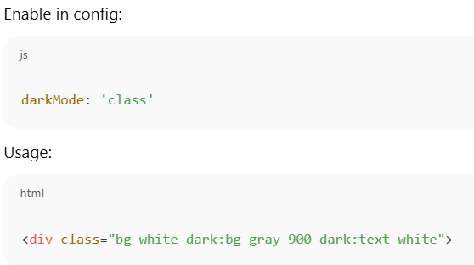
9️⃣ Dark Mode

Slide 19
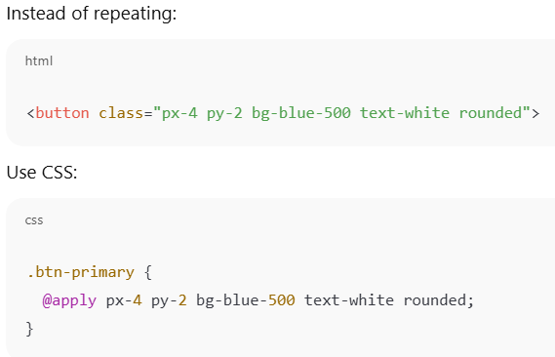
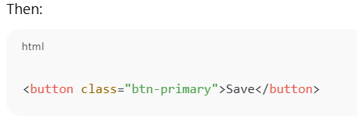
🔟 Reusing Styles (@apply)

Slide 20
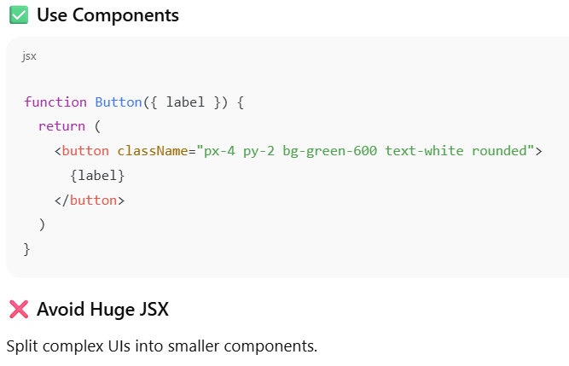
1️⃣1️⃣ Tailwind in React (Best Practices)

Slide 21
1️⃣2️⃣ Tailwind vs Bootstrap
Feature | Tailwind | Bootstrap
Design freedom | ⭐⭐⭐⭐⭐ | ⭐⭐
File size | Small | Large
Custom UI | Easy | Hard
Learning curve | Medium | Easy

Slide 22
1️⃣3️⃣ When to Use Tailwind
✅ Use Tailwind if:
React / Vite / Next.js
Custom UI design
Design systems
Performance matters
❌ Avoid if:
You want ready-made components only
Minimal customization

Slide 23
1️⃣4️⃣ Real-World Example
<div className="max-w-md mx-auto p-6 bg-white rounded-lg shadow">
<h2 className="text-xl font-bold mb-4">Login</h2>
<input className="border p-2 w-full mb-3 rounded" />
<button className="w-full bg-blue-600 text-white py-2 rounded">
Login
</button>
</div>

Slide 24
Questions

Slide 25
Module Summary
1️⃣ What is Tailwind CSS?
2️⃣ Utility-First Philosophy (Core Concept)
3️⃣ Why Tailwind is Popular
4️⃣ Tailwind Installation (Vite + React)
5️⃣ Core Tailwind Building Blocks
6️⃣ Colors System
7️⃣ Responsive Design (VERY IMPORTANT)
8️⃣ Hover, Focus, Active States
9️⃣ Dark Mode

