Slide 1
IO

Slide 2
Recall
We already learnt how to get input from console. Do you remember the class we used for this?

Slide 3
Console IO
Java 6 introduces a new class called Console in java.io package.
This class has convenient method that can prompt the user for the input and read input from the terminal at the same time.
It is also does has features that will not echo the password entry on the screen.
This class is character based.
Console is a final class with no public constructors. To obtain Console object
System.console() method is used which returns the only instance that JVM has for this class
Read and write operations are synchronized methods.

Slide 4
JVM and Console
JVM has a console that is dependent upon the underlying platform. This object can be obtained using the System.console() method that returns Console object
If the JVM is started from command line then its console will exist.
If the virtual machine is started automatically or from an IDE then console will not be available.
Therefore before using the Console object, a check for null has to be done to ensure that the object exists.
if ((cons = System.console()) != null){
…
}

Slide 5
Console Methods
Console format(String fmt, Object... args)
Console printf(String fmt, Object... Args)
  Used to write formatted data. The fmt represents format string which are same as the one that was used for System.out.printf.
String readLine(String fmt, Object... args0)
  Prompts and reads a single line of text
String readLine()
  reads a single line of text
char[] readPassword(String fmt, Object... args)
  Prompts and reads a password or passphrase from the console with echoing disabled
char[] readPassword()
  reads a password or passphrase from the console with echoing disabled

Slide 6
Example
import java.io.Console;
import java.util.Arrays;
public class Test {
public static void main(String[] args) {
String pass="abcd";
Console c = System.console();
if (c == null) {
System.err.println("Console Object is not available.");
System.exit(1);
}
String login = c.readLine(“Login:");
char [] pwd = c.readPassword(“Password: ");
String s=new String(pwd);
if(s.equals(pass)) System.out.println("Right pwd");
else System.out.println("Incorrect pwd");
}}
Note that this code throws an exception at runtime when run on eclipse. It prints “Console Object is not available”.
But it works fine when you run from the command prompt.

Slide 7
Working with files at OS level
java.io.File class can be used to work with system dependent commands for files and directories.
The path name in the code hence will depend on the underlying OS in which JVM is installed.
To make the code portable so that it works on all systems, static member separator defined in the File class can be used.
The path name can be either absolute or relative.
The access permissions on an File object may cause some methods in this class to fail.
Instances of the File class are immutable; that is, once created, the abstract pathname represented by a File object will never change!

Slide 8
Creating a file using File
File(String pathname)
  Creates a new File instance (if relative path is given then it converts it into abstract pathname)
File(String parent, String child)
File(File parent, String child)
  Creates a new File instance from a parent pathname and a child pathname string. If “parent” is null then it behaves like the single-argument File constructor
  boolean createNewFile() throws IOException
  creates a new, empty file if a file with the name (as specified in the constructor) does not exist and returns true; otherwise it returns false. Note that this method throws IOException if I/O error occurs
So to create a file:
  Create instance of File object
  Call createNewFile method

Slide 9
Other members in File
static final String separator
  system-dependent separator character
boolean delete()
  Deletes the file or directory. Directory must be empty in order to be deleted. Returns true if the delete operation is successful.
void deleteOnExit()
  Deletes the file or directory when the virtual machine terminates. Deletion happen only for normal termination of the virtual machine. Once deletion has been requested, it is not possible to cancel the request
  boolean renameTo(File dest )
    Renames the file . This is system dependent so return value should always be checked to make sure that the rename operation was successful

Slide 10
boolean mkdir()
  Creates the directory named by the pathname. Returns true if the directory was created; false otherwise
boolean mkdirs()
  Creates the directory named by this pathname, including any necessary but nonexistent parent directories. Note that if this operation fails it may have succeeded in creating some of the necessary parent directories.
  boolean isDirectory()
  Returns true if the File object denotes a directory; false otherwise.
  String getName()
  Returns the name of the file or directory . just the last name in the pathname's name sequence

Slide 11
String[] list()
  Returns list names files and directories in the directory
boolean isFile()
  Returns true if the File object denotes a file; false otherwise.
boolean isHidden()
  Returns true if the File object is a hidden file; false otherwise.
boolean exists()
  Returns true if the file or directory exists; false otherwise
String getAbsolutePath()
  Returns the absolute pathname string of this abstract pathname
long lastModified()
  Returns the time that the file object was last modified.
long length()
  Returns the length of the file, unspecified it is a directory.

Slide 12
New methods added in Java 6
boolean canExecute()
boolean canRead()
boolean canWrite()
  Returns true if the application can execute/read/write the file denoted; false otherwise
boolean setXxx(boolean permission)
setXxx(boolean permission, boolean ownerOnly)
  Xxx could be Readable, Executable or Writable
  Sets the read/execute/write permission if permission is true
  ownerOnly is true then the read/execute/write permission applies only to the owner's execute permission provided underlying file system can distinguish between owner and others; otherwise, it applies to everybody.

Slide 13
Example: Creating a file
Creates a new file named newFile.txt. If file exists then it deletes the file and creates a new one
import java.io.*;
class FileOper{
public static void main(String str[]){
try{
File file = new File("newFile.txt");
if(file.exists())
file.delete();
boolean b=file.createNewFile();
System.out.println(b);
}catch(IOException e){ }
}}

Slide 14
What are streams
An IO stream is an abstract term for any type of input or output device.
There are 2 types of stream
  Input stream to read data from a source. An input stream may be files, keyboard, console, other programs, a network, or an array!
  Output stream to read data into a destination. An output stream may be disk files, monitor, a network, other programs, or an array
Fundamentally stream may be
  Byte stream : data read or written is in the form of byte
  or
  Character stream: data read or written is in the form of character
Stream is a sequence of data

Slide 15
Stream types in Java
Character stream
  Character stream writer classes
  Character stream reader classes
Byte stream
  Byte stream writer classes
  Byte stream reader classes
  Supports Serialization

Slide 16
Character stream
As we are aware, the character in java is in the form of unicode.
Character stream I/O automatically translates unicode to the local character set.
At the top of the hierarchy we have Reader and Writer abstract classes are provided
First we will explore Writer classes

Slide 17
Hierarchy of character stream writer
Writer
CharArrayWriter
StringWriter
OutputStreamWriter
FileWriter
BufferedWriter
…

Slide 18
Writer
void write(char[] cbuf)
void write(char[] cbuf, int off, int len)
void write(String str)
void write(String str, int off, int len)
void write(int c)
void close()
void flush()
It is an abstract class for writing to character streams. Methods are to write or append a character or character array or strings and flush.
All the methods throw IOException.

Slide 19
CharArrayWriter
CharArrayWriter allows to write data into char array.
Constructors:
CharArrayWriter()
CharArrayWriter(int initialSize)
Methods
char[] toCharArray()
int size()
String toString()
CharArrayWriter append(char c)
void writeTo(Writer out)
And all the methods of the Writer class.

Slide 20
StringWriter
StringWriter allows to write data string.
Constructors:
  StringWriter()
  StringWriter(int initialSize)
Methods
  StringWriter append(char c)
  String toString()
  StringBuffer getBuffer()

Slide 21
OutputStreamWriter
An OutputStreamWriter is a used as a bridge from character streams to byte streams:
Constructor:
OutputStreamWriter(OutputStream out)
OutputStream is a the top-most class in the byte stream (like Writer is top-most class in the character stream )
Example:
Writer out = new OutputStreamWriter(System.out);
If you remember out is a member of System class which is of type PrintStream which is subclass of OutputStream.
public void write(int c)

Slide 22
Example : OutputStreamWriter
The code extracts part of string and displays on the console.
Note the way we have used finally to close the stream.
public class Test {
public static void main(String[] args) {
Writer out = new OutputStreamWriter(System.out);
String s="hello java";
try {
out.write(s, 3, 5);
} catch (IOException e) {e.printStackTrace();}
finally{
try {
out.close();
} catch (IOException e) {
e.printStackTrace();
}
}}}
Result
lo ja

Slide 23
FileWriter
FileWriter inherits from OutputStreamWriter.
Constructors:
FileWriter(File file)
FileWriter(String fileName)
Creates an instance of FileWriter and also the file if it does not exist. If it exists it overwrites.
If the file exists but is a directory rather than a regular file IOException is thrown
FileWriter(File file, boolean append)
FileWriter(String fileName, boolean append)
Provide same functionalities as that of the previous constructor, if append is true, then data will be written to the end of the file rather than the beginning.
All constructors throw IOException

Slide 24
Example: Using CharArrayWriter & FileWriter
In this example we first get all the command-line strings in a CharArrayWriter and then copy the content of CharArrayWriter to a file using FileWriter
import java.io.*;
public class CharWriterMain {
public static void main(String args[]) {
FileWriter f2 =null;
try{
CharArrayWriter f= new CharArrayWriter();
int i=1;
for (String s:args){
char buf[] = s.toCharArray() ;
f.write(i++ +".");
f.write(buf,0,s.length());
f.write("\n");
}
f2 =new FileWriter("register.txt");
f.writeTo(f2);
} catch(IOException ioe){}

Slide 25
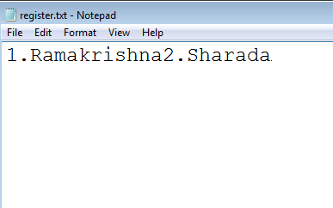
finally{
try{if(f2!=null)f2.close();}
catch(IOException e){}}
}}
On executing with the following command line arguments
java CharWriterMain Ramakrishna Sharada
register.txt file gets created .
When we open the file we find that the newline char is written into the file.
This happen s because Notepad expects "lines" to be separated by \r\n.
Since line separator is OS dependent best way to code this would be to use newLine() discussed in the next slide.

Slide 26
BufferedWriter
This class wraps the Writer class to provide additional functionality of buffering characters for the efficient writing of single characters, arrays, and strings.
Constructors:
BufferedWriter(Writer out)
BufferedWriter(Writer out, int size)
Creates a buffered character stream object. The default buffer size is large enough for most purposes. In cases where more is required size can be specified.
If size<0 _________________ is thrown.
(Can you guess what exception it could be?)
Methods:
void newLine() throws IOException
Notes:
IllegalArgumentException

Slide 27
Example : Creating a CSV file
This example creates a csv file by getting the inputs from the user.
Note the use of separator while specifying absolute path.
import java.io.*;
public class CSVWrite {
public static void main(String args[]) {
BufferedWriter f2=null;
try{
f2= new BufferedWriter(new FileWriter("D:"+File.separator+"a.csv"));
while(true){
Console c= System.console();
String s=c.readLine("Enter Name");
f2.write(s+",");

Slide 28
s=c.readLine("Enter ID");
f2.write(s+",");
f2.append(',');
s=c.readLine("Enter Degree");
f2.write(s+",");
f2.newLine();
s=c.readLine("do you want to continue(y/n)");
if(s.equalsIgnoreCase("n")) return;
} } catch(IOException ioe){}
finally{
try{if(f2!=null)f2.close();}
catch(IOException e){}}
}}

Slide 29
Hierarchy of character stream reader
Reader class hierarchy is very similar to that of the Writer hierarchy.
FileReader and FileWriter form pairs where one can be used for reading the text which other has written. Similarly we have CharArrayReader and CharArrayWriter, InputStreamReader and OutputStreamWriter, BufferedReader and BufferedWriter
Reader
CharArrayReader
BufferedReader
LineNumberInputStream
FilterReader
PushbackReader
InputStreamReader
FileReader
…

Slide 30
Reader
Reader is an abstract class for reading character streams.
Methods:
void close()
int read() : -1 as return value indicates the end of stream
int read(char[] cbuf, int off, int len)
void mark(int readAheadLimit)
void reset()
Marks the current position in the stream. When reset() is called after mark() the file pointer is positioned to the marked position.
readAheadLimit is used to specify how many characters can be read further from the marked position so as to retain the marked position. If characters read is greater than what is specified in readAheadLimit, then calling reset does not position the file pointer in the marked position.

Slide 31
long skip(long n)
boolean markSupported()
mark() and reset() are optional methods that is not all implementing class need to provide the implementation for mark() and reset(). Therefore before they are used we must test if they are supported by the implementing class using markSupported()
All of the methods except markSupported() throw IOException.

Slide 32
CharArrayReader and StringReader
The data source for this class is a character array. Therefore reading happens from here.
CharArrayReader(char[] buf)
CharArrayReader(char[] buf, int offset, int length)
This class supports mark() and reset()
The data source for this class is a character array. Therefore reading happens from here.
StringReader(String s)
This class supports mark() and reset()

Slide 33
Example: using mark and reset
This example reads from a string and prints “Right-Shift” when it encounters “>>” and “Greater-Than” when it encounters ‘>’.
Note how we have read-ahead to see if the next symbol to > is again a >, used mark to go back and read if the symbol is not >.
import java.io.*;
class Expression {
public static void main(String[] s) throws IOException{
String s1="1>>2>3>4>>5;";
StringReader sw= new StringReader(s1);
int i;
while((i=sw.read())!=';‘){
if(i=='>') {
sw.mark(1);
i=sw.read();
if(i=='>') System.out.print(" Right-Shift ");
else{ System.out.print(" Greater-Than ");
sw.reset();}}
else System.out.print((char)i);}} }
1 Right-Shift 2 Greater-Than 3 Greater-Than 4 Right-Shift 5

Slide 34
PushbackReader
This class allows characters to be pushed back into the stream. This is a wrapper class.
This class supports mark() and reset()
Constructor
  PushbackReader(Reader in)
Methods
  void unread(int c)
  Pushes back a character specified by c by copying it to the front of the pushback buffer. Next character that will be read is c.
  void unread(char[] cbuf)
  void unread(char[] cbuf, int off, int len)
  Pushes back a char array or part of char array (of length len starting from offset off) by copying it to the front of the pushback
  long skip(long n)
  Places the file pointer after n characters.

Slide 35
Example: PushbackReader
Same as the previous example using PushbackReader.
import java.io.*;
class TestWrite {
public static void main(String[] s) throws IOException{
String s1="1>>2>3>4>>5;";
StringReader sw= new StringReader(s1);
PushbackReader f = new PushbackReader(sw);
int i;
while((i=f.read())!=';'){
if(i=='>') {
i=f.read();
if(i=='>') System.out.print(" Right-Shift ");
else{ System.out.print(" Greater-Than ");
f.unread(i);}}
else System.out.print((char)i);}} }
Can you guess the result if f.unread(i) changed to f,unread(‘#’)

Slide 36
InputStreamWriter
An InputStreamWriter is a used as a bridge from character streams to byte streams:
Constructor:
InputStreamWriter(InputStream out)
InputStream is a the top-most class in the byte stream (like Reader is top-most class in the character stream )
Example:
Reader out = new new InputStreamReader(System.in);
System.in returns InputStream object.

Slide 37
FileReader
FileReader is subclass of InputStreamWriter
This class is used to read from a text file.
Constructors:
FileReader(File file) throws FileNotFoundException
FileReader(String fileName) throws FileNotFoundException
Either filename can be specified as a String or File object is passed to the FileReader constructor.
If the file specified by the name does not exist a FileNotFoundException is thrown
FileNotFoundException is a subclass of IOException

Slide 38
BufferedReader
Reads text from a character-input stream by buffering characters for the efficient reading of characters, arrays, and lines.
Constructor:
BufferedReader(Reader in)
BufferedReader(Reader in, int sz)
The default buffer size is large enough for most purposes. In cases where more is required size can be specified.
Methods:
String readLine() throws IOException
This class supports mark() and reset()

Slide 39
LineNumberReader
This class is subclass of BufferedReader. So in addition to providing buffering it is also used to get and set the line number.
Constructor:
LineNumberReader(Reader in)
LineNumberReader(Reader in, int sz)
Methods:
int getLineNumber()
void setLineNumber(int lineNumber)
By default the line number begins from 0.
This class supports mark() and reset()

Slide 40
Example: Reading from a CSV file
Code reads from a CSV file and prints on the console
public static void main(String[] as) throws IOException{
LineNumberReader f2=null;
try{
f2= new LineNumberReader(new FileReader("D:"+File.separator+"a.csv"));
String s=null;
while((s=f2.readLine())!=null){
StringTokenizer st=new StringTokenizer(s,",");
while(st.hasMoreElements()){
System.out.print(f2.getLineNumber());
System.out.print(" Name:" +st.nextElement());
System.out.print("ID:" +st.nextElement());
System.out.println("Degree:" +st.nextElement());
} } }catch(IOException ioe){}
finally{
try{if(f2!=null)f2.close();}
catch(IOException e){}} }}

Slide 41
Hierarchy of byte stream
InputStream
Reading happens in the form of byte.
ObjectInputStream
ByteArrayInputStream
FilterInputStream
BufferedInputStream
LineNumberInputStream
PushbackInputStream
DataInputStream

Slide 42
OutputStream
DataOutput interface
ObjectOutputStream
ByteArrayOutputStream
FilterOutputStream
BufferedOutputStream
Writing happens in the form of byte.
ObjectOutputStream
PrintStream
DataOutputStream

Slide 43
Example: using byte stream
Classes which are not in red in the last 2 slides are similar/parallel to character stream classes . Only difference is in place of char array we have byte array. So we end with an example for these classes.
Example below copies the content of one file into another file.
import java.io.*;
public class CopyFile {
public static void main(String[] args) throws IOException {
File file1 = new File("D:"+File.separator+"read.txt");
File file2 = new File("D:"+File.separator+"write.txt");
FileInputStream fin=null;
FileOutputStream fout=null;

Slide 44
try {
fin = new FileInputStream(file1);
fout = new FileOutputStream (file2);
byte fileContent[] = new byte[(int)file1.length()];
fin.read(fileContent);
String strFileContent = new String(fileContent);
fout.write(fileContent);
System.out.println(strFileContent);
}
catch(FileNotFoundException e) {
System.out.println("File not found" + e);
}
catch(IOException ioe) {
System.out.println("Exception while reading the file " + ioe);
}
finally{
if(fin!=null)fin.close();
if(fout!=null)fout.close();}}}

Slide 45
DataInputStream and DataOutputStream
A data input stream and data output stream lets an application read and write primitive Java data types from an underlying input stream and output stream in a machine-independent way.
An application uses a data output stream to write data that can later be read by a data input stream and vice versa.

Slide 46
DataOutputStream methods
Inherited from OutputStream
void write(int b)
void write(byte[] b, int off, int len)
void writeXxx(xxx v)
DataInputStream methods
int read(byte[] b)
int read(byte[] b, int off, int len)
xxx readXxx()
where xxx can be byte, short, int, long, char, float, double.
All the above methods throw IOException
Inherited from InputStream

Slide 47
Example: using DataInputStream and DataOutputStream
Example shows how primitive can be written and read using DataOutputtream and DataInputStream
import java.io.*;
class Test{
public static void main(String[] st) throws Exception{
DataOutputStream out= new DataOutputStream(new FileOutputStream("a.txt"));
int i=10;
double d= 12.3;
out.writeInt(i);
out.writeDouble(d);
out.close();
DataInputStream in= new DataInputStream(new FileInputStream("a.txt"));
System.out.println( in.readInt() );
System.out.println( in.readDouble() );
in.close();
} }

Slide 48
PrintStream
PrintStream is a class that has functionality like the ability to print representations of various data values conveniently.
System.out is an instance of PrintStream.
Apart from this, two other functionalities that are provided here are:
Unlike other output streams, a PrintStream never throws an IOException
The flush() method can be made to automatically invoked after println method is invoked or newline (‘\n’) is written.

Slide 49
PrintStream members
Constructors:
PrintStream(File file) throws FileNotFoundException
PrintStream(OutputStream out,[boolean autoFlush])
PrintStream(String fileName) throws FileNotFoundException
( The option in square brackets are optional)
void print(xxx b)
void println(xxx b)
where xxx is any primitive type, String or Object.
PrintStream printf(String format, Object... args)
PrintStream format(String format, Object... args)
Both of the above methods have same functionality.
We have been using theses method extensively through System.out

Slide 50
Serialization
The mechanism of storing the state of an object in the hard disk so that it can be restored later by your program.
Serialization enables storing values of all instance variables which includes both primitives and Serializable objects.
Serialization mechanism creates a file into which the state of the object is written.
This file can later be read by the java program which can then restore the object’s state.
ObjectOutputStream and ObjectInputStream classes are used for these purposes. They are wrapper classes that take OutputStream and InputStream objects respectively

Slide 51
ObjectOutputStream & ObjectInputStream
ObjectOutputStream
  ObjectOutputStream(OutputStream out)throws IOException
  void writeXxx(xxx v) where xxx is any primitive type, or Object
  void write(int x) out)throws IOException
  And all the methods from OutputStream
ObjectInputStream
  ObjectInputStream(InputStream in) throws IOException
  xxx readXxx() out)throws IOException where xxx is any primitive type, or Object
  readObject()throws ClassNotFoundException also in addition to IOException
  int read()
  And all the methods from InputStream

Slide 52
Steps to save and retrieve an object’s state
Saving an object state
FileOutputStream f= new FileOutputStream(“MySerFile.ser”);
ObjectOutputStream obfile= new ObjectOutputStream(f);
obfile.writeObject(objectInstance);
Obfile.close();
Retrieving an object state
FileInputStream f= new FileInputStream(“MySerFile.ser”);
ObjectInputStream obfile= new ObjectInputStream(f);
Object o=obfile.readObject();
MyObject m=(MyObject)o;
Obfile.close();

Slide 53
java.io.Serializable
Only the objects which implement Serializable interface can be serialized.
class MyObject implements Serializable{… }
Serializable is a marker interface.
If object has references, then the references also must be either Serializable or should be marked transient.
In JSE, some classes are not Serializable. For example Thread class, Subclasses of Writer, Reader, InputStream, OutputStream.
All the collection classes, all primitive wrappers, String, StringBuffer, StringBuilder are Serializable
If an attempt to serialize an object that does not implement Serializable is made, NotSerializableException is thrown.

Slide 54
transient
Instance variables marked transient will not be saved.
When object is de-serialized the transient variables are set to the default value based on their type.
During serialization even the private state of the object is stored.
Hence sensitive information like credit card number, password, a file descriptor contains a handle that provides access to an operating system resource must be marked transient.
Also if a class contains references of object that cannot be serialized (like Thread), must be marked Serializable .

Slide 55
Example: Serialization
package general;
public abstract class Person
implements Serializable{
…
}
import java.io.*;
public class SerializeP {
public static void main(String str[]) throws IOException{
Teacher f=new Teacher ("Tom");

Slide 56
//saving Teacher
ObjectOutputStream o=
new ObjectOutputStream(
new FileOutputStream("t.ser"));
o.writeObject(f);
o.close();
// reloading the object state from file
ObjectInputStream in= new ObjectInputStream(
new FileInputStream(“t.ser"));
f=(Teacher )in.readObject();
System.out.println(f);
in.close();
}}
Could be any extension

Slide 57
Beware!
You could save any number of object in a file. The definition of readObject doesn't specify that it will return null when the end of stream is reached. Instead an exception is thrown if you attempt to read an additional object beyond the end of the file.
Care must be taken while de-serializing the objects.
The objects must be cast into its correct type otherwise an ClassCastException will be thrown at runtime
The objects must be retrieved in the same way as they are saved. For instance, if you save an integer using writeInt() then you must retrieve using readInt() method. Using readObject() and casting it back to int will not work( an java.io.OptionalDataException will be thrown at runtime)
Safest and more common way to save and retrieved is to use writeObject() and readObject() methods.
readObject() and writeObject() are only for non-static and non-transient fields

Slide 58
Properties
Properties are strings stored as key-value pairs that are stored in a file.
These values are generally used for configuration purpose like application startup parameter values, database configuration values or can be even used to standardize error messages
The application reads the value of a property based on the key.
For example
  username scott
  password tiger
  could represent key-value pair for a database configuration file.
Invariably most of the application need to read from this kind of file.

Slide 59
java.util.Properties
Java provides a simple class called Properties that helps reading from and writing into property file.
Properties class inherits from Hashtable class.
Call you recall methods of Hashtable class?
Using the methods of Hashtable is not advisable as they allow the insertions of key-value that are not strings.
Instead methods provided in Properties class like setProperties(), getProperties() are to be used.
The class has methods to load data from XML file as well. At this point we are not going to look at these methods.

Slide 60
Members of Properties
Properties()
Properties(Properties defaults)
void load(InputStream inStream) throws IOException
void load(Reader reader) throws IOException
Reads a key and element pairs from a character stream or byte stream.
Object setProperty(String key, String value
String getProperty(String key)
String getProperty(String key, String defaultValue)
  setProperty()calls sets the key-value pair in the
  getProperty() looks for the property with the specified key in this property list. If the key is not found in this file, the default property list, and its defaults, recursively, are then checked. The method returns null in case of the 1st getProperty() method and defaultValue in case of 2nd if the property is not found.

Slide 61
void store(OutputStream out, String comments) throws IOException
void store(Writer writer, String comments) throws IOException
Write the key-values pairs in the property list to the byte/character stream.

Slide 62
Structure of a property file
Properties are processed in terms of lines. There are 2 types of line (as specified by the API)
  Natural line:
    Line of characters terminated by \n or \r or \r\n
    Example: blank line, comment line
      Comment line begins within # or !
      # This is a property file
  Logical line:
    Line that holds all the data of a key-element pair or
    Multiple (natural) lines by escaping the line terminator sequence with a backslash character \. Any white space at the start of subsequent line is ignored. (example in next slide)

Slide 63
Key-Value pair in a logical line
The key contains all of the characters in the line starting with the first non-white space character and up to, but not including, the first = or : or blank spaces.
Examples of acceptable key-value pairs:
  flowers rose
  flowers:rose, lily
  flowers:rose,lily
  flowers : rose
  flowers=rose
  flowers = rose
  flowers rose, lily, \
    lotus, orchid

Slide 64
Example: Property file
import java.io.*;
import java.util.Properties;
public class PtyFile {
public static void writeProperties() {
FileWriter fileWriter = null;
try{
Properties props = new Properties();
fileWriter = new FileWriter("D:"+ File.separator+"db.properties");
props.setProperty("uname", "scott");
props.setProperty("pwd", "tiger");
props.store(fileWriter,"Database credentials");
}catch(IOException ioe){ ioe.printStackTrace(); }
finally{ try{
fileWriter.close();
}catch(IOException ioe1){} }
}

Slide 65
public static void main(String[] args) {
//writeProperties();
readProperties(); }
public static void readProperties() {
FileReader fileReader = null;
try{
Properties props = new Properties();
fileReader = new FileReader("D:"+ File.separator+"db.properties");
props.load(fileReader);
System.out.println(props.getProperty("uname")); System.out.println(props.getProperty("pwd"));
}catch(IOException ioe){ ioe.printStackTrace();} finally{
try{ fileReader.close();
}catch(IOException ioe1){ }
} }

Slide 66
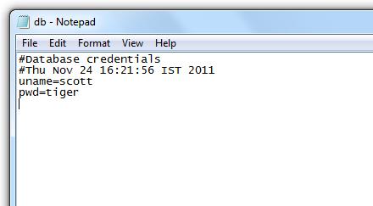
Result
Result of execution of the code
scott
tiger

Slide 67
i18n
Considering the globalized world that businesses increasingly work in, software applications must be both international and local.
Therefore internationalization and localization have become an important part of modern languages.
i18n is the process of planning and implementing products and services so that they can easily be adapted to specific local languages and cultures, a process called localization . The internationalization process is sometimes called translation or localization enablement.
‘i’ and ‘n’ in i18n refers to the 1st and last letters of “internationalization” and 18 refers to the number of letters between ‘i’ and ‘n’ in “internationalization”.

Slide 68
Resource bundles
Resource bundle is also like properties files.
But these are specifically used to store locale-specific information usually used for internationalization/globalization of messages.
For every locale there could be separate resource bundle.
For example, we could have 2 different files one for US (English ) as ResBun_en_US.properties and another for France(french) as ResBun_fr_FR.properties.
Two java classes are of help here
  ResourceBundle
  Locale

Slide 69
java.util.Locale
This class is used to represents a specific geographical, political, or cultural region.
The date format, for instance are different in different regions. In India, we have dd/mm/yyyy where as in US they follow mm/dd/yyyy.
Application must be locale sensitive when it displays data so that users are comfortable.
Constructor
  Locale(String language)
  Locale(String language, String country)
  Locale(String language, String country, String variant)
Language argument should be ISO Language Code(http://www.loc.gov/standards/iso639-2/englangn.html)
Country argument should be ISO Country (http://www.iso.ch/iso/en/prods-services/iso3166ma/02iso-3166-code-lists/list-en1.html )

Slide 70
Members of Locale
Static constant that return local for many language and countries (some of them are listed here)
  static final Locale ENGLISH
  static final Locale FRENCH
  static final Locale GERMAN
  static final Locale CHINESE
  static final Locale JAPANESE
  static final Locale US
  static final Locale UK
  static final Locale GERMANY
  static final Locale CHINA
  static final Locale JAPAN
Get methods like
  String getCountry()
  String getLanguage()
  static Locale getDefault() which gets the current value of the default locale for this instance of the Java Virtual Machine.

Slide 71
ResourceBundle
This is abstract class.
This class allows working with the resource bundle files with the help of Locale class.
The resource bundle files are to be named in specific manner.
  baseName + "_" + language1 + "_" + country1
  baseName + "_" + language1
  baseName
  Extension could be either .properties or .class.
Example:
  ResBun_en_US.properties
  ResBun_fr_FR.properties
  ResBun_en_US.class

Slide 72
Members of ResourceBundle
There are many overloaded getBundle() methods in this class of which we are looking at only two in this session:
static final ResourceBundle getBundle(String baseName)
  Gets the default locale specific resource bundle using the specified base name
static final ResourceBundle getBundle(String baseName, Locale locale)
  Gets the locale specific resource bundle using the specified base name
These methods throw a MissingResourceException when the file is not found
Locale getLocale()
  This method is usually called after getBundle() to make sure that the resource bundle returned was really corresponds to the requested locale or is a fallback.

Slide 73
Example: ResourceBundle
GreetResourceBundle.properties
  GoodMorning=Good Morning
  Goodbye=Good Bye
GreetResourceBundle_fr_FR.properties
  GoodMorning=Bonjour
  Goodbye=Au revoir

Slide 74
import java.util.Locale;
import java.util.ResourceBundle;
import java.util.MissingResourceException;
public class ResBundle {
public static void main(String [] argv) {
try {
ResourceBundle rb1 = ResourceBundle.getBundle("GreetResourceBundle");
System.out.println(rb1.getLocale());
System.out.println(rb1.getString("GoodMorning"));
System.out.println(rb1.getString("Goodbye"));
Locale frenchLocale = new Locale("fr", "FR");
ResourceBundle rb = ResourceBundle.getBundle("GreetResourceBundle", frenchLocale);
System.out.println(rb.getString("GoodMorning"));
System.out.println(rb.getString("Goodbye"));
} catch (MissingResourceException mre) {
mre.printStackTrace(); } }}

Slide 75
RandomAccessFile
This class supports both reading and writing to a file simultaneously.
A file pointer is maintained which can be read by the getFilePointer() method and set by the seek() method.
Constructor:
  RandomAccessFile(File file, String mode)
Methods:
  String readLine()
  void writeBytes(String s)
  XXX readXXX() where XXX represents all primitive type.
  XXX writeXXX() where XXX represents all primitive type.
  void seek(long pos)
  long length()
  long getFilePointer()

Slide 76
Modes
r: Open for reading only. Invoking any of the write methods of the resulting object will cause an IOException to be thrown.
rw: Open for reading and writing. If the file does not already exist then an attempt will be made to create it.
rws: Same as rw, and also require that every update to the file's content or metadata be written synchronously to the underlying storage device.
rwd: Same as rw, and also require that every update to the file's content be written synchronously to the underlying storage device.

Slide 77
Example: RandomAccessFile
Code that replaces : by ;
import java.io.*;
public class Semi {
public static void main(String str[]) {
try {
File file = new File("Test1.java");
RandomAccessFile raf = new RandomAccessFile(file,"rw");
String s="";
long fp=raf.getFilePointer();
while((s= raf.readLine())!=null){
System.out.println("line: " +s);
if(s.contains(":")){
s= s.replace(':', ';');
raf.seek(fp);
raf.writeBytes(s); }
fp=raf.getFilePointer(); }
raf.close(); } catch (IOException e){
e.printStackTrace();} }}

Slide 78
NIO
Java has provided a second I/O system called NIO (New I/O). Java NIO provides the different way of working with I/O than the standard I/O API's. It is an alternate I/O API for Java (from Java 1.4).
It supports a buffer-oriented, channel based approach for I/O operations.
With the introduction of JDK 7, the NIO system is expanded, providing the enhanced support for file system features and file-handling.
Due to the capabilities supported by the NIO file classes, NIO is widely used in file handling.

Slide 79
NIO
NIO was developed to allow Java programmers to implement high-speed I/O without using the custom native code.
NIO moves the time-taking I/O activities like filling, namely and draining buffers, etc back into the operating system, thus allows for great increase in operational speed.

Slide 80
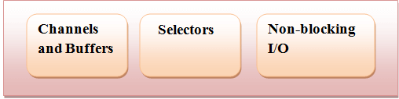
NIO

Slide 81
NIO
Channels and Buffers: In standard I/O API the character streams and byte streams are used.
In NIO we work with channels and buffers. Data is always written from a buffer to a channel and read from a channel to a buffer.
Selectors: Java NIO provides the concept of "selectors".
It is an object that can be used for monitoring the multiple channels for events like data arrived, connection opened etc.
Therefore single thread can monitor the multiple channels for data.
Non-blocking I/O: Java NIO provides the feature of Non-blocking I/O. Here the application returns immediately whatever the data available and application should have pooling mechanism to find out when more data is ready.

Slide 82
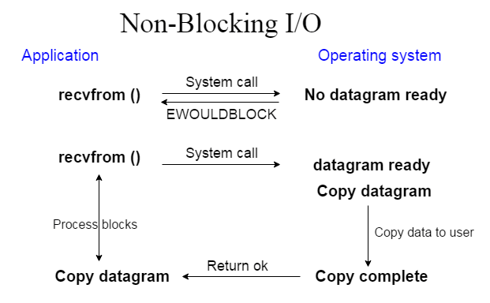
NIO

Slide 83
NIO
In Java NIO reading and writing are the fundamental process of I/O. Reading from channel: We can create a buffer and then ask a channel to read the data. Writing from channel: We can create a buffer, fill it with data and ask a channel to write the data.
The core components used in the reading and writing operation are:
Channels
Buffers
Selectors

Slide 84
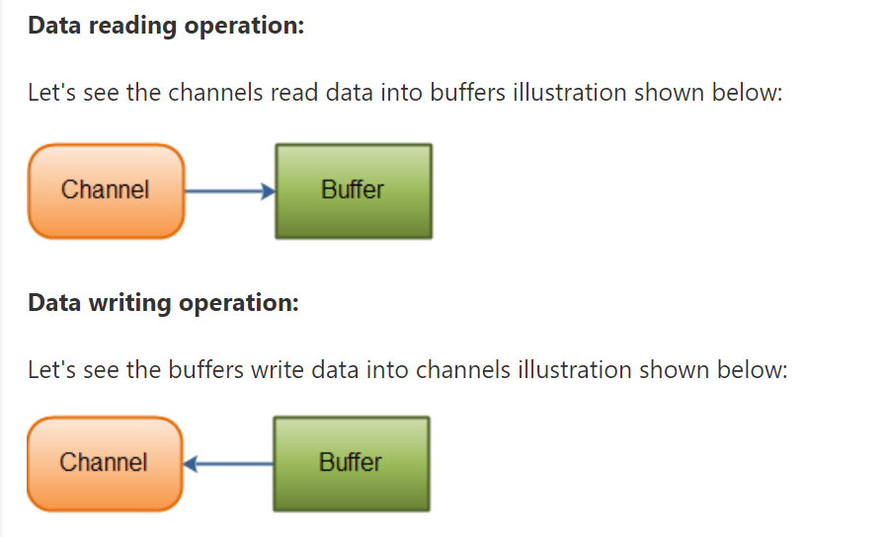
NIO - Channels and Buffers
In standard I/O API the character streams and byte streams are used. In NIO we work with channels and buffers.
All the I/O in NIO is started with a channel.
Data is always written from a buffer to a channel and read from a channel to a buffer.

Slide 85
NIO - Channel List
In Java NIO the primary Channels used are given below:
DatagramChannel
SocketChannel
FileChannel
ServerSocketChannel

Slide 86
NIO – Buffers List
Buffers List
In Java NIO the core Buffer used are given below:
CharBuffer
DoubleBuffer
IntBuffer
LongBuffer
ByteBuffer
ShortBuffer
FloatBuffer

Slide 87
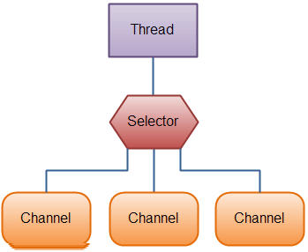
NIO –Selectors
Java NIO provides the concept of "selectors". It is an object that can be used for monitoring the multiple channels for events like data arrived, connection opened etc.
Therefore single thread can monitor the multiple channels for data.
It is used if the application has many Channels (connections) open, but has low traffic on each connection. For example: In a chat server.

Slide 88
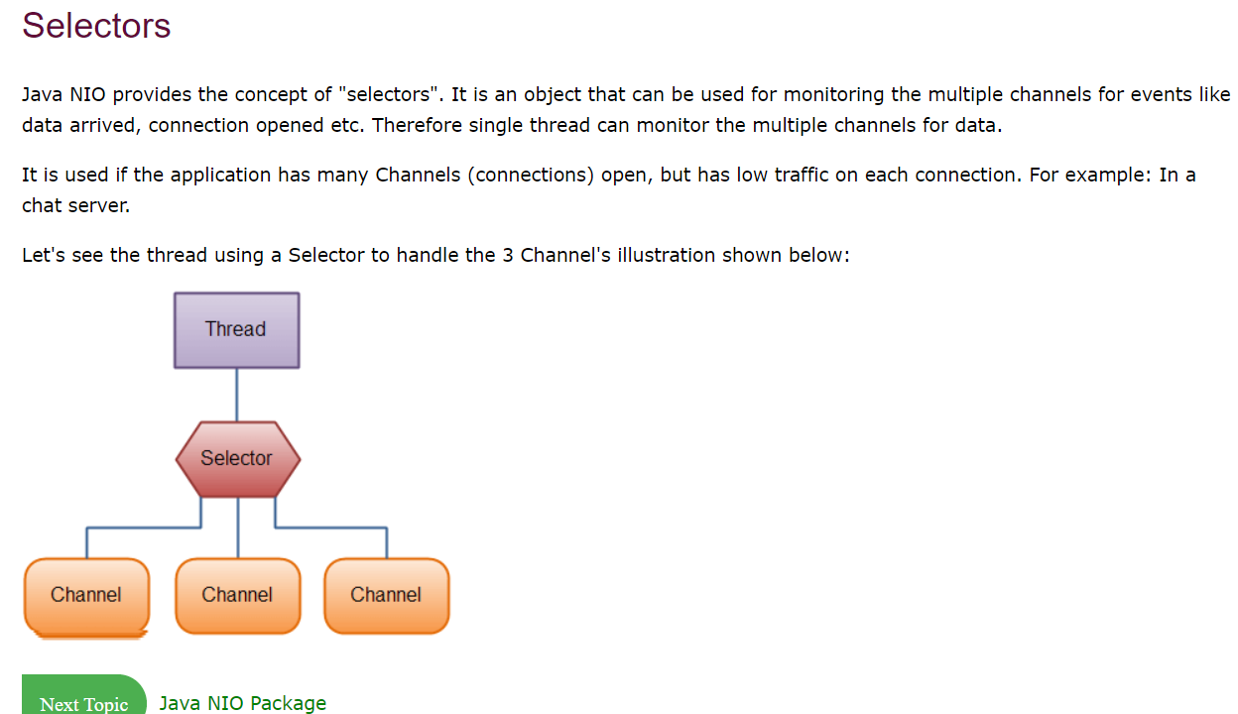
NIO

Slide 89
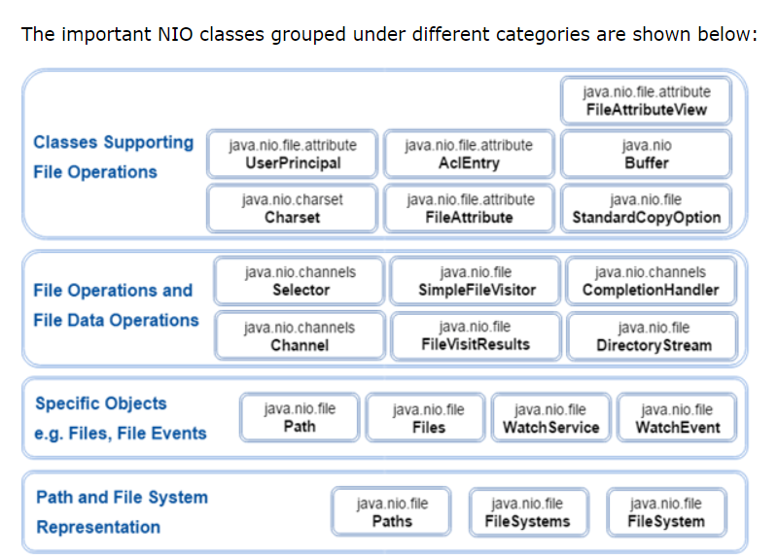
NIO - Packages

Slide 90
NIO VS IO
IO | NIO
It is based on the Blocking I/O operation | It is based on the Non-blocking I/O operation
It is Stream-oriented | It is Buffer-oriented
Channels are not available | Channels are available for Non-blocking I/O operation
Selectors are not available | Selectors are available for

Slide 91
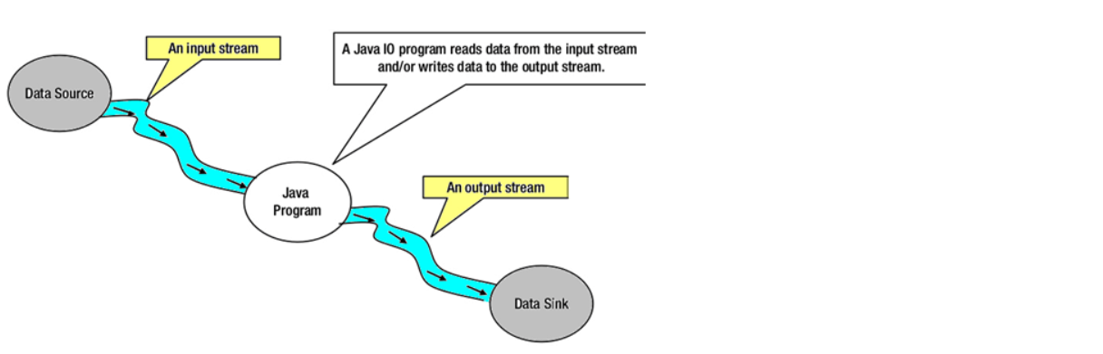
NIO – Stream Oriented vs Buffer Oriented
Stream Oriented
Java IO is stream oriented I/O means we need to read one or more bytes at a time from a stream. It uses streams for transferring the data between a data source/sink and a java program. The I/O operation using this approach is slow.

Slide 92
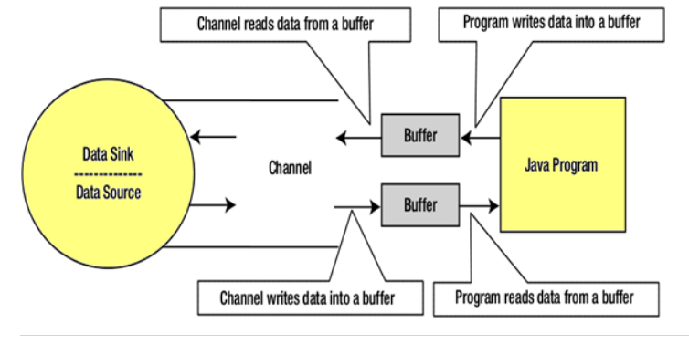
NIO - Buffer Oriented
Java NIO is buffer oriented I/O approach. Data is read into a buffer from which it is further processed using a channel. In NIO we deal with the channel and buffer for I/O operation.
The major difference between a channel and a stream is:
A stream can be used for one-way data transfer.
A channel provides a two-way data transfer facility.
Therefore with the introduction of channel in java NIO, the non-blocking I/O operation can be performed.

