Slide 1

Parameswari Ettiappan

Slide 2
Goals
PHP Basics
Object Oriented Programming
Collections
File Handling
Lambda Expressions
Data Structures

Slide 3
Programming Basics
What is PHP?
PHP is an acronym for "PHP: Hypertext Preprocessor"
PHP is a widely-used, open-source scripting language
PHP scripts are executed on the server
PHP is free to download and use

Slide 4
Programming Basics
What is a PHP File?
PHP files can contain text, HTML, CSS, JavaScript, and PHP code
PHP code is executed on the server, and the result is returned to the browser as plain HTML
PHP files have extension ".php"

Slide 5
Programming Basics
What Can PHP Do?
PHP can generate dynamic page content
PHP can create, open, read, write, delete, and close files on the server
PHP can collect form data
PHP can send and receive cookies
PHP can add, delete, modify data in your database
PHP can be used to control user-access
PHP can encrypt data

Slide 6
Programming Basics
Why PHP?
PHP runs on various platforms (Windows, Linux, Unix, Mac OS X, etc.)
PHP is compatible with almost all servers used today (Apache, IIS, etc.)
PHP supports a wide range of databases
PHP is free. Download it from the official PHP resource: www.php.net
PHP is easy to learn and runs efficiently on the server side

Slide 7

History of PHP
Created by Rasmus Lerdorf in 1994
Originally a set of Perl scripts used by Lerdorf to show off his résumé as well as collect information on his website, such as the site’s traffic info.
Lerdorf later transcribed these Perl scripts into a set of CGI binaries written in C, and in doing so, combined it with his own Form Interpreter to create PHP/FI.

Slide 8
PHP Programming Paradigms
Object Oriented PHP
Like Java, example of an object class:
<?php class BaseClass { function __construct() { echo "In BaseClass constructor<br>"; } } class SubClass extends BaseClass { function __construct() { parent::__construct(); echo "In SubClass constructor<br>"; } } $obj = new BaseClass(); $obj = new SubClass(); ?> | public class BaseClass { public BaseClass() { System.out.println("In BaseClass constructor\n"); } } class SubClass extends BaseClass { public SubClass() { super(); System.out.println("In SubClass constructor\n"); } } ----------------------------------------- public class Output { public static void main(String[] args) { Object obj; obj = new BaseClass(); obj = new SubClass(); } }

Slide 9
Features of PHP
Very Efficient – Can serve millions of hits per day.
Database Integration – Supports many databases, such as mySQL and Oracle. Also has excellent XML support as of PHP 5.
Built-in Libraries – Tailored to web development, one can connect to other network services, send email, work with cookies, generate PDF documents, and make GIF images on the fly all with a few lines of code.
It’s Free – Available on http://www.php.net
Easy to Learn – Very similar in syntax to C/C++/Java and Perl.
Portable – Works on Unix based operating systems, on Mac OS X, as well as on versions of Microsoft Windows. Your PHP code will often work without modification on a different system running PHP.

Slide 10
Database Support
The following is a list of supported databases in PHP
Adabas D InterBase PostgreSQL dBase FrontBase SQLite Empress mSQL | FilePro (read-only) Solid Direct MS-SQL Sybase Hyperwave MySQL Velocis | ODBC Unix dbm Informix Oracle (OCI7 and OCI8) Ingres Ovrimos IBM DB2

Slide 11
Differences From Java
Data types are not required in variable declarations.
The $ symbol precedes all variables in PHP
Constants are declared using the define() method in PHP: ex. define(“AOL", "something");
Constructors do not necessarily have to be the same name as the class name.
Destructors are used in PHP to remove objects from memory after they are constructed.

Slide 12
What is PHP Good For?
It is great for complex web page designs
E-commerce sites with heavy traffic (ex. Amazon)
Complex bulletin boards and forums (ex. phpBB)
Secure websites (ex. Novasis)
Email web hosts (ex. Gmail)
Working with and integrating XML into your webpage
Database management and search (ex. theFaceBook)

Slide 13
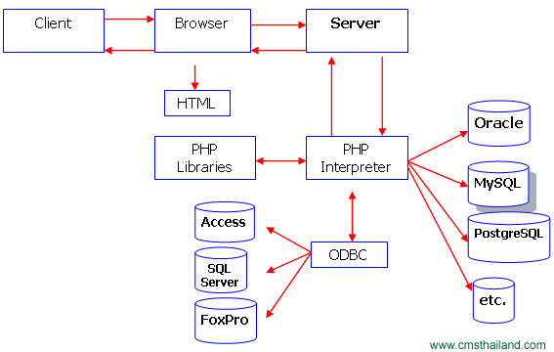
Processing a PHP Page

Slide 14
How works PHP internally?
Zend Engine is the internal compiler and runtime engine for PHP
PHP isolates every execution. No shared memory or shared resources among the executions.

Slide 15
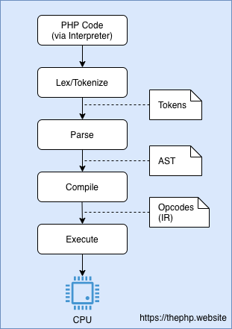
How works PHP internally?

Slide 16
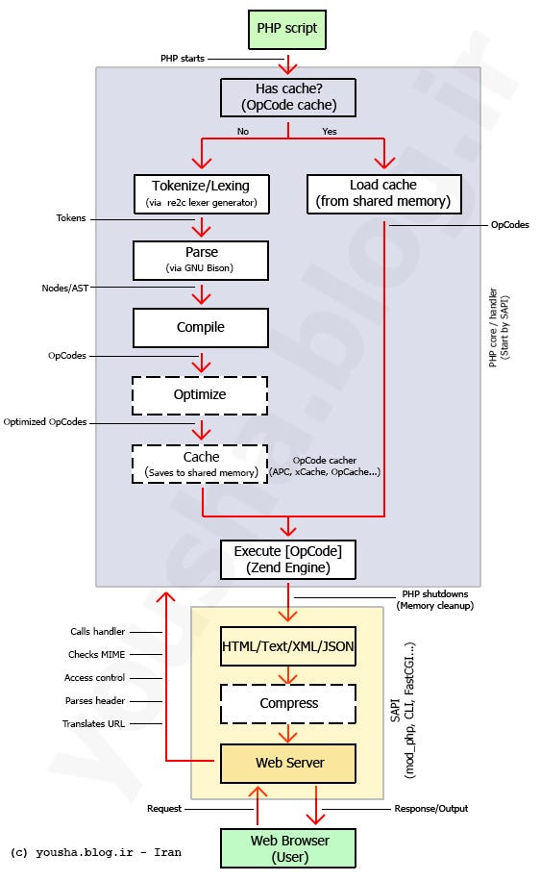
How works PHP internally?

Slide 17
Garbage Collector
The PHP Garbage Collector is a feature introduced in PHP 5.3 to automatically free up memory occupied by objects that are no longer in use.
In PHP, memory management is crucial, as inefficient memory usage can lead to performance issues and even application crashes.
The garbage collector helps mitigate these problems by identifying and cleaning up unreferenced objects.

Slide 18
Garbage Collector
The PHP Garbage Collector employs a reference counting mechanism to keep track of object references.
When an object is no longer referenced, its reference count drops to zero, indicating that it can be safely removed from memory.
The garbage collector periodically scans the memory for objects with zero reference counts and releases their memory.

Slide 19
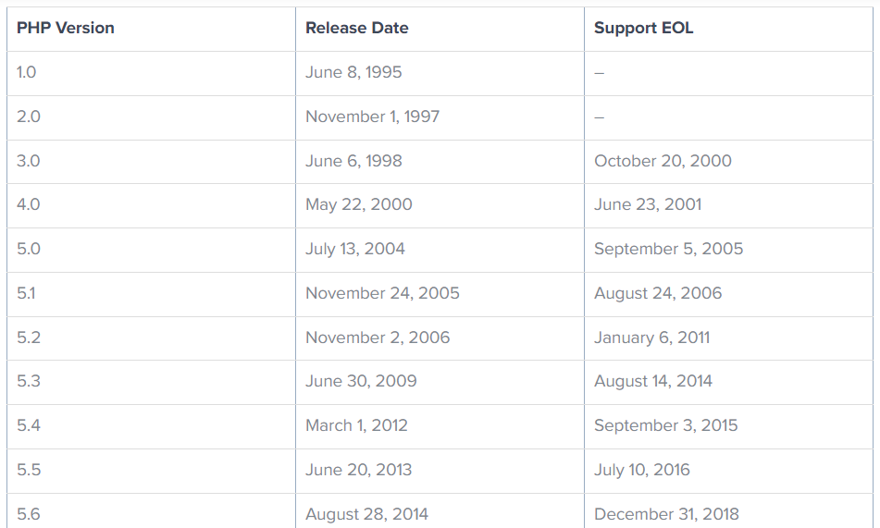
PHP Versions

Slide 20
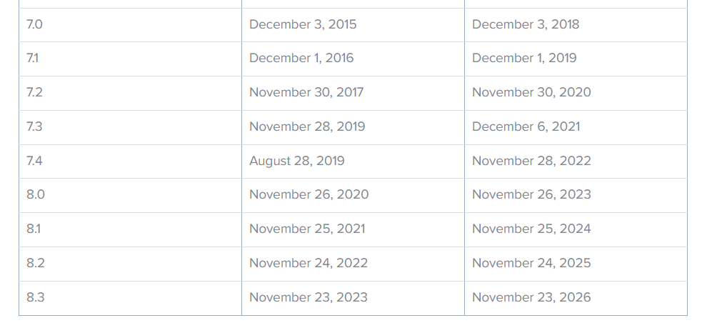
PHP Versions

Slide 21
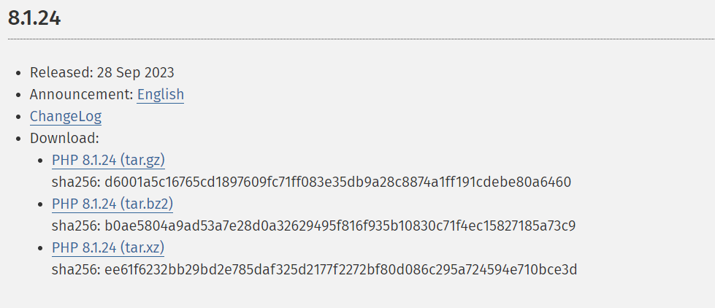
PHP Versions

Slide 22
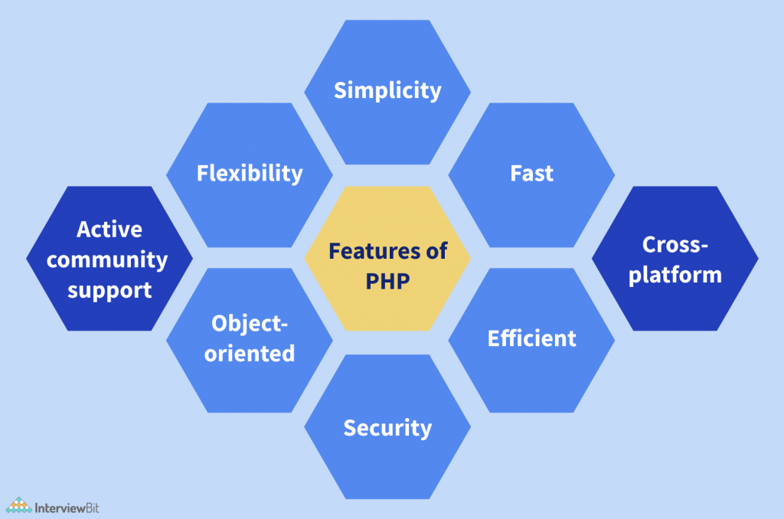
PHP Features

Slide 23
Getting Started
Download Apache 2 Windows Binary (MSI installer) at http://httpd.apache.org/download.cgi
The zip must end with win32-x86-no_ssl.msi
Download the PHP zip package at http://www.php.net/downloads.php
Download the zip pack, not the installer
Install Apache 2, use recommended settings
If error message is given, go here (Google port 80 problem): http://httpd.apache.org/docs/2.0/platform/windows.html
Unzip PHP file to C:\PHP

Slide 24
Getting Started
Next, copy/paste "php.ini-dist" to C:/Program Files/Apache Group/Apache2, and rename it to php.ini.
Copy the following list of .dll files from your C:\PHP and C:\PHP\ext directory to your root Apache directory (where you put php.ini):
fdftk.dll fribidi.dll gds32.dll libeay32.dll libmash.dll libmysql.dll libmysqli.dll msql.dll ntwdblib.dll php5apache2.dll php5apache.dll php5apache_hooks.dll php5isapi.dll php5nsapi.dll php5ts.dll phpmsql.dll phpmssql.dll phpmysql.dll phpmysqli.dll ssleay32.dll yas.dll

Slide 25
Getting Started
Set the PHP path for Windows:
Go to: Control Panel > System > Advanced tab
Click on "Environment variables"
Look in the "System variables" pane
Find the "Path" entry
Double click it and add at the end of the string your PHP dir
Need to start with ";" without double quotes!
And follow by: C:php
So, it will look like: ";C:\php" Again, without double quotes!
Now restart the Apache server.
Test: Create a simple file (using notepad) such as php5_info.php <? phpinfo();?>

Slide 26
Getting Started
Save it in C:/Program Files/Apache Group/Apache2/htdocs/php5_info.php
Open a browser and enter the following address http://localhost/php5_info.php
It should display your complete PHP setting.
If it does not work properly, we might have done something wrong with the multiple edits; check them out and give it another go.
Now we can use any text editor or html editor to create PHP files

Slide 27
Basic PHP Syntax
A PHP script can be placed anywhere in the document.
A PHP script starts with <?php and ends with ?>:
<?php
// PHP code goes here
?>
The default file extension for PHP files is ".php".
A PHP file normally contains HTML tags, and some PHP scripting code.

Slide 28
Basic PHP Syntax
A PHP script can be placed anywhere in the document.
A PHP script starts with <?php and ends with ?>:
<?php
// PHP code goes here
?>
The default file extension for PHP files is ".php".
A PHP file normally contains HTML tags, and some PHP scripting code.

Slide 29
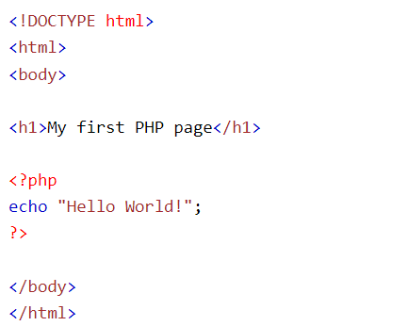
Basic PHP Syntax

Slide 30
Basic PHP Comments
// This is a single-line comment
# This is also a single-line comment
/*
This is a multiple-lines comment block
that spans over multiple
lines
*/

Slide 31
PHP echo and print Statements
echo is a statement, which is used to display the output.
echo can be used with or without parentheses.
echo does not return any value.
We can pass multiple strings separated by comma (,) in echo.
echo is faster than print statement.

Slide 32
PHP echo and print Statements
print is also a statement, used as an alternative to echo at many times to display the output.
print can be used with or without parentheses.
print always returns an integer value, which is 1.
Using print, we cannot pass multiple arguments.
print is slower than echo statement.

Slide 33
PHP Variables
In PHP, a variable is declared using a $ sign followed by the variable name.
Here, some important points to know about variables:
As PHP is a loosely typed language, so we do not need to declare the data types of the variables.
It automatically analyzes the values and makes conversions to its correct datatype.
After declaring a variable, it can be reused throughout the code.
Assignment Operator (=) is used to assign the value to a variable.

Slide 34
PHP Variables
Syntax of declaring a variable in PHP is given below:
$variablename=value;

Slide 35
PHP Variables
Rules for declaring PHP variable:
A variable must start with a dollar ($) sign, followed by the variable name.
It can only contain alpha-numeric character and underscore (A-z, 0-9, _).
A variable name must start with a letter or underscore (_) character.
A PHP variable name cannot contain spaces.
One thing to be kept in mind that the variable name cannot start with a number or special symbols.
PHP variables are case-sensitive, so $name and $NAME both are treated as different variable.

Slide 36
PHP Variables
Creating (Declaring) PHP Variables
In PHP, a variable starts with the $ sign, followed by the name of the variable:
<?php
$txt = “RPS Consulting Services";
$x = 5;
$y = 10.5;
?>

Slide 37
PHP Variables Scope
In PHP, variables can be declared anywhere in the script.
The scope of a variable is the part of the script where the variable can be referenced/used.
PHP has three different variable scopes:
local
global
static

Slide 38
PHP $ and $$ Variables
The $var (single dollar) is a normal variable with the name var that stores any value like string, integer, float, etc.
The $$var (double dollar) is a reference variable that stores the value of the $variable inside it.

Slide 39
PHP $ and $$ Variables
<?php
$x = "abc";
$$x = 200;
echo $x."<br/>";
echo $$x."<br/>";
echo $abc;
?>

Slide 40
PHP Constants
PHP constants are name or identifier that can't be changed during the execution of the script except for magic constants, which are not really constants.
PHP constants can be defined by 2 ways:
Using define() function
Using const keyword
Constants are like the variable except once they defined, they can never be undefined or changed.
They remain constant across the entire program.
PHP constants follow the same PHP variable rules.
For example, it can be started with a letter or underscore only.
Conventionally, PHP constants should be defined in uppercase letters.

Slide 41
PHP constant vs variable
Constant | Variables
Once the constant is defined, it can never be redefined. | A variable can be undefined as well as redefined easily.
A constant can only be defined using define() function. It cannot be defined by any simple assignment. | A variable can be defined by simple assignment (=) operator.
There is no need to use the dollar ($) sign before constant during the assignment. | To declare a variable, always use the dollar ($) sign before the variable.
Constants do not follow any variable scoping rules, and they can be defined and accessed anywhere. | Variables can be declared anywhere in the program, but they follow variable scoping rules.
Constants are the variables whose values can't be changed throughout the program. | The value of the variable can be changed.
By default, constants are global. | Variables can be local, global, or static.

Slide 42
Magic Constants
Magic constants are the predefined constants in PHP which get changed based on their use.
They start with double underscore (__) and ends with double underscore.
They are like other predefined constants but as they change their values with the context, they are called magic constants.

Slide 43
Magic Constants
There are nine magic constants in PHP. In which eight magic constants start and end with double underscores (__).
__LINE__
__FILE__
__DIR__
__FUNCTION__
__CLASS__
__TRAIT__
__METHOD__
__NAMESPACE__
ClassName::class

Slide 44
PHP Data Types
PHP data types are used to hold different types of data or values.
PHP supports 8 primitive data types that can be categorized further in 3 types:
Scalar Types (predefined)
Compound Types (user-defined)
Special Types

Slide 45
PHP Data Types: Scalar Types
It holds only single value. There are 4 scalar data types in PHP.
boolean
integer
float
string

Slide 46
PHP Data Types: Compound Types
It can hold multiple values.
There are 2 compound data types in PHP.
array
object

Slide 47
PHP Operators
Arithmetic Operators
Assignment Operators
Bitwise Operators
Comparison Operators
Incrementing/Decrementing Operators
Logical Operators
String Operators
Array Operators
Type Operators
Execution Operators
Error Control Operators

Slide 48
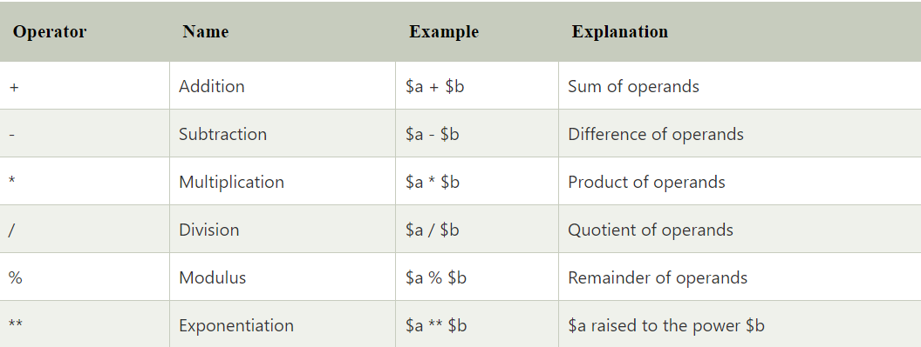
Arithmetic Operators

Slide 49
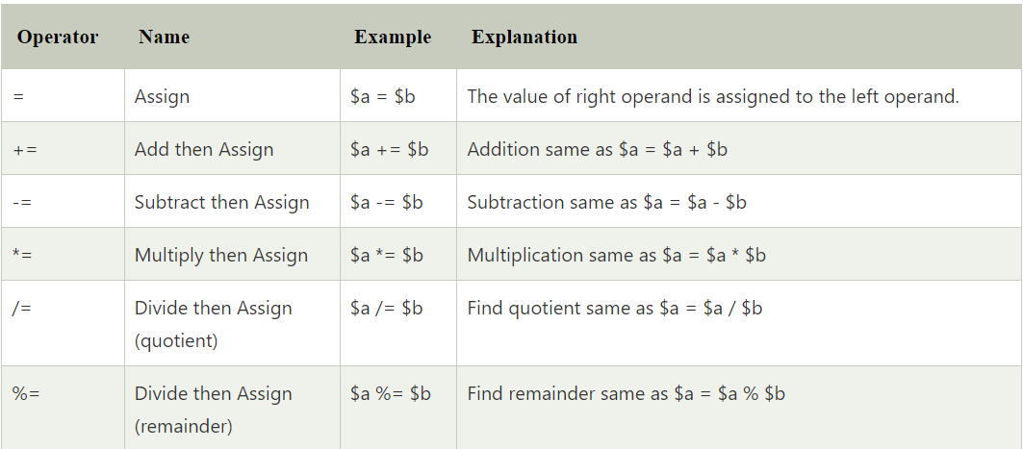
Assignment Operators

Slide 50
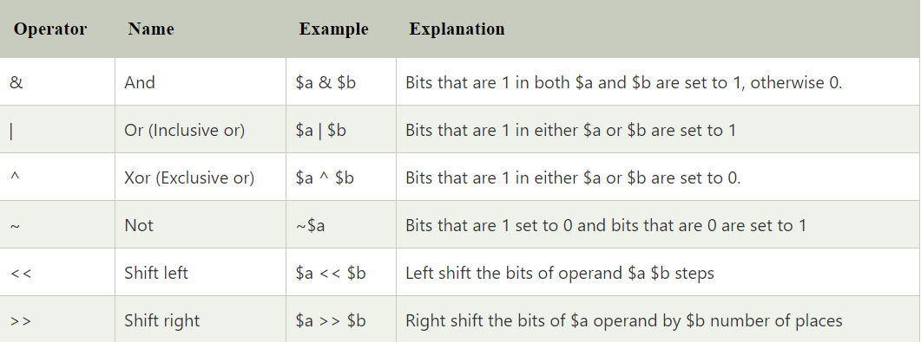
Bitwise Operators

Slide 51
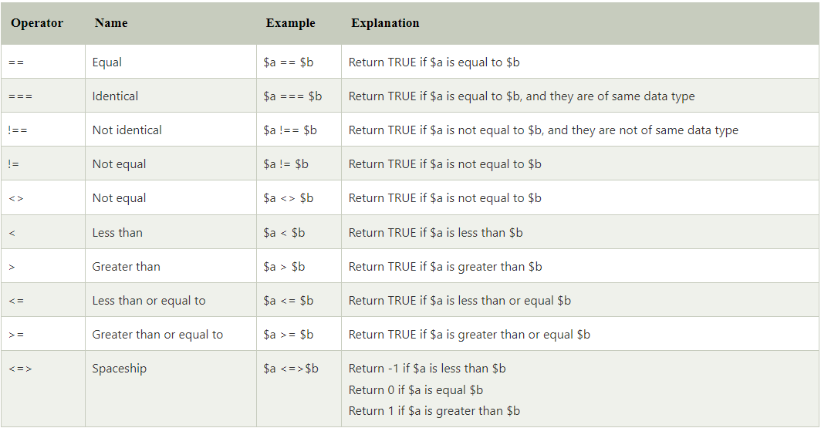
Comparison Operators

Slide 52
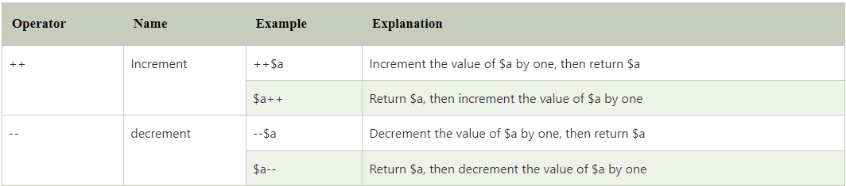
Incremental and Decremental Operators

Slide 53
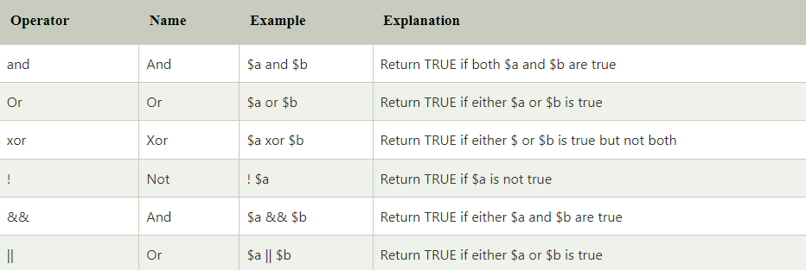
Logical Operators

Slide 54
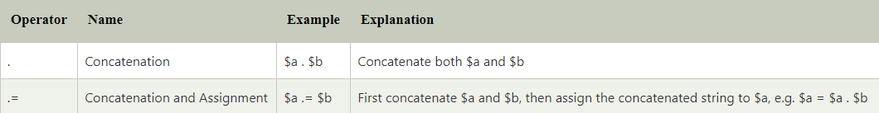
String Operators

Slide 55
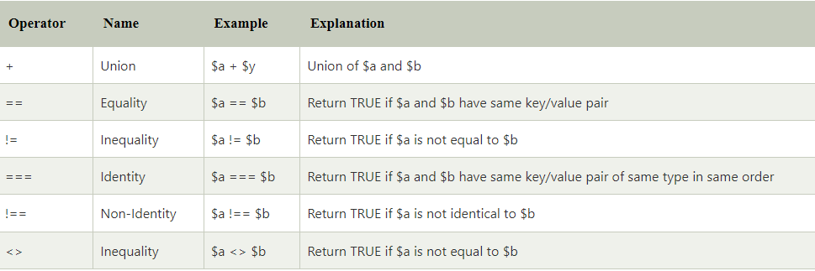
Array Operators

Slide 56

Type Operators

Slide 57
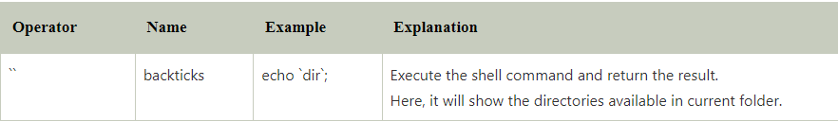
Execution Operators

Slide 58
Error Control Operators

Slide 59
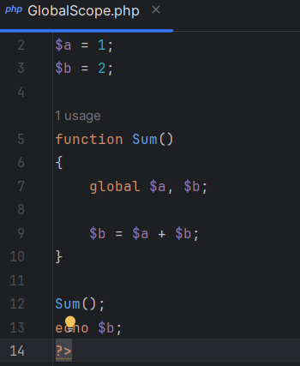
PHP Variables Scope - Global

Slide 60
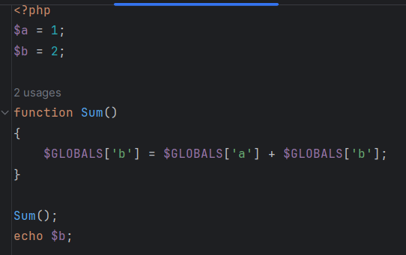
PHP Variables Scope - Global

Slide 61
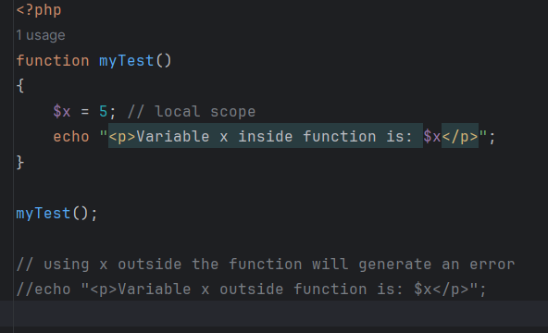
PHP Variables Scope - Local

Slide 62
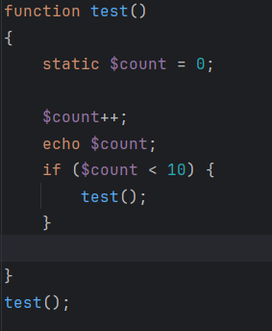
PHP Variables Scope - Static

Slide 63
Statements - Control
PHP If else
PHP Switch
PHP For Loop
PHP foreach loop
PHP While Loop
PHP Do While Loop
PHP Break
PHP Continue

Slide 64
Arrays
PHP array is an ordered map (contains value since key).
It is used to hold multiple values of similar type in a single variable.
Less Code: We don't need to define multiple variables.
Easy to traverse: By the help of single loop, we can traverse all the elements of an array.
Sorting: We can sort the elements of array.

Slide 65
Arrays
There are 3 types of array in PHP.
Indexed Array
Associative Array
Multidimensional Array

Slide 66
Arrays
There are 3 types of array in PHP.
Indexed Array
Associative Array
Multidimensional Array

Slide 67
Date and Time
var_dump(checkdate(12,31,-400));
echo "<br>";
var_dump(checkdate(2,29,2003));
echo "<br>";
var_dump(checkdate(2,29,2004));

Slide 68
Date and Time
$date=date_create("2013-03-15");
date_add($date,date_interval_create_from_date_string("40 days"));
echo date_format($date,"Y-m-d");

Slide 69
Date and Time
$date=date_create_from_format("j-M-Y","15-Mar-2013");
$date=date_create("2013-03-15");
echo date_format($date,"Y/m/d H:i:s");

Slide 70
Date and Time
print_r(date_parse("2013-05-01 12:30:45.5"));
// Prints the day
echo date("l") . "<br>";
// Prints the day, date, month, year, time, AM or PM
echo date("l jS \of F Y h:i:s A");

Slide 71
Date and Time
$date=date_create();
date_date_set($date,2020,10,30);
echo date_format($date,"Y/m/d");

Slide 72
Date and Time
$date1=date_create("2013-03-15");
$date2=date_create("2013-12-12");
$diff=date_diff($date1,$date2);
print_r(date_parse_from_format("mmddyyyy","05122013"));

Slide 73
Date and Time
print_r(localtime());
echo "<br><br>";
print_r(localtime(time(),true));
$tz=timezone_open("Asia/Taipei");
print_r(timezone_location_get($tz));

Slide 74
Functions
PHP function is a piece of code that can be reused many times.
It can take input as argument list and return value.
There are thousands of built-in functions in PHP.
In PHP, we can define Conditional function, Function within Function and Recursive function also.

Slide 75
Functions
PHP function is a piece of code that can be reused many times.
It can take input as argument list and return value.
There are thousands of built-in functions in PHP.
In PHP, we can define Conditional function, Function within Function and Recursive function also.
Code Reusability: PHP functions are defined only once and can be invoked many times, like in other programming languages.
Less Code: It saves a lot of code because you don't need to write the logic many times. By the use of function, you can write the logic only once and reuse it.

Slide 76
OOPS
Class
Objects
Inheritance
Interface
Abstraction
Magic Methods

Slide 77
OOPS
Class:
OOP programming begins with classes, a class being an abstract definition of a thing:
What information must be stored and what functionality must be possible with that information?
A User class would be able to store information such as the user’s name, ID, email address, and so forth.
The functionality of a User could be login, logout, change password, and more.

Slide 78
OOPS
Class:
Class is a programmer-defined data type, which includes local methods and local variables.
Class is a collection of objects. Object has properties and behavior.
First, we must define a php class, where class name should be same as filename.

Slide 79

OOPS
Syntactically, a class definition begins with the word class, followed by the name of the class.
The class name cannot be a reserved word and is often written in uppercase, as a convention.

Slide 80
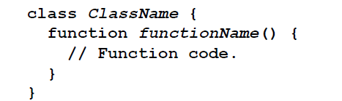
OOPS
Classes contain variables and functions, which are referred to as attributes (or properties) and methods, respectively.
Collectively, a class’s attributes and methods are called its members..

Slide 81
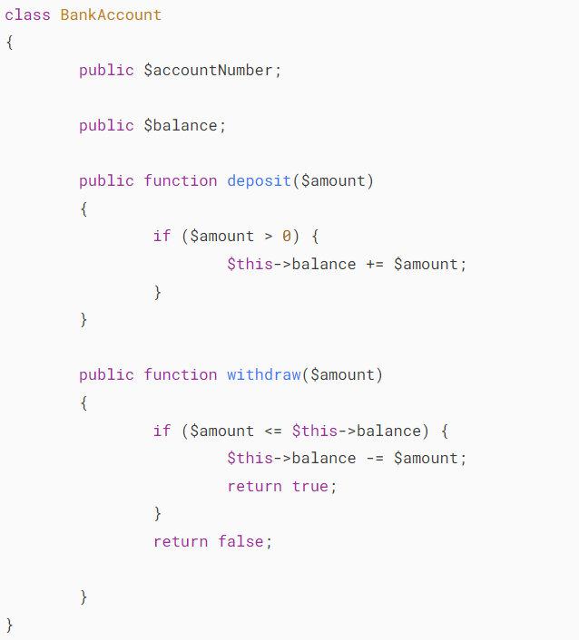
OOPS

Slide 82
Constructor
A constructor allows you to initialize an object's properties upon creation of the object.
If you create a __construct() function, PHP will automatically call this function when you create an object from a class.
Notice that the construct function starts with two underscores (__)!

Slide 83
Constructor
PHP allows you to declare a constructor method for a class with the name __construct() as follows:
<?php
class ClassName
{
function __construct()
{
// implementation
}
}
$object = new ClassName()

Slide 84
Destructor
A destructor is called when the object is destructed or the script is stopped or exited.
If you create a __destruct() function, PHP will automatically call this function at the end of the script.
Notice that the destruct function starts with two underscores (__)!

Slide 85
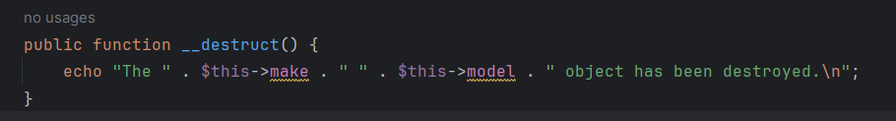
Destructor

Slide 86
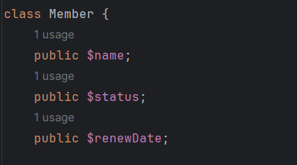
Access Modifiers
There are three access modifiers:
public - the property or method can be accessed from everywhere. This is default
protected - the property or method can be accessed within the class and by classes derived from that class
private - the property or method can ONLY be accessed within the class

Slide 87
Chaining class methods
PHP helps developers to write concise code by allowing chain class methods.
For example, if you have a class that handles login and logout, we might also want to change the user's status accordingly.

Slide 88
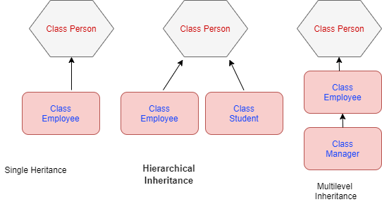
Inheritance

Slide 89
Multiple Inheritance
Multiple Inheritance not supported by PHP.
But indirectly we achieve using Traits

Slide 90
Trait
PHP trait has an abstract and non-abstract method that is used by multiple classes.
These methods have the following access modifiers such as (public, private, or protected).
The trait has the followings characteristics:
The trait method can be used by the different child classes.
The method can use a public, private, and protected modifier.
It consists of both abstract and non-abstract methods.
It reduces code duplication hence it saves a lot of time.
The trait can not be instantiated means no object can be created from the trait class.

Slide 91
Abstract Class
PHP has abstract classes and methods.
Classes defined as abstract cannot be instantiated, and any class that contains at least one abstract method must also be abstract.
Methods defined as abstract simply declare the method's signature; they cannot define the implementation.

Slide 92
Interfaces
Interface are like abstract classes.
The difference between interfaces and abstract classes are:
Interfaces cannot have properties, while abstract classes can
All interface methods must be public, while abstract class methods is public or protected
All methods in an interface are abstract, so they cannot be implemented in code and the abstract keyword is not necessary
Classes can implement an interface while inheriting from another class at the same time.

Slide 93
Polymorphism
Polymorphism in PHP is achieved by using abstract classes or interfaces to write code that can be easily extended and modified without modifying the existing code. (SOLID)
It also allows you to write more generic code that can work with objects of different classes rather than writing separate code for each class.
This reduces code duplication and increases code reusability, making your code more efficient and maintainable.

Slide 94
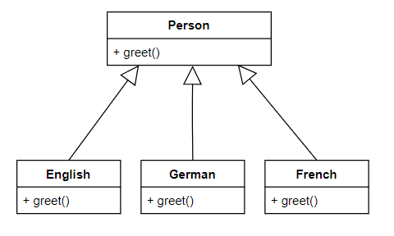
Polymorphism

Slide 95
Questions

Slide 96
Module Summary
In this module we discussed
PHP Basics
Object Oriented Programming
Collections
File Handling
Lambda Expressions
Data Structures

