Slide 1
Java: Immutable and mutable strings and primitive objects

Slide 2
Recall
What does it mean when we say an object is immutable?
Which class among the classes you have learnt so far is immutable?

Slide 3
Immutable Objects and their advantages
An object is immutable if its state cannot be change after it is created.
String class is immutable because any modification methods on string object (like replace() or substring()) does not change the original string.
Immutable objects are thread-safe!
Therefore they useful in applications that have multiple threads concurrently executing.

Slide 4
Tell me how
How are Immutable objects thread-safe?
If a thread manipulates the state of an object but not under synchronized context and at the same time if another thread manipulates the state of the same object, the object is in inconsistent state. The Account object in the previous section clearly demonstrates this.
A immutable object does not require the synchronized context. This is because once they are created they cannot be changed. So there is no question of inconsistent state.
Therefore, they are thread-safe.

Slide 5
Tell me how
How to create a thread-safe object?
The thread safe class should not allow any manipulations to its member variables after creation. What will you do in your class to make this happen?
Make member variables final
Provide no setters
Don’t allow subclasses to make the object mutable. So either make the class itself as final or provide a private constructor.
Also if member variables are instances of other classes, they themselves have to be made mutable by this class– it gets more complicated!

Slide 6
Disadvantages of Immutable objects
Some implementations create and return a new object if immutable objects are changed (like String which we have seen). The cost of creating a new object is more compared to updating an object in place.
Immutable objects are not always desirable for thread-safe code. For instance, does Account object being immutable make sense!
In cases where the object has to under go a lot of updations by design, then it is desirable to have mutable objects with synchronized methods.

Slide 7
Revisiting problem with String
String class objects are immutable.
In cases where we have lots of string manipulation we may end up with creating lot of strings in the string pool which are unnecessary.
Therefore, in such cases we need to go for StringBuffer or StringBuilder
pool
s1.concat(“Beans”)
Java
Java
Java Beans
s1
s2
Beans
Java Beans
+
Enterprise
Enterprise
Enterprise Java Beans
Enterprise Java Beans
String s1=“Java”;
String s2=s1.concat(“Beans”);
String s3=“ Enterprise ” + s2

Slide 8
StringBuilder
This final class can be used in the situations where we require lot of string manipulations.
StringBuilder objects are mutable .
Constructors
  StringBuilder()
  StringBuilder(String str)

Slide 9
Methods
Methods that are common in both String and StringBuilder classes:
  char charAt(int index)
  int length()
  String substring(int start)
  String substring(int start, int end)
  int indexOf(String str)
  int indexOf(String str,int fromIndex)
  int lastIndexOf(String str)
  int lastIndexOf(String str, int fromIndex)

Slide 10
Concatenation
  StringBuilder append(String str)
  StringBuilder append(StringBuffer str)
  StringBuilder append(char[] c)
  StringBuilder append(xx b)
where xx is boolean, char, int, long float and double
Example: s1= new StringBuilder("Now");
s1.append(" Showing"); // Now Showing
  How do you achieve this in String class?
Replacing characters
StringBuilder replace(int start, int end, String s)
Example: StringBuilder s1= new StringBuilder("now");
s1.replace(0,0,"S");// Snow
s1.replace(0,1,"S");// Sow
s1.replace(0,2,"S"); //Sw
  Compare this to the replace() method in String class

Slide 11
Insertion and deletion of characters
  StringBuilder insert(int offset, Object str)
  StringBuilder insert(int offset, String str)
  StringBuilder insert(int offset, xx b)
where xx is boolean, char, int, long float and double
In case of Object as 2nd argument the string that is returned by toString() method is inserted.
Example: StringBuilder s1= new StringBuilder("Teacher():");
s1.insert(8, new Teacher("Tom"));
// Teacher(Tom (1)):
StringBuilder delete(int start, int end)
Example: StringBuilder deleteCharAt(int index)
StringBuilder s1= new StringBuilder("Teacher():");
s1.delete(7, s1.length()); // Teacher

Slide 12
Example: StringBuilder
Reverse:
StringBuilder reverse()
Check if a string is a palindrome.. Try to do this with String class.
And then compare your code with the code here.
It turns out that the code here is far simpler!
public class Palindrome {
public static void main(String[] args) {
  String palindrome = "MalayalaM";
  StringBuilder sb = new StringBuilder(palindrome);
  System.out.println(sb.equals(sb.reverse()));
  System.out.println(sb);
}
}

Slide 13
Beware!
Unlike String, StringBuilder (StringBuffer in the next slide) does not override equals() method.
That is,
StringBuilder sb = new StringBuilder(palindrome);
StringBuilder sb3 = new StringBuilder(palindrome);
System.out.println(sb3.equals(sb));
return false!
Then how did previous example work?
Recall that by default equals() method of Object class functions the same as the that of the ==. Having said this, since sb.reverse() changes string in that same location, sb before and after calling reverse are same!
Also note that StringBuilder(StringBuffer) is not Comparable (unlike String)

Slide 14
StringBuffer
StringBuffer has same methods as StringBuilder and it can also be used to create mutable Strings. It is also a final class
Only difference between both the classes is
  StringBuffer is thread-safe while StringBuilder is not thread-safe
Thread-safe class have methods that are synchronized.
synchronized makes only one thread at a time access an object’s synchronized methods. This may impact performance.
Thinking of this issue, JSE built StringBuilder class that does not have synchronized methods. So, now it is up to programmers to make sure of the consistency of strings from StringBuilder class by providing synchronized blocks locking the object.

Slide 15

Wrapper classes
Wrapper classes in java are classes that wrap other classes.
Therefore wrapper class’ constructor will always take the object of the class they wrap as a parameter.
Did we come across this term before?
Flask
The two important packages that have wrapper classes are in
java.lang and java.io
Cover is a wrapper enhancing the bottles functionality
Notes:
Wrapper Exceptions

Slide 16
Primitive Wrappers
There are some special kinds of wrapper classes in java.lang package which wrap primitive types.
All wrapper classes are final classes except Number which is abstract class.
Number
Byte
Character
Abstract class
Short
Boolean
Integer
Long
Float
Double

Slide 17
Why should one wrap the primitive types?
For various conversions
  These classes have methods that allow conversion between string and numeric types
Collection work with objects
  Collection framework in java has numerous classes like LinkedList, ArrayList etc that allow storing collection of objects. But only objects can be stored in collection. So in cases where we want ints to be stored we need to wrap it in a class. Instead JSE already provides us with classes for all primitives as wrappers that can be used.
Serialization
  Java stores object state in the hard disk and this is called serialization. But this technique is available only for objects. Therefore if we want to save primitives we need to wrap them inside a class. Instead of this we can use wrapper classes.

Slide 18
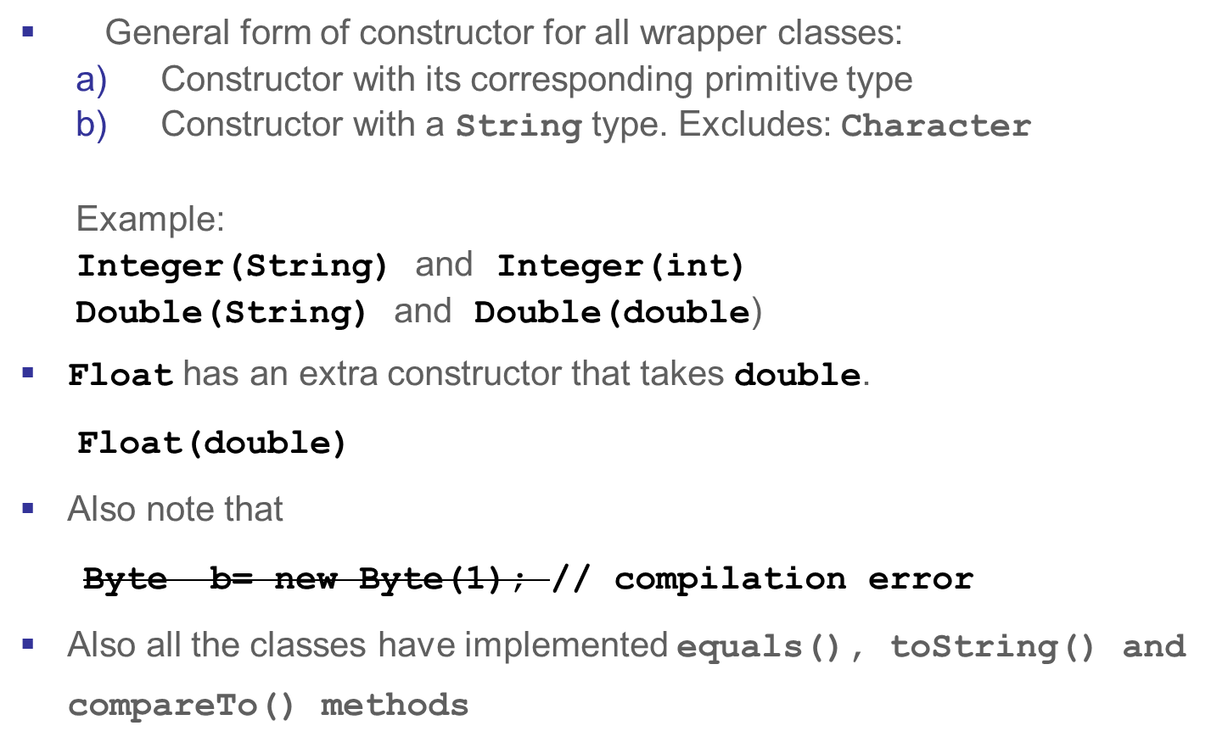
Constructors and common methods

Slide 19
Test your knowledge
Can you write the declaration for equals(), toString() and compareTo() for Byte?
String toString()
boolean equals(Object o)
int compareTo(Byte a)
The first 2 methods remain the same for all classes but the last method parameter changes based on the wrapper class.
Where did you come across these methods?
equals()and toString()are Object class methods that wrapper classes have overridden and compareTo is in Comparable which obviously means that wrapper classes have implemented Comparable!

Slide 20
Methods in Number Subclass
Byte
Number
byte byteValue()
double doubleValue()
float floatValue()
int intValue()
long longValue()
short shortValue()
Short
Integer
Long
Float
Double

Slide 21
Conversion of String to numeric primitive type
General form of method:
static xxx parseXxx(String s)
where xxx is all numeric primitives
parseXxx method are there in all Number subclasses
Each class has Xxx replaced by the type it encapsulates.
For example
Byte class has
static byte parseByte(String s)
Float class has
static float parseFloat(String s)
This method throws a NumberFormatException if the string is not convertible to number.

Slide 22
Examples
int x=Integer.parseInt(“-3”);//OK
float x=Float.parseFloat("3.14"); //OK
byte x=Byte.parseByte("10”); //OK
Integer.parseInt(“abc”);
NumberFormatException thrown at runtime
Integer.parseInt("12.23");
NumberFormatException thrown at runtime
Float.parseFloat("12e10"); //OK

Slide 23
Methods for Character
Character
char charValue()
boolean isLetter(char ch)
boolean isDigit(char ch)
boolean isUpperCase(char ch)
boolean isLowerCase(char ch)
char toUpperCase(char ch)
char toLowerCase(char ch)
boolean isWhitespace(char ch)

Slide 24
Methods for Boolean
Boolean
boolean booleanValue()
static boolean parseBoolean(String s)

Slide 25
Autoboxing
Autoboxing refers to the automatic conversion of
  wrapper class type to its primitive type
    Called Boxing
  and vice versa
    Called Unboxing
This was included in JSE 5.0.
Older Java code needed explicit calls to constructors or xxxValue() methods for these conversions.
Now compiler does these conversions automatically.
Boxing and unboxing may hit performance. So be careful where you use it.

Slide 26
Autoboxing Examples
Boxing Examples
  Integer ii=10; ii++;
  Boolean bb=true; if(bb){}
  Long ll=34L; but Long ll=34 leads to error
  Byte bt=34; but Byte bt= 1000; leads to error
  Float fl= 3.14f; but Float fl= 3.14; leads to error
  Double dl= 3.14;
  Character c=‘a’;
  You will find that literal conversions here is very similar to what we had for primitives.
Unboxing is the reverse. That is a wrapper objects automatically convertible to its primitive.
  int i=ii; boolean b=bb; long l=ll;

Slide 27
Pros and Cons
When compiler allows Integer ii=10, what it does is it converts the code as
Integer ii = new Integer(10);
Advantage of boxing are
  the code I neat and clutter free.
  Less coding for developers
Disadvantages of boxing is
  Experiments and experience yields the fact that when boxing conversions are used within a loop, it affects the performance of a program. Therefore while allowing both wrapper and primitives gives greater flexibility in a collection (like array or List (coming up)), care must be taken when to use them. For instance, if only primitive int is required, then restricted int array can be created instead of an Integer array. Or Integer List.

Slide 28
Overloading Resolution including autoboxing
Compiler resolves overloaded methods using the following sequence
  Finds if there are any exact match possible
  If not, finds if there are any automatic conversion possible
  If not, finds if any specific conversion apply
  If not, finds if there are any auto-boxing conversion possible
  If not, finds if there are any var-args conversion possible
No boxing does not work in case of arrays
Integer[] i= new int[10]; // error
  Let us work out some code to understand this better.

Slide 29
Test your understanding
static void change(int i){ System.out.println("int");}
static void change(Integer i){ System.out.println("Integer");}
Call: change(123);
static void change(int i){ System.out.println("int");}
static void change(Byte i){ System.out.println(“Byte");}
Call: byte b1=45; change(b1);
static void change(char i){ System.out.println(“char");}
static void change(Byte i){ System.out.println("Byte");}
Call: byte b1=45; change(b1);
Prints : int
Prints : int
Prints : Byte

Slide 30
static void change(Integer i){ System.out.println("integer");}
static void change(Number i){ System.out.println("number");}
Call: change(45);
static void change(Number i){ System.out.println(“number");}
static void change(int i){ System.out.println(“int");}
Call: Byte b1=45; change(b1);
static void change(Integer i){ System.out.println("integer");}
static void change(Number i){ System.out.println("number");}
Call: byte b1=25;change(b1);
Prints : integer
Prints : number
Prints : number

Slide 31
static void change(Object i){ System.out.println("Object");}
static void change(Long i){ System.out.println("Long");}
Call: change(10);
static void change(Integer i){ System.out.println("integer");}
static void change(int... i){ System.out.println("int");}
Call: change(10);
static void change(Integer... i){
System.out.println("Integer"); }
static void change(int... i ){
System.out.println("int"); }
Call: change(10); // error
Prints : Object
Prints : integer
Compilation error

Slide 32
Immutability
Like String, Wrapper objects are also immutable.
So using new creates primitives in the pool(if not there already) as well as in the heap and directly assigning a literal will create primitives in the heap alone.
That is why there are no setters in wrapper classes.
Integer int i=10;
Integer int j= new Integer(20);
10
20
pool
20
heap

Slide 33
Test your understanding?
What will the code print?
class ImmutablilityTest{
public static void main(String... args){
Integer x=10;
change(x);
System.out.println(x);
}
static void change(Integer i){
i=20;
}
}
Prints 10!

Slide 34
Beware!
How can you exchange 2 primitives?
Will the code below work?
public static void main(String[] args) { Integer x=10;
Integer y=30;
exchange(x,y);
}
static void exchange(Integer i,Integer j){
Integer t;
t=i;
i=j;
j=t;
}

