Slide 1
Java: Inner Classes

Slide 2
Inner Class
Like variables and methods, class can also be defined inside a class.
An inner class is a class defined inside the scope of another class.
Classes that were covered so far were top-level classes.
The class inside which the inner class is defined is called outer class.
Inner class can access even the private members of the outer class. Similarly outer class can also access the private members of inner class.
Similar to inner class, inner interface can also be created.

Slide 3
Inner class example
Inside the Outer class scope, Inner class name is same as what is declared in Outer class.
Outside the Outer class scope, Inner class name is combination of Outer class name and Inner class name and a dot (.) separating them. Inner class name can be same as outer class name.
The name of the inner class’s .class file name: OuterClass$InnerClass.class
class OuterClass{
private static int k;
InnerClass I;
private InnerClass(){int j;}
…
}
class SomeClass{
OuterClass.InnerClass c;
…
}

Slide 4
Types of Inner Class
Member class
  Static Inner Class/ Top-Level nested classes
  Non Static Inner Class
Local Inner Class
Anonymous Class
Non Static Inner Class, Local Inner Class, Anonymous Class are generally called inner class.
Static inner class are considered to be top-level class.

Slide 5
Non static inner class
Structure:
  public class OuterClass{
  public class InnerClass{..}
  }
Non static inner class object cannot be created without a outer class instance.
The private fields and methods of the member classes are available to the enclosing class and other member classes
All the private fields and methods of the outer classes are also available to inner class.
Non-static inner class cannot have static members.
Other modifier applicable here are abstract, final, public, protected, private

Slide 6
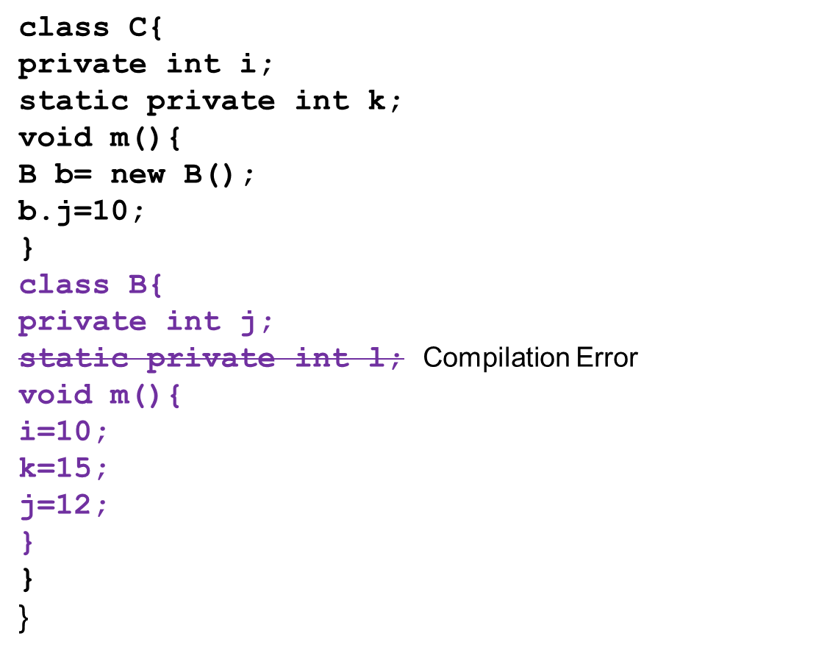
Example: Non static inner class instance
Can access inner class private members
Can access outer class private members

Slide 7
Creating instance of non static inner class outside the outer class
Outside outer class non-static inner class creation requires outer class instance also.
There are 2 ways to do this.
  If you don’t need outer class instance , then create it like line 1,
  If you need outer class instance or already have one, create it like line 2
class A
{
C.B b= new C(). new B(); //line 1
C c= new C();
C.B b1= c. new B(); // line 2
}
  If Inner class was defined in a package say p, then it can be created using the syntax:
  new p.C(). new B();

Slide 8
Outer class implicit reference in inner class
Non-static inner class instance cannot exist without Outer class instance.
This inner class has implicit reference to the outer class object using which it is created.
Therefore no explicit reference required in inner class for the outer class.
However, if outer class needs a inner class reference it has to create it explicitly.
C
i
k
B
j

Slide 9
Tell me how?
If inner class can be created only with outer class reference, then how is outer class able to create inner class?
Outer class creates inner class as instance member or locally inside instance method. In both of this context, the current object (this) is available. Hence the current object in context becomes the implicit reference for inner class instance.
Please note that the code below gives a compilation error because there is “No enclosing instance of type C is accessible”.
  class P{
  static Q q= new Q(); //error
  Q q1= new Q(); //ok
  void f(){ Q q2= new Q(); } //ok
  static void g(){ Q q2= new Q(); } //error
  class Q{}}

Slide 10
Name conflict
If the name of the members in Outer class and inner class are same, then how to refer to the name of the outer class member in the inner class?
This can be done using Outer class name dot (.) this dot (.) member name.
    class P{
    int i;
    class Q{
    int i;
    void f(){
    i=10;
    P.this.i=9;
    }
    }}

Slide 11
Example 2: Static inner class in practice
Here is a practical case where static inner class could be used.
An AddressBook class encapsulating Address class.
Address class encapsulates house address part – city, state etc. AddressBook encapsulates name, address and phone number. Please note that Address class is defined as private which means that only AddressBook will use this class.

Slide 12
Example 2
public class AddressBook{
  private class Address{
  private String name;
  private String houseNumber;
  private String street;
  private String city;
  private String state;
  private String pin;
  private Address(){}
  private Address(String a,String b,String c, String d,String e){
    this.name=AddressBook.this.name;
    houseNumber=a;street=b;
    city=c;state=d;pin=e;}
  public String toString(){
    return name+ ",\n"+houseNumber+ ",\n"+street+ ",\n"+city+",\n"+state+ ",\nPIN:"+ pin;
  }}
name of the person is same as that of what was assigned in the Address object

Slide 13
String name;
Address addr;
String pno;
public AddressBook(String name,String pno, String ad)
{
  this.name=name;
  this.pno=pno;
  String s[]=ad.split(",");
  if(s.length>=5){
  String str=“,”:
  for(int i=1;i<s.length-3;i++)
  str=str+s[i]+”,”; }
  addr=new Address(s[0],str,s[s.length-3],s[s.length-2], s[s.length-1]);
}
Address is considered valid only if it has 5 or more words separated by commas.

Slide 14
public String toString(){
  return addr.toString() + "\nPhone no.:"+pno;
}
public static void main(String str[]){
  AddressBook a=new AddressBook("Crossword","9008200021", "Icon Mall-2981,5th Cross,12th Main,Indira Nagar,Bangalore,560038");
  System.out.println(a);
}
}

Slide 15
Activity: Linked List
Another situation where non-static inner class used is linked list.
Can you figure down the skeleton of the code. (structure of the class, members etc.)
Hint:
A linked list is a chain of nodes. So you will have a Node class.
Where will you define this Node class?
To answer this, ask yourself if it is necessary for a LinkedList class to expose the Node class or is it just enough for it to provide public methods that returns the required data.

Slide 16
LinkedList Code outline
public class LinkedList{
private Node header = new Node(null, null, null);
public LinkedList(){...}
public Object getFirst() {...}
public Object getLast() {...}
public Object removeFirst() {...}
public Object removeLast() {...}
public void addFirst(Object Object) {...}
public void addLast(Object Object) {...}
…
private static class Node {
Object element;
Node next;
Node previous;
Node(Object element, Node next, Node previous) {
this.element = element;
this.next = next;
this.previous = previous; } }}

Slide 17
Static Inner Class
A static inner class is a class that’s a static member of the outer class
It can access only all static members of the outer class.
But like main method, instances of outer class can be created inside static inner class and using this private members can be accessed.
It is created without an instance of the outer class unlike the regular inner classes.
That is why the static classes are sometimes called top-level nested classes.
Other modifier applicable to member classes
abstract, final, public, protected, private

Slide 18
Syntax
Structure:
public class OuterClass{
public static class InnerClass{}
}
Creating instance:
  Outside the outer class:
  OuterClass.InnerClass sinner
  =new OuterClass.InnerClass();
  Inside the outer class:
InnerClass inner=new InnerClass();

Slide 19
Example: scenario for static inner class
Let us say you have a class that maintains list of integers in sorted manner. How will you test this class (without a tool) ?
May be you will do this.
You will create at least 3 test cases – one that check for underflow, one for overflow and one for right number of inputs- as 3 methods of a class say TestSortedList class and a main method which calls these three methods.
After you are satisfied, you submit SortedList.class and SortedList.java.
Now let us say the code come back to for more additions, and alias you have lost the TestSortedList class somewhere… or you don’t remember the name of the class!
There is also another issue with this TestSortedList class, you cannot test the private methods, because they are not accessible!
So the best way to do this would be to make TestSortedList a private static inner class.

Slide 20
public class SortedList{
private int size;
private int[] nums= new int[0];
private SortedList(int size)
{
nums= new int[size];
}
private void insertInt(int temp) {
  int j = size++;
  while (j > 0 && nums[j-1] > temp){
  nums[j] = nums[j - 1];
  j--; }
  nums[j] = temp;
}
public void add(int i){insertInt(i);
}
Specify the size of the list during construction
Inserts numbers in sorted order

Slide 21
public String toString(){
  String s="";
  if (nums.length>0)
  for(int d:nums)
  s=s+d+ " ";
  return s;}
static class TestSortedList{
public static void main(String str[]){
  test0items();
  test3items();
  testoverflow();}
static void test0items(){
  SortedList list = new SortedList(0);
  list.insertInt(14);
  System.out.println(list);
  }
static inner class for unit testing

Slide 22
static void test3items(){
  SortedList list = new SortedList(3);
  list.add(11);
  list.add(4);
  list.insertInt(14);
  System.out.println(list);
}
static void testoverflow(){
  SortedList list = new SortedList(2);
  list.add(11);
  list.add(4);
  list.add(14);
  System.out.println(list);
}
}
}

Slide 23
Local Inner class defined
An inner class that is defined inside a method is called local inner class (or method local inner class).
A local inner class can be instantiated only by the method which defined it.
Therefore no access specifier is applicable for the local inner class declaration. Only abstract and final modifiers are allowed.
Also like other inner classes, local inner class can access all the members of the outer class including private members.
Apart from the above, the local inner class can also access local variables which are final.
class OuterClass {
  void someMethod(){
  class InnerClass{}
  }

Slide 24
Example
In this example, we create a local inner class that will use sort method of Arrays class to sort student objects based on the name. (Recall NameSortStudent class that we created in the interface)
In this case we create this class inside the sort method.
package student;
import java.util.*;
class ArraySortStudent{
public static void sortStudents(Student[] s){
class NameSort implements Comparator<Student>{
  public int compare(Student s1, Student s2){
  return s1.getName().compareTo(s2.getName());
}}

Slide 25
Arrays.sort(s,new NameSort());
  for(Student s1:s){
  System.out.println(s1);
}}
public static void main(String str[]){
  Student s[]= { new Student("Ram"), new Student("Bharat"), new Student("Lakshman")};
  sortStudents(s);
}}
How many objects of NameSort() are we going to create?
Only one in this cases. And we don’t seem to require a named object.
We just created an unnamed object on the fly.
Also the only purpose that we created this class was to create this one-time object that will carry the implementation of interface method.
Java provides better syntax to do the same thing as above in the form of anonymous classes. And the cool thing is this syntax can be used any where not just inside the method!

Slide 26
Anonymous Inner Classes
Inner class without a class name is an anonymous inner class.
Allows creation of one time use object !
Anonymous inner class can be created either inside a method or outside a method. It is implicitly final.
No modifier is allowed anywhere in the class declaration
Also declaration cannot have an implements or extends clause.
No constructors can be defined.
An anonymous inner class is either inherited from an interface or from a class and so polymorphism is applicable. It cannot inherit from more than one class directly.

Slide 27
Syntax
General way to create an anonymous inner class:
class OuterClass{
…
SomeClassOrInterface s
= new SomeClassOrInterface(){
// overridden methods
};
}
Note the semicolon here!

Slide 28
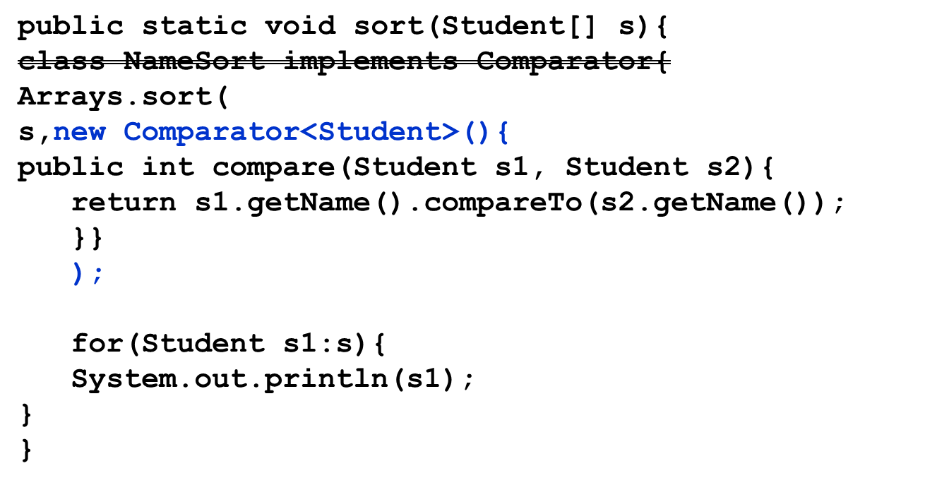
Example1: Anonymous Inner Classes
Let us change the sort method of the previous example to use an anonymous inner class

Slide 29
Example2: Anonymous Inner Classes
Overriding a method of concrete class.
Note the way the this is created. It is important to make sure that the right constructors are called.
class Test{
static {
  HOD h=new HOD("Rana",""){
  public void display(){
  System.out.println("Name "+getName()); }
  };
}
}

Slide 30
Test your understanding
class E {
E() {
System.out.print("E");}
static class Z {
Z(){
System.out.print("Z");}}
public static void main(String args[]){
new E.Z();}}
What is the result of attempting to compile and run the program?
Notes:
ANS: Z

Slide 31
Test your understanding
class B {
private static String s1 = "s1";
final String s2 = "s2";
B () {new Z("s5","s6");}
static class Z {
final String s3 = "s3";
static String s4 = "s4";
Z (final String s5, String s6) {
System.out.print(???);
}}
public static void main(String args[]) {new B();}}
Which variable (in red) cannot be substituted for “???” without causing a compile-time error?
Notes:
Ans: s2

Slide 32
Test your understanding
class F {
public void m1() {Z.m1();}
private static class Y {
private static void m1() {
System.out.print("Y.m1 ");}
}
private static class Z {
private static void m1(){
System.out.print("Z.m1 ");
Y.m1();
}}
public static void main(String[] args) {
new F().m1();}}
What is the result of attempting to compile and run the program?
Notes:
Prints: Z.m1 Y.m1

Slide 33
Test your understanding
class Outer {
static class StaticNested {
static final int a = 25; // 1
static final int b; // 2
static int c; // 3
int d; // 4
static {b = 42;} // 5
}
class NonStaticInner {
static final int e = 25; // 6
static final int f; // 7
static int g; // 8
int h; // 9
static {f = 42;} // 10
}}
Compile-time errors are generated at which lines?
Notes:
Ans: 7 8 10

Slide 34
Inner class in interface and vice versa
A class can be nested inside an interface. Though this is allowed in java, it is a bad practice to include implementation inside abstraction.
A interface can be nested inside a class (or an interface). This is a very rarely used feature.

