Slide 1


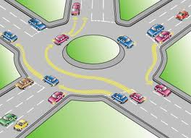
Rules Engine :Drools
Rule Engine Concepts and Drools Expert

Slide 2

Overview
Rule
Rule engine introduction & Working
Why use a Rule Engine?
ReteOO
Introduction to Drools
Drools Expert & Drools Rule Formats
Drools Rule Language Details
Drools Eclipse IDE &
Drools Guvnor Overview
Drools Flow Overview

Slide 3

Rule
Rule Bean
Constraints for above rule
Object type constraint - Applicant Object Type.
Field constraints - age < 18
An object type constraint plus its zero or more field constraints is referred to as a pattern.
The process of matching patterns against the inserted data is, referred to as pattern matching.
rule "Is of valid age" when $a : Applicant( age < 18 ) ← Constraints then $a.setValid( false ); ← Action end
public class Applicant { private String name; private int age; private boolean valid; //getter and setter methods here }

Slide 4
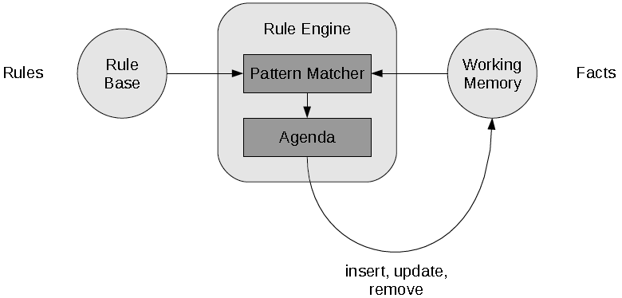
Rule Engine introduction & Working
The rule engine is the computer program that delivers Knowledge Representation and Reasoning(KRR) functionality to the developer. At a high level it has three components:
Ontology (“Things” e.g java Classes/Beans )
Rules
Data

Slide 5
Why use a Rule Engine?
Separates application from dynamic logic
Rules can be modified by different groups
No need to recompile or redeploy
All rules are in one place
Declarative Programming
– Readable and Anyone can easily modify rules.
Centralization of Knowledge
- Repository of business policy
Speed and Scalability
- Rete algorithm, Leaps algorithm

Slide 6
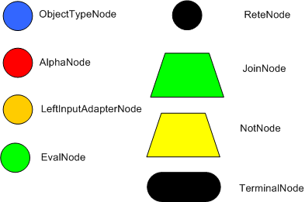
ReteOO
Rete algorithm was invented by Dr. Charles Forgy.
Rete algorithm can be broken into 2 parts: rule compilation and runtime execution.
Rule base is compiled into discrimination network.
Discrimination network is used to filter data as it propagates through the network.

Slide 7
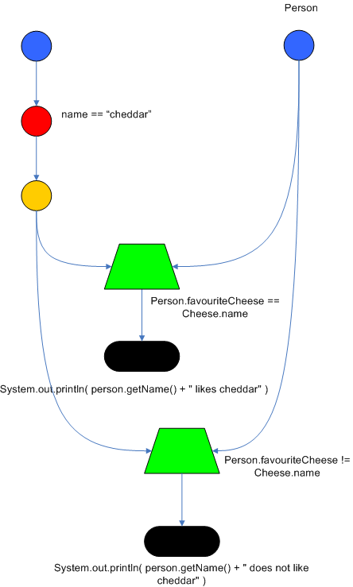
Rete Algorithm example
rule 1
when
Cheese( $cheddar : name == "cheddar" )
$person : Person( favouriteCheese == $cheddar )
then
System.out.println( $person.getName() + " likes cheddar" );
end
rule 2
when
Cheese( $cheddar : name == "cheddar" )
$person : Person( favouriteCheese != $cheddar )
then
System.out.println( $person.getName() + " not likes cheddar" );
end

Slide 8


Introduction to Drools & Drools Expert
Drools 5 introduces the Business Logic integration Platform which provides a unified and integrated platform for Rules, Workflow and Event Processing.
Drools consist out of several projects:
Drools Expert (rule Engine)
Drools Guvnor (Business Rule Manager)
jBPM (Process/Workflow)
Drools Fusion (event processing /temporal reasoning)
Drools Planner (automated planning)

Slide 9
Drools Expert & Drools Rule Format
Drools has an enhanced and optimized implementation of the Rete algorithm for object oriented systems called as ReteOO.
Drools Expert is a declarative, rule based, coding environment.
Drools Rule Formats
Drools Rule Language (DRL)
Domain-specific language (DSL)
Decision tables
Guided rule editor
XML

Slide 10
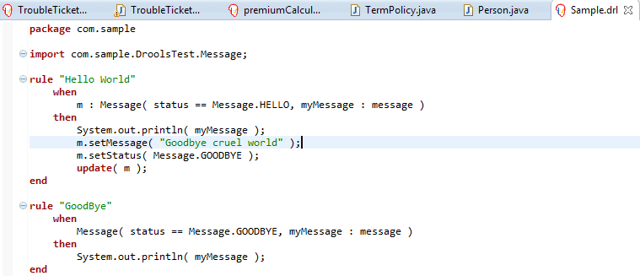
Drools Rule Language(DRL)

Slide 11
Domain-specific language (DSL)
DSL are written in natural language statements.
Domain experts (such as business analysts) can validate and do changes as per requirements.
DSL definitions consists of transformations from DSL "sentences" to DRL constructs.
DRL
DSL
DSLR
DRL & DSL mapping
Cheese(age < 5, price == 20, type=="stilton", country=="ch")
[when]There is a Cheese with=Cheese() [when]- age is less than {age}=age<{age} [when]- type is '{type}'=type=='{type}‘ [when]- country equal to '{country}'=country=='{country}'
There is a Cheese with - age is less than 42 - type is 'stilton'
[when]Something is {colour}=Something(colour=="{colour}")

Slide 12
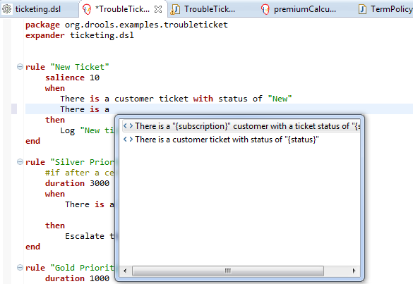
Domain-specific language (DSL)

Slide 13
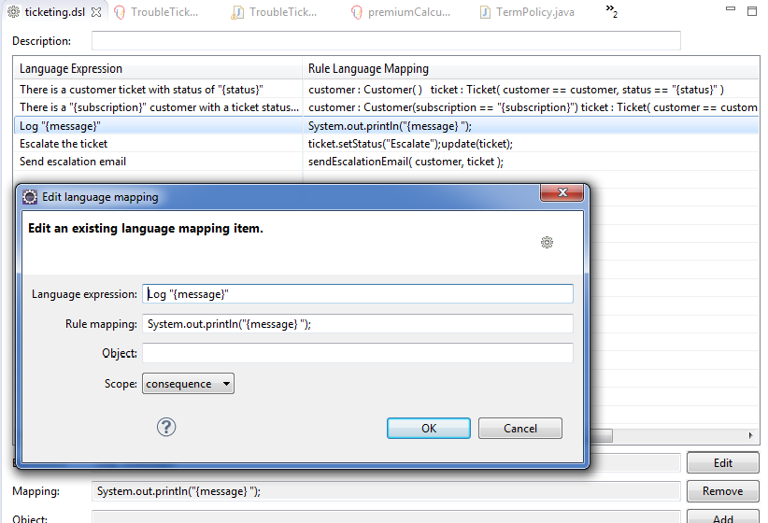
Domain-specific language (DSLR)

Slide 14
Decision table
Decision tables are a "precise yet compact" (ref. Wikipedia) way of representing conditional logic, and are well suited to business level rules.
spreadsheet format (XLS), and CSV.
Decision tables are not recommended for rules that do not follow a set of templates, or where there are a small number of rules
Each row in spreadsheet is a rule
Decision tables are essentially a tool to generate DRL rules automatically

Slide 15
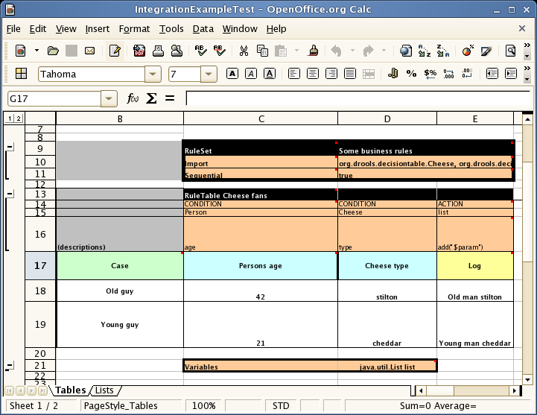
Decision tables

Slide 16
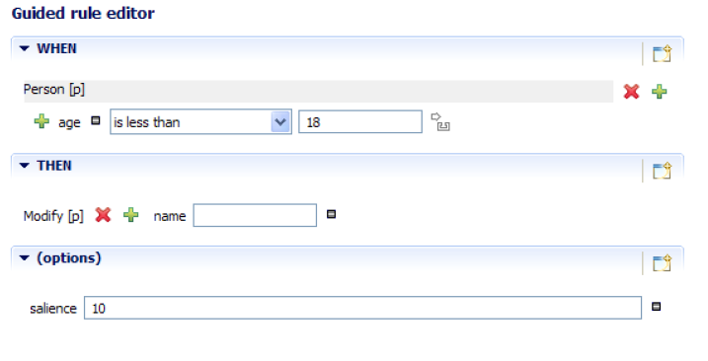
Guided Rule Editor

Slide 17
XML Rule Language

Slide 18
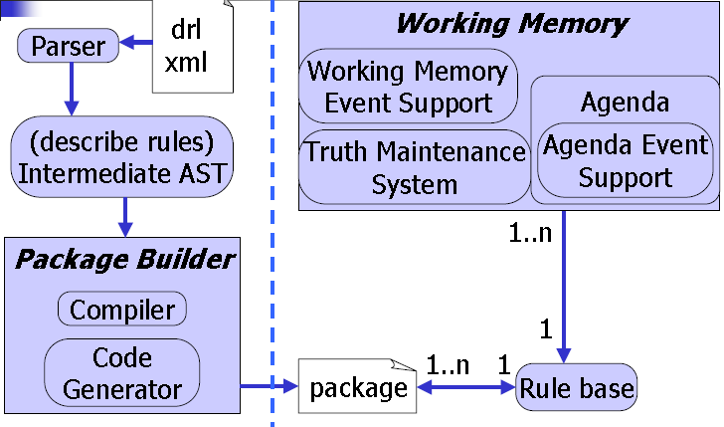
Drools Rule Language :Executing Rules

Slide 19
Drools Rule Language :Executing Rules
A Knowledge Base is what we call our collection of compiled definitions, such as rules and processes, which are compiled using the KnowledgeBuilder.
First, we will create Knowledge Builder
Add DRL file to Knowledge Builder , it parses and compiles DRL files
If there are no errors, we can add the resulting packages to our Knowledge Base
KnowledgeBuilder knowledgeBuilder = KnowledgeBuilderFactory.newKnowledgeBuilder();
knowledgeBuilder.add(drlFileAsResource, ResourceType.DRL);
Collection pkgs = knowledgeBuilder.getKnowledgePackages();
knowledgeBase = KnowledgeBaseFactory.newKnowledgeBase();
knowledgeBase.addKnowledgePackages(pkgs);

Slide 20
Drools Rule Language :Executing Rules
KnowledgeSession provides the way of exposing objects to be ruled.
Stateless Knowledge Session
Stateful Knowledge Session
StatelessKnowledgeSession ksession = kbase.newStatelessKnowledgeSession();
Applicant applicant = new Applicant( “Rajesh Kumar", 16 );
ksession.execute( applicant );
assertFalse( applicant.isValid() );
StatelessKnowledgeSession ksession = kbase.newStatelessKnowledgeSession();
Applicant applicant = new Applicant( “Rajesh Kumar", 16 );
knowledgeSession.insert(applicant);
knowledgeSession.fireAllRules();

Slide 21
Drools Rule Language
Knowledge base can be updated inside rule’s body
insert()
Inserted object will be used by rules engines inside current session
update()
Updates existing in working memory object for the rest of rules
delete()
Removed object will not be ruled on current execution

Slide 22
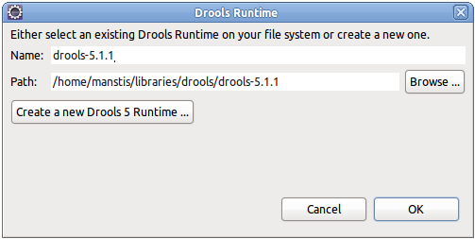
Drools Eclipse IDE
The Eclipse based IDE provides users with an environment to edit and test rules in various formats, and integrate it deeply with their applications.
Required plugins
GEF plugin , GEF is the Eclipse Graphical Editing Framework.
http://download.eclipse.org/tools/gef/updates/releases/
Drools Eclipse IDE plugin
http://download.jboss.org/drools/release/5.4.0.Final/org.drools.updatesite/
Defining a Drools Runtime
Go to windows preferences
under the Drools category,
select "Installed Drools runtimes“
use the default jar files as included in
the Drools Eclipse plugin
by clicking "Create a new Drools 5 runtime"

Slide 23
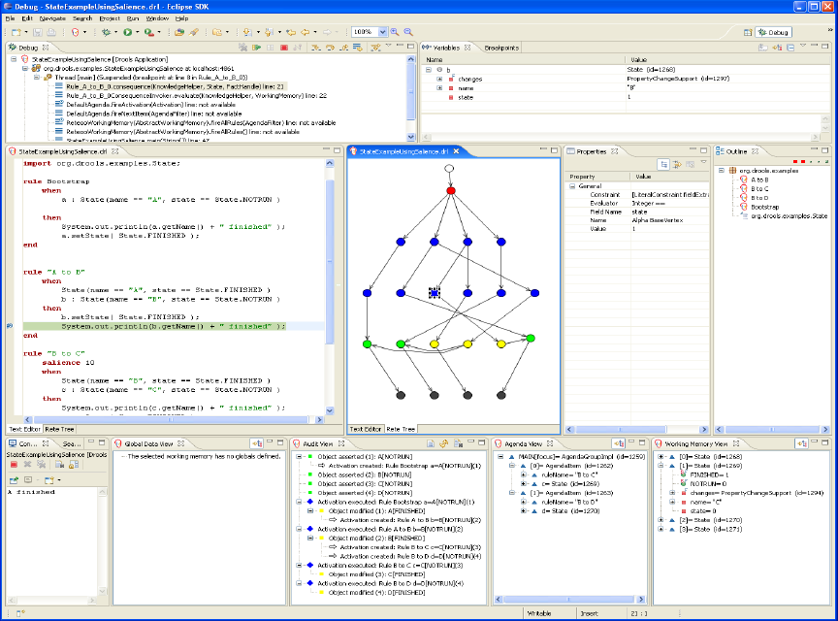

Slide 24
Drools Guvnor Overview
Web-based rule management, storage, editing and deployment environment.
Rule editing
text, guided, decision tables, etc.
Version control
Categorization
Build and deploy
Scenarios

Slide 25
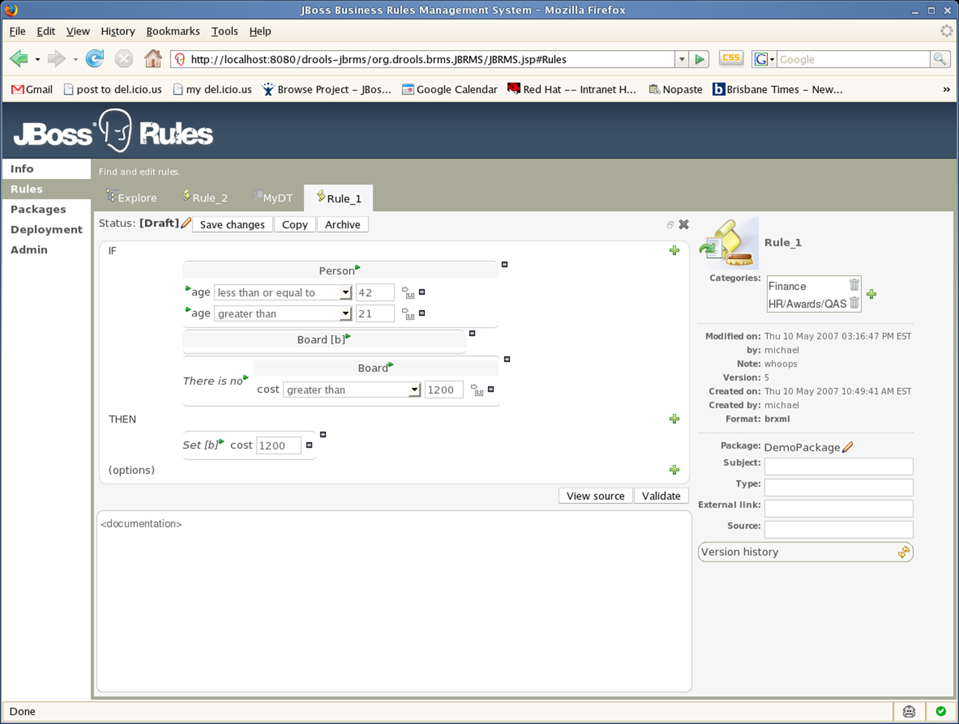
Guvnor Rule Editing

Slide 26
Guvnor Rule Deployment

Slide 27
Guvnor Test Scenarios

Slide 28
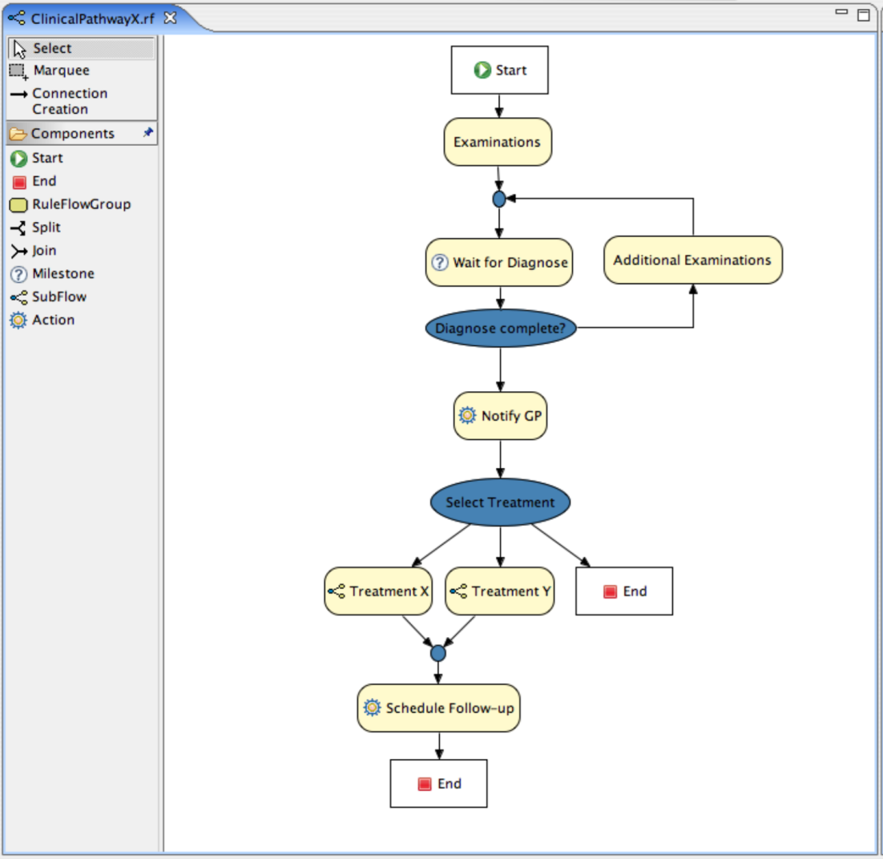
Drools Flow Overview

Slide 29
References
Drools Homepage
http://www.jboss.org/drools/
Drools Blog
http://blog.athico.com/
Drools Chat
irc.codehaus.org #drools
Drools Mailing List
rules-users@lists.jboss.org

Slide 30

Thank you
Any questions?

