Slide 1


Drools 6 Deep Dive
(Core Engine)
Edson Tirelli
etirelli@redhat.com
Drools Project Lead
Principal Software Engineer
Mario Fusco
mfusco@redhat.com
Senior Software Engineer

Slide 2
Drools 6 Deep Dive
Core Engine Internals
  Phreak Algorithm (and ReteOO comparison)
  Set based propagation
Deployment model
  Kjar modules
  Incremental compilation and KieScanner
  Type declarations changes from Drools 5
Most useful less known features
  Property reactivity
  Backward chaining
  Multi-function accumulates
  Conditional named consequences

Slide 3
Core Engine Internals

Slide 4
ReteOO was cool
Node Sharing
Alpha Indexing
Tree-based graphs
Modify-in-place
Property reactive
Sub-networks for nested CEs
Backward chaining support
Lazy Truth Maintenance
Heap based agenda
Dynamic Rules support

Slide 5
But Phreak is better
New algorithm:
  Inspired by Rete, LEAPS, Collection Oriented Match, L/R Unlinking
Preserves all ReteOO optimizations (that still make sense)
Adds a whole new level of innovations:
  Full rule and segment unlinking
  Lazy evaluation, rule scoping
  Set-based propagation
Results:
  On average, 20% faster than ReteOO*
    On specific use cases, up to 400% faster
  Reduced memory footprint
  More forgiving algorithm to badly written rules
* see the Drools blog for details

Slide 7
Phreak – memory structure

Slide 8
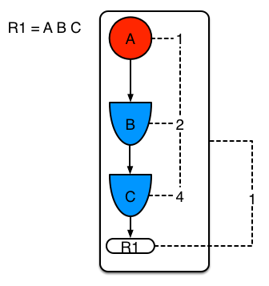
Phreak – in-memory network

Slide 9
Phreak – in-memory network

Slide 10
Set-based propagation

Slide 11
Why set-based propagation
For large amounts of data, the number of tuples that match individual conditions is likely to be large
In such situations, the number of collections will be much smaller than the number of tuples
Collections of tuples that match individual conditions are the unit of matching, rather than individual tuples
Tame the combinatorial explosion, since it generates combinations of collections instead of combinations of tuples

Slide 12
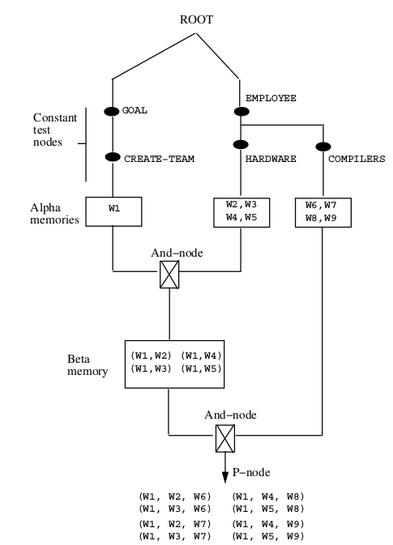
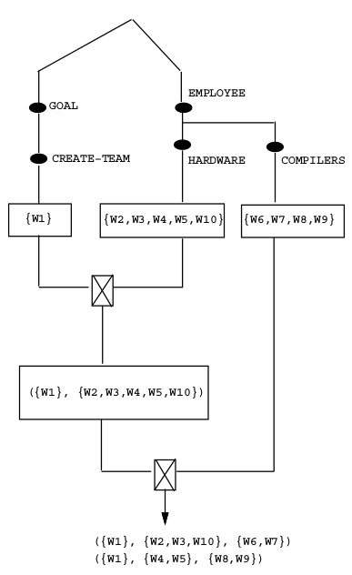
From tuple-based to set-based propagation

Slide 13
Deployment Model
(and build API)

Slide 14







Drools and jBPM 5 - Concepts
Guvnor
Application
JCR Repository
Dependencies
Resources
KSessions
Client
Compiled
Resources
KBases
Dependencies
Packages
Packages

Slide 15
Drools and jBPM 5 - Shortcomings
Guvnor
Application
JCR Repository
3. Complexity
Leak
Dependencies
Resources
KSessions
Client
Compiled
Resources
KBases
Dependencies
Packages
Packages
1. Java Serialization
2. Dependency management

Slide 16

KIE 6 - Concepts
Kie Workbench
Application
Git Repository
Project
Project
Module (kjar)
Module (kjar)
Module (kjar)
KContainer
Maven Repository

Slide 17
Kie Workbench
Source stored in GIT repositories
Modules (kjars) stored in maven repositories
Kie Workbench
Repositories
contain
Projects
contain
Packages
define
include
KBases
define
KSessions

Slide 18
Module (kjar)
Fully mavenized
Versioned
Standard JAR file
Completely self-contained
Contains:
  Source files
  Compiled classes and assets (rules, processes, etc)
  KBases and KSessions definitions (kmodule.xml)
  Module configuration and dependencies (pom.xml)
Ready for deployment in a KContainer

Slide 19
Module (kjar)
Utilizes sensible defaults
Convention based (java, maven)
Automatic discover:
  META-INF/kmodule.xml
No need to programatically build (although supported)
Supports inheritance and composition (includes)
Allows for multiple named entities

Slide 20
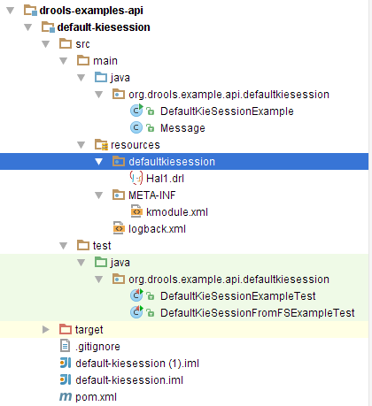
Meaningful defaults
KieServices ks = KieServices.Factory.get();
KieContainer kContainer = ks.getKieClasspathContainer();
KieSession kSession = kContainer.newKieSession();
kSession.fireAllRules();
<kmodule
xmlns="http://jboss.org/kie/6.0.0/kmodule">
</kmodule>

Slide 21
Defining multiple named
Kiebases and KieSessions
<kmodule xmlns:xsi="http://www.w3.org/2001/XMLSchema-instance"
xmlns="http://jboss.org/kie/6.0.0/kmodule">
<kbase name="ServerKB" packages="org.myproject.example.server,
org.myproject.example.server.model"
eventProcessingMode="stream" equalsBehavior="identity">
<ksession name="ServerKS" default="true" />
</kbase>
<kbase name="ClientKB" packages="org.myproject.example.client">
<ksession name="StatefulClientKS" type="stateful"/>
<ksession name="StatelessClientKS" type="stateless"/>
</kbase>
</kmodule>
KieContainer kc = KieServices.Factory.get().getKieClasspathContainer();
KieSession serverKsession = kc.newKieSession( "ServerKS" );
KieSession clientKsession = kc.newKieSession( "StatelessClientKS" );

Slide 22
Loading a KieModule from Maven
<dependency>
<groupId>org.mycompany</groupId>
<artifactId>myproject</artifactId>
<version>1.0.0</version>
</dependency>
KieServices ks = KieServices.Factory.get();
KieContainer kContainer =
ks.newKieContainer(ks.newReleaseId("org.mycompany",
"myproject",
"1.0.0"));
KieSession kSession = kContainer.newKieSession("ksession1");
Don't forget to add kie-ci
(maven integration module)
to your dependencies!

Slide 23
Incremental compilation & KieScanner

Slide 24
Incremental Compilation
KieServices ks = KieServices.Factory.get();
ReleaseId rel1 = ks.newReleaseId( "org.mycompany", "myproject", "1.0.0" );
// creates a KieContainer for the project identified by rel1
KieContainer kc = ks.newKieContainer( rel1 );
// instance the default KieSession from the KieContainer ...
KieSession ksession = kc.newKieSession();
// … and do some work on that KieSession
// programmatically upgrade the KieContainer to a newer version
ReleaseId rel2 = ks.newReleaseId( "org.mycompany", "myproject", "1.1.0" );
kc.updateToVersion( rel2 );
// the rule base used by the KieSession is dynamically updated
// so you can keep using the same KieSession instance with newer rules

Slide 25
KieScanner
Allows continuous monitoring of your Maven repository to check whether a new release of a Kie project is available
When it finds a newer version of the project used by the KieContainer on which it has been registered, automatically downloads it and triggers an incremental build
Can be configured to run with a fixed time interval, but it is also possible to run it on demand
Use maven
version range
KieServices kieServices = KieServices.Factory.get();
ReleaseId releaseId = kieServices.newReleaseId( "org.mycompany",
"myproject",
"LATEST" );
KieContainer kContainer = kieServices.newKieContainer( releaseId );
KieScanner kScanner = kieServices.newKieScanner( kContainer );
// Start the KieScanner polling the Maven repository every 10 seconds
kScanner.start( 10000L );

Slide 26
Type declarations changes

Slide 27
In Drools 5 type declarations were compiled at runtime
// a knowledge base with a declared type:
KieBase kbase = ...
// get the declared FactType
FactType personType =
kbase.getFactType( "org.mypackage",
"Person" );
// handle the type as necessary:
// create instances:
Object bob = personType.newInstance();
// set attributes values
personType.set( bob, "name", "Bob" );
personType.set( bob, "age", 42 );
// insert fact into a session
KieSession ksession = ...
ksession.insert( bob );
ksession.fireAllRules();
package org.mypackage
declare Person
name : String
age : int
end
rule "Find adults" when
Person( age > 18,
$name : name )
then
System.out.println( $name );
end
Type declarations can
be used in Java code
only via reflection

Slide 28
In Drools 6 type declarations are added to the kjar at compile time
<dependency>
<groupId>org.mycompany</groupId>
<artifactId>myproject</artifactId>
<version>1.0.0</version>
</dependency>
package org.mypackage
declare Person
name : String
age : int
end
rule "Find adults" when
Person( age > 18,
$name : name )
then
System.out.println( $name );
end
import org.mypackage.Person;
// create new instance of a plain Java class
Person bob = new Person();
// set attributes values
bob.setName( “Bob” );
bob.setAge( 2 );
// insert fact into a session
KieSession ksession = ...
ksession.insert( bob );
ksession.fireAllRules();
Type declarations is compiled
and added to the kjar so you
can use it as a plain Java class

Slide 29
Property Reactivity

Slide 30
Solving loop problems
rule “Salary award for min 2 years service”
when
e : Employee( lengthOfService > 2 )
then
modify( e ) { setSalary( e.getSalary() * 1.05 ) };
end

Slide 31

Solving loop problems
rule “Salary award for min 2 years service” no-loop
when
e : Employee( lengthOfService > 2 )
then
modify( e ) { setSalary( e.getSalary() * 1.05 ) };
end

Slide 32

Solving loop problems
rule “Salary award for min 2 years service” no-loop
when
e : Employee( lengthOfService > 2 )
then
modify( e ) { setSalary( e.getSalary() * 1.05 ) };
end
rule “Salary award for min 8 years service” no-loop
when
e : Employee( lengthOfService > 8 )
then
modify( e ) { setSalary( e.getSalary() * 1.05 ) };
end

Slide 33
Solving loop problems
rule “Salary award for min 2 years service” when
e : Employee( lengthOfService > 2 )
not SalaryMin2Years( employee == e )
then
modify( e ) { setSalary( e.getSalary() * 1.05 ) };
insert ( new SalaryMin2Years(e) );
end
rule “Salary award for min 8 years service” when
e : Employee( lengthOfService > 8 )
not SalaryMin8Years( employee == e )
then
modify( e ) { setSalary( e.getSalary() * 1.05 ) };
insert ( new SalaryMin8Years(e) );
end

Slide 34
Solving loop problems
rule “Year End” when
d : ChangeDate( )
e : Employee( )
then
modify( e ) { lengthOfService(
d.getYear() - e.getStartYear() ) };
end

Slide 35


Slide 36
Property Reactive
Annotate the class:
  Java:
  DRL:
@PropertyReactive
public class Employee {
int salary;
int lengthOfService;
// … getters/setters
}
declare Employee
@PropertyReactive
salary : int
lengthOfService : int
}

Slide 37
Property Reactive – problem solved
rule “Salary award for min 2 years service”
when
e : Employee( lengthOfService > 2 )
then
modify( e ) { setSalary( e.getSalary() * 1.05 ) };
end
rule “Salary award for min 8 years service”
when
e : Employee( lengthOfService > 8 )
then
modify( e ) { setSalary( e.getSalary() * 1.05 ) };
end

Slide 38
Property Reactive – @Watch
rule “Record Salary Changes”
when
e : Employee( ) @Watch( salary )
then
insert( new SalaryChange( e, e.getSalary() );
end

Slide 39
Property Reactive – @Watch
rule “Salary award for min 2 years service”
when
e : Employee( salary < 1000, lengthOfService > 2 ) @Watch( !salary )
then
modify( e ) { setSalary( e.getSalary() * 1.05 ) };
end

Slide 40
Property Reactive - @Watch
@Watch( salary, lengthOfService, age )
@Watch( * )
@Watch( !* )
@Watch( *, !salary )
@Watch( !*, salary )

Slide 41
Backward Chaining

Slide 42
Forward and Backward Chaining
Forward Chaining starts with facts/data and trigger actions or output conclusions
Backward Chaining starts with goals and search how to satisfy them (e.g. Prolog)
Drools is a Hybrid Chaining Systems meaning that it allows to mix these 2 strategies
Backward-Chaining is often referred to as derivation queries and then Drools implements with the query construct
A query is a simple way to search the working memory for facts that match the stated conditions
A query is just a rule with no consequence. It collects all the results and returns them to the caller

Slide 43
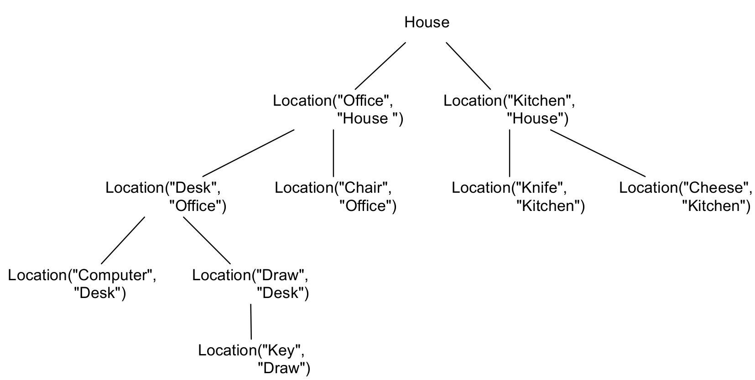
A Backward Chaining example
rule “Print all things contained in the Office” when
isContainedIn(thing, "Office"; )
then
System.out.println( "thing " + thing + " is in the Office" );
end
In Var
(buond)
Out Var
(unbuond)
query isContainedIn( String x, String y )
Location( x, y; )
or
( Location( z, y; ) and isContainedIn( x, z; ) )
end
thing Key is in the Office
thing Computer is in the Office
thing Draw is in the Office
thing Desk is in the Office
thing Chair is in the Office

Slide 44
Multi-function Accumulates

Slide 45
Drools 6 – Multi-function accumulates
rule “accumulate in Drools 5”
when
$s : Number() from accumulate( $p : Product(),
sum( $p.price ) )
$a : Number() from accumulate( $p : Product(),
average( $p.price ) )
then ...
rule “accumulate in Drools 6”
when
acc( $p : Product(),
$s : sum( $p.price ),
$a : average( $p.price ) )
then ...

Slide 46
(Conditional) Named Consequences

Slide 47
Why more than one consequence?
Sometimes the constraint of having one single consequence for each rule can be somewhat limiting and leads to verbose and difficult to be maintained repetitions
rule "Give 10% discount to customers older than 60"
when
$customer : Customer( age > 60 )
then
modify($customer) { setDiscount( 0.1 ) };
end
rule "Give free parking to customers older than 60"
when
$customer : Customer( age > 60 )
$car : Car ( owner == $customer )
then
modify($car) { setFreeParking( true ) };
end

Slide 48
Named Consequences
rule "Give 10% discount and free parking to customers older than 60"
when
$customer : Customer( age > 60 )
do[giveDiscount]
$car : Car ( owner == $customer )
then
modify($car) { setFreeParking( true ) };
then[giveDiscount]
modify($customer) { setDiscount( 0.1 ) };
end
When the pattern matching
evaluation reaches this point
activate the named consequence
and continue evaluation
Give 10% discount to a customer
older than 60 regardless
if he owns a car or not

Slide 49
Conditional Named Consequences
rule "Give free parking and 10% discount to over 60
Golden customer and 5% to Silver ones"
when
$customer : Customer( age > 60 )
if ( type == "Golden" ) do[giveDiscount10]
else if ( type == "Silver" ) break[giveDiscount5]
$car : Car ( owner == $customer )
then
modify($car) { setFreeParking( true ) };
then[giveDiscount10]
modify($customer) { setDiscount( 0.1 ) };
then[giveDiscount5]
modify($customer) { setDiscount( 0.05 ) };
endd
If the condition evaluates to
true activate the named
consequence and continue
Else If this other condition is
met activate the named
consequence and but block
any further evaluation

Slide 50

Thanks … Questions?
Q
A
Edson Tirelli
etirelli@redhat.com
Mario Fusco
mfusco@redhat.com

