Slide 1
Application Software

Slide 2
Day 1 Session
Welcome to the Day 1 Session on
Application Software

Slide 3
Accounting, payroll, and finance management
Accounting
QuickBooks (great for small and medium businesses)
Xero (cloud-based alternative to QuickBooks)
Sage Accounting (more advanced for larger businesses)
Zoho Books (affordable and simple to use)

Slide 4
Accounting, payroll, and finance management
Payroll:
ADP Workforce Now (scalable for large organizations)
Gusto (user-friendly and affordable for small businesses)
Paychex (robust option with built-in HR tools)
Rippling (combines payroll and HR management)

Slide 5
Accounting, payroll, and finance management
Finance:
SAP Concur (expense and financial management)
NetSuite ERP (comprehensive enterprise-level tool)
Zoho Finance Plus (for smaller companies)
FreshBooks (ideal for freelancers and small businesses)

Slide 6
Project management
Trello (Kanban-Based and Visual Organization)
Asana (Comprehensive Project Management)
Monday.com (Highly Customizable Workflows)
Jira (Agile Project Management)
Microsoft Project (Traditional Project Management)
Notion (All-in-One Workspace)
Smartsheet (Spreadsheet-Style Project Management)
Wrike (Powerful for Collaboration and Reporting)

Slide 7
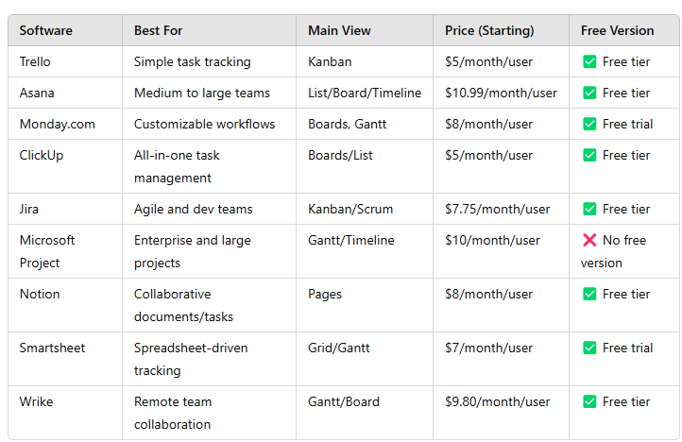
Comparison Table (Quick Overview)

Slide 8
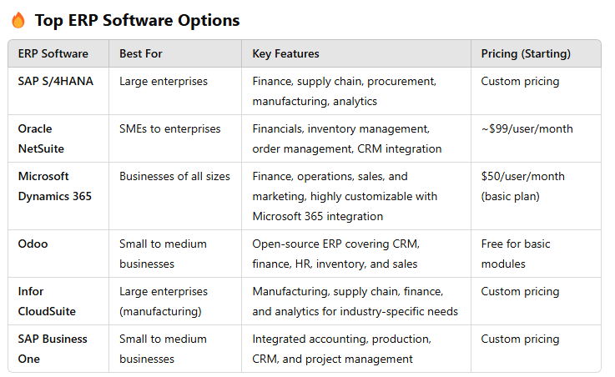
Resource (ERP and CRM system) and HR management

Slide 9
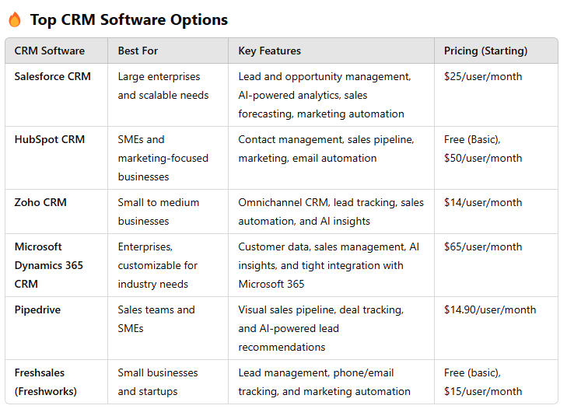
Customer Relationship Management (CRM) Software

Slide 10
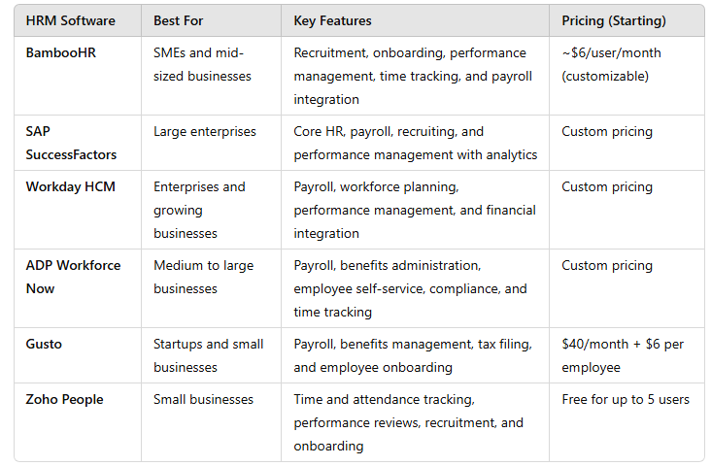
Top HR Management Software Options

Slide 11
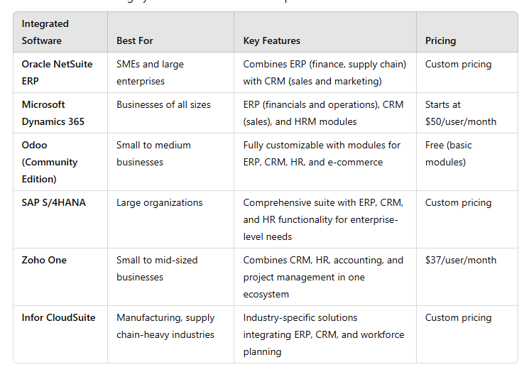
Integrated Solutions (ERP + CRM + HRM)

Slide 12
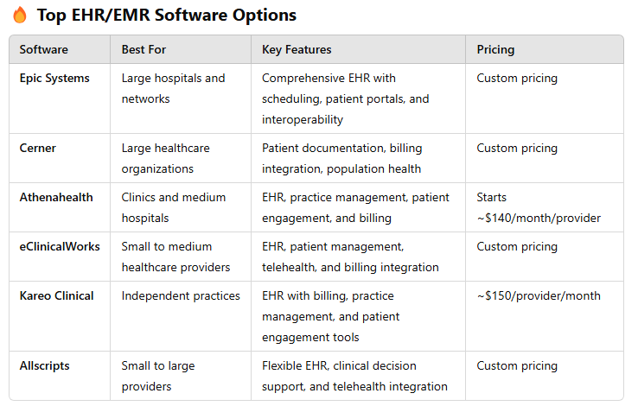
Electronic Health Records (EHR) and Electronic Medical Records (EMR) Systems

Slide 13
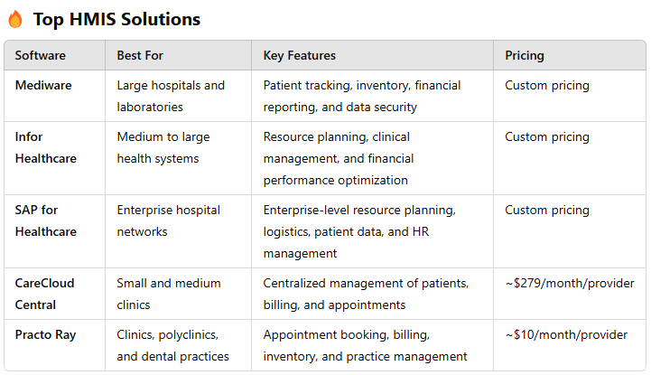
Hospital Management Information Systems (HMIS)

Slide 14
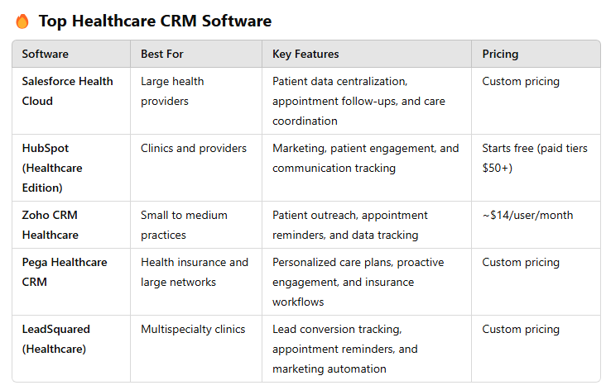
Hospital Management Information Systems (HMIS)

Slide 15
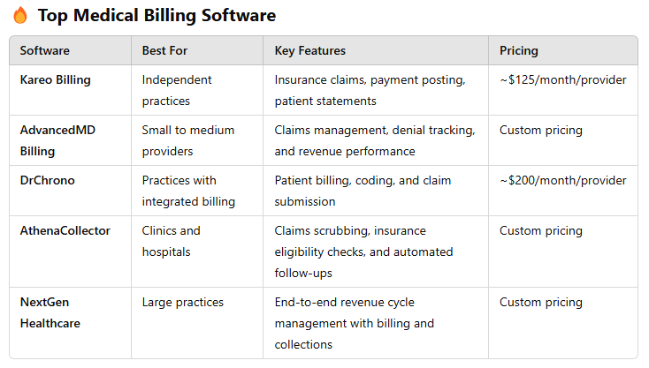
Hospital Management Information Systems (HMIS)

Slide 16
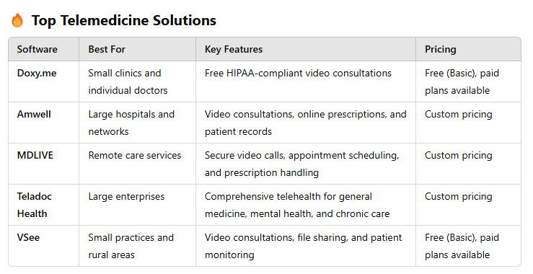
Hospital Management Information Systems (HMIS)

Slide 17
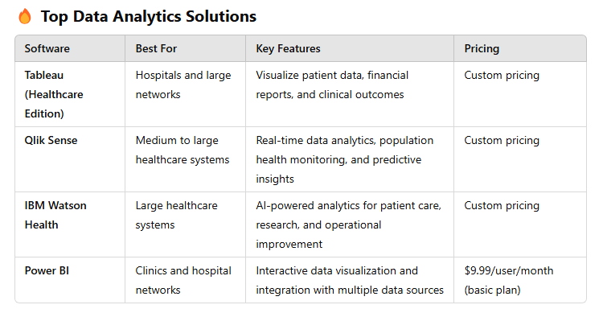
Hospital Management Information Systems (HMIS)

Slide 18
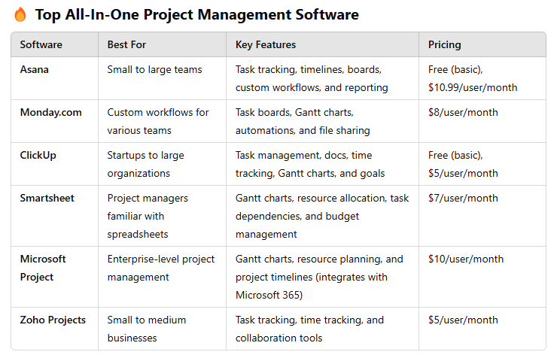
All-In-One Business Project Management Tools

Slide 19
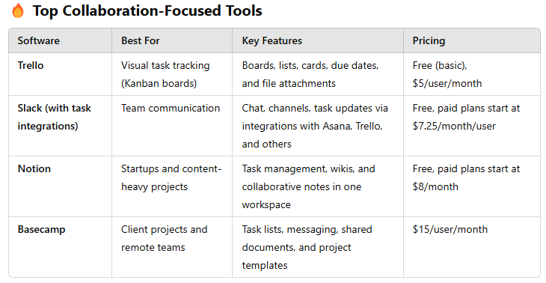
All-In-One Business Project Management Tools

Slide 20
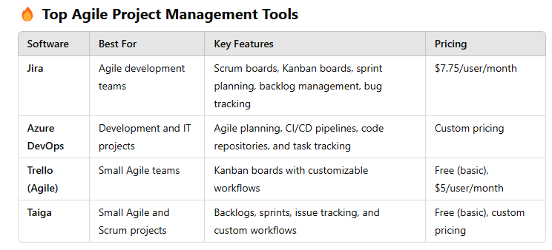
All-In-One Business Project Management Tools

Slide 21
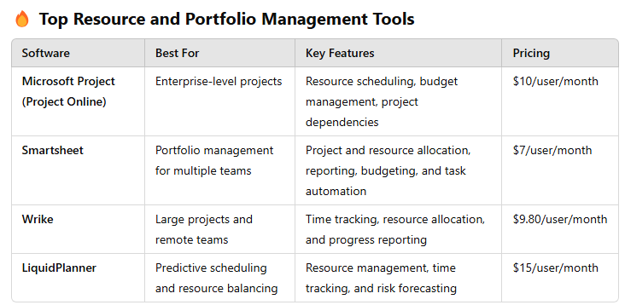
All-In-One Business Project Management Tools

Slide 22
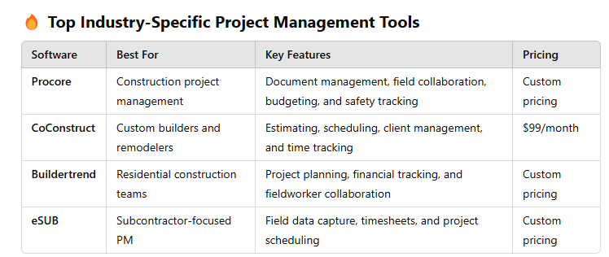
All-In-One Business Project Management Tools

Slide 23
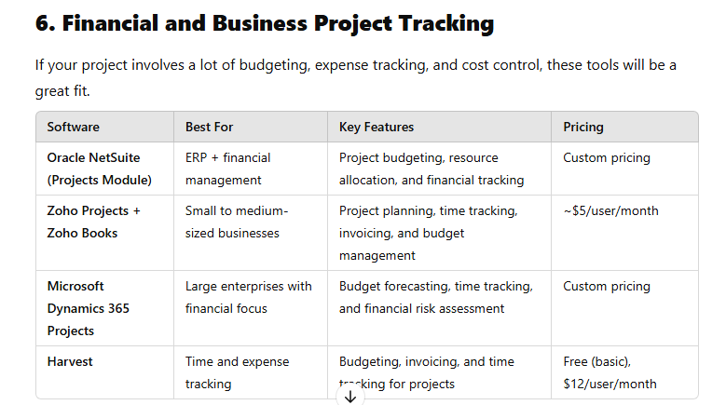
All-In-One Business Project Management Tools

Slide 24
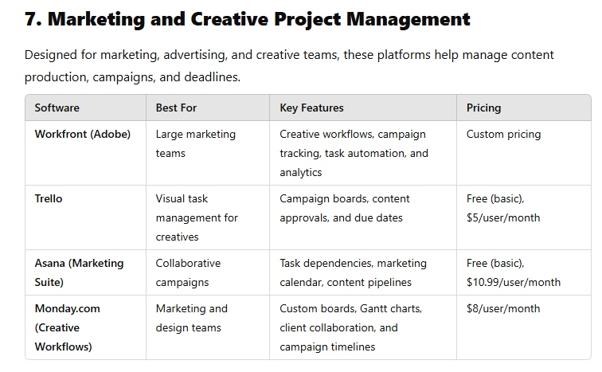
All-In-One Business Project Management Tools

Slide 25
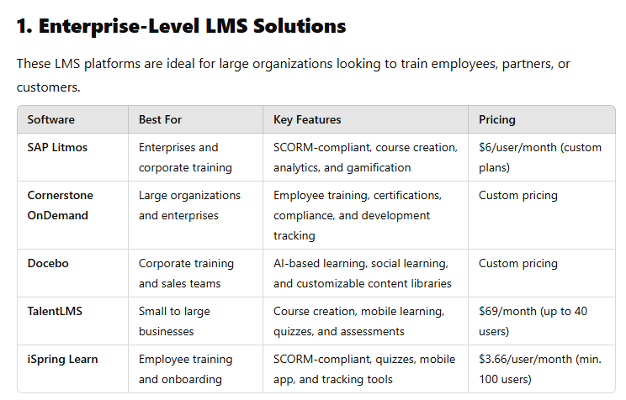
LMS and eLearning software

Slide 26
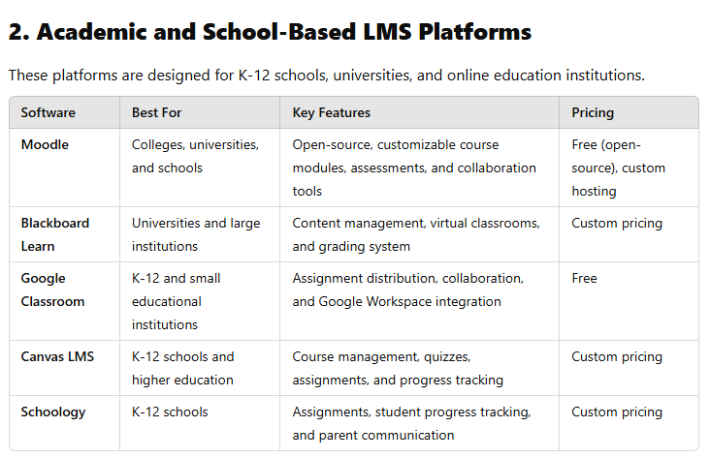
LMS and eLearning software

Slide 27
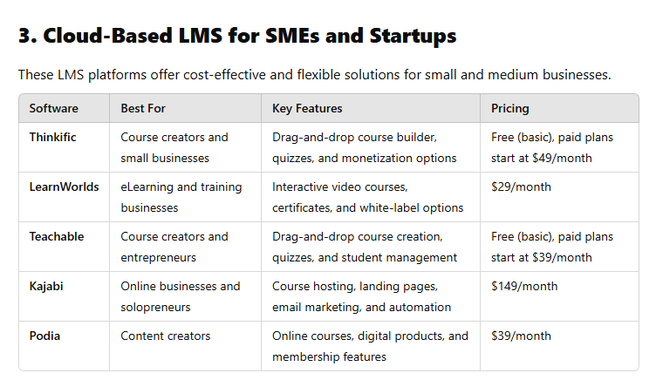
LMS and eLearning software

Slide 28
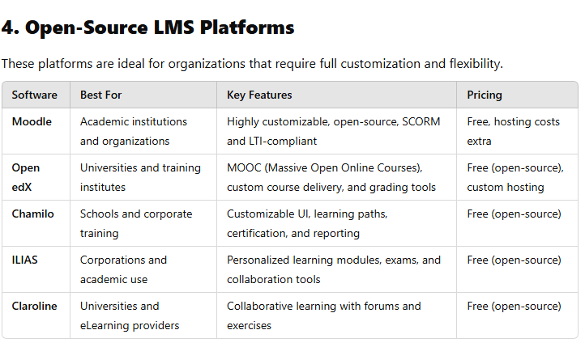
LMS and eLearning software

Slide 29
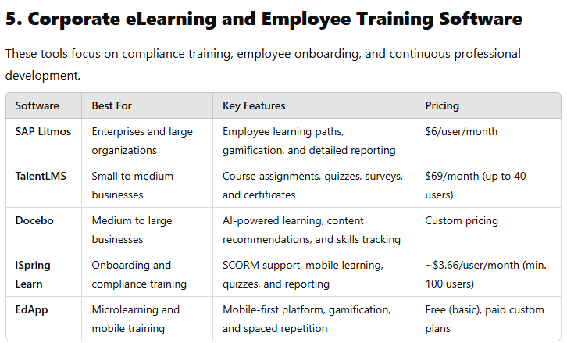
LMS and eLearning software

Slide 30
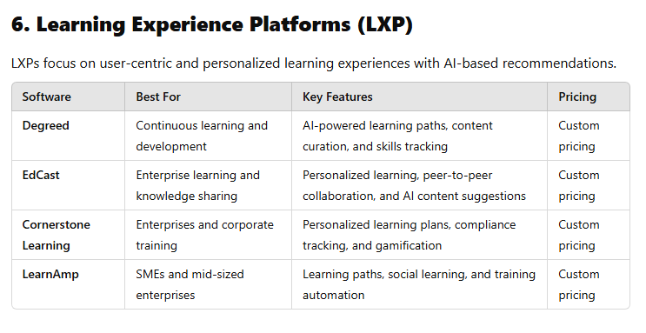
LMS and eLearning software

Slide 31
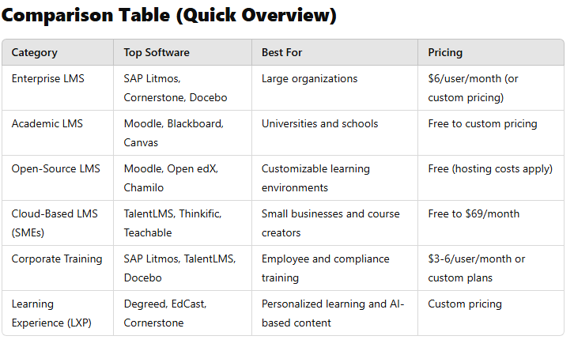
LMS and eLearning software

Slide 32
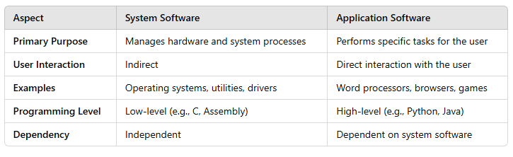
System software vs Application Software

Slide 33
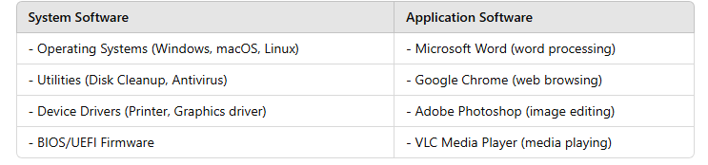
System software vs Application Software

Slide 34
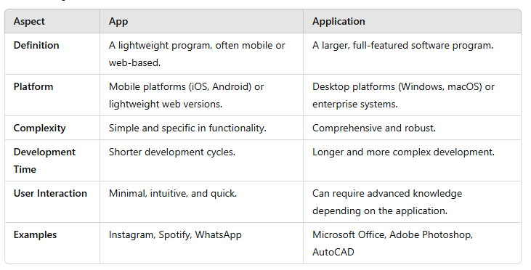
App vs Application

Slide 35
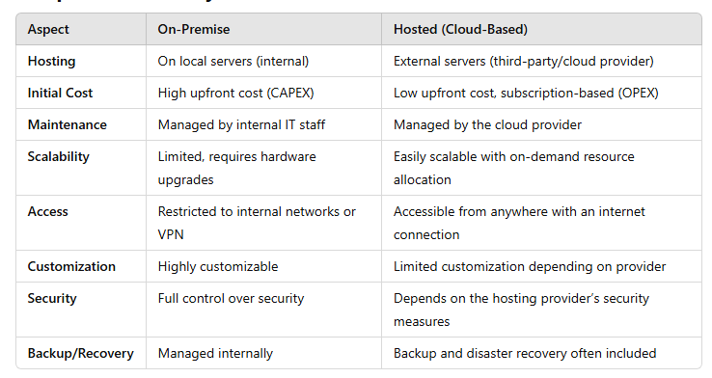
On Premises vs Hosted

Slide 36
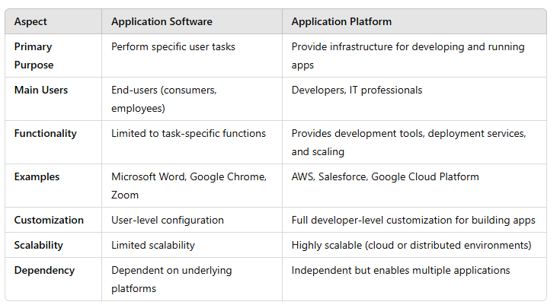
Application Software vs Application Platform

Slide 37
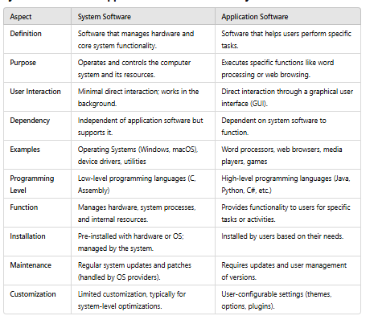
System Software vs Application Software

Slide 38
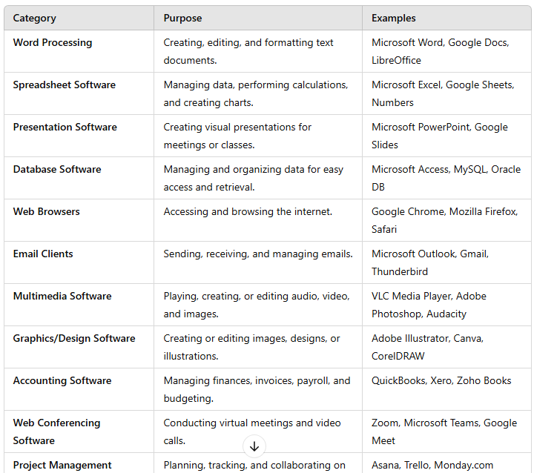
General Application Software

Slide 39
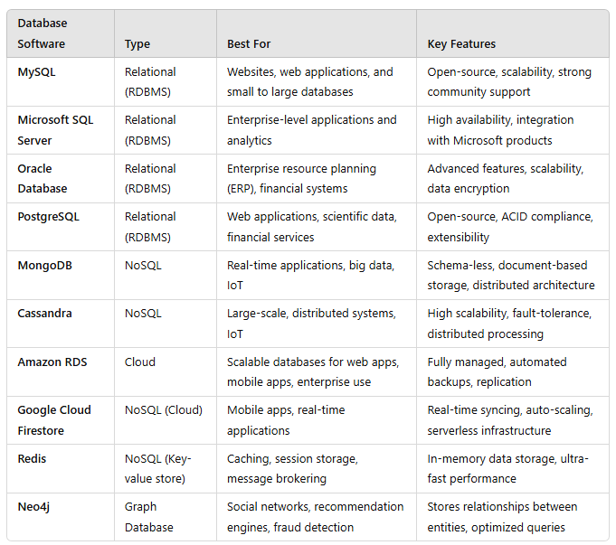
Database Software

Slide 40
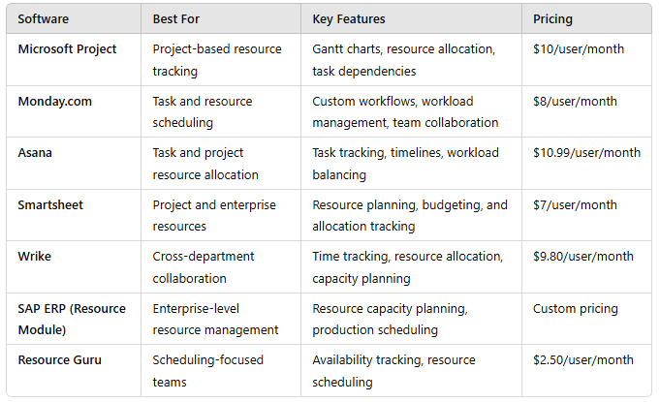
Resource Management Software

Slide 41
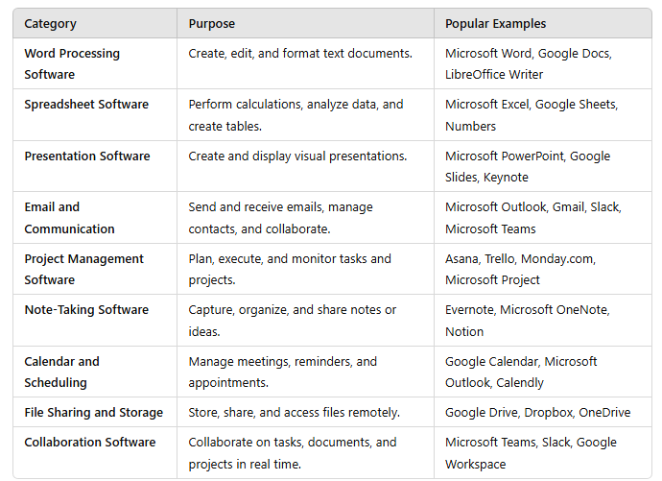
Productivity Software

Slide 42
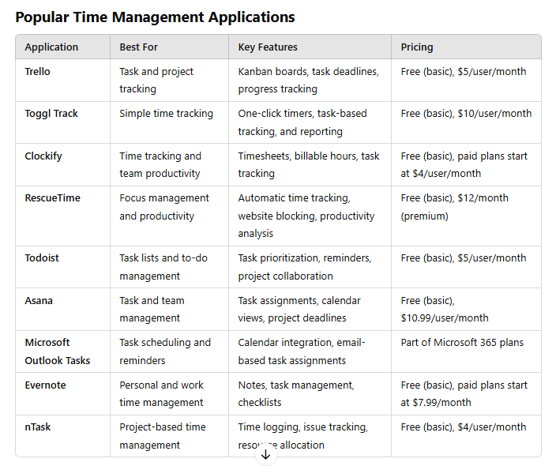
Time Management Application Software

Slide 43
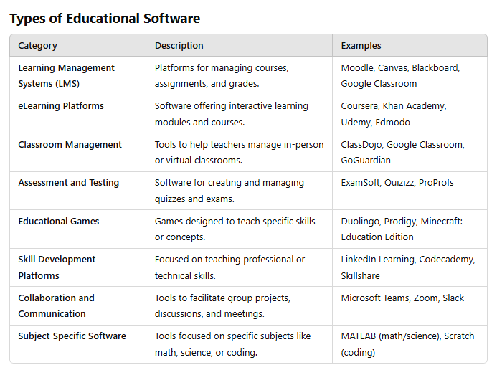
Education Software

Slide 44
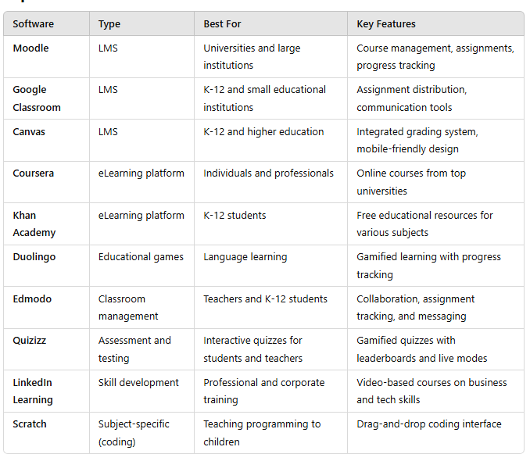
Education Software

Slide 45
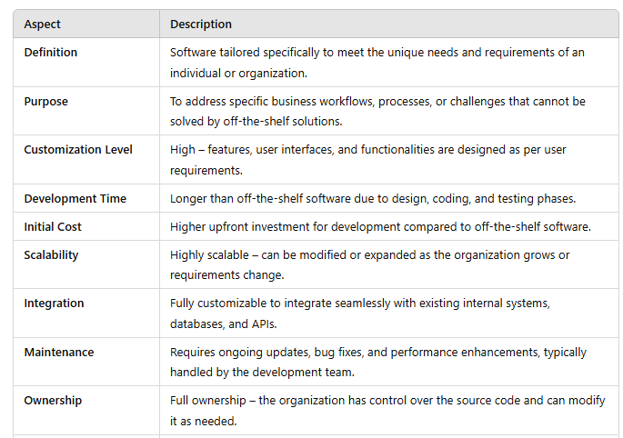
Customized Software

Slide 46
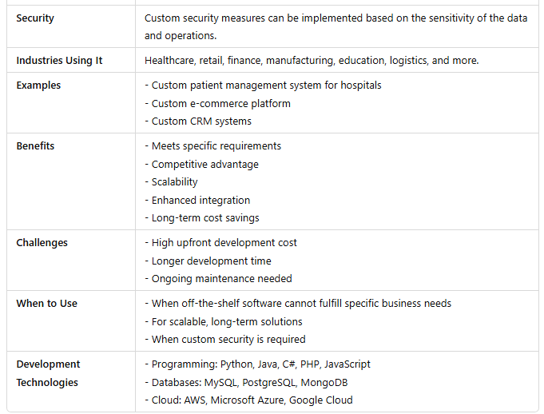
Customized Software

Slide 47
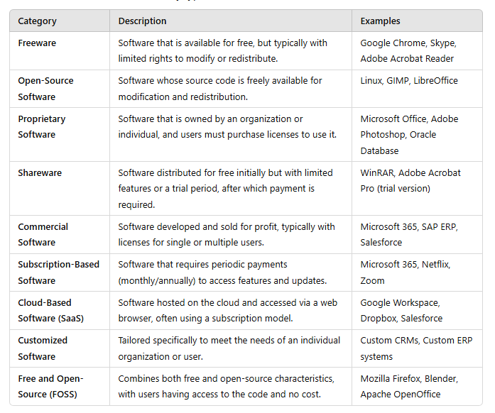
Classification of Application Software Based on Availability

Slide 48
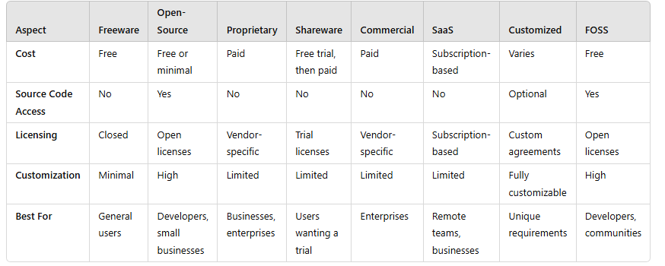
Benefits

Slide 49
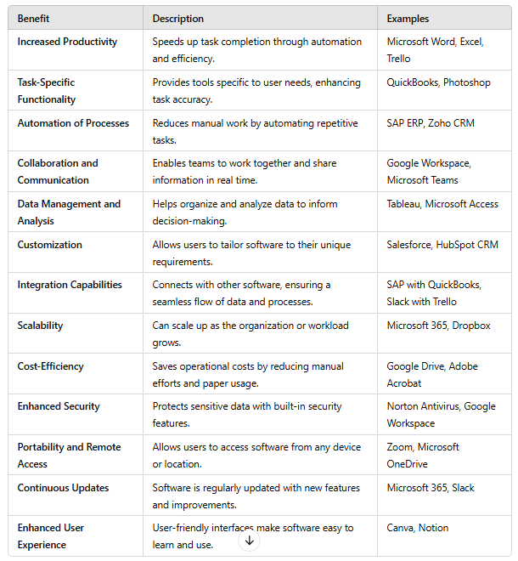
Benefits

Slide 50
Thank You

Slide 51

Assessment
Time for an Assessment

