Slide 1
Virtualization

Slide 2
Agenda
1
Virtualization

Slide 3
Day 1 Session
Welcome to the Day 1 Session on
Virtualization

Slide 4
Virtualization
Virtualization refers to the process of creating a virtual version of a physical resource, such as a server, desktop, storage device, network, or operating system.
It allows a single physical machine to run multiple virtual environments, improving resource utilization, scalability, and flexibility.

Slide 5
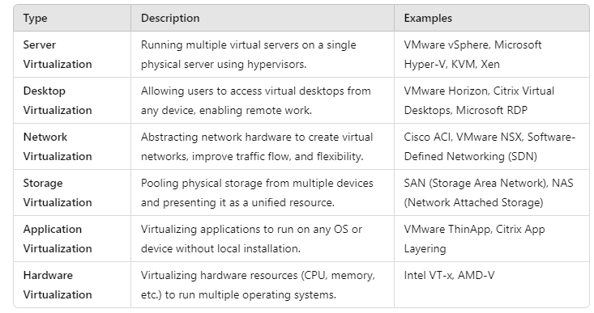
Types of Virtualization

Slide 6
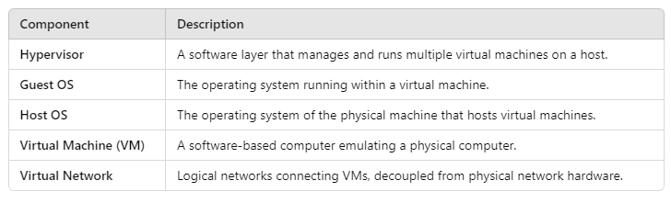
Key Components

Slide 7
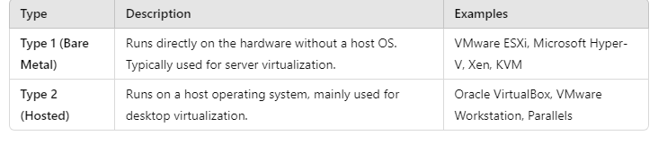
Types of Hypervisors

Slide 8
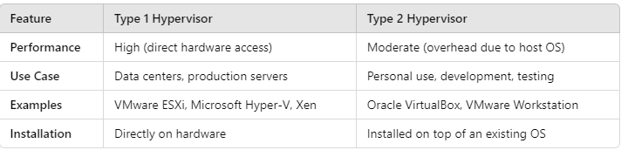
Comparison of Type 1 and Type 2 Hypervisors

Slide 9
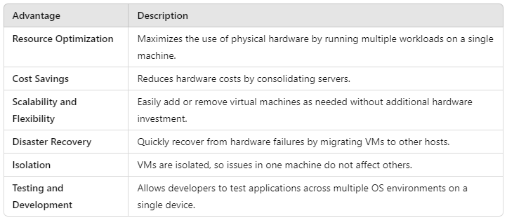
Advantages of Virtualization

Slide 10
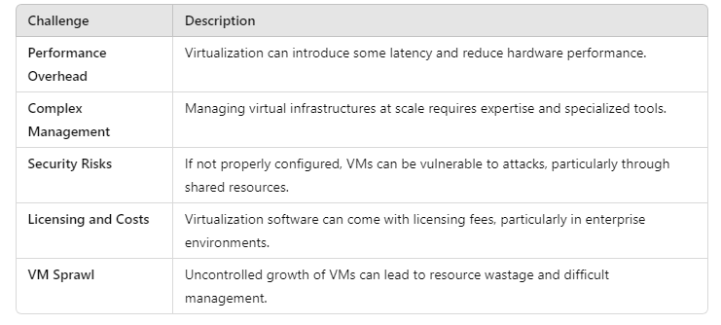
Challenges of Virtualization

Slide 11
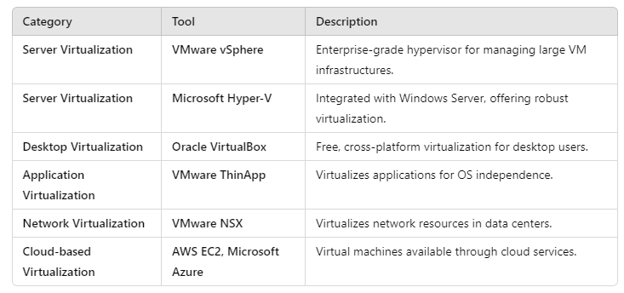
Popular Virtualization Software

Slide 12
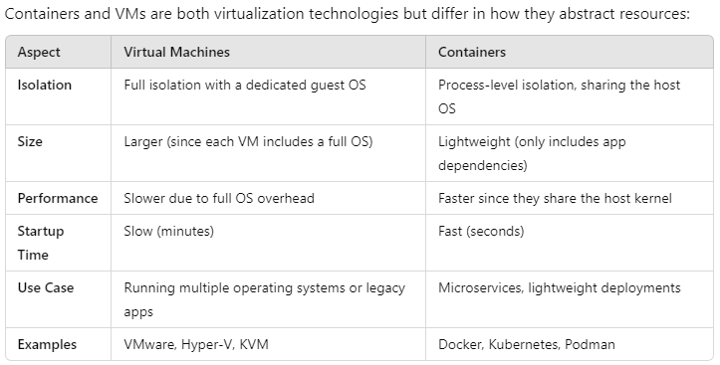
Containers vs. Virtual Machines

Slide 13
Cloud and Virtualization
Virtualization is a foundational technology for cloud computing. Most cloud services (like AWS, Microsoft Azure, and Google Cloud) rely on virtualization to provide:
Infrastructure as a Service (IaaS): Virtual machines (e.g., AWS EC2 instances).
Platform as a Service (PaaS): Virtualized development environments.
Software as a Service (SaaS): Apps hosted on virtual servers.

Slide 14
Virtualization Security Best Practices
Network segmentation: Isolate critical workloads using virtual LANs (VLANs).
Regular patching: Keep hypervisors and virtual environments up to date.
VM monitoring: Use intrusion detection/prevention systems for VMs.
Access control: Limit admin access to hypervisors and VM management systems.

Slide 15
Virtualization Characteristics
1. Resource Abstraction
Virtualization abstracts physical hardware resources like CPU, memory, storage, and network interfaces and presents them as virtual resources to virtual machines (VMs).
This abstraction enables the efficient and dynamic allocation of resources, making it possible to run multiple VMs on a single physical machine.

Slide 16
Virtualization Characteristics
2. Isolation
Each VM operates independently of others, even though they share the same physical hardware.
If one VM encounters a failure or security breach, it won’t affect other VMs running on the same host.
Example: Running a Linux VM and a Windows VM on the same hardware without interference.

Slide 17
Virtualization Characteristics
3. Scalability and Elasticity
Virtualization allows the creation, resizing, and removal of VMs on demand.
Horizontal scalability: New VMs can be added when additional resources are required.
Vertical scalability: Resource allocation (CPU, RAM) for individual VMs can be dynamically increased.

Slide 18
Virtualization Characteristics
4. Portability and Migration
Virtualization enables live migration of VMs between physical servers without downtime.
This is useful for load balancing, hardware maintenance, or scaling applications.
Portability: VMs can be easily moved to other physical hosts or even cloud environments.

Slide 19
Virtualization Characteristics
5. Resource Efficiency (Consolidation)
Multiple VMs can run on a single physical server, optimizing resource utilization.
This leads to server consolidation, reducing the need for physical machines and lowering hardware and maintenance costs.
Example: A data center can consolidate 10 physical servers into one powerful server running 10 VMs.

Slide 20
Virtualization Characteristics
6. Hardware Independence
VMs are decoupled from the underlying hardware, meaning they can run on different hardware platforms without modification.
Example: A VM created on one machine can be migrated to another machine with a different CPU architecture or hardware configuration.

Slide 21
Virtualization Characteristics
7. Snapshotting and Backup
Virtualization allows snapshots of VMs, capturing the current state of a VM (including memory, disk, and configurations).
Snapshots are useful for backup, disaster recovery, and testing, as you can revert to a previous state if needed.

Slide 22
Virtualization Characteristics
8. Security and Sandboxing
Virtualization provides security isolation, limiting the impact of security breaches or malware to the affected VM.
It also supports sandboxing, which allows applications to run in isolated VMs to prevent them from affecting the host system.

Slide 23
Virtualization Characteristics
9. Flexibility and Dynamic Allocation
Resources such as CPU, memory, and storage can be dynamically allocated and reallocated based on workload demands.
This flexibility is critical for cloud environments where workloads can vary rapidly.

Slide 24
Virtualization Characteristics
10. Fault Tolerance and High Availability
Virtualization enables high availability (HA) by allowing VMs to be migrated automatically in case of hardware failure.
Fault-tolerant systems create replica VMs that can take over when the primary VM fails.

Slide 25
Virtualization Characteristics
11. Load Balancing
Virtualization allows for load balancing across multiple VMs by distributing workloads to ensure optimal resource utilization and prevent bottlenecks.
Combined with auto-scaling, VMs can be created or destroyed dynamically based on traffic demands.

Slide 26
Virtualization Characteristics
12. Multi-Tenancy
Virtualization enables multiple users (or organizations) to share the same physical hardware while keeping their workloads isolated.
Example: Cloud service providers like AWS use virtualization to host multiple customer environments on shared infrastructure.

Slide 27
Virtualization Characteristics
13. Virtual Networks and Virtual Switches
Virtualization supports virtual networking by creating virtual networks and virtual switches within the hypervisor.
These allow VMs to communicate with each other or external networks without relying on physical network hardware.

Slide 28
Virtualization Characteristics
14. Automation and Orchestration
Virtualization technologies support automation tools to deploy, configure, and manage VMs.
Orchestration platforms like Kubernetes (for containers) and VMware vCenter (for VMs) automate tasks like load balancing, scaling, and resource provisioning.

Slide 29
Virtualization Characteristics
15. Cost Efficiency
By reducing hardware dependency and optimizing resource use, virtualization lowers operational costs.
Virtual environments can share storage, compute, and networking resources, leading to energy savings and reduced hardware expenses.

Slide 30
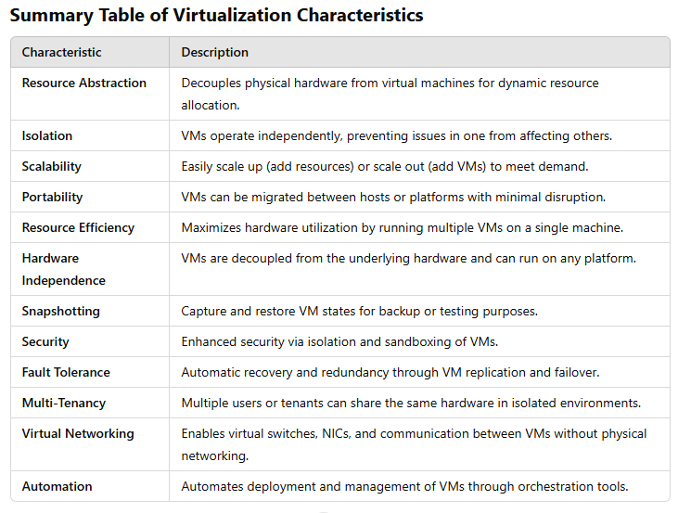
Virtualization Characteristics

Slide 31
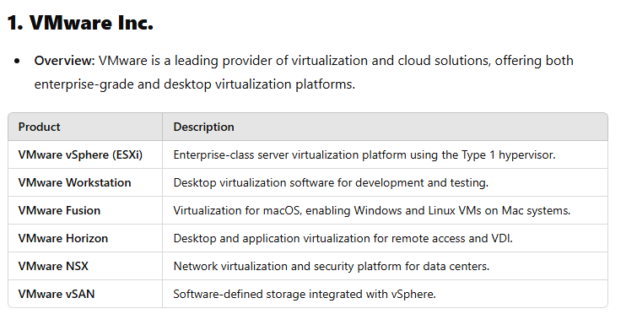
Common Virtualization Vendors

Slide 32
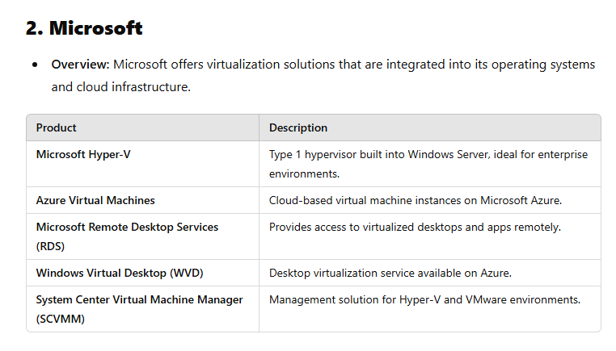
Common Virtualization Vendors

Slide 33
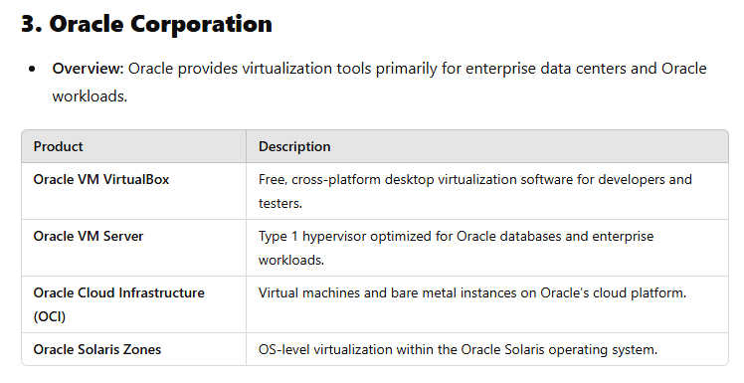
Common Virtualization Vendors

Slide 34
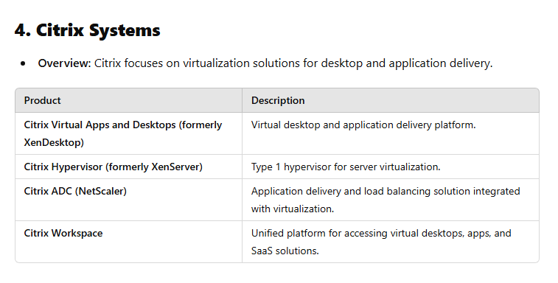
Common Virtualization Vendors

Slide 35
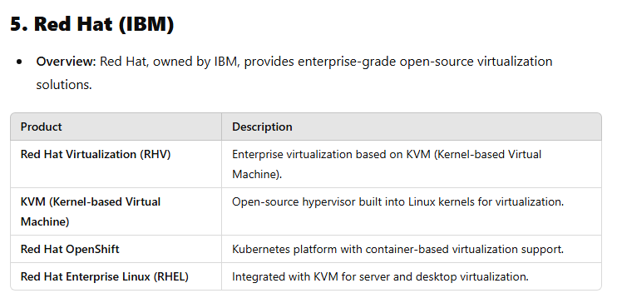
Common Virtualization Vendors

Slide 36
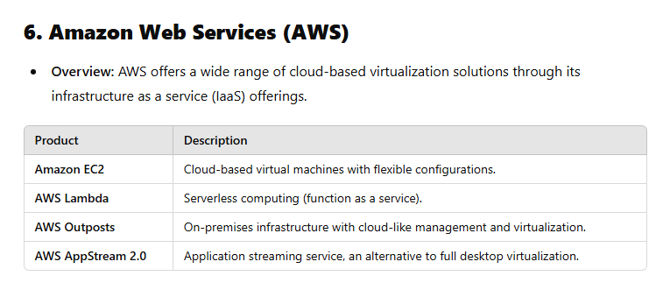
Common Virtualization Vendors

Slide 37
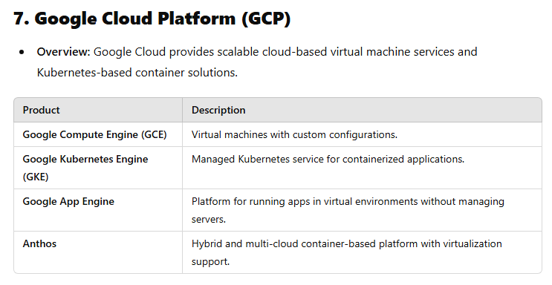
Common Virtualization Vendors

Slide 38
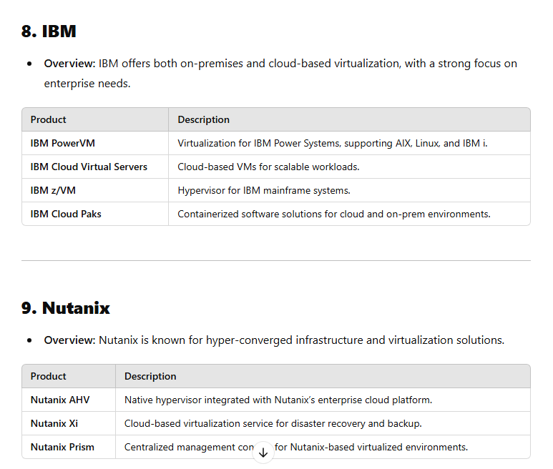
Common Virtualization Vendors

Slide 39
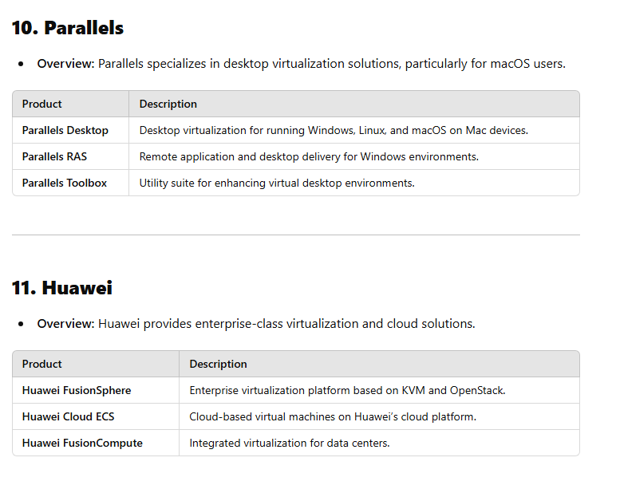
Common Virtualization Vendors

Slide 40
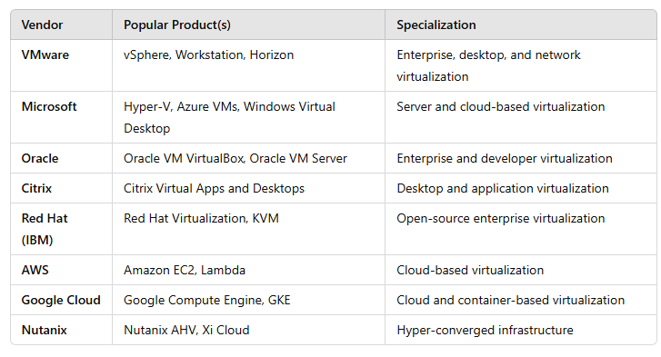
Common Virtualization Vendors

Slide 41
Virtualization Security and Concerns
Virtualization improves efficiency and scalability but introduces unique security risks.
Virtual machines (VMs), hypervisors, and the overall virtual infrastructure require specialized security controls to protect them from threats.

Slide 42
Virtualization Security and Concerns
1. Key Security Risks and Concerns
1.1. Hypervisor Vulnerabilities
The hypervisor is a critical part of the virtualized environment that allows multiple VMs to share a physical host.
Threat: If compromised, an attacker can gain control over all VMs on that host.
Examples of attacks:
VM Escape: When a VM breaks out of isolation and interacts directly with the hypervisor.
Hyperjacking: Taking control of the hypervisor to gain control of VMs.

Slide 43
Virtualization Security and Concerns
1.2. VM Sprawl
VM sprawl occurs when organizations create too many VMs without adequate management.
Threat: Unmonitored VMs can lead to outdated systems, unpatched vulnerabilities, and security gaps.
Result: Increased attack surface and resource wastage.
1.3. Data Breach and Leakage
Data within VMs is vulnerable if not properly isolated and protected.
Threat: Data could be leaked between VMs or stolen during migration to other hosts.
Common causes:
Misconfigured VM-to-VM communications.
Insecure storage and backups of virtual machine images.

Slide 44
Virtualization Security and Concerns
1.4. Lack of Network Segmentation
Virtual environments often consolidate multiple workloads on the same physical network.
Threat: If the network is not properly segmented, attackers can use lateral movement to compromise multiple VMs.
1.5. Insecure VM Migration
VMs can be migrated across physical hosts or data centers for load balancing or maintenance.
Threat: If migration is not encrypted or authenticated, attackers can intercept or tamper with the VM.

Slide 45
Virtualization Security and Concerns
1.6. Shared Resources
Multiple VMs share the same CPU, memory, disk, and network resources.
Threat: Resource-based side-channel attacks (e.g., Spectre, Meltdown) can leak sensitive data by exploiting shared hardware.
1.7. Insider Threats
Administrators with privileged access to hypervisors and VMs could intentionally or accidentally cause damage.
Threat: Malicious insiders can manipulate VM settings, steal data, or disrupt services.

Slide 46
Virtualization Security and Concerns
2. Best Practices for Virtualization Security
2.1. Secure Hypervisors
Keep hypervisors patched and updated.
Deploy security-hardened hypervisors with minimal attack surfaces.
Monitor for unusual hypervisor activities using intrusion detection systems.
Tools to consider:
VMware vSphere Security Hardening Guides
Microsoft Security Compliance Toolkit (for Hyper-V)

Slide 47
Virtualization Security and Concerns
2.2. Isolate and Segment VMs
Ensure proper VM isolation by assigning sensitive VMs to separate networks or hosts.
Implement network segmentation using VLANs or virtual firewalls.
Block unnecessary communication between VMs unless explicitly required.

Slide 48
Virtualization Security and Concerns
2.4. Encrypt VM Data
Encrypt virtual disks, memory dumps, and VM snapshots to prevent unauthorized data access.
Ensure encrypted migration of VMs between hosts.
Example:
VMware vSphere offers vMotion with encryption options.

Slide 49
Virtualization Security and Concerns
2.5. Secure Virtual Networks
Use virtual firewalls and intrusion detection/prevention systems (IDS/IPS) to secure communications.
Implement microsegmentation to isolate workloads and reduce lateral movement risks.
Popular Solutions:
VMware NSX (microsegmentation)
Cisco ACI (Application Centric Infrastructure)

Slide 50
Virtualization Security and Concerns
2.6. Secure Remote Access
Limit remote access to hypervisor consoles and management interfaces.
Require multi-factor authentication (MFA) for administrators.
Use secure communication protocols like SSL/TLS.

Slide 51
Virtualization Security and Concerns
2.7. Protect Against Insider Threats
Implement role-based access control (RBAC) to limit privileges.
Enforce the principle of least privilege (PoLP), granting only the minimum access necessary.
Use logging and monitoring tools to track administrative activities.

Slide 52
Virtualization Security and Concerns
2.8. Patch Management
Regularly update and patch:
Hypervisors
Guest operating systems
Management software
Virtual network components
Use automated tools to deploy and verify patches.

Slide 53
Virtualization Security and Concerns
2.9. Backup and Disaster Recovery
Implement secure backup policies for VM images, configurations, and snapshots.
Ensure backups are encrypted and stored securely.
Regularly test the recovery process to ensure backups are functional.

Slide 54
Virtualization Security and Concerns
2.10. Monitor and Respond to Threats
Continuously monitor virtual environments for anomalies or unauthorized activities.
Deploy endpoint protection on VMs.
Integrate with a Security Information and Event Management (SIEM) solution.
Recommended Tools:
Splunk
VMware vRealize Log Insight
Microsoft Sentinel

Slide 55
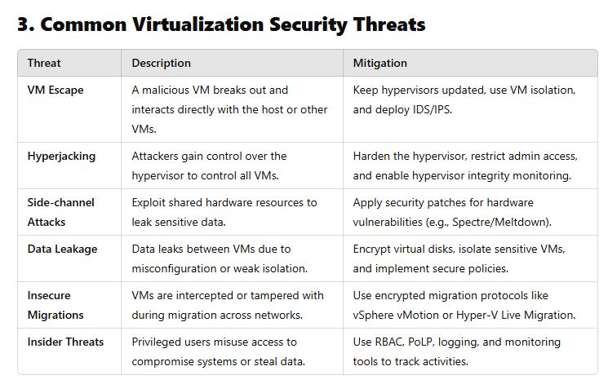
Virtualization Security and Concerns

Slide 56
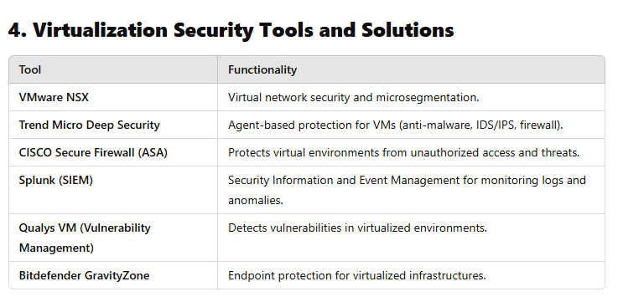
Virtualization Security and Concerns

Slide 57
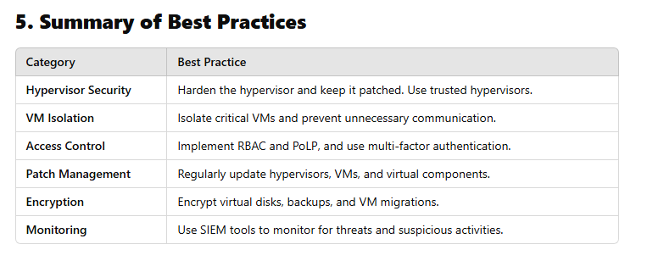
Virtualization Security and Concerns

Slide 58
Virtual Firewall: Overview and Key Details
A virtual firewall is a software-based security system designed to monitor, filter, and secure network traffic within virtualized and cloud environments.
Unlike traditional hardware firewalls, virtual firewalls are deployed inside virtual machines (VMs) or hypervisors, making them ideal for protecting modern dynamic infrastructures such as data centers and cloud services.

Slide 59
Virtual Firewall: Overview and Key Details
1. What is a Virtual Firewall?
A virtual firewall (VF) performs the same core functions as traditional hardware firewalls but is designed to operate in virtualized or cloud-based environments.
It monitors and controls east-west traffic (traffic between VMs or containers within a data center) and north-south traffic (traffic entering or leaving the data center).
Can be deployed on individual VMs, hypervisors, or within containerized environments.

Slide 60
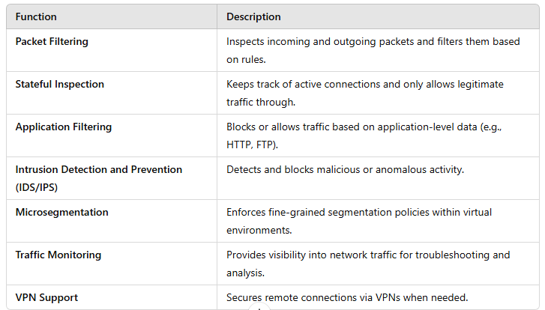
Key Functions of a Virtual Firewall

Slide 61
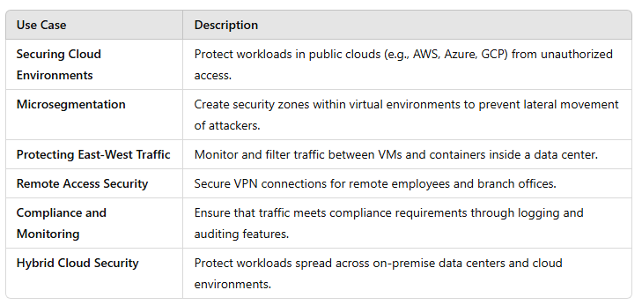
Virtual Firewall Use cases

Slide 62
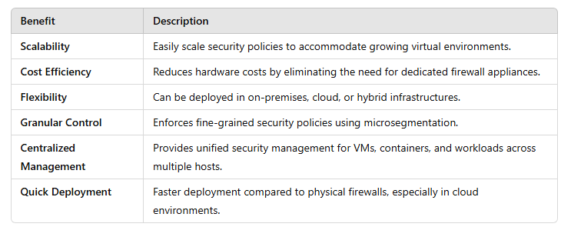
Benefits of Virtual Firewall

Slide 63
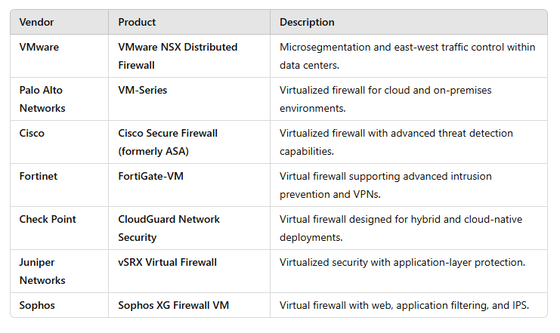
Common Virtual Firewall Vendors and Products

Slide 64
Virtual Operating Systems
A virtual operating system (virtual OS) runs on top of a physical host system within a virtual machine (VM).
This virtualization technology enables multiple operating systems to share the same hardware resources, providing flexibility, isolation, and cost efficiency.

Slide 65
What is a Virtual Operating System?
A virtual operating system is an OS running inside a virtual environment, typically created by a hypervisor.
The host OS provides hardware access and management, while the guest OS operates as if it were installed directly on the hardware.
Example: Running Linux Ubuntu as a guest OS on Windows using Oracle VirtualBox.

Slide 66
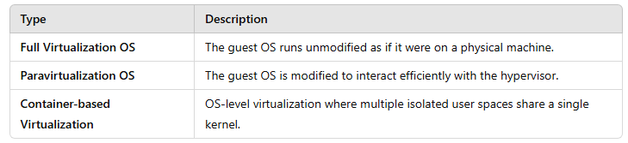
Types of Virtual Operating Systems

Slide 67
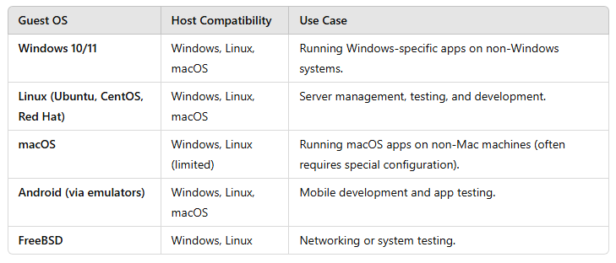
Examples of Virtual Operating Systems

Slide 68
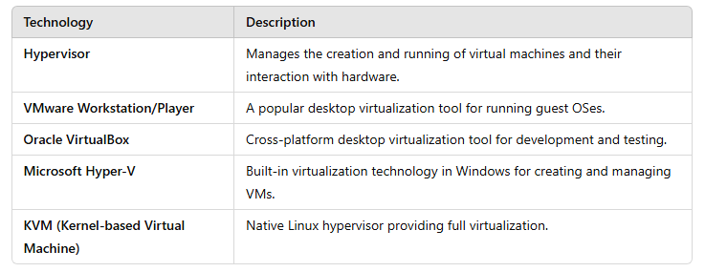
Key Technologies Enabling Virtual Operating Systems

Slide 69
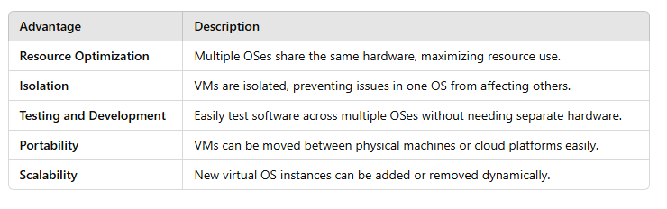
Advantages of Virtual Operating Systems

Slide 70
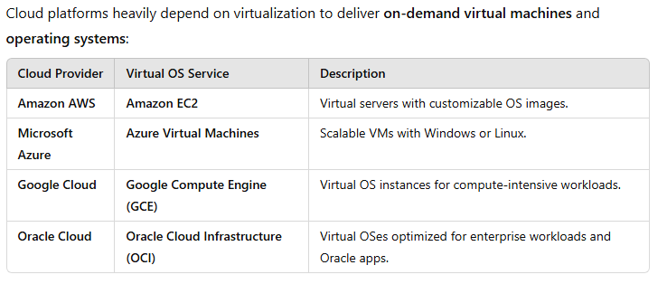
Virtual OS in Cloud Computing

Slide 71
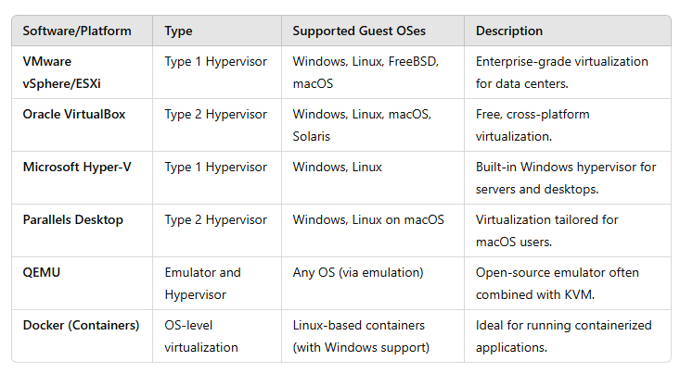
Common Virtualization Software for Virtual OSes

Slide 72
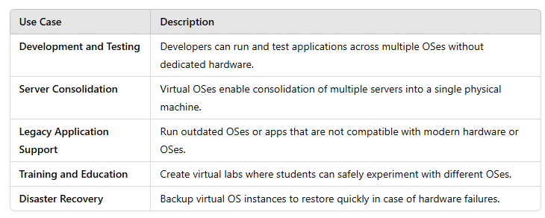
Common Use Cases of Virtual Operating Systems

Slide 73
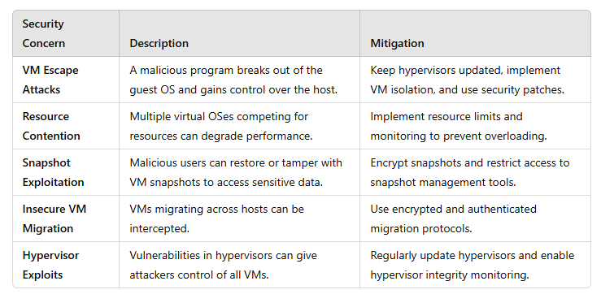
Security Considerations for Virtual Operating Systems

Slide 74
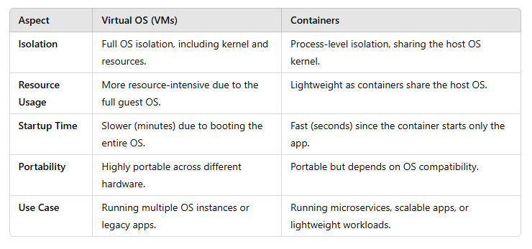
Virtual OS vs. Containerization

Slide 75
Virtual Databases
A virtual database provides an abstraction layer that allows users to access, query, and manipulate data from multiple sources without physically copying or moving the data into a centralized location.
It acts as a bridge between disparate data sources, offering unified access while keeping the underlying databases independent.

Slide 76
What is a Virtual Database?
A virtual database (VDB) is an abstraction layer that integrates multiple databases or data sources into a single logical database view.
It doesn’t store the data itself but pulls data on-demand from underlying sources.
Users and applications can interact with a virtual database as if they are querying a single database, even though the data may be distributed across multiple locations.

Slide 77
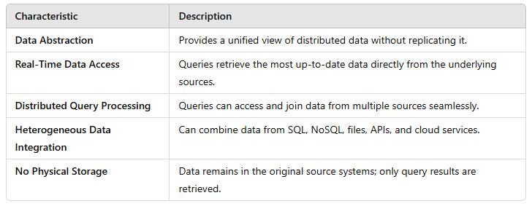
Characteristics of Virtual Databases

Slide 78
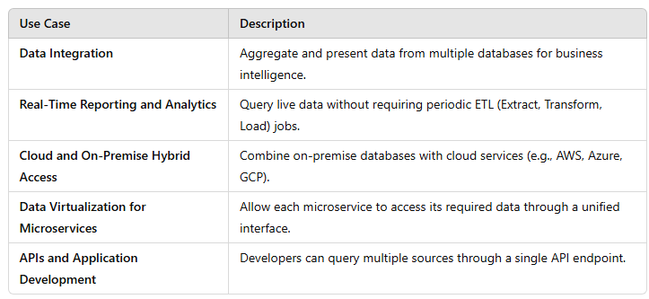
Common Use Cases of Virtual Databases

Slide 79
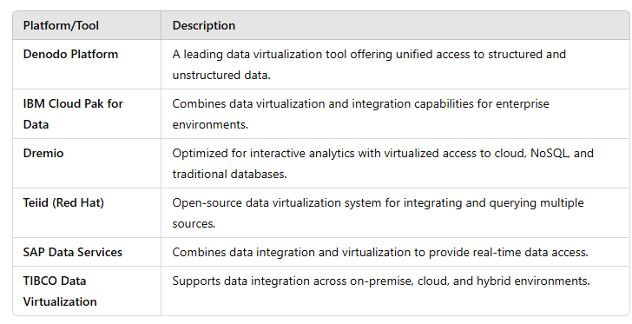
Examples of Virtual Database Platforms

Slide 80
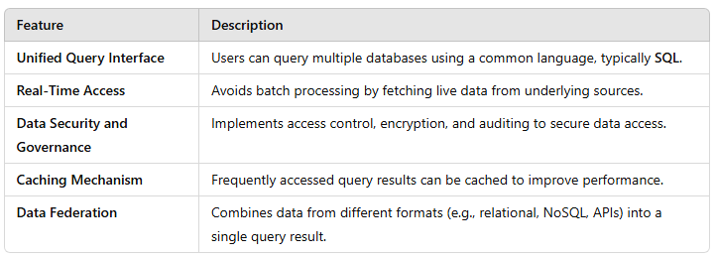
Key Features of Virtual Databases

Slide 81
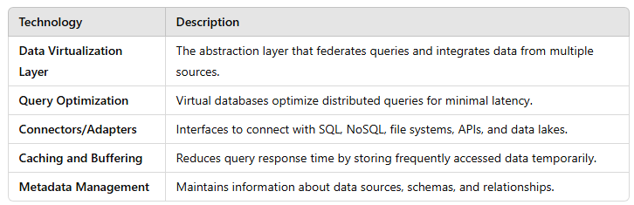
Key Technologies Enabling Virtual Databases

Slide 82
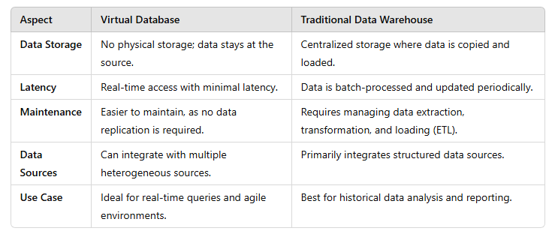
Virtual Databases vs. Traditional Data Warehousing

Slide 83
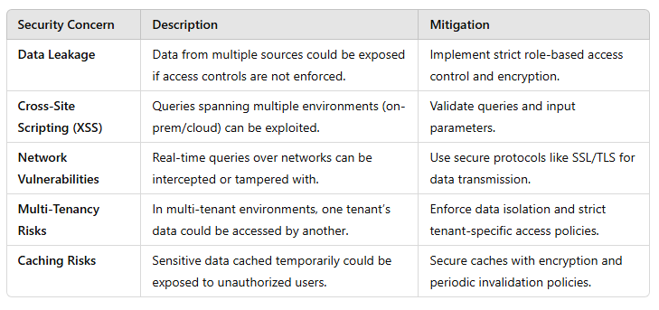
Security Considerations for Virtual Databases

Slide 84
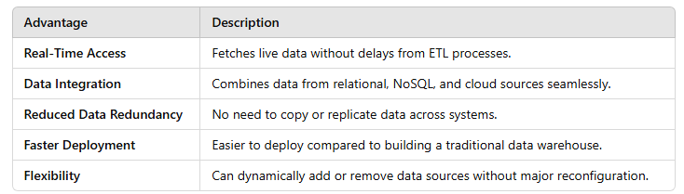
Advantages of Virtual Databases

Slide 85
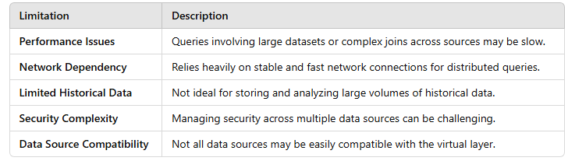
Limitations of Virtual Databases

Slide 86
Thank You

Slide 87

Assessment
Time for an Assessment

