Slide 1
Snowflake

Slide 2
Goals
PySpark Training Objectives
Snowflake Architecture
  Warehouse Sizing
  Auto Suspend & Resume
  Roles & RBAC
  Query Lifecycle
  Query Profile Analysis
  Micro-partitions & Clustering
  Expensive Query Identification
  Initial Performance Optimization Techniques

Slide 3
Virtual Warehouses
A Virtual Warehouse in Snowflake is an independent compute cluster responsible for executing SQL queries, loading and transforming data, and performing analytical operations.
A virtual warehouse provides:
  CPU: Executes SQL queries and data transformations.
  Memory (RAM): Supports joins, sorting, and aggregations.
  Temporary storage: Caches data to improve query performance.
  Elastic computing: Allows compute resources to scale up or down.
  Workload isolation: Separate warehouses can process different workloads without competing for the same compute resources.

Slide 4
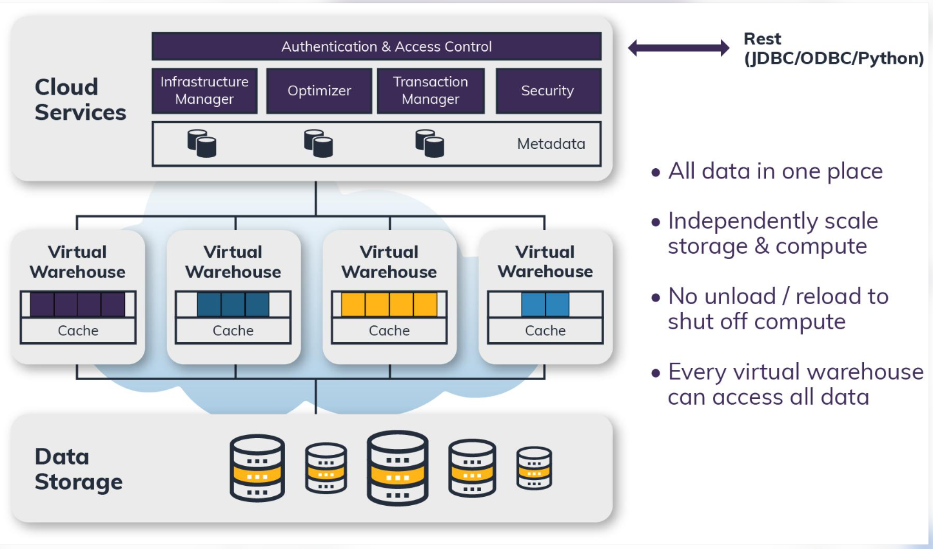
Virtual Warehouse Architecture

Slide 5
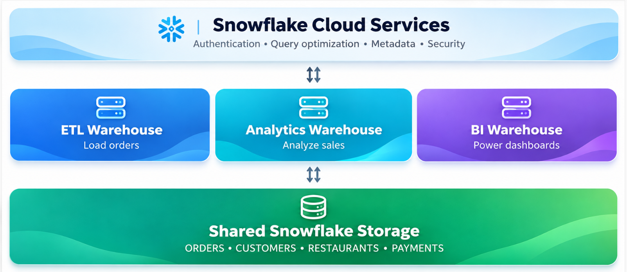
Virtual Warehouse Architecture

Slide 6
Snowflake
Snowflake is a fully managed, cloud-native data platform used for data warehousing, data engineering, analytics, AI/ML and secure data sharing.
Its core architectural principle is multi-cluster, shared-data architecture, where storage and computing resources are separated and can scale independently.

Slide 7
Snowflake
Snowflake is a fully managed, cloud-native data platform used for data warehousing, data engineering, analytics, AI/ML and secure data sharing.
Its core architectural principle is multi-cluster, shared-data architecture, where storage and computing resources are separated and can scale independently.

Slide 8
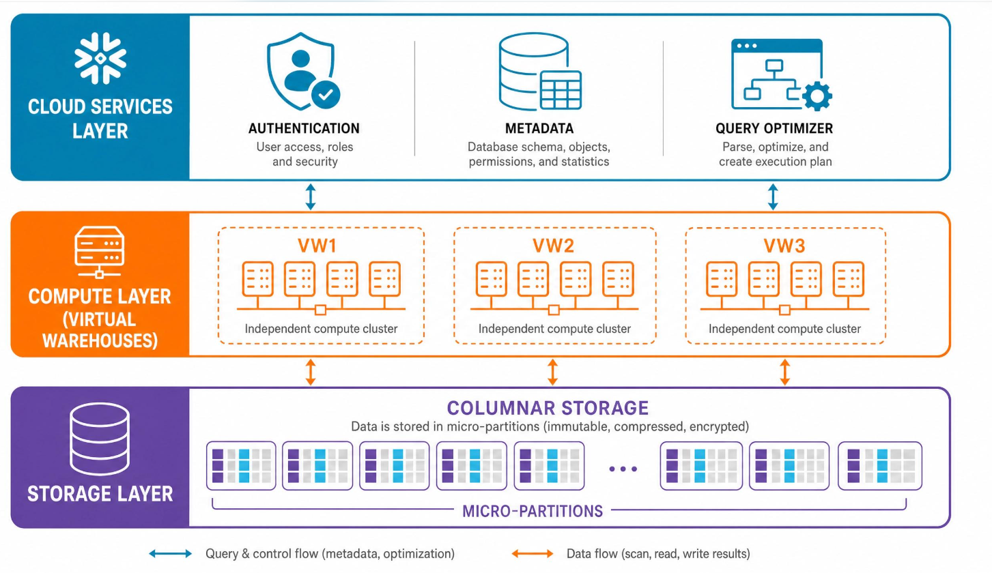
Snowflake Three-Layer Architecture

Slide 9
Snowflake Three-Layer Architecture
Layer | Responsibility | Main components
Cloud Services | Controls and coordinates Snowflake operations | Authentication, metadata, access control, SQL optimizer
Compute | Executes SQL and data processing workloads | Virtual warehouses, CPU, memory, local cache
Database Storage | Stores data persistently | Compressed columnar data, micro-partitions, cloud object storage

Slide 10
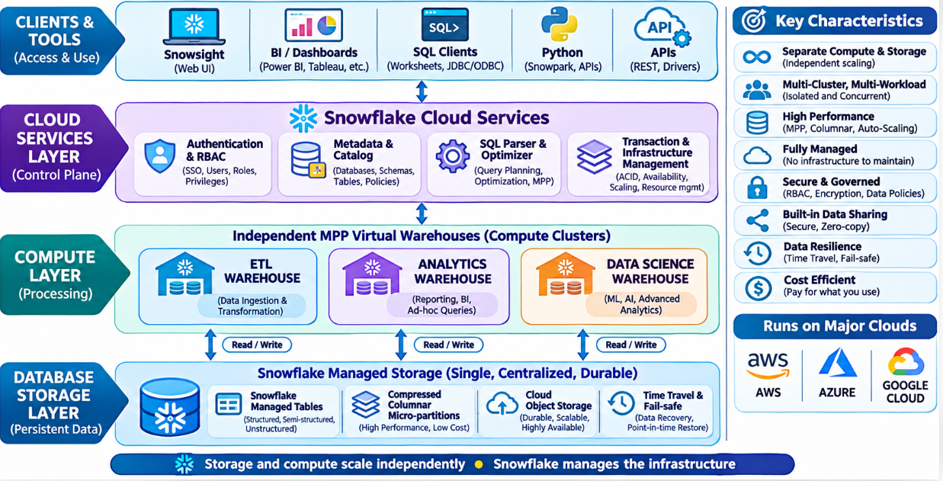
Snowflake Architecture

Slide 11
Layer 1: Database Storage
The storage layer is responsible for maintaining all data loaded into Snowflake-managed tables.
Snowflake automatically organizes that data into an optimized, compressed, columnar format.

Slide 12
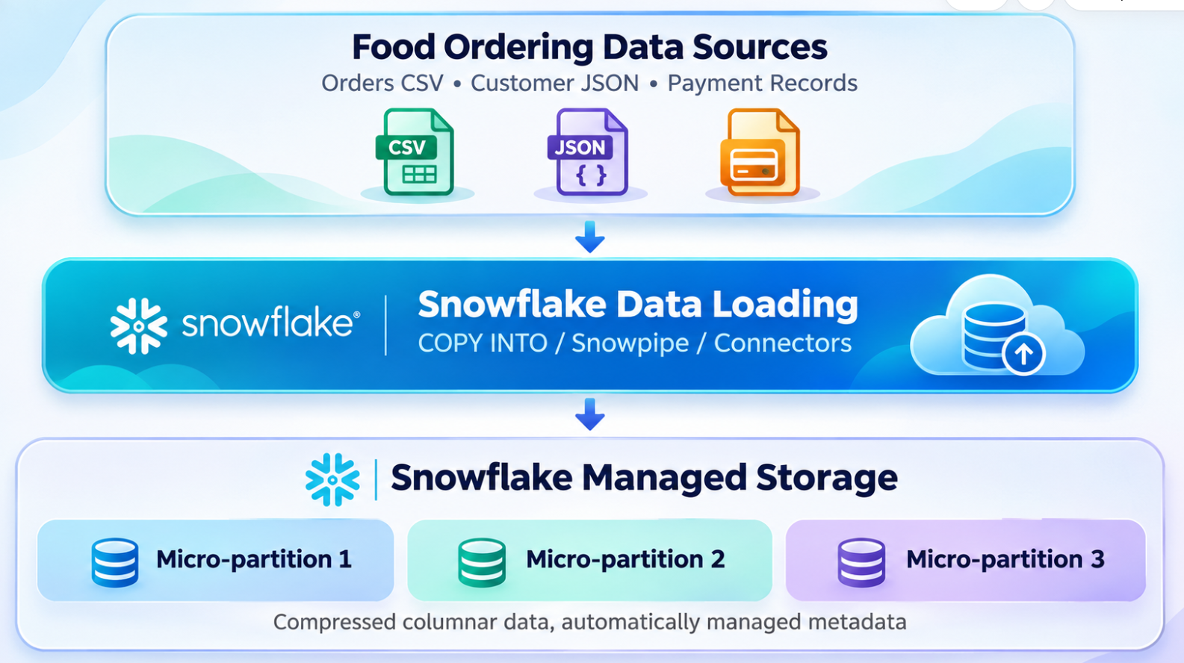
Layer 1: Database Storage

Slide 13
Layer 1: Database Storage
Micro-partitions: Snowflake automatically divides table data into small storage units, typically containing 50–500 MB of uncompressed data.
Columnar storage: Helps analytical queries read only relevant columns.
Compression: Reduces storage usage.
Metadata: Includes column statistics used for micro-partition pruning.
Time Travel: Supports querying or recovering historical data within the configured retention period.
Zero-copy cloning: Creates logical copies without immediately duplicating all underlying data.

Slide 14
Layer 1: Database Storage
Example: An ORDERS table with 100 million rows can be distributed across many micro-partitions.
A query filtering by ORDER_DATE may scan only relevant partitions rather than the entire table.

Slide 15
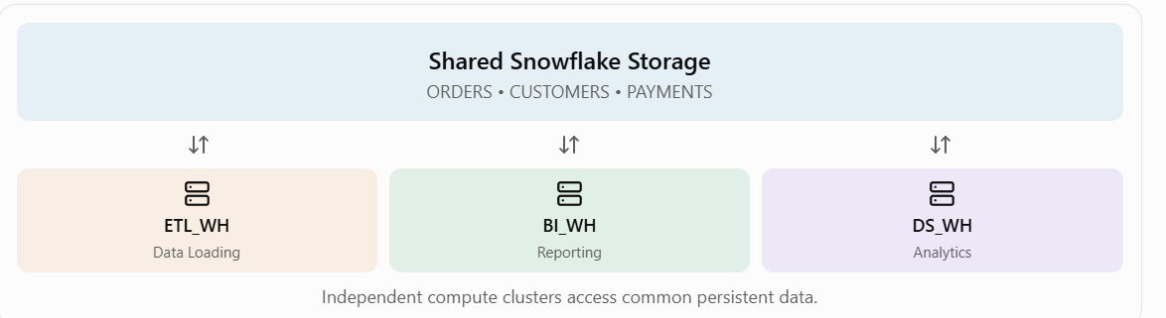
Layer 2: Compute – Virtual Warehouses
A virtual warehouse is a compute cluster used to execute queries and data processing operations.
It provides CPU, memory, and temporary storage. The warehouse does not permanently own the database table data.

Slide 16
Why separate virtual warehouses?
Virtual warehouse | Users | Purpose
ETL_WH | Data engineers | Load and transform daily orders
BI_WH | Business analysts | Generate sales reports
DS_WH | Data scientists | Analyze customer behavior

Slide 17
Scaling compute
Snowflake provides two important scaling mechanisms:
Scale up (vertical scaling): Increase the warehouse size from Small to Medium or Large to give a compute cluster more resources.
Scale out (horizontal scaling): Use multi-cluster warehouses to handle more concurrent queries. This capability depends on the Snowflake edition and configuration.

Slide 18
Layer 3: Cloud Services
Cloud Services is the coordination and control layer of Snowflake.
It performs the management functions required to execute workloads securely and efficiently.

Slide 19
Layer 3: Cloud Services
Component | Function
Authentication | Verifies the identity of users
Authorization | Checks roles and access privileges
Metadata management | Maintains information about databases, tables, and partitions
SQL parsing | Validates SQL statements
Query optimization | Determines an efficient execution plan
Query coordination | Dispatches work to compute resources
Infrastructure management | Coordinates underlying Snowflake services

Slide 20
Layer 3: Cloud Services
For example, when a user sends:
  SELECT city, SUM(total_amount) AS revenue FROM food_orders GROUP BY city;
The Cloud Services layer authenticates the user, verifies privileges, parses and optimizes the SQL, and coordinates execution.
The selected virtual warehouse performs the actual data processing, reading the required data from storage or its cache.

Slide 21
How Snowflake processes a query
User submits SQL
  The user runs a query from Snowsight, a BI tool, or a Python application.
Cloud Services validates and optimizes
  Snowflake checks permissions, resolves table metadata, and prepares the execution plan.
Virtual warehouse executes
  The warehouse uses its compute resources, accessing locally cached data where available.
Storage supplies required data
  Snowflake reads relevant micro-partitions, using pruning to avoid unnecessary scanning.
Results return to the user
  The warehouse executes filtering, joins, and aggregation, and Snowflake returns the query result.

Slide 22
Practical example: Food delivery analytics
Assume a food delivery company processes orders from Chennai, Bengaluru, and Hyderabad.
Its architecture might contain three independent warehouses accessing the same FOOD_DELIVERY database.

Slide 23
Practical example: Food delivery analytics
Example SQL: Create a virtual warehouse
CREATE WAREHOUSE IF NOT EXISTS FOOD_BI_WH
WAREHOUSE_SIZE = 'SMALL'
AUTO_SUSPEND = 60
AUTO_RESUME = TRUE
INITIALLY_SUSPENDED = TRUE;
USE WAREHOUSE FOOD_BI_WH;

Slide 24
Practical example: Food delivery analytics
Create a database and table
CREATE DATABASE IF NOT EXISTS FOOD_DELIVERY;
CREATE SCHEMA IF NOT EXISTS FOOD_DELIVERY.SALES;
CREATE OR REPLACE TABLE FOOD_DELIVERY.SALES.ORDERS (
ORDER_ID NUMBER,
CITY VARCHAR(50),
RESTAURANT VARCHAR(100),
AMOUNT NUMBER(10,2),
STATUS VARCHAR(20)
);
INSERT INTO FOOD_DELIVERY.SALES.ORDERS VALUES
(101, 'Chennai', 'Spice Hub', 250, 'Delivered'),
(102, 'Bengaluru', 'Cafe Cloud', 180, 'Delivered'),
(103, 'Chennai', 'Spice Hub', 350, 'Delivered'),
(104, 'Hyderabad', 'Food Corner', 200, 'Cancelled');

Slide 25
Practical example: Food delivery analytics
Analyze revenue by city
SELECT CITY, SUM(AMOUNT) AS TOTAL_REVENUE
FROM FOOD_DELIVERY.SALES.ORDERS
WHERE STATUS = 'Delivered'
GROUP BY CITY
ORDER BY TOTAL_REVENUE DESC;

Slide 26
Practical example: Food delivery analytics
City | Total revenue
Chennai | 600.00
Bengaluru | 180.00

Slide 27
Snowflake scaling and cost optimization
Feature | Purpose
Warehouse resizing | Allocate more compute for demanding queries
Multi-cluster warehouses | Handle more concurrent users
Auto-suspend | Stop an idle warehouse to reduce compute costs
Auto-resume | Automatically restart compute when needed
Micro-partition pruning | Reduce unnecessary data scanning
Warehouse caching | Reduce repeated reads of frequently accessed data
Resource monitors | Monitor and help control credit consumption

Slide 28
Snowflake vs traditional data warehouse
Characteristic | Traditional warehouse | Snowflake
Storage and compute | Often tightly coupled | Independently scalable
Infrastructure management | Frequently customer-managed | Snowflake-managed
Concurrent workloads | May compete for shared resources | Independent virtual warehouses
Scaling | May require hardware provisioning | Elastic warehouse scaling
Maintenance | Patching and administration required | Managed cloud service
Cost | Often provisioned capacity | Usage-based compute and storage

Slide 29
Data lake vs Snow Flake
AWS Data Lake | Snowflake
S3 stores data | Snowflake manages storage
Glue discovers schema | Snowflake has native catalog/schema
Lake Formation handles governance | Snowflake has native RBAC/governance
Athena executes SQL | Virtual Warehouses execute SQL
Several AWS services work together | Much is integrated in one platform
Excellent for raw object storage | Excellent for structured analytics
Strong AWS ecosystem integration | Multi-cloud data platform

Slide 30
Warehouse Sizing – Data Warehouse Architecture
Warehouse sizing is the process of estimating the storage, compute, memory, and infrastructure capacity required for a data warehouse to handle current workloads and future growth.

Slide 31
Warehouse Sizing – Data Warehouse Architecture
Parameter | Description
Data volume | Initial source data size (GB/TB)
Daily ingestion | New data loaded per day
Retention period | Number of months or years data is retained
Data growth | Expected annual increase
Concurrent users | Number of users running queries simultaneously
Query complexity | Simple reporting, joins, aggregations, analytics
SLA | Expected query response time
ETL/ELT workload | Data transformation and loading requirements
Availability | High availability and disaster recovery
Compression | Reduction in physical storage

Slide 32
Storage sizing example
Parameter | Value
Initial data | 2 TB
Daily ingestion | 50 GB
Retention | 3 years
Compression ratio | 3:1
Storage overhead

Slide 33
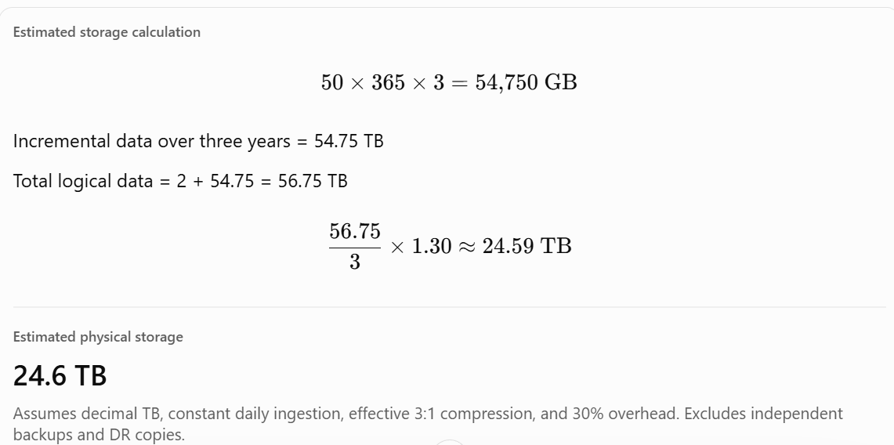
Storage sizing example

Slide 34
Compute sizing
Workload | Primary sizing consideration
Batch ETL | Data loaded within the batch window
BI reporting | Concurrent queries and response time
Complex analytics | CPU, memory, joins and aggregations
Near-real-time ingestion | Continuous throughput and latency
Machine learning | Memory and compute-intensive operations
For example, sizing a Snowflake, BigQuery, Redshift, Synapse, or Databricks warehouse requires considering the platform's execution architecture, query characteristics, and concurrency model.

Slide 35
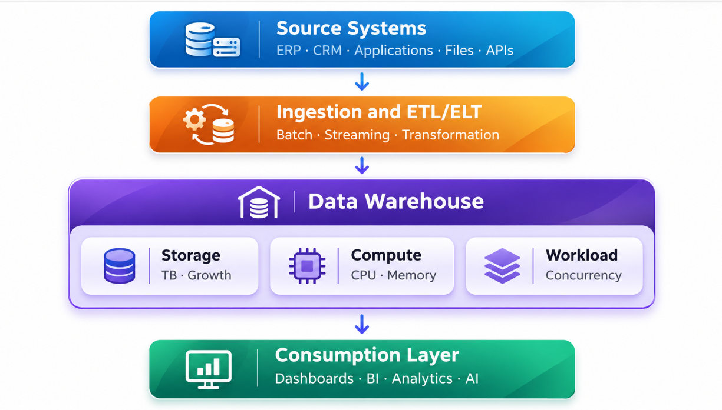
Compute sizing

Slide 36
Warehouse sizing approaches
There are three common approaches:
  Capacity-based sizing: Estimate using ingestion volumes, retention, compression and growth.
  Workload-based sizing: Use query complexity, execution time, user concurrency and performance SLAs.
  Benchmark-based sizing: Test representative queries and ingestion jobs on a sample dataset, then scale the results.

Slide 37
Snowflake – Databases & Schemas
In Snowflake, Databases and Schemas are logical containers used to organize, manage, secure, and access data objects such as tables, views, stages, and stored procedures.
Snowflake follows a three-level organizational hierarchy:
Database → Schema → Object

Slide 38
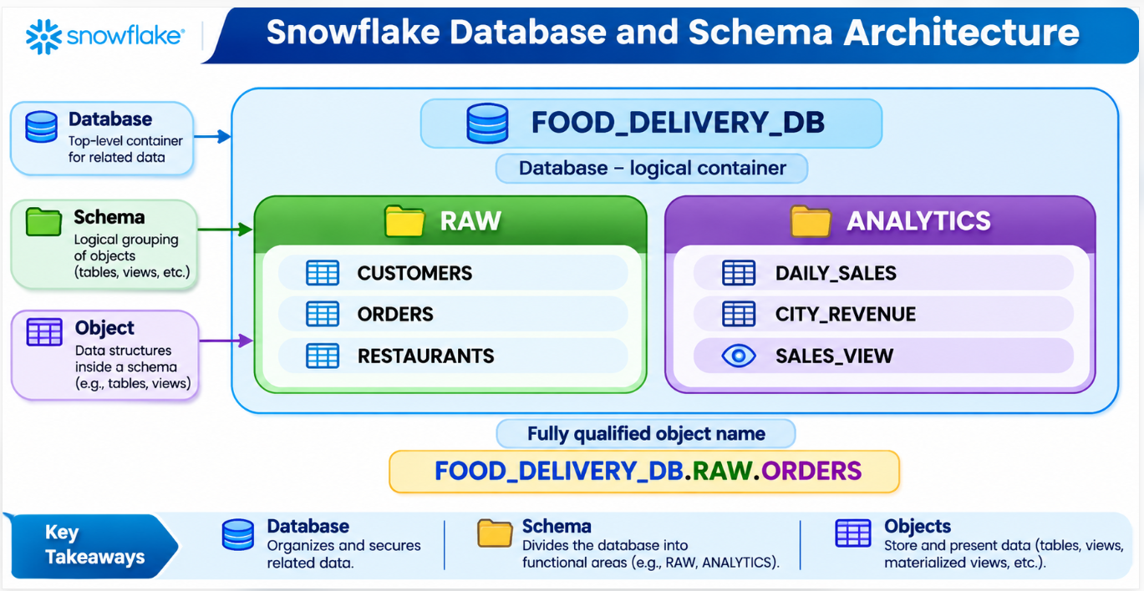
Snowflake – Databases & Schemas

Slide 39
Snowflake – Databases & Schemas
In this example:
FOOD_DELIVERY_DB is the database.
RAW and ANALYTICS are schemas.
ORDERS, CUSTOMERS, and DAILY_SALES are tables.
SALES_VIEW is a view.

Slide 40
Database vs Schema vs Table
Component | Purpose | Example
Database | Groups related schemas | FOOD_DELIVERY_DB
Schema | Groups related objects | RAW
Table | Stores structured data | ORDERS
View | Provides a stored query definition | SALES_VIEW

Slide 41
Hands-on Lab – Create Database, Schemas and Tables
Step 1 – Open Snowflake SQL Worksheet
Sign in to Snowflake Snowsight.
Navigate to Projects → Worksheets.
Create a new SQL worksheet.
Select a role with database creation privileges, and a warehouse you can use.
Step 2 – Create a database
CREATE DATABASE IF NOT EXISTS FOOD_DELIVERY_DB;

Slide 42
Hands-on Lab – Create Database, Schemas and Tables
Verify:
SHOW DATABASES LIKE 'FOOD_DELIVERY_DB';
Step 3 – Create schemas
CREATE SCHEMA IF NOT EXISTS
FOOD_DELIVERY_DB.RAW;
CREATE SCHEMA IF NOT EXISTS
FOOD_DELIVERY_DB.STAGING;
CREATE SCHEMA IF NOT EXISTS
FOOD_DELIVERY_DB.ANALYTICS;

Slide 43
Hands-on Lab – Create Database, Schemas and Tables
Check schemas:
SHOW SCHEMAS IN DATABASE FOOD_DELIVERY_DB;
Step 4 – Set database and schema context
USE DATABASE FOOD_DELIVERY_DB;
USE SCHEMA RAW;
SELECT
CURRENT_DATABASE(),
CURRENT_SCHEMA();

Slide 44
Hands-on Lab – Create Database, Schemas and Tables
Step 5 – Create a table
CREATE OR REPLACE TABLE
FOOD_DELIVERY_DB.RAW.ORDERS (
ORDER_ID INTEGER,
CITY VARCHAR(50),
RESTAURANT VARCHAR(100),
QUANTITY INTEGER,
UNIT_PRICE NUMBER(10,2),
STATUS VARCHAR(30),
ORDER_DATE DATE
);

Slide 45
Hands-on Lab – Create Database, Schemas and Tables
Step 6 – Insert sample records
INSERT INTO FOOD_DELIVERY_DB.RAW.ORDERS
VALUES
(101, 'Chennai', 'Spice Hub',
2, 220.00, 'Delivered', '2026-11-01'),
(102, 'Erode', 'Cafe Cloud',
1, 180.00, 'Delivered', '2026-11-01'),
(103, 'Trichy', 'Spice Hub',
1, 180.00, 'Cancelled', '2026-11-01'),
(104, 'Chennai', 'Food Corner',
3, 150.00, 'Delivered', '2026-11-02');

Slide 46
Hands-on Lab – Create Database, Schemas and Tables
Step 7 – Query the table
SELECT *
FROM FOOD_DELIVERY_DB.RAW.ORDERS;

Slide 47
Hands-on Lab – Create Database, Schemas and Tables
Step 8 – Create a table in another schema
CREATE OR REPLACE TABLE
FOOD_DELIVERY_DB.ANALYTICS.CITY_REVENUE AS
SELECT
CITY,
SUM(QUANTITY * UNIT_PRICE) AS REVENUE
FROM FOOD_DELIVERY_DB.RAW.ORDERS
WHERE STATUS = 'Delivered'
GROUP BY CITY;

Slide 48
Hands-on Lab – Create Database, Schemas and Tables
Query the results:
SELECT *
FROM FOOD_DELIVERY_DB.ANALYTICS.CITY_REVENUE
ORDER BY REVENUE DESC;

Slide 49
How Snowflake resolves object names
Snowflake supports three ways of referring to a table.
-- Fully qualified name
SELECT * FROM FOOD_DELIVERY_DB.RAW.ORDERS;
-- Schema-qualified name
USE DATABASE FOOD_DELIVERY_DB;
SELECT * FROM RAW.ORDERS;
-- Unqualified name
USE SCHEMA RAW;
SELECT * FROM ORDERS;

Slide 50
Explore database metadata
-- List databases
SHOW DATABASES;
-- List schemas
SHOW SCHEMAS IN DATABASE FOOD_DELIVERY_DB;
-- List tables
SHOW TABLES IN SCHEMA FOOD_DELIVERY_DB.RAW;
-- Describe table structure
DESCRIBE TABLE FOOD_DELIVERY_DB.RAW.ORDERS;
-- Query database metadata
SELECT TABLE_SCHEMA, TABLE_NAME, ROW_COUNT
FROM FOOD_DELIVERY_DB.INFORMATION_SCHEMA.TABLES
WHERE TABLE_SCHEMA = 'RAW';

Slide 51
Standard vs Managed Access Schemas
Feature | Standard Schema | Managed Access Schema
Object privilege grants | Object owners can grant privileges | Schema owner or role with MANAGE GRANTS controls grants
Administration | Decentralized | Centralized
Typical usage | Development and small teams | Enterprise governance

Slide 52
Snowflake Roles & RBAC (Role-Based Access Control)
1. What is RBAC in Snowflake?
Role-Based Access Control (RBAC) is the security mechanism in Snowflake that controls who can access which database objects and what operations they can perform.
Instead of assigning permissions directly to individual users, Snowflake assigns privileges to roles, and roles are granted to users or other roles.

Slide 53
Snowflake Roles & RBAC (Role-Based Access Control)
Example: Food Order Analytics Platform
Suppose a company has three teams:
Data Engineers: Create databases, schemas, tables, and load data.
Data Analysts: Query order data and generate reports.
Business Managers: View approved sales reports without modifying data.
Each team should receive only the privileges necessary to perform its tasks. This is called the principle of least privilege.

Slide 54
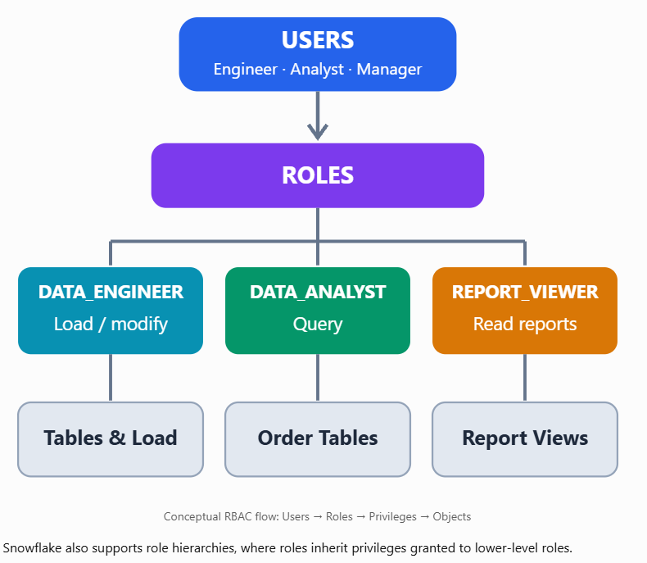
Snowflake RBAC Architecture

Slide 55
Snowflake System-Defined Roles
Role | Responsibility
ACCOUNTADMIN | Highest account administration privileges
SECURITYADMIN | Manages security grants, users, and roles
USERADMIN | Creates and manages users and roles
SYSADMIN | Creates and manages warehouses, databases, and other objects
PUBLIC | Automatically available to every user and role
ORGADMIN / GLOBALORGADMIN | Organization-level administration, depending on account configuration

Slide 56
Common Snowflake Privileges
Privilege | Purpose
USAGE | Access a warehouse, database, or schema
SELECT | Read table data
INSERT | Add records
UPDATE | Modify records
DELETE | Remove records
CREATE TABLE | Create tables in a schema
CREATE SCHEMA | Create schemas in a database
MODIFY | Change warehouse configuration
OPERATE | Start, stop, or manage warehouse operation
OWNERSHIP | Control an object and its ownership-related permissions

Slide 57
Hands-on Lab: Implement RBAC in Snowflake
Scenario: Build a food-order analytics database and restrict analysts to read-only access.
LAB 1 — CREATE DATABASE AND TABLE
In Snowsight, open Projects → Workspaces → SQL Worksheet (or the SQL editor available in your interface).
Run the following as a role authorized to create databases and warehouses, such as SYSADMIN.

Slide 58
Hands-on Lab: Implement RBAC in Snowflake
USE ROLE SYSADMIN;
CREATE WAREHOUSE IF NOT EXISTS FOOD_WH
WAREHOUSE_SIZE = 'XSMALL'
AUTO_SUSPEND = 60
AUTO_RESUME = TRUE;
CREATE DATABASE IF NOT EXISTS FOOD_DB;
CREATE SCHEMA IF NOT EXISTS FOOD_DB.SALES;
CREATE OR REPLACE TABLE FOOD_DB.SALES.ORDERS (
ORDER_ID INT,
CITY VARCHAR(50),
AMOUNT NUMBER(10,2)
);
INSERT INTO FOOD_DB.SALES.ORDERS VALUES
(101, 'Chennai', 500),
(102, 'Bangalore', 800),
(103, 'Erode', 350);

Slide 59
Hands-on Lab: Implement RBAC in Snowflake
LAB 2 — CREATE CUSTOM ROLE
USE ROLE USERADMIN;
CREATE ROLE IF NOT EXISTS DATA_ANALYST;

Slide 60
Hands-on Lab: Implement RBAC in Snowflake
LAB 3 — GRANT READ-ONLY PRIVILEGES
Run these statements as SECURITYADMIN or another role authorized to manage the relevant grants.
USE ROLE SECURITYADMIN;
GRANT USAGE ON WAREHOUSE FOOD_WH
TO ROLE DATA_ANALYST;
GRANT USAGE ON DATABASE FOOD_DB
TO ROLE DATA_ANALYST;
GRANT USAGE ON SCHEMA FOOD_DB.SALES
TO ROLE DATA_ANALYST;
GRANT SELECT ON TABLE FOOD_DB.SALES.ORDERS
TO ROLE DATA_ANALYST;
GRANT ROLE DATA_ANALYST TO ROLE SYSADMIN;

Slide 61
Hands-on Lab: Implement RBAC in Snowflake
LAB 4 — ASSIGN ROLE TO USER
Substitute an existing Snowflake username.
USE ROLE SECURITYADMIN;
GRANT ROLE DATA_ANALYST
TO USER YOUR_USERNAME;

Slide 62
Hands-on Lab: Implement RBAC in Snowflake
LAB 5 — TEST RBAC
Switch to the analyst role.
USE ROLE DATA_ANALYST;
USE SECONDARY ROLES NONE;
USE WAREHOUSE FOOD_WH;
SELECT * FROM FOOD_DB.SALES.ORDERS;

Slide 63
Hands-on Lab: Implement RBAC in Snowflake
Now attempt an unauthorized operation:
DELETE FROM FOOD_DB.SALES.ORDERS
WHERE ORDER_ID = 101;
Expected result: Access denied / insufficient privileges.
The DATA_ANALYST role has SELECT privileges but not DELETE.

Slide 64
Hands-on Lab: Implement RBAC in Snowflake
6. Verify Role Privileges
-- Identify active roles
SELECT
CURRENT_ROLE(),
CURRENT_SECONDARY_ROLES();
-- View role privileges
SHOW GRANTS TO ROLE DATA_ANALYST;
-- View grants for a specific user
SHOW GRANTS TO USER YOUR_USERNAME;
-- View available roles
SHOW ROLES;

Slide 65
Hands-on Lab: Implement RBAC in Snowflake
7. Advanced RBAC Concepts
Account roles vs. Database roles
Account roles can control resources across an account, including warehouses. Database roles are scoped to database-level access and must be granted to account roles before users can activate their privileges.
Role hierarchy
  If REPORT_VIEWER is granted to DATA_ANALYST, the DATA_ANALYST role inherits the privileges of REPORT_VIEWER.
Future grants
Administrators can automatically grant SELECT on tables created in the future:

Slide 66
Hands-on Lab: Implement RBAC in Snowflake
GRANT SELECT ON FUTURE TABLES
IN SCHEMA FOOD_DB.SALES
TO ROLE DATA_ANALYST;

Slide 67
Hands-on Lab: Implement RBAC in Snowflake
8. RBAC Best Practices
Use custom roles for business functions.
Apply least-privilege access.
Avoid using ACCOUNTADMIN for daily workloads.
Separate data engineering, analytics, and administration privileges.
Use future grants where automatic access provisioning is appropriate.
Review grants periodically and revoke unnecessary privileges.

Slide 68
Snowflake Query Lifecycle
The Query Lifecycle in Snowflake describes how a SQL query travels from submission through authentication, parsing, optimization, execution, and result delivery.
Snowflake separates query planning and coordination from query execution, using its Cloud Services layer, Virtual Warehouses, and centralized storage.

Slide 69
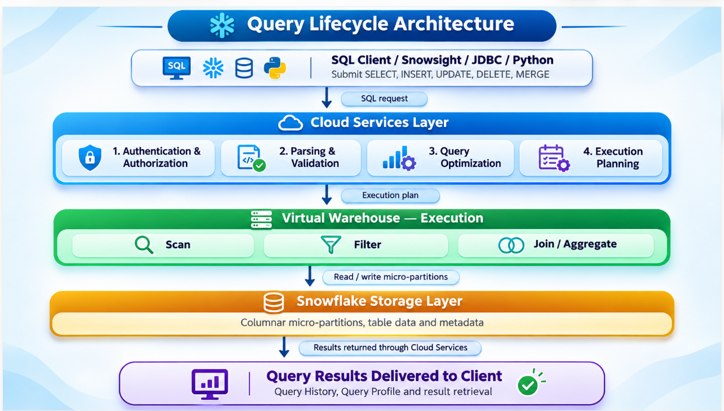
Query Lifecycle Architecture

Slide 70
Detailed Stages of Query Lifecycle
Stage | What Snowflake does | Key observation
1. Submission | Receives SQL from client | Query ID
2. Authentication | Verifies identity and privileges | RBAC
3. Parsing | Checks SQL syntax and object references | Compilation errors
4. Optimization | Determines an efficient execution plan | Pruning, join strategy
5. Cache evaluation | Checks whether results can be reused | Result cache hit
6. Warehouse scheduling | Allocates available compute or queues query | Queue time
7. Execution | Scans, filters, joins and aggregates | Execution operators
8. Result delivery | Returns rows or completion status | Total elapsed time
9. Monitoring | Records execution details | Query History and Profile

Slide 71
Detailed Stages of Query Lifecycle
Example: Food Delivery Analytics
Suppose a food delivery company wants to determine total revenue by city.
SELECT
city,
SUM(quantity * unit_price) AS total_revenue
FROM food_orders
WHERE status = 'Delivered'
GROUP BY city
ORDER BY total_revenue DESC;

Slide 72
Detailed Stages of Query Lifecycle
Snowflake processes the query as follows:
Parsing: Verifies SQL syntax, columns, and table references.
Optimization: Identifies relevant micro-partitions and selects aggregation and sorting operations.
Scheduling: Uses the selected virtual warehouse if execution is required.
Execution: Reads relevant data, filters delivered orders, calculates revenue, and sorts results.
Result delivery: Returns revenue by city.

Slide 73
Detailed Stages of Query Lifecycle
3. Query Optimization Explained
During optimization, Snowflake can apply several techniques:
Micro-partition pruning: Avoid scanning partitions that cannot satisfy predicates.
Column pruning: Read only columns needed by the query.
Predicate pushdown: Apply supported filters early to reduce intermediate data.
Join optimization: Choose efficient join strategies based on available statistics and query structure.
Aggregation optimization: Reduce intermediate data and distribute aggregation work.

Slide 74
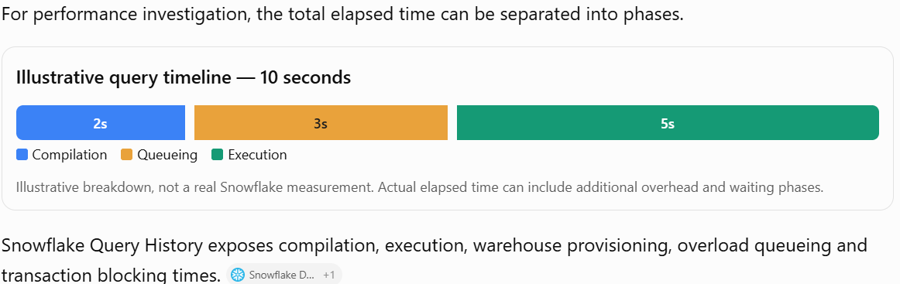
Query Lifecycle Timing

Slide 75
Hands-on Lab: Analyze Query Lifecycle
Lab objective: Execute a query, identify its lifecycle phases, and inspect its execution profile.
Step 1 — Select a warehouse
USE WAREHOUSE COMPUTE_WH;
SELECT CURRENT_WAREHOUSE();
Replace COMPUTE_WH with your available warehouse.

Slide 76
Hands-on Lab: Analyze Query Lifecycle
Step 2 — Execute a sample analytical query
SELECT
C_NAME,
C_MKTSEGMENT,
C_ACCTBAL
FROM SNOWFLAKE_SAMPLE_DATA.TPCH_SF1.CUSTOMER
WHERE C_ACCTBAL > 5000
ORDER BY C_ACCTBAL DESC
LIMIT 100;
Requires access to the SNOWFLAKE_SAMPLE_DATA database.

Slide 77
Hands-on Lab: Analyze Query Lifecycle
Step 3 — Capture the query ID
SELECT LAST_QUERY_ID();
Copy the query ID for the analytical query from Query History if other statements have executed afterward.

Slide 78
Hands-on Lab: Analyze Query Lifecycle
Step 4 — View Query History
In Snowsight, navigate to Monitoring → Query History, select the query, and open Query Profile.
Inspect:
  TableScan and Filter operators
  Sort and Limit operators
  Partitions scanned versus partitions total
  Bytes scanned
  Execution time
  Most expensive operators

Slide 79
Hands-on Lab: Analyze Query Lifecycle
Step 5 — Compare query execution with and without result reuse
ALTER SESSION SET USE_CACHED_RESULT = FALSE;
SELECT COUNT(*)
FROM SNOWFLAKE_SAMPLE_DATA.TPCH_SF1.CUSTOMER;

Slide 80
Hands-on Lab: Analyze Query Lifecycle
Then:
ALTER SESSION SET USE_CACHED_RESULT = TRUE;
SELECT COUNT(*)
FROM SNOWFLAKE_SAMPLE_DATA.TPCH_SF1.CUSTOMER;

Slide 81
Hands-on Lab: Analyze Query Lifecycle
Step 6 — Examine query timing using SQL
SELECT QUERY_ID, QUERY_TEXT, WAREHOUSE_NAME, TOTAL_ELAPSED_TIME, COMPILATION_TIME, EXECUTION_TIME, QUEUED_PROVISIONING_TIME, QUEUED_OVERLOAD_TIME, BYTES_SCANNED, PARTITIONS_SCANNED, PARTITIONS_TOTAL FROM TABLE( INFORMATION_SCHEMA.QUERY_HISTORY( DATEADD('hour', -1, CURRENT_TIMESTAMP()), CURRENT_TIMESTAMP(),100 )) ORDER BY START_TIME DESC;

Slide 82
Troubleshooting Each Query Lifecycle Phase
Symptom | Likely area | Recommended action
High compilation time | Planning and metadata | Simplify complex SQL; check query structure
High provisioning time | Warehouse resume or resize | Review auto-suspend and warehouse availability
High overload queue time | Compute concurrency | Consider multi-cluster warehouse or workload balancing
Excessive scanned partitions | Ineffective pruning | Improve selective filters and clustering where justified
Expensive join | Join processing | Check join keys, data volume and intermediate rows
Local disk spill | Memory pressure | Evaluate query design and warehouse sizing
High bytes scanned | Large table scan | Prune columns and partitions

Slide 83
Snowflake – Query Profile Analysis
1. What is Query Profile?
Query Profile is a performance analysis tool in Snowflake that provides a graphical representation of how a SQL query was executed.
It helps developers, data engineers and administrators understand:
  How Snowflake executes a query.
  Which operations consume the most execution time.
  How much data is scanned.
  Whether micro-partition pruning is effective.
  Whether joins generate excessive records.
  Whether memory or disk spilling occurs.
  How to optimize query performance and compute costs.

Slide 84
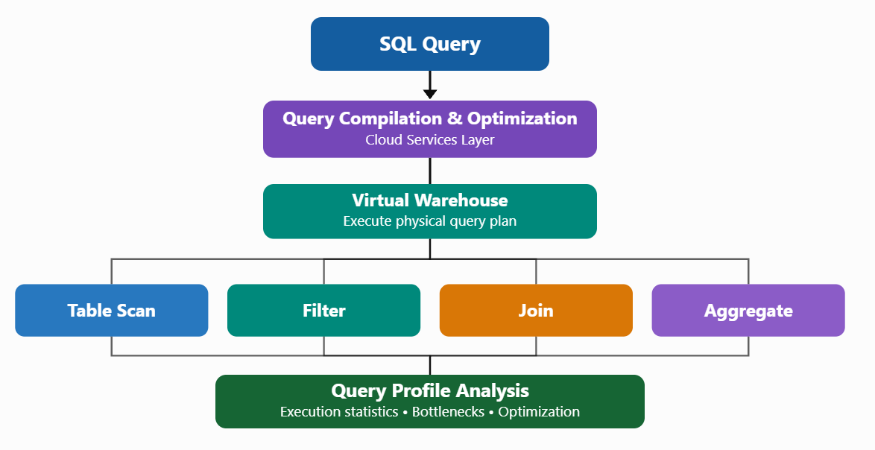
Query Profile – Execution Architecture

Slide 85
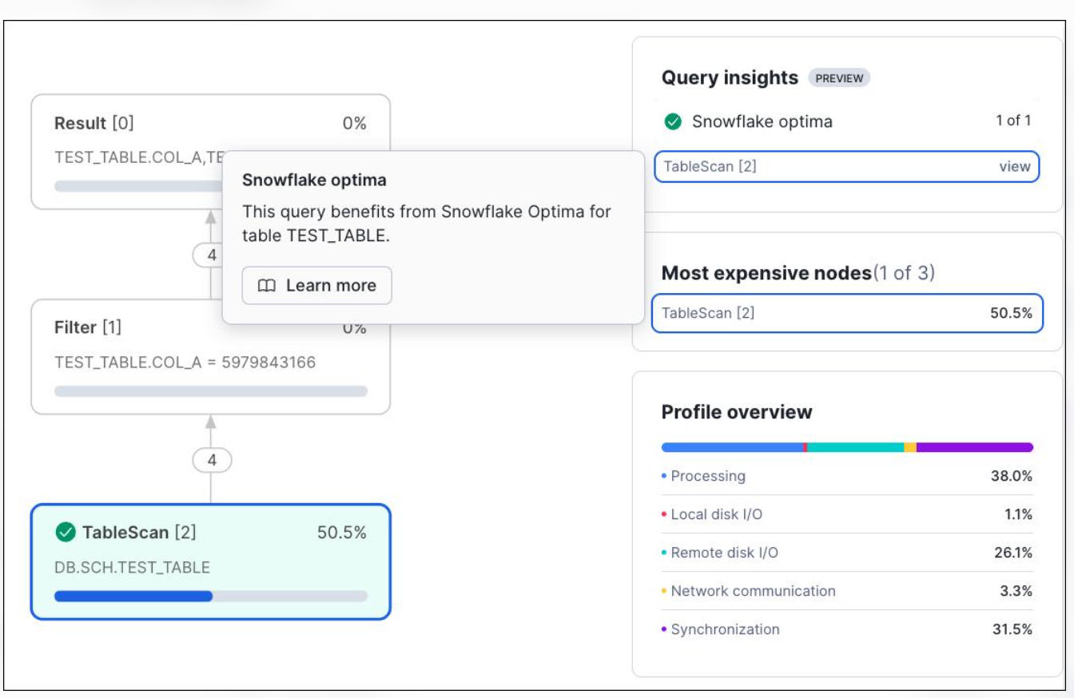
How to access Query Profile in Snowsight

Slide 86
How to access Query Profile in Snowsight
Log in to Snowflake Snowsight.
  Execute a SQL query in a worksheet.
  Navigate to Monitoring → Query History.
  Select the corresponding Query ID.
  Open the Query Profile tab.
  Select individual operator nodes to examine their statistics.
  Snowflake Documentation+1

Slide 87
Understanding Query Profile operators
Operator | Responsibility | Potential performance issue
TableScan | Reads table data | Excessive data scanning
Filter | Removes unwanted rows | Inefficient filtering
Join | Combines datasets | Exploding joins
Aggregate | Performs SUM, COUNT, GROUP BY | High memory utilization
Sort | Orders records | Disk spilling
WindowFunction | Executes analytical functions | Expensive computation
UnionAll | Combines result sets | Excessive intermediate rows
Result | Produces final output | Large result size

Slide 88
Sample Query Profile – Food Delivery Analytics
Business requirement: Identify total revenue generated by restaurants for delivered food orders.
SELECT
r.restaurant_name,
SUM(o.quantity * o.unit_price) AS revenue
FROM orders o
JOIN restaurants r
ON o.restaurant_id = r.restaurant_id
WHERE o.status = 'Delivered'
GROUP BY r.restaurant_name
ORDER BY revenue DESC;

Slide 89
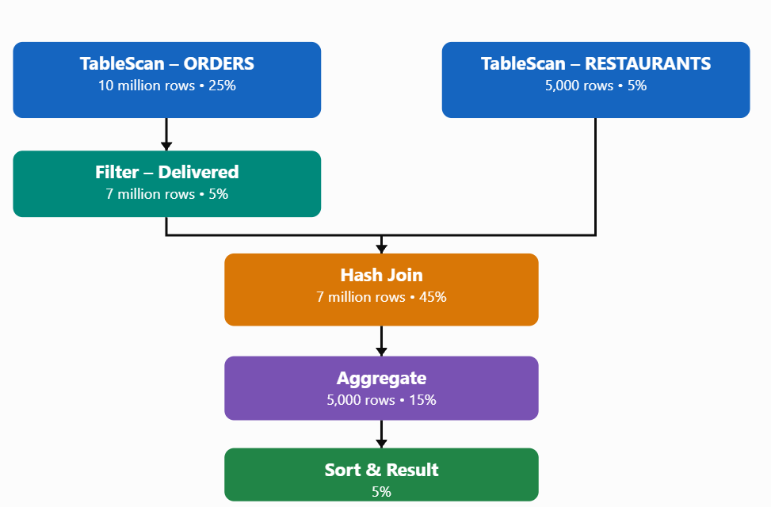
Sample Query Profile – Food Delivery Analytics

Slide 90
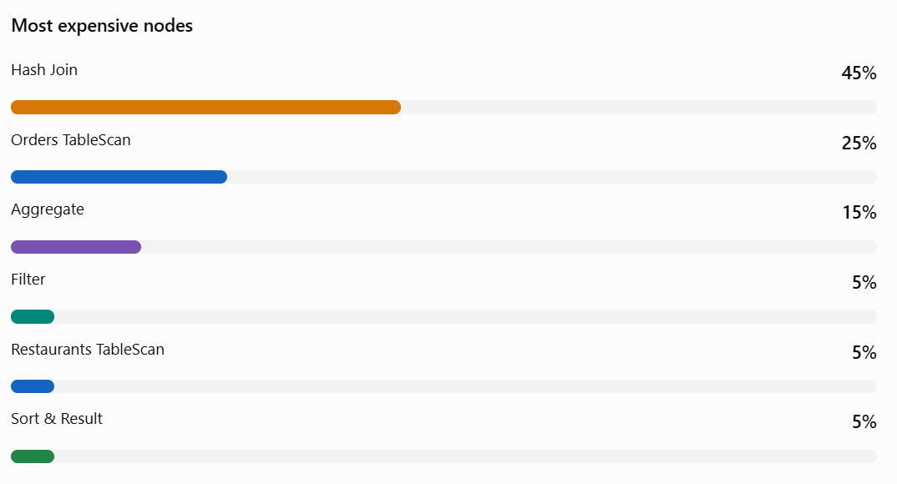
Sample Query Profile – Food Delivery Analytics

Slide 91
Important performance metrics
Metric | Interpretation
Total elapsed time | Overall query latency
Compilation time | Time required to prepare the execution plan
Execution time | Time spent executing the query
Bytes scanned | Amount of data read
Partitions scanned | Number of micro-partitions accessed
Partitions total | Total available micro-partitions
Local disk spilling | Intermediate data exceeds available memory
Remote disk spilling | Intermediate data spills to remote storage
Queued overload time | Warehouse resources are occupied
Network communication | Data transfer overhead between execution processes

Slide 92
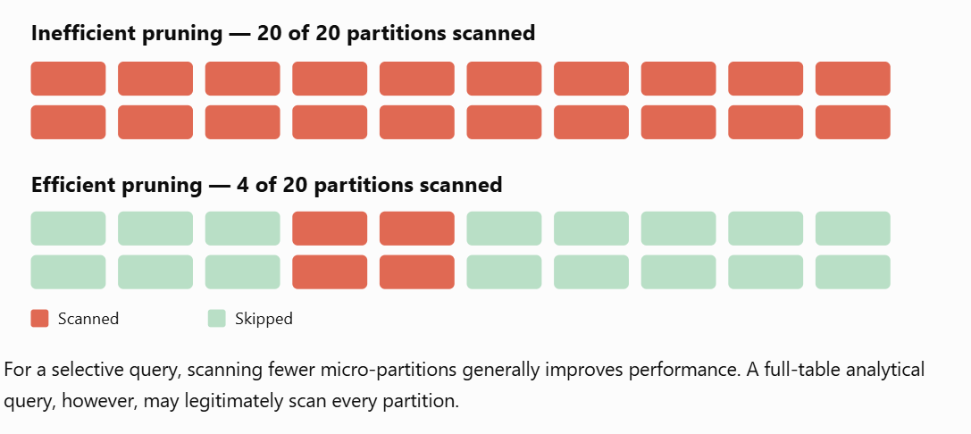
Micro-partition pruning analysis

Slide 93
Performance problems and optimization techniques
Problem | Recommended solution
Excessive table scanning | Select required columns and apply selective filters
Poor partition pruning | Evaluate data organization and clustering
Exploding joins | Correct join predicates and validate cardinality
Local disk spilling | Reduce intermediate results or increase warehouse size
Remote disk spilling | Process smaller batches or increase warehouse size
High sorting cost | Remove unnecessary ORDER BY operations
Warehouse overload | Separate workloads or consider multi-cluster warehouses
Expensive aggregation | Pre-aggregate data where appropriate

Slide 94
Hands-on lab – Analyze Query Profile
Step 1: Select warehouse and sample database
USE WAREHOUSE COMPUTE_WH;
USE DATABASE SNOWFLAKE_SAMPLE_DATA;
USE SCHEMA TPCH_SF10;
Use an existing warehouse and ensure that the role has access to the sample database

Slide 95
Hands-on lab – Analyze Query Profile
Step 2: Disable persisted result reuse
ALTER SESSION SET USE_CACHED_RESULT = FALSE;
This prevents the query from simply returning a previously persisted result. Warehouse-local caching can still influence performance.

Slide 96
Hands-on lab – Analyze Query Profile
Step 3: Execute analytical query
SELECT
L_RETURNFLAG,
L_LINESTATUS,
SUM(L_QUANTITY) AS TOTAL_QUANTITY,
SUM(L_EXTENDEDPRICE) AS TOTAL_REVENUE
FROM LINEITEM
GROUP BY L_RETURNFLAG, L_LINESTATUS;

Slide 97
Hands-on lab – Analyze Query Profile
Step 4: Execute a selective query
SELECT
L_RETURNFLAG,
L_LINESTATUS,
SUM(L_QUANTITY) AS TOTAL_QUANTITY,
SUM(L_EXTENDEDPRICE) AS TOTAL_REVENUE
FROM LINEITEM
WHERE L_SHIPDATE >= '1996-01-01'
AND L_SHIPDATE < '1996-02-01'
GROUP BY L_RETURNFLAG, L_LINESTATUS;

Slide 98
Hands-on lab – Analyze Query Profile
Step 5: Compare execution profiles
Open Query History and record the following:
Metric | Query 1 | Query 2
Execution time | Observe | Observe
Bytes scanned | Observe | Observe
Partitions scanned | Observe | Observe
Partitions total | Observe | Observe
Most expensive node | Observe | Observe
Bytes spilled | Observe | Observe

Slide 99
Hands-on lab – Analyze Query Profile
Step 6: Analyze operator statistics using SQL
SELECT *
FROM TABLE(
GET_QUERY_OPERATOR_STATS(
LAST_QUERY_ID()
)
);
Alternatively, supply the Query ID of the analytical query directly.

Slide 100
Hands-on lab – Analyze Query Profile
Step 7: Identify slow queries across the account
SELECT
QUERY_ID,
QUERY_TEXT,
WAREHOUSE_NAME,
TOTAL_ELAPSED_TIME / 1000 AS ELAPSED_SECONDS,
BYTES_SCANNED,
PARTITIONS_SCANNED,
PARTITIONS_TOTAL,
BYTES_SPILLED_TO_LOCAL_STORAGE,
BYTES_SPILLED_TO_REMOTE_STORAGE
FROM SNOWFLAKE.ACCOUNT_USAGE.QUERY_HISTORY
WHERE START_TIME >= DATEADD(
'DAY', -1, CURRENT_TIMESTAMP()
)
AND EXECUTION_STATUS = 'SUCCESS'
ORDER BY TOTAL_ELAPSED_TIME DESC
LIMIT 10;

Slide 101
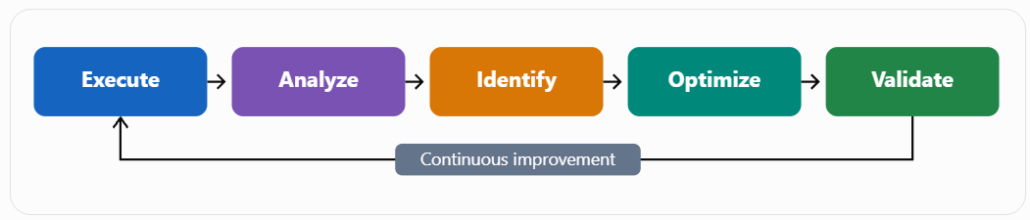
10. Query performance optimization lifecycle

Slide 102
Snowflake – Micro-partitions & Clustering
Micro-partitioning and clustering are fundamental Snowflake storage optimization mechanisms that improve query performance by reducing the amount of data scanned during query execution.
Unlike traditional relational databases, Snowflake automatically partitions data without requiring users to create physical partitions or indexes.

Slide 103
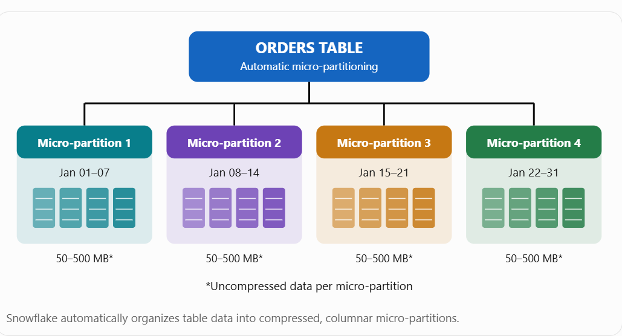
Snowflake – Micro-partitions & Clustering
1. What is a micro-partition?
A micro-partition is a small, contiguous unit of storage automatically created and managed by Snowflake when data is loaded into a table.

Slide 104
Snowflake – Micro-partitions & Clustering
Feature | Description
Size | 50–500 MB of uncompressed data
Creation | Automatic
Storage format | Columnar
Compression | Automatic
Mutability | Immutable
Metadata | Automatically maintained
Partition management | Managed by Snowflake
Primary benefit | Efficient data pruning

Slide 105
Micro-partition metadata
Snowflake maintains metadata for each micro-partition, which helps the query optimizer decide which storage units to access.
Snowflake Documentation+1
Consider a food delivery application with the ORDERS table.

Slide 106
Micro-partition metadata
Micro-partition | Minimum date | Maximum date | Rows (illustrative)
MP1 | 01-Jan | 07-Jan | 100,000
MP2 | 08-Jan | 14-Jan | 100,000
MP3 | 15-Jan | 21-Jan | 100,000
MP4 | 22-Jan | 31-Jan | 100,000

Slide 107
3. What is partition pruning?
Partition pruning is the process of eliminating unnecessary micro-partitions before scanning data.
SELECT SUM(order_amount)
FROM orders
WHERE order_date BETWEEN '2026-01-08'
AND '2026-01-14';

Slide 108
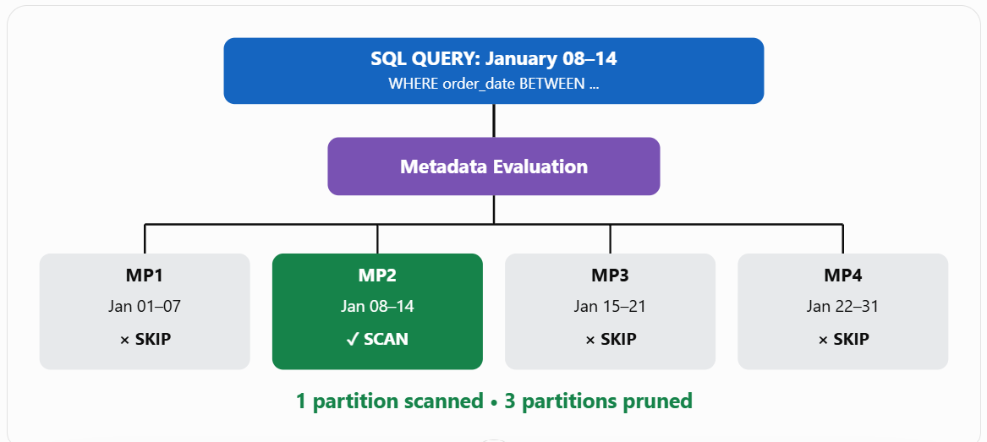
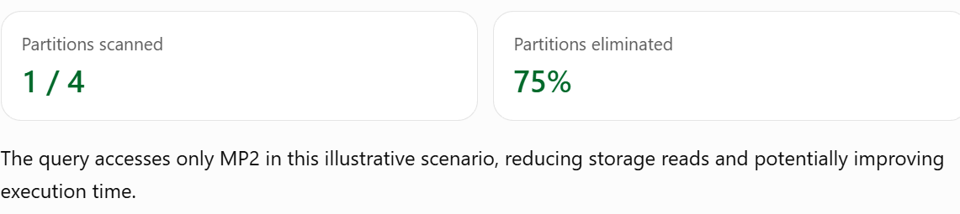
What is partition pruning?

Slide 109
What is clustering?
Clustering is the organization of related data across micro-partitions based on common column values.
For example, food orders can be clustered based on:
  Order date
  City
  Restaurant ID
  Region
When related values are stored close together, partition pruning becomes more effective.

Slide 110
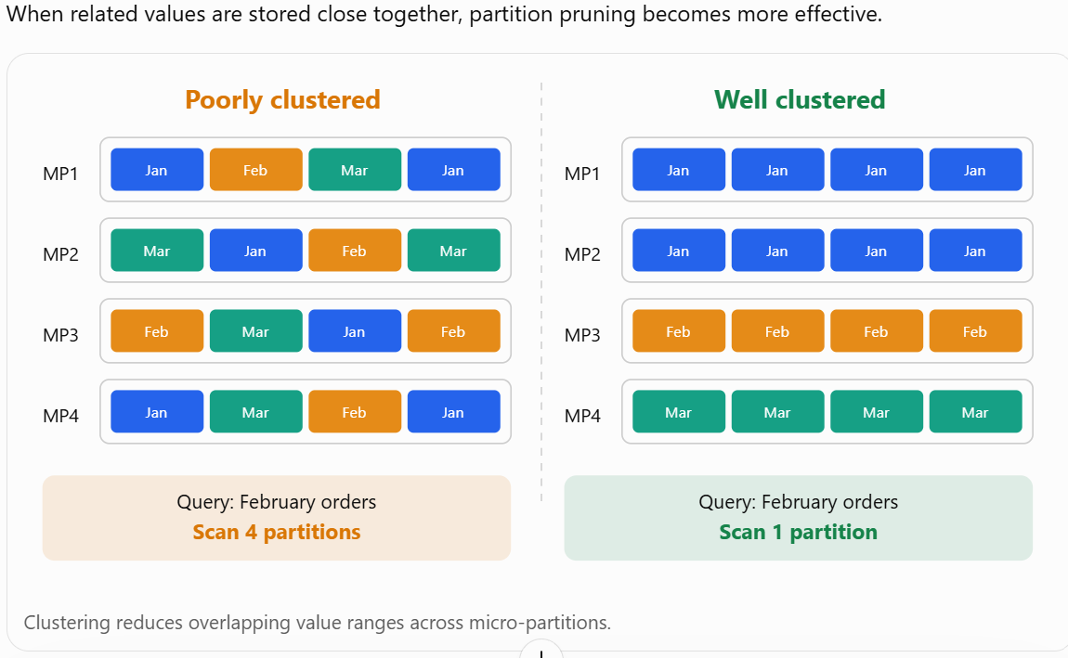
What is clustering?

Slide 111
Natural clustering vs explicit clustering
Feature | Natural clustering | Explicit clustering
Creation | Automatic during data loading | Defined using CLUSTER BY
Organization | Based on loading order | Based on selected expressions
Configuration | Not required | Clustering key required
Maintenance | Normal data operations | Automatic Clustering service
Additional clustering cost | None | Serverless compute credits
Suitable for | Naturally ordered data | Large tables with inefficient pruning

Slide 112
What is Auto Suspend?
Auto Suspend automatically stops a Snowflake Virtual Warehouse after a configured period of inactivity.
For example, when Auto Suspend is configured to 60 seconds:
A query runs successfully.
  The warehouse remains idle for approximately 60 seconds.
  Snowflake automatically suspends the warehouse.
  Compute credit consumption stops when the warehouse is fully suspended.

Slide 113
What is Auto Resume?
Auto Resume automatically starts a suspended warehouse when a new SQL query requiring warehouse compute is submitted.
For example:
  Warehouse status: SUSPENDED
  User executes SELECT * FROM ORDERS;
  Snowflake automatically starts the warehouse.
  The query executes after the warehouse becomes available.
No manual restart is required.

Slide 114
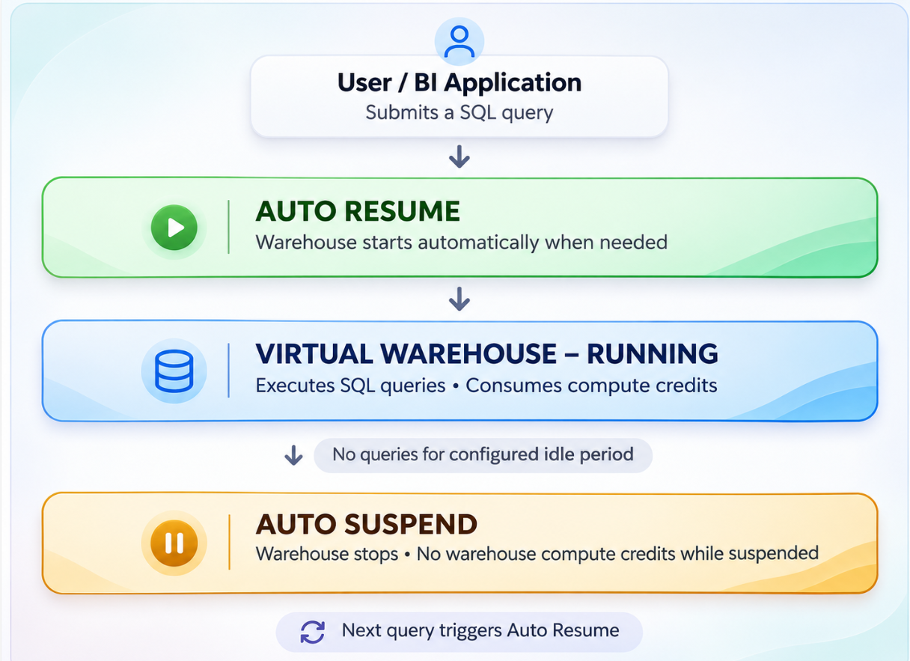
Auto Suspend and Resume architecture

Slide 115
Hands-on lab: Configure Auto Suspend and Auto Resume
Step 1 – Create a virtual warehouse
Open Snowflake → Projects → Worksheets → SQL Worksheet.
Execute:
CREATE WAREHOUSE IF NOT EXISTS TRAINING_WH
WITH
WAREHOUSE_SIZE = 'XSMALL'
AUTO_SUSPEND = 60
AUTO_RESUME = TRUE
INITIALLY_SUSPENDED = TRUE;

Slide 116
Hands-on lab: Configure Auto Suspend and Auto Resume
Step 2 – Select the warehouse
USE WAREHOUSE TRAINING_WH;
Step 3 – Execute a query
SELECT
CURRENT_TIMESTAMP(),
CURRENT_WAREHOUSE();

Slide 117
Hands-on lab: Configure Auto Suspend and Auto Resume
Step 4 – Check warehouse status
SHOW WAREHOUSES LIKE 'TRAINING_WH';
The warehouse should show STARTED after resuming.
Step 5 – Test Auto Suspend
After your query finishes, leave the warehouse idle for approximately 60–90 seconds without submitting another compute query.
Execute:
SHOW WAREHOUSES LIKE 'TRAINING_WH';

Slide 118
Hands-on lab: Configure Auto Suspend and Auto Resume
Step 6 – Test Auto Resume again
Execute:
SELECT COUNT(*)
FROM SNOWFLAKE_SAMPLE_DATA.TPCH_SF1.CUSTOMER;
This step assumes the standard Snowflake sample database is available to your role.

Slide 119
Hands-on lab: Configure Auto Suspend and Auto Resume
Step 6 – Test Auto Resume again
Execute:
SELECT COUNT(*)
FROM SNOWFLAKE_SAMPLE_DATA.TPCH_SF1.CUSTOMER;
This step assumes the standard Snowflake sample database is available to your role.

Slide 120
Hands-on lab: Configure Auto Suspend and Auto Resume
Expected results:
  Warehouse resumes automatically.
  Query runs successfully.
  Warehouse returns to an idle state after execution.
  It subsequently suspends when the idle timeout is reached.

Slide 121
Auto Suspend vs Auto Resume
Feature | Auto Suspend | Auto Resume
Trigger | Inactivity timeout | New compute query
Action | Stops compute | Starts compute
Cost impact | Reduces idle cost | Starts compute billing
Configuration | Seconds | TRUE/FALSE
Recommended | Yes, for intermittent workloads | Yes, for convenient access

Slide 122
Hands-on lab – Micro-partitions & Clustering
Objective: Create a food orders table, examine clustering information and compare query performance.
Step 1: Create a warehouse and database
CREATE WAREHOUSE IF NOT EXISTS LAB_WH WITH WAREHOUSE_SIZE = 'XSMALL’ AUTO_SUSPEND = 60 AUTO_RESUME = TRUE;
USE WAREHOUSE LAB_WH;
CREATE DATABASE IF NOT EXISTS FOOD_DELIVERY_DB;
USE DATABASE FOOD_DELIVERY_DB;
USE SCHEMA PUBLIC;

Slide 123
Hands-on lab – Micro-partitions & Clustering
Step 2: Create a sample table
Generate five million food order records with randomly distributed dates.
CREATE OR REPLACE TABLE ORDERS AS SELECT SEQ4() AS ORDER_ID,
DATEADD( DAY, UNIFORM(0, 364, RANDOM()),
'2025-01-01'::DATE ) AS ORDER_DATE,
CASE UNIFORM(1, 4, RANDOM()) WHEN 1 THEN 'Chennai'
WHEN 2 THEN 'Bangalore’ WHEN 3 THEN 'Trichy'
ELSE 'Erode'
END AS CITY,
UNIFORM(100, 2000, RANDOM()) AS ORDER_AMOUNT
FROM TABLE(GENERATOR(ROWCOUNT => 5000000));

Slide 124
Hands-on lab – Micro-partitions & Clustering
Step 3: Examine clustering information
SELECT SYSTEM$CLUSTERING_INFORMATION(
'ORDERS',
'(ORDER_DATE)'
);

Slide 125
Hands-on lab – Micro-partitions & Clustering
Parameter | Interpretation
total_partition_count | Number of micro-partitions examined
average_overlaps | Average overlapping partitions
average_depth | Average overlap depth
cluster_by_keys | Columns or expressions evaluated
clustering_errors | Automatic Clustering errors

Slide 126
Hands-on lab – Micro-partitions & Clustering
Step 4: Execute an analytical query
Disable persisted query result reuse for testing.
ALTER SESSION SET USE_CACHED_RESULT = FALSE;
SELECT CITY, SUM(ORDER_AMOUNT) AS TOTAL_SALES
FROM ORDERS
WHERE ORDER_DATE BETWEEN '2025-06-01'
AND '2025-06-07'
GROUP BY CITY;

Slide 127
Hands-on lab – Micro-partitions & Clustering
Open Query History and examine the Query Profile.
Record the following:
  Partitions scanned
  Partitions total
  Bytes scanned
  Execution time

Slide 128
Hands-on lab – Micro-partitions & Clustering
Step 5: Create an ordered table for comparison
CREATE OR REPLACE TABLE ORDERS_SORTED AS SELECT * FROM ORDERS ORDER BY ORDER_DATE;

Slide 129
Hands-on lab – Micro-partitions & Clustering
Step 6: Define a clustering key
ALTER TABLE ORDERS_SORTED
CLUSTER BY (ORDER_DATE);
Snowflake can maintain the specified clustering organization using Automatic Clustering. This is a background service and can incur additional credits.

Slide 130
Hands-on lab – Micro-partitions & Clustering
Step 7: Execute the same analytical query
SELECT CITY, SUM(ORDER_AMOUNT) AS TOTAL_SALES
FROM ORDERS_SORTED
WHERE ORDER_DATE BETWEEN '2025-06-01'
AND '2025-06-07'
GROUP BY CITY;

Slide 131
Hands-on lab – Micro-partitions & Clustering
Step 8: Compare clustering depth
SELECT SYSTEM$CLUSTERING_DEPTH(
'ORDERS', '(ORDER_DATE)'
);
SELECT SYSTEM$CLUSTERING_DEPTH(
'ORDERS_SORTED', '(ORDER_DATE)'
);

Slide 132
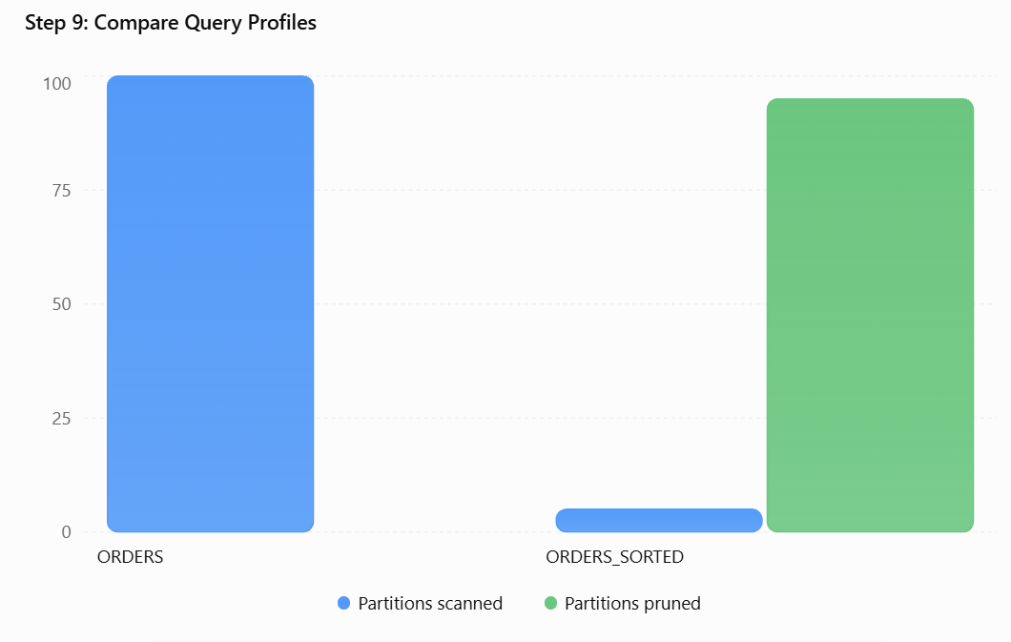
Hands-on lab – Micro-partitions & Clustering

Slide 133
Hands-on lab – Micro-partitions & Clustering
Performance metric | Before | After
Partitions scanned | Higher | Lower
Bytes scanned | Higher | Lower
Clustering depth | Higher | Lower
Execution time | Potentially slower | Potentially faster

Slide 134
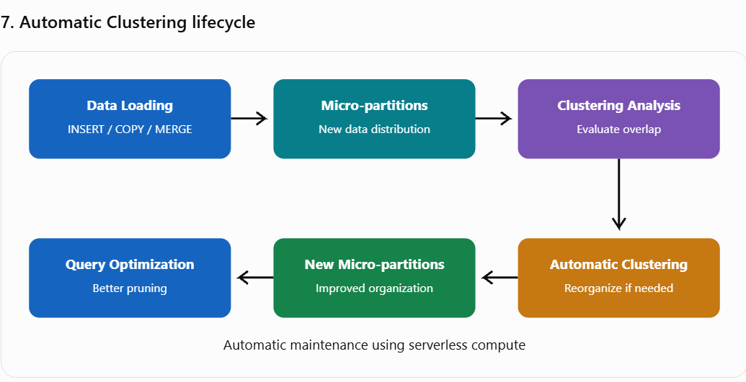
Hands-on lab – Micro-partitions & Clustering

Slide 135
Hands-on lab – Micro-partitions & Clustering
Manage Automatic Clustering:
-- Suspend Automatic Clustering
ALTER TABLE ORDERS_SORTED SUSPEND RECLUSTER;
-- Resume Automatic Clustering
ALTER TABLE ORDERS_SORTED RESUME RECLUSTER;
-- Remove clustering key
ALTER TABLE ORDERS_SORTED DROP CLUSTERING KEY;

Slide 136
Hands-on lab – Micro-partitions & Clustering
Recommended practice | Reason
Select frequently filtered columns | Improves partition pruning
Consider date or region columns | Common analytical filtering dimensions
Avoid unnecessarily high-cardinality keys | Can increase maintenance overhead
Avoid clustering small tables unnecessarily | Limited performance benefit
Monitor Query Profile | Validates actual performance improvement
Monitor clustering credits | Controls operational costs
Use expressions where appropriate | Helps manage cardinality

Slide 137
Hands-on lab – Micro-partitions & Clustering
9. Micro-partitioning vs clustering vs warehouse sizing
Aspect | Micro-partitioning | Clustering | Warehouse sizing
Layer | Storage | Storage optimization | Compute
Purpose | Divide data | Organize data | Execute queries
Automatic | Yes | Natural or configured | Configurable
Main benefit | Efficient storage access | Reduced data scanning | Increased compute capacity

Slide 138
Expensive Query Identification in Snowflake
Expensive Query Identification is the process of identifying SQL queries that consume excessive compute resources, execution time, memory, or Snowflake credits and optimizing them to improve performance and reduce operational costs.
In a production data platform, a Data Engineer or Snowflake Administrator must continuously monitor queries to identify performance bottlenecks.

Slide 139
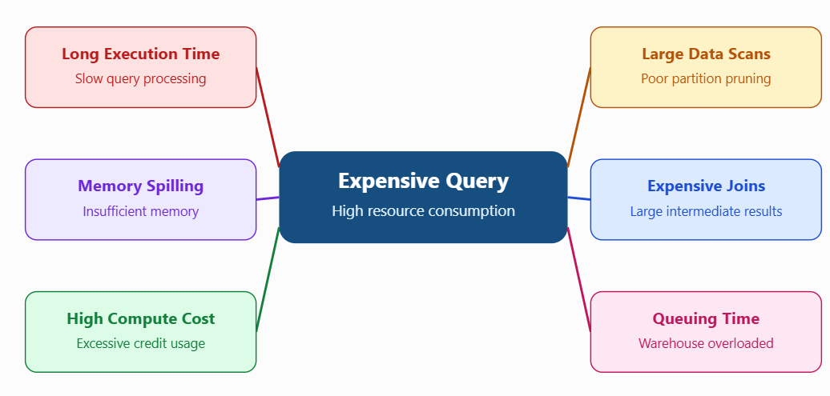
Expensive Query Identification in Snowflake

Slide 140
Key Performance Metrics
Metric | What it indicates
Total elapsed time | Overall query duration
Execution time | Time spent executing the query
Bytes scanned | Volume of data read
Partitions scanned | Number of micro-partitions accessed
Local disk spilling | Intermediate results exceeding available memory
Remote disk spilling | More severe memory pressure
Queued overload time | Warehouse concurrency bottleneck
Compilation time | Time spent preparing the execution plan
Compute credits | Attributed query compute cost
Rows produced | Size of the query result

Slide 141
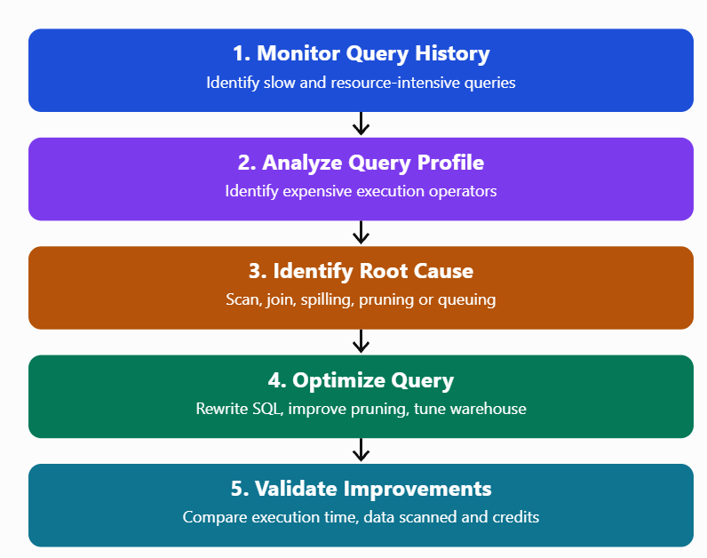
Expensive query identification workflow

Slide 142
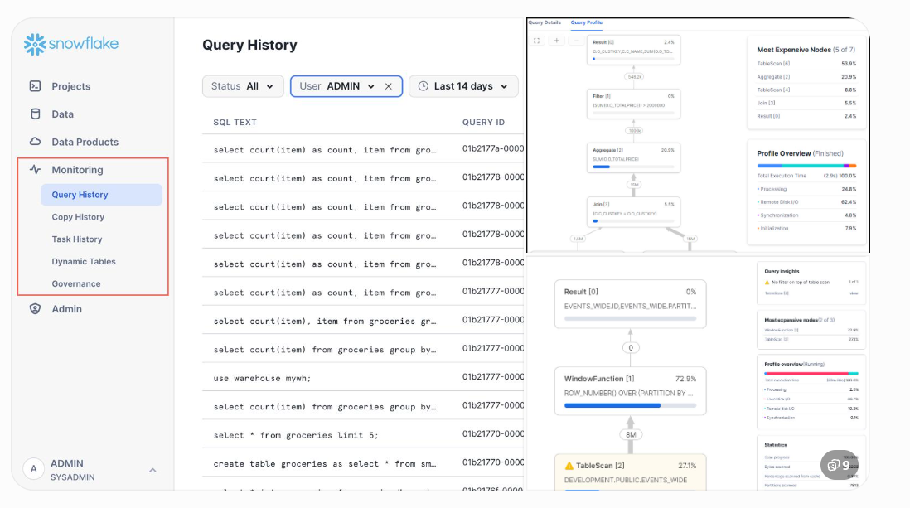
Identify expensive queries using Snowsight

Slide 143
Identify expensive queries using Snowsight
Log in to Snowsight.
Navigate to Monitoring → Query History (or Query History under Activity, depending on the interface).
Select the time range.
Filter by warehouse, user or execution status.
Sort queries by duration.
Select a long-running query.
Open Query Profile.
Examine the most expensive operators.

Slide 144
Identify expensive queries using Snowsight
5. Identify expensive queries using SQL
A. Top 10 long-running queries
SELECT
QUERY_ID,
QUERY_TEXT,
WAREHOUSE_NAME,
USER_NAME,
TOTAL_ELAPSED_TIME / 1000 AS DURATION_SEC,
EXECUTION_TIME / 1000 AS EXECUTION_SEC,
BYTES_SCANNED
FROM SNOWFLAKE.ACCOUNT_USAGE.QUERY_HISTORY
WHERE START_TIME >= DATEADD('day', -1, CURRENT_TIMESTAMP())
ORDER BY TOTAL_ELAPSED_TIME DESC
LIMIT 10;

Slide 145
Identify expensive queries using Snowsight
B. Queries scanning large amounts of data
SELECT
QUERY_ID,
QUERY_TEXT,
ROUND(BYTES_SCANNED / POWER(1024,3), 2)
AS GB_SCANNED,
PARTITIONS_SCANNED,
PARTITIONS_TOTAL,
ROUND(
100.0 * PARTITIONS_SCANNED /
NULLIF(PARTITIONS_TOTAL, 0), 2
) AS SCAN_PERCENTAGE
FROM SNOWFLAKE.ACCOUNT_USAGE.QUERY_HISTORY
WHERE START_TIME >= DATEADD('day', -1, CURRENT_TIMESTAMP())
ORDER BY BYTES_SCANNED DESC
LIMIT 10;

Slide 146
Identify expensive queries using Snowsight
C. Identify memory spilling
SELECT
QUERY_ID,
QUERY_TEXT,
BYTES_SPILLED_TO_LOCAL_STORAGE,
BYTES_SPILLED_TO_REMOTE_STORAGE,
EXECUTION_TIME / 1000 AS EXECUTION_SEC
FROM SNOWFLAKE.ACCOUNT_USAGE.QUERY_HISTORY
WHERE START_TIME >= DATEADD('day', -1, CURRENT_TIMESTAMP())
AND (
BYTES_SPILLED_TO_LOCAL_STORAGE > 0
OR BYTES_SPILLED_TO_REMOTE_STORAGE > 0
)
ORDER BY BYTES_SPILLED_TO_REMOTE_STORAGE DESC;

Slide 147
Identify expensive queries using Snowsight
D. Identify warehouse overload
SELECT
QUERY_ID,
WAREHOUSE_NAME,
QUERY_TEXT,
QUEUED_OVERLOAD_TIME / 1000 AS QUEUED_SEC
FROM SNOWFLAKE.ACCOUNT_USAGE.QUERY_HISTORY
WHERE START_TIME >= DATEADD('day', -1, CURRENT_TIMESTAMP())
AND QUEUED_OVERLOAD_TIME > 0
ORDER BY QUEUED_OVERLOAD_TIME DESC;

Slide 148
Identify expensive queries using Snowsight
E. Identify queries consuming the most credits
SELECT
QUERY_ID,
WAREHOUSE_NAME,
USER_NAME,
CREDITS_ATTRIBUTED_COMPUTE,
COALESCE(CREDITS_USED_QUERY_ACCELERATION, 0)
AS ACCELERATION_CREDITS
FROM SNOWFLAKE.ACCOUNT_USAGE.QUERY_ATTRIBUTION_HISTORY
WHERE START_TIME >= DATEADD('day', -7, CURRENT_TIMESTAMP())
ORDER BY CREDITS_ATTRIBUTED_COMPUTE DESC
LIMIT 10;

Slide 149
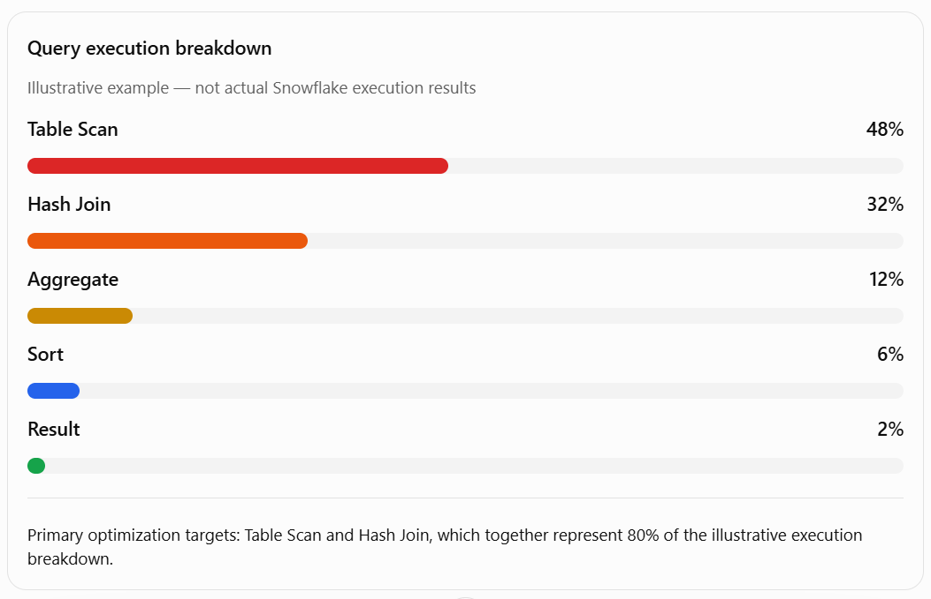
6. Identify expensive operators in Query Profile

Slide 150
6. Identify expensive operators in Query Profile
Operator | Possible problem | Optimization
Table Scan | Excessive data scanning | Improve filters and pruning
Join | Exploding join | Correct join conditions
Aggregate | High-cardinality grouping | Pre-aggregate data
Sort | Large sorting operation | Avoid unnecessary ORDER BY
Window Function | Large window partitions | Reduce input data
Remote Spill | Insufficient memory | Optimize SQL or resize warehouse
Queuing | Excessive concurrency | Isolate workloads or scale out

Slide 151
7. Hands-on example — Food delivery analytics
Business scenario: A food delivery company wants to calculate revenue generated by each city during November 2026.
Step 1: Disable persisted result reuse for testing
ALTER SESSION SET USE_CACHED_RESULT = FALSE;
ALTER SESSION SET QUERY_TAG =
'EXPENSIVE_QUERY_LAB';

Slide 152
7. Hands-on example — Food delivery analytics
Step 2: Execute a potentially expensive query
SELECT
CITY,
SUM(QUANTITY * UNIT_PRICE) AS REVENUE
FROM FOOD_ORDERS
WHERE TO_CHAR(ORDER_DATE, 'YYYY-MM') = '2026-11'
GROUP BY CITY
ORDER BY REVENUE DESC;
Potential issue: Applying a function to the date column may make partition pruning less effective.

Slide 153
7. Hands-on example — Food delivery analytics
Step 3: Execute the optimized query
SELECT
CITY,
SUM(QUANTITY * UNIT_PRICE) AS REVENUE
FROM FOOD_ORDERS
WHERE ORDER_DATE >= '2026-11-01'
AND ORDER_DATE < '2026-12-01'
GROUP BY CITY
ORDER BY REVENUE DESC;
Using a direct date range can help Snowflake eliminate irrelevant micro-partitions.

Slide 154
7. Hands-on example — Food delivery analytics
Step 4: Compare results
Metric | Original query | Optimized query
Execution time | 45 sec | 6 sec
Data scanned | 25 GB | 2 GB
Partitions scanned | 500 | 40
Remote spilling | 1 GB | 0 GB

Slide 155
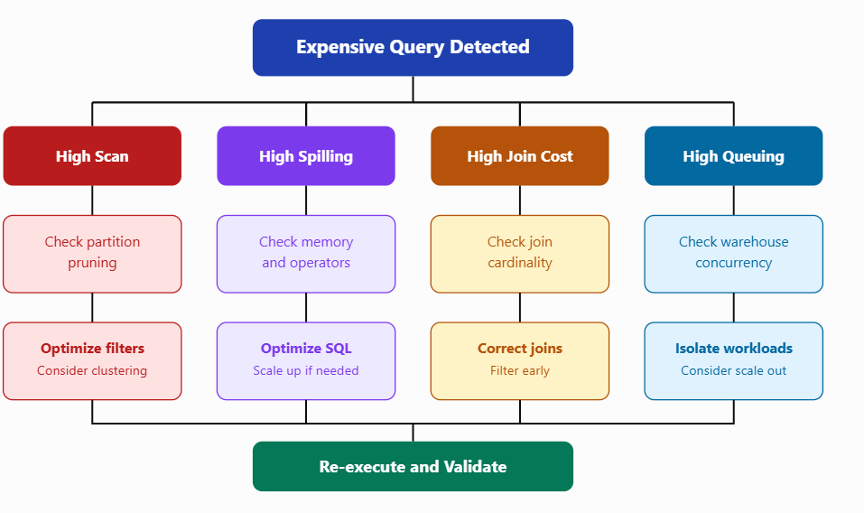
8. Production troubleshooting decision tree

Slide 156
9. Recommended optimization techniques
Problem | Recommended solution
Unnecessary columns | Avoid SELECT *
Full table scans | Apply selective filters
Poor micro-partition pruning | Consider clustering for large tables
Repeated complex calculations | Consider materialized views
Large intermediate results | Filter and aggregate early
Memory spilling | Optimize SQL or scale up warehouse
Concurrent query overload | Multi-cluster warehouse where supported
Frequently repeated queries | Reuse cached results where appropriate
High overall credit consumption | Monitor query attribution and warehouse metering

Slide 157
Snowflake – Initial Performance Optimization Techniques
Performance optimization in Snowflake involves improving query execution time, resource utilization and compute cost without compromising data accuracy.
Unlike traditional databases, Snowflake automatically manages micro-partitions, metadata and many storage-level optimizations.
However, developers and data engineers must still optimize SQL queries, warehouse configurations and data access patterns.

Slide 158
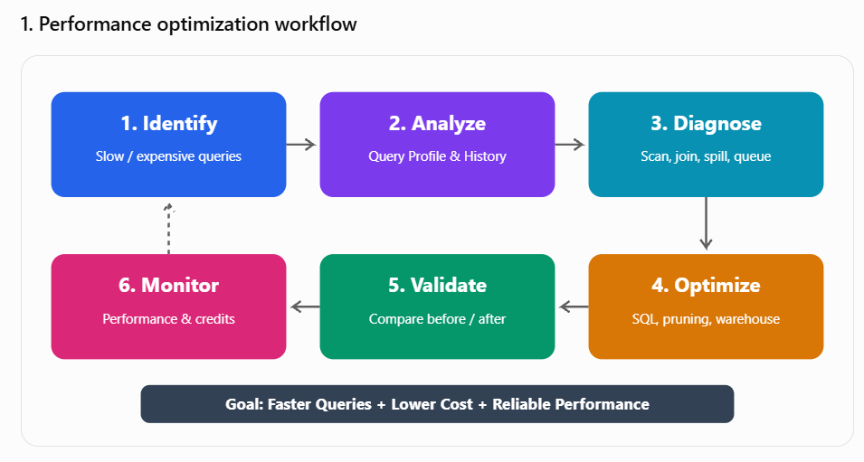
Snowflake – Initial Performance Optimization Techniques

Slide 159
Key performance optimization techniques
Technique | Purpose
Column selection | Reduce unnecessary data scanning
Filter optimization | Reduce rows and partitions scanned
Micro-partition pruning | Skip irrelevant micro-partitions
Join optimization | Reduce expensive join processing
Warehouse sizing | Provide appropriate compute capacity
Query result caching | Avoid repeated query computation
Clustering | Improve pruning for large tables
Aggregation optimization | Reduce processing overhead
Concurrency management | Reduce query queuing
Materialized views | Accelerate suitable repeated computations

Slide 160
Optimize column selection
Snowflake uses columnar storage. Selecting only required columns reduces unnecessary data reads.
Before optimization
SELECT *
FROM SNOWFLAKE_SAMPLE_DATA.TPCH_SF10.ORDERS;
After optimization
SELECT O_ORDERKEY, O_ORDERDATE, O_TOTALPRICE
FROM SNOWFLAKE_SAMPLE_DATA.TPCH_SF10.ORDERS;

Slide 161
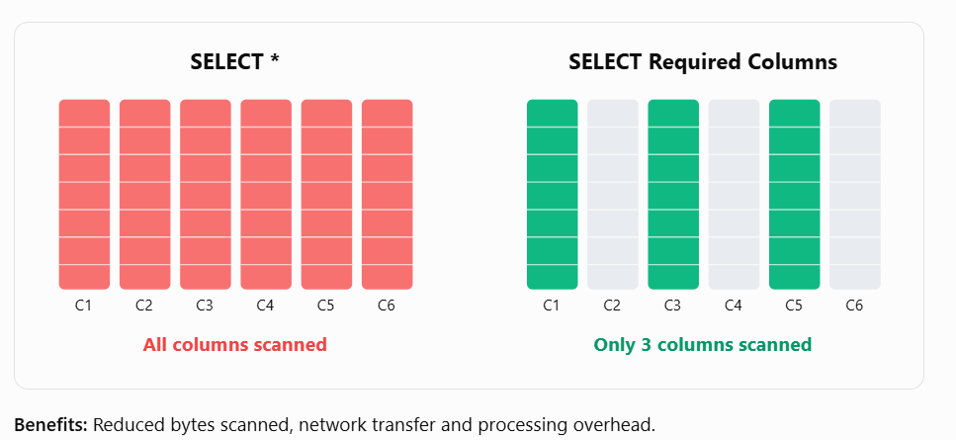
Optimize column selection

Slide 162
Optimize filters and micro-partition pruning
Use selective filters to help Snowflake eliminate irrelevant micro-partitions.
Before optimization
SELECT SUM(O_TOTALPRICE)
FROM SNOWFLAKE_SAMPLE_DATA.TPCH_SF10.ORDERS
WHERE YEAR(O_ORDERDATE) = 1995;

Slide 163
Optimize filters and micro-partition pruning
After optimization
SELECT SUM(O_TOTALPRICE)
FROM SNOWFLAKE_SAMPLE_DATA.TPCH_SF10.ORDERS
WHERE O_ORDERDATE >= '1995-01-01'
AND O_ORDERDATE < '1996-01-01';
Direct range predicates can make pruning more straightforward. Snowflake may also optimize the original expression, so verify the actual improvement using Query Profile.

Slide 164
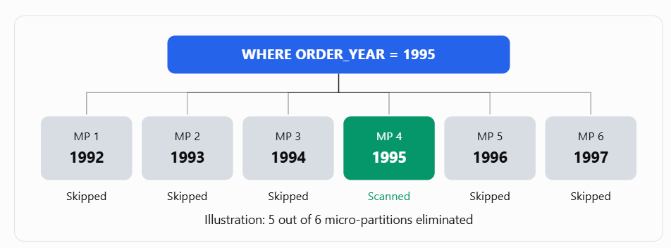
Optimize filters and micro-partition pruning

Slide 165
Optimize joins
Incorrect join conditions can generate excessive intermediate rows, resulting in an exploding join.
Before optimization
SELECT *
FROM ORDERS O
CROSS JOIN CUSTOMER C;

Slide 166
Optimize joins
After optimization
SELECT O.O_ORDERKEY,
C.C_NAME,
O.O_TOTALPRICE
FROM ORDERS O
JOIN CUSTOMER C
ON O.O_CUSTKEY = C.C_CUSTKEY
WHERE O.O_ORDERDATE >= '1995-01-01';

Slide 167
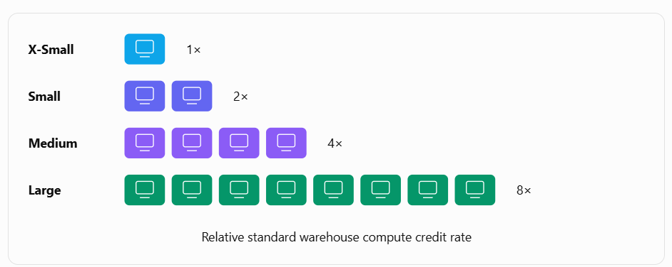
Optimize warehouse size
ALTER WAREHOUSE TRAINING_WH
SET WAREHOUSE_SIZE = 'MEDIUM';

Slide 168
Optimize warehouse size
Problem | Recommended action
Query spilling to disk | Scale up or reduce intermediate data
CPU-intensive query | Test a larger warehouse
Multiple queries waiting | Consider scale-out or separate warehouses
Warehouse remains idle | Configure auto-suspend
Small, simple queries | Use a smaller warehouse
Scale up increases compute capacity for query processing. Scale out with multi-cluster warehouses primarily addresses concurrent workloads.
Do not increase warehouse size without identifying the actual bottleneck.

Slide 169
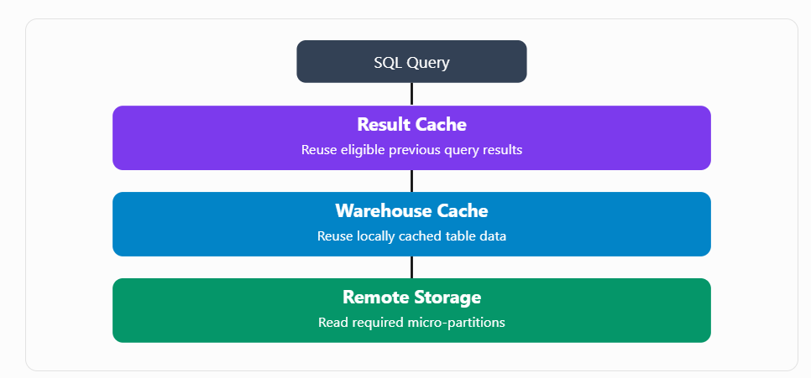
Utilize caching

Slide 170
Utilize caching
For performance testing, disable persisted result reuse:
ALTER SESSION SET USE_CACHED_RESULT = FALSE;
Enable it again after testing:
ALTER SESSION SET USE_CACHED_RESULT = TRUE;

Slide 171
Optimize sorting and aggregation
Avoid unnecessary operations such as:
  ORDER BY when sorted output is not required.
  DISTINCT when duplicates are not present.
  UNION when duplicate elimination is unnecessary.
  GROUP BY on unnecessary columns.

Slide 172
Optimize sorting and aggregation
For example:
-- Duplicate elimination required
SELECT CITY FROM ONLINE_ORDERS
UNION
SELECT CITY FROM STORE_ORDERS;
-- Duplicate elimination not required
SELECT CITY FROM ONLINE_ORDERS
UNION ALL
SELECT CITY FROM STORE_ORDERS;

Slide 173
Optimize sorting and aggregation
Use UNION ALL only when duplicate preservation is acceptable.

Slide 174
Use clustering for large tables
Clustering can improve pruning when large tables are repeatedly queried using particular filter columns.
ALTER TABLE FOOD_ORDERS
CLUSTER BY (ORDER_DATE, CITY);
Check clustering information:
SELECT SYSTEM$CLUSTERING_INFORMATION(
'FOOD_ORDERS',
'(ORDER_DATE, CITY)'
);
Clustering requires additional maintenance compute. Evaluate the performance benefit against the credit consumption before enabling it.

Slide 175
Performance troubleshooting decision matrix
Query Profile observation | Possible root cause | Optimization
High table scan | Excessive data access | Select columns and filter rows
Poor partition pruning | Data organization | Improve predicates or clustering
High join processing | Large intermediate results | Optimize join conditions
High remote spilling | Insufficient memory | Reduce data or scale up
High sorting time | Unnecessary sorting | Remove unnecessary ORDER BY
High queuing time | Warehouse contention | Isolate workloads or scale out
Repeated identical queries | Result reuse unavailable | Check result cache eligibility

Slide 176
Hands-on lab – Initial query optimization
Step 1: Configure the session
USE WAREHOUSE TRAINING_WH;
USE DATABASE SNOWFLAKE_SAMPLE_DATA;
USE SCHEMA TPCH_SF10;
ALTER SESSION SET USE_CACHED_RESULT = FALSE;

Slide 177
Hands-on lab – Initial query optimization
Replace TRAINING_WH with your existing training warehouse name.
Step 2: Execute the baseline query
SELECT *
FROM ORDERS
WHERE YEAR(O_ORDERDATE) = 1995;

Slide 178
Hands-on lab – Initial query optimization
Step 3: Execute the optimized query
SELECT O_ORDERKEY,
O_ORDERDATE,
O_TOTALPRICE
FROM ORDERS
WHERE O_ORDERDATE >= '1995-01-01'
AND O_ORDERDATE < '1996-01-01';

Slide 179
Hands-on lab – Initial query optimization
Step 4: Analyze Query History
SELECT QUERY_ID,
QUERY_TEXT,
WAREHOUSE_SIZE,
TOTAL_ELAPSED_TIME / 1000 AS TIME_SECONDS,
BYTES_SCANNED,
PARTITIONS_SCANNED,
PARTITIONS_TOTAL,
BYTES_SPILLED_TO_LOCAL_STORAGE,
BYTES_SPILLED_TO_REMOTE_STORAGE
FROM TABLE(
INFORMATION_SCHEMA.QUERY_HISTORY(
RESULT_LIMIT => 20
)
)
ORDER BY START_TIME DESC;

Slide 180
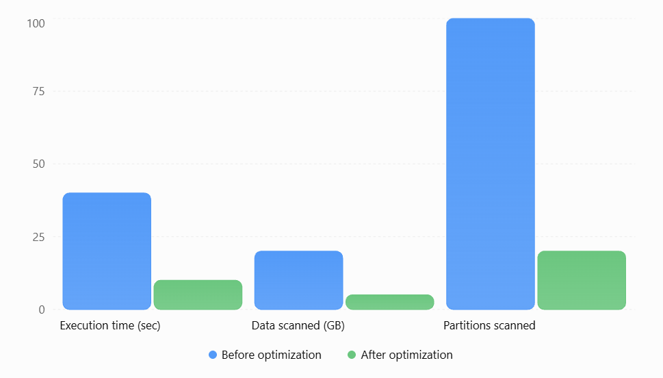
Compare performance

Slide 181
Compare performance
Metric | Before | After
Execution time | 40 seconds | 10 seconds
Data scanned | 20 GB | 5 GB
Partitions scanned | 100 | 20
Execution time reduction | — | 75%

