Slide 1
Data Analytics and Platforms

Slide 2
Goals
PySpark Training Objectives
Modern Data Platform Architecture & Ecosystem
Databricks Operations & Job Troubleshooting
Snowflake Administration & Performance Analysis
Apache Kafka Operations & Streaming Platforms
Pipeline Orchestration & Data Pipeline Troubleshooting
Performance Tuning & Platform Troubleshooting
Incident Management, Monitoring & Production Support

Slide 3
Evolution of Data Platforms
Data platforms have evolved from
traditional file-based systems
relational databases into cloud-native
real-time
AI-powered architectures capable of handling structured, semi-structured, and unstructured data.

Slide 4
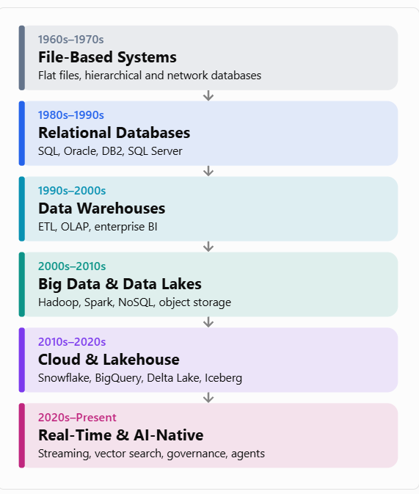
Evolution of Data Platforms

Slide 5
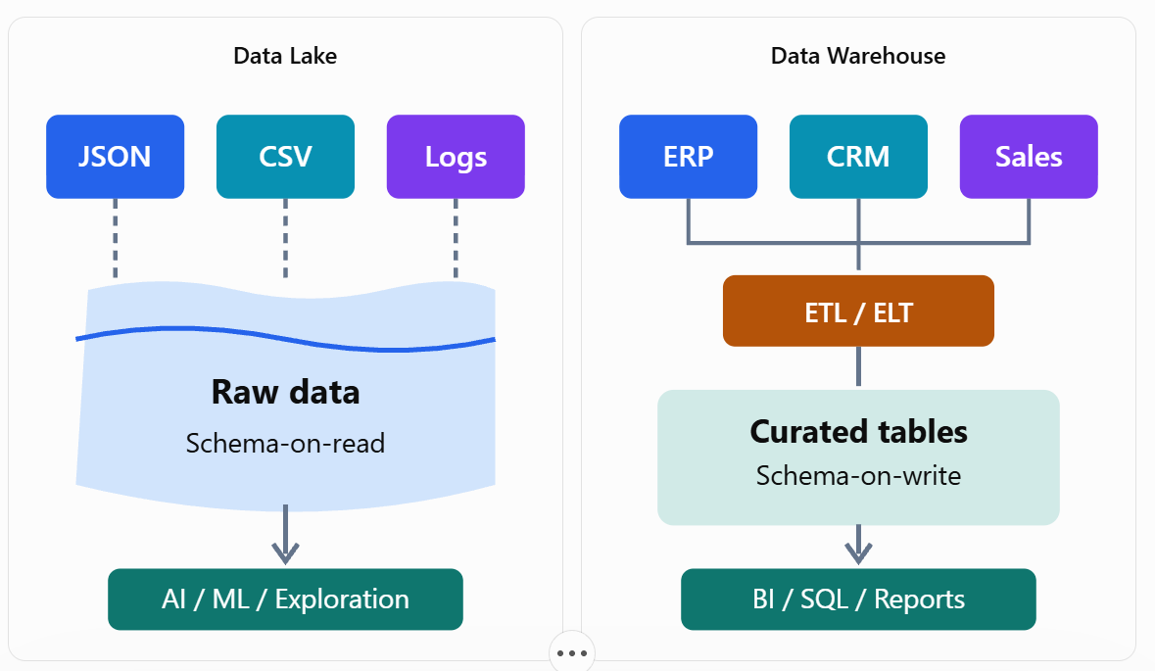
Evolution of Data Platforms

Slide 6
Key Stages and Technologies
Generation | Architecture | Technologies | Primary Purpose
1. Traditional Systems | File storage | COBOL, VSAM | Transaction records
2. RDBMS | Centralized databases | Oracle, SQL Server, PostgreSQL | Structured transactions
3. Data Warehouses | ETL + OLAP | Teradata, Informatica, SSIS | Reporting and BI
4. Big Data | Distributed processing | Hadoop, Hive, Spark, HBase | Large-scale data processing
5. Cloud Data Platforms | Elastic storage and compute | Snowflake, BigQuery, Redshift | Scalable analytics
6. Data Lakehouse | Unified lake and warehouse | Databricks, Delta Lake, Apache Iceberg | BI, analytics and ML
7. AI-Native Platforms | Streaming + AI + vector indexing | Kafka, Flink, Vector Databases, AI Agents | Real-time intelligence and AI

Slide 7
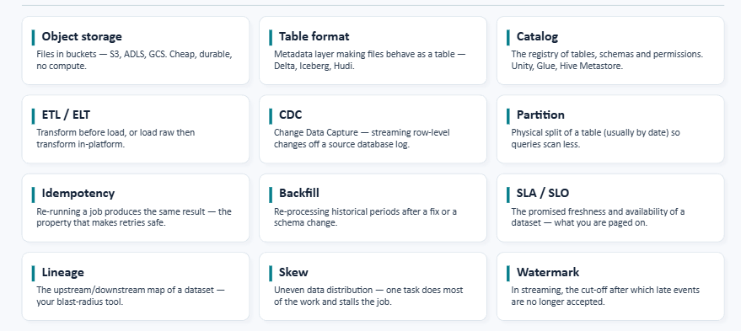
The tewleve words that matter today

Slide 8
The twelve words that matter today
1. Object Storage
FOUNDATION — DATA STORAGE
Definition: Object storage stores data as objects in scalable storage systems rather than traditional database tables or files on local disks.
Examples include Amazon S3, Azure Data Lake Storage and Google Cloud Storage.
Retail example: Your retail application generates multiple datasets:

Slide 9
The twelve words that matter today
2. Table Format
FOUNDATION — LAKEHOUSE TABLE MANAGEMENT
Definition: A table format is a metadata and management layer that enables data files in a lake to behave like database tables.
Popular formats:
  Delta Lake
  Apache Iceberg
  Apache Hudi
Retail example: Sales transactions are stored as Parquet files. Apache Iceberg or Delta Lake manages which files belong to the sales table.
This enables capabilities such as ACID transactions, schema evolution, snapshot-based time travel, and controlled updates or deletes.
Important distinction: Parquet is a file format, whereas Iceberg or Delta Lake is a table format.

Slide 10
The twelve words that matter today
3. Catalog
FOUNDATION — DATA DISCOVERY
Definition: A catalog is a central system that maintains information about available datasets, tables, schemas, locations, and often permissions or governance metadata.
Examples: AWS Glue Data Catalog, Unity Catalog, Hive Metastore.

Slide 11
The twelve words that matter today
Database | Table | Purpose
retail | customers | Customer information
retail | products | Product master data
retail | orders | Sales transactions
retail | payments | Payment records
Why it matters: Without a catalog, users may not know which datasets exist, where they are stored, or how to access them.

Slide 12
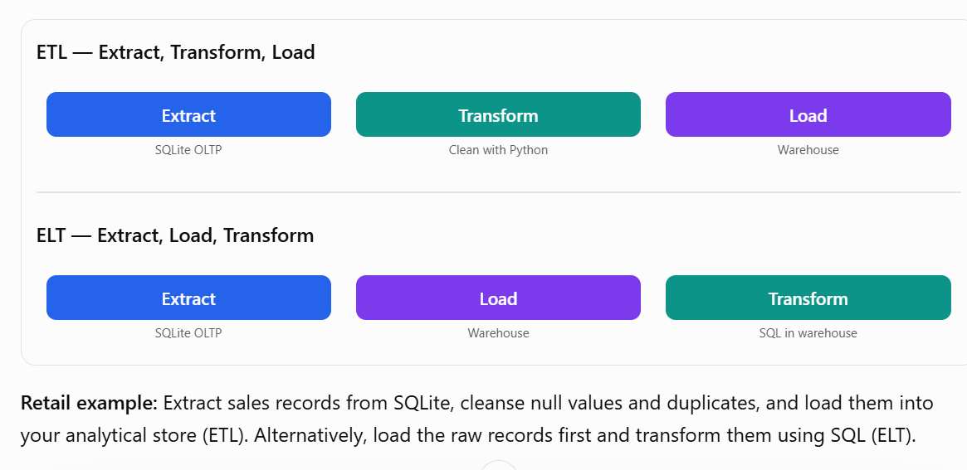
The twelve words that matter today
4. ETL / ELT
DATA INTEGRATION
These are two different approaches to moving and transforming data.

Slide 13
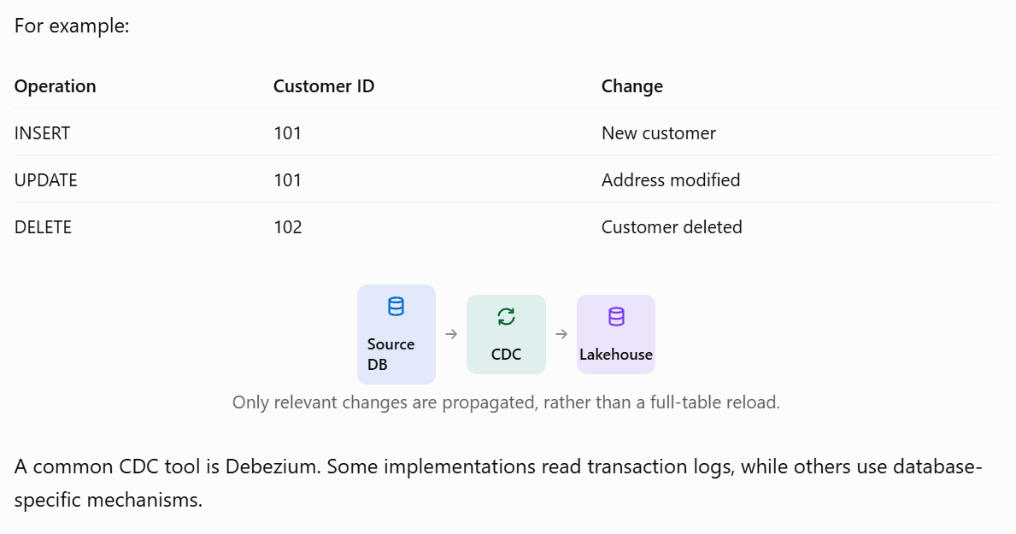
The twelve words that matter today
5. CDC — Change Data Capture
DATA INGESTION
Definition: CDC identifies changes in source databases and propagates those changes to downstream systems without repeatedly copying all records.

Slide 14
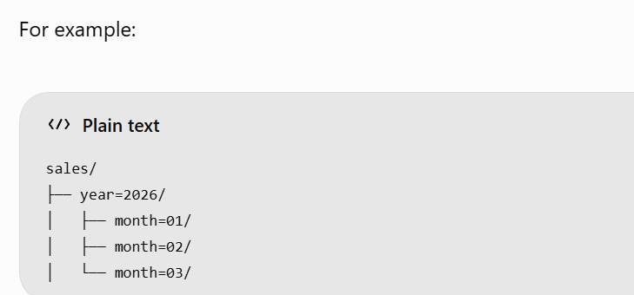
The twelve words that matter today
6. Partition
DATA ORGANIZATION
Definition: Partitioning divides a large table or dataset into smaller logical groups, often based on dates, regions, or categories.

Slide 15
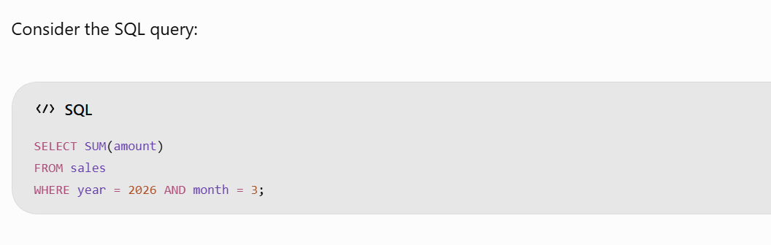
The twelve words that matter today
With suitable partitioning and query-engine support, the engine can skip unrelated partitions instead of scanning all the data. This is called partition pruning.

Slide 16
The twelve words that matter today
7. Idempotency
DATA RELIABILITY
Definition: Idempotency means repeating the same operation produces the same intended final state, without unwanted duplication or side effects.
Retail example: An ingestion job processes 1,000 orders and then fails. When restarted, it should not create 2,000 records.
A common SQL technique is:

Slide 17
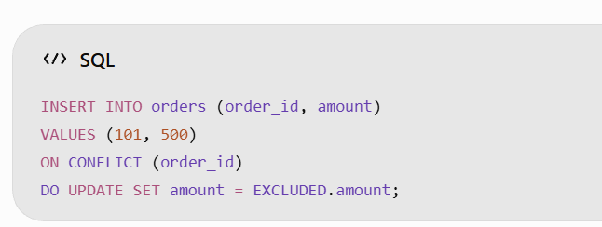
The twelve words that matter today
This PostgreSQL example assumes order_id has a unique constraint.
Why it matters: Production data pipelines must recover safely from crashes, retries, and network failures.

Slide 18
The twelve words that matter today
8. Backfill
HISTORICAL DATA RECOVERY
Definition: Backfill means processing or reprocessing historical data to fill gaps or apply corrected business logic.
Retail example:
A sales pipeline fails to process transactions for November 5, 2026. After the issue is fixed, the engineering team reprocesses that day's transactions.

Slide 19
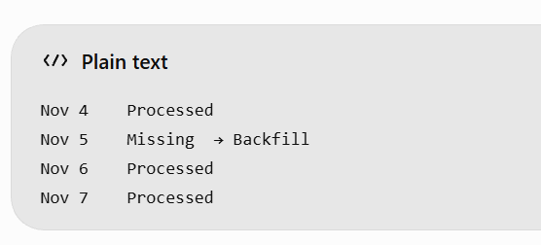
The twelve words that matter today
Backfill is particularly important when correcting incorrect calculations, restoring missing data, or introducing new columns to historical datasets.

Slide 20
The twelve words that matter today
9. SLA / SLO
DATA SERVICE RELIABILITY
SLA — Service Level Agreement: A formal commitment about the quality or availability of a service, potentially including contractual consequences.
SLO — Service Level Objective: A measurable target used to evaluate service reliability.
Metric | Example objective
Data freshness | Sales data within 15 minutes
Availability | 99.9% monthly
Pipeline success | 99.5%
Data completeness | At least 99.9% of expected records

Slide 21
The twelve words that matter today
9. SLA / SLO
A retail analytics team may establish an SLO that daily sales reports must be ready by 7:00 AM.
An SLO is a target; it becomes an SLA commitment only when formally agreed.

Slide 22
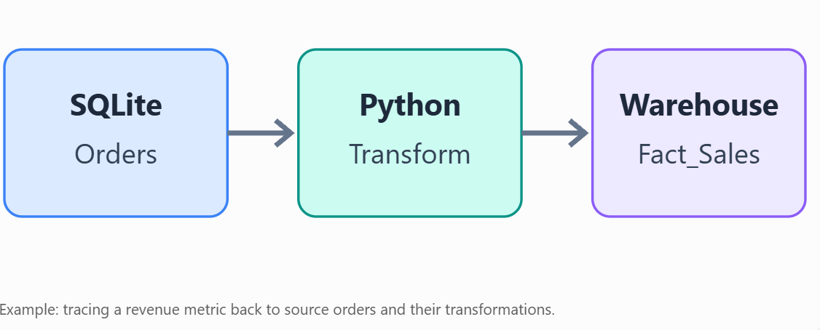
The twelve words that matter today
10. Lineage
DATA GOVERNANCE
Definition: Data lineage documents where data originates, how it is transformed, and which downstream systems depend on it.

Slide 23
The twelve words that matter today
10. Lineage
Lineage helps answer: "Why is the sales dashboard incorrect?" It shows the upstream datasets and transformations that should be investigated.

Slide 24
The twelve words that matter today
11. Skew
DISTRIBUTED PROCESSING
Definition: Data skew occurs when work or data is unevenly distributed across processing tasks or partitions.
Consider a distributed Spark job processing 1 million records:

Slide 25
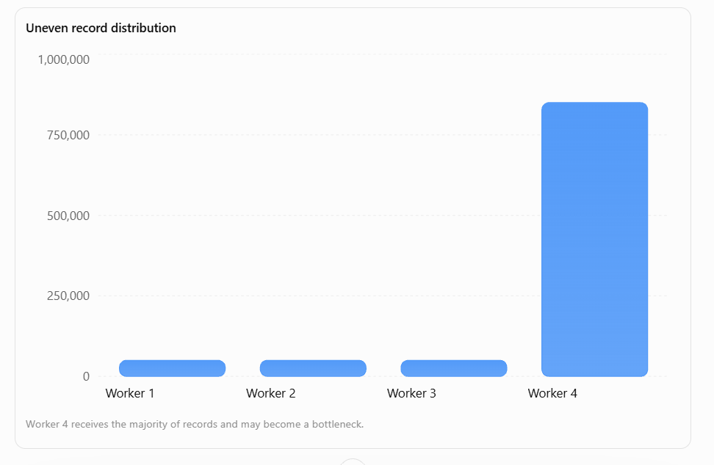
The twelve words that matter today

Slide 26
The twelve words that matter today
Worker 4 processes significantly more data than the others. Even if three workers finish quickly, the whole stage may be delayed.
Common solutions include repartitioning, key salting, skew-aware joins, and better partition keys.

Slide 27
The twelve words that matter today
12. Watermark
STREAM PROCESSING
Definition: A watermark is a streaming system's estimate of event-time progress. It helps determine when time windows can be finalized and how late-arriving events should be handled.
Retail example:
  An order is created at 10:05 AM, but due to network delay, the event arrives at the processing system at 10:12 AM.
  Event time: 10:05 AM
  Processing arrival time: 10:12 AM
  Event delay: 7 minutes
If a streaming job is configured to tolerate 10 minutes of lateness, the event may still be included in the appropriate window.
A watermark is not always a strict deadline after which every event is discarded. The handling of late events depends on the stream processor and configuration.

Slide 28
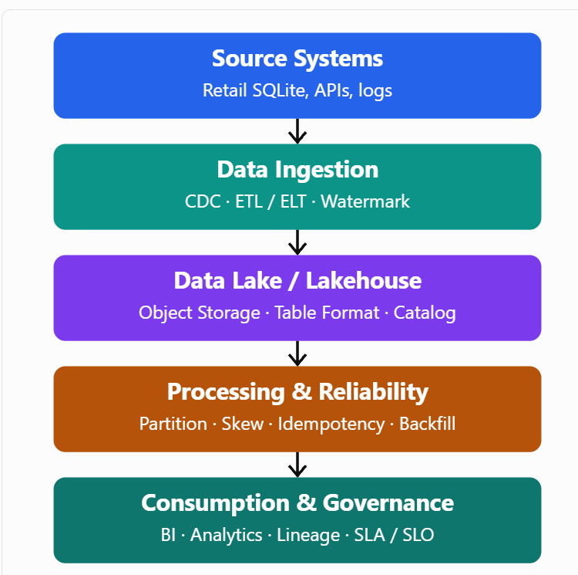
The twelve words that matter today

Slide 29
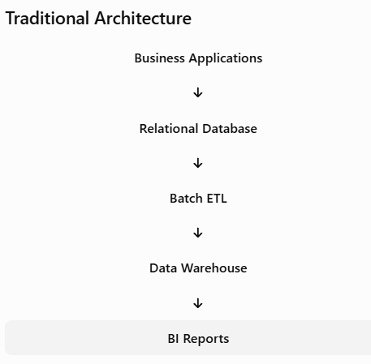
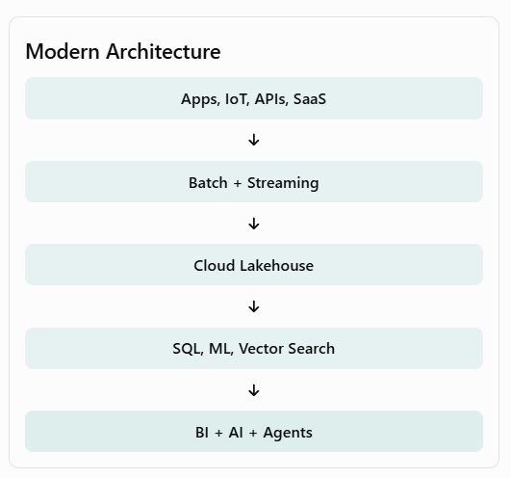
Traditional vs Modern Data Platforms

Slide 30
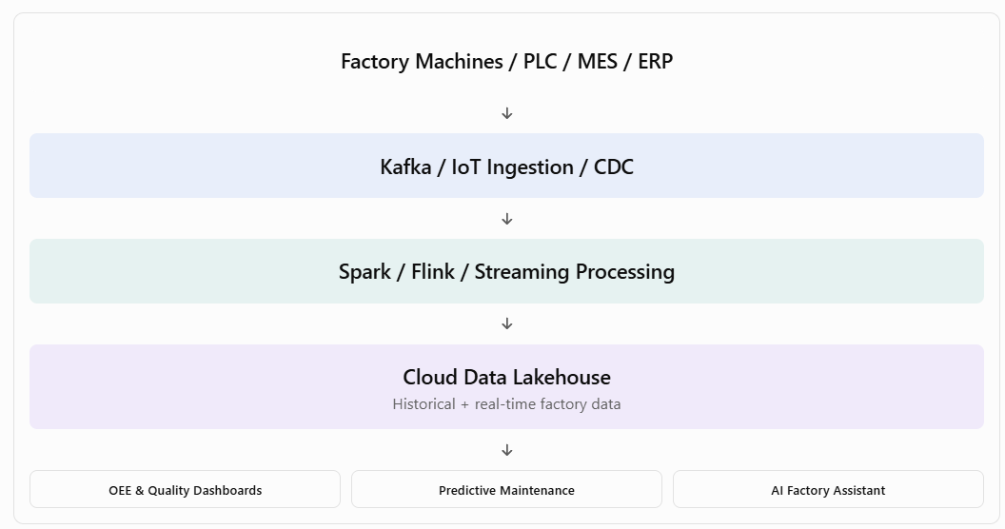
Practical Industry Example — Manufacturing

Slide 31
Key Trends in Modern Data Platforms
Data Lakehouse: Unifies data lake flexibility with warehouse-style management and SQL analytics.
Data Fabric: Uses metadata, integration and automation to manage data across distributed environments.
Data Mesh: Introduces domain-owned data products and federated governance.
Real-Time Analytics: Processes events as they arrive through Kafka, Flink and streaming engines.
DataOps: Automates pipeline testing, deployment, observability and quality checks.
AI-Native Data Platforms: Integrate feature engineering, embeddings, vector search, RAG and agent-based analytics.
Governance and Security: Apply access control, cataloging, data lineage, privacy and regulatory policies across the platform.

Slide 32
Evolution from Traditional ETL to a Modern Lakehouse
Store factory data in PostgreSQL.
Create a batch ETL pipeline using Python.
Store transformed data in a warehouse-style reporting model.
Ingest event streams using Kafka.
Process data using PySpark or Flink.
Save processed data as Parquet with a lakehouse table format.
Build an OEE and production performance dashboard.
Extend the solution with anomaly detection or a natural-language AI assistant.

Slide 33
OLTP vs OLAP
Aspect | OLTP | OLAP
Primary purpose | Process operational transactions | Analyze data and support decisions
Workload | Many short, concurrent reads/writes | Fewer but heavier scans, joins, aggregations
Data | Current, detailed operational records | Historical, integrated, often summarized
Typical operations | Insert, update, delete, point lookups | Large scans, group-by, aggregations, comparisons
Schema | Normalized (usually 3NF) for integrity | Often denormalized (star/snowflake) or wide tables
Storage | Typically row-oriented | Typically column-oriented
Latency goal | Milliseconds (predictable low latency) | Seconds (or more) is often acceptable
Concurrency | High number of short transactions | Fewer concurrent but resource-intensive queries
Data freshness | Real-time / near real-time | Often near-real-time via CDC or batch loads
Users | Applications, frontline staff, customers | Analysts, executives, BI tools, data scientists
Examples | PostgreSQL, MySQL, SQL Server, Oracle, Aurora | Snowflake, BigQuery, Redshift, ClickHouse, Databricks

Slide 34
Common Use Cases
OLTP examples:
  E-commerce order placement and payment processing
  Banking transfers and account updates
  Airline or hotel reservations
  Inventory adjustments
  User account management

Slide 35
Common Use Cases
OLAP examples:
  Sales trend analysis and dashboards
  Financial reporting and forecasting
  Customer segmentation and cohort analysis
  Inventory or supply-chain analytics
  Marketing performance measurement

Slide 36
Bronze, Silver & Gold Architecture
Bronze, Silver, and Gold Architecture (also called Medallion Architecture) is a data design pattern for organizing data in a lakehouse.
It progressively refines data quality and structure as it moves through layers: Bronze → Silver → Gold.
It was popularized by Databricks around 2019–2020 but is a general convention, not a proprietary feature.
It works with open table formats such as Delta Lake, Apache Iceberg, and Apache Hudi.

Slide 37
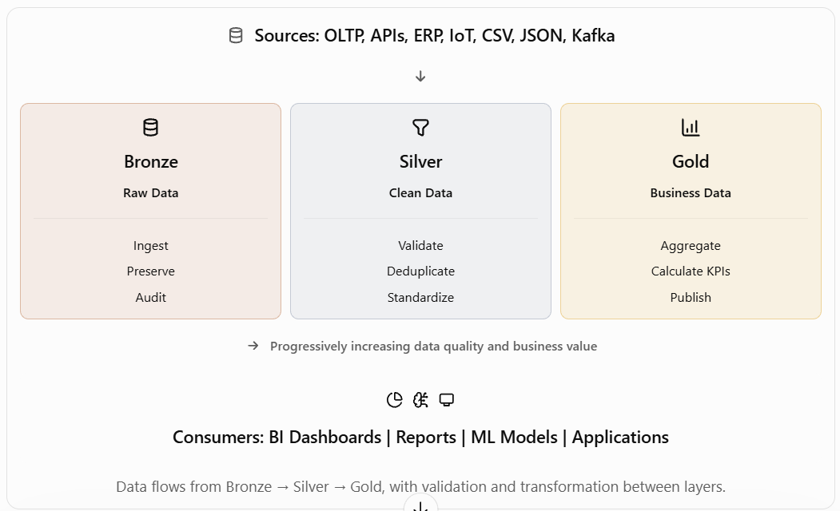
The Three Layers

Slide 38
Bronze vs Silver vs Gold Comparison
Feature | Bronze | Silver | Gold
Purpose | Raw ingestion | Data cleansing | Business analytics
Data quality | As received | Validated | Business-ready
Transformation | Minimal | Moderate to extensive | Business calculations
Data structure | Source-oriented | Standardized | Dimensional or aggregated
Duplicates | May exist | Removed or resolved | Controlled
Historical data | Retained for replay | Curated history | Business-specific history
Main users | Data engineers | Data engineers, analysts | BI users, management, data scientists
Example tables | raw_orders | clean_orders | daily_sales_summ

Slide 39
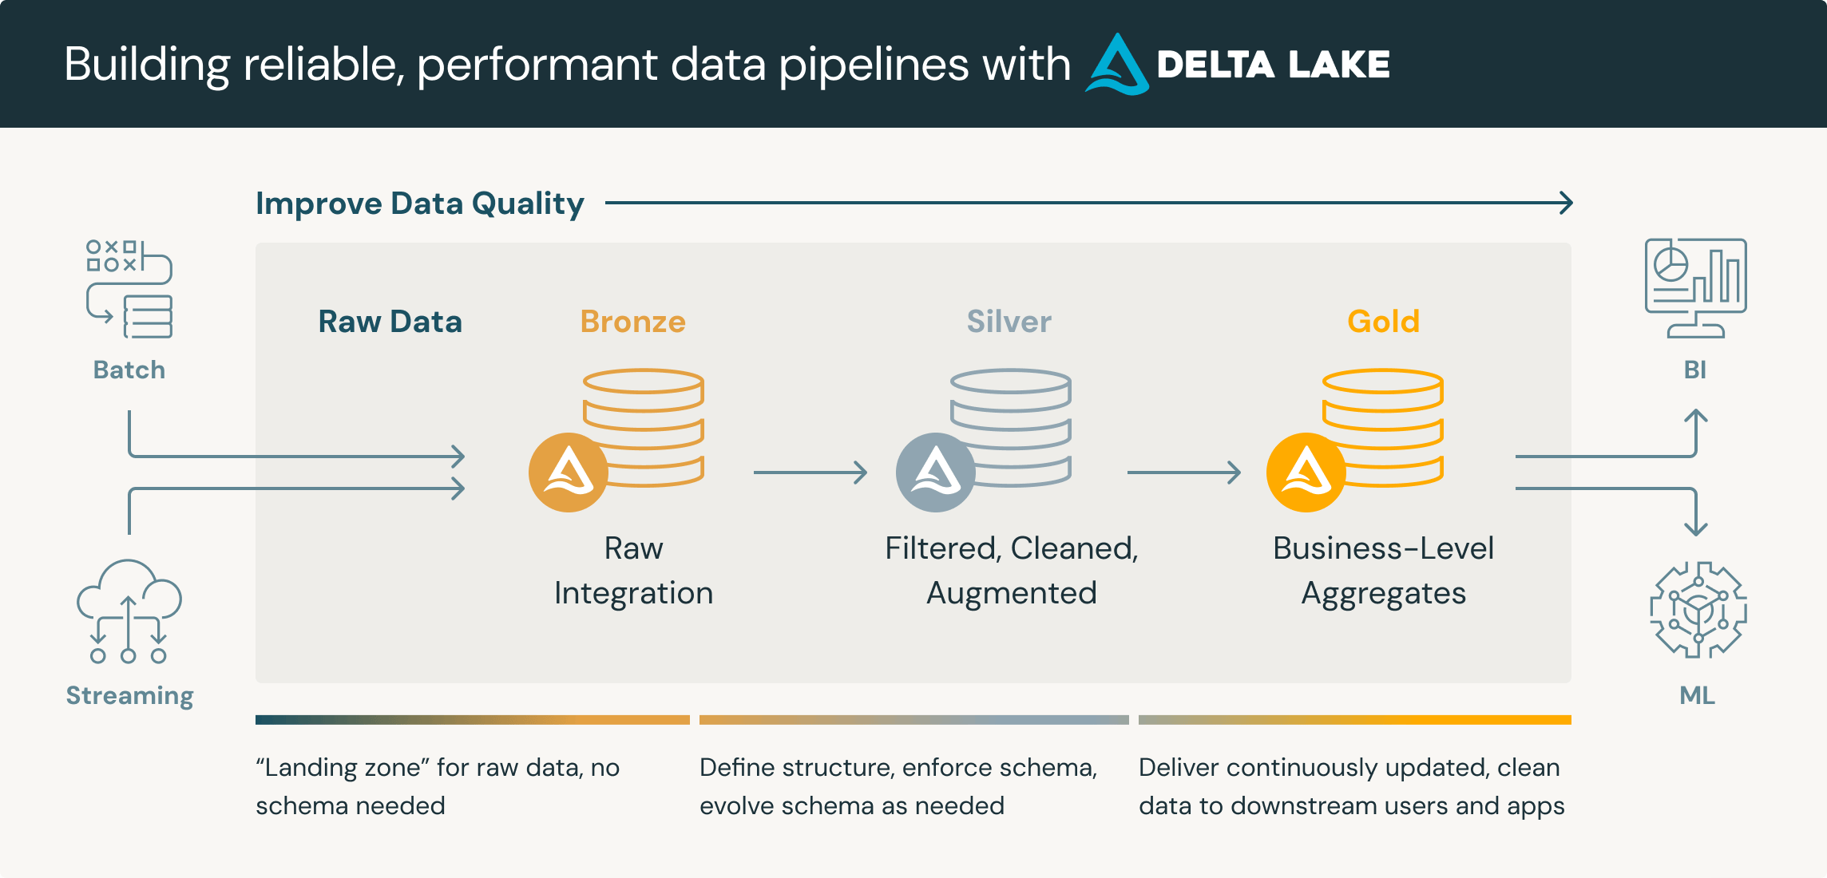
Medallion Architecture

Slide 40
Practical Example — Retail Sales
Raw sales data received
Order ID | Customer | Amount | Date
101 | Ravi | 1000 | 10-10-2026
102 | Priya | NULL | 10-10-2026
101 | Ravi | 1000 | 10-10-2026
Cleaned and validated sales data
Order ID | Customer | Amount | Date
101 | Ravi | 1000.00 | 2026-10-10
Duplicates are removed, formats standardized, and the record missing its amount is sent for correction or quarantine.

Slide 41
Practical Example — Retail Sales
Daily sales summary
Sales Date | Total Orders | Revenue (₹)
2026-10-10 | 1 | 1,000

Slide 42
Technologies Used
Component | AWS | Azure | GCP
Raw data storage | Amazon S3 | ADLS Gen2 | Cloud Storage
Data ingestion | Glue, DMS, Kinesis | Data Factory, Event Hubs | Dataflow, Pub/Sub
Data transformations | Glue, EMR | Databricks, Fabric | Dataproc, Dataflow, BigQuery
Gold analytics | Redshift, Athena | Fabric Warehouse, Synapse | BigQuery
Visualization | QuickSight | Power BI | Looker

Slide 43
Key Advantages
Data quality: Problems are addressed systematically before business consumption.
Reprocessing: Raw Bronze data enables rebuilding downstream datasets.
Auditability: Source records can be traced through transformations.
Reusability: Silver datasets can serve many Gold data products.
Performance: Gold tables can be optimized for reporting and analytical queries.
Governance: Clear boundaries support security, lineage, and ownership.

Slide 44
Structured, Semi-Structured & Unstructured Data
Data is broadly classified into three categories based on its organization, schema, and format.
Understanding these categories is essential for Data Engineering, Data Lakes, Data Warehouses, Big Data, and Medallion Architecture.

Slide 45
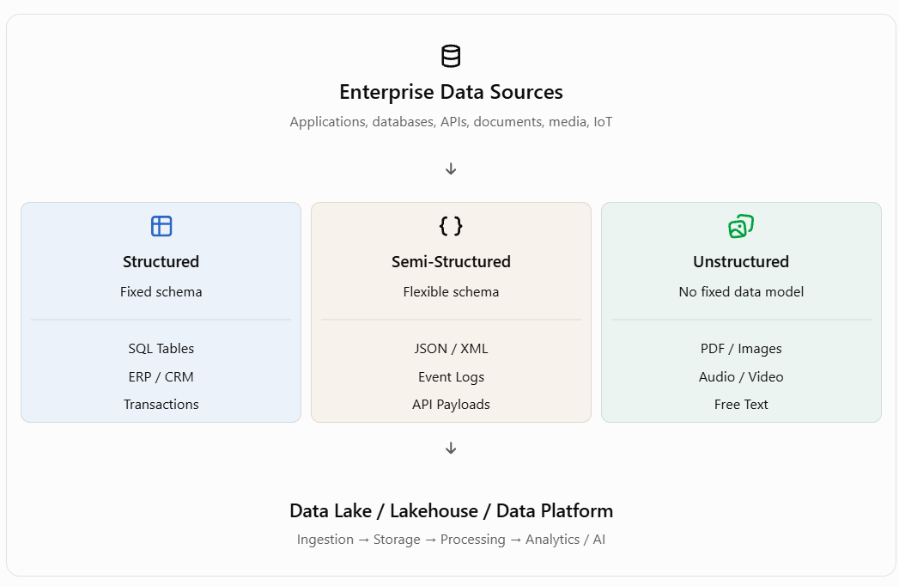
Structured, Semi-Structured & Unstructured Data

Slide 46
Structured, Semi-Structured & Unstructured Data
Feature | Structured | Semi-Structured | Unstructured
Schema | Fixed, predefined | Flexible, self-describing | No fixed schema
Organization | Rows and columns | Keys, tags, nested fields | Documents, text, media
Querying | SQL | SQL, JSONPath, XPath | Search, NLP, AI
Storage | Relational DB | NoSQL, object storage | Object storage, file systems
Examples | Customer, orders, invoices | JSON, XML, event logs | PDF, images, audio, video
Processing | Relatively straightforward | Requires parsing and flattening | Often requires content extraction
Data validation | Schema constraints | Schema validation | Content and metadata checks
Main applications | OLTP, BI | APIs, IoT, streaming | GenAI, RAG, computer vision

Slide 47
Practical Examples
A. Structured Data
Data stored in predefined rows and columns.
SELECT department, AVG(salary) AS avg_salary FROM employees GROUP BY department;
Common technologies: PostgreSQL, MySQL, Oracle, SQL Server, Snowflake, BigQuery.
Emp_ID | Name | Department | Salary
101 | Ravi | IT | 75000
102 | Priya | HR | 65000
103 | Kumar | Finance | 80000

Slide 48
Practical Examples
B. Semi-Structured Data
Data contains keys, attributes, or tags, but records do not necessarily have identical fields.
    {
    "employeeId": 101,
    "name": "Ravi",
    "department": "IT",
    "skills": ["Python", "SQL", "AWS"],
    "address": {
    "city": "Chennai",
    "pincode": 600001
    }
    }
Unlike a relational table, new attributes and nested objects can be added without changing every existing record.
Common technologies: MongoDB, Kafka, Elasticsearch, PostgreSQL JSONB, Spark.

Slide 49

Practical Examples
C. Unstructured Data
Data whose meaningful content is not organized according to a predefined tabular schema.
Unstructured data can contain useful information that must be extracted using techniques such as OCR, speech recognition, Natural Language Processing (NLP), and computer vision.

Slide 50
Real-World Use Cases
Industry | Structured | Semi-Structured | Unstructured
Banking | Transactions, accounts | Payment API JSON | KYC documents
Healthcare | Patient records | HL7 FHIR JSON | Medical images
Retail | Sales, inventory | Customer clickstream | Product photographs
Manufacturing | Production metrics | IoT sensor events | CCTV, inspection images
Insurance | Policies, claims | Claim submission JSON | Claim PDFs and photographs

Slide 51
Technologies for Processing Different Data Types
Technology | Structured | Semi-Structured | Unstructured
Apache Spark | Yes | Yes | Yes, with suitable libraries
PostgreSQL | Yes | JSON / JSONB | Binary storage / metadata
MongoDB | Yes, as documents | Yes | Metadata / file references
Data Lake | Yes | Yes | Yes
Databricks | Yes | Yes | Yes
Snowflake | Yes | Yes | Yes, with supported services
GenAI / LLM | Via structured context | Via parsed content | Via extraction or multimodal models

Slide 52
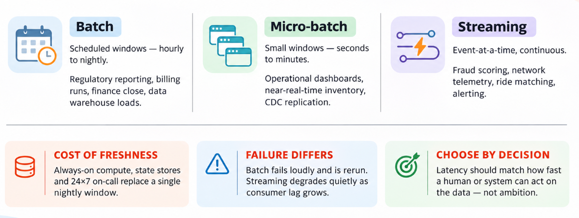
Batch MicroBatch and Streaming

Slide 53
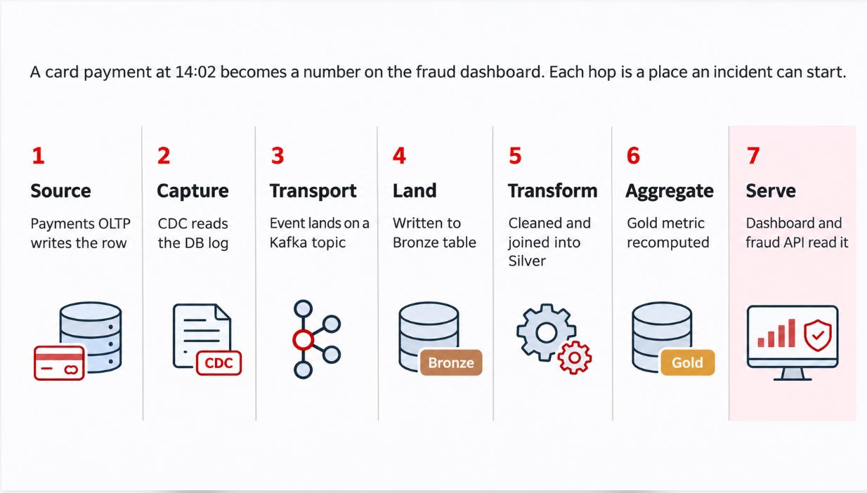
One transaction, seven hops

Slide 54
What You Own at Each Hop – Data Platform Monitoring
Hop | Signal You Watch | Typical Incident | First Action
Source / CDC | Replication slot lag, connector state | Connector stopped after source failover | Check connector status; restart from last offset
Transport | Consumer-group lag, broker disk | Lag growing; retention about to expire | Scale consumers; confirm retention headroom
Bronze Land | Table freshness, rows loaded, reject count | Schema drift sends rows to quarantine | Inspect rejects; notify source owner
Transform | Job duration, task failures, shuffle spill | Job overruns SLA due to skew | Open the job UI; find the straggler stage
Orchestration | DAG run state, retries, queue time | Tasks stuck queued — no free workers | Check scheduler and worker pool capacity
Serve | Query latency, warehouse queue, cache hit | Dashboard timeouts at month-end peak | Check concurrency limits and scaling policy

Slide 55
Modern Data Platform Reference Architecture
Modern Data Platform Architecture is a structured approach to building reliable, scalable systems that move data from operational sources into governed analytical layers for reporting, analytics, and decision-making.
It emphasizes separation of concerns, data quality, security, observability, and recoverability—especially important when businesses grow (e.g., expanding from 20 to 120 stores) and outgrow direct queries against production systems or manual spreadsheets.

Slide 56
Modern Data Platform Reference Architecture
The design follows a classic medallion (Bronze–Silver–Gold) pattern with strong operational/analytical separation, orchestration, governance, and monitoring.

Slide 57
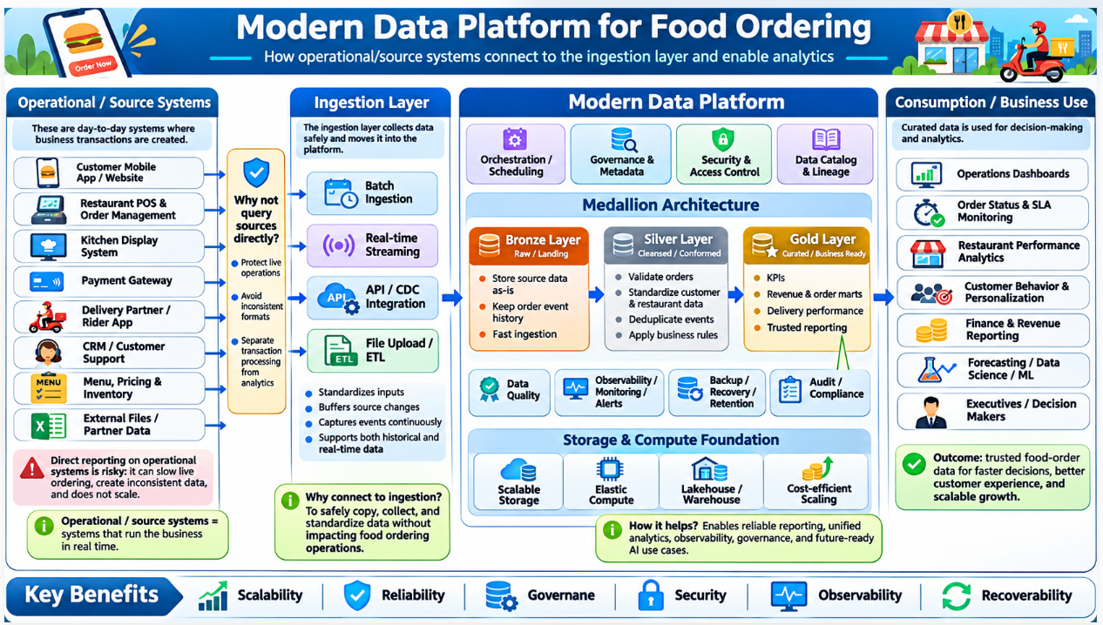
Modern Data Platform Architecture

Slide 58
Core Principles
Operational vs. Analytical Separation: Dashboards and reports must not repeatedly query live POS, inventory, or other transactional systems.
Operational systems stay focused on transactions; the analytics platform consumes controlled, governed outputs.
Source-aligned retention: Preserve raw/source data with original timestamps, ingestion timestamps, batch/event IDs, and the ability to replay.

Slide 59
Core Principles
Layered refinement: Raw → cleaned/conformed → trusted business aggregates.
Reliability by design: Retry, checkpointing/watermarks, deduplication, quarantine, controlled replay, and clear ownership.
Governance & security: Catalog/ownership, least privilege, sensitive-field classification, retention, audit, and controlled consumer access.

Slide 60
Core Principles
Observability: Monitor job status, freshness, volume/schema changes, quality results, and SLA risk. Every alert needs an owner and runbook.
No single-vendor lock-in: Equivalent services are acceptable if fit, limits, controls, and validation are explained. Cloud is not required for the conceptual design.

Slide 61
Typical End-to-End Stages
Source Systems
POS/e-commerce transactions, inventory events, product/store master data, and other files or event streams. Identify what each source can support (CDC, events, batch/files).
Ingestion
  CDC/incremental for changing transactional data (when supported).
  Event/stream ingestion for timely inventory or similar high-velocity events.
  Scheduled batch or file ingestion for reference/master data.
  Land data in controlled storage while preserving provenance and enabling replay.

Slide 62
Typical End-to-End Stages
Landing / Bronze Layer
Raw or source-aligned data. Minimal transformation. Focus on completeness, replayability, and auditability. Keep source timestamps and identifiers.
Silver Layer
Typed, deduplicated, conformed, and quality-checked data. Apply validation rules, handle duplicates, standardize keys and formats, and prepare for business use. Quarantine bad records where appropriate.

Slide 63
Typical End-to-End Stages
Gold Layer
Trusted business aggregates and consumer-ready datasets (sales/margin metrics, inventory visibility views, etc.). Only validated Gold outputs are published to BI/SQL consumers. Support last-known-good with visible staleness indicators when needed.
Orchestration
One primary orchestrator per workflow. Define dependencies, retry policy, timeouts, backfill/replay approach, and clear run ownership.

Slide 64
Typical End-to-End Stages
Serving & Consumption
BI tools, SQL endpoints, or APIs consume only governed Gold data. Never point production reports at operational systems or uncontrolled spreadsheets.
Governance, Security & Catalog
Data ownership, classification (especially sensitive customer fields), least-privilege access, masking/tokenization where needed, retention policies, and audit trails. Collect only fields required for the business purpose.

Slide 65
Typical End-to-End Stages
Monitoring & Alerting
Track pipeline health, freshness/SLA risk, data quality (nulls, duplicates, invalid values, reconciliation failures), schema/volume anomalies, and access changes. Minimum useful alerts typically include:
  Pipeline failure (after retries)
  Freshness/SLA breach risk
  Data quality failure (quarantine + stop publication until fixed)
Recovery & Operations
Documented runbooks for failure, reconciliation, safe rerun, and incident evidence. Ownership of recovery must be explicit.

Slide 66
Production-Readiness Checklist Highlights
All major stages (source → landing → Bronze → Silver → Gold → serving) are present.
Operational/analytical separation is explicit.
Quality, deduplication, retry/replay, lineage/ownership, and recovery are addressed.
At least three material architecture gaps identified with business impact, severity, remediation, validation, and owner.
At least three actionable alerts with measurable trigger, severity, responder, immediate action, recovery path, and closure evidence.
Assumptions and unsupported source/platform capabilities are called out.
Only validated Gold is published; stale data is visible if used.

Slide 67
Common Pitfalls to Avoid
Reporting directly against operational systems or relying on manual spreadsheets.
Missing quality/deduplication controls.
Undefined freshness SLAs or ownership.
No safe retry/replay capability.
Unspecified sensitive-data handling.
Alerts without clear responders or runbooks.
Promising latency the source or platform cannot deliver.
Silent use of stale “last-known-good” data.

Slide 68
Typical End-to-End Stages
Requirement | Preferred Pattern | Key Validation / Caveat
Daily sales & margin | CDC/incremental (or scheduled incremental batch) | Reconcile row counts & totals; confirm business definitions of net sales, returns, discounts, margin
Inventory freshness / stockout | Event/stream if source supports it; otherwise batch | Check event timestamps, latest state, duplicates, freshness metric. Do not promise sub-2-minute freshness without source + platform support
Product/store reference | Scheduled batch/file | Validate keys, required fields, values; handle unmatched facts; confirm authoritative master-data owner
Sensitive customer fields | Classification + least privilege + restricted raw access + masking/tokenization | Verify role-based access, audit evidence; no secrets in logs
Recoverable ingestion | Retry + checkpoint/watermark + dedup + quarantine + controlled replay | Simulate failure; prove reconciliation and safe rerun; document ownership and source replay limits

Slide 69
Architecture Layers and Responsibilities
Layer | Primary responsibility | Technologies / patterns
Data Sources | Produce enterprise and external data | PostgreSQL, Oracle, SAP, Salesforce, APIs, IoT
Ingestion | Capture data continuously or periodically | Kafka, Debezium, Airbyte, cloud pipelines
Storage | Durable and scalable data persistence | S3, ADLS, GCS
Bronze | Preserve raw data and ingestion metadata | Parquet, JSON, Delta, Iceberg
Silver | Cleanse, validate, standardize, join, deduplicate | Spark, SQL, dbt, Flink
Gold | Publish business-aligned data products | Star schemas, KPIs, aggregates
Serving | Enable efficient, governed access | Trino, Athena, BigQuery, SQL warehouses
Consumption | BI, AI/ML, applications, GenAI | Power BI, Tableau, SageMaker, Vertex AI
Governance | Security, classification, access and lineage | Data catalogs, policy engines, IAM
Operations | Scheduling, monitoring, testing and deployment | Airflow, Dagster, CI/CD, OpenTelemetry

Slide 70
Bronze, Silver and Gold – Example
 | Bronze | Silver | Gold
Data | Raw transaction events | Validated transactions joined to customers | Daily transaction summaries
Transformation | Minimal, preserve source | Type validation, deduplication, cleansing | Aggregation and business calculations
Granularity | Original source records | Trusted transaction-level records | Daily/customer/product summaries
Consumers | Data engineers | Data engineers, analysts | Finance, management, BI, AI
Example table | bronze.transactions_raw | silver.transactions | gold.daily_revenue

Slide 71
Technology Mapping – AWS vs Azure vs GCP
Capability | AWS | Azure / Microsoft Fabric | GCP
Batch ingestion | AWS Glue, DMS | Fabric Data Factory, Azure Data Factory | Dataflow, Datastream
Streaming | Kinesis, MSK | Event Hubs, Eventstream | Pub/Sub
Data lake storage | Amazon S3 | OneLake, ADLS Gen2 | Cloud Storage
Lakehouse processing | Glue, EMR, Spark | Fabric Spark, Azure Databricks | Managed Spark, Dataflow
Lakehouse tables | Apache Iceberg, Delta Lake | Delta Lake | Apache Iceberg
SQL analytics | Athena, Redshift | Fabric Warehouse, SQL endpoint | BigQuery
Governance | Glue Catalog, Lake Formation | Microsoft Purview, Fabric governance | Knowledge Catalog (formerly Dataplex Universal Catalog)
Orchestration | Step Functions, MWAA | Fabric Data Pipelines | Managed Airflow, Workflows
BI | Amazon Quick | Power BI | Looker
AI / ML | SageMaker | Azure ML, Azure AI services | Vertex AI

Slide 72
Data Ingestion, Processing & Serving Layers
In a Modern Data Platform, the Data Ingestion, Processing, and Serving layers work together to move raw data from enterprise systems into reliable, business-ready information for analytics, reporting, and AI.

Slide 73
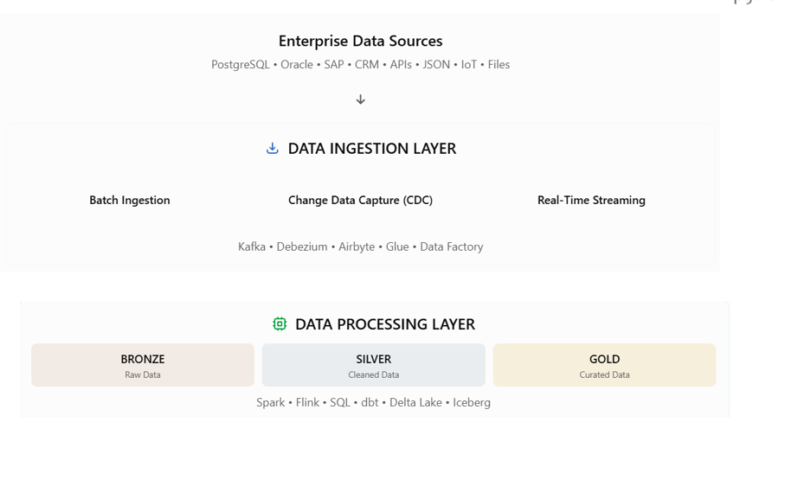
Data Ingestion, Processing & Serving Layers

Slide 74
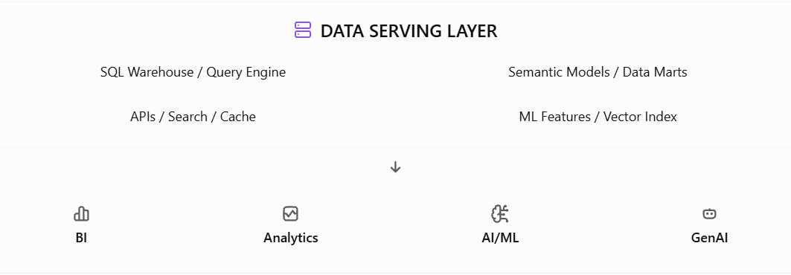
Data Ingestion, Processing & Serving Layers

Slide 75
Data Ingestion Layer
Ingestion type | Description | Example technologies
Batch ingestion | Loads data at scheduled intervals | AWS Glue, Azure Data Factory, Airbyte
Real-time streaming | Continuously receives events | Apache Kafka, Amazon Kinesis, Google Pub/Sub
Change Data Capture (CDC) | Captures database inserts, updates, and deletes | Debezium, AWS DMS, Datastream
API ingestion | Retrieves data through REST or GraphQL interfaces | Python, Airbyte, NiFi
File ingestion | Ingests CSV, JSON, XML, Parquet, Excel | Cloud storage events, Data Factory
IoT ingestion | Collects sensor and device events | MQTT, Kafka, IoT platforms

Slide 76
Data Processing Layer
Type | How it works | Common technologies
Batch processing | Processes datasets periodically | Apache Spark, SQL, dbt
Stream processing | Processes events as they arrive | Apache Flink, Spark Structured Streaming
Micro-batch processing | Processes small groups of records frequently | Spark Structured Streaming
ETL | Transforms data before loading into the target | Spark, Glue, Data Factory
ELT | Loads data first, then transforms within the platform | dbt, SQL, BigQuery, Snowflak

Slide 77
Data Serving Layer
Serving mechanism | Purpose | Example
SQL query engine | Interactive analytical queries | Trino, Athena, BigQuery
Data warehouse | High-performance analytical access | Snowflake, Redshift, Fabric Warehouse
Semantic layer | Consistent business metrics and definitions | Power BI semantic models, LookML
REST / GraphQL APIs | Expose selected data to applications | FastAPI, GraphQL
Search / vector index | Retrieve documents and semantic context | OpenSearch, pgvector
Feature serving | Supply ML model input features | Feast, managed feature stores
Cache | Reduce latency for frequent queries | Redis

Slide 78
End-to-End Banking Example
Stage | Example implementation | Output
Source | PostgreSQL banking database | Transaction records
Ingestion | Debezium + Kafka | CDC events
Bronze | S3 / ADLS / GCS | Raw transaction history
Silver | Spark transformations | Validated, deduplicated transactions
Gold | SQL aggregations | Daily totals, monthly summaries, KPIs
Serving | SQL warehouse, APIs | Queryable business data
Consumption | Power BI, fraud analytics | Reports, predictions, alerts

Slide 79
Comparison of the Three Layers
Aspect | Ingestion | Processing | Serving
Primary question | How do we acquire data? | How do we make data trustworthy and useful? | How do users and applications access it?
Input | Enterprise source systems | Raw / intermediate datasets | Curated or trusted datasets
Main operations | Extract, capture, stream, load | Clean, transform, join, aggregate | Query, expose, optimize access
Typical latency | Seconds to hours | Milliseconds to hours, by workload | Milliseconds to seconds or longer for complex analytics
Primary users | Data engineers | Data engineers, analytics engineers | Analysts, BI users, applications, AI systems
Main concern | Reliability and completeness | Quality and correctness | Performance, security, availability

Slide 80
Important Design Considerations
Ingestion: Incremental loading, CDC correctness, late-arriving records, idempotency, retries, and schema drift.
Processing: Data quality rules, incremental transformation, data lineage, testing, partitioning, and stream state management.
Serving: Query optimization, semantic consistency, caching, authorization, concurrency, and workload-specific SLAs.
Across all layers: Encryption, IAM, PII protection, cataloging, observability, orchestration, CI/CD, cost optimization, and disaster recovery.

Slide 81
Role of Orchestration Platforms (Airflow, dbt, ADF)
Orchestration is the process of coordinating, scheduling, executing, monitoring, and managing data pipelines automatically.
In a modern data platform, orchestration ensures that data moves through different processing stages in the correct sequence, at the correct time, with proper error handling and recovery.

Slide 82
Why do we need orchestration?
Consider an online food-ordering application such as Swiggy or Zomato.
Data is generated from multiple sources:
  Customer orders
  Restaurant details
  Payments
  Delivery tracking
The data must be ingested, validated, transformed, and made available for analytics.
Without orchestration, someone may need to manually execute each process and check whether it succeeded.
With orchestration, the entire workflow runs automatically.

Slide 83
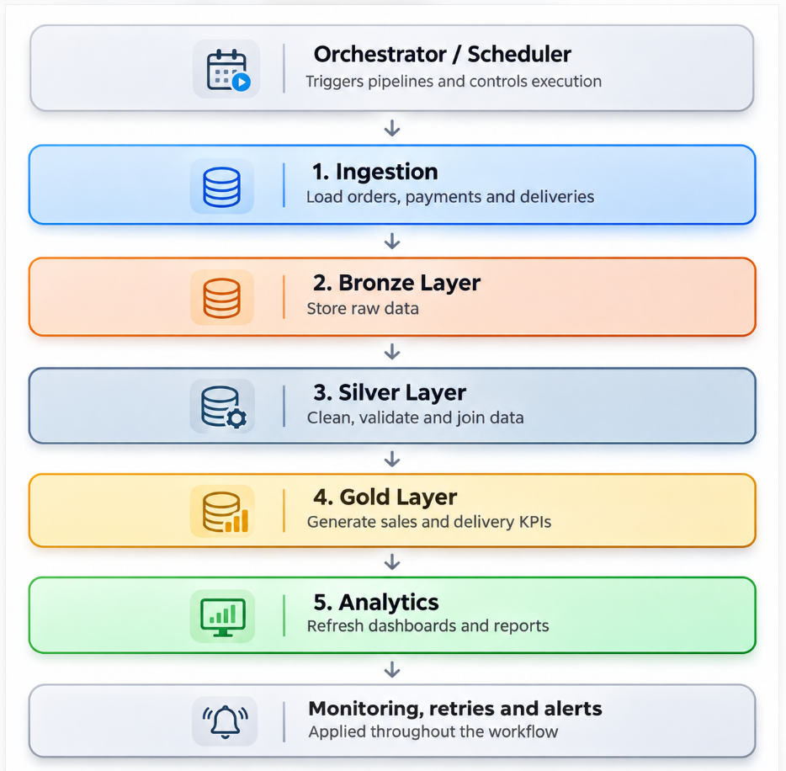
How orchestration works

Slide 84
Key responsibilities of orchestration
Responsibility | Purpose
Scheduling | Execute pipelines hourly, daily, or on an event
Dependency management | Run Silver processing only after Bronze completes successfully
Execution control | Run independent tasks in parallel
Error handling | Detect and handle failed tasks
Retry policies | Automatically retry temporary failures
Monitoring | Track pipeline status, duration, and failures
Notifications | Alert operations teams when jobs fail
Recovery | Restart failed tasks without unnecessarily repeating successful tasks

Slide 85
What’s Apache Airflow
Apache Airflow is an open-source workflow orchestration platform used to schedule, execute, monitor, and manage data pipelines automatically.
In simple terms, Apache Airflow acts as a coordinator that controls when different data processing tasks should run, in what order, and what should happen if a task fails.
For example, in a modern data platform, Airflow can coordinate data extraction, transformation, loading into Databricks, and report generation.

Slide 86
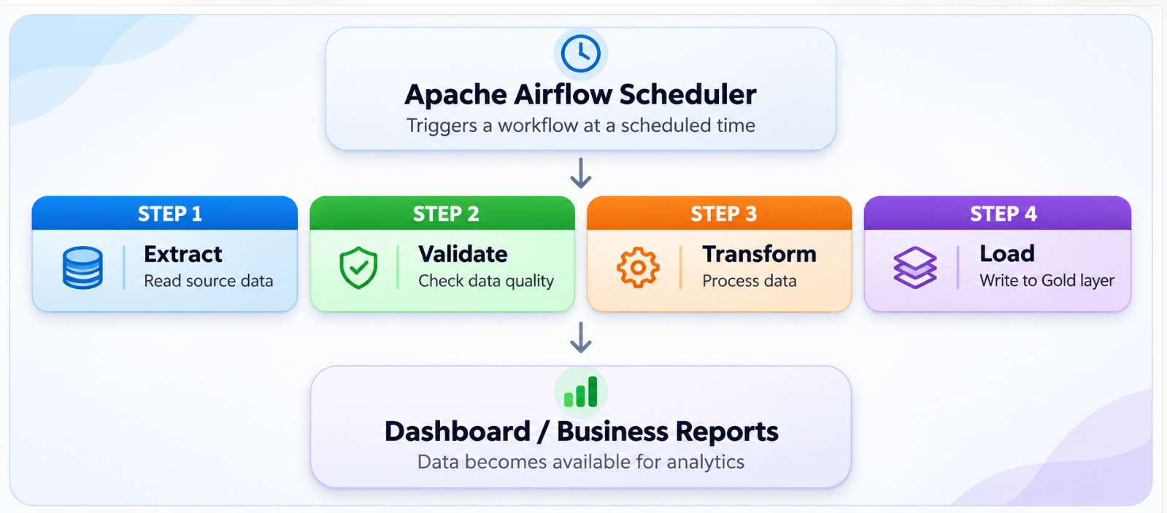
What’s Apache Airflow

Slide 87
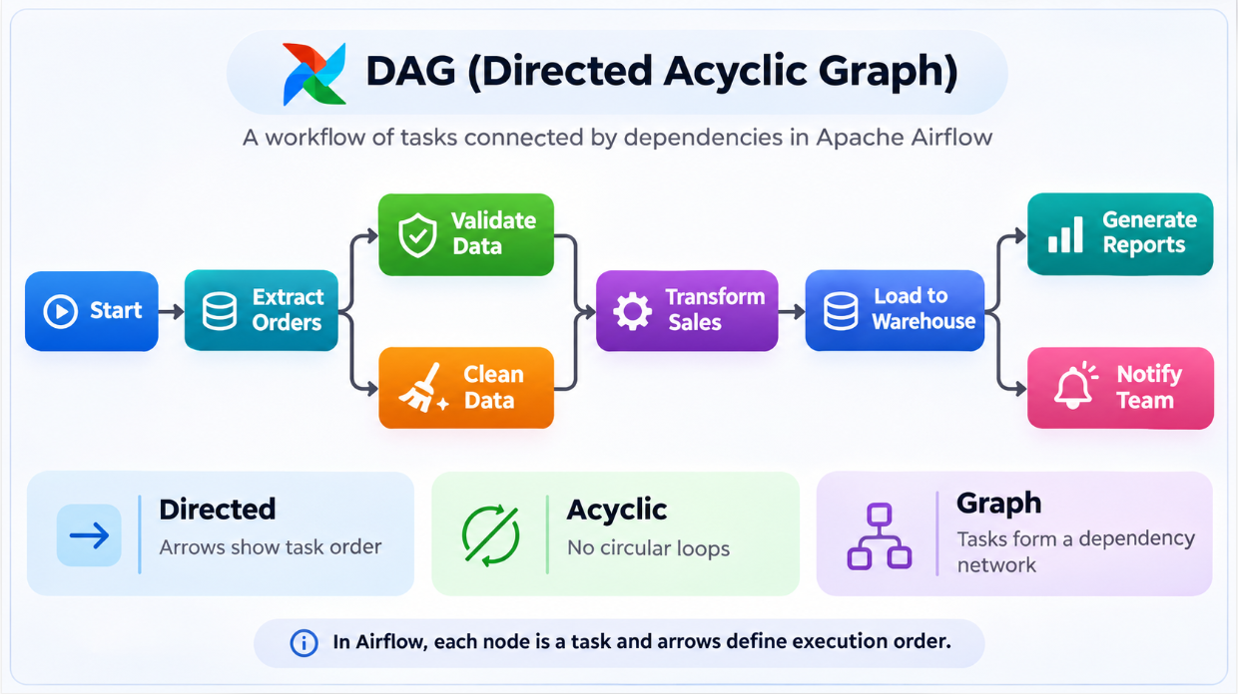
What is a DAG?
DAG stands for Directed Acyclic Graph.
It defines the sequence and dependencies of tasks without circular execution paths.

Slide 88
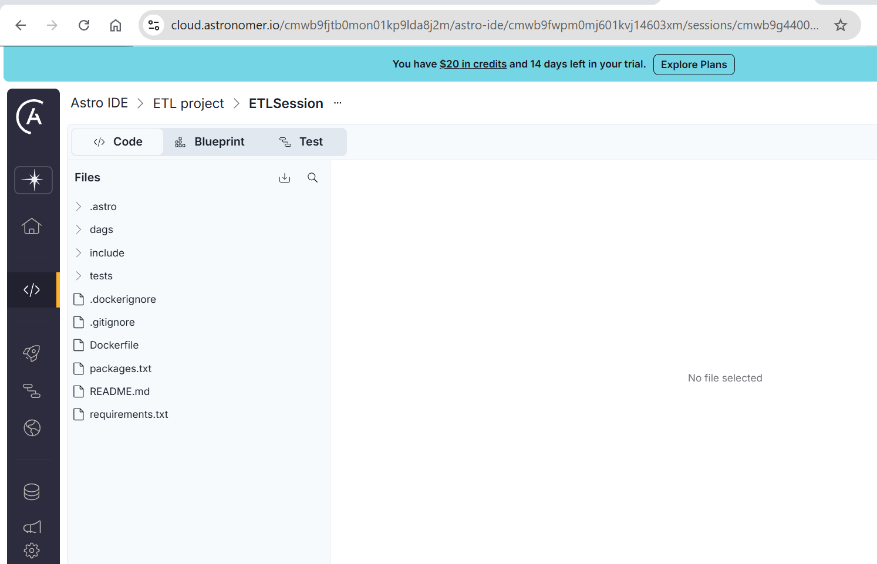
Apache Airflow using Astronomer
https://www.astronomer.io/lp/signup

Slide 89
Important Apache Airflow components
Component | Purpose
DAG | Defines the workflow and its task dependencies
Task | One unit of work, such as extracting data
Scheduler | Determines when workflows and tasks should run
Executor | Determines how tasks are executed
Worker | Executes assigned tasks
DAG Processor | Reads and processes workflow definitions
Metadata Database | Stores workflow runs, task states and configuration
Web UI / API Server | Allows monitoring, triggering and troubleshooting

Slide 90
Role of Orchestration Platforms (Airflow, dbt, ADF)
Feature | Apache Airflow | dbt | Azure Data Factory
Primary role | General-purpose workflow orchestration | SQL transformation and model dependency management | Managed data integration and orchestration
Development approach | Python DAGs | SQL, YAML, Jinja | Visual pipelines, JSON
Scheduling | Native scheduling | Via dbt Platform jobs or external orchestrator | Native triggers
Dependencies | Task dependencies | Model dependencies | Activity dependencies
Data movement | Invokes external tools | Not its primary function | Built-in Copy activity
Transformation | Orchestrates Spark, SQL, dbt, etc. | Core strength: SQL-based ELT | Data Flows or invokes other engines
Monitoring | DAG/task logs and UI | Model/job status and test results | Pipeline monitoring
Deployment | Self-managed or managed offerings | dbt Core and hosted dbt Platform | Azure-managed service
Best suited for | Complex, multi-system workflows | Warehouse/lakehouse SQL transformations | Azure-centric data pipeline

Slide 91
Introduction to DataOps and Observability
DataOps (Data Operations) is a set of practices that combines Agile methodologies, DevOps principles, automation, collaboration, and continuous data-quality management to deliver reliable and high-quality data faster.
DataOps applies software engineering practices to the entire data lifecycle, from ingestion and transformation to analytics and AI consumption.

Slide 92
Introduction to DataOps and Observability
Automate data pipelines and deployments.
Improve data quality and consistency.
Reduce manual intervention and operational failures.
Enable CI/CD for data engineering workflows.
Improve collaboration among data engineers, analysts, and operations teams.
Detect issues early and reduce recovery time.
Deliver trustworthy data products continuously.

Slide 93
DataOps Practises
Practice | Description | Example tools
Version Control | Manage SQL, Python, pipelines, configuration as code | Git, GitHub
CI/CD | Automate testing, validation, and deployment | GitHub Actions, Azure DevOps, Jenkins
Orchestration | Schedule and coordinate workflows | Airflow, ADF, Dagster
Data Testing | Validate data quality and business rules | dbt tests, Great Expectations, Soda
Infrastructure as Code | Provision environments reproducibly | Terraform, Bicep
Monitoring | Track runtime performance, errors, and delays | Prometheus, Grafana
Data Lineage | Track data sources, transformations, and dependencies | OpenLineage, Marquez
Incident Management | Alert teams and coordinate recovery | PagerDuty, ServiceNow

Slide 94
What is Data Observability?
Data Observability is the ability to understand the health, reliability, quality, and movement of data throughout a platform by examining metadata, measurements, lineage, and operational signals.
It helps answer questions such as:
  Did today's customer data arrive?
  Are any transactions missing or duplicated?
  Why did the pipeline fail?
  Did a source schema change?
  Which Power BI reports are affected?
  Is data fresh enough to support business decisions?

Slide 95
DataOps vs Data Observability
Aspect | DataOps | Data Observability
Primary objective | Build and deliver reliable data products | Detect and explain data problems
Focus | Development and operations lifecycle | Data and pipeline health
Main practices | CI/CD, testing, automation, orchestration | Monitoring, anomaly detection, lineage, alerting
Key question | How do we deliver data reliably? | Can we trust the data being delivered?
Example | Automatically deploy a new dbt transformation | Detect unexpected null values after deployment
Result | Faster, repeatable delivery | Higher data reliability and faster troubleshooting

Slide 96
Operational Observability vs Data Observability
Operational Observability | Data Observability
CPU and memory utilization | Missing or invalid records
Job execution duration | Data freshness
Pipeline failures | Unexpected volume changes
Application logs | Data quality failures
Distributed traces | Data lineage
Infrastructure availability | Business metric anomalies

Slide 97
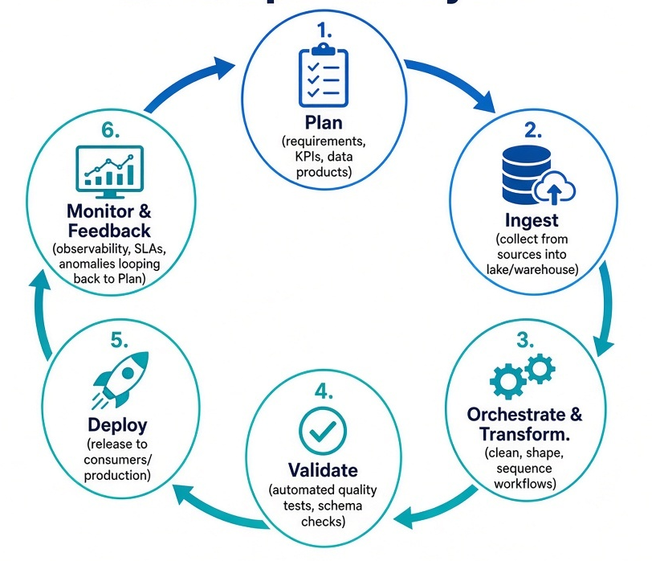
Dataops Lifecycle

Slide 98
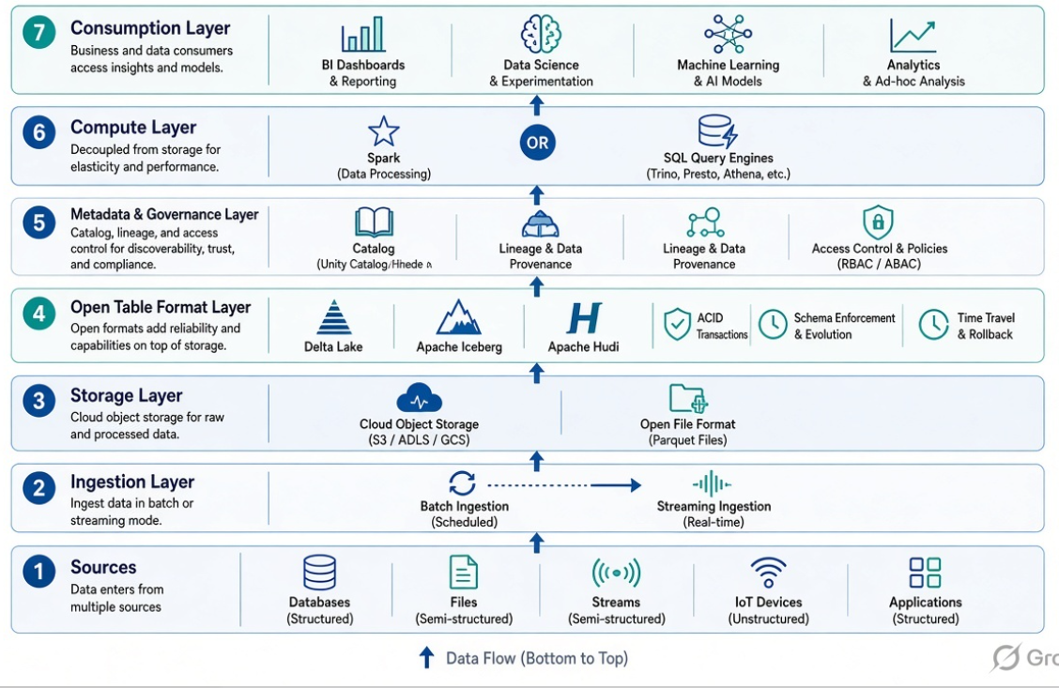
Lakehouse Architecture

Slide 99
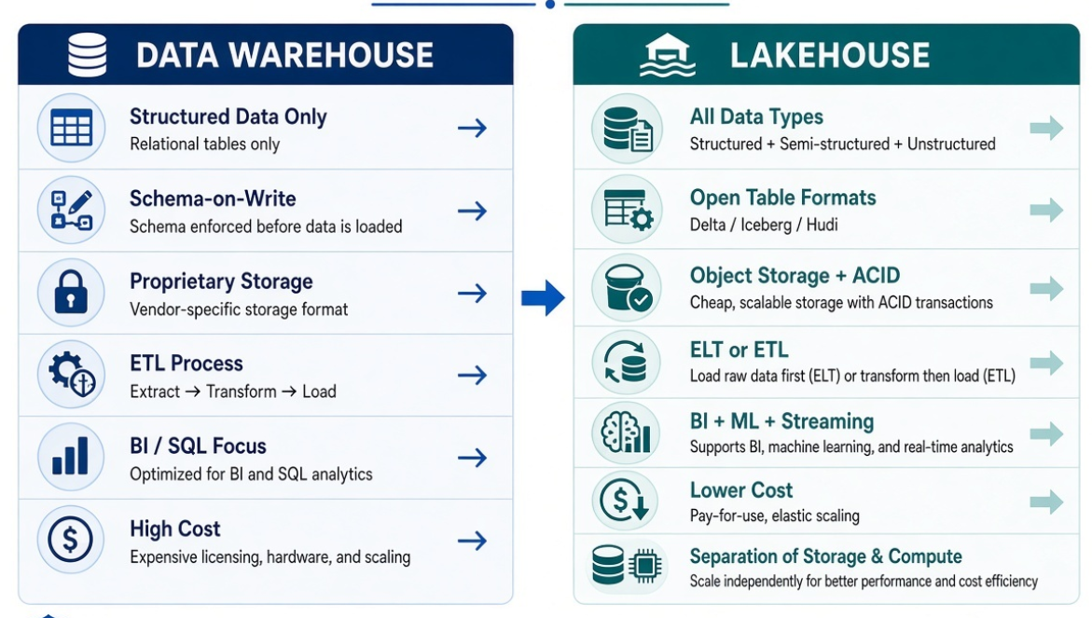
Data Warehouse vs Lakehouse

Slide 100
Databricks Workspace Components
A Databricks Workspace is the collaborative environment where data engineers, analysts, and data scientists access notebooks, compute, data, jobs, and AI assets.
It sits under an Account and is typically governed by Unity Catalog.

Slide 101
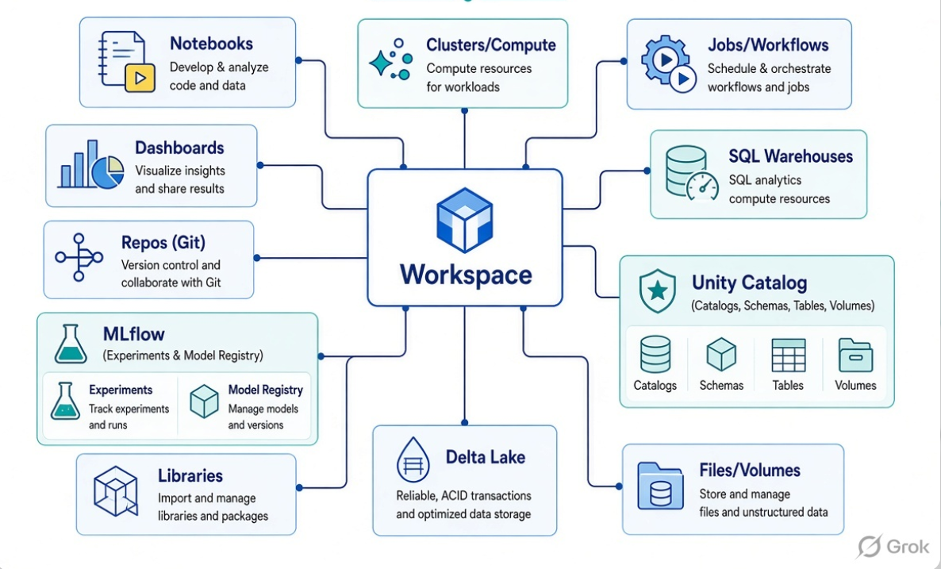
Databricks Workspace Components

Slide 102
Core Components
Component | Purpose | Key Notes
Workspace | Central collaborative hub (folders, UI, permissions) | Organizes all assets; supports collaboration
Notebooks | Interactive code + visualization + documentation | Python, SQL, Scala, R; versioned via Repos
Compute (Clusters) | Execution engines | All-purpose (interactive) and Job clusters; Spark + Photon
Jobs / Workflows | Scheduled or triggered pipelines | Orchestrate notebooks, Python, SQL, etc.
Repos | Git integration | Version control, CI/CD, collaboration
SQL Warehouses | Serverless or classic SQL compute for analytics | Used with SQL Editor and Dashboards

Slide 103
Core Components
Component | Purpose | Key Notes
Unity Catalog | Unified governance layer | Catalogs → Schemas → Tables/Volumes/Models; lineage, access control, auditing
Delta Lake | Open table format (ACID, time travel, schema enforcement) | Foundation of the Lakehouse
MLflow | Experiment tracking, model registry, deployment | Integrated with notebooks and jobs
Dashboards | Interactive visualizations and reports | AI/BI dashboards, Genie
Libraries | Custom packages (Maven, PyPI, JARs, wheels) | Attached to clusters
Files / Volumes | Store code, data files, or non-tabular assets | Managed or external volumes under Unity Catalog

Slide 104
Important Databricks Components
Component | Purpose
Apache Spark | Distributed processing of large datasets
Delta Lake | Reliable transactional data storage
Unity Catalog | Data governance, security and lineage
Databricks Notebooks | Develop SQL, Python and Scala workloads
Lakeflow | Data ingestion, pipelines and orchestration
Databricks SQL | Data analytics and warehousing
MLflow | Machine learning experiment tracking and lifecycle management
Mosaic AI | Build and manage AI applications
Databricks Workflows / Jobs | Schedule and run production workloads

Slide 105
Banking Data Pipeline
Layer | Input / Processing | Output
Source | PostgreSQL banking transactions | Customer and transaction records
Bronze | Ingest original records | bronze.transactions
Silver | Remove duplicates, validate amounts and timestamps | silver.transactions
Gold | Calculate daily transaction totals | gold.daily_summary
Reporting | Query using Databricks SQL | Banking analytics dashboard

Slide 106
Delta Lake
Delta Lake is an open-source storage framework that brings database-like reliability, transactions, and data management capabilities to a Data Lake.
It is a key technology used in Modern Data Platforms, Data Lakehouse Architecture, Data Engineering, and Databricks.
Delta Lake combines the flexibility and low-cost storage of a Data Lake with important reliability features associated with a Data Warehouse.

Slide 107
Delta Lake
Delta Lake is an open-source storage layer (also called an open table format) that adds reliability, ACID transactions, and advanced data management capabilities to data lakes.
It sits on top of existing object storage (Amazon S3, Azure Data Lake Storage, Google Cloud Storage, HDFS, etc.) and turns folders of Parquet files into reliable, versioned tables.
It is the foundation of the lakehouse architecture—combining the flexibility and low cost of data lakes with the reliability and performance of data warehouses.

Slide 108
Core Architecture
A Delta table consists of:
  Data files: Standard Apache Parquet files containing the actual data.
  Transaction log (_delta_log/): An ordered sequence of JSON commit files (plus periodic checkpoints) that records every change atomically. This log is what enables ACID guarantees, time travel, and consistent concurrent reads/writes.

Slide 109
Core Architecture
Feature | Description
ACID Transactions | Serializable isolation — operations complete fully or not at all. Prevents partial writes and data corruption.
Time Travel | Query previous versions by version number or timestamp (VERSION AS OF / TIMESTAMP AS OF). Useful for audits, rollbacks, and reproducible ML.
Schema Enforcement & Evolution | Blocks bad/mismatched data on write; supports controlled schema changes.
Unified Batch + Streaming | The same table works as a batch table and as a streaming source/sink.
DML Operations | Full support for MERGE (upserts), UPDATE, and DELETE.
Scalable Metadata | Handles petabyte-scale tables with billions of files efficiently via Spark.
Performance | Data skipping, Liquid Clustering (successor to Z-ordering), file compaction, deletion vectors.
Change Data Feed (CDF) | Efficient incremental processing and CDC.
Interoperability | Connectors for Spark (native), Flink, Trino, Hive, Athena, DuckDB, and more. Delta UniForm improves compatibility with other formats like Iceberg

Slide 110
Data Lake vs Data Brick vs Delta Lake
Term | What it is | Role
Data Lake | Storage system | Where the data lives
Delta Lake | Open table format / storage layer | How the data is organized and made reliable
Databricks | Analytics platform | What processes, queries, governs, and analyzes the data

Slide 111
Cluster Lifecycle
Cluster Lifecycle in Databricks refers to the states a compute cluster goes through from creation to termination (and possible restart).

Slide 112
Main Cluster States
State | Description | What you can do
PENDING | Cluster is being created / starting. VMs are being provisioned by the cloud provider. | Wait
RUNNING | Cluster is fully up and ready. You can run notebooks, jobs, and queries. | Run workloads
RESTARTING | Cluster is restarting (software reset). Machines stay allocated. | Wait
RESIZING | Autoscaling is adding or removing workers. | Usually still usable
TERMINATING | Cluster is shutting down. | Wait
TERMINATED | Cluster is stopped. Configuration is preserved. No compute cost (only storage of config). | Start it again
ERROR | Cluster failed to start or run. | Check event log / fix config

Slide 113
Main Cluster States
State | Description | What you can do
PENDING | Cluster is being created / starting. VMs are being provisioned by the cloud provider. | Wait
RUNNING | Cluster is fully up and ready. You can run notebooks, jobs, and queries. | Run workloads
RESTARTING | Cluster is restarting (software reset). Machines stay allocated. | Wait
RESIZING | Autoscaling is adding or removing workers. | Usually still usable
TERMINATING | Cluster is shutting down. | Wait
TERMINATED | Cluster is stopped. Configuration is preserved. No compute cost (only storage of config). | Start it again
ERROR | Cluster failed to start or run. | Check event log / fix config

Slide 114
Jobs & Scheduling
Jobs & Scheduling in Databricks (now part of Lakeflow Jobs, formerly Databricks Workflows) is the built-in orchestration layer for automating notebooks, SQL, pipelines, ML workflows, and other tasks.

Slide 115
Jobs & Scheduling
Concept | Description
Job | A workflow that contains one or more tasks, a trigger/schedule, and settings (notifications, parameters, concurrency, etc.).
Task | A single unit of work (notebook, Python script, SQL, pipeline, dbt, condition, for-each loop, etc.). Tasks form a DAG with dependencies.
Trigger / Schedule | Defines when the job runs.
Run | An execution of the job. You can view history, logs, and repair failed runs.

Slide 116
Unity Catalog Basics
Unity Catalog is Databricks’ unified governance layer for data and AI.
It provides centralized access control, automatic lineage, auditing, and discovery across workspaces.

Slide 117
Unity Catalog Basics
Level | What it is | Typical use
Metastore | Top-level container (usually one per cloud region) | Holds all catalogs and permissions
Catalog | Highest organizational unit | Environment (dev, prod), business domain, or team
Schema | Logical grouping inside a catalog | Project, subject area, or layer (bronze/silver/gold)
Object | Table, view, volume, function, model, etc. | The actual data or AI asset

Slide 118
Managed vs External Table
Aspect | Managed Table | External Table
Storage location | Controlled by Unity Catalog | You specify the path
Data lifecycle | Managed by Databricks (drop deletes data) | You manage the files
Recommendation | Preferred for most new workloads | Use when data must stay in a specific location or be shared outside Databricks
Formats | Delta Lake or Iceberg | Delta (recommended) + other formats

