Slide 1
AngularJS
Parameswari Ettiappan

Slide 2
Course objective
Attendees of the session you will be able to learn:
What is AngularJS
Global opportunities for AngularJS
Why you should learn AngularJS
AngularJS Features
MVW Architecture
How to build a responsive single page application

Slide 3
Who are all using

Slide 4
Global job opportunities

Slide 5
Challenges in web development
1. Device: Need to adapt user interface to a wide variety of devices like laptops, mobile-phones, tablets running on different operating systems
2. User Preferences: Diverse User preferences in viewing data ranging from spreadsheets to charts
3. Skill Sets: Resource skills rarely cover all aspects of development. A good graphic designer usually does not have coding skills and vice-versa
4. Agility: Need to rapidly service new requests for information in a highly competitive environment faced by enterprises

Slide 7
AngularJS
AngularJS is an open-source web application framework.
It was originally developed in 2009 by Misko Hevery and Adam Abrons.
It is now maintained by Google.
The current stable release of AngularJS is 1.5.7
AngularJS 2 first release candidate was published in May 2016.

Slide 8
AngularJS
AngularJS is a structural framework for dynamic web applications.
It uses HTML as template language.
It extends HTML's syntax to express application components.
Its data binding and dependency injection makes code compact.

Slide 9
General Features
AngularJS is a efficient framework that can create Rich Internet Applications (RIA).
AngularJS provides developers an option to write client side applications using JavaScript in a clean Model View Whaever way (Whatever stands for "whatever works for you").
Applications written in AngularJS are cross-browser compliant. AngularJS automatically handles JavaScript code suitable for each browser.
AngularJS is open source, completely free, and used by thousands of developers around the world.

Slide 10
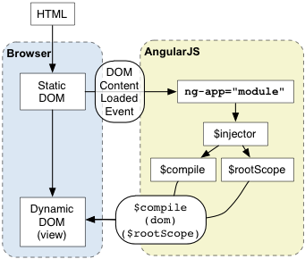
Angular js architecture

Slide 11
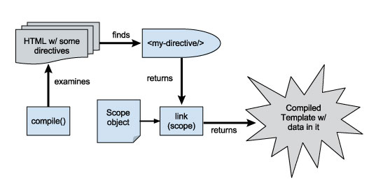

Slide 12
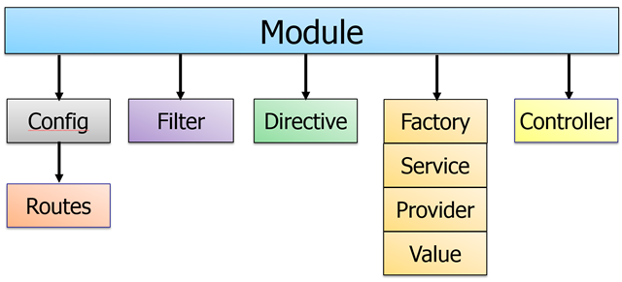
Core Features

Slide 13
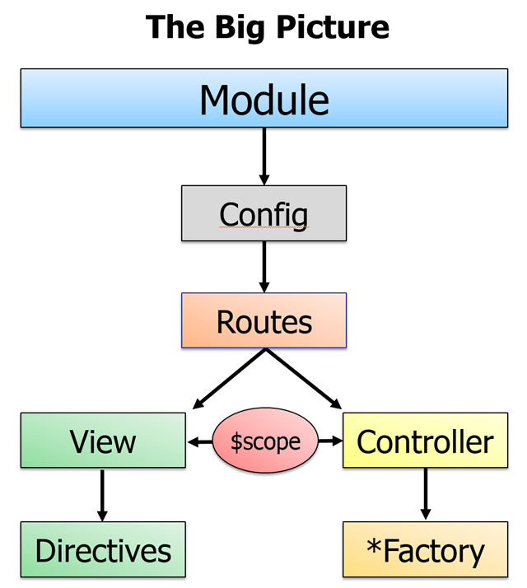

Slide 14
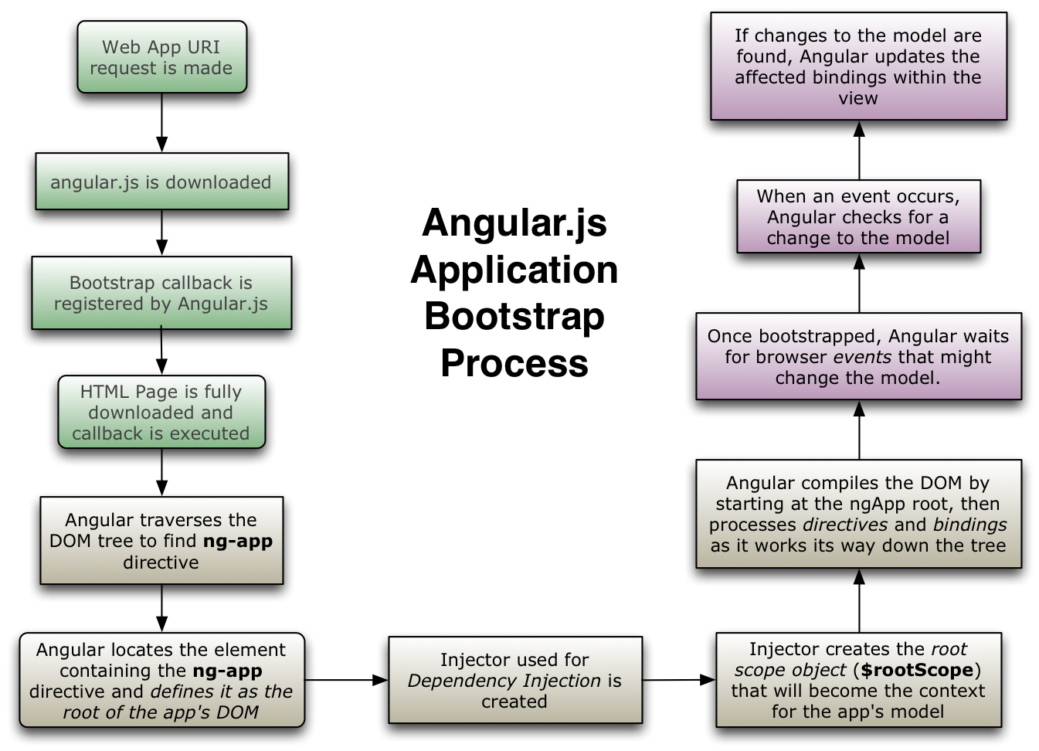

Slide 15
Scope demystified

Slide 16
Request flow in AngularJS
Module
Config
Routes
View
Controller
Directives
$scope
Factory
Service
Provider
Value

Slide 17

Scope
is an object that refers to the application model
Can have properties, functions attached to it
In case of AngularJS, it gets injected without a need to construct
Only one root scope, for every angular application
ng-app – creates the root scope of application
However can have multiple scopes/child scopes
Other directives, controllers in app creates these child scopes

Slide 18
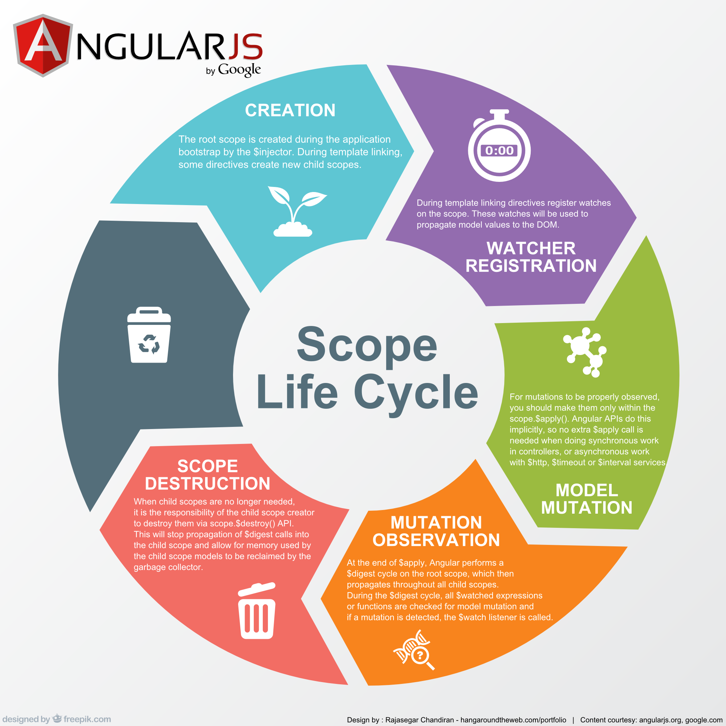

Slide 19
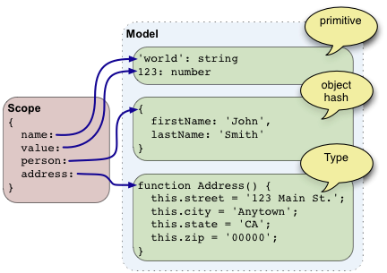

Slide 20
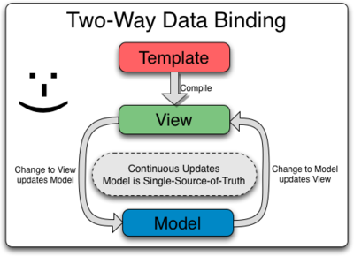

Slide 21
Scope – DOM
Scopes are attached to DOM. $scope is the data property that should be looked after
To examine the scope in the debugger:
Right click on the element of interest in your browser and select 'inspect element'. You should see the browser debugger with the element you clicked on highlighted.
The debugger allows you to access the currently selected element in the console as $0 variable.
To retrieve the associated scope in console execute: angular.element($0).scope() or just type $scope

Slide 22
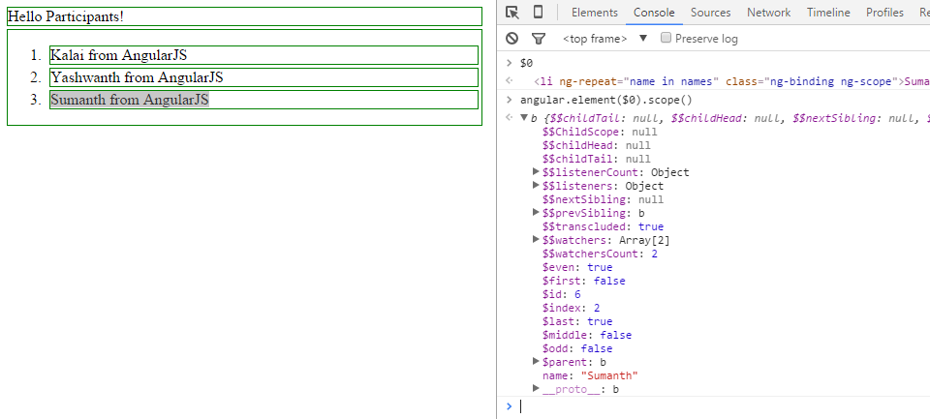
Scope - Examine

Slide 23
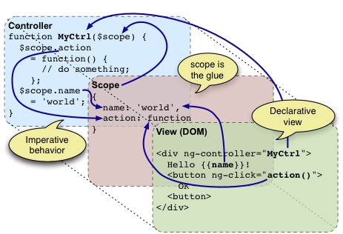
$Scope View Model

Slide 24
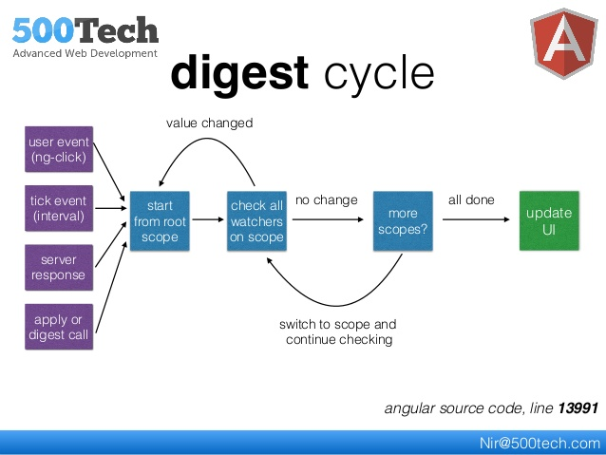
$digest

Slide 25
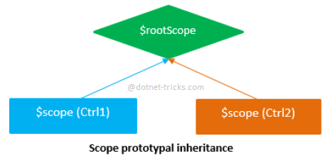
Rootscope

Slide 26
$watch,$digest,$apply
The $scope.watch() function is used to observe changes in a variable on the $scope.
The $scope.$digest() function iterates through all the watches in the $scope object, and its child $scope objects (if it has any).
When $digest() iterates over the watches, it checks if the value of the expression has changed.
If the value has changed, AngularJS calls the change callback(listener) with the new value and the old value.

Slide 27
Scope - watchers
Dirty checking the scope for property changes is a common operation in Angular.
For this reason the dirty checking function must be efficient.
Care should be taken that the dirty checking function does not do any DOM access, as DOM access is orders of magnitude slower than property access on JavaScript object.
Dirty checking can be done with three strategies: By reference, by collection contents, and by value.
The strategies differ in the kinds of changes they detect, and in their performance characteristics.

Slide 28
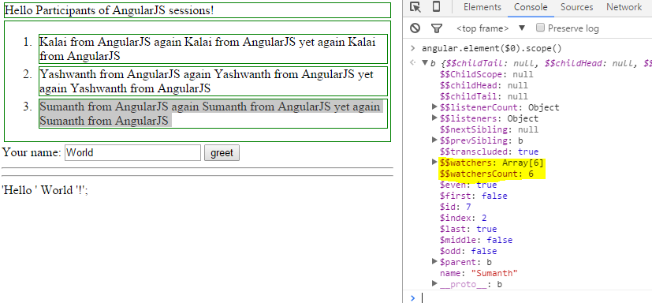
Scope – Watchers count

Slide 29
Scope - $watch
Watching by reference (scope.$watch (watchExpression, listener))
detects a change when the whole value returned by the watch expression switches to a new value.
If the value is an array or an object, changes inside it are not detected. This is the most efficient strategy.

Slide 30
Scope - $watch
Expression that is evaluated on each $digest cycle. A change in the return value triggers a call to the listener.
string: Evaluated as expression
function(scope): called with current scope as a parameter.
Callback called whenever the value of watchExpression changes.
newVal contains the current value of the watchExpression
oldVal contains the previous value of the watchExpression
scope refers to the current scope
Compare for object equality using angular.equals instead of comparing for reference equality. (default: false)

Slide 31
Scope - $watchCollection
Watching collection contents (scope.$watchCollection (watchExpression, listener)) detects changes that occur inside an array or an object: When items are added, removed, or reordered.
The detection is shallow - it does not reach into nested collections.
Watching collection contents is more expensive than watching by reference, because copies of the collection contents need to be maintained.
However, the strategy attempts to minimize the amount of copying required.

Slide 32
Scope - $watch value
Watching by value (scope.$watch (watchExpression, listener, true))
detects any change in an arbitrarily nested data structure.
It is the most powerful change detection strategy, but also the most expensive.
A full traversal of the nested data structure is needed on each digest, and a full copy of it needs to be held in memory.

Slide 33
$watch,$digest,$apply
$apply()
Angular do auto-magically updates only those model changes which are inside AngularJS context.
When you do change in any model outside of the Angular context (like browser DOM events, setTimeout, XHR or third party libraries), then you need to inform Angular of the changes by calling $apply() manually.
When the $apply() function call finishes AngularJS calls $digest() internally, so all data bindings are updated.

Slide 34
Scope - $apply
$apply() is used to execute an expression in angular from outside of the angular framework.
For example from browser DOM events, setTimeout, XHR or third party libraries.
Because we are calling into the angular framework we need to perform proper scope life cycle of exception handling, executing watches.
An AngularJS $scope has a function called $apply() which takes a function as an argument.
So, you simply need to put the code that changes models inside a function and call $scope.$apply() passing that function as an argument.
After the $apply() function call ends, AngularJS knows that some model changes might have occurred. It then starts a digest cycle by calling another function $rootScope.$digest()―which propagates to all child scopes.

Slide 35
Scope - $digest
After the $apply() function call ends, AngularJS knows that some model changes might have occurred. It then starts a digest cycle by calling another function $rootScope.$digest()―which propagates to all child scopes.
In the digest cycle all the watchers are called to check if the model value has changed.
After calling the listener functions, the digest cycle starts all over again and fires each watcher to check if any of the models have been mutated in the last loop.
The digest cycle continues to loop until no model changes have been detected or it hits the maximum loop count of 10 (whichever comes first).
At a minimum the $digest() cycle runs twice even if there are no model mutation in the listener functions.

Slide 36
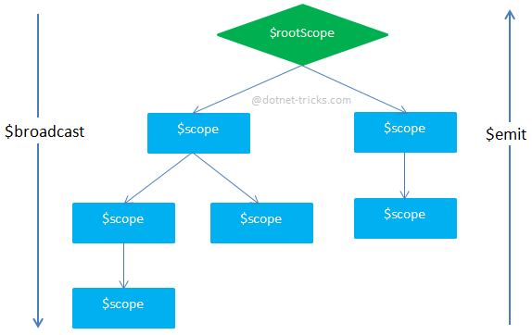

Slide 37
Scope – Broadcast, Emit
$scope.$broadcast(name,args) For Broadcasting Events
The $broadcast() function is the same as $emit() except the event propagates downwards in the scope hierarchy to all the child scopes.
The parameters list is also same as that of $emit().
Like $emit, the $scope which broadcasts the event also receives a notification (via $on) when it's broadcast.

Slide 38
Scope - on
$scope.$on(name,handlerFunction) For Registering Listeners
The $on function registers event listeners that should be called when the event occurs.
The first parameter is the name of the event you are interested in.
The second parameter is a callback function which gets called when the event occurs.

Slide 39
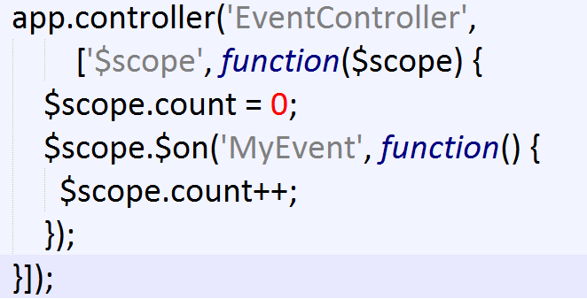
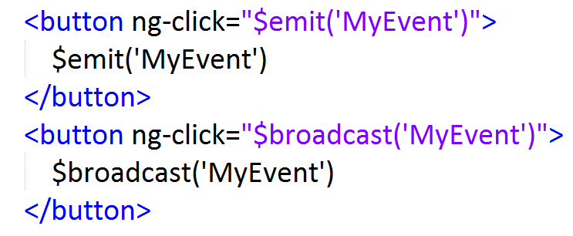
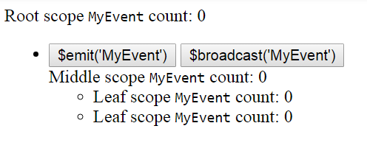
Scope – Broadcast, Emit, On

Slide 40
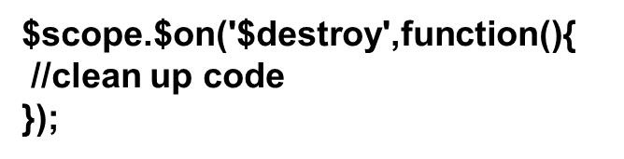
Scope - destroy
When a scope is being destroyed a $destroy event is broadcast on the scope.
You can listen for this event and perform any necessary cleanups.

Slide 41
Scope - $digest
The cycle runs once more to make sure the models are stable and no change has been made in last loop. This is called dirty checking.
If you want to get notified whenever $digest() is called, you can set up a watcher without any listener function.
The first and only argument to $scope.$watch() should be the function whose return value you want to monitor.
This function gets called in every digest cycle.
That is why the second argument to $watch() is optional.
Calling $apply() will automatically trigger a $digest on $rootScope which subsequently visits all the child scopes calling the watchers.

Slide 42
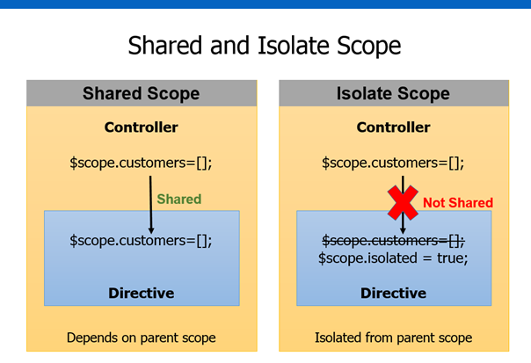

Slide 43
Core Features
Data-binding: It is the automatic synchronization of data between model and view components.
Scope: These are objects that refer to the model. They act as a glue between controller and view.
Controller: These are JavaScript functions bound to a particular scope.

Slide 44
Core Features
Services: AngularJS comes with several built-in services such as $http to make a XMLHttpRequests. These are singleton objects which are instantiated only once in app.
Filters: These select a subset of items from an array and returns a new array.
Directives: Directives are markers on DOM elements such as elements, attributes, css, and more.
These can be used to create custom HTML tags that serve as new, custom widgets.
AngularJS has built-in directives such as ngBind, ngModel, etc.

Slide 45
Core Features
Templates:These are the rendered view with information from the controller and model. These can be a single file (such as index.html) or multiple views in one page using partials.
Routing: It is concept of switching views.
Model View Whatever: MVW is a design pattern for dividing an application into different parts called Model, View, and Controller, each with distinct responsibilities.

Slide 46
Core Features
Deep Linking: Deep linking allows to encode the state of application in the URL so that it can be bookmarked.
The application can then be restored from the URL to the same state.
Dependency Injection: AngularJS has a built-in dependency injection subsystem that helps the developer to create, understand, and test the applications easily.

Slide 47
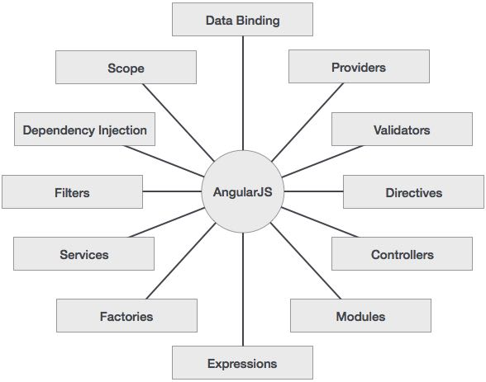
Concepts

Slide 48
Advantages of AngularJS
It provides the capability to create Single Page Application in a very clean and maintainable way.
It provides data binding capability to HTML. Thus, it gives user a rich and responsive experience.
AngularJS code is unit testable.
AngularJS uses dependency injection and make use of separation of concerns.
AngularJS provides reusable components.
With AngularJS, the developers can achieve more functionality with short code.
In AngularJS, views are pure html pages, and controllers written in JavaScript do the business processing.

Slide 49
Disadvantages of AngularJS
Not secure : Being JavaScript only framework, application written in AngularJS are not safe. Server side authentication and authorization is must to keep an application secure.
Not degradable: If the user of your application disables JavaScript, then nothing would be visible, except the basic page.

Slide 50
AngularJS Directives
The AngularJS framework can be divided into three major parts:
ng-app : This directive defines and links an AngularJS application to HTML.
ng-model : This directive binds the values of AngularJS application data to HTML input controls.
ng-bind : This directive binds the AngularJS application data to HTML tags.

Slide 51
AngularJS Directives
AngularJS starts automatically when the web page has loaded.
The ng-app directive tells AngularJS that the <div> element is the "owner" of an AngularJS application.
The ng-model directive binds the value of the input field to the application variable name.
The ng-bind directive binds the innerHTML of the <p> element to the application variable name.

Slide 52
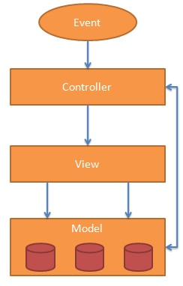

Slide 53
AngularJS Expressions
AngularJS expressions are written inside double braces: {{ expression }}.
AngularJS expressions bind data to HTML the same way as the ng-bind directive.
AngularJS will "output" data exactly where the expression is written.

Slide 54
AngularJS Expressions
<div ng-app="" ng-init=“principal=1; interest=5"> <p>Total in Euro: {{ principal * interest }}</p> </div> .

Slide 55
AngularJS Expressions
AngularJS Arrays
<div ng-app="" ng-init=“data=[1,15,19,2,40]"> <p>The points are {{ data[2] }}</p> </div>

Slide 56
Repeating HTML Elements
<div ng-controller="EmployeeController">
<ul>
<li ng-repeat="obj in emp|orderBy:'name'">
{{obj.name|uppercase}} base location is {{obj.location}}
</li>
</ul>
</div>

Slide 57
AngularJS Controllers
var bankingApp = angular.module('bankingApp',[]); bankingApp.controller('BankCustomerController',['$scope',function($scope) { $scope.customerobj={Name:"Santhosh",Type:"SavingsAccount"}; }]); bankingApp.controller('RDController',['$scope', function($scope) { $scope.RDObj = {interest:'0.9'} }]);

Slide 58
AngularJS - Filters
.No. | Name | Description
1 | uppercase | converts a text to upper case text.
2 | lowercase | converts a text to lower case text.
3 | currency | formats text in a currency format.
4 | filter | filter the array to a subset of it based on provided criteria.
5 | orderBy | orders the array based on provided criteria.

Slide 59
AngularJS - Filters
<div ng-app="" ng-controller="personController"> <p>The name is {{ lastName | uppercase }}</p> </div>

Slide 60
AngularJS - Filters
₠ 8352 EURO-CURRENCY SIGN ₡ 8353 COLON SIGN ₢ 8354 CRUZEIRO SIGN
₣ 8355 FRENCH FRANC SIGN ₤ 8356 LIRA SIGN ₥ 8357 MILL SIGN ₦ 8358 NAIRA SIGN ₧ 8359 PESETA SIGN ₨ 8360 RUPEE SIGN ₩ 8361 WON SIGN ₪ 8362 NEW SHEQEL SIGN ₫ 8363 DONG SIGN € 8364 EURO SIGN ₭ 8365 KIP SIGN ₮ 8366 TUGRIK SIGN ₯ 8367 DRACHMA SIGN ₰ 8368 GERMAN PENNY SYMBOL ₱ 8369 PESO SIGN ₲ 8370 GUARANI SIGN ₳ 8371 AUSTRAL SIGN ₴ 8372 HRYVNIA SIGN ₵ 8373 CEDI SIGN ₶ 8374 LIVRE TOURNOIS SIGN ₷ 8375 SPESMILO SIGN ₸ 8376 TENGE SIGN ₹ 8377 INDIAN RUPEE SIGN

Slide 61
CustOM FILTERS
<p>Calculated Interest = {{calobj.amount|currency :'&#8377;'}}</p> <p>Calculated Interest = {{calobj.amount|nfcurrency}}</p>

Slide 62
Filter - date
'yyyy': 4 digit representation of year (e.g. AD 1 => 0001, AD 2010 => 2010)
'yy': 2 digit representation of year, padded (00-99). (e.g. AD 2001 => 01, AD 2010 => 10)
'y': 1 digit representation of year, e.g. (AD 1 => 1, AD 199 => 199)
'MMMM': Month in year (January-December)
'MMM': Month in year (Jan-Dec)
'MM': Month in year, padded (01-12)
'M': Month in year (1-12)
'dd': Day in month, padded (01-31)
'd': Day in month (1-31)
'EEEE': Day in Week,(Sunday-Saturday)
'EEE': Day in Week, (Sun-Sat)
'HH': Hour in day, padded (00-23)
'H': Hour in day (0-23)
'hh': Hour in AM/PM, padded (01-12)
'h': Hour in AM/PM, (1-12)
'mm': Minute in hour, padded (00-59)
'm': Minute in hour (0-59)
'ss': Second in minute, padded (00-59)
's': Second in minute (0-59)

Slide 63
Filter - date
•'medium': equivalent to 'MMM d, y h:mm:ss a' for en_US locale (e.g. Sep 3, 2010 12:05:08 PM)
•'short': equivalent to 'M/d/yy h:mm a' for en_US locale (e.g. 9/3/10 12:05 PM)
•'fullDate': equivalent to 'EEEE, MMMM d, y' for en_US locale (e.g. Friday, September 3, 2010)
•'longDate': equivalent to 'MMMM d, y' for en_US locale (e.g. September 3, 2010)
•'mediumDate': equivalent to 'MMM d, y' for en_US locale (e.g. Sep 3, 2010)
•'shortDate': equivalent to 'M/d/yy' for en_US locale (e.g. 9/3/10)
•'mediumTime': equivalent to 'h:mm:ss a' for en_US locale (e.g. 12:05:08 PM)
•'shortTime': equivalent to 'h:mm a' for en_US locale (e.g. 12:05 PM)

Slide 64
Filter - date
<script src="https://code.angularjs.org/1.2.5/i18n/angular-locale_hi-in.js"></script>
<div ng-controller="mycontroller"> {{theDate | date : "fullDate"}} <br/> {{theValue | currency }} </div>

Slide 65
Filter - date
In HTML Template Binding
{{ date_expression | date : format : timezone}}
In JavaScript
$filter('date')(date, format, timezone)

Slide 66
Forms
Validate Data
The following can be used to track error.
$dirty - states that value has been changed.
$invalid- states that value entered is invalid.
$error- states the exact error.

Slide 67
AngularJS - HTML DOM
S.No. | Name | Description
1 | ng-disabled | Disables a given control.
2 | ng-show | Shows a given control.
3 | ng-hide | Hides a given control.
4 | ng-click | Represents a AngularJS click event

Slide 68
AngularJS - Modules
Application Module - used to initialize an application with controller(s).
Controller Module - used to define the controller.

Slide 69
Events
ng-click
ng-dbl-click
ng-mousedown
ng-mouseup
ng-mouseenter
ng-mouseleave
ng-mousemove
ng-mouseover
ng-keydown
ng-keyup
ng-keypress
ng-change

Slide 70
AngularJS - Includes
Using Ajax - Make a server call to get the corresponding HTML page and set it in the innerHTML of HTML control.
Using Server Side Includes - JSP, PHP and other web side server technologies can include HTML pages within a dynamic page.

Slide 71
AngularJS - Custom Directives
Custom directives allow you to extend HTML with new tags and attributes.
Directives can be reused within and across projects, and are roughly equivalent to custom controls in platforms like .NET.

Slide 72
AngularJS - Custom Directives
Element directive - This activates when a matching element is encountered.
Attribute - This activates when a matching attribute is encountered.
CSS - This activates when a matching CSS style is encountered.
Comment - Directive activates when a matching comment is encountered.

Slide 73
AngularJS - Custom Directives
At a minimum, the Directive Definition Object, defines the following options…
template: The User Interface defined in HTML to be shown as the directive.
As an alternative, the template attribute can be replaced with templateUrl for complex User Interface.
.

Slide 74
AngularJS - Custom Directives
The templateUrl points to .html file.
restrict: Value can be one of or all of the following:
E: Directive defined as an element. <star-Rating rating=”rating”></star-Rating>
A: Directive applied as an attribute on existing element. <div star-rating rating=”rating”></div>
C: Directive applied as a css class to existing element <div class="star-rating" rating="rating "></div>
M: Directive applied as comment

Slide 75
Building Custom Directives:
An Angular directive comes in four flavors in terms of appearance.
A new HTML element (<date-picker></date>).
An attribute on an element (<input type="text" date-picker/>).
As a class (<input type="text" class="date-picker"/>).
As comment (<!--directive:date-picker-->).

Slide 76
AngularJS - Dependency Injection
Dependency Injection is a software design in which components are given their dependencies instead of hard coding them within the component.
It relieves a component from locating the dependency and makes dependencies configurable.
It also helps in making components reusable, maintainable and testable.

Slide 77
Why do you need to inject dependencies?
Separate the process of creation and consumption of dependencies
Let the consumer worry only about how to use the dependency, and leave the process of creation of the dependency to somebody else
Allow concurrent/independent development of the dependency and the dependent entity, while only maintaing a known contract
Facilitate changing of the dependencies when needed
Allow injecting mock objects as dependencies for testing, by maintaining the agreed contract

Slide 78
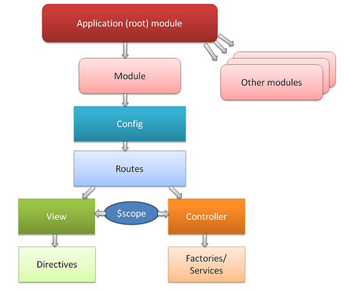
Why do you need to inject dependencies?

Slide 79
How does dependency injection work in Angular?
Angular leverages dependency injection all across the framework.
It works with functions defined for controller, directive, service, factory, etc.

Slide 80
How does dependency injection work in Angular?
var app = angular.module("DemoApp", []);
// Controller is injected with $scope and $http as dependencies app.controller("DemoController", function ($scope, $http) { $http.get('https://api.github.com/users/angular/repos') .success(function (repos) { $scope.repos = repos });
});

Slide 81
AngularJS - Dependency Injection
AngularJS provides a supreme Dependency Injection mechanism.
It provides following core components which can be injected into each other as dependencies.
Value
Factory
Service
Provider
Constant

Slide 82
AngularJS - Dependency Injection
Services
Syntax: module.service( 'serviceName', function ); Result: When declaring serviceName as an injectable argument you will be provided with an instance of the function. In other words new FunctionYouPassedToService().

Slide 83
AngularJS - Dependency Injection
Factories
Syntax: module.factory( 'factoryName', function ); Result: When declaring factoryName as an injectable argument you will be provided with the value that is returned by invoking the function reference passed to module.factory.

Slide 84
AngularJS - Dependency Injection
Providers
Syntax: module.provider( 'providerName', function ); Result: When declaring providerName as an injectable argument you will be provided with ProviderFunction().$get(). The constructor function is instantiated before the $get method is called - ProviderFunction is the function reference passed to module.provider.

Slide 85
AngularJS - Internalization
AngularJS supports inbuilt internationalization for three types of filters : Currency, Date, and Numbers.
We only need to incorporate corresponding java script according to locale of the country.
By default, it considers the locale of the browser.
<script src="https://code.angularjs.org/1.2.5/i18n/angular-locale_da-dk.js"></script>

Slide 86
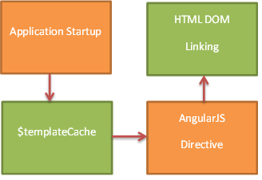
AngularJS Template Cache PUT & GET

Slide 87
Mobile Angular js

Slide 88
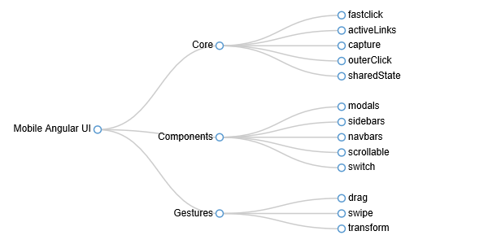
Overview

