Slide 1
Microservice Course Coverage

Slide 2
Architecture and Hands on

Slide 3
Sample Microservice Interaction

Slide 4
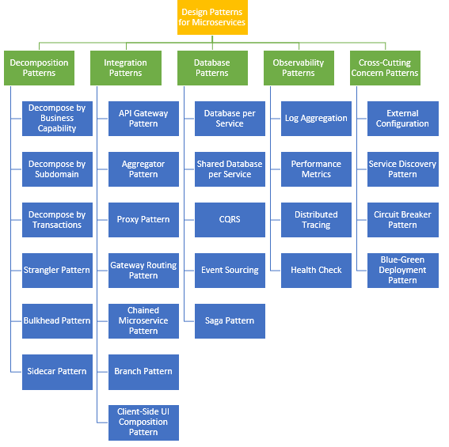
Design Patterns

