Slide 1
An introduction to principal component analysis

Slide 2
Outline of talk
1. PCA: what the analysis can do
2. Simple examples of use
3. Application to radiosonde data:
detection of inversions
4. Summary

Slide 3
INTRODUCTION: PCA
An objective method for determining underlying
patterns in data.
Many meteorological (usually climatological) applications.
Very simple matter to determine the underlying
structures…
…interpreting the structures is the difficult part;
often the results have no obvious physical significance.

Slide 4
What you need: some data
some variables
Time | Temp. 1 | Temp. 2 | Temp. 3 | RH | Cloud cover
0.000 | 23.4 | 20.5 | 17.2 | 87% | 0
0.234 | 25.0 | 19.2 | 17.1 | 89% | 1
0.571 | 24.9 | 19.8 | 17.8 | 91% | 1
… | … | … | … | … | …
… | … | … | … | … | …
1.000 | 27.9 | 29.2 | 23.3 | 94% | 3

Slide 5
Mathematical aspects
1. Form the data matrix X containing your data;
X is of size K x N (K stations, measurement
points, grid points, etc; N samples)
2. Calculate the covariance matrix S, based on X;
3. Solve Se = λe for the eigenvectors e and
eigenvalues λ (K EOFs and eigenvalues)
4. Solve P = Xe to calculate the principal
components (N PCs)
Many off-the-shelf packages, e.g. IDL, have
PCA routines.

Slide 6
PCA – what you get
PCA produces three types of analysis:
The empirical orthogonal functions (EOFs): the patterns, or structures, in the data;
The principal components (PCs): a time series, reflecting the relative contribution of each EOF at a given time
The eigenvalues: give the overall importance of each EOF
N.B. The theory states that the EOFs must be orthogonal
to each other, regardless of the underlying physical
processes…

Slide 7
EOFs: Simple example
Daily maximum termperatures for November 1985
from Ilkley, Bradford and Jersey were subjected to
two separate PC analyses:
Ilkley and Bradford
Ilkley and Jersey
This will reveal if there is any relationship between
the temperatures at these locations for the selected
times.
Here, the PCA will have two variables sampled at
thirty points.

Slide 8
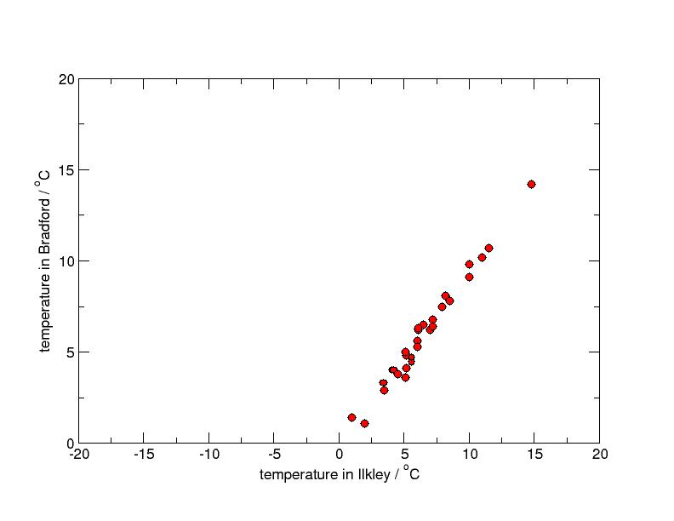
temp. in Bradford /degrees C
temperature in Ilkley /degrees C

Slide 9
EOF₁ explains 99.4% of the total variance in the data
E₁
E₂
temp. in Bradford /degrees C
temperature in Ilkley /degrees C

Slide 10
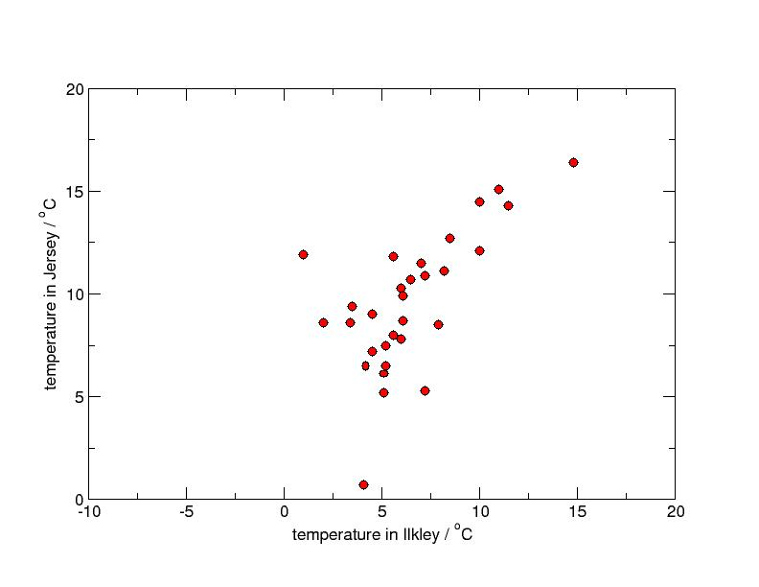
temp. in Jersey /degrees C
temperature in Ilkley /degrees C

Slide 11
E₁
E₂
temp. in Jersey /degrees C
EOF₁ explains 83% of the total variance in the data
temperature in Ilkley /degrees C

Slide 12
PCA results
In this simple example, the EOFs may be interpreted as
defining an alternative co-ordinate system in which to view
the data:
EOF 1:
Reflects the maximum
temperature in the Ilkley –
Bradford/Jersey area;
2
EOF 2:
variations (possibly random)
departing from the overall
regional value.
1

Slide 13
PC time series
Principal components are a time series which represent
how much each EOF contributes.
Thus:
A relatively large value of PC_{i} implies that EOF_{i} is
dominant at that point
A relatively low value of PC_{i} implies that EOF_{i} is
not contributing much to the struture

Slide 14
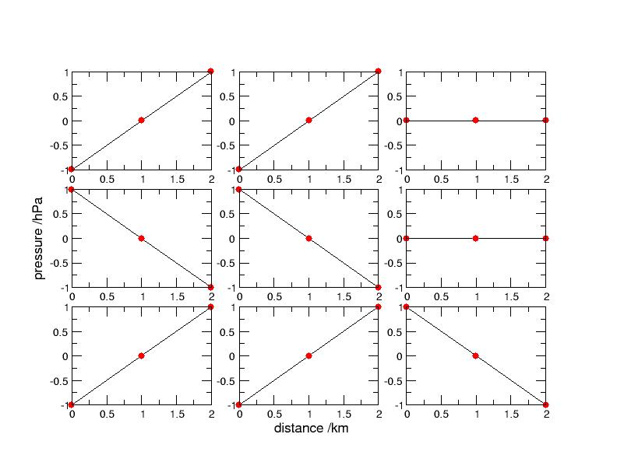
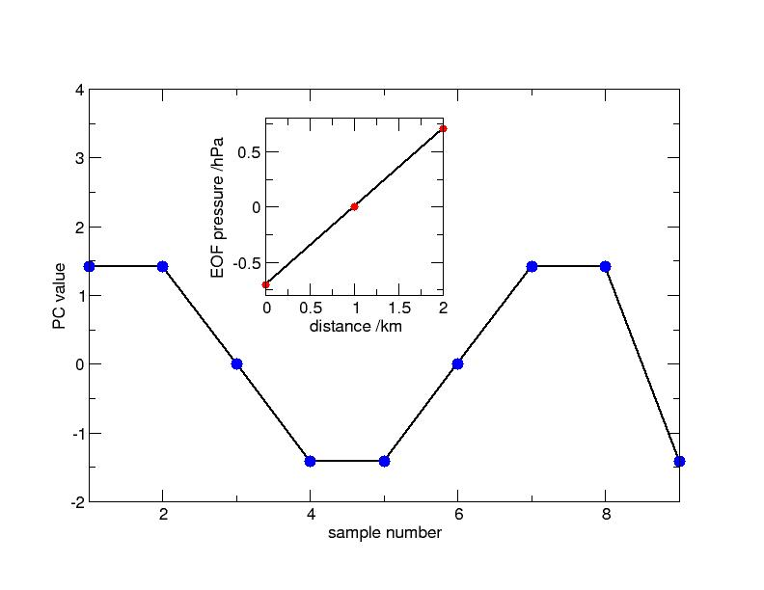
Consider a time series of
pressures, measured at
three points; 9 samples.
3
1
2
pressure /hPa
6
4
5
7
8
9
EOF1
distance /km
In this idealised example,
EOF1 accounts for 100%
of the variance in the data.
PC1 score
Data compression.
Sample number

Slide 15
Which EOFs are significant? - eigenvalues
An initial problem is to determine the “signal” from the
“noise”; not all EOFs are significant.
The most widely used and robust method is to compare the PCA of your data with a PCA of random data; the so-called Rule N
Rule N
1. Substitute randomly generated data for your data;
2. Perform PCA on this random data; retain eigenvalues
3. Repeat steps 1-2 a large number (O1000) times,
a “Monte-Carlo” (MC) simulation;
4. Calculate the mean eigenvalues from the above;
5. Compare your data eigenvalues with the Monte-
Carlo eigenvalues.

Slide 16

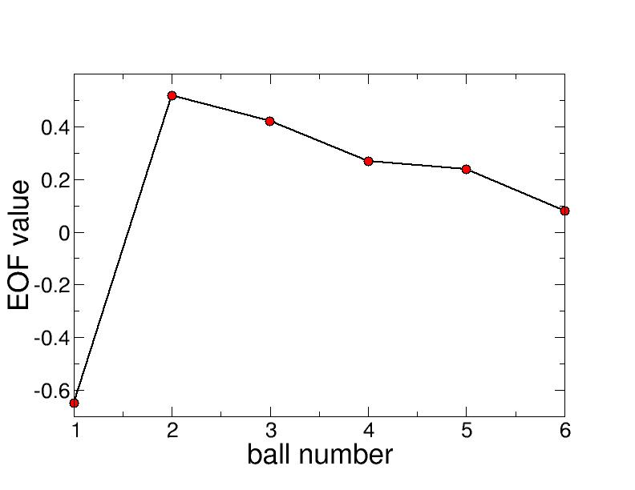
Example: national lottery results.
Are there patterns in lottery results?…
A PCA of two years-worth of lottery results was
performed (not including the bonus ball):
EOF1 explains 23% of
the variance in the data!!
Pick: lowest value,
highest value,
then 4 lower values…
EOF 1
It could be you…
But…

Slide 17
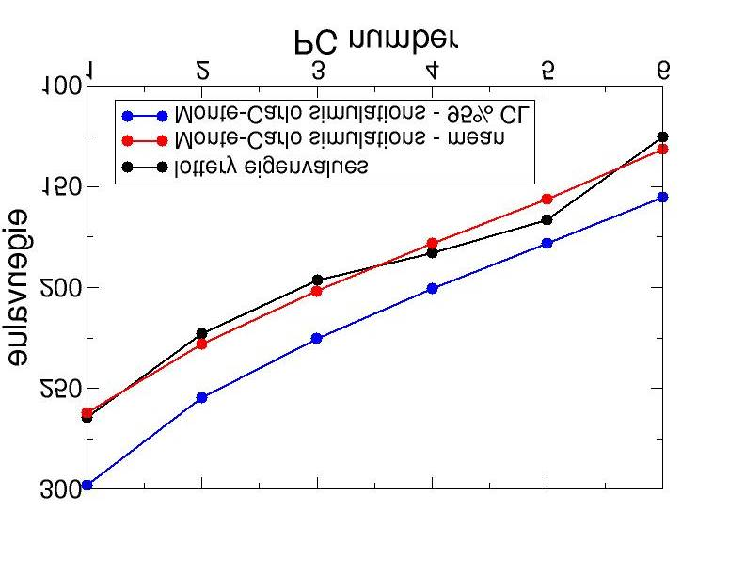
A set of 1000
Monte-Carlo
simulations were
compared
with the lottery data:
Rule N states that for a PC to be significant, the
corresponding eigenvalue must be higher than the
95% confidence limit on the MC simulations.
…unfortunately, the patterns in lottery data cannot be
distinguished from noise.

Slide 18
More typically…
Keep the first two
eigenvalues
e-value
PC number
e-value
Keep the first three
eigenvalues
PC number

Slide 19
Thus, we must be very careful in interpreting PCA
results:
Are the results significant (in the sense just
described)?
Can the results be interpreted in a physical
manner?
* * *

Slide 20
Application: inversion detecting
Inversions are thought to play a crucial part in the formation
of rotor clouds on the Falkland Islands.
Thus, an algorithm for detecting inversions is desirable
However, it is actually quite difficult to construct a
robust algorithm which works for all inversions.
T₂
T₁
height
height
height
height
H₂
??
H₁
temp.
temp.
temp.
temp.
Easy…
Not easy…

Slide 21
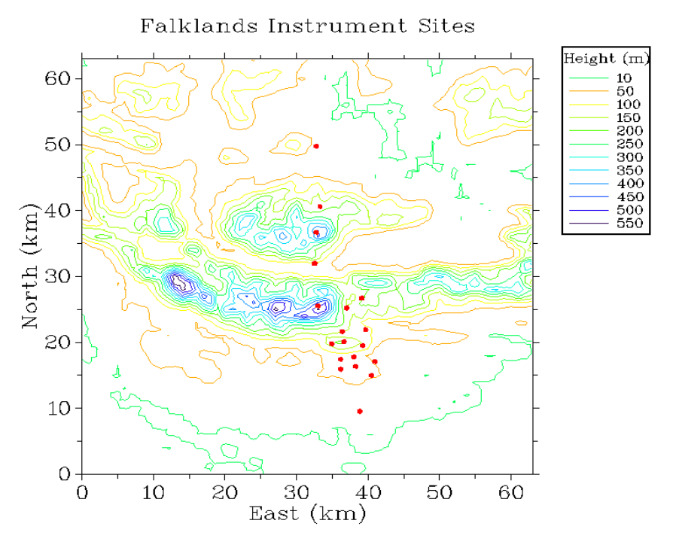
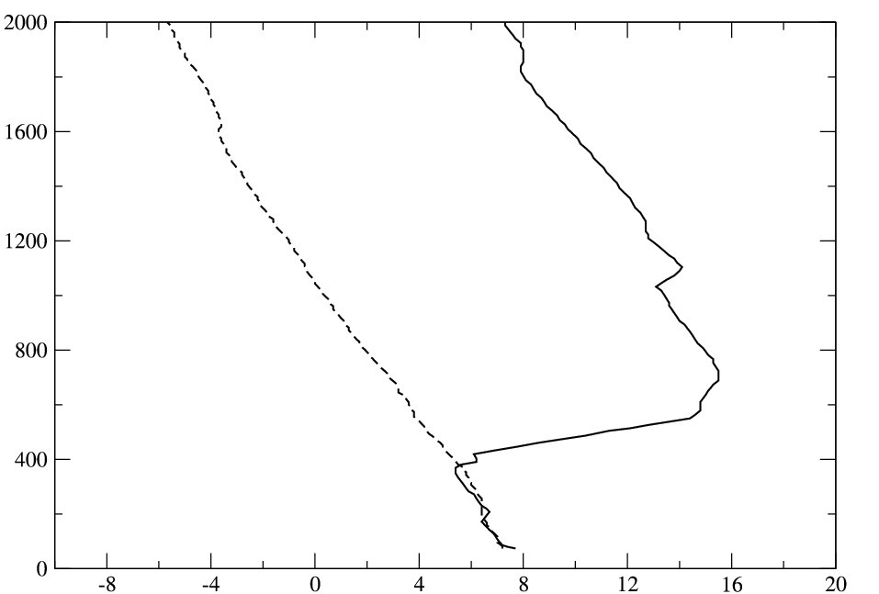
Orography in vicinity of MPA
PCA was applied to radiosonde
data from Mount Pleasant
Airport (MPA), Falkland Islands
A series of 499 ascents were used.
The lowest 2km of each profile
was selected.
MPA
The PCA allows the dominant
thermal structures to be
revealed objectively; no
algorithm is used to
estimate where the inversion
starts/stops etc.
height
temperature

Slide 22
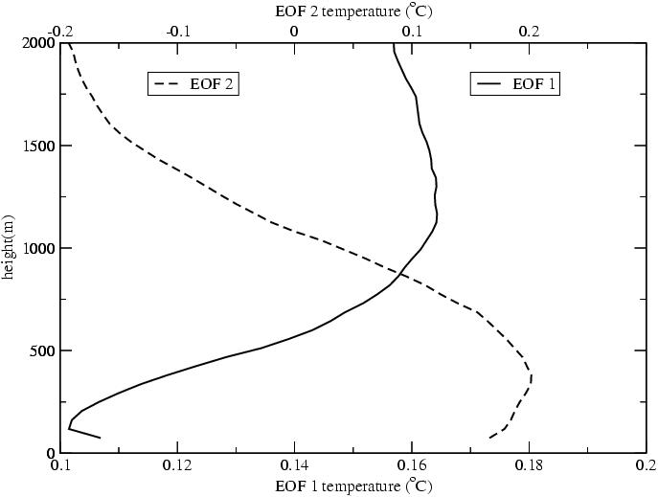
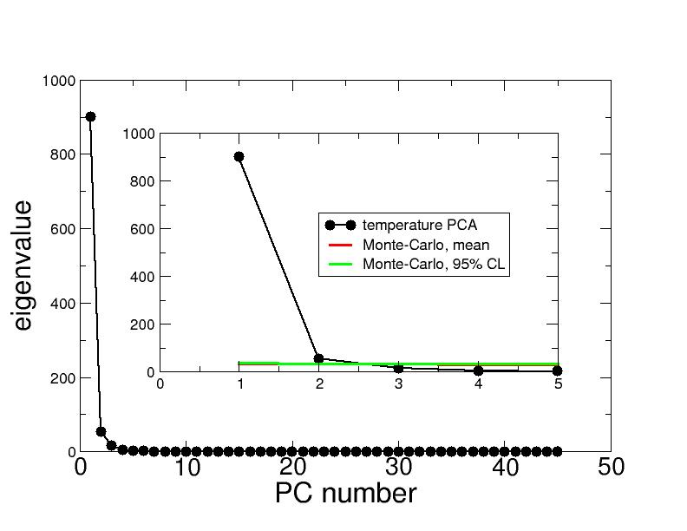
Physical interpretation
The first EOF reflects the strength of the inversion;
a higher PC score will imply a stronger inversion.
EOF2 acts to change the vertical location of the
inversion.

Slide 23
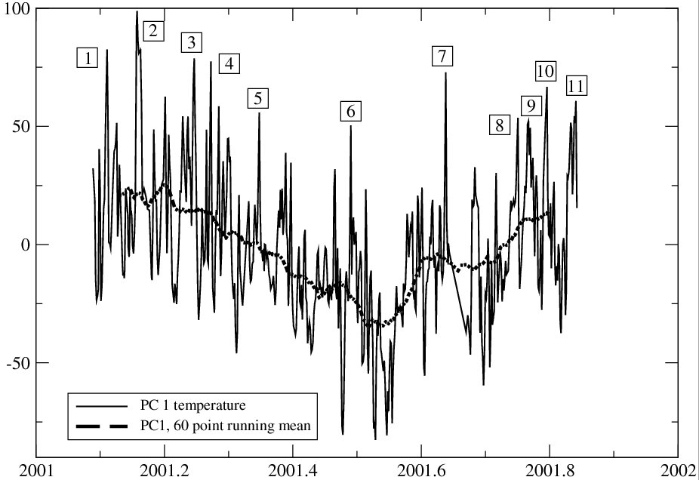
PC1 score
Time
PC1 score showing peaks in the time series

Slide 24
Ground observations at the 11 events
Event # | Comments
1 | direction highly variable; gusts up to 40kts
2 | gusts up to 45 kts
3 | direction variable, gusts up to 30 kts
4 | N/A
5 | gusts up to 30 kts
6 | direction highly variable; gusts up to 40kts
7 | gusts up to 65 kts
8 | gusts up to 35 kts
9 | gusts up to 30 kts
10 | gusts up to 60 kts
11 | N/A

Slide 25
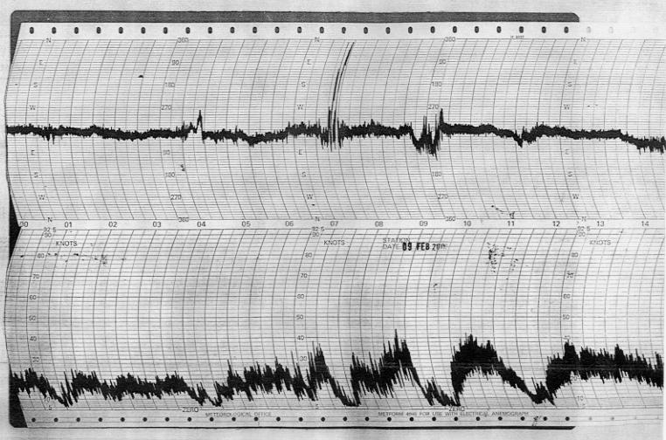
Direction
Speed
Anemograph trace for time 1

Slide 26
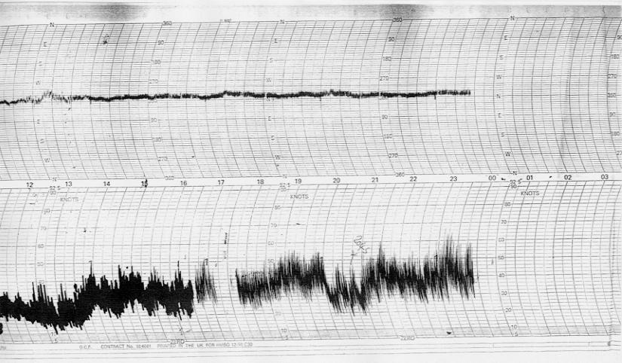
Direction
Speed
60 kts
Anemograph trace for time 7

Slide 27
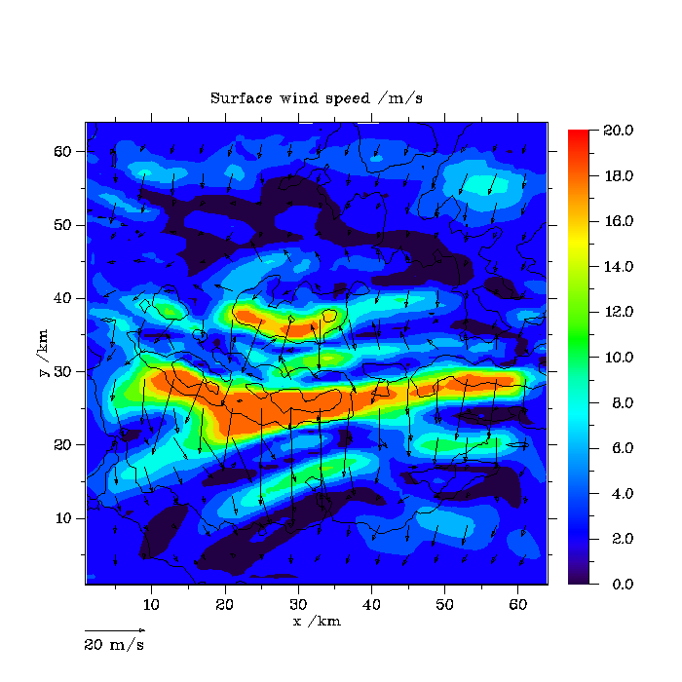
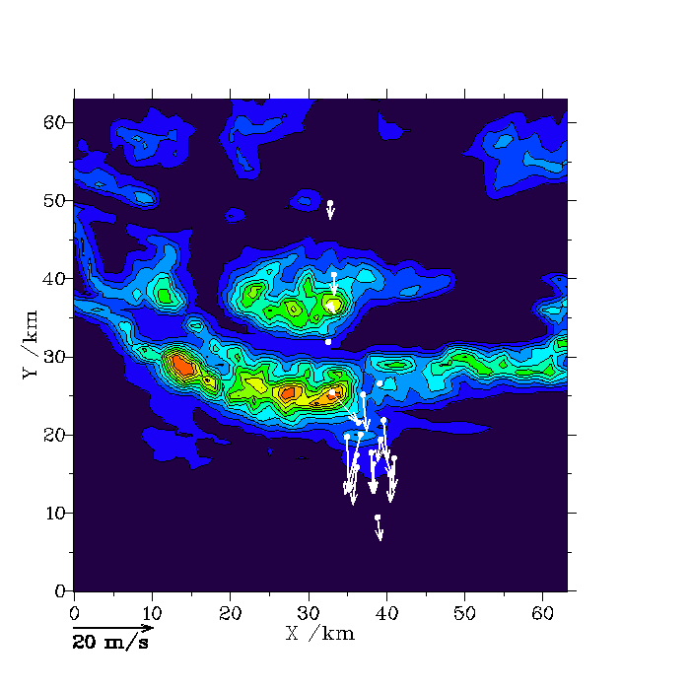
3dVOM
Measurements
Event no. 1: 09/02/01

Slide 28
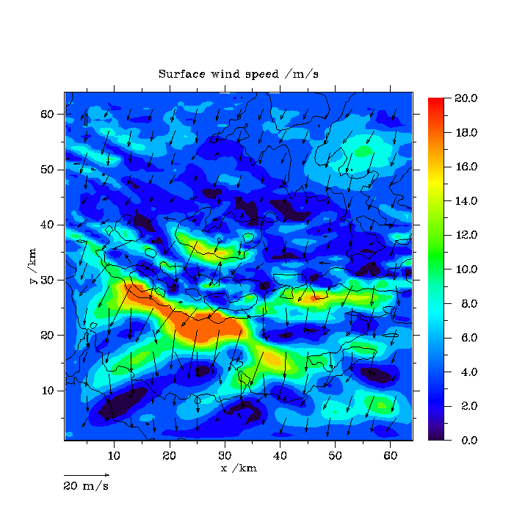

3dVOM
Measurements
Event no. 2: 26/02/01

Slide 29
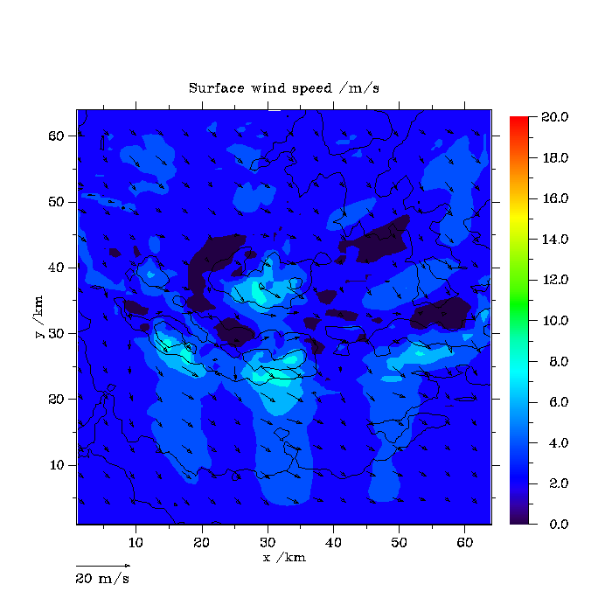

3dVOM
Measurements
Event no. 3: 30/03/01

Slide 30
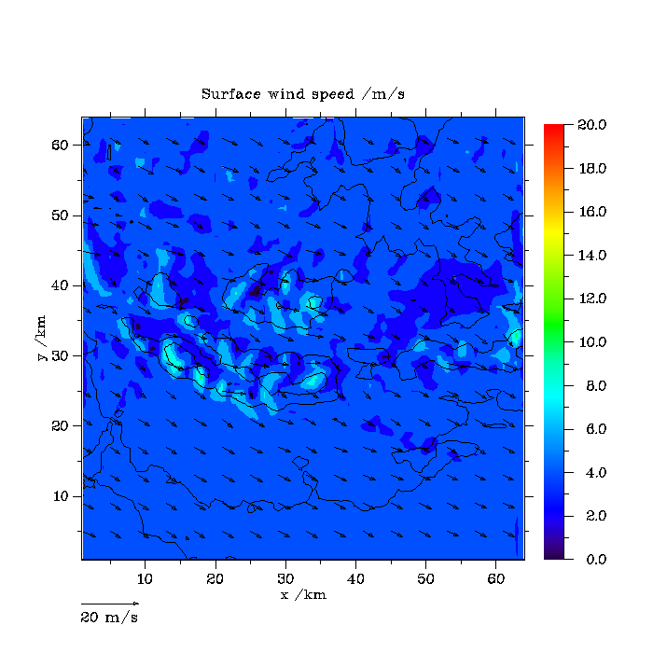

3dVOM
Measurements
Event no. 4: 10/04/01

Slide 31
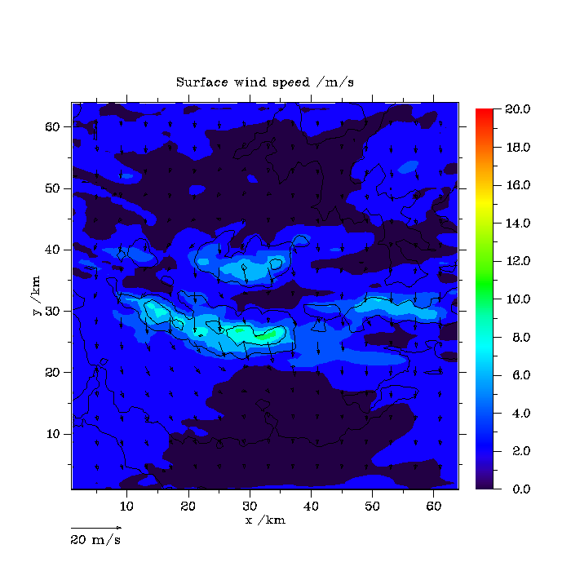

3dVOM
Measurements
Event no. 5: 06/05/01

Slide 32
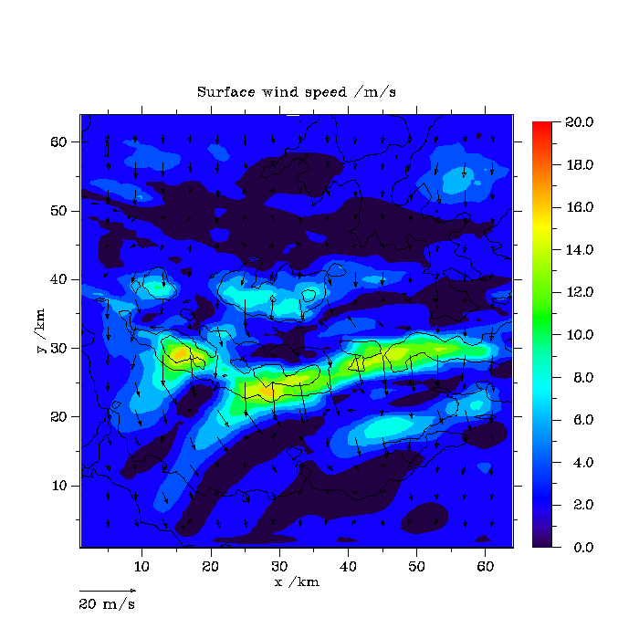

3dVOM
Measurements
Event no. 6: 27/06/01

Slide 33
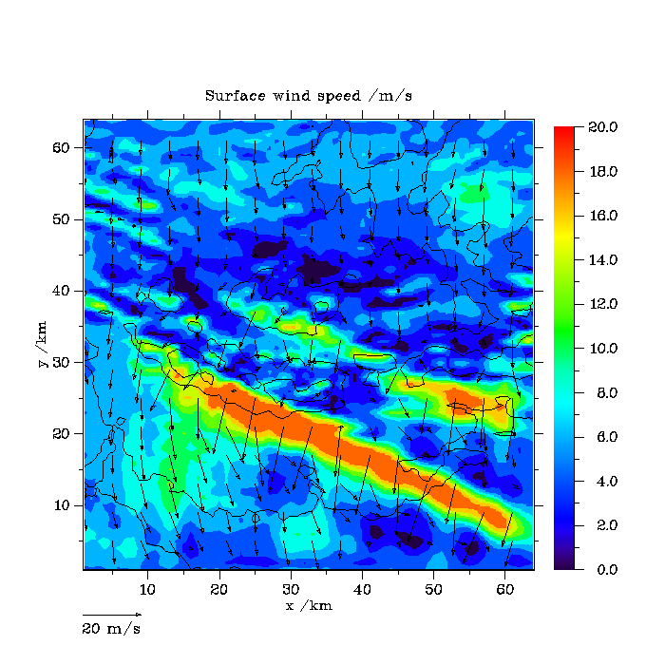
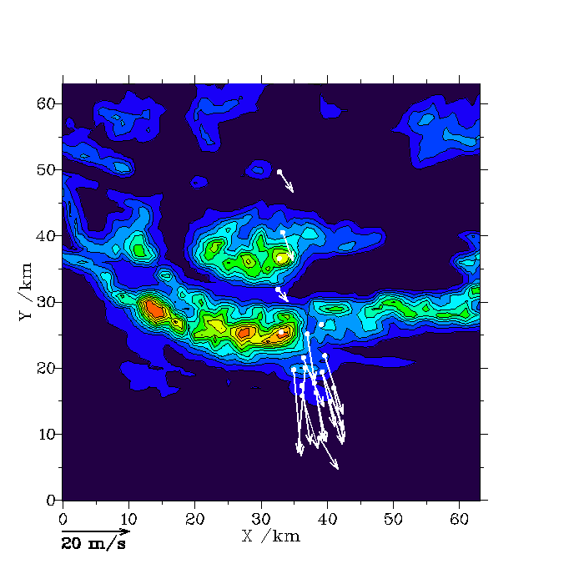
3dVOM
Measurements
Event no. 7: 20/08/01

Slide 34
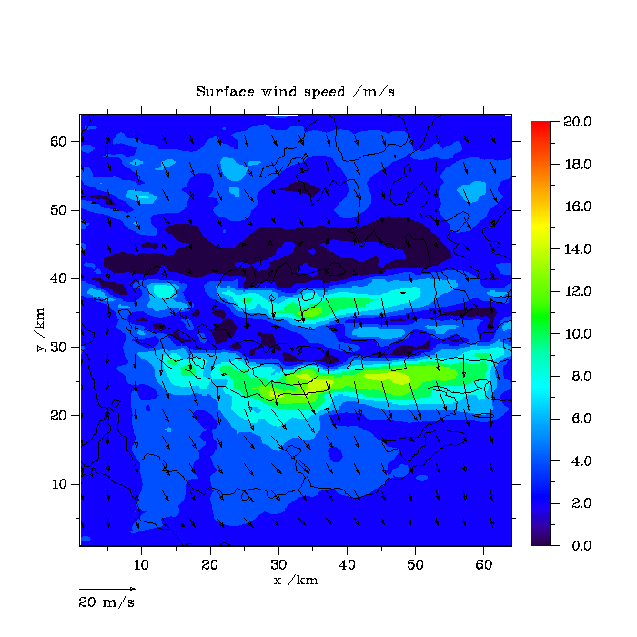

3dVOM
Measurements
Event no. 8: 30/09/01

Slide 35
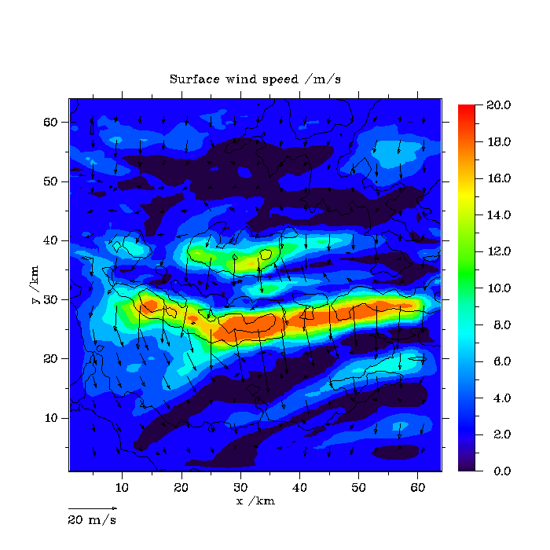

3dVOM
Measurements
Event no. 9: 06/10/01

Slide 36
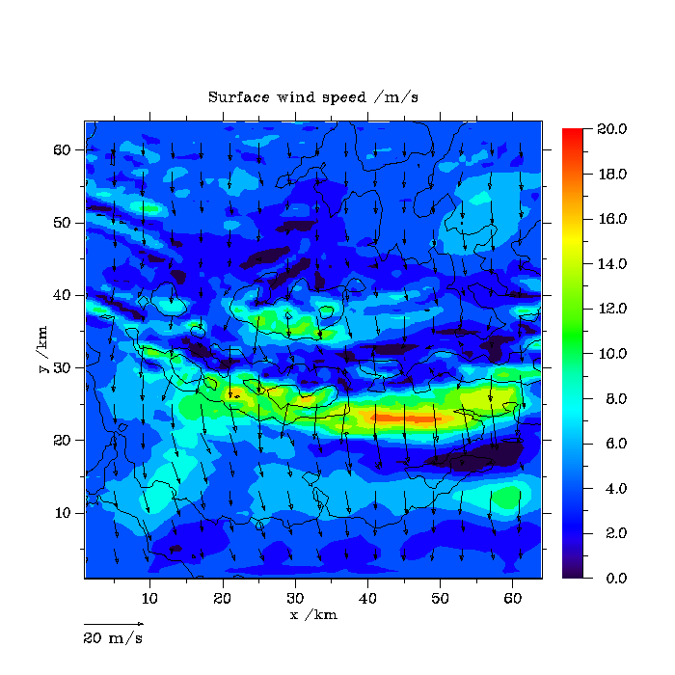

3dVOM
Measurements
Event no. 10: 17/10/01

Slide 37
It appears that high PC1, coupled with a
Northerly upstream wind direction, occurs
during severe weather at the ground, as
reflected in both the model and the observations.
* * *

Slide 38
Application to nowcasting
It has been seen that high PC1 scores appear to be
related to what is going on at ground level, in terms of
wind at least.
Can a “new” ascent be assimilated into the matrix to
determine its significance?
solid line -
high PC1 score
(event 7)
height
dashed line -
very low PC1 score
temperature

Slide 39
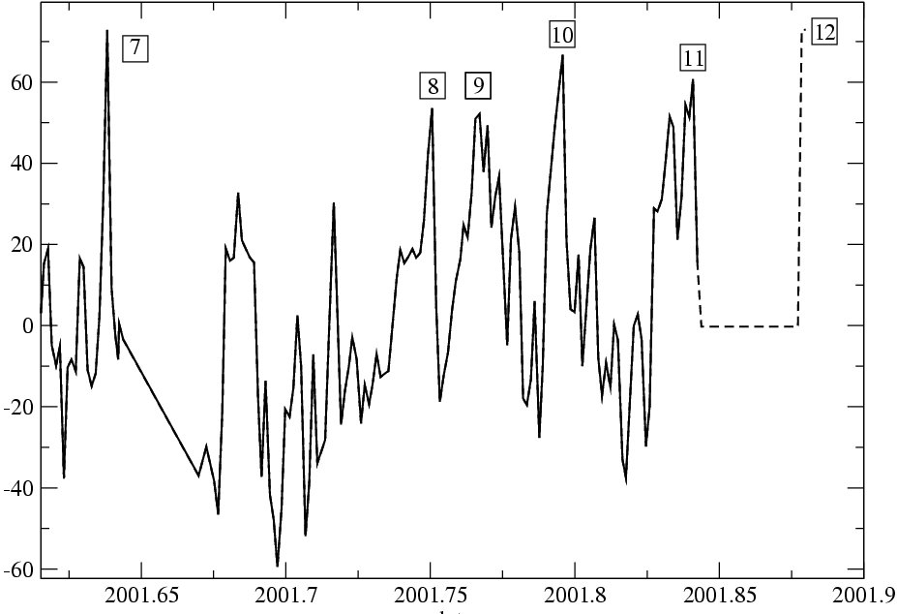
To test the validity of this approach, append a week’s worth of ascents with no inversion, followed by the strong inversion.
PC1 score
date
As can be seen, the time series gives a peak when the inversion is present.

Slide 40
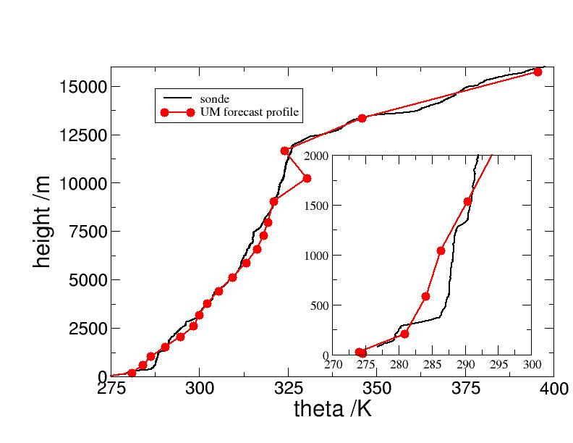
Application to forecasting
Can a similar approach be used to predict extreme events?
Answer: use UM forecast profiles instead of sonde profiles.
;
Event 7
The sonde and
forecast profiles
show good agree-
ment here.
N.B. the resolution
of the UM profile
is lower than that
for the sonde.

Slide 41
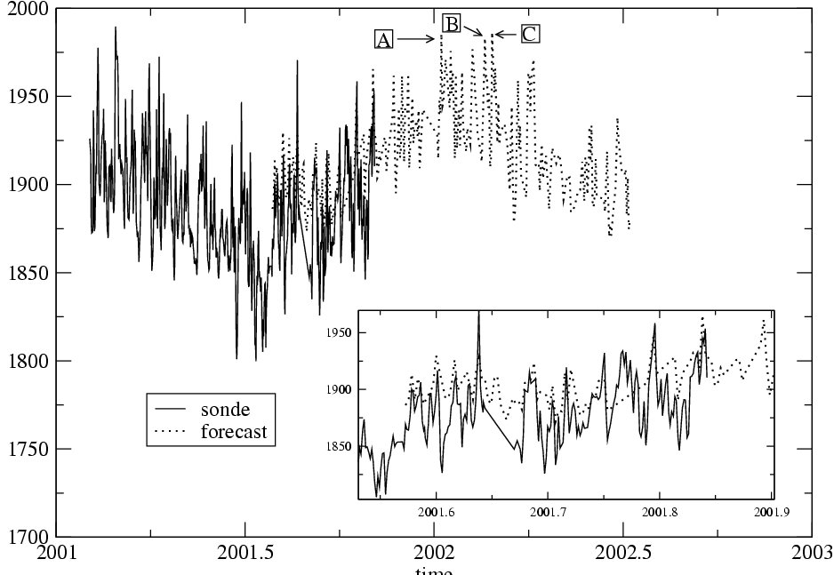
A set of UM forecast profiles were subjected to a
PCA; the EOFs (not shown) are similar to those
for the sonde profiles. The PCs are shown below.
Solid line –
sonde
Dashed line –
UM
PC score
Time

Slide 42
Result of the intercomparison
The first PC for sonde and UM profiles show
good agreement;
The first PC for sonde ascents can be related to
severe weather at the ground;
The first PC for UM profiles may be used in a PCA
to deduce severe weather.

Slide 43
Summary
PCA has been successfully applied to a series of radio-
sonde ascents:
The first EOF reflects the strength of the inversion;
The time series of PCs shows a series of distinct peaks
(or “events”);
During most of these events, both modelling studies
and observations show severe weather at the ground
…application to forecasting.

