Slide 1
Polynomial Regression
Parameswari Ettiappan
Xuhua Xia

Slide 2
Polynomial Regression
A regression equation is a polynomial regression equation if the power of independent variable is more than 1.
The equation below represents a polynomial equation:
        y=a+b*x^2
Xuhua Xia

Slide 3
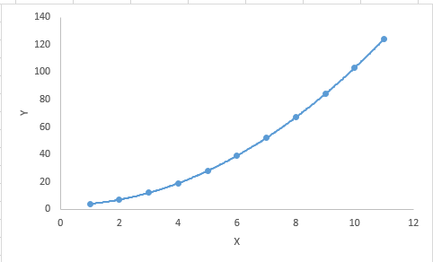
Polynomial Regression
Xuhua Xia

Slide 4
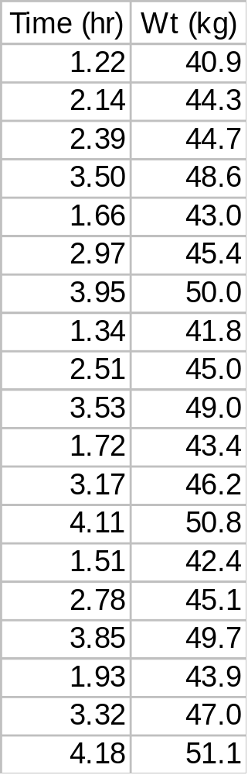
Polynomial Regression
A biologist is interested in the relationship between feeding time and body weight in the males of a mammalian species. The data he recorded are shown in the table. The objectives are:
  Construct an equation relating TIME to BODYWT.
  Understand the model selection criteria.
  Estimate mean TIME for a given BODYWT with 95% CLM.
Xuhua Xia

Slide 5
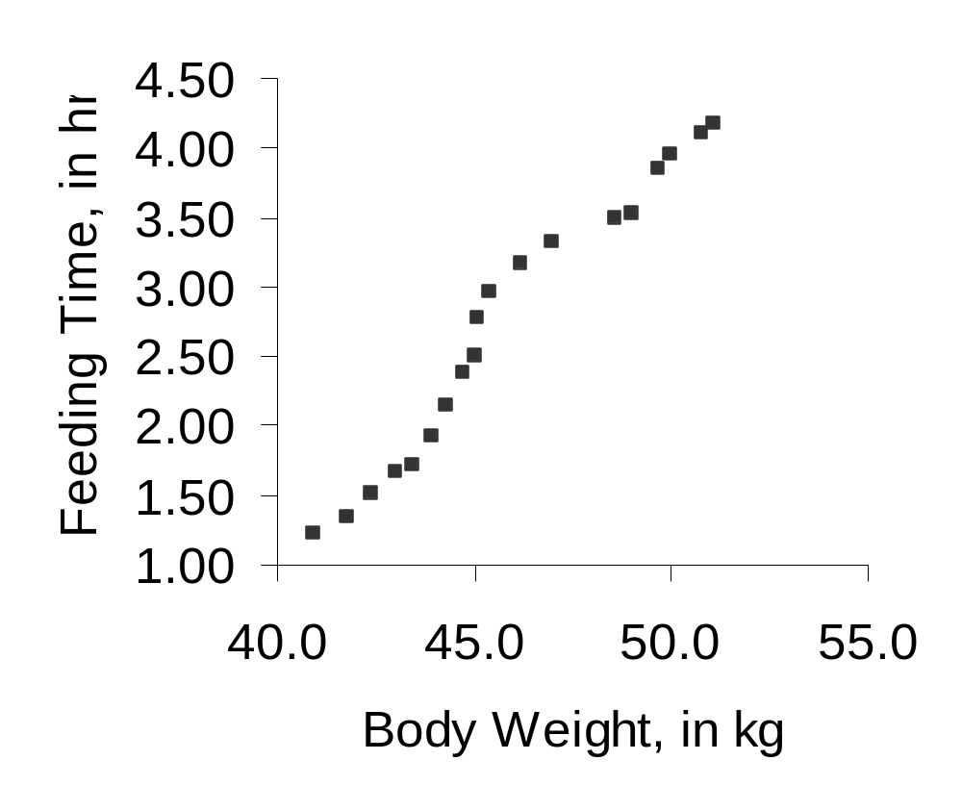
The Relationship Is Nonlinear
Y = a + b X ?
Y = a e^{X} ?
Y = a X^{b} ?
Xuhua Xia

Slide 6
Polynomial Regression
Polynomial regression is a special type of multiple regression whose independent variables are powers of a single variable X. It is used to approximate a curve with unknown functional form.
Y_{i} = α + β₁ X + β₂ X² + … + β_{k} X^{k} + ε_{i}
Model selection is done by successively testing highest order terms and discarding insignificant highest-order terms. Tests should use a liberal level of significance, such as α = 0.25. The starting order should usually be k < N/10, where N is the number of observations.
Xuhua Xia

Slide 7
Polynomial Regression
The main reason for successively testing/discarding highest degree terms and discarding insignificant terms is because the higher order terms are more prone to random error in X, i.e, the random error is multiplied several times in higher order terms.
Suppose the true value for X is 2 but, because of measurement error, we obtain a value of 3. X² is then 9. If we had measured the X value accurately, the X² value would have been 4. So the value of 9 obtained is 4 + 5 units of error. X³ = 27 = 8 + 19 units of error.
Thus, if an order-4 regression is not significantly better than an order-3 regression, then the X⁴ term is dropped.
Contrast with the model selection in multiple regression with X¹, X², etc.
Xuhua Xia

Slide 8
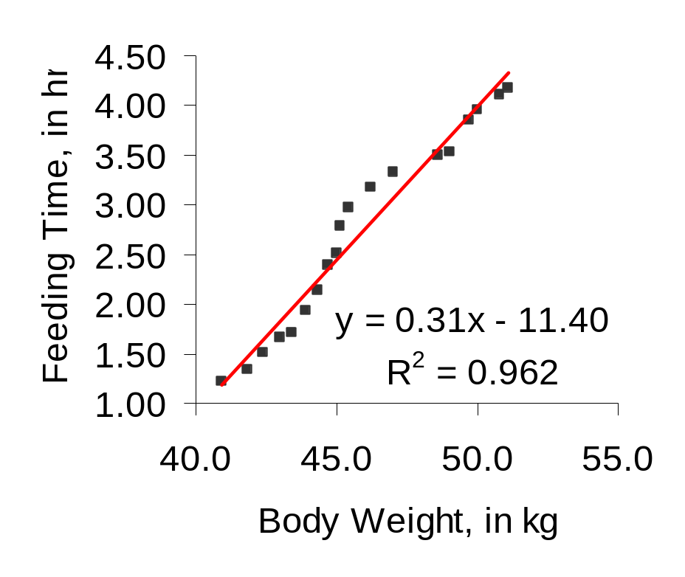
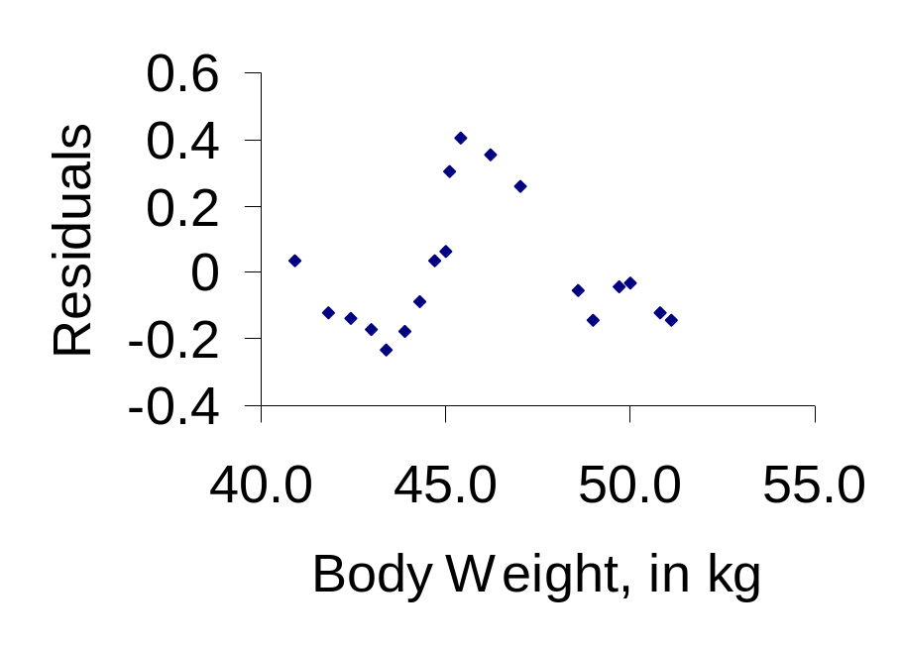
Try Linear Regression First
Xuhua Xia

Slide 9
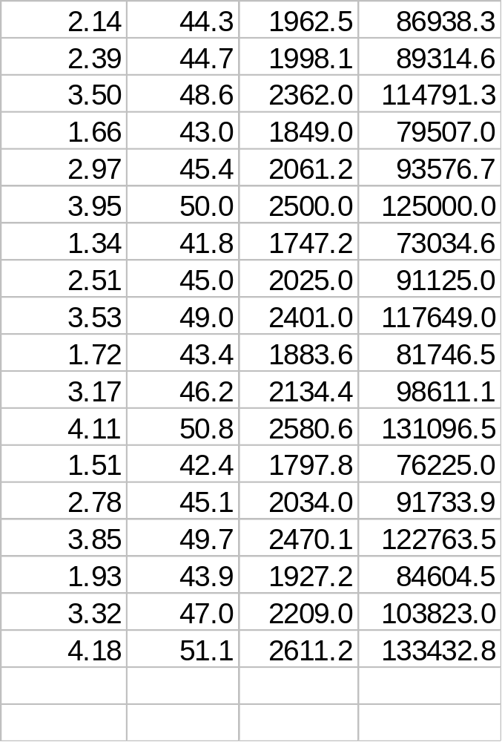
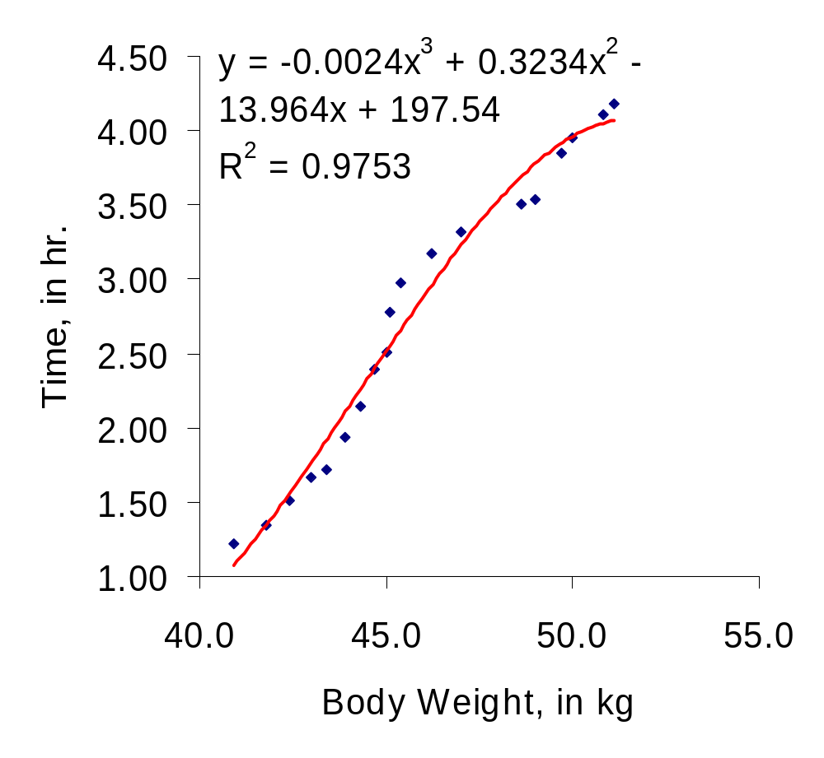
Polynomial Regression (order 3)
Xuhua Xia

Slide 10
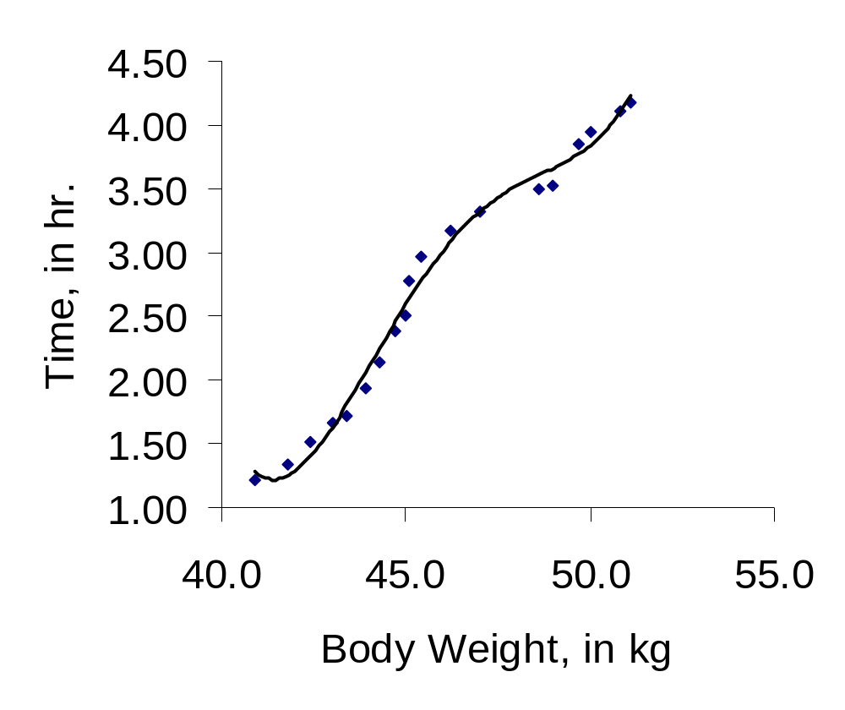
Polynomial Regression (order 4)
Xuhua Xia

Slide 11
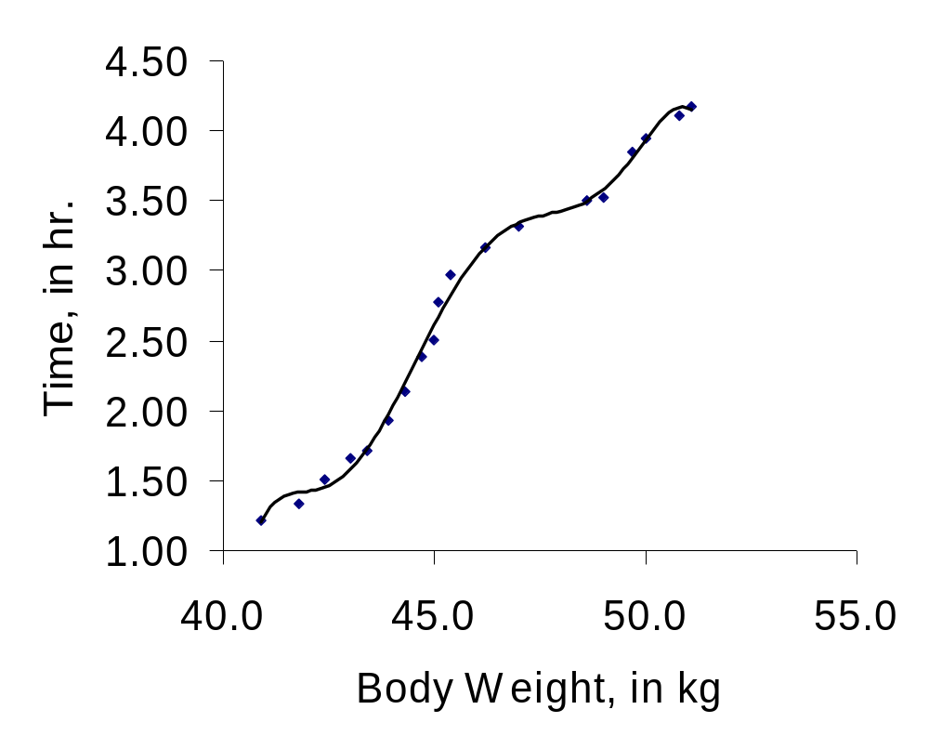
Polynomial Regression (order 6)
If you keep increasing the number of polynomial terms in the equation, eventually you will have perfect fit. Is that what you want?
Xuhua Xia

Slide 12
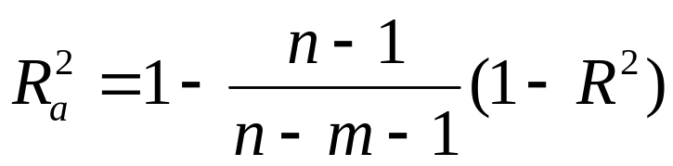
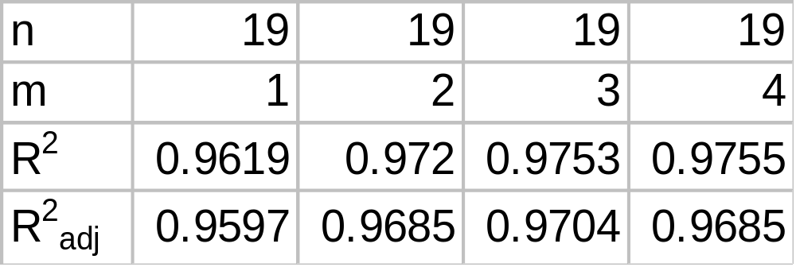
Criteria of Model Selection
Xuhua Xia

Slide 13
Do the Test in SAS
data polydat;
input FeedTime BodyWt @@;
BodyWt2=BodyWt*BodyWt;
BodyWt3=BodyWt2*BodyWt;
BodyWt4=BodyWt3*BodyWt;
cards;
1.22 40.9 2.14 44.3 2.39 44.7 3.50 48.6
1.66 43.0 2.97 45.4 3.95 50.0 1.34 41.8
2.51 45.0 3.53 49.0 1.72 43.4 3.17 46.2
4.11 50.8 1.51 42.4 2.78 45.1 3.85 49.7
1.93 43.9 3.32 47.0 4.18 51.1
;
proc glm;
model FeedTime=BodyWt BodyWt2 BodyWt3/SS1;
run;
proc glm;
model FeedTime=BodyWt BodyWt2/ss1 p clm;
run;
Xuhua Xia

Slide 14
SAS Output
Dependent Variable: FEEDTIME
Source DF Sum of Squares F Value Pr > F
Model 3 17.16627141 197.13 0.0001
Error 15 0.43540228
Corrected Total 18 17.60167368
R-Square C.V. FEEDTIME Mean
0.975264 6.251601 2.72526316
Source DF Type I SS F Value Pr > F
BODYWT 1 16.93053484 583.27 0.0001
BODYWT2 1 0.17828754 6.14 0.0256
BODYWT3 1 0.05744902 1.98 0.1799
Xuhua Xia

Slide 15
SAS Output: order of 3
T for H0: Pr>|T| Std Error of
Parameter Estimate Parameter=0 Estimate
INTERCEPT 197.5414064 1.19 0.2533 166.2638449
BODYWT -13.9642883 -1.28 0.2200 10.9105501
BODYWT2 0.3234063 1.36 0.1945 0.2381090
BODYWT3 -0.0024311 -1.41 0.1799 0.0017280
T-Test here is equivalent to F-test based on Type II SS (Type II, Type III and Type IV are all the same in regression).
Note: T-tests give misleading results for polynomial models. For our data, all t-tests are nonsignificant, which is clearly misleading. Why? (Hint: what models are the t-tests comparing?)
Xuhua Xia

Slide 16
SAS output: Order of 2
Dependent Variable: FEEDTIME
Source DF Sum of Squares F Value Pr > F
Model 2 17.10882239 277.71 0.0001
Error 16 0.49285130
Corrected Total 18 17.60167368
Source DF Type I SS F Value Pr > F
BODYWT 1 16.93053484 549.64 0.0001
BODYWT2 1 0.17828754 5.79 0.0286
T for H0: Pr>|T| Std Error of
Parameter Estimate Parameter=0 Estimate
INTERCEPT -35.94660928 -3.52 0.0029 10.22189563
BODYWT 1.37306931 3.10 0.0069 0.44306000
BODYWT2 -0.01150885 -2.41 0.0286 0.00478376
Feeding Time = -35.947 + 1.373 BodyWt - 0.012 BodyWt²
Hand-compute the adjusted R² for the two polynomial regressions (i.e., order 3 and order 2) and decide whether X³ should be kept or discarded.
Xuhua Xia

Slide 17
Prediction
Observation Observed Predicted Residual
1 1.22000000 0.95980313 0.26019687
2 2.14000000 2.29435461 -0.15435461
3 2.39000000 2.43386721 -0.04386721
4 3.50000000 3.60111164 -0.10111164
5 1.66000000 1.81550409 -0.15550409
6 2.97000000 2.66915245 0.30084755
7 3.95000000 3.93472678 0.01527322
......
95% Confidence Limits for
Observation Mean Predicted Value
1 0.70344686 1.21615939
2 2.18244285 2.40626636
3 2.31762886 2.55010556
4 3.47982526 3.72239801
......
Xuhua Xia

Slide 18
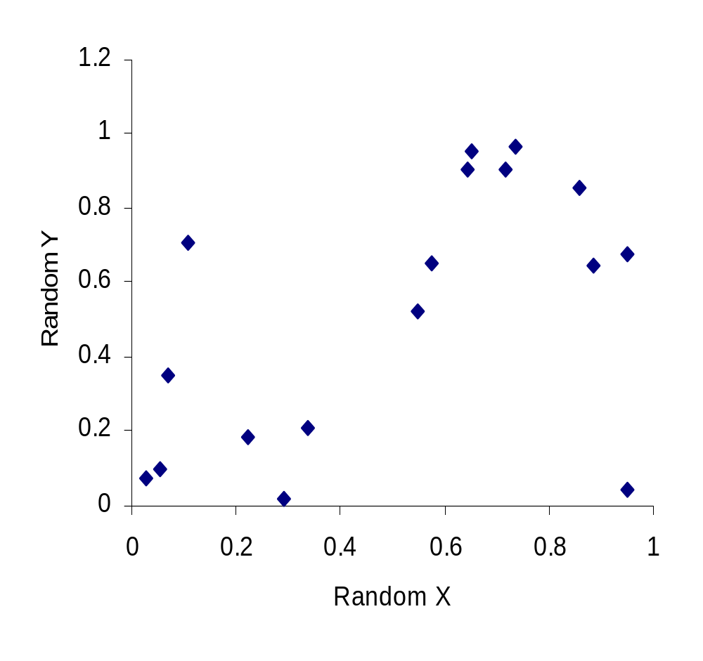
The Danger of Polynomial Regression
RandX | RandY
0.65232 | 0.95616
0.10743 | 0.70663
0.29166 | 0.01942
0.64533 | 0.90362
0.95148 | 0.67739
0.71822 | 0.90728
0.88513 | 0.64330
0.02542 | 0.07266
0.85852 | 0.85366
0.73669 | 0.96528
0.22272 | 0.18555
0.54621 | 0.52321
0.57460 | 0.65462
0.33640 | 0.21208
0.95080 | 0.04560
0.05365 | 0.09695
0.06928 | 0.35087
Xuhua Xia

Slide 19
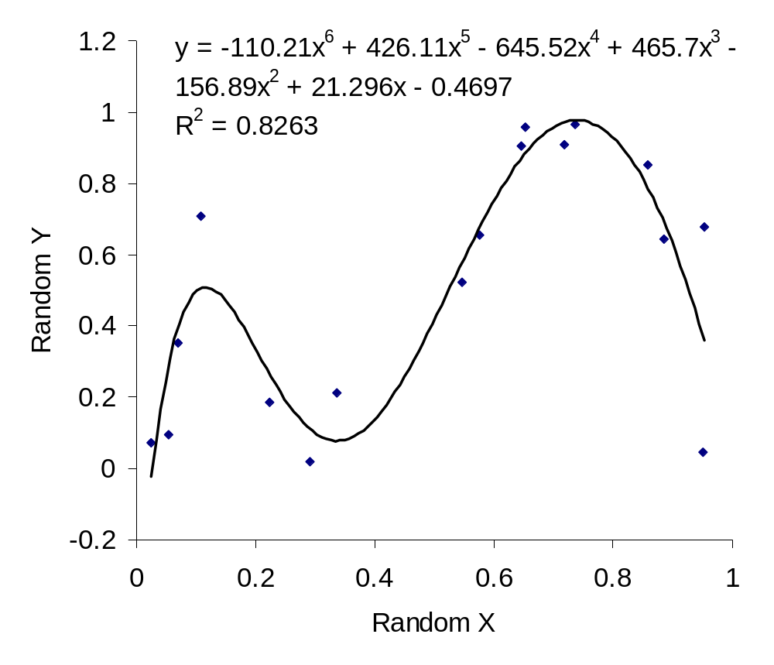
Polynomial Regression (order 6)
Xuhua Xia

