Slide 1
Kernel Density Estimation - concept and applications
Bohyung Han
bhhan@cs.umd.edu

Slide 2
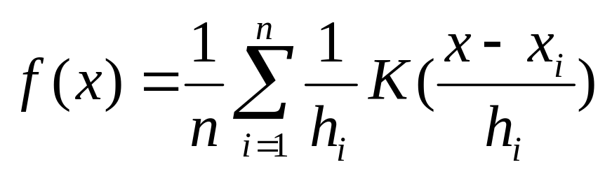
Kernel Density Estimation
Definition of KDE
Characteristics
  Nonparametric technique
  Effective multi-modal data representation
  Consideration of noise for observed data
  Representation of model/state

Slide 3
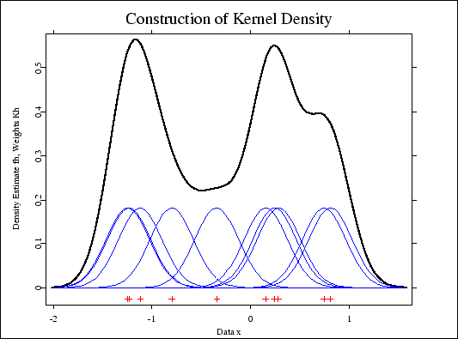
Example

Slide 4
Variations
Kernel
  Uniform
  Gaussian
  Epanechnikov
  …
Bandwidth
  Fixed to every data
  Variable according to data pattern

Slide 5
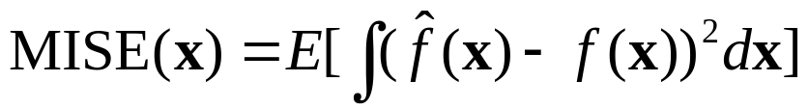
Issues
Bandwidth selection
  Automatic data-dependent bandwidth selection
    MISE (Mean Integrated Squared Error)
      Error between the estimated and the true density (which is not known)
  Variable bandwidth selection
    Mean-shift
    No good method yet

Slide 6
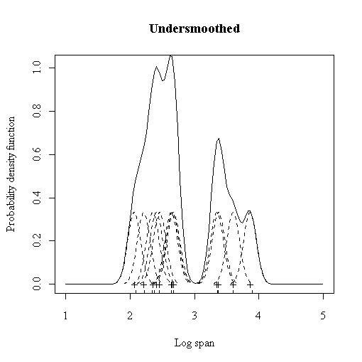
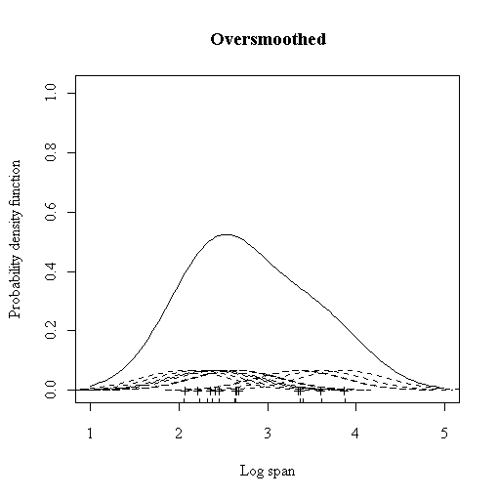
Issues – cont’d

Slide 7
Issues – cont’d
Computational cost
  Slow
    No closed form
    A lot of exponential computations (Gaussian kernel)
  Memory consumption
    Must store all the data in most cases!

Slide 8
Application – BGS (1)
Overview
  PDF per pixel by KDE
  Classification by global threshold
  Nonparametric representation
    Better than parametric representation
  Very high computational cost in high dimension, especially
  Huge memory requirement
  Bandwidth selection issue

Slide 9

Application – BGS (2)
Contribution
  Good background modeling for multi-modal cases
  False alarm reduction: using spatial information
  Shadow detection

Slide 10
Application – BGS (3)
Solution for issues
  Exponential computations
    Large pre-generated table
    producing round-off error
  No good solution for memory depletion
  Variable bandwidth selection
    Median absolute deviation over the sample for consecutive intensity values

