Slide 1




1
Auditing
Parameswari Ettiappan

Slide 2
MongoDB Auditing
The auditing framework provided as part of MongoDB Enterprise Advanced.
It logs all access and actions executed against the database.
The auditing framework captures administrative actions (DDL) such as schema operations as well as authentication and authorization activities.
It also captures read and write (DML) operations to the database.
Administrators can construct and filter audit trails for any operation against MongoDB, whether DML, DCL or DDL without having to rely on third party tools.

Slide 3
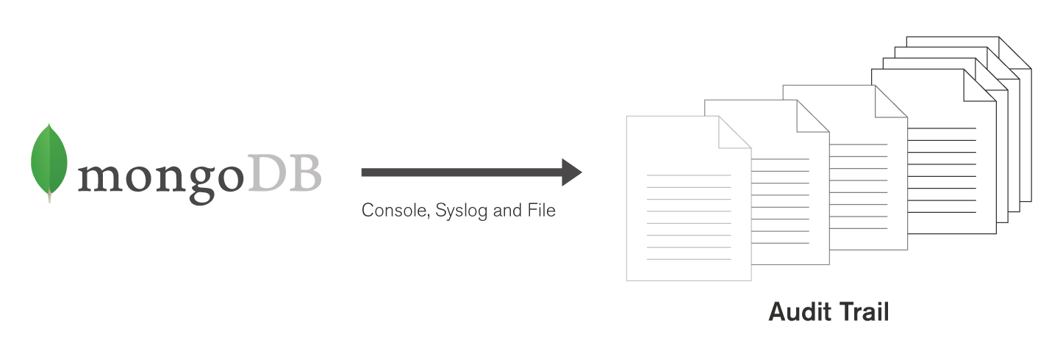
MongoDB Auditing
For example, it is possible to log and audit the identities of users who retrieved specific documents, and any changes made to the database during their session.

Slide 4
MongoDB Auditing
Administrators can configure MongoDB to log all actions or apply filters to capture only specific events, users or roles.
The audit log can be written to multiple destinations in a variety of formats including to the console and syslog (in JSON format), and to a file (JSON or BSON).
It can be loaded to MongoDB and analyzed to identify relevant events.
MongoDB Enterprise Advanced also supports role-based auditing.

Slide 5
MongoDB Auditing
It is possible to log and report activities by specific role, such as userAdmin or dbAdmin – coupled with any inherited roles each user has – rather than having to extract activity for each individual administrator.
Auditing adds performance overhead to a MongoDB system.
The amount is dependent on several factors including which events are logged and where the audit log is maintained, such as on an external storage device and the audit log format.
Users should consider the specific needs of their application for auditing and their performance goals in order to determine their optimal configuration.

Slide 6
Configure Auditing
Output to console
mongod --dbpath data/db --auditDestination console
Output to syslog
mongod --dbpath data/db --auditDestination syslog
Output to json
mongod --dbpath data/db --auditDestination file
--auditFormat JSON --auditPath data/db/auditLog.json
Output to bson
mongod --dbpath data/db --auditDestination file
--auditFormat BSON --auditPath data/db/auditLog.bson

Slide 7
Configure Auditing
Configuration Log
storage:
dbPath: data/db
auditLog:
destination: console
storage:
dbPath: data/db
auditLog:
destination: file
format: BSON
path: data/db/auditLog.bson
storage:
dbPath: data/db
auditLog:
destination: file
format: JSON
path: data/db/auditLog.json

Slide 8
Configure Audit Filters
mongod --dbpath data/db --auditDestination file --auditFilter '{ atype: { $in: [ "createCollection", "dropCollection" ] } }' --auditFormat BSON --auditPath data/db/auditLog.bson
storage:
dbPath: data/db
auditLog:
destination: file
format: BSON
path: data/db/auditLog.bson
filter:[ '{ atype: { $in: [ "createCollection", "dropCollection" ] }, }’,’{ roles: { role: "readWrite", db: "test" } }’]

Slide 9
Configure Audit Filters
Audits only the authenticate operations that occur against the
test database by using the filter
{ atype: "authenticate", "param.db": "test" }
Filter on Collection Creation and Drop Operations for a Single Database
{ atype: { $in: [ "createCollection", "dropCollection" ] },
"param.ns": /^test\\./ } }
Filter by Authorization Role
{ roles: { role: "readWrite", db: "test" } }

Slide 10
Configure Audit Filters
Filter on Read and Write Operations
{ atype: "authCheck", "param.command":
{ $in: [ "find", "insert", "delete", "update", "findandmodify" ] } }
Filter on Read and Write Operations for a Collection
{ atype: "authCheck", "param.ns": "test.orders",
"param.command": { $in: [ "find", "insert", "delete",
"update", "findandmodify" ] } }

