Slide 1




1
Encryption
Parameswari Ettiappan

Slide 2
Encrypting communication using TLS/SSL
mongod --sslMode requireSSL --sslPEMKeyFile <pem> --sslCAFile <ca>
Configuration File
net:
ssl:
mode: requireSSL
PEMKeyFile: /etc/ssl/mongodb.pem
CAFile: /etc/ssl/ca.pem
disabledProtocols: TLS1_0,TLS1_1,TLS1_2

Slide 3
Encrypting data in MongoDB
Key component of MongoDB’s toolset is to help customers achieve strong data security through encryption of data in flight and at rest.

Slide 4
Data-in-Motion Encryption
For securing data in motion, all versions of MongoDB support TLS (Transport Layer Security) and SSL (Secure Socket Layer) to send and receive data over networks.
TLS and SSL are the types of encryption commonly used to secure website traffic and file sharing.
They are cryptographic protocols that secure data while it is traveling from one point to another.
However, before the data is sent and after the data arrives at its endpoint, the data appears unencrypted, or “in the clear”.

Slide 5
Data-in-Motion Encryption
When considering encryption, enterprise customers must be aware of governmental and private regulations that require protecting sensitive information.
For example, the Payment Card Industry (PCI) requires that credit card numbers be encrypted in storage.
The HIPAA medical regulations require protection of Electronic Protected Health Information (ePHI).
There are many other regulations that require proper protection of Personally Identifiable Information (PII).
A challenge for MongoDB users is that it is often difficult to know when sensitive information is being added to the database.
The safe security strategy is to always encrypt the MongoDB database and use proper key management.

Slide 6
Data-at-Rest Encryption
To encrypt data at rest, MongoDB Enterprise offers native storage-based file symmetrickey encryption.
Users can use transparent data encryption (TDE) to encrypt whole database files at the storage level.
First offered in version 3.2, MongoDB utilizes the Advanced Encryption Standard (AES) 256-bit encryption algorithm, an encryption cipher which uses the same secret key to encrypt and decrypt data.
MongoDB also provides the option to turn encryption on in “FIPS mode”, which means the encryption you use in MongoDB is built to meet the highest standard and meet compliance.

Slide 7
Data-at-Rest Encryption
The Federal Information Processing Standard (FIPS) is a National Institute of Standards and Technology (NIST) validation that demonstrates your encryption algorithm has undergone rigorous tests.
The NIST FIPS validation is often required for government and Department of Defense contractors;
Today NIST-validated AES encryption is considered an industry standard and is typically recommended or required by most industry-based compliance regulations.
Data at rest encryption is only available on MongoDB Enterprise and Atlas editions using the required WiredTiger storage engine.

Slide 8
Data-at-Rest Encryption
When encrypting data natively using TDE, it is important to know how encryption keys are stored in MongoDB.
When a database file is encrypted, a unique, private encryption key is generated.
Each encrypted database file generates a new private symmetric key, and all keys in your storage device are encrypted using a master key.
While the database keys are stored alongside the encrypted data, the MongoDB never allows the master key to be stored on the same server as the encrypted data.
This means that the database or security administrator must identify a secure storage location for the encryption key.

Slide 9
Data-at-Rest Encryption
MongoDB strongly recommends a third-party enterprise key management solutions;
However, users have the option to store the key locally using a keyfile.
This second option is extremely risky, and almost never recommended for key protection.
Encryption is performed at the page level to provide optimal performance.
Instead of having to encrypt/decrypt the entire file or database for each change, only the modified pages need to be encrypted or decrypted.

Slide 10
Data Encryption Process
Generating a master key.
Generating keys for each database.
Encrypting data with the database keys.
Encrypting the database keys with the master key.
The encryption occurs transparently in the storage layer; i.e. all data files are fully encrypted from a filesystem perspective, and data only exists in an unencrypted state in memory and during transmission.

Slide 11
Configure Data Encryption
MongoDB Enterprise 3.2 introduces a native encryption option for the Wired Tiger storage engine.
With storage encryption, the secure management of the encryption keys is critical.
Only the master key is external to the server and requires external management.
To manage the master key, MongoDB’s encrypted storage engine supports two key management options:
  Integration with a third party key management appliance via the Key Management Interoperability Protocol (KMIP) → Recommended
  Use of local key management via a key file.

Slide 12
Configure Data Encryption
Key Manager
MongoDB Enterprise supports secure transfer of keys with compatible key management appliances.
Using a key manager allows for the keys to be stored in the key manager.
MongoDB Enterprise supports secure transfer of keys with Key Management Interoperability Protocol (KMIP) compliant key management appliances.
Any appliance vendor that provides support for KMIP is expected to be compatible.

Slide 13
Configure Data Encryption
Prerequisites
Your key manager must support the KMIP communication protocol.
To authenticate MongoDB to a KMIP server, you must have a valid certificate issued by the key management appliance.

Slide 14
Configure Data Encryption
Encrypt Using a New Master Key
To create a new master key, connect mongod to the key manager by starting mongod with the following options:
--enableEncryption
--kmipServerName
--kmipPort
--kmipServerCAFile
--kmipClientCertificateFile

Slide 15
Configure Data Encryption
mongod --enableEncryption --kmipServerName <KMIP Server HostName> \
--kmipPort <KMIP server port> --kmipServerCAFile ca.pem \
--kmipClientCertificateFile client.pem

Slide 16
Configure Data Encryption
Encrypt Using a Existing Master Key
To create a existing master key, connect mongod to the key manager by starting mongod with the following options:
--enableEncryption
--kmipServerName
--kmipPort
--kmipServerCAFile
--kmipClientCertificateFile
--kmipKeyIdentifier

Slide 17
Configure Data Encryption
mongod --enableEncryption --kmipServerName <KMIP Server HostName> \
--kmipPort <KMIP server port> --kmipServerCAFile ca.pem \
--kmipClientCertificateFile client.pem --kmipKeyIdentifier <UID>

Slide 18
Local Key Management
Create the base64 encoded keyfile with the 16 or 32 character string. You can generate the encoded keyfile using any method you prefer. For example,
openssl rand -base64 32 > mongodb-keyfile
Update the file permissions.
chmod 600 mongodb-keyfile
To use the key file, start mongod with the following options:
--enableEncryption,
--encryptionKeyFile <path to keyfile>,
mongod --enableEncryption --encryptionKeyFile mongodb-keyfile

Slide 19
Evaluating Performance
Encrypting and decrypting data requires the use of additional resources.
Encrypted Storage Engine benchmarking tests, we saw an average throughput overhead between 10% and 20%.
Test for Insert Only, Read Only.
With 50%-Read/50%-Insert workloads.

Slide 20
Evaluating Performance
For testing, chosen Intel Xeon X5675 CPUs, which support the AES-NI instruction set, and ran the CPUs at high load(100%).
There were four different configurations that was evaluated; “Working Set Fits In Memory”, “Working Set Exceeds Memory”, “Encrypted”, and “Unencrypted”.
The ‘Working Set’ refers to the amount of data and indexes that is actively used by your system.

Slide 21
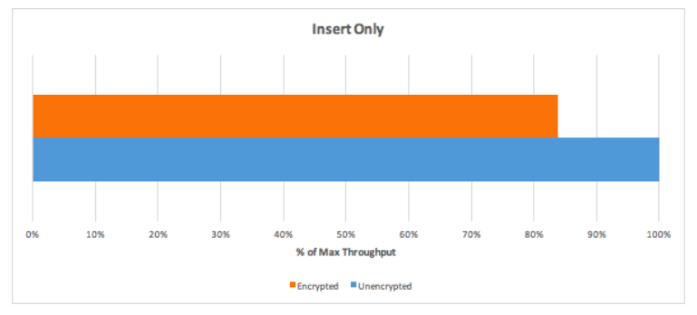
Evaluating Performance
First case for Insert-Only workload.
With a high CPU load, encryption overhead is around ~16%.

Slide 22
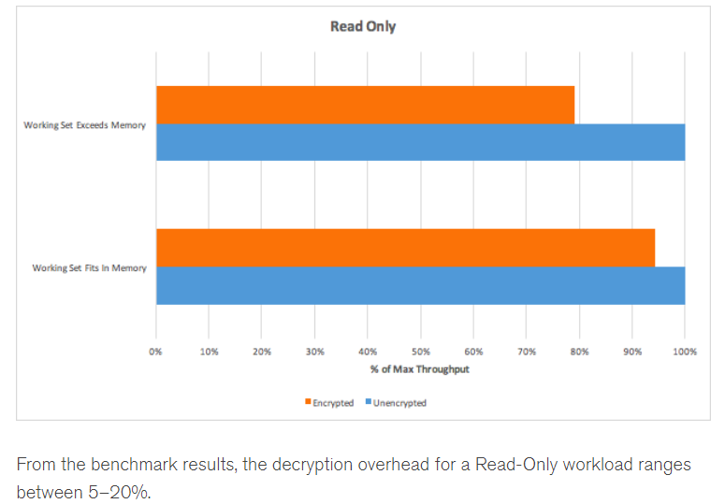
Evaluating Performance
Second case for Read-Only Workload. Tested for two scenarios; “Working Set Fits In Memory” and “Working Set Exceeds Memory”.

Slide 23
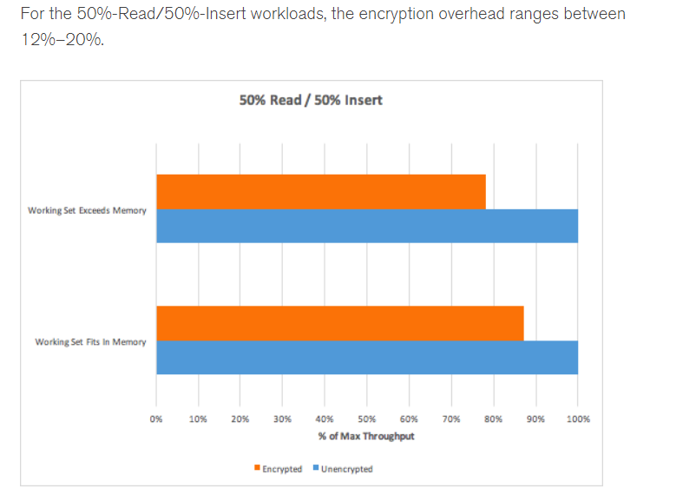
Evaluating Performance

Slide 24
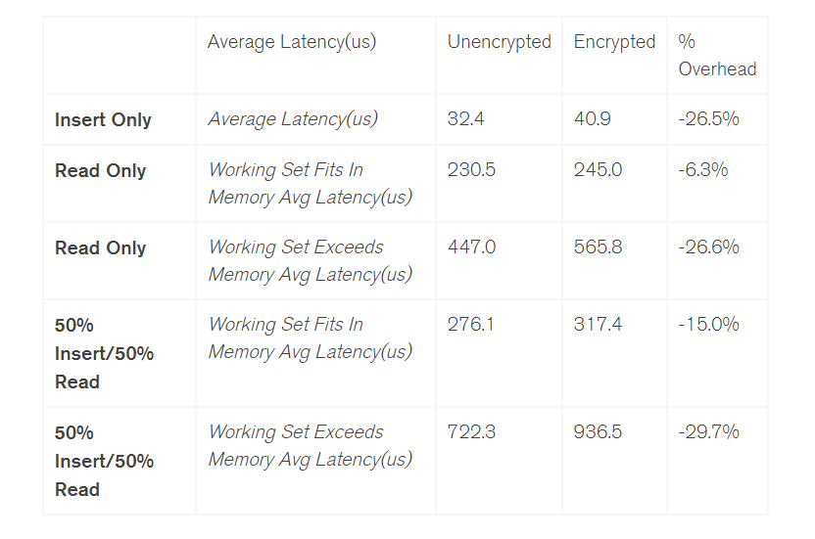
Evaluating Performance

