Slide 1



P

Slide 2
What is MongoDB?
Definition: MongoDB is an open-source document oriented database that provides high performance, high availability, and automatic scaling.
Instead of storing data in tables and rows as with a relational database, in MongoDB stores data in JSON-like documents with dynamic schemas(schema-free).
NoSQL Database
Document Oriented
Database
Mongo DB

Slide 3
What is MongoDB? Contd…
MongoDB represents data as collections of JSON documents.
MongoDB uses object querying.
MongoDB does not support joins, but it does multi-dimensional data types such as arrays and even other documents (embedded documents).
MongoDB does not support transactions.
MongoDB is schema free.

Slide 4
Key Feature
High Performance
High Availability (Replication)
Automatic Scaling( Horizontal Scaling)
Aggregation
Indexing
Load Balancing(Sharding)
File Storage( GridFS)
Easy Readability

Slide 5
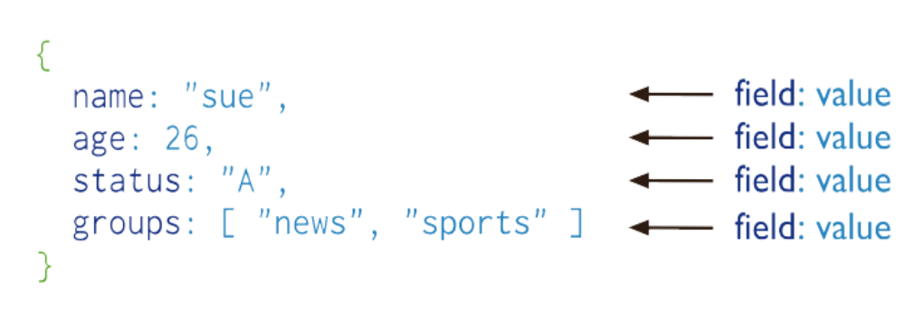
Document
MongoDB store record/data in the form of documents, which is a data structure composed of field and value pairs.
MongoDB documents are similar to JSON objects.
The value of a field can be any of the BSON data types, including other documents, arrays, and arrays of documents.

Slide 6
Document Contd…
Every document has a special key, "_id", that is unique within a collection.
Important Note: Documents in MongoDB cannot contain duplicate keys.
    For example, the following is not a legal document:
  {greeting : "Hello, world!",
  greeting : "Hello, MongoDB!"}

Slide 7
Document Structure
MongoDB documents are composed of field-and-value pairs and have the following structure:
        {
        field1: value1,
        field2: value2,
        ...
        fieldN: valueN
        }
The value of a field can be any of the BSON data types, including other documents, arrays, and arrays of documents.
Field name are String.

Slide 8
Document Structure Contd…
Example:
{
_id: ObjectId("5099803df3f4948bd2f98391"),
name: { first: "Alan", last: "Turing" },
birth: new Date('Jun 23, 1912'),
death: new Date('Jun 07, 1954'),
contribs: [ "Turing machine", "Turing test", "Turingery" ],
views : Number(250)
}

Slide 9
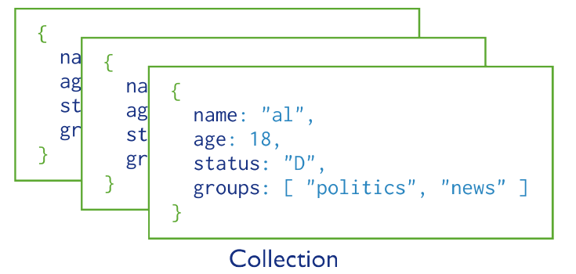
Collection
MongoDB stores all documents in collections.
A collection is a group of related documents.
Collections are analogous to a table in relational databases.

Slide 10
In short We Can say:
Database
Collection
Documents

Slide 11
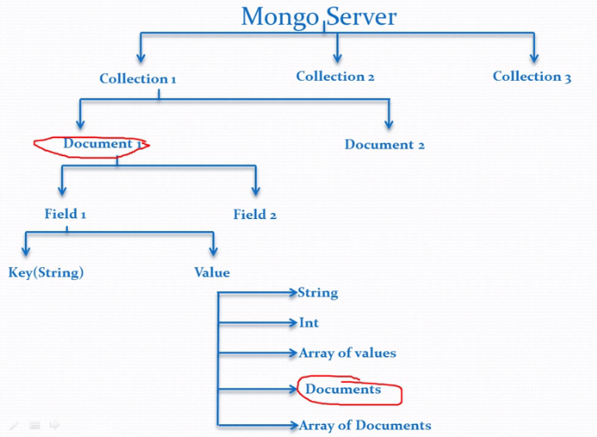
Data Storage Mechanism

Slide 12
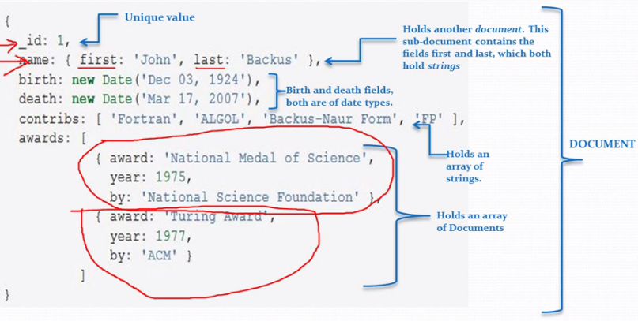
Data Storage Mechanism Contd..

Slide 13
MongoDB-Datatypes
  Documents in MongoDB can be thought of as “JSON-like” in that they are conceptually similar to objects in JavaScript.
  JSON is a simple representation of data:
  Null: Use to represent both a null value and a nonexistent field:
  {field : null}
  Boolean: which can be used for the values true and false:
  {field : true}
  String: Any string of characters can be represented using the string type:
  {field : "foodbar"}

Slide 14
MongoDB-Datatypes contd…
Number: The shell defaults to using 64-bit floating point numbers. Thus, these numbers look “normal” in the shell:
{field : 3.14} or: {field : 3}
For integers, use the NumberInt or NumberLong classes, which represent 4-byte or 8-byte signed integers, respectively.
{field : NumberInt(3)}
{field : NumberLong(3)}
Dates: are stored as milliseconds. The time zone is not stored:
{field : new Date()}

Slide 15
MongoDB-Datatypes contd…
Array: Sets or lists of values can be represented as arrays:
{field : ["a", "b", "c"]}
Embedded document: Documents can contain entire documents embedded as values in a parent document:
{field : {field : "abc"}}
object id: An object id is a 12-byte ID for documents.
{_id : ObjectId()}

Slide 16

_id and ObjectIds
Every document stored in MongoDB must have an "_id" key.
ObjectId is the default type for "_id".
Unique _id field that acts as a primary key
ObjectIds use 12 bytes of storage, which gives them a string representation that is 24 hexadecimal digits: 2 digits for each byte.

Slide 17
MongoDB CRUD Operations
CRUD stands for Create Read Update and Delete operation.
Read operation(Find operation)
Write operation(Create ,Update and Delete operation)

Slide 18
Read Operation:
Read operations, or queries, retrieve data stored in the database.
In MongoDB, queries select documents from a single collection.
Queries specify criteria, or conditions, that identify the documents that MongoDB returns to the clients.
A query may include a projection that specifies the fields from the matching documents to return.

Slide 19
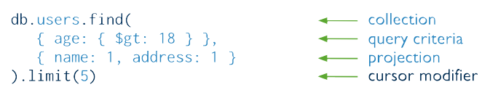
Read Operation Contd..
Query Interface
  For query operations, MongoDB provide a method
db.collection.find() or db.collection.findone()
  The method accepts both the query criteria and projections and returns a cursor to the matching documents.
Fig: Component of Find Operation

Slide 20
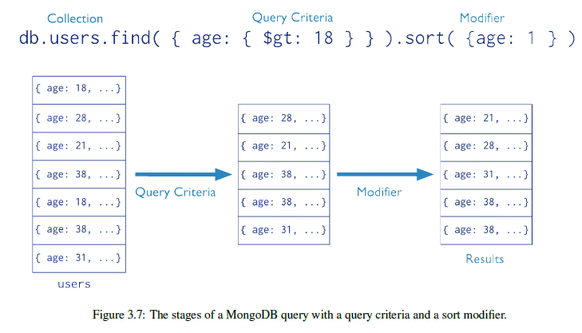
Read Operation Contd..
  MongoDB queries exhibit the following behavior:
  The order of documents returned by a query is not defined unless you specify a sort().

Slide 21
Read Operation Contd..
  Find method with skip()
db.userdetails.find().skip(2)
  To display output in structure format
db.userdetails.find().skip(2).pretty()
  Using both limit and skip with find
db.userdetails.find().skip(1).limit(2).pretty()

Slide 22
Read Operation Contd..
Projection
  Queries in MongoDB return all fields in all matching documents by default.
  In MongoDB, the _id field is always included in results unless explicitly excluded.
  To display field display its value to 1 otherwise 0

Slide 23
Read Operation Contd..
Projection Examples
1. Exclude One Field From a Result Set:
  db.records.find( {"user_id: { $lt: 42} }, { history: 0} )
  2. Return Two fields and the _id Field:
  db.records.find({ user_id: { $lt: 42} }, { name: 1, email: 1})
  3. Return Two Fields and Exclude _id:
  db.records.find( { user_id: { $lt: 42} }, { _id: 0, name: 1 , email: 1 } )

Slide 24
Write Operation:
Write operation is any operation that creates or modifies data in the MongoDB instance.
There are three classes of write operations in MongoDB:
Insert (Create) , Update, and Remove (Delete)
For the update and remove operations, you can specify criteria, or conditions, that identify the documents to update or remove.

Slide 25
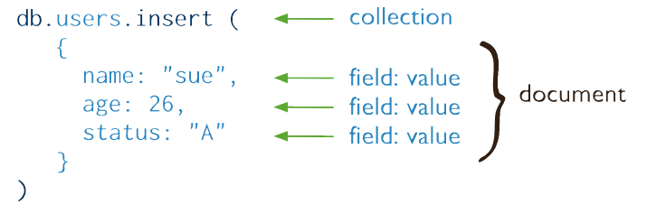
Create:
Create operations add new documents to a collection.
In MongoDB, the db.collection.insert() method perform create operations.

Slide 26
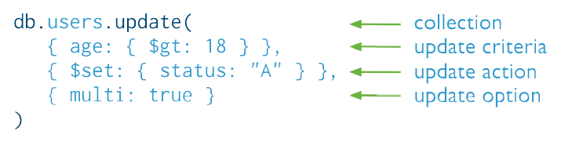
Update:
Update operations modify existing documents in a collection.

Slide 27
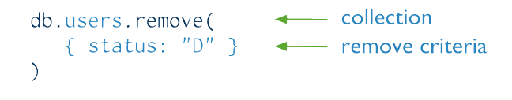
Delete:
Delete operations remove documents from a collection.
In MongoDB, db.collection.remove() method performs delete operations.

Slide 28
Example
of
CRUD Operation

Slide 29
Insert Document
There are 3 ways to insert document:
Insert a Document with insert() Method
Insert a Document with update() Method
Insert a Document with save() Method

Slide 30
1.Insert a Document with insert() Method:
  The following statement inserts a document with three fields into the collection inventory:
db.inventory.insert( {
_id: 10,
type: "misc",
item: "card",
qty: 15
}
)
  In the example, the document has a user-specified _id field value of 10. The value must be unique within the inventory collection.

Slide 31
2.Insert a Document with
update() Method:
Call the update() method with the upsert flag to create a new document if no document matches the update’s query criteria.
The following example creates a new document if no document in the inventory collection contains { type : "books", item : "journal" }:
        db.inventory.update(
        { type: "book", item : "journal" },
        { $set : { qty: 10 } },
        { upsert : true }
        )

Slide 32
3.Insert a Document with save() Method:
To insert a document with the save() method, pass the method a document that does not contain the _id field or a document that contains an _id field that does not exist in the collection.
db.inventory.save( { type: "book", item: "notebook", qty: 40 } )
db.inventory.save( { _id:10, type: "book", item: "notebook", qty: 40 } )

Slide 33
Modify Document
There are 2 ways to update document:
Modify Multiple Documents with update() Method
Modify a Document with save() Method

Slide 34
1.Modify Multiple Documents with
update() Method:
By default, the update() method updates a single document that matches its selection criteria.
Call the method with the multi option set to true to update multiple documents.
  The following example finds all documents with type equal to "book" and modifies their qty field by -1. The example uses $inc, which is one of the update operators available.
        db.inventory.update(
        { type : "book" },
        { $inc : { qty : -1 } },
        { multi: true }
        )

Slide 35
2.Modify a Document with save() Method:
The save() method can replace an existing document. To replace a document with the save() method, pass the method a document with an _id field that matches an existing document.
  The following example completely replaces the document with the _id equal to 10 in the inventory collection:
        db.inventory.save(
        { _id: 10,
        type: "misc",
        item: "placard"
        } )

Slide 36
Remove Document
Remove All Document:
    To remove all documents from a collection, pass an empty query document {} to the remove() method.
db.inventory.remove({})
Remove Documents that Match a Condition:
    To remove the documents that match a deletion criteria, call the remove() method with the <query> parameter.
db.inventory.remove( { type : "food" } )
Remove a Single Document that Matches a Condition:
    To remove a single document, call the remove() method with the just One parameter set to true or 1.
db.inventory.remove( { type : "food" }, 1 )

Slide 37
Query Document
In MongoDB, the db.collection.find() method retrieves documents from a collection.
The db.collection.find() method returns a cursor to the retrieved documents.

Slide 38
1.Select All Documents in a Collection:
  An empty query document ({}) selects all documents in the collection:
db.collection.find( {} )

Slide 39
2.Specify Equality Condition:
  To specify equality condition, use the query document
  { <field>: <value> }
  to select all documents that contain the <field> with the specified <value>.
    The following example retrieves from the inventory collection all documents where the type field has the value snacks:
db.inventory.find( { type: "snacks" } )

Slide 40
3.Specify Conditions Using
Query Operators:
  A query document can use the query operators to specify conditions in a MongoDB query.
      The following example selects all documents in the inventory collection where the value of the type field is either ’food’ or ’snacks’:
  db.inventory.find( { type: { $in: [ 'food', 'snacks' ] } } )

Slide 41
4.Specify AND Conditions:
  In the following example, the query document specifies an equality match on the field food and a less than ($lt) comparison match on the field price:
  db.inventory.find( { $and:[
  type: 'food',
  price: { $lt: 9.95 } ]
  } )
  This query selects all documents where the type field has the value ’food’ and the value of the price field is less than 9.95.

Slide 42
5.Specify OR Conditions:
db.inventory.find( { $or: [
{ qty: { $gt: 100 } },
{ price: { $lt: 9.95 } }
]
} )
  In the above example, the query document selects all documents in the collection where the field qty has a value greater than ($gt) 100 or the value of the price field is less than ($lt) 9.95.

Slide 43
6.Specify AND as well as OR Conditions:
db.inventory.find( {
$and : [
{ $or : [ { price : 0.99 }, { price : 1.99 } ] },
{ $or : [ { sale : true }, { qty : { $lt : 20 } } ] }
]
} )

Slide 44
7.Embedded Documents:
  When the field holds an embedded document, a query can either specify an exact match on the embedded document or specify a match by individual fields in the embedded document using the dot notation.
  Exact Match on the Embedded Document
  Equality Match on Fields within an Embedded Document

Slide 45
A. Exact Match on the Embedded Document
  To specify an equality match on the whole embedded document, use the query document { <field>: <value> } where <value> is the document to match.
  Equality matches on an embedded document require an exact match of the specified <value>, including the field order.
  In the following example, the query matches all documents where the value of the field producer is an embedded document that contains only the field company with the value ’ABC123’ and the field address with the value ’123 Street’, in the exact order:
db.inventory.find(
{
producer: {
company: 'ABC123',
address: '123 Street'
}
} )

Slide 46
B. Equality Match on Fields within an Embedded Document
  Use the dot notation to match by specific fields in an embedded document.
  Equality matches for specific fields in an embedded document will select documents in the collection where the embedded document contains the specified fields with the specified values.
  The embedded document can contain additional fields.
  In the following example, the query uses the dot notation to match all documents where the value of the field producer is an embedded document that contains a field company with the value ’ABC123’ and may contain other fields:
  db.inventory.find( { producer.company: 'ABC123' } )

Slide 47
8. Arrays:
Exact Match on an Array
Match an Array Element
Match a Specific Element of an Array
Array of Embedded Documents

Slide 48
Array Condt…
A. Exact Match on an Array
db.inventory.find( { tags: [ 'fruit', 'food', 'citrus' ] } )
B. Match an Array Element
db.inventory.find( { tags: 'fruit' } )
C. Match a Specific Element of an Array
db.inventory.find( { 'tags.0' : 'fruit' } )
D. Array of Embedded Documents
Case 1: Match a Field in the Embedded Document Using the Array Index
Case 2: Match a Field Without Specifying Array Index
Case 3: Match Multiple Fields

Slide 49
D. Array of Embedded Documents
Consider that the inventory collection includes the following documents :
{ _id: 100,
type: "food",
item: "xyz",
qty: 25,
price: 2.5,
memos: [ { memo: "on time", by: "shipping" }, { memo: "approved", by: "billing" } ] }
{ _id: 101,
type: "fruit",
item: "jkl",
qty: 10,
price: 4.25,
memos: [ { memo: "on time", by: "payment" }, { memo: "delayed", by: "shipping" } ] }

Slide 50
Case 1: Match a Field in the Embedded Document Using the Array Index
If you know the array index of the embedded document, you can specify the document using the subdocument’s position using the dot notation.
The following example selects all documents where the memos contains an array whose first element (i.e. index is 0) is a document that contains the field by whose value is ’shipping’:
db.inventory.find( { memos.0.by: 'shipping' } )
The operation returns document with _id:100 as output.

Slide 51
Case 2: Match a Field Without Specifying Array Index
If you do not know the index position of the document in the array, concatenate the name of the field that contains the array, with a dot (.) and the name of the field in the subdocument.
The following example selects all documents where the memos field contains an array that contains at least one embedded document that contains the field by with the value ’shipping’:
db.inventory.find( { 'memos.by': 'shipping' } )
The operation returns both document with _id:100 and _id:101 as output.

Slide 52
Case 3: Match Multiple Fields
To match by multiple fields in the embedded document, you can use either dot notation or the $elemMatch operator:
The following example uses dot notation to find documents where whose memos field is an array that contains at least one document that contains the field memo equal to ’on time’ and at least one document that contains the field by equal to ’shipping’.
db.inventory.find(
{
'memos.memo': 'on time',
'memos.by': 'shipping'
}
)

Slide 53
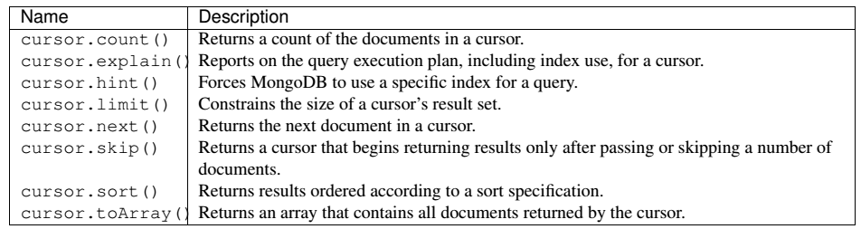
Query Cursor Methods

Slide 54
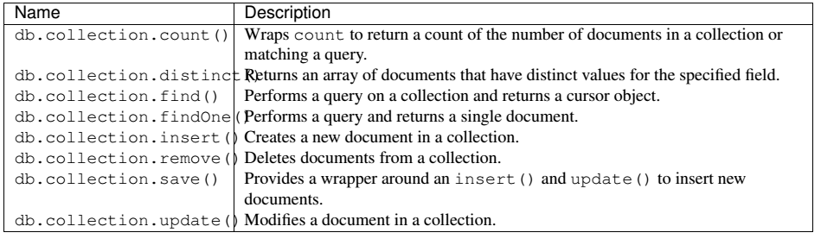
Query and Data Manipulation Collection Methods

Slide 55
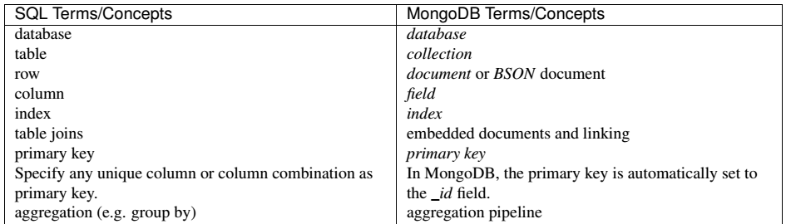

SQL to MongoDB Mapping Chart

Slide 56
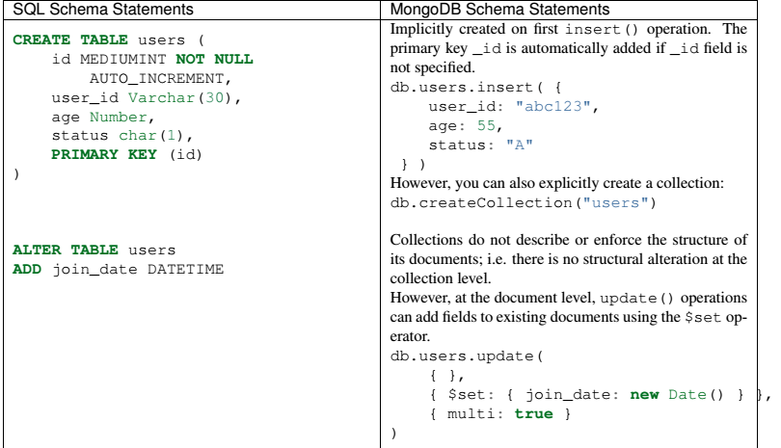
Create and Alter Opeartion

Slide 57
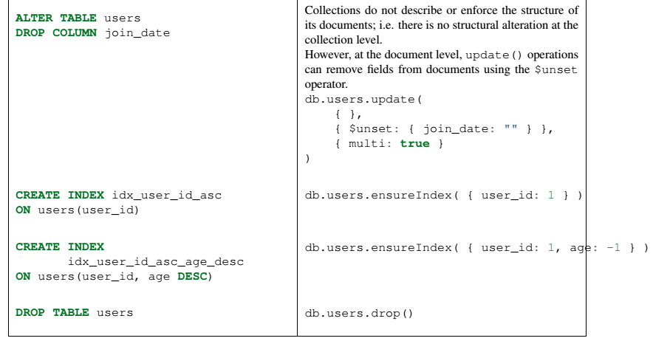
Create and Alter Operation

Slide 58
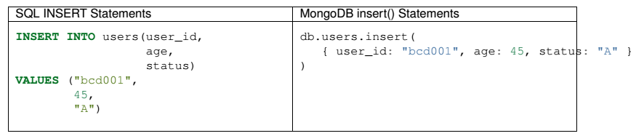
Insert Operation

Slide 59
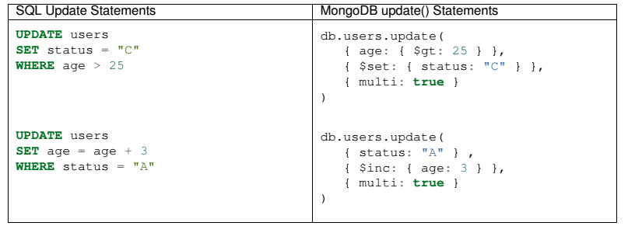
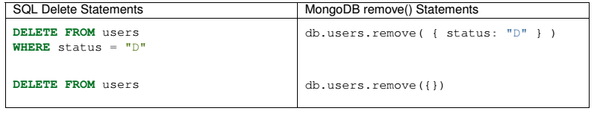
Update Operation
Delete Operation

Slide 60
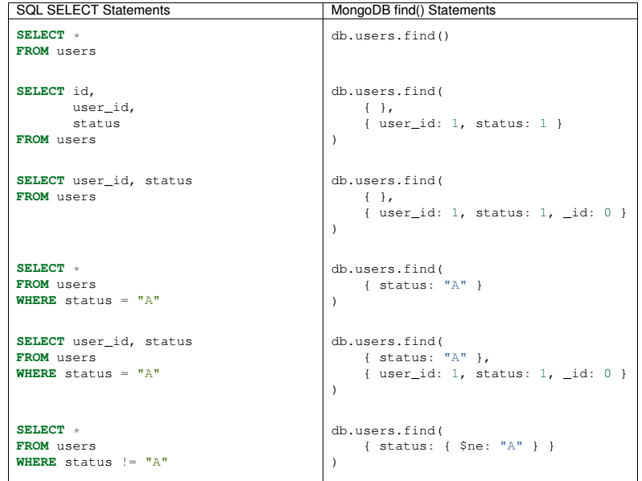
Select Operation

Slide 61
CREATE OPERATION
SQL Schema Statements | MongoDB Schema Statements
CREATE TABLE users ( id MEDIUMINT NOT NULL AUTO_INCREMENT, user_id Varchar(30), age Number, status char(1), PRIMARY KEY (id) ) | db.users.insert( { user_id: "abc123", age: 55, status: "A" } ) However, you can also explicitly create a collection: db.createCollection("users")

Slide 62
ALTER OPERATION
ALTER TABLE users ADD join_date DATETIME ALTER TABLE users DROP COLUMN join_date | db.users.update( { }, { $set: { join_date: new Date() } }, { multi: true } ) db.users.update( { }, { $unset: { join_date: "" } }, { multi: true } )
SQL Schema Statements MongoDB Schema Statements

Slide 63
READ OPERATION
SQL SELECT Statements | MongoDB find() Statements
SELECT * FROM users | db.users.find()
SELECT id, user_id, status FROM users | db.users.find( { }, { user_id: 1, status: 1 } )
SELECT user_id, status FROM users | db.users.find( { }, { user_id: 1, status: 1, _id: 0 } )
SELECT * FROM users WHERE status = "A" | db.users.find( { status: "A" } )

Slide 64
SELECT * FROM users WHERE status = "A" AND age = 50 | db.users.find( { status: "A", age: 50 } )
SELECT * FROM users WHERE status = "A" OR age = 50 | db.users.find( { $or: [ { status: "A" } , { age: 50 } ] } )
SELECT * FROM users WHERE age > 25 | db.users.find( { age: { $gt: 25 } } )
SELECT * FROM users WHERE age < 25 | db.users.find( { age: { $lt: 25 } } )
SELECT * FROM users WHERE age > 25 AND age <= 50 | db.users.find( { age: { $gt: 25, $lte: 50 } } )

Slide 65
SELECT * FROM users WHERE status = "A" ORDER BY user_id DESC | db.users.find( { status: "A" } ).sort( { user_id: -1 } )
SELECT COUNT(*) FROM users | db.users.count() or db.users.find().count()
SELECT COUNT(user_id) FROM users | db.users.count( { user_id: { $exists: true } } ) or db.users.find( { user_id: { $exists: true } } ).count()
SELECT COUNT(*) FROM users WHERE age > 30 | db.users.count( { age: { $gt: 30 } } ) or db.users.find( { age: { $gt: 30 } } ).count()
SELECT DISTINCT(status) FROM users | db.users.distinct( "status" )

Slide 66
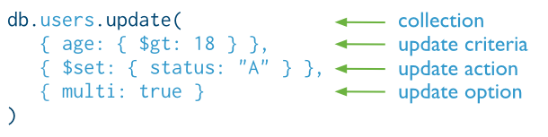
UPDATE OPERATION
UPDATE `users` SET `status` = ‘A’ WHERE `age` > ’18’;

Slide 67
DELETE OPERATION
db.collection.remove() | Delete a single document or all documents that match a specified filter.
db.collection.deleteOne() | Delete at most a single document that match a specified filter even though multiple documents may match the specified filter.
db.collection.deleteMany() | Delete all documents that match a specified filter.
db.users.remove({“name”:”bob”})
db.users.deleteOne({“name”:”bob”})
db.users.deleteMany({“age” :{$gt : 50}})

Slide 68
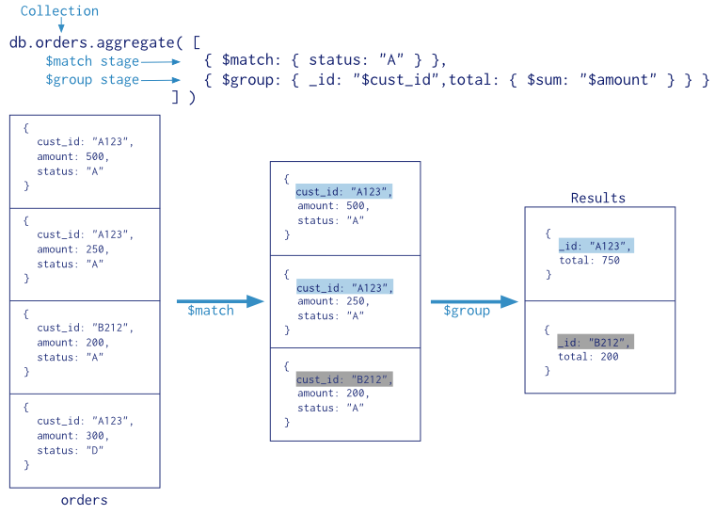
AGGREGATION PIPELINE
Notes:
Select sum(amount) from orders group by cust_id having status = ‘A’;

Slide 69
db.collection.insertOne()
Inserts a single document into a collection.
db.collection.insertMany()
db.collection.insertMany() inserts multiple documents into a collection.
db.collection.insert()
db.collection.insert() inserts a single document or multiple documents into a collection.

Slide 70
Bulk insert
db.inventory.insertMany([
{ item: "journal", qty: 25, tags: ["blank", "red"], size: { h: 14, w: 21, uom: "cm" } },
{ item: "mat", qty: 85, tags: ["gray"], size: { h: 27.9, w: 35.5, uom: "cm" } },
{ item: "mousepad", qty: 25, tags: ["gel", "blue"], size: { h: 19, w: 22.85, uom: "cm" } }
])

Slide 71
Thank
You

