Slide 1
Unit Testing with Junit and Mockito
Parameswari Ettiappan
Notes:
SWAT 2010

Slide 2
Iterative Software development
Write and execute unit tests
Execute acceptance tests
Write acceptance tests
increment
+
system
Prioritized
functionalities
“Written before”
“Executed after the development”
Notes:
SWAT 2010

Slide 3
Testing tools
Jemmy/Abbot/JFCUnit/…
FIT/Fitnesse (High level)
GUI
Perfomance and
Load Testing
JMeter/JUnitPerf
Cactus
Business
Logic
HttpUnit/Canoo/Selenium
Junit (Low level)
Web UI
Persistence
Layer
Junit/SQLUnit/XMLUnit

Slide 4
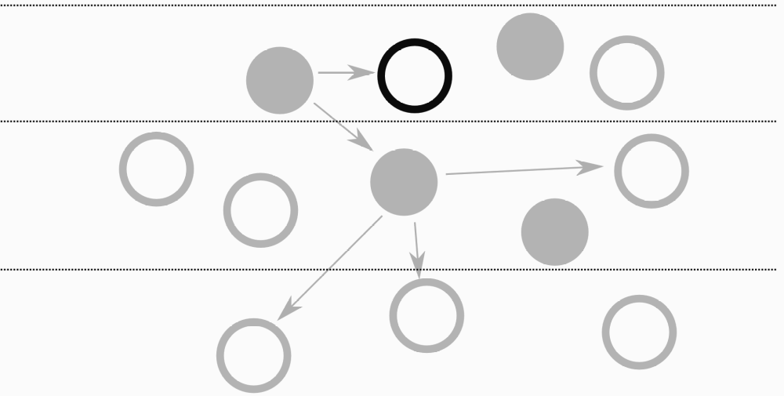
Scope of Unit Testing

Slide 5
Scope of Unit Testing
it is to make sure the class you are working on right now works correctly – to make sure it does its job.
This concerns whether, given certain input data, it will respond with a certain expected output, or whether, fed with nonsense data, it will throw an appropriate exception, and so on.

Slide 6
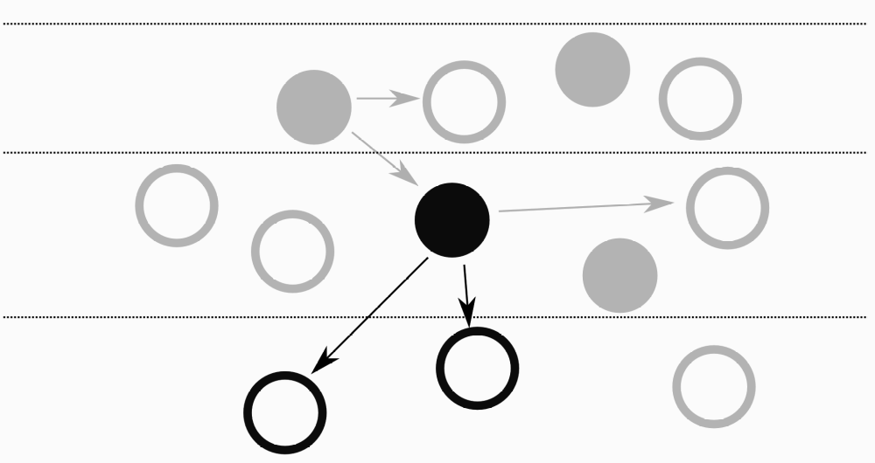
Scope of Integration Test
Extends across Layers

Slide 7
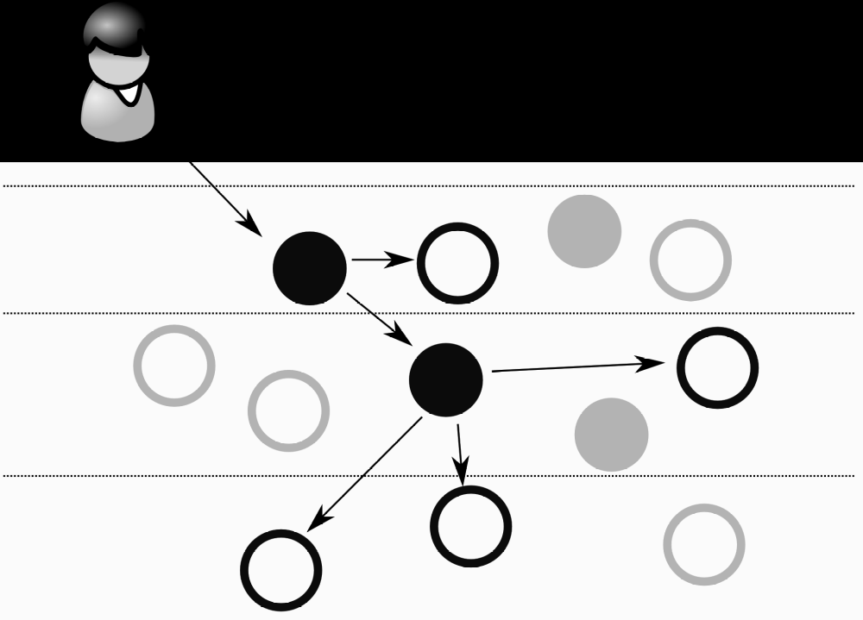
Scope of an end-to-end test
from the front end
(GUI, web services layer or any other external API of the tested system) to the storage layers (e.g.
database storage).

Slide 8
Types of test example
Unit Test
• An object of the class FootballPlayer should change its status to fired after receiving a second yellow card.
• A constructor of the class Product should throw an IllegalArgumentException (with meaningful message) if the price argument is less than 0.

Slide 9
Types of test example
Integration Test
• An invocation of deleteAccount() method of the class UserService with an argument ID of value 1 should result in removal of the account with this ID from the database.
• When asked for an item with ID = 5 for a second time, the ItemDAO class should not touch the real database, but fetch the requested item from the cache instead.
• ParcelService should communicate with some web service, in order to find the parcel’s details, and send an email with the appropriate error information (using EmailService), if the parcel is not found.

Slide 10
Types of test example
End-to-End Test
• A logged on user can add comments to any public picture by clicking on the “add comment” button next to it.
Guest users (users not logged on) can see this comment after it is published, but cannot post their own comments.
• When a shop owner adds a new product to his shop using an Add Product form, it will be possible to locate this product using a Search Form by entering its name in the search field.
• When a user sends his/her geo-location data using a whatCityIsThis web service, the system should respond with a city name.

Slide 11
Testing with JUnit
Junit is a unit test environment for Java programs developed by Erich Gamma and Kent Beck.
    Writing test cases
    Executing test cases
    Pass/fail? (expected result = obtained result?)
Consists in a framework providing all the tools for testing.
  framework: set of classes and conventions to use them.
It is integrated into eclipse through a graphical plug-in.

Slide 12
But Should Developers Test Their Own Code?!
The more trust a development team has (and the more pride it takes!) in its code, the better the results it will achieve.
Developers’ tests help a team to gain confidence and proceed further without being hampered by too much self-doubt.
Also, catching bugs early on (greatly) reduces cost, and shortens the time of repair. The more bugs you find early on, the less they will cost you.

Slide 13
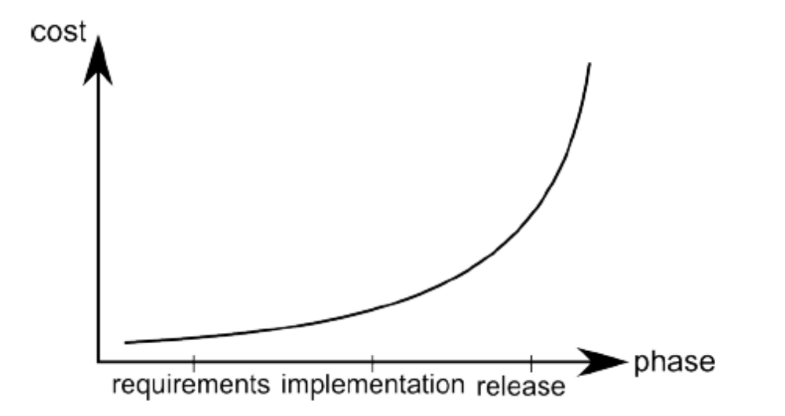
But Should Developers Test Their Own Code?!

Slide 14
Tools Introduction
Use the right tool for the job.
— Andrew Hunt and David Thomas The Pragmatic Programmer: From Journeyman

Slide 15
Tools Introduction
Testing Framework: Junit
Mock Library: Mockito
Other Tools
  Matcher Libraries: FEST And Hamcrest
  JUnitParams
  EasyTest
  Code Coverage: Cobertura

Slide 16
Tools Introduction
Other Tools
  Mock Libraries: PowerMock and EasyMock
  Mutation Testing: PIT
  Utilities: Catch-Exception, Tempus-Fugit, and Unitils

Slide 17
JUnit
JUnit (http://junit.org) is an open-source testing framework for Java.
It was created by Kent Beck around 1997, and since that time has been, de facto, the standard testing tool for Java developers.
It is supported by all IDEs (Eclipse, IntelliJ IDEA), build tools (Ant, Maven, Gradle) and by popular frameworks (e.g. Spring). JUnit has a wide community of users, and is supplemented by a range of interesting extension projects.
It was built especially for unit testing, but is also widely used for other kinds of test.

Slide 18
Mock Library: Mockito
Mockito (http://mockito.org) is a relatively new mocking framework (or rather test-spy framework).
It was born in Q4 2007 (Szczepan Faber being the proud father) and has quickly matured into a top-quality product.
It offers complete control over the mocking process, and "lets you write beautiful tests with clean & simple API".
Originally, Mockito was derived from Easymock, but has evolved substantially, and now differs in many respects from its predecessor.
It is very easy to use Mockito in combination with JUnit.

Slide 19
Build Tools: Gradle and Maven
Unit tests are usually included within the build process, which means they are run by a build tool.

Slide 20
IDEs: IntelliJ IDEA and Eclipse
Even though IDE is THE tool in your toolbox, we will not devote a lot of time to it.
All we need to know is how to use an IDE to execute unit tests.

Slide 21
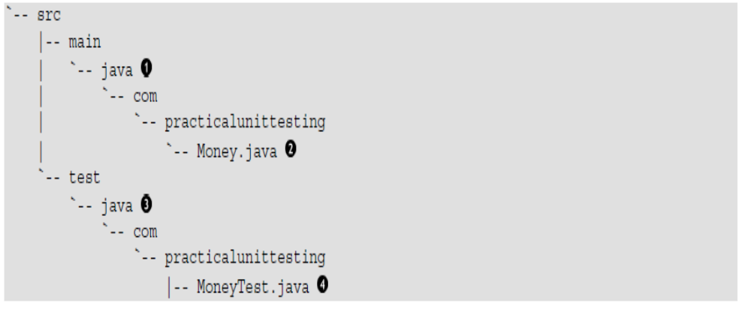
Project Structure and Naming
Conventions

Slide 22
Junit (3.x and 4.x)
Test framework
  test cases are Java code
  test case = “sequence of operations +inputs + expected values”
Test code
testDoubleOf2(){ //..
doubleOf2();
//..
}
Production code
int doubleOf2(){ //…
}

Slide 23
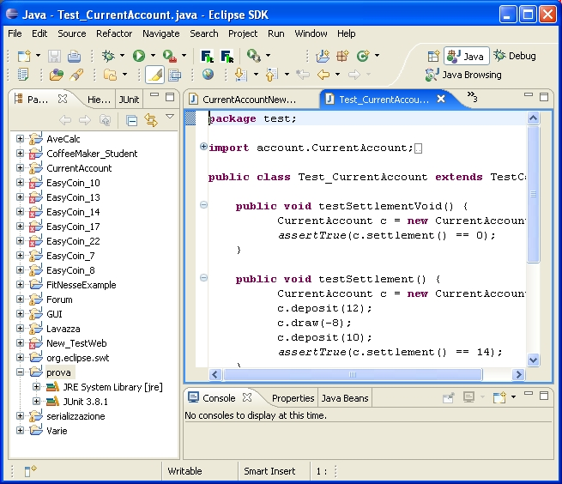
Junit in eclipse - Setup
In Eclipse
  Create a new project
  Open project’s property window (File -> Properties)
  Select: Java build path
  Select: libraries
  Add Library
  Select Junit
    Select the type 3.x or 4.x

Slide 24
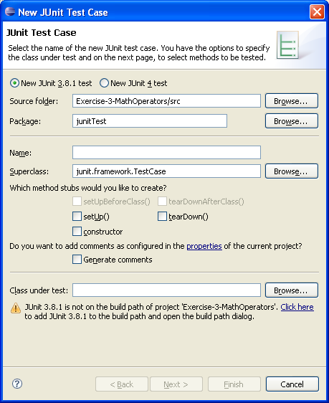
Create a new JUnit test case
Eclipse Menu
File Edit Source Refactor Navigate Search Project Run Window Help
File
  New
    Junit Test Case
      Set the parameters:
        Junit 3.x or 4.x
        name of the class
        etc.
      Finish

Slide 25
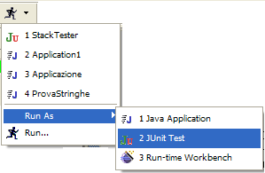
Run as JUnit Test
Eclipse Menu
File Edit Source Refactor Navigate Search Project Run Window Help
Run
  Run As
    Junit Test

Slide 26
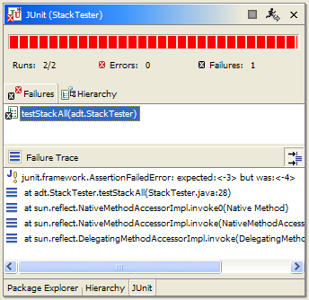

Red / Green Bar
Fail
Pass
expected <-3> but was <-4>

Slide 27
Framework elements
TestCase
  Base class for classes that contain tests
assert*()
  Method family to check conditions
TestSuite
  Enables grouping several test cases
Testcase 1
Testsuite
Testcase 2
Testcase 3

Slide 28
JUnit 3.x for testing programs
JUnit tests
  “substitute the use of main() to check the program behaviour”
All we need to do is:
  write a sub-class of TestCase
  add to it one or more test methods
  run the test using JUnit
  junit.framework.*

Slide 29
An example
class Stack {
public boolean isEmpty(){ ... }
public void push(int i){ ... }
public int pop(){ ... }
…
}
import junit.framework.TestCase;
public class StackTester extends TestCase {
public StackTester(String name) {
super(name);
}
public void testStack() {
Stack aStack = new Stack();
if(!aStack.isEmpty()) {
System.out.println(“Stack should be empty!”);
aStack.push(10);
aStack.push(-4);
System.out.println(“Last element:“ + aStack.pop());
System.out.println(“First element: “ +aStack.pop());
}
}
Must begin with “test”

Slide 30
Assert*()
Method family to check conditions …
They are public methods defined in the base class TestCase
Their names begin with “assert” and are used in test methods
  es. assertTrue(“stack should be empty”, aStack.empty());
If the condition is false:
  test fails
  execution skips the rest of the test method
  the message (if any) is printed
If the condition is true:
  execution continues normally

Slide 31
Assert*()
for a boolean condition
  assertTrue(“message for fail”, condition);
  assertFalse(“message”, condition);
for object, int, long, and byte values
  assertEquals(expected_value, expression);
for float and double values
  assertEquals(expected, expression, error);
for objects references
  assertNull(reference)
  assertNotNull(reference)
…
obtained
http://junit.org/apidocs/org/junit/Assert.html

Slide 32
Assert: example
public void testStack() {
Stack aStack = new Stack();
assertTrue(“Stack should be empty!”, aStack.isEmpty());
aStack.push(10);
assertTrue(“Stack should not be empty!”,!aStack.isEmpty());
aStack.push(4);
assertEquals(4, aStack.pop());
assertEquals(10, aStack.pop());
}
class Stack {
public boolean isEmpty(){ ... }
public void push(int i){ ... }
public int pop(){ ... }
…
}

Slide 33
TestSuite
junit.framework.*
Groups several test cases:
public class AllTests extends TestSuite {
public static TestSuite suite() {
TestSuite suite = new TestSuite();
suite.addTestSuite(StackTester.class);
suite.addTestSuite(AnotherTester.class);
return suite;
}
}

Slide 34
Test of “Exceptions”
There are two cases:
  We expect a normal behavior and then no exceptions.
  We expect an anomalous behavior and then an exception.

Slide 35
We expect a normal behavior …
try {
// We call the method with correct parameters
object.method("Parameter");
assertTrue(true); // OK
} catch(PossibleException e){
fail(“method should not fail !!!");
}
class TheClass {
public void method(String p)
throws PossibleException
{ /*... */ }
}

Slide 36
We expect an exception …
try {
// we call the method with wrong parameters
object.method(null);
fail(“method should fail!!");
} catch(PossibleException e){
assertTrue(true); // OK
}
class TheClass {
public void method(String p)
throws PossibleException
{ /*... */ }
}

Slide 37
From JUnit 3.x to 4.x
JUnit 4 requires Java 5 or newer
Don’t extend junit.framework.TestCase; just use an ordinary class
Import org.junit.* and org.junit.Assert.*
  Use a static import for org.junit.Assert.*
  Static imports replace inheritance from junit.framework.TestCase
Use annotations instead of special method names:
  Instead of a setUp method, put @Before before some method
  Instead of a tearDown method, put @After before some method
  Instead of beginning test method names with ‘test’, put @Test before each test method
Notes:
SWAT 2010

Slide 38
Annotations in J2SE
J2SE 5 introduces the Metadata feature (data about data)
Annotations allow you to add decorations to your code (remember javadoc tags: @author )
Annotations are used for code documentation, compiler processing (@Deprecated ), code generation, runtime processing
New annotations can be created by developers

Slide 39
Annotations in J2SE … an example
…. @Override — it is a predefined annotation used by the Java compiler
It informs the compiler that the element (a method) is meant to override an element declared in a superclass
  // mark method as a superclass method
  // that has been overridden
  @Override
  public int overriddenMethod() { …}
While it's not required to use this annotation when overriding a method, it helps to prevent errors. If a method marked with @Override fails in correctly overriding the original method in its superclass, the compiler generates an error.

Slide 40
Junit 4.x for testing programs
Import the JUnit 4 classes you need
import org.junit.*;
import static org.junit.Assert.*;
Declare your (conventional) Java class
public class MyProgramTest {
Declare any variables you are going to use, e.g., an instance of the class being tested
MyProgram program;
int [ ] array;
int solution;
Notes:
SWAT 2010

Slide 41
@Before and @After methods
More than one @Before and/or @After methods can be defined in a test case
  Attention: we don’t know in what order they will execute
We can inherit @Before and @After methods from a superclass; execution is as follows:
    Execute the @Before methods in the superclass
    Execute the @Before methods in this class
    Execute a @Test method in this class
    Execute the @After methods in this class
    Execute the @After methods in the superclass
Notes:
SWAT 2010

Slide 42
SetUp() and tearDown()
setUp() method initialize object(s) under test.
  called before every test method
tearDown() method release object(s) under test
  called after every test case method.
ShoppingCart cart;
Book book;
protected void setUp() {
cart = new ShoppingCart();
book = new Book(“JUnit", 29.95);
cart.addItem(book);
}
…

Slide 43
JUnit 3.x and JUnit 4.x
Most things are about equally easy
  JUnit 4 can still run JUnit 3 tests
All the old assertXXX methods are the same
JUnit 4 has some additional features
JUnit 4 provides protection against infinite loops
Junit 4 uses annotations (@)
Notes:
SWAT 2010

Slide 44
Junit 4.x for testing programs (2)
If needed, define one method to be executed just once, when the class is first loaded. For instance, when we need to connecting to a database
@BeforeClass
public static void setUpClass() throws Exception {
// one-time initialization code
}
If needed, define one method to be executed just once, to do cleanup after all the tests have been completed
@AfterClass
public static void tearDownClass() throws Exception {
// one-time cleanup code
}
Notes:
SWAT 2010

Slide 45
Junit 4.x for testing programs (3)
If needed, define one or more methods to be executed before each test, e.g., typically for initializing values
@Before
public void setUp() {
program = new MyProgram();
array = new int[] { 1, 2, 3, 4, 5 };
}
If needed, define one or more methods to be executed after each test, e.g., typically for releasing resources (files, etc.)
@After
public void tearDown() {
}
Notes:
SWAT 2010

Slide 46
Junit 4.x for testing programs (4)
- A test method is annotated with @Test
It takes no parameters, and returns no result.
All the usual assertXXX methods can be used
@Test
public void sum() {
assertEquals(15, program.sum(array));
assertTrue(program.min(array) > 0);
}
Notes:
SWAT 2010

Slide 47
Additional Features of @Test
To avoid infinite loops, an execution time limit can be used. The time limit is specified in milliseconds. The test fails if the method takes too long.
@Test (timeout=10)
public void greatBig() {
assertTrue(program.ackerman(5, 5) > 10e12);
}
Some method calls should throw an exception. We can specify that an exception is expected. The test will pass if the expected exception is thrown, and fail otherwise
@Test (expected=IllegalArgumentException.class)
public void factorial() {
program.factorial(-5);
}
Notes:
SWAT 2010

Slide 48
Parameterized tests
import org.junit.runner.RunWith;
import org.junit.runners.Parameterized;
import org.junit.runners.Parameterized.Parameters;
Using @RunWith(value=Parameterized.class) and a method @Parameters, a test class is executed with several inputs
@RunWith(value=Parameterized.class)
public class FactorialTest {
private long expected;
private int value;
@Parameters
public static Collection data() {
return Arrays.asList( new Object[ ][ ] { { 1, 0 }, { 1, 1 }, { 2, 2 }, { 120, 5 } });
}
public FactorialTest(long expected, int value) { // constructor
this.expected = expected;
this.value = value;
}
@Test
public void factorial() {
assertEquals(expected, new Calculator().factorial(value));
}
}
Parameters used to exercise
different instances of the class
Notes:
SWAT 2010

Slide 49
Test suites
import org.junit.runners.Suite;
import org.junit.runners.Suite.SuiteClasses;
As before, you can define a suite of tests
@RunWith(value=Suite.class)
@SuiteClasses(value={
value=test1.class,
value=test2.class
})
public class AllTests { … }
It could be empty
Notes:
SWAT 2010

Slide 50
Additional features of Junit 4
Instead of JUnit 3’s AssertionFailedError, now failed tests throw an AssertionError
There is now an additional version of assertEquals for arrays of objects:
assertEquals(Object[] expected, Object[] actual)
JUnit 3 had an assertEquals(p, p) method for each kind of primitive p, but JUnit 4 only has an assertEquals(object, object) and depends on autoboxing
@Override
public boolean equals(Object o){
… return …;
}
Notes:
SWAT 2010

Slide 51
Autoboxing example
Consider the following method:
  “long sum(long x, long y) { return x + y; }”
and the following test:
  @Test
  public void sum() {
  assertEquals(4, s.sum(2, 2));
  }
  it fails and gives:
    expected: <4> but was: <4>
This is for the autoboxing
  assertEquals no longer exists for primitives, only for objects!
  Hence, the 4 is autoboxed to an Integer, while sum returns a long
  The error message means: expected int 4, but got long 4
  To make this work, change the 4 to a “4L” or “(long)4”
  assertEquals((long)4, s.sum(2, 2));
Note that this problem has been fixed starting form JUnit 4.4
Notes:
SWAT 2010

Slide 52
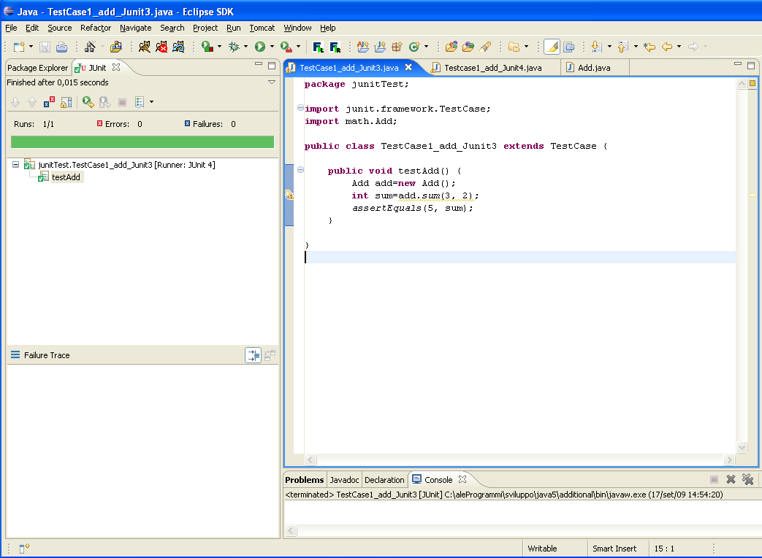
Summarizing… an example (Junit 3.x)
Test case 1
public class Add {
public static int sum (int a, int b) {
return a+b;
}
}
import junit.framework.TestCase; import math.Add; public class TestCase1_add_Junit3 extends TestCase { public void testAdd() { Add add=new Add(); int sum=add.sum(3, 2); assertEquals(5, sum); } }

Slide 53
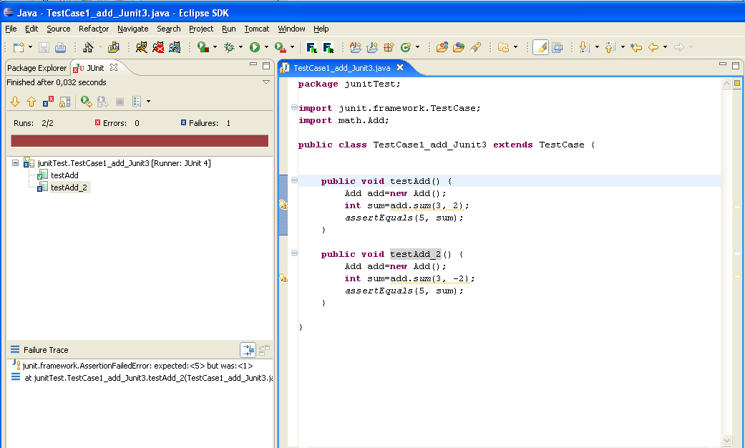
Summarizing… an example (Junit 3.x)
Test case 2
import junit.framework.TestCase; import math.Add; public class TestCase1_add_Junit3 extends TestCase { public void testAdd() {… } public void testAdd_2() { Add add=new Add(); int sum=add.sum(3, -2); assertEquals(5, sum); } }

Slide 54
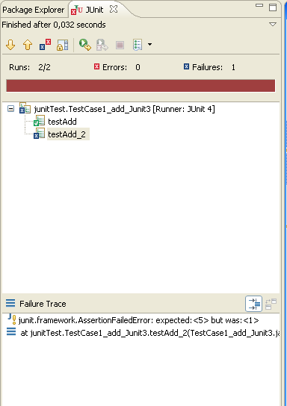
Summarizing… an example (Junit 3.x)
Test case 2
import junit.framework.TestCase; import math.Add; public class TestCase1_add_Junit3 extends TestCase { public void testAdd() {… } public void testAdd_2() { Add add=new Add(); int sum=add.sum(3, -2); assertEquals(5, sum); } }

Slide 55
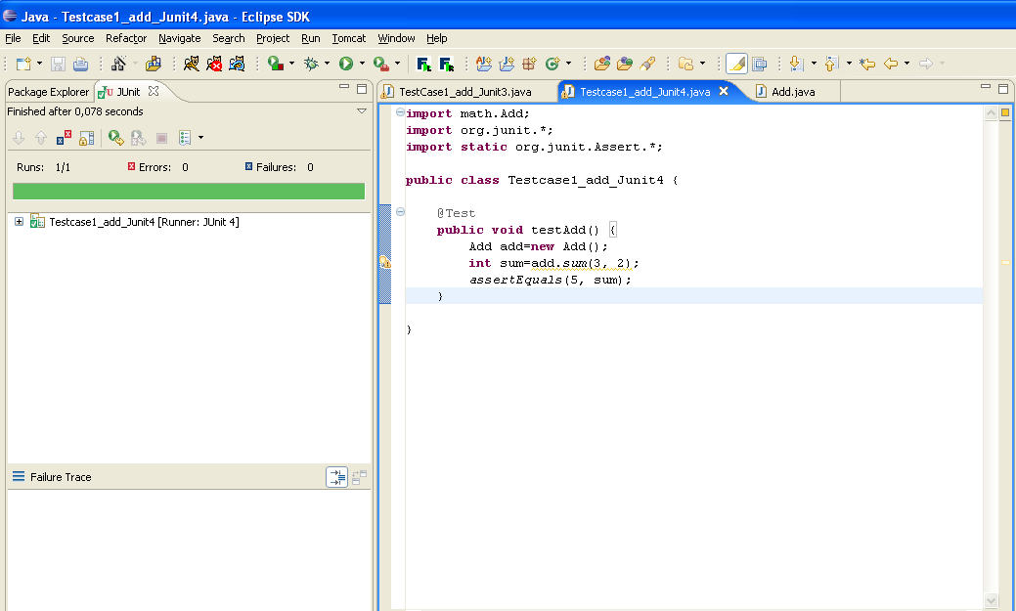
Summarizing… an example (Junit 4.x)
public class Add {
public static int sum (int a, int b) {
return a+b;
}
}
import math.Add; import org.junit.*; import static org.junit.Assert.*; public class Testcase1_add_Junit4 { @Test public void testAdd() { Add add=new Add(); int sum=add.sum(3, 2); assertEquals(5, sum); } }

Slide 56
Junit 3 vs Junit 4 Overview
JUnit 4 requires Java 5 or higher, it uses a lot from Java 5 annotations, generics, and static import features.
The JUnit 3.x version can work with JDK 1.2+ and any higher versions.

Slide 57
Junit 3 vs Junit 4 Overview
JPackage Structure
  JUnit 4 is built on the idea of backward compatibility, it leaves the old package org.junit.
  For all JUnit 4.x new features, they were added to a new package junit.framework.

Slide 58
Junit 3 vs Junit 4 Overview
How to define a text case? Junit 3 VS Junit 4
  In the new version of JUnit, test classes are no longer required to extend junit.framework.
  TestCase class, test names are no longer need required to follow the testXXX pattern.
  Instead, in Junit4.x, any public classes with a zero-argument public constructor can act as a test class.
  Any method which need to consider as a test method should be annotated with the @Test annotation.

Slide 59
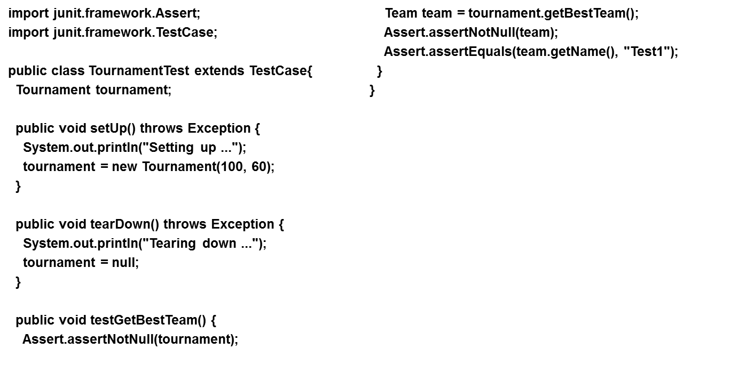
Junit 3 vs Junit 4 Overview
A typical test case in Junit 3.x

Slide 60
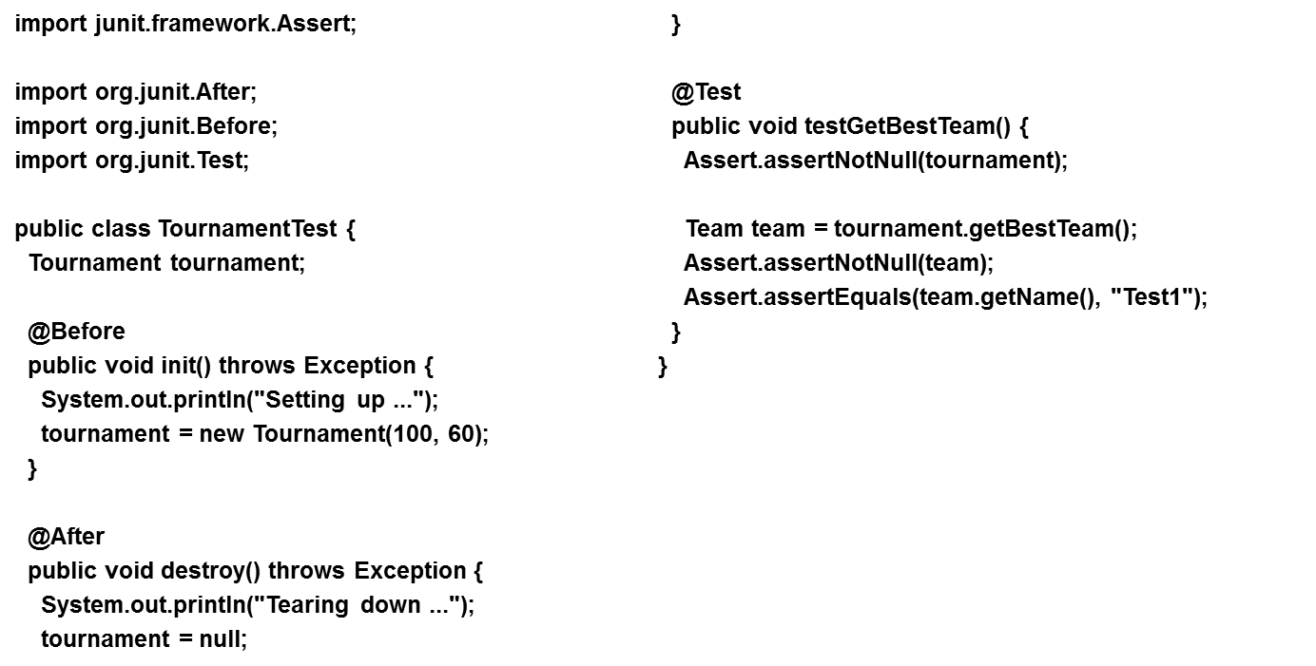
Junit 3 vs Junit 4 Overview
A typical test case in Junit 4.x

Slide 61
Annotations and new features added (Junit 3 VS Junit 4).
Feature | JUnit 3.x | JUnit 4.x
test annotation | testXXX pattern | @Test
run before the first test method in the current class is invoked | None | @BeforeClass
run after all the test methods in the current class have been run | None | @AfterClass
run before each test method | override setUp() | @Before
run after each test method | override tearDown() | @After
ignore test | Comment out or remove code | @ignore
expected exception | catch exception assert success | @Test(expected = ArithmeticException.class)
timeout | None | @Test(timeout = 1000)

Slide 62
Exception testing (Difference between Junit 3 and Junit 4)
public void testGetElement() {
try {
(new ArrayList()).get(0);
fail("The test should have failed");
} catch (NullPointerException e) {
assertTrue("Sanity check", true);
}
}

Slide 63
Exception testing (Difference between Junit 3 and Junit 4)
@Test(expected = IndexOutOfBoundsException.class)
public void testGetElement() {
(new ArrayList()).get(0);
}

Slide 64
When testing programs?
Test last
  The conventional way for testing in which testing follows the implementation
Test first
  The Extreme-Programming view in which testing is used as a developement tool

Slide 65
Working rule
For each test case class, JUnit
  execute all of its public test methods
    i.e. those whose name starts with “test”
  ignores everything else …
Test classes can contain “helper methods” provided that are:
  non public, or
  whose name does not begin with “test”

Slide 66
Test last
New functionality
Understand
Implement functionality
Write tests
Run all tests
fail
Rework
Result?
pass
Next functionality

Slide 67
Test first
“Extreme programming” (XP) champions the use of tests as a development tool …
“Extreme programming” (XP) champions the use of tests as a development tool …
New functionality
Understand
Add a single test
Add code for the test
Run all test
fail
No
Rework
Result?
pass
Functionality
complete?
Yes
Next functionality

Slide 68
Test First Advantages
Each method has associated a testcase
  the confidence of our code increases …
It simplifies:
  refactoring/restructuring
  maintenance
  the introduction of new functionalities
Test first help to build the documentation
  testcases are good “use samples”
Programming is more fun …

Slide 69
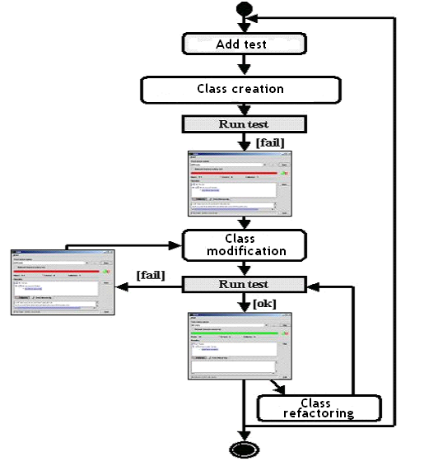
Test-first with Junit
Add a testcase
Add the skeleton of the class and methods (without body)
Run test
Rework
Refactoring
“improving the structure”
Run test

Slide 70
Junit in practice …
Existing system: a class current account to manage a bank account
    deposit
    withdraw
Add a new functionality
    settlement
Example:
CurrentAccount cc = new CurrentAccount();
cc.deposit(12);
cc.draw(-8);
cc.deposit(10);
cc.settlement()
expected value 14 euro!

Slide 71
Add a testcase

Slide 72
Add Testcases for the settlement method
class Test_CurrentAccount extends TestCase{
public void test_settlementVoid() {
CurrentAccount c = new CurrentAccount();
assertEquals(0, c.settlement());
}
public void test_settlement() {
CurrentAccount c = new CurrentAccount();
c.deposit(12);
c.draw(-8);
c.deposit(10);
assertEquals(14, c.settlement());
}
}
test first …

Slide 73
Add the skeleton of the class and methods (without body)

Slide 74
Add the skeletone code of
the method
class CurrentAccount {
int account[];
int lastMove;
CurrentAccount(){
lastMove=0;
account=new int[10];
}
public void deposit(int value){
account[lastMove]=value;
lastMove++;
}
public void draw(int value) {
account[lastMove]=value;
lastMove++;
}
public int settlement() {return 0;}
public static void main(String args[]) {}
}
class Test_CurrentAccount extends TestCase{
public void test_settlementVoid() {
currentAccount c = new currentAccount();
assertEquals(0, c.settlement());
}
public void test_settlement() {
currentAccount c = new currentAccount();
c.deposit(12);
c.draw(-8);
c.deposit(10);
assertEquals(14, c.settlement());
}
}

Slide 75
Run test

Slide 76
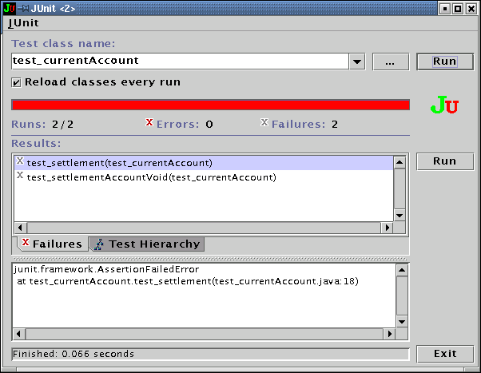
Run Junit (first time)

Slide 77
Rework

Slide 78
Rework
class CurrentAccount {
int account[];
int lastMove;
CurrentAccount(){
lastMove=0; account=new int[10];
}
public void deposit(int value){ …}
public void draw(int value) { …}
public int settlement() {
int result = 0
for (int i=0; i<account.length; i++) {
result = result + account[i];
}
return result;
}
public static void main(String args[]) {}
}
class Test_CurrentAccount extends TestCase{
public void test_settlementVoid() {
currentAccount c = new currentAccount();
assertEquals(0, c.settlement());
}
public void test_settlement() {
currentAccount c = new currentAccount();
c.deposit(12);
c.draw(-8);
c.deposit(10);
assertEquals(14, c.settlement());
}
}

Slide 79
Run test

Slide 80
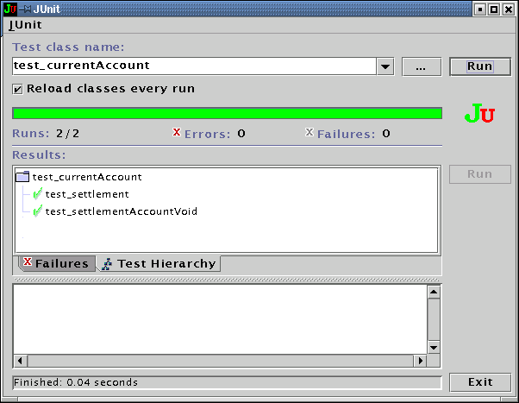
Run Junit (second time)

Slide 81
Add a testcase

Slide 82
Add a new testcase
class CurrentAccount {
int account[];
int lastMove;
CurrentAccount(){
lastMove=0; account=new int[10];
}
public void deposit(int value){ …}
public void draw(int value) { …}
public int settlement() {
int result = 0
for (int i=0; i<account.length; i++) {
result = result + account[i];
}
return result;
}
public static void main(String args[]) {}
}
class Test_currentAccount extends TestCase{
…
public void test_realCaseSettlement() {
currentAccount c = new currentAccount();
for (int i=0; i <10 ; i++)
c.deposit(1);
c.draw(-10);
assertEquals(0, c.settlement());
}
}

Slide 83
Run test

Slide 84
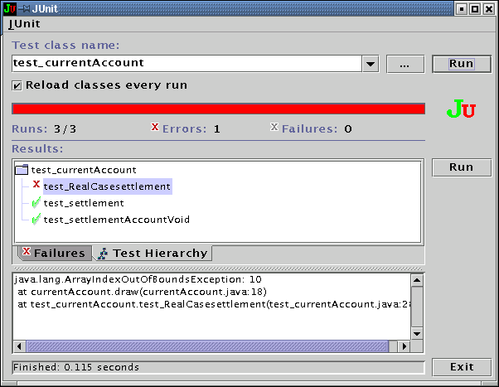
Run JUnit (third time)
Run time error

Slide 85
Rework

Slide 86
Rework
class CurrentAccount {
int account[];
int lastMove;
CurrentAccount(){
lastMove=0; account=new int[100];
}
public void deposit(int value){ …}
public void draw(int value) { …}
public int settlement() {
int result = 0
for (int i=0; i<account.length; i++) {
result = result + account[i];
}
return result;
}
public static void main(String args[]) {}
}
class Test_currentAccount extends TestCase {
…
public void test_realCaseSettlement() {
currentAccount c = new currentAccount();
for (int i=0; i <10 ; i++)
c.deposit(1);
c.draw(-10);
assertTrue(0, c.settlement());
}
}

Slide 87
Run test

Slide 88
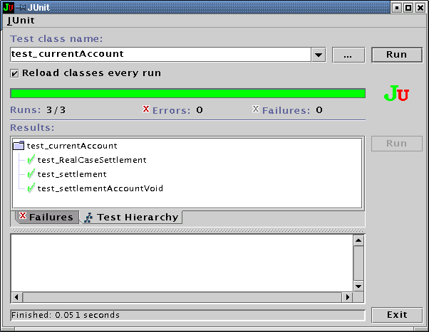
Run JUnit (fourth time)

Slide 89
Refactoring
“improving the structure”

Slide 90
public class CurrentAccount {
List account = new LinkedList();
public void deposit(int value) {
account.add(new Integer(value));
}
public void draw(int value) {
account.add(new Integer(value));
}
public int settlement() {
int result = 0;
Iterator it=account.iterator();
while (it.hasNext()) {
Integer value_integer = (Integer)it.next();
int val = value_integer.intValue();
result = result + val;
}
return result;
}
}
Refactoring
“changing the data structure: Array --> List”

Slide 91
Run test

Slide 92
Run JUnit (fifth time)

Slide 93
The End

Slide 94
Hamcrest
Hamcrest is a framework for software tests.
Hamcrest allows checking for conditions in your code via existing matchers classes.
It also allows you to define your custom matcher implementations.
To use Hamcrest matchers in JUnit you use the assertThat statement followed by one or several matchers.

Slide 95
Hamcrest
Hamcrest is typically viewed as a third generation matcher framework.
The first generation used assert(logical statement) but such tests were not easily readable.
The second generation introduced special methods for assertions, e.g., assertEquals(). This approach leads to lots of assert methods.
Hamcrest uses assertThat method with a matcher expression to determine if the test was successful.

Slide 96
Hamcrest
boolean a;
boolean b;
// all statements test the same
assertThat(a, equalTo(b));
assertThat(a, is(equalTo(b)));
assertThat(a, is(b));

Slide 97
Hamcrest
// JUnit 4 for equals check
assertEquals(expected, actual);
// Hamcrest for equals check
assertThat(actual, is(equalTo(expected)));
// JUnit 4 for not equals check
assertFalse(expected.equals(actual));
// Hamcrest for not equals check
assertThat(actual, is(not(equalTo(expected))));

Slide 98
Overview of Hamcrest matcher
The following are the most important Hamcrest matchers:
allOf - matches if all matchers match (short circuits)
anyOf - matches if any matchers match (short circuits)
not - matches if the wrapped matcher doesn’t match and vice

Slide 99
Overview of Hamcrest matcher
equalTo - test object equality using the equals method
is - decorator for equalTo to improve readability
hasToString - test Object.toString
instanceOf, isCompatibleType - test type
notNullValue, nullValue - test for null
sameInstance - test object identity

Slide 100
Overview of Hamcrest matcher
hasEntry, hasKey, hasValue - test a map contains an entry, key or value
hasItem, hasItems - test a collection contains elements
hasItemInArray - test an array contains an element
closeTo - test floating point values are close to a given value

Slide 101
Overview of Hamcrest matcher
greaterThan, greaterThanOrEqualTo, lessThan, lessThanOrEqualTo
equalToIgnoringCase - test string equality ignoring case
equalToIgnoringWhiteSpace - test string equality ignoring differences in runs of whitespace
containsString, endsWith, startsWith - test string matching

Slide 102
Mock Object
In object-oriented programming, mock objects are simulated objects that mimic the behavior of real objects in controlled ways.
A programmer typically creates a mock object to test the behavior of some other object, in much the same way that a car designer uses a crash test dummy to simulate the dynamic behavior of a human in vehicle impacts.

Slide 103
Easy Mock
Mock objects do the mocking of the real service.
A mock object returns a dummy data corresponding to some dummy input passed to it.

Slide 104
Easy Mock
Easy Mock provides the means (through the use of mock objects) to specify the response that will be returned when the code being tested makes calls to external methods.
This will allow the result of the unit test to be isolated from variables outside of the scope of the unit test code.

Slide 105
Easy Mock
It uses Java Reflection in order to create mock objects for a given interface.
Mock objects are nothing but proxy for actual implementations.

Slide 106
Benefits of EasyMock
No Handwriting – No need to write mock objects on your own.
Refactoring Safe – Renaming interface method names or reordering parameters will not break the test code as Mocks are created at runtime.

Slide 107
Benefits of EasyMock
Return value support – Supports return values.
Exception support – Supports exceptions.
Order check support – Supports check on order of method calls.
Annotation support – Supports creating mocks using annotation.

Slide 108
Easy Mock has four stages:
createMock - Create the mock based on an existing interface or class
expect - Record the method calls that you expect your code under test to call indicating what you expect to be returned, if valid

Slide 109
Easy Mock has four stages:
replay - Set the mock into 'playback' mode which switches the mock into 'real' mode and starts recording method calls and returning objects as set up in the previous stage
verify - make sure that the right methods were called in the right order

Slide 110
Mockito
Mockito is a popular mock framework which can be used in conjunction with JUnit.
Mockito allows you to create and configure mock objects.
Using Mockito simplifies the development of tests for classes with external dependencies significantly.

Slide 111
Mockito
If you use Mockito in tests you typically:
Mock away external dependencies and insert the mocks into the code under test
Execute the code under test
Validate that the code executed correctly

Slide 112
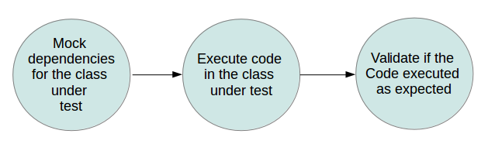
Mockito

Slide 113
Adding Mockito as dependencies to a project
If you use Gradle, add the following dependency to the Gradle build file.
repositories { jcenter() }
dependencies { testCompile "org.mockito:mockito-core:2.0.57-beta" }

Slide 114
Adding Mockito as dependencies to a project
If you use Maven, add the following dependency to the POM.xml.
<dependency>
<groupId>org.mockito</groupId>
<artifactId>mockito-core</artifactId>
<version>2.0.91-beta</version>
</dependency>

