Slide 1
Introduction

Slide 2
What is persistence?
Preserving data entered by users when the host machine is switched off.
Means storing data in a relational database using SQL Or in Files

Slide 3
Persistence in object-oriented applications
In an object-oriented application, persistence allows an object to outlive the application that created it.
The state of the object may be stored in the hard disk and an object with the same state re-created at some point in the future.
Entire graphs of interconnected objects may be made persistent and later re-created in a new process.

Slide 4
Ways to achieve persistence
Writing raw database code into the application.
Using services which provide ORM(Object/Relational mapping)

Slide 5
Object/Relational Mapping (ORM)
Object/Relational mapping is
mapping an object to the tables in a relational database
automatic and transparent
uses metadata that describes the mapping between the objects and the database.
ORM transforms data from one representation to another.
An ORM solution consists of the following four components:
An API for performing basic CRUD operations on objects of persistent classes.
A language or API for specifying queries that refer to classes and properties of classes.
A facility for specifying mapping metadata.
A technique for the ORM implementation to interact with transactional objects to perform optimization functions

Slide 6
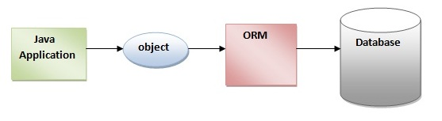
Object/Relational Mapping (ORM)

Slide 7
Why ORM?
Productivity
No writing tedious JDBC code. Hibernate significantly reduces time
Maintainability
Less complex with a fewer lines of code. Most features already tried and tested
Performance
optimizations already provided by automated ORM
Vendor independence
An ORM abstracts your application away from the underlying SQL database and SQL dialect.

Slide 8
Why ORM?
Open Source and Light Weight
Fast Performance- First level and Second level Cache
Database Independent Queries- HQL
Automatic table creation
Simplifies Complex Join
Provides Query Statistics and database status

Slide 9
Java Persistence API
The Java Persistence API provides an object/relational mapping facility to Java developers for managing relational data in Java applications.
Three components
The Java Persistence API
The query language
Object/relational mapping metadata

Slide 10
What is Hibernate 3
An object/relational mapping service.
Implements standard Java Persistence API for Java SE and Java EE persistent .
Classes in Hibernate are plain old java objects and so like any normal java classes they can participate in relationships like association, inheritance, polymorphism, composition, and collections.
Provides query and retrieval services
Provides relational persistence for Java and .NET (NHibernate)

Slide 11
Whose is it?
JBoss, a division of Red Hat
Hibernate is an open source project and a critical component of the JBoss Enterprise Middleware System (JEMS) suite of products.

Slide 12
Hibernate modules
Our area of discussion
Hibernate Core | Hibernate for Java, native APIs and XML mapping metadata
Hibernate EntityManager | Standard Java Persistence API for Java SE and Java EE
Hibernate Annotations | Map classes with JDK 5.0 annotations
Hibernate Shards | Horizontal data partitioning framework
Hibernate Validator | Data integrity annotations and validation API
Hibernate Search | Hibernate integration with Lucene for indexing and querying data
Hibernate Tools | Development tools for Eclipse and Ant
NHibernate | The NHibernate service for the .NET framework
JBoss Seam | Framework for JSF, Ajax, and EJB 3.0/Java EE 5.0 applications

Slide 13
Why Hibernate?
No JDBC code writing
Can be used in both managed(application server) and unmanaged environments( standalone application)
Common way to persistence development for both .NET and JEE.
SQL can be combined with an object-oriented approach.

Slide 14
Hibernate in java application
Can be used with
Unmanaged environment
Stand-alone application
Managed environment
Web application
Enterprise application (can be used in place of entity beans)
The same power of SQL can be used with hibernate also.

Slide 15
High-level Hibernate Architecture
Application
Persistent objects
Hibernate
hibernate.cfg
xxx..hbm
Database

Slide 16
Simple Hibernate application
Steps:
Create a MYSQL database called test.
Create a dynamic web application
Copy the required libraries
Write a POJO class representing the table
Write a hbm file
Write cfg file
Write a servlet code to connect through hibernate and insert data into the table.
Steps 1 and 2 do not require any explanation. So lets us start with 3.

Slide 17
3. Copy the required libraries
Jars required for hibernate to work
hibernate-core
slf4j-simple (Hibernate uses slf4j for logging, for our purposes here use the simple backend )
Javassist (Hibernate gives you a choice of bytecode providers between cglib and javassist )
Apart from these we may want servlet-api, struts 2 related api etc as well for web application.
For hibernate annotations, , hibernate-annotation and hibernate-commons-annotation can also be included.
Copy the jar files from this folder into your web application.

Slide 18
Copy the required libraries
Cglib
Log4j
Commons
SLF4j
Dom4j
Xalan
xerces

Slide 19
4. Write a POJO class representing the table
Let us maintain customer details in the database table
The POJO representing the Customer is given below in the src folder
package hib;
public class Customer {
private String firstName;
private String lastName;
private String email;
private long id;
public String getEmail() {return email;}
public String getFirstName() {return firstName;}
public String getLastName() {return lastName;}
public void setEmail(String e) {email = e;}
public void setFirstName(String f) {firstName = f;}
public void setLastName(String l){lastName = l;}
public long getId() {return id;}
public void setId(long l) {id = l;
}}

Slide 20
5. Write a hbm file
hbm file is a Hibernate mapping file.
File name can be anything but extension should be hbm.
File must be in the same place where classes are located.
Create an XML file with the name customer.hbm.xml in the src folder
<?xml version="1.0"?>
<!DOCTYPE hibernate-mapping PUBLIC
"-//Hibernate/Hibernate Mapping DTD 3.0//EN"
"http://hibernate.sourceforge.net/hibernate-mapping-3.0.dtd">
<hibernate-mapping>
<class name="hib.Customer" table="CUSTOMER">
<id name="id" type="long" column="ID" >
<generator class="assigned"/>
</id>
Class name
Table name
Primary key column name in class, type, column name in the database
The primary key will be explicitly assigned by the application

Slide 21
<property name="firstName">
<column name="FIRSTNAME" />
</property>
<property name="lastName">
<column name="LASTNAME"/>
</property>
<property name="email">
<column name="EMAIL"/>
</property>
</class>
</hibernate-mapping>
Other columns
Other ways to write property:
<property name="firstName"><column name="FIRSTNAME"/> </property>
Or simply
<property name="firstName“ column=“FIRSTNAME”/>
Type can be explicitly specifies as:
<property name="name" type="java.lang.String" column=" firstName " length="50" />

Slide 22
6. Write cfg file
cfg file is a Hibernate configuration file that details about the database that is going to be used by hibernate.
File name is hibernate.cfg.xml.
File must be in the same place where classes are located.
Create an XML file with the name hibernate.cfg.xml in the src folder.
<?xml version='1.0' encoding='utf-8'?>
<!DOCTYPE hibernate-configuration PUBLIC
"-//Hibernate/Hibernate Configuration DTD//EN"
"http://hibernate.sourceforge.net/hibernate-configuration-3.0.dtd">
<hibernate-configuration>
<session-factory>
<property name="hibernate.connection.driver_class">
com.mysql.jdbc.Driver
</property>
MySQL driver

Slide 23
<property name="hibernate.connection.url">
jdbc:mysql://localhost/test
</property>
<property name="hibernate.connection.username">
root
</property>
<property name="hibernate.connection.password">
ROOT
</property>
<property name="hibernate.connection.pool_size">
10
</property>
<property name="show_sql">
true
</property>
<property name="dialect">
org.hibernate.dialect.MySQLDialect
</property>
<property name="hibernate.hbm2ddl.auto">
update
</property>
<property name="hibernate.connection.autocommit">
true
</property>
MySQL database URL
MySQL User name
MySQL Password
Connection Pool Size
Echo all executed SQL to stdout
SQLdialect for MySQL so that Hibernate will use sensible defaults
Update the database schema on startup
Enable auto-commit

Slide 24
<!-- Mapping files -->
<mapping resource="customer.hbm.xml"/>
</session-factory>
</hibernate-configuration>
All the hbm files can be listed here
hibernate.hbm2ddl.auto can have values like validate | update | create | create-drop
With create-drop, the database schema will be dropped when the SessionFactory is closed explicitly.
hibernate.connection.autocommit is false by default.

Slide 25
7. Write a servlet
@WebServlet("/HibernateServletEx")
public class HibernateServletEx extends HttpServlet {
protected void doGet(HttpServletRequest request, HttpServletResponse response) throws ServletException, IOException {
Session session = null;
try{
SessionFactory sessionFactory = new Configuration().configure().buildSessionFactory();
session =sessionFactory.openSession();
System.out.println("Inserting Record");
read hibernate.cfg.xml and prepare hibernate for use

Slide 26
Customer c= new Customer();
c.setId(11);
c.setFirstName(“Seema");
c.setLastName(“Sai");
c.setEmail(“seema@yahoo.com");
session.save(c);
System.out.println(“Inserted");
}catch(Exception e){
System.out.println("Exception"+ e);
}finally{
session.flush();
session.close();
}
}
Save the data in the session so that it can be flushed later in the database
insertion will happen here

Slide 27
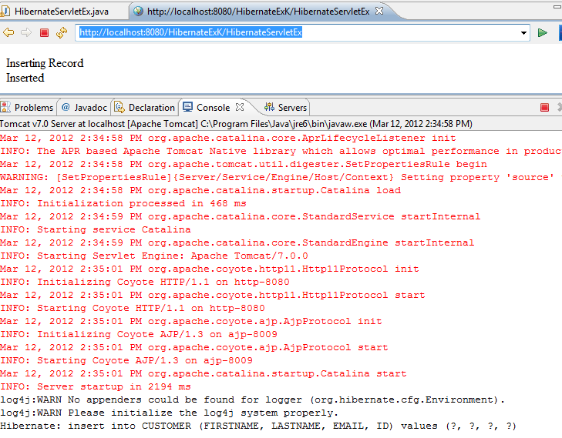
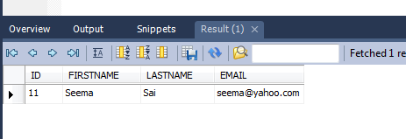
Database

Slide 28
Alternative to cfg file
Hibernate is designed to operate for different databases and so a there are broad range of configuration parameters.
In such case Hibernate distributed comes with hibernate.properties comes handy which has default values for several different configuration parameters.
The file can be alerted to suit the needs of the application and is to be placed in the classpath.
Note that both hibernate.cfg.xml file and hibernate.properties files can be there in an application to provides different properties.
If there is an overlap of properties hibernate.cfg.xml value is used.

Slide 29
Hibernate Proxy
By default Hibernate creates a proxy for each of the entity class in mapping file. This class contain the code to invoke JDBC.
Proxies are created dynamically by sub-classing the entity object at runtime.
The subclass has all the methods of the parent, so when a method on the entity object is called, the proxy loads up the data from the database and calls the method.

