Slide 1
2. Hibernate API And Working With More Tables

Slide 2
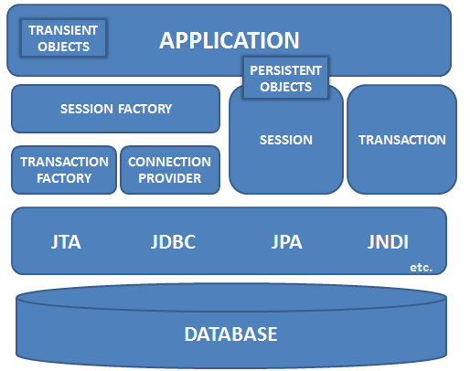
Complete Hibernate Architecture

Slide 3
Core Interfaces
Used to perform basic CRUD and querying operations
Session
SessionFactory
Configuration
Transaction interface
Query
Criteria

Slide 4
Session
Session
primary interface used by Hibernate applications to create, read and delete operations for instances of mapped entity classes
This instance wraps the JDBC connection and is also used to create transactions.
The persistent objects (POJO) are associated with exactly one Session. Once the Session is closed, they are detached.
Instance is created using SessionFactory
Session openSession() throws HibernateException
Session instance is not thread-safe. Instead each thread/transaction should obtain its own instance from a SessionFactory.

Slide 5
SessionFactory and Configuration
The application obtains Session instances from a SessionFactory interface
There is typically a single SessionFactory for the whole application—created during application initialization.
An instance of SessionFactory is obtained from Configuration class
buildSessionFactory() creates a SessionFactory using the properties and mappings that was set using configure() method
To use mappings and properties specified in an application resource named hibernate.cfg.xml, configure() method is used
Configuration configure() throws HibernateException
SessionFactory buildSessionFactory() throws HibernateException
An Configuration also allows the application to specify properties and mapping documents to be used when creating a SessionFactory
Configuration configure(File configFile) throws HibernateException

Slide 6
Persistent object states
The POJO or persistent objects can be in one of the three states is defined in relation to a persistence context (that means it is loaded into the Hibernate Session object)
Transient
Persistent
Detached

Slide 7
Transient state
The instance is not associated with any persistence context. It has no persistent identity or primary key value.
Transient instances may be made persistent by calling save(), persist() or saveOrUpdate() of Session
Serializable save(Object object) throws HibernateException
Persist the given transient instance, first assigning a generated identifier or using the current value of the identifier property if the assigned generator is used. This operation cascades to associated instances if the association is mapped with cascade="save-update".

Slide 8
void saveOrUpdate(Object object) throws HibernateException
Either save(Object) or update(Object) the given instance, depending upon resolution of the unsaved-value checks.
This operation cascades to associated instances if the association is mapped with cascade="save-update”
void persist(Object object) throws HibernateException
Make a transient instance persistent. This operation cascades to associated instances if the association is mapped with cascade="persist".

Slide 9
Tell me why?
Why do we have 2 methods – save() and persist()?
persist() unlike save() doesn't guarantee that the identifier value will be assigned to the persistent instance immediately, the assignment might happen at flush time while save() returns a the generated identifier .
persist() also guarantees that it will not execute an INSERT statement if it is called outside of transaction boundaries. This is useful in long-running conversations with an extended Session/persistence context.
save() does not guarantee the same, it returns an identifier, and if an INSERT has to be executed to get the identifier (e.g. "identity" generator, not "sequence"), this INSERT happens immediately, no matter if you are inside or outside of a transaction. This is not good in a long-running conversation with an extended Session/persistence context.
(extract from Hibernate ORM HHH-1273)

Slide 10
Persistent state
The instance is currently associated with a persistence context. It has a persistent identity (primary key value) and can have a corresponding row in the database.
Any instance returned by a get() or load() method is persistent. Persistent instances may be made transient by calling delete().
Object get(Class clazz, Serializable id) throws HibernateException
Return the persistent instance of the given entity class with the given identifier, or null if there is no such persistent instance.
If the instance is already associated with the session, return that instance. This method never returns an uninitialized instance.

Slide 11
Object load(Class clazz, Serializable id) throws HibernateException
Return the persistent instance of the given entity class with the given identifier, assuming that the instance exists. This method might return a proxied instance that is initialized on-demand, when a non-identifier method is accessed.
Difference between the load() and get() methods is that while load() assumes that instance exists and may return a proxy and we cannot guarantee that instance actually exists in the database (it may have got deleted).
Hence get() must be used instead of load() to determine if an instance exists.
Also note that the load() will throw an exception if instance does not exist.

Slide 12
Detached
The instance was once associated with a persistence context/session but not is not attached to it may because the session was closed.
It has a persistent identity and can have a corresponding row in the database.
While for persistent instance Hibernate guarantees the relationship between persistent (database ) identity and Java identity for detached instance there is no such guarantees .
Detached instances may be made persistent by calling update(), saveOrUpdate()
The state of a transient or detached instance may also be made persistent as a new persistent instance by calling merge().

Slide 13
update()and merge()
void update(Object object) throws HibernateException
Update the persistent instance with the identifier of the given detached instance.
If there is a persistent instance with the same identifier, an exception is thrown.
This operation cascades to associated instances if the association is mapped with cascade="save-update".
Object merge(Object object) throws HibernateException
Copy the state of the given object onto the persistent object with the same identifier.
This operation cascades to associated instances if the association is mapped with cascade="merge".

Slide 14
Example: update(),merge()differences
public class UpdateAndMergeServletEx extends HttpServlet {
protected void doGet(HttpServletRequest request, HttpServletResponse response) throws ServletException, IOException {
SessionFactory sessionFactory1 = new Configuration().configure().buildSessionFactory();
Session session = sessionFactory1.openSession();
Customer c = (Customer) session.get(Customer.class, new Long(1));
session.close(); → c is now detached
c.getId();
c.setEmail("xyz@yahoo.com");
Session session2 = sessionFactory1.openSession();
Customer c1 = (Customer) session2.get(Customer.class, new Long(1));
//session2.update(c); → Throws NonUniqueObjectException
session2.merge(c); → This is fine and data gets updated
session2.flush();
session2.close();}}

Slide 15
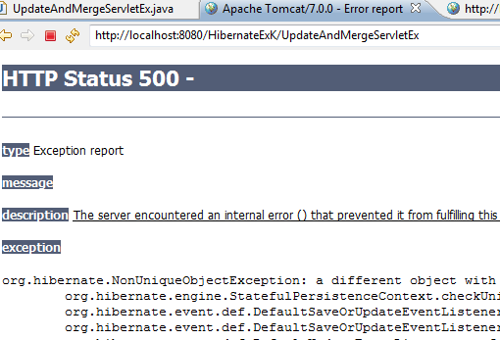

When
session2.update(c); is used instead of
session2.merge(c);
This is if there is a persistent instance with the same identifier in the session, update() will throw an exception!
When session2.merge(c);
is used the data gets updated because the instance that the session is holding gets its values from the detached instance when merge is called on detached instance.

Slide 16
delete() and refresh()
void delete(Object object) throws HibernateException
Remove a persistent instance from the datastore. The argument may be an instance associated with the receiving Session or a transient instance with an identifier associated with existing persistent state. This operation cascades to associated instances if the association is mapped with cascade="delete".
void refresh(Object object) throws HibernateException
This method is useful to sync the state of the given instance with underlying database in cases where there are chances that database might have been altered outside the application as a result of a trigger. This is also useful in cases where direct SQL is used by the application to update the data.

Slide 17
flush(), close(), clear
void flush() throws HibernateException
This is the method that actually synchronizing the underlying database with persistent object held in session memory.
This should be called at the end of a unit of work, before committing the transaction and closing the session (depending on flush-mode, Transaction.commit() calls this method).
Connection close() throws HibernateException
End the session by releasing the JDBC connection and cleaning up. It is not strictly necessary to close the session but at least it must be disconnected by calling disconnect()
void clear()
Completely clear the session. Evict all loaded instances and cancel all pending saves, updates and deletions. Do not close open iterators or instances of ScrollableResults.

Slide 18
Transaction
Transaction can be set using the methods of Session.
Transaction beginTransaction() throws HibernateException
If Transaction object is associated with the session return that else create a new transaction.
Transaction getTransaction()
Get the Transaction instance associated with this session
In both the cases the class of the returned Transaction object is determined by the property hibernate.transaction_factory.
The most common approach is the session-per-request pattern where a single Hibernate Session has same scope as a single database transaction.
The Hibernate session can be used for multiple DB operations (save, query, update) within the same request.

Slide 19
Transaction methods
void begin() throws HibernateException
void commit() throws HibernateException
void rollback() throws HibernateException
To check if transactions was committed or rolled-back properly
boolean wasRolledBack() throws HibernateException
boolean wasCommitted() throws HibernateException
Code snippet wrapping statements in a transactions:
Session sess = factory.openSession();
Transaction tx;
try { tx = sess.beginTransaction();
//do some work ...
tx.commit();
}
catch (Exception e) {
if (tx!=null) tx.rollback(); throw e; }
finally { sess.close(); }

Slide 20
Mapping file
We have seen in the last session that the mapping file tells Hibernate what table in the database it has to access, and what columns in that table it should use.
All persistent entity classes go in between the <hibernate-mapping> tags, include a class element.
We have also looked at how to map the bean columns to the database tables. By default, no properties of the class are considered persistent unless it is specified in hbm.
Some more important things to know about the mapping files are
Key generation
Relationship management
Lazy loading

Slide 21
Hibernate persistent class
Class should have a constructor with no arguments.
Implementing Serializable is not compulsory. However if the object in to be stored in HttpSession then it will be necessary to make the persistent class Serializable.
The instance variables of the class represent attributes of business entity. The accessor and mutator methods needs to be provided for them as laid out by JavaBean specification guidelines. However the methods may not be declared public.
Can contain some business methods also.

Slide 22
Accessor code
Hibernate uses accessor methods to populate the state of an object when loading the object from the database.
But what if we have a validation code in the setter method and we don’t want hibernate to run this validation while loading the data?
In that case, we need to tell Hibernate to directly access the instance variables
<property name=“fname“ type=“java.lang.String" column=“fname” access="field”>
forcing Hibernate to bypass the setter method and access the instance variable directly.

Slide 23
Key generation
<id name="id" type="long" column="ID" >
<generator class="native"/>
</id>
There is an alternative <composite-id> declaration that allows access to legacy data with composite keys. Its use is strongly discouraged for anything else.
The optional <generator> child element names a Java class used to generate unique identifiers for instances of the persistent class.
Hibernate provides a range of built-in key implementations.

Slide 24
List of Key generator
Generator | Description
increment | It generates identifiers of type long, short or int that are unique only when no other process is inserting data into the same table. It should not the used in the clustered environment.
identity | It supports identity columns in DB2, MySQL, MS SQL Server, Sybase and HypersonicSQL. The returned identifier is of type long, short or int.
sequence | The sequence generator uses a sequence in DB2, PostgreSQL, Oracle, SAP DB, McKoi or a generator in Interbase. The returned identifier is of type long, short or int
assigned | lets the application to assign an identifier to the object before save() is called. This is the default strategy if no <generator> element is specified.

Slide 25
Generator | Description
hilo | The hilo generator uses a hi/lo algorithm to efficiently generate identifiers of type long, short or int, given a table and column (by default hibernate_unique_key and next_hi respectively) as a source of hi values. The hi/lo algorithm generates identifiers that are unique only for a particular database. Do not use this generator with connections enlisted with JTA or with a user-supplied connection.
seqhilo | The seqhilo generator uses a hi/lo algorithm to efficiently generate identifiers of type long, short or int, given a named database sequence.
uuid | The uuid generator uses a 128-bit UUID algorithm to generate identifiers of type string, unique within a network (the IP address is used). The UUID is encoded as a string of hexadecimal digits of length 32.
guid | It uses a database-generated GUID string on MS SQL Server and MySQL.
native | It picks identity, sequence or hilo depending upon the capabilities of the underlying database.

Slide 26
Generator | Description
select | retrieves a primary key assigned by a database trigger by selecting the row by some unique key and retrieving the primary key value
foreign | uses the identifier of another associated object. Usually used in conjunction with a <one-to-one> primary key association.

Slide 27
Relationship / Associations
Types:
One-to-One
One-to-Many or Many-to-One
Many-to-Many
Relationship can be both
Unidirectional
Bidirectional

Slide 28
One-to-One
In the entity classes attribute is added to indicate the relationship.
If bidirectional access is required then both the classes must have attributes of each other.
For instance, Customer can have only one LoginAccount. So Customer class will have an attribute for LoginAccount( and LoginAccount could have an attribute of Customer class if relationship in that direction is required.)
Customer
1..1
1..1
LoginAccount

Slide 29
One-to-Many or Many-to-One
The one-part of the class will have the Collection object that will represent the many objects of many-part class.
The collection object can be either a List or a Set.
If bidirectional relation ship is desired, many part of the class will hold a reference of one-part .
Example, Customer can register many Complaints, Customer class will have a collection of Complaint objects and Complaint class will have an instance of Customer object.
Customer
1..1
1..n
Complaints

Slide 30
Many-to-Many
Both the relationships classes involved will have collection objects if bidirectional relationship is desired.
The collection object can be either a List or a Set.
Customer and SavingAccount both will have collection of each other types.
Customer
1..n
1..n
SavingAccount

Slide 31
Mapping in hbm
<class name="hib.Customer" table="CUSTOMER">
…
<one-to-one name=“acct“ class=“LoginAccount"/>
</class>
<class name="hib.Customer" table="CUSTOMER">
…
<list name="complaints">
<key column="parentId" />
<index column="idc" />
<one-to-many class="hib.Complaint" />
</list> </class>
<class name="hib.Complaint" table="COMPLAINT">
…
<many-to-one name="cust" class="hib.Customer" column="parentId" />
</class>
Can be a set also

Slide 32
<class name="hib.Customer" table="CUSTOMER">
…
<many-to-many entity-name="com.mkyong.stock.Category">
<column name="CATEGORY_ID" not-null="true" />
</many-to-many>
</class>

Slide 33
Cascade operations
cascade attribute can be specified with any of the relation ship to cascade operations from the parent object to the associated object
For each operation of the Hibernate session like persist(), merge(), saveOrUpdate(), delete()- there is a corresponding cascade style. Respectively, the cascade styles are named persist, merge, save-update, delete.
cascade="persist,delete” Or to specify all
cascade=“all”
The default cascade="none" specifies that no operations are to be cascaded.
It does not usually make sense to enable cascade on a <many-to-one> or <many-to-many> association. Cascade is often useful for <one-to-one> and <one-to-many> associations.
cascade is also specified with the <list> or <set>

Slide 34
Example: bidirectional one to many
This example demonstrates Customer-Complaints one-to-many relationship.
Insertion and deletion is demonstrated.
package hib;
import java.util.List;
public class Customer {
private String firstName;
private String lastName;
private String email;
private long id;
List complaints;
public List getComplaints(){return complaints;}
public void setComplaints(List complaints){
this.complaints = complaints;}
Entity class: Customer
Relationship representing many part

Slide 35
public String getEmail() {return email;}
public String getFirstName() {return firstName;}
public String getLastName() {return lastName;}
public void setEmail(String string) {email = string;}
public void setFirstName(String string) {
firstName = string;}
public void setLastName(String string) {
lastName = string;}
public long getId() {return id;}
public void setId(long l) {id = l;}
}

Slide 36
package hib;
public class Complaint {
private long compNum;
public long getCompNum() {return compNum;}
public Complaint(){}
public Complaint(String s){this.text=s;}
public void setCompNum(long compNum) {this.compNum = compNum;}
public String getText() {return text; }
public void setText(String text) {this.text = text;}
public Customer getCust() {return cust;}
public void setCust(Customer cust) {this.cust = cust;}
private String text;
Customer cust;
}
Relationship representing one part

Slide 37
Insertion into tables
@WebServlet("/HibernateServletEx")
public class HibernateServletEx extends HttpServlet {
private static final long serialVersionUID = 1L;
protected void doGet(HttpServletRequest request, HttpServletResponse response) throws ServletException, IOException {
Session session = null;
PrintWriter out= response.getWriter();
Transaction tr=null;
try{
// This step will read hibernate.cfg.xml and prepare hibernate for use
SessionFactory sessionFactory = new Configuration().configure().buildSessionFactory();
session =sessionFactory.openSession();

Slide 38
tr = session.beginTransaction();
out.println("Create Customer and complaints");
Customer c = new Customer();
c.setFirstName("Vivek");
c.setLastName("Bose");
c.setEmail("vivek@yahoo.com");
ArrayList cm=new ArrayList();
cm.add(new Complaint("Internet not working "));
cm.add(new Complaint("Service delays"));
c.setComplaints(cm);
session.save(c);
Create a customer object and set values
Create a Complaint objects and add to the list
Link the complains and Customer
Note that saving the parent object results in saving data into both the tables. There is no need to explicitly save the Complaint objects

Slide 39
out.println("Inserted <br>");
tr.commit();
}catch(Exception e)
{
if(tr!=null) tr.rollback();
out.println("Exception"+ e);
}finally{session.close();
}
}
Commit will insert the data into tables
Rollback if things go wrong
Also note that since we have transactions here we don’t need session.flush()

Slide 40
@WebServlet("/HibServletDel")
public class HibServletDel extends HttpServlet {
private static final long serialVersionUID = 1L;
protected void doGet(HttpServletRequest request, HttpServletResponse response) throws ServletException, IOException {
Session session = null;
Transaction tr=null;
PrintWriter out= response.getWriter();
try{
SessionFactory sessionFactory = new Configuration().configure().buildSessionFactory();
session =sessionFactory.openSession();
tr = session.beginTransaction();
Customer c=(Customer)session.load(hib.Customer.class, new Long(1));
Deletion from table
Assuming that the previous inserted customer record will have id as 1, load the customer instance

Slide 41
Deletes the customer object. What happens to relationship table is determined by what is entered in the hbm file.
if(c!=null){
session.delete(c);
out.println("Deleted <br>");
tr.commit();
}
}catch(Exception e){
out.println("Exception"+ e);
}finally{
if(tr!=null) tr.rollback();
session.close();
}
}}

Slide 42
<?xml version="1.0"?>
<!DOCTYPE hibernate-mapping PUBLIC
"-//Hibernate/Hibernate Mapping DTD 3.0//EN"
"http://hibernate.sourceforge.net/hibernate-mapping-3.0.dtd">
<hibernate-mapping>
<class name="hib.Customer" table="CUSTOMER">
<id name="id" type="long" column="ID" >
<generator class="native"/>
</id>
<property name="firstName">
<column name="FIRSTNAME" />
</property>
customer.hbm.xml
native generator for mysql gets the max of the column and increments it by 1

Slide 43
<property name="lastName">
<column name="LASTNAME"/>
</property>
<property name="email">
<column name="EMAIL"/>
</property>
<list name="complaints" cascade="all”>
<key column="parentId"/>
<index column="idc" />
<one-to-many class="hib.Complaint" />
</list>
</class>
We do not need to iterate over the children when saving or deleting a Parent.
session.delete(c); or
session.save(c);
deletes and saves both the records in both the tables.

Slide 44
<class name="hib.Complaint" table="COMPLAINT">
<id name="compNum" type="long" column="COMPNUM" >
<generator class="increment"/>
</id>
<property name="text" column="TEXT"/>
<many-to-one name="cust" class="hib.Customer" column="parentId"/>
</class>
</hibernate-mapping>

Slide 45
<?xml version='1.0' encoding='utf-8'?>
<!DOCTYPE hibernate-configuration PUBLIC
"-//Hibernate/Hibernate Configuration DTD//EN"
"http://hibernate.sourceforge.net/hibernate-configuration-3.0.dtd">
<hibernate-configuration>
<session-factory>
<property name="hibernate.connection.driver_class">com.mysql.jdbc.Driver</property>
<property name="hibernate.connection.url">jdbc:mysql://localhost/test</property>
<property name="hibernate.connection.username">root</property>
hibernate.cfg.xml
No changes here

Slide 46
<property name="hibernate.connection.password">ROOT</property>
<property name="hibernate.connection.pool_size">10</property>
<property name="show_sql">true</property>
<property name="dialect">org.hibernate.dialect.MySQLDialect</property>
<property name="hibernate.hbm2ddl.auto">update</property>
<!-- <property name="hibernate.connection.autocommit">true</property> -->
<!-- Mapping files -->
<mapping resource="customer.hbm.xml"/>
</session-factory>
</hibernate-configuration>

Slide 47

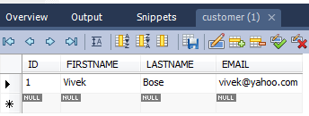
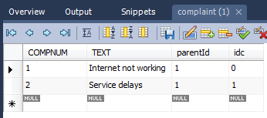
Execution

Slide 48

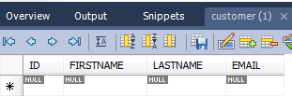
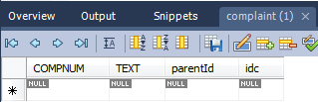

Slide 49
These is what is printed in the console:
Hibernate: insert into CUSTOMER (FIRSTNAME, LASTNAME, EMAIL) values (?, ?, ?)
Hibernate: select max(COMPNUM) from COMPLAINT
Hibernate: insert into COMPLAINT (TEXT, parentId, COMPNUM) values (?, ?, ?)
Hibernate: insert into COMPLAINT (TEXT, parentId, COMPNUM) values (?, ?, ?)
Hibernate: update COMPLAINT set parentId=?, idc=? where COMPNUM=?
Hibernate: update COMPLAINT set parentId=?, idc=? where COMPNUM=?
Hibernate: select customer0_.ID as ID4_0_, customer0_.FIRSTNAME as FIRSTNAME4_0_, customer0_.LASTNAME as LASTNAME4_0_, customer0_.EMAIL as EMAIL4_0_ from CUSTOMER customer0_ where customer0_.ID=?
Hibernate: select complaints0_.parentId as parentId1_, complaints0_.COMPNUM as COMPNUM1_, complaints0_.idc as idc1_, complaints0_.COMPNUM as COMPNUM5_0_, complaints0_.TEXT as TEXT5_0_, complaints0_.parentId as parentId5_0_ from COMPLAINT complaints0_ where complaints0_.parentId=?
Hibernate: update COMPLAINT set parentId=null, idc=null where parentId=?
Hibernate: delete from COMPLAINT where COMPNUM=?
Hibernate: delete from COMPLAINT where COMPNUM=?
Hibernate: delete from CUSTOMER where ID=?
For primary key
For insertion
For load
For delete
What makes the console is print the sql queries ?

Slide 50
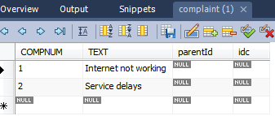

Tell me how
Suppose that we don’t want to delete the child table rows when parent row is deleted. How can we achieve this?
In such case we need to create a detached object like instead od session.load.
Customer c = new Customer();
c.setId(1);
Calling session.delete(c);
Will delete a row from the customer table and make the parentId of Complaints table null.

Slide 51
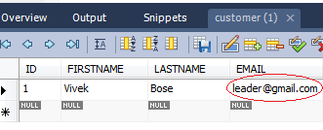
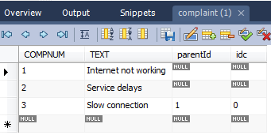
Update
Hibernate works for update as well in the same way as that od insert and delete, making cascade update possible through automatic state detection.
Transaction tr = session.beginTransaction();
Customer c=(Customer)session.load(hib.Customer.class, new Long(1));
if(c!=null){
c.setEmail("leader@gmail.com");
ArrayList cm=new ArrayList();
cm.add(new Complaint("Slow connection"));
c.setComplaints(cm);
session.update(c);
out.println("Updated <br>");
tr.commit();
}

Slide 52
Lazy loading
In cases where application needs to navigate the association, Hibernate uses a fetching strategy that can be specified in the O/R mapping metadata (over-ridden by a particular HQL or Criteria query)
By default Lazy collection fetching is used. (lazy=“true”)
Lazy collection fetching: a collection is fetched when the application invokes an operation upon that collection.
Immediate fetching: an association, collection or attribute is fetched immediately when the owner is loaded. lazy="false
There are others values as well which at this point we will not be looking at.

Slide 53
Lazy associations
Look at the code below:
protected void doGet(HttpServletRequest request, HttpServletResponse response) throws ServletException, IOException {
SessionFactory sessionFactory1 = new Configuration().configure().buildSessionFactory();
Session session = sessionFactory1.openSession();
Customer c = (Customer) session.get(Customer.class, new Long(1));
session.close();
System.out.println(c.getEmail()); //ok
Complaint com=(Complaint)c.getComplaints().get(0);
System.out.println(com.getText()); //not ok
}

Slide 54
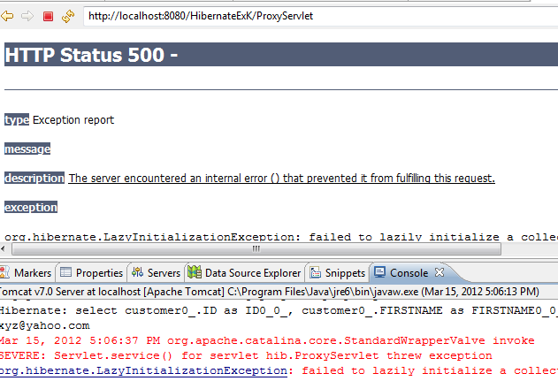
Since the complaints collection was not initialized before the Session was closed, the collection will not be able to load its state.
Hibernate does not support lazy initialization for detached objects.
This can be fixed by moving the code that reads from the collection before the session is closed.

Slide 55
Dirty checking
Hibernate automatically detects the changes in persistent object state and synchronize the updated state with the database when inside a transaction.
It compares the object state by value. Therefore a getter method can return a new object different from the instance variable that has been set.
Only exception to this is in cases where the object/property (instance variable) is a collection (in case of association).
For a property mapped as a persistent collection, the return form the getter must exactly be the same collection instance as that of what Hibernate passed to the setter method. Otherwise Hibernate will update the database, even if no update is necessary, every time the session synchronizes state held in memory with the database.
To disable this feature for particular properties/collections/class optimistic-lock mapping attribute is to be set to false.

Slide 56
Hibernate Annotations
Hibernate applications can be created with annotations.
Hibernate annotations are based on JPA 2.
All JPA annotations are in javax.persistence.* package.
Hibernate Entity Manager implements all the interfaces and life cycle defined by JPA.
The core advantage of annotations, we don’t have to create hbm files.

Slide 57
Annotation jar files
hibernate-commons-annotations.jar
ejb3-persistence.jar
hibernate-annotations.jar

Slide 58
Logging in Hibernate
During development or after release, sometimes some unexpected error occurred with the application.
To trace the error, logging is very helpful. Log4j is the tool which helps in displaying logs or keeping it's track(for example in a log file).
Using Log4j logging can be enable at run time without modifying the application code.
we included log4j-1.2.14.jar in the lib directory to implement logging usingLog4j.
Log4j is reliable, faster and extensible. It is easy to understand and easy to implement.

Slide 59
Logger Levels
TRACE, DEBUG, INFO, WARN, ERROR and FATAL

