Slide 1
Agile Introduction

Slide 2
Agenda
Introductory topics:
  What is Agile?
  Why is Agile important?
  How hard is it to be Agile?
Iterative development
Overview of Scrum (one popular Agile method)
Agile Estimation exercise
Notes:
“What is Agile” is a difficult question. It is both a philosophy and a set of software development practices.
“Why is Agile important” is a good question for an introductory course. The simple answer: Agile is a good way to make software product more responsive to customer needs – saving effort and money as a side effect.
“How hard is it to be Agile” is a deep question. It generally very easy to use agile methods for small software products and with small development teams. For larger products and cross-location teams, it is still possible to apply many agile practices – but there will be more organizational obstacles.

Slide 3
Agile Basics

Slide 4
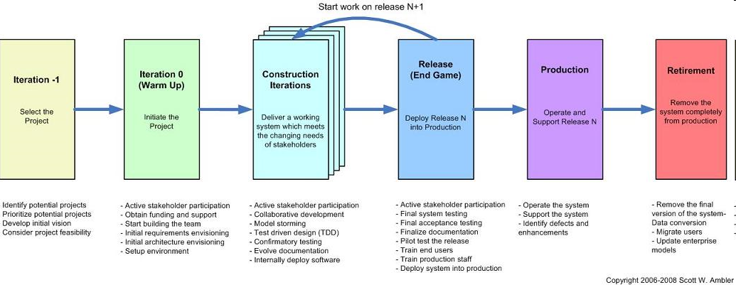
Agile Development – What does it mean?
Agile is a set of practices, values, and principles for software product development.
In software product development, we think about “methodologies,” “activities,” “interactions,” “results, work products or artifacts;” we think about “processes” that we use to organize the work:
  documents
  meetings and reviews
  diagrams and models
  coding and user documentation standards
So will Agile Development define a new set of process activities? Not necessarily.
Notes:
The main tasks of software development are still the same in Agile development – but the flow of activities will look a lot different.

Slide 5
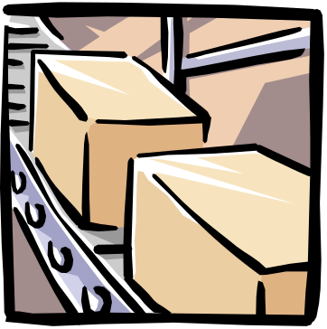

What is Agile? (Agile vs. Sequential Models or Frameworks)
Many of us are familiar with the Waterfall Model – it is a “framework” for the software development process
  Waterfall Model talks about “development activities through time”
  Waterfall Model talks about “teams of people”
Development activities | Teams
Divide the work into stages | A separate team of specialists for each stage
At each stage, the work is passed from one team to another | Some coordination is required for the handoff from team to team – using “documents”
At the end of all of the stages, you have a software product ready to ship | As each team finishes, they are assigned to a new product
Notes:
The main ideas of Waterfall:
Each of the development activities is a separate “stage” – with a “gate” that they must pass at the end of the stage
We can think of team of specialists as working at its own station on a factory assembly line
Waterfall can be thought of as an “efficient” process because the work is structured in a way that allows each team to be reassigned to other projects when their part of the project is complete.
Unfortunately, this doesn’t always work so well. The communication between teams is usually imperfect and inefficient. It is a lot of work to create “complete” documentation at each stage of the process, and if the requirements or architecture teams have moved on to other projects, the design/development and test teams might not be able to get their questions answered promptly.
If there are late requirements and architecture changes, the waterfall process has even more overhead costs – documents need to be updated, re-reviewed, and approved in order to conform to the overall process.

Slide 6

What is Agile? (continued)
The core ideas in Agile Development:
  Adaptive
  Iterative/incremental
  People-oriented
Adaptive means that the teams and the process should be flexible in the presence of “rapid-fire change”.
Iterative and incremental means that Agile Development produces working products in stages – a growing set of “completed and working software”.
People-oriented means the team organization and processes will support good people, who are the most important ingredient to project success.
Notes:
The list of “core ideas” is from this paper -- Noura Abbas, Andrew M. Gravell, and Gary B. Wills, “Historical Roots of Agile Methods: Where Did “Agile Thinking” Come From?” Proceedings of XP 2008, pp. 94-103.
In theory, the Waterfall Model could be used in an Adaptive and People-oriented way. In practice, however, Waterfall projects are pretty rigid and bureaucratic.
(It is interesting that most manufacturing work has been moving away from the old-fashioned rigid assembly line techniques of the early twentieth century – because management has found that they can get better quality and productivity with cross-trained cross-functional teams. So why are “knowledge workers” (software professionals) are often managed in a more assembly-line style than factory workers?)

Slide 7
Iterative development
One way to organize agile development is using short iterations:
Each iteration
might be 4 weeks
iteration
planning
iteration
1
iteration
2
iteration
3
iteration
4
iteration
5
iteration
6
Today
Ship date
Internal prototype (demo 1)
Customer-viewable prototype (demo 2)
Customer-viewable prototype (demo 3)
Each iteration step:
  has some analysis, some design, some coding, some integration and testing
  executed by a cross-functional team
  delivers some kind of internally or externally usable functionality – intermediate demos or deliveries are possible!
Question:
  Could we do a “demo” every iteration?
  Absolutely yes! The team gets practice at doing system integration
Notes:
Why iteration? It gives the development team a chance to change course several times during the course of development.
In this example, with six iterations of 4 weeks each, the team can take a breath and say “we are done with part of the system” six times during a 24-week period – and they should be able to demonstrate that they have implemented some real customer-visible functionality. Then the team can ask some most important questions:
“Are we building the right things?”
“Will the performance be adequate for the customer?”
“Can we find some tools, components, architecture changes, or development process changes that can improve the rest of the development work?”

Slide 8

Main characteristics of Agile Development
Agile Development as a “software development framework” says:
  keep things small
  deliver partially-completed software frequently
  talk to the customer often
  write more code than documentation
  everyone on the team learns together
Every 4 weeks, produce a new shippable product
Work for the
current
iteration
Work for future
iterations
Notes:
Planning in Agile development:
The most detailed plans are for the current iteration
The work for future iterations can be adjusted after talking with the customers
No “big design document” – because the future work might change, depending on the customers’ priorities
In a good Agile project, the team “gets into a rhythm” – delivering a set of new features every cycle

Slide 9




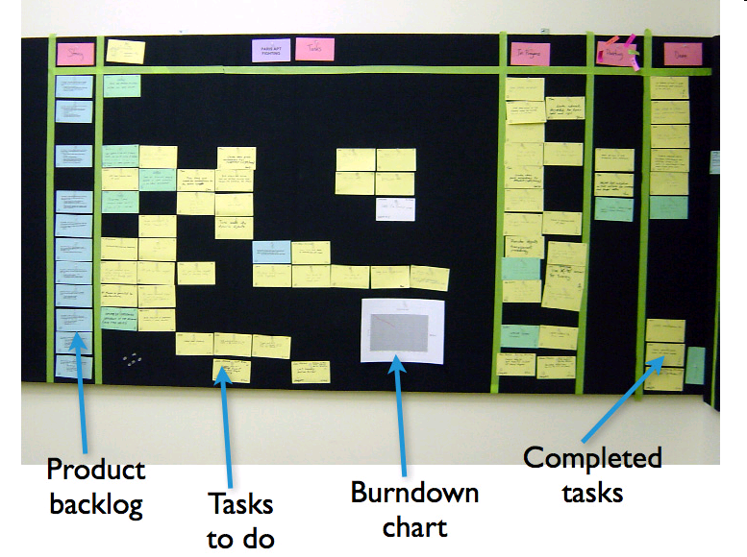
Agile Practices
There are many Agile practices:
  short timeboxed iterations
  continuous integration
  daily unit testing
  regular retrospectives
  direct communication between developers and the customer or a customer surrogate
  a single list of features and tasks
  short-term estimation of development tasks
  information radiators
  refactoring
Will you use every Agile practice? Maybe not…. they are not all required.
What is required? Agile values…
Check in changes
update build status
Continuous
Integration
Server
Product
Source code repository
(Subversion)
Developer workstations
Product Backlog Items for current Sprint
Notes:
This is a list of common Agile practices. Most of these practices have been used in a range of projects – from small web-based applications to embedded real-time systems to complex communications systems.
You don’t need to use every Agile practice to be an agile project. It is more important to understand the set of agile values and principles – and to use the values and principles to select a reasonable set of practices.

Slide 10

The Agile Manifesto: An Eloquent Statement of Agile Values or Goals
We are uncovering better ways of developing software by doing it and helping others do it. Through this work we have come to value:
  Individuals and interactions over processes and tools
  Working software over comprehensive documentation
  Customer collaboration over contract negotiation
  Responding to change over following a plan
That is, while there is value in the items on the right, we value the items on the left more.
Agile Alliance: http://www.agilealliance.org
Kent Beck
Mike Beedle
Arie van Bennekun
Alistair Cockburn
Ward Cunningham
Martin Fowler
James Grenning
Jim Highsmith
Andrew Hunt
Ron Jeffries
Jon Kern
Brian Marick
Robert Cecil Martin
Steve Mellor
Ken Schwaber
Jeff Sutherland
Dave Thomas
© 2001, the above authors
this declaration may be freely copied in any form,
but only in its entirety through this notice.
Notes:
Most of you have seen the Agile Manifesto. It is a brilliant document, and we let it speak for itself here. Let me ask you a couple of things about the Manifesto:
What does it say about iteration?
What does it say about customer satisfaction with the product?
What new things does it tell you to do that you are not already doing?
What are the consequences of using processes, tools, documentation, contracts, and plans?
You get the idea. The Manifesto is a framework for thinking about what you value; it is not a framework that you can fill in according to your needs.
It is nonetheless a firm starting point for Scrum—which itself is a framework that guides you and you can fill in. However, don’t leave your brains behind: you will need your wits just as much as a Scrum practitioner as an Agile fan.

Slide 11
Agile principles
1. Our highest priority is to satisfy the customer through early and continuous delivery of valuable software.
5. Build projects around motivated individuals. Give them the environment and support they need, and trust them to get the job done.
9. Continuous attention to technical excellence and good design enhances agility.
2. Welcome changing requirements, even late in development. Agile processes harness change for the customer's competitive advantage.
6. The most efficient and effective method of conveying information to and within a development team is face-to-face conversation.
10. Simplicity--the art of maximizing the amount of work not done--is essential.
3. Deliver working software frequently, from a couple of weeks to a couple of months, with a preference to the shorter timescale.
7. Working software is the primary measure of progress.
11. The best architectures, requirements, and designs emerge from self-organizing teams.
4. Business people and developers must work together daily throughout the project.
8. Agile processes promote sustainable development. The sponsors, developers, and users should be able to maintain a constant pace indefinitely.
12. At regular intervals, the team reflects on how to become more effective, then tunes and adjusts its behavior accordingly.
Notes:
http://www.agilemanifesto.org/principles.html

Slide 12
Requirements process
There is no “standard way” to do requirements in Agile development
  Could be a normal “Software Requirements Document”
  But it is better to be more lightweight
One way to do requirements:
Start with a much slimmer “initial requirements document” at the beginning of the iterations…
  Initial list of overall “systems capabilities” – written in the form of User Stories
  Plus a section containing “global non-functional requirements” (security, reliability, performance, usability, etc.)
The list of system capabilities and global non functional requirements will be the first draft of the SRD.
In each iteration, elaborate a small set of the functional requirements (the high-priority behavior)
  This avoids creating a big requirements document too soon
  A good strategy is to delay writing most of the “fine details” in the requirements until the iteration when they will be implemented
  Why? Because you will have learned more about the problem…
For some key requirements, create some acceptance tests at the same time as you write the requirements
<number> | Agile Intro | June 2010
Notes:
User stories, scenarios, and use cases are popular methods of writing lightweight requirements – you write stories of how the system will be used from the viewpoint of one of the users. It is a “scenario-based” requirements technique, and it always uses vocabulary that makes sense to the customer.
A good requirement / use case / user story is never really “complete” – it is just an outline of what should happen, and it can’t possibly cover all possible errors and branches. But – scenarios are a good thing to focus on during discussions with the customer. A good agile team member will get the customer to talk about some of the alternatives that weren’t listed in the original requirement.

Slide 13
Agile – questions and challenges?
  Documentation – it is still important in an Agile project.
    If it is the only kind of communication in your project, it isn’t good
    Real working code is more valuable than documents – less ambiguous
    Documents – easy to leave something out, easy to misinterpret
  Development plans – also important in an Agile project
    the format of an Agile development schedule is a bit different from a conventional project plan.
    Development plan includes “iterations”
    Each iteration gives the team has a chance to incorporate what they learn, rather than just following a non-adaptive plan
  Contracts – we expect to have contracts, but we need to talk with the customers as well.
    Customer collaboration is one way to reduce development costs
    Do you want to deliver “everything” the customer asked for in the original contract? No – if the customer no longer needs it, the extra code will increase maintenance costs
    Always ask: Who needs this feature and how does it contribute to the value of the product?
Notes:
Documentation is not necessarily contrary to Agile values. You should think about keeping the process lightweight -- eliminating documentation that isn’t providing value. Scott Ambler has some interesting thoughts about what kinds of documentation make sense in an agile environment:
http://www.agilemodeling.com/essays/agileDocumentation.htm
Iterative development changes the way that development planning is done. In Agile methodologies such as Scrum, there is an organized way of doing adaptive planning, and there is a special vocabulary for describing both long-term and short-term plans
http://www.mountaingoatsoftware.com/product-backlog
http://www.mountaingoatsoftware.com/sprint-backlog
Alistair Cockburn has some good ideas about how to use Agile development techniques for situations such as fixed-price, fixed-scope contracts:
http://alistair.cockburn.us/Agile+contracts

Slide 14
Why is Agile Development important?
The world is a lot different today. A large feature set might only increase costs for the customer.
  There is a constant introduction of new technology
  New players enter the market,
  New requirements are added
  “Small is Beautiful”
  If we are listening to the customer, we will reduce our chances of being “blindsided” by a smaller, more flexible competitor
  Anything that helps reduce maintenance costs will contribute to the bottom line
Notes:
What is more important – delivering hundreds of features in a product, or delivering just the right set of features to meet your customer’s greatest needs? The answer is not obvious. But here is one consideration:
A product with a lot of features can be costly to deploy and costly to maintain. In today’s market, our customers are often looking to reduce their internal training and deployment costs – so it might be better to forget about delivering 92 features in a release… just think about the 16 features that are needed to implement the top 5 use cases.
If you develop a product with a small but well-coordinated feature set, you might be able to get it on the market faster – beat the competition.
Here are a few good articles on the benefits of keeping your code small:
“Keep It Small” by Jack Ganssle - http://www.ganssle.com/articles/keepsmall.htm
“Less Software” (from the online book Getting Real ) - http://gettingreal.37signals.com/ch10_Less_Software.php
“Small is Beautiful” by John Mashey (slides from an ACM talk in the late 1970s) -- http://www.usenix.org/events/bsdcon/mashey_small/

Slide 15
How hard is it to be Agile?
“Don’t do Agile, be Agile”
  Just doing “development in iterations” isn’t enough
Agile Development is about:
  Keeping the process lightweight
  Making real progress in each iteration
  Communicating – face-to-face when possible
  Actively gathering customer input – early and often
  Being willing to make minor changes to your process
Notes:
What does it mean to “Be Agile”?
“Agile is not a practice. It is a quality of the organization and its people to be adaptive, responsive, continually learning and evolving – to be agile, with the goal of competitive business success and rapid delivery of economically valuable products and knowledge.” (Craig Larman and Bas Vodde, Scaling Lean & Agile Development, Chapter 6.)
There are a number of Agile practices – you can “do iteration”, “do continuous integration”, “do automated testing”, “do regular customer demos”, and “do regular retrospectives”. These practices will help you be more adaptive and responsive.

Slide 16
Agile Methods: Scrum

Slide 17
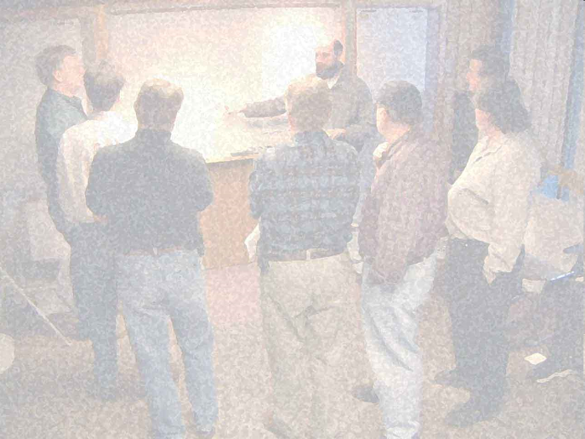
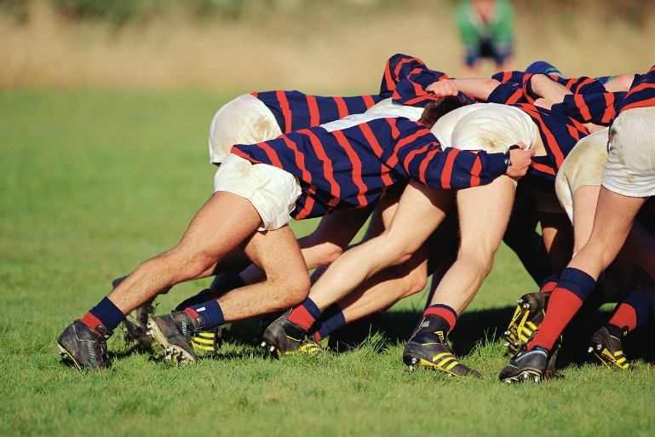
Agile methodologies
In this course, we will discuss the Scrum methodology
  Scrum has been around since the early 1990s
  The structure of Scrum is very simple (3 roles, 3 meetings)
  Scrum is not as “extreme” as some other methodologies
What is a Scrum?
  It is a meeting with attitude – good teamwork is necessary
a software scrum
a rugby scrum
Notes:
A “scrum” is “a meeting with an attitude”.
In rugby, the linemen have their arms linked together, and they are working cooperatively to move their opponents back so they can get the ball back to their teammates.
In a software scrum, it doesn’t look like the team is doing much, but they really are doing some hard work. They are getting a report on the status of every team member – each person is giving a short summary of the problems they are faced with on their tasks in the current iteration.

Slide 18
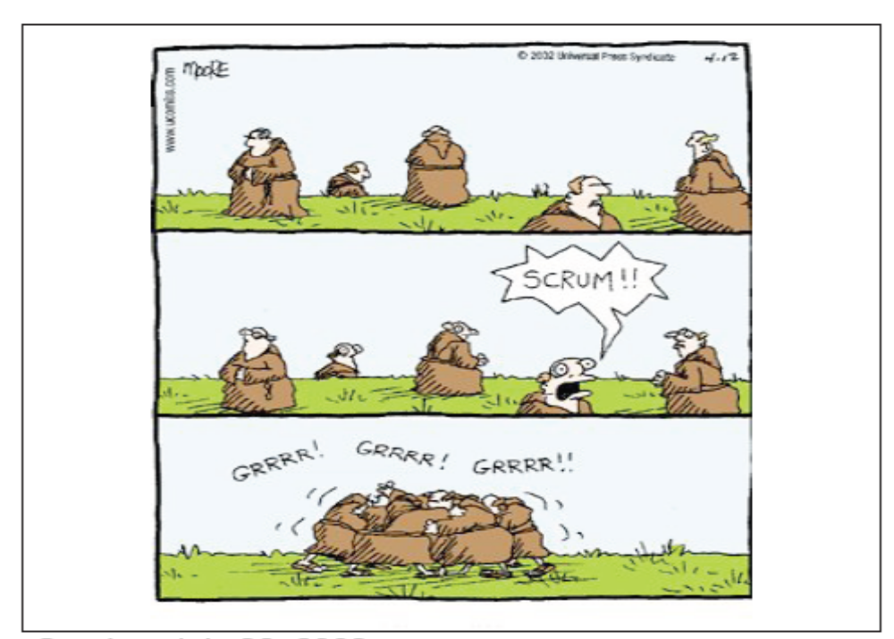
Let’s Scrum

Slide 19
Scrum overview
The Scrum presentation is short and simple:
  Scrum iteration process
  Product Backlog
  Roles: Team Member, Product Owner, and Scrum Master
  Project estimation and iteration estimation
  Daily Scrum Meeting
  Management
  Retrospectives
Notes:
A good Scrum overview: Scrum Guide, a short (about 20-page) article by Ken Schwaber -- http://www.scrum.org/scrumguides
See also:
Mike Cohn’s Scrum introduction -- http://www.mountaingoatsoftware.com/scrum
Short video on Scrum roles -- http://www.youtube.com/watch?v=vmGMpME_phg
Notes on Scrum on the Alcatel-Lucent ACOS Be-Agile wiki: http://acos.alcatel-lucent.com/wiki/g/be-agile/Scrum

Slide 20
Scrum iteration process
Scrum is designed to organize the work of a single cross-functional team
The team will do software product development this way:
  Iteration planning – create a plan for one iteration
    Select next features or sub-features to deliver (choose from highest priority items), define and estimate tasks, negotiate scope of the delivered product
  Iteration execution – implement the items in the plan
    Fill in missing requirements, design, code, integrate/build, and test the modules needed in the plan
  Deliver the results of the iteration – give a demo
Steps 1 – 3 will be executed many times – based on the Release Plan
Each cycle is a fixed-length timebox:
  Always end each iteration on schedule, even if it isn’t complete
    (Don’t say – “we can finish everything in this iteration in 2 more days”. Just deliver and run the next iteration planning meeting.)
  The team learns to make good short-term estimates – so over time, most of the iterations will deliver as expected
Notes:
Scrum uses timeboxed iterations. This is important. Everyone on the team knows when the iteration will end – and this is useful information when the team members make estimates at the beginning of the iteration.

Slide 21
Scrum Elements
THREE Roles
  Product Owner
  Scrum Master
  Team Member
THREE Meetings
  Planning (Release & Sprint)
  Daily Scrum
  Sprint Review
THREE Lists
  Product Backlog
  Spring Backlog
  Impediments List
  For details, see
  Scrum Guide: http://www.scrum.org/scrumguides

Slide 22
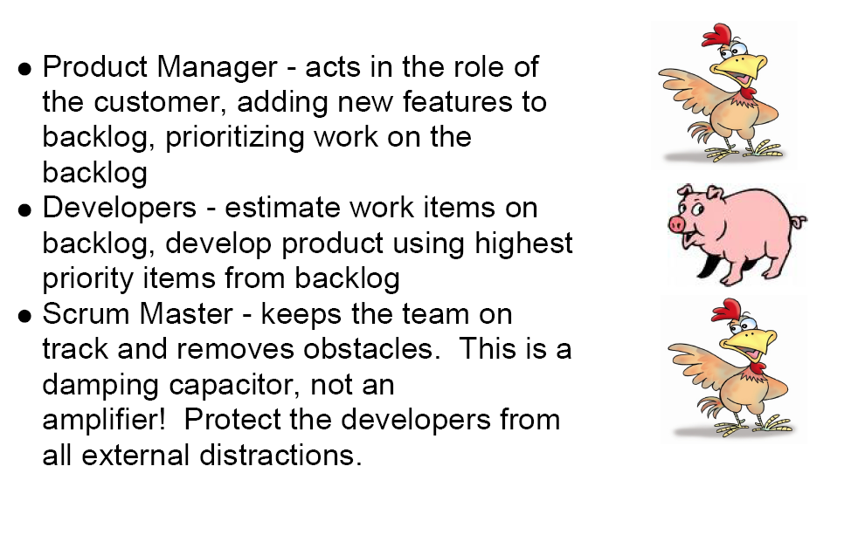
More on Scrum Introductopn
http://www.youtube.com/watch?v=vmGMpME_phg

Slide 23
Scrum iteration process
The Product Backlog is the set of all features and sub-features that you know you need to do to build the product
  This is the “plan” for multiple iterations
  The items in the Product Backlog is ordered by priority – value to the customer
    you want to deliver some value to the customer in each iteration, so you put the most important things early
  It is OK to add things to the Product Backlog at any time
Backlog item Prio Size
Subfeature 1 1 5
Subfeature 2 2 8
Subfeature 5 3 13
Subfeature 4 4 1
Subfeature 3 5 2
…
A Scrum iteration (called a Sprint) contains a list of tasks and work product outputs that will be done in a 4-week* timebox
  At the beginning of the 4 weeks, each team member has a pretty good idea of what they will be working on
  Management should not add new work product outputs to the Sprint – any new items should be added to the Product Backlog instead
  If new work items are important enough, they will get done in the next 4 week iteration
* (30-day iteration in the original Scrum articles – most teams use a 2-week
to 6-week iteration)
Notes:
The Product Backlog is the list of “everything” – in priority order.
In a Sprint, the team will work on a very small subset of the Product Backlog. When planning the Sprint, the team will consider the business value they will be able to deliver at the end of the Sprint.
The reasons for the Product Backlog:
The team can start doing the “most valuable” parts of the system in early iterations – the system features that have the highest business value to the customer.
If some new “high-value features” are discovered later, they can be added to the Product Backlog – and they might actually push some other less valuable features out of the release. This is OK – assuming that your customers really want you to build the newly discovered features (instead of just blindly delivering the items in the original release plan).
The estimates in the Product Backlog help managers plan the release: they should try not to promise more than the team thinks they can deliver.
Even if there are problems delivering everything in the release plan, following the Product Backlog in each iteration will result in the team delivering the maximum customer value possible with the resources available.

Slide 24
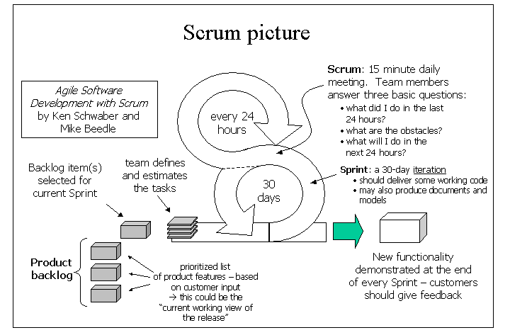
a 2 to 4 week iteration
2 to 4 weeks

Slide 25
Product Backlog
What does a Product Backlog look like?
  It is a simple spreadsheet
  All “Product Backlog Items (PBIs)” are in priority order
  Some PBIs are the names of “customer features”
    Could be a user screen, an interaction scenario or use case, a new report, a new algorithm
    Much, much smaller than a telecom system feature
  Some PBIs are internal tasks that contribute to the value of the product
    Can a design document be a PBI? Maybe.
    If it is a document that nobody reads, leave it out (because you are Agile)
    Can an early GUI prototype be a PBI? Certainly.
Effort estimates – each PBI should have an “estimated effort” that is assigned by the team
  Should managers do the estimation of Product Backlog Items? No, never.
  Estimates must come from the team – and they should be realistic
Notes:
There are a number of commercial and open source tools that could be used to manage the Product Backlog. See http://acos.alcatel-lucent.com/wiki/g/be-agile/Tools%20for%20Agile for more information.

Slide 26
Project estimation and iteration estimation
The Product Backlog – managers and customers use it to set the working agenda of the development team
  Managers and customers work with Product Owner to set the priority of each item
  Development team estimates the size/effort for each item
  Even if the managers and customers don’t like the estimates, they are not allowed to change them
Backlog item Prio Size
Subfeature 1 1 5
Subfeature 2 2 8
Subfeature 5 3 13
Subfeature 4 4 1
Subfeature 3 5 2
…
Within an iteration, the team divides the Product Backlog Items into individual tasks – the “task view” is only used within the iteration
  Development team defines tasks and the estimated effort
  The list of tasks is flexible – new items might be discovered during the iteration, some items might be combined or eliminated
  Development team tracks all “tasks” on a Task Board
  Development team tracks progress with a burndown chart
Notes:
The most common technique for doing estimates of the Product Backlog is to use an “artificial” estimation unit: Story Points. This often works better than trying to estimate the number of days of effort.
Estimation for a single Sprint – estimating in days or hours makes more sense here.

Slide 27



Roles on a Scrum team
Product Owner
  Responsible for the ROI
  Available for the Team during the whole product development period
  Gets answers to all requirements questions
  Talks with customers and understands their priorities
  Keeps the Product Backlog current
Scrum Master
  Scrum rules guardian
  Coach the team
  Removes impediments
  Prevents outside interference during an iteration
  Scrum Master is both a teacher and a referee
Notes:
For more information on how traditional project roles are changed when using Scrum, read Chapter 8 of Mike Cohn’s book Succeeding with Agile -- http://www.infoq.com/articles/cohn-chapter8
The Scrum Master is not the “manager of the team” – the team is actually “self-organizing”. But every team needs help staying organized, and every team needs help with obstacles and impediments.

Slide 28
Burndown chart
Tracking an iteration:
  A burndown chart tracks the amount of estimated effort remaining in the current iteration
    it should go down each day
    but if you discover that something is missing, or you have mis-estimated a difficult task, it could go up
    it’s OK: better to acknowledge reality early
  Don’t make your estimates too pessimistic
    you will get a burndown chart that gets to zero well before the end of the iteration
100
80
60
effort remaining
40
20
0
Burndown chart #1
time (days)
100
80
60
40
20
0
Burndown chart #2
Notes:
More information on burndown charts:
http://alistair.cockburn.us/Earned-value+and+burn+charts
What are the units in the burndown chart? Vertical axis is “person days”, horizontal axis is “days” – one point on the curve for each working day.
How to create the curve?? Each day, go to the Task Board. Each task should have an index card, with the remaining estimated effort to complete the task. Just add up the numbers.
At the end of the iteration, all of the cards should be “completed” – zero time left to complete.
Why could the curve go higher? You might have missed a task in the initial iteration planning, or you might discover as you start a task that it will take longer than the original estimate.
If the burndown chart isn’t going down fast enough… the team has to take action to improve things – usually immediately. Slide 19 listed the top three recovery actions:
Get more resources
Try to reduce scope (negotiate with the Product Owner)
Revisit the product’s software architecture

Slide 29
Daily Scrum Meeting
The Scrum Team has two kinds of “once-per-iteration” meetings:
  An Iteration Planning meeting at the beginning of each Sprint
  A Sprint Review meeting at the end of each Sprint
In addition, the Scrum Team has one daily meeting: the Daily Scrum
  Daily Scrum is 15 minutes – no longer
  Everyone is supposed to speak:
    “This is what I did yesterday.”
    “Here is what I am planning to do today.”
    “These are the obstacles in my way.”
  No problem solving in the meeting – everything is taken offline later.
What is the purpose of the Daily Scrum? To make sure that problems and obstacles are visible to the team
  Obstacles are valuable input for managers
Notes:
The Daily Scrum Meeting (also known as the “standup meeting”) is a daily ritual. It isn’t really a traditional status meeting. Its main function: to make sure that if someone in the team is stuck for one day, the rest of the team will help get them unstuck immediately.

Slide 30
Retrospectives
One important idea in Agile Development: take time to reflect and learn
  Iteration is good, because you have a natural breakpoint to apply some of what you have learned
In Scrum (and many other Agile methodologies), the team runs a Retrospective meeting at the end of each iteration
  A Retrospective is like a post-mortem, but it isn’t dead yet
  An end-of-iteration retrospective meeting takes an hour or two
The end-of-iteration Retrospective meeting is a chance to learn what worked well, what should be changed
  don’t use a Retrospective to blame team members or managers for all of the problems – focus on fixing the process
Notes:
A popular book on end-of-iteration retrospectives: Agile Retrospectives by Esther Derby and Diana Larsen.
The classic book on Retrospectives for software projects: Project Retrospectives by Norm Kerth.

Slide 31
Retrospectives
The Retrospectives Prime Directive:
Regardless of what we discover, we understand and truly believe that everyone did the best job they could, given what they knew at the time, their skills and abilities, the resources available, and the situation at hand.
(From Norm Kerth’s book on Project Retrospectives
See also http://www.retrospectives.com )
Why this rule? The goal of a retrospective is to improve the process, not to assign blame for the problems
Notes:
Retrospectives should never be used as part of the “performance management” system for a company – you want the retrospective participants to be free to focus on learning the lessons of the past to make things work better in the future. “Blame the process, not the person.”
See the following InfoQ article for more information on the application of the Retrospectives Prime Directive:
http://www.infoq.com/articles/retrospective-prime-directive
Norm Kerth’s book on Project Retrospectives or Esther Derby and Diana Larsen’s book on Agile Retrospectives.

Slide 32
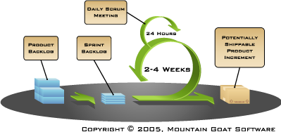
Scrum summary
Scrum is a “team-oriented” Agile methodology
Short timeboxed iterations
Each iteration produces some real software that has value to the customer
Each iteration has
  iteration planning
  development work
  iteration review
All estimation is done by the team
Within a Sprint, the progress is tracked using a burndown chart
Product Owner determines the priorities in the Product Backlog (list of things to build)
Scrum Master helps enforce the rules of Scrum
There is a 15-minute daily meeting to report what was done and identify obstacles
100
80
60
effort remaining
40
20
0
Burndown chart #1
time (days)

Slide 33
Scrum Adoption
This high-level presentation of Scrum has focused on the simple Scrum structure and rules.
But running Scrum and getting the core benefits from it is HARD
  Cross-functionality and self-organization
  Transparency, Inspect and Adapt
  Continuous improvement
<number> | Agile Intro | June 2010

Slide 34
More on Scrum
There are many more things to learn about Scrum. We will touch on some of those in the discussion:
  How to run big projects (more than one Scrum team)
  Can managers interfere with a Sprint in progress?
  Fixed schedule and fixed cost contracts
  Part-time team members (specialists)
  A single Scrum team with members in multiple locations
  Architecture
  CMMI / ISO9000 standards
Some references:
  Scrum Guide: http://www.scrum.org/scrumguides
  Scrum Primer: http://scrumtraininginstitute.com/home/stream_download/scrumprimer
  Craig Larman’s books on Safari: http://techbus.safaribooksonline.com/9780321685117
<number> | Agile Intro | June 2010
Notes:
Big projects – look for information on the “Scrum of Scrums” approach.
Managers can “cancel a Sprint” – a bit extreme, but sometimes necessary when the goals of a project change. This “abnormal early termination process” is mentioned in many of the Scrum books.
Fixed schedule and fixed contract is never easy, but an experienced Scrum team can do a pretty good job – because they have some practice at doing short term estimation. It is still necessary to add some extra “slack” to the estimates to handle unexpected variation from the estimates.
Part-time specialists are almost inevitable – there are specialists in our company who are in demand for their skills, so it may be necessary to adapt Scrum to use them in a part-time capacity. Also, some part-time workers might be needed in the transition to Scrum – such as testers.
Multiple-location teams are possible but difficult. You need to think about using several kinds of communication technology to get the effect of face-to-face.
Scrum doesn’t directly address architecture issues – but architecture has been discussed by many industry experts.
CMMI, ISO9000, and TL9000 certification is possible, even for a team using Scrum. There will be some extra “documentation” that needs to be created and maintained to meet certification requirements.

Slide 35
Summary
Agile Development – it is a different way of organizing product development
  Emphasizes iterative development with small cross-functional teams instead of waterfall development in separate silos
  At the end of each iteration, there is some functionality that is “done”
  Better communication, faster feedback
Why do we need to be Agile?
  Products are different from 20 years ago
  Customers are in a changing environment – and our processes need to be working at the same pace
  Working in short cycles reduces time to market and time to quality
There are many ways to be Agile
  Scrum is the most popular Agile approach
  Scrum promotes some good Agile practices
    Small cross-functional teams, short timeboxed iterations, adaptive planning, single product backlog, frequent integration, test automation

Slide 36
Agile Estimation

Slide 37

Estimation – Poker Planning
Scrum is fun, so estimation is a game.
The Delphi technique brought up-to-date
Visibility of differences
Drives to consensus
Breaks down linear thinking
References:
Mike Cohn, Agile Estimating and Planning, Prentice Hall PTR, Upper Saddle River, NJ, 2005. Read Chapter 6: Techniques for Estimating online.
J. W. Grenning, Planning Poker, 2002, http://www.objectmentor.com/resources/articles/PlanningPoker.zip

Slide 38
Units of Estimation
PBI: Ideally, estimation/story points: relative estimation
Alternatively, “ideal hours”
For Sprints, use “ideal hours” and it eventually can come down to hours
However, try to learn how many story points you can do per Sprint.
This ratio is called the team’s velocity

Slide 39
Simple Rules of the Game
Each participant gets a deck of estimation cards.
The moderator (usually the product owner or an analyst), presents
one user story at a time
The product owner answers any questions the team might have.
Each participant privately selects a card representing his or her
estimate.
When everybody is ready with an estimate, all cards are presented simultaneously.
In the (very likely) event that the estimates differ, the high and low estimators defend their estimates.
The group briefly debates the arguments.
Make a new round of estimation.
Continue until consensus has been reached.
The moderator notes the estimate, and the group continues with the next user story.

Slide 40
Planning Poker Tips
Baseline the rating system by scanning all user stories and assigning the estimate value of "1" to the simplest story
The cards reflect a moderately narrow range of numbers ranging about one order of magnitude.
Overly large user estimates suggest that the PBI/task can be split into multiple items.
Consider time boxing the debate period. The goal is that the technique be simple and lightweight
The technique works best with three to five participants representing architecture, development, testing, and deployment.
Work from a list that has already been sorted by business value, and avoid focusing on business value during the work queue priority ordering.
Use the three-finger test as an audit on the confidence of whether the team will accomplish all Tasks during a sprint

Slide 41
Exercise: Kitchen Remodeling
Install new hardwood floor
Refinish (remove, sand, repaint) the cabinets
Install granite countertop instead of tile
Repaint entire kitchen
Lay shelf paper
Install recessed lighting
Replace electric stove
Install built-in refrigerator
Install a new oven
Plumb the island and add sink
Replace simple window with a bay window

Slide 42

Backups & More Ressources
www.alcatel-lucent.com
<number> | RDC presentation |June 2009

Slide 43
BACKUPS

Slide 44

What is Agile (Development)?
It comes down to a few basic concepts (not necessarily independent):
  Self-organization
  Constant feedback
  Ability to respond to change
  Respect
  Communication
  Rhythm (e.g., time boxing)
  Flow value at the pull of the customer
  Push decisions as close to the work as possible
  Make decisions as late as possible
As typically used, “Agile” refers to a set of development methodologies and frameworks (software development methodologies) based on and implementing the above principles.
It is a light weight and at the same time very structured development framework – marking the current step in software development models (from waterfall/sequential models – to V-shaped – to incremental – to spiral - to iterative - to “agile”). Note, that agile is more than a process model.

Slide 45
Continuous integration
Estimation and planning are at the core of doing effective iteration, but let’s start with continuous integration – a development-centric practice
  All code is stored in a source code control system
    ClearCase, CCMS, Subversion, Microsoft SourceSafe
  Every day – build the system and run a series of acceptance tests
  The build and test process is automated – no human interaction
  You evaluate how much development work you have done (and how much work you have left to do) from the acceptance tests
  One option – there is a special “build server”
    it checks out the current code and builds it – maybe multiple times per day
Everyone gets feedback on bugs, everyone knows if the project is on schedule
Notes:
Continuous integration is one of the most important agile practices for maintaining quality throughout the development cycle. It makes it possible to react early to design and implementation problems.
“Automating the build” is something that all Alcatel-Lucent projects should do. We already have many existing practices that help us, such as the use of a source code control system.
The biggest obstacle to continuous integration is the amount of time needed to do a “complete build” for large products. This is a common problem on our big systems – but there are some things we can do to make things better for doing “incremental builds”.

Slide 46

Requirements process
There is no “standard way” to do requirements in Agile development
  Could be a normal “Software Requirements Document”
  But it is better to be more lightweight
One way to do requirements:
  Initial list of overall “system capabilities” – written in the form of “User Stories” - http://www.agilemodeling.com/artifacts/userStory.htm
  Plus a document of “global non-functional requirements” (security, reliability, performance, usability, etc.)
  In each iteration, some of the user stories are elaborated – don’t create a lot of requirements detail too soon
    Delay writing the requirements details – especially if they might change
    You will have learned more about the system as you go along – late requirements are often better
  For some key requirements, create some acceptance tests at the same time as you write the requirements
    The tests will be useful in the continuous integration process
Notes:
User stories are a popular method of writing lightweight requirements – you write stories of how the system will be used from the viewpoint of one of the users. It is a “scenario-based” requirements technique, and it always uses vocabulary that makes sense to the customer.
A good user story is never really “complete” – it is just an outline of what should happen, and it can’t possibly cover all possible errors and branches. But – the user story is a good thing to focus on during discussions with the customer. A good agile team member will get the customer to talk about some of the alternatives that weren’t listed in the original user story.

Slide 47

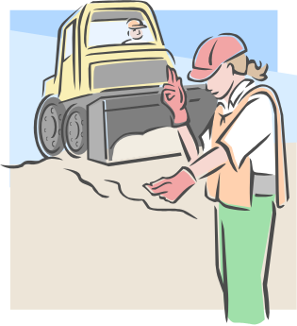
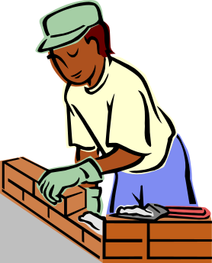

Roles on a Scrum team
There are three important roles:
  Team Member – the people who do all of the hard work.
    The team will have a range of experience and skills
      one or two team members with good architecture/design experience
      one or two team members who know a lot about test strategies
    But every team member is prepared to help do activities outside of their main area of expertise
      when testing that needs to be done before the end of the iteration or new user screens to be designed, anyone in the team could jump in to contribute to the work
    Normal team: 5 to 9 members, all working in a single location
  Product Owner – the single person who interacts with customers and product management (a very difficult job)
  Scrum Master – the single person who enforces the Scrum process rules
  Example of self-organization
Notes:
All three of these roles are difficult.
Most of the decisions in Scrum are made by the team – it is a “self-managing” team.
Decisions about the product requirements need to be made in consultation with the customer… so the Product Owner role is very important.
Scrum Master is supposed to help keep everyone on track. If there are “impediments” to the team, the Scrum Master will help find some ways to resolve the blockages. If the team has communications problems, the Scrum Master needs to be ready to facilitate.
Example of self-organization
http://www.youtube.com/watch?v=T8Doy_7sOoM

Slide 48
The Nokia Test and the Key Agile Concepts
Iterations
Expanding scope of Done to deployment
Up-front specifications w/User Stories
Product owner who plans
Up-front Product Backlog
Up-front estimates
Business-oriented burndown chart
Team disruption

Slide 49
What is Lean?
Lean is a more complex (production) system aimed at adding value for the end user and customer
To do that,
  We eliminate waste
  We eliminate inconsistency
  We smooth and optimize the production flow
  We are constantly improving: Kaizen
SKILLED PEOPLE
TOOLS & TECHNOLOGY
LEAN
PRODUCT
DEVELOPMENT
SYSTEM
PROCESS

