Slide 1
Agile Practices

Slide 2
Scrum calculator
2 weeks = 10 work days
- 20% (2 days) for Scrum rituals
- 1.5 day for integration and manual deployment
- 1.5 day for manual testing
= 5 work days!

Slide 3
Challenge
How to increase number of development days up-to 7 (~30%) ?

Slide 4
Agile best practices to the rescue!
Nightly builds
Continuous integration
Unit tests
Automatic deployment
Automatic functional and UI tests
Unified release packages
Continuous deployment

Slide 5
Unfortunately, not every company uses Agile best practices

Slide 6
Adform before: basic practices only
All source code in SVN
Nightly builds on TeamCity
Few unit and functional tests

Slide 7
Known fact
Without appropriate cultural and technical skills Agile teams will FAIL

Slide 8
Nevertheless, let’s do Scrum!

Slide 9

Sprint #1, #2, …
We are too slow!

Slide 10
What are the problems?

Slide 11
Identified problems
Time killers
Manual testing
Manual deployment
Integrations done at the end

Slide 12
Identified problems
Code horror
Small change requires full regression testing

Slide 13
Identified problems
Release “jams”
Release packages various from team to team
On-site participation of 1-2 team members during release

Slide 14



Release “jams”
Team releases
Release manager
PROD
Awaiting teams

Slide 15
Eliminating time killers
Integrations done at the end
Automatic builds on commit
Integration tests
Manual deployment
Automatic deployment to DEV (x2) and INT environments from TeamCity
Manual testing
Unit and integration tests
Functional and UI tests (SoapUI, Selenium)

Slide 16
Eliminating code horror
Small change requires full regression testing
Unit tests
Best to have experienced person in place
Will require code refactoring
Separate data storage from the business logic
Are part of the task DONE criteria
Integration tests
Working with DB, Web services, file system, etc.

Slide 17
Eliminating release “jams”
Unified release packages
MSBuild scripts with custom tasks
One-click principle
Single package for all environments
Initially takes some time to create, but later is semi- or fully-automatically created on TeamCity
Centralized release server
Single place to deploy packages to remote servers

Slide 18

Adform now: most Agile practices
Nightly builds
Continuous integration
Unit tests
Automatic deployment
Automatic functional and UI tests
Unified release packages
Continuous deployment

Slide 19
Adform next: continuous deployment
Nightly builds
Continuous integration
Unit tests
Automatic deployment
Automatic functional and UI tests
Unified release packages
Continuous deployment

Slide 20
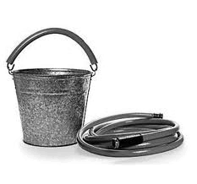
Continuous deployment
Continuous, successful and repeatable methodology to deploying code

Slide 21
Who is doing?
WordPress.com
“Everyone has access to a deploy button”
“Deployment to 400 production servers in our web tier in less than 30 seconds”
Facebook
Flickr
Atlassian
others...

Slide 22
Adform Releazr
Unified way of releasing applications and visualizing release process for developers and release managers across all environments

Slide 23
Releazr features
Release planning
Quick and easy way to fill release plans
Automatic pre-fill of fields and from history
Visual representation of the current release state
Ability to select group of servers

Slide 24
Releazr features
Release dashboard
Easy and intuitive way to release applications
Ability to deploy, rollback and rerelease packages
Visual representation of the current release state
Comprehensive release log per package per server

Slide 25
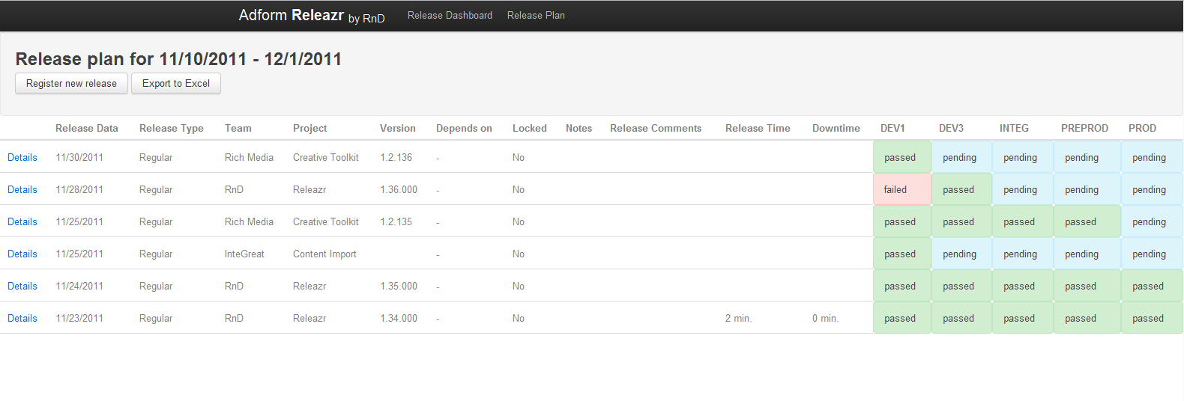

Slide 26
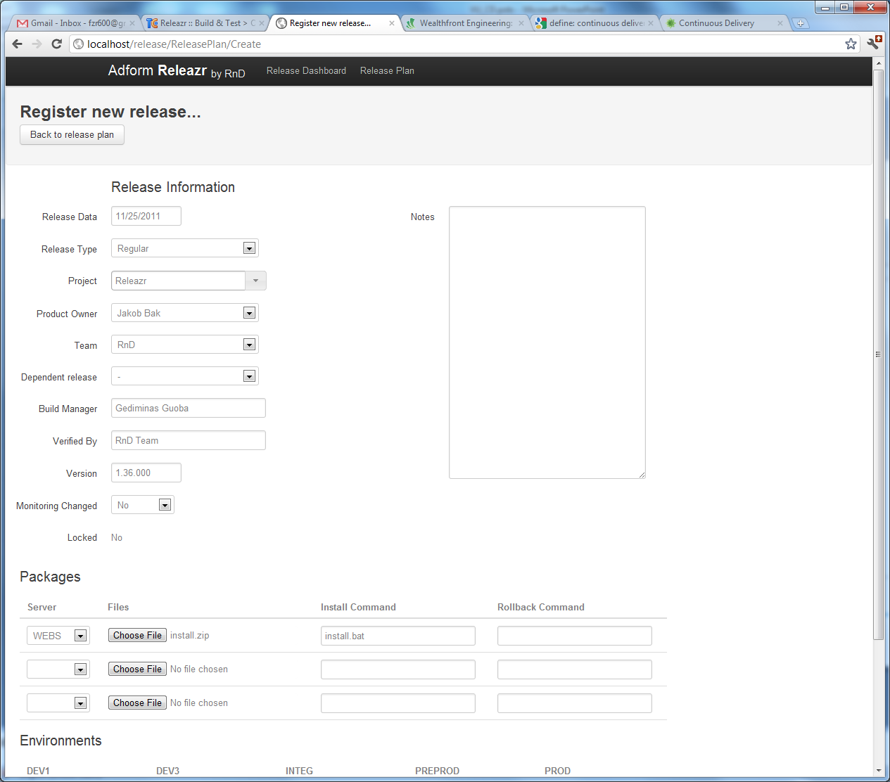

Slide 27
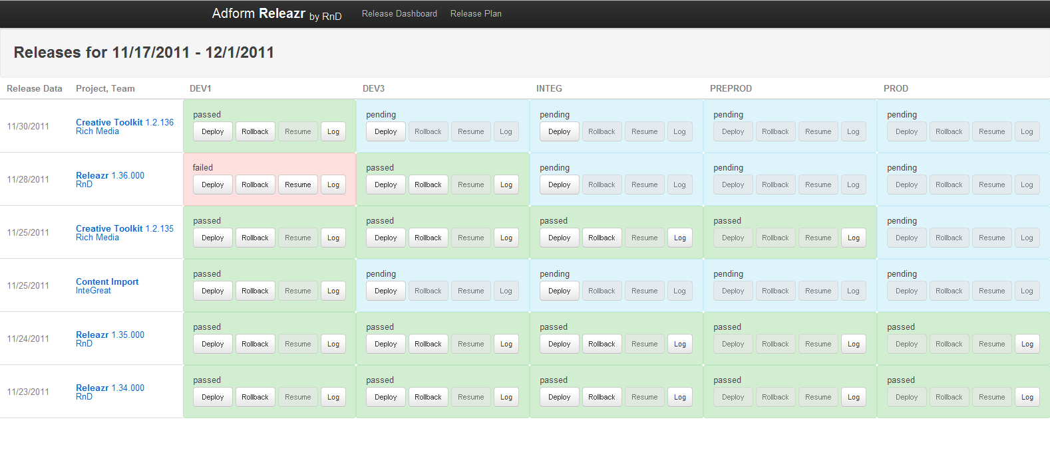

Slide 28
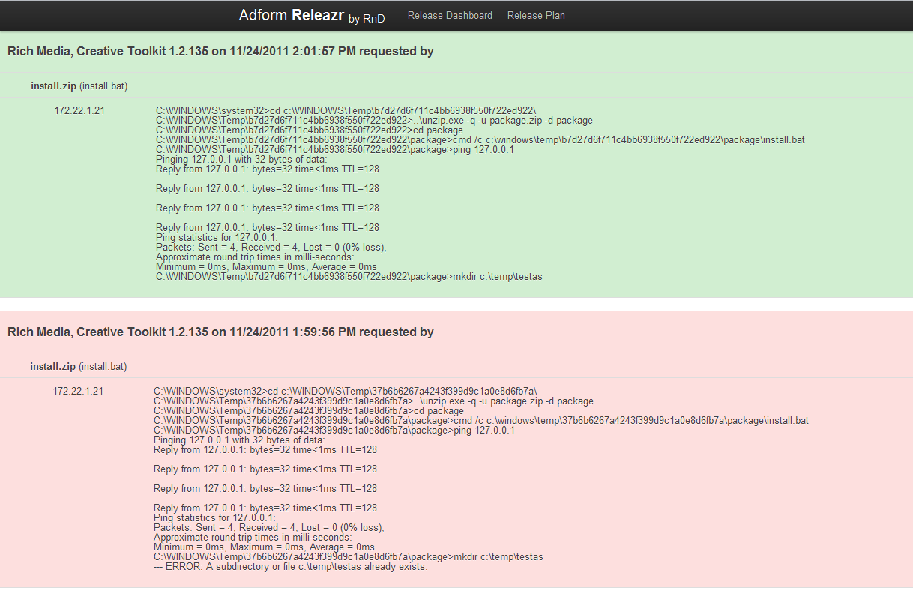

Slide 29
We are still in very early stage with Releazr and continuous deployment in general

Slide 30
Summary
Agile is THE WAY to develop software
To be effective teams need to have appropriate cultural and technical skills
With Agile best practices in place you will be able to continuously deliver valuable software

Slide 31
Last note…
We started using Agile best practices because we were forced to, not because it is cool

Slide 33

Agile culture
Continuous delivery of valuable software
Welcome changing requirements
Build projects around motivated individuals
Business people and developers must work together daily

