Slide 1
Application Delivery Fundamentals 2.0 B: Java
Introduction to Gradle

Slide 2
Course Goals / Objectives
At the end of this module, participants will be able to understand:
o Introduction
o Folder Structure
o build.gradle
o Dependencies
o Goals
o Scopes
o The Compiler Plugin
o Source Plugin
o Jar Plugin

Slide 3
Gradle
Gradle is an opensource build automation tool that is based on the concept of Apache Maven and Apache Ant.
It is capable of building almost any type of software. It is designed for the multi-project build, which can be quite large.
It introduces a Java and Groovy-based DSL(Domain Specific Language) instead of XML (Extensible Markup Language) for declaring the project configuration.
It uses a DAG (Directed Acyclic Graph) to define the order of executing the task.

Slide 4
Gradle
Gradle offers an elastic model that can help the development lifecycle from compiling and packaging code for web and mobile applications.
It provides support for the building, testing, and deploying software on different platforms.
It has been developed for building automation on many languages and platforms, including Java, Scala, Android, C / C ++, and Groovy.
Gradle provides integration with several development tools and servers, including Eclipse, IntelliJ, Jenkins, and Android Studio.

Slide 5
Gradle
Gradle is used by large projects such as Spring Projects, Hibernate Projects, and Grails Projects.
Some Leading Enterprise companies like LinkedIn and Netflix use Gradle.

Slide 6
What is a Build Tool?
Build tools are programs that are used to automate the creation of executable applications from source code.
The building process involves compiling, linking, and packaging the code into a useful or executable form.
Developers often implement the build process manually for small projects.
But this cannot be done for large projects where it is complicated to keep track of what is needed for construction, in what order, and what dependencies are in the building process.
Using the automation tools makes the build process more consistent.

Slide 7
Projects and Tasks in Gradle
Gradle describes everything on the basis of projects and tasks. Every Gradle build contains one or more projects, and these projects contain some tasks.
Gradle Projects
In Gradle, A project represents a library JAR or a web application.
It may also represent a distribution ZIP, which is assembled from the JARs produced by other projects.
A project could be deploying your application to staging or production environments.
Each project in Gradle is made up of one or more tasks.
Gradle Tasks
In Gradle, Task is a single piece of work that a build performs. For example, it could compile classes, create a JAR, Generate Javadoc, and publish some archives to a repository and more.

Slide 8
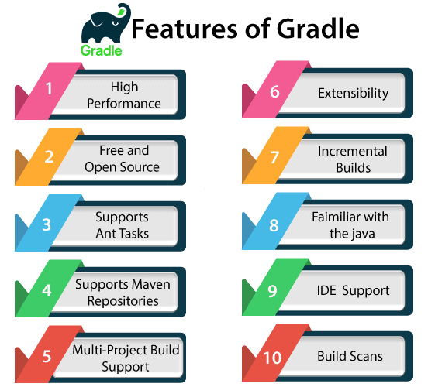
Features of Gradle

Slide 9
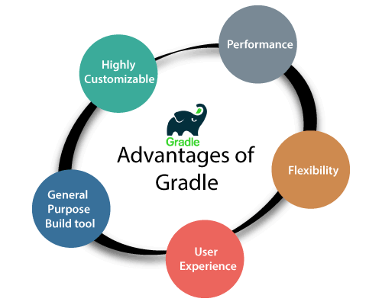
Advantages of Gradle

Slide 10
Why Gradle?
Gradle is a modern build tool that comes up thinking about the challenges we have faced on other tools like ANT and Maven.
The build tool should help us accomplish the goal of automating the project.
Therefore we should not compromise on maintainability, usability, flexibility, extendibility, or performance.
It is developed to overcome the drawbacks of Maven and Ant and supports a wide range of IDEs.
It features lots of plug-ins that can be written on our prediction.
Also, it can be used for large projects such as Spring projects, Hibernate projects, and Grails projects.
So it may be the right choice for us to choose Gradle as our build tool.

Slide 11
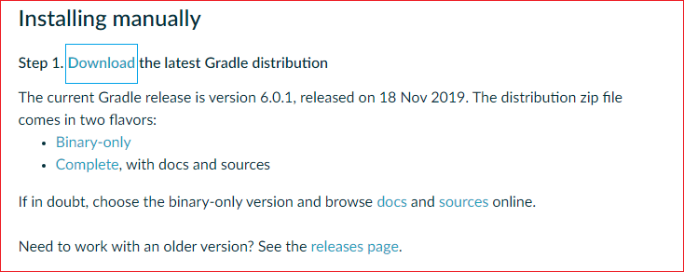
Gradle Installation

Slide 12
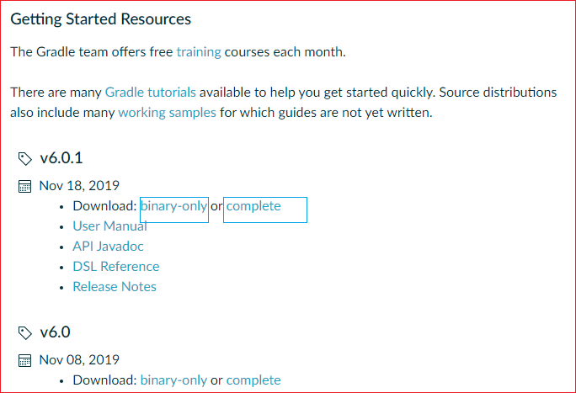
Gradle Installation

Slide 13
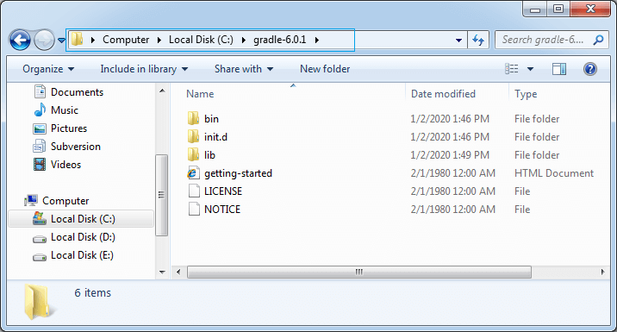
Gradle Installation

Slide 14
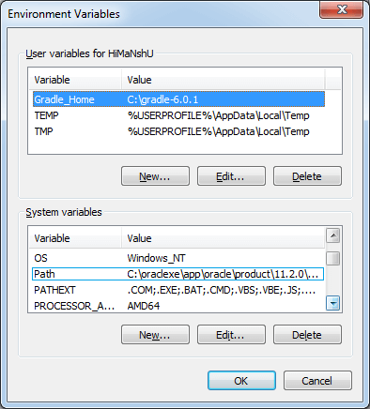
Gradle Installation

Slide 15
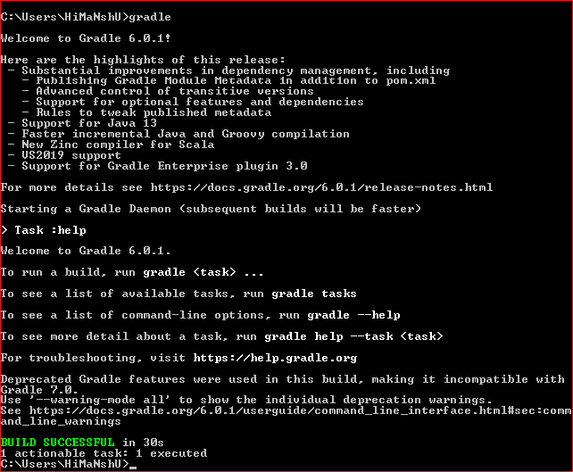
Gradle

Slide 16
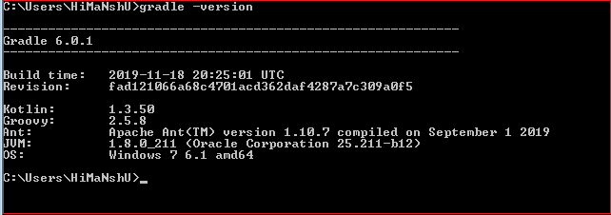
Gradle

Slide 17
Gradle vs Maven
Gradle | Maven
It is a build automation system that uses a Groovy-based DSL (domain-specific language ) | It is a software project management system that is primarily used for java projects.
It does not use an XML file for declaring the project configuration. | It uses an XML file for declaring the project, its dependencies, the build order, and its required plugin.
It is based on a graph of task dependencies that do the work. | It is based on the phases of the fixed and linear model.
In Gradle, the main goal is to add functionality to the project. | In maven, the main goal is related to the project phase.
It avoids the work by tracking input and output tasks and only runs the tasks that have been changed. Therefore it gives a faster performance. | It does not use the build cache; thus, its build time is slower than Gradle.
Gradle is highly customizable; it provides a wide range of IDE support custom builds. | Maven has a limited number of parameters and requirements, so customization is a bit complicated.
Gradle avoids the compilation of Java. | The compilation is mandatory in Maven.

Slide 18
Build.gradle
plugins {
id 'java'
}
group 'org.example'
version '1.0-SNAPSHOT'
repositories {
mavenCentral()
}
dependencies {
testCompile group: 'junit', name: 'junit', version: '4.12'
}

Slide 19
Create Executable jar
jar {
manifest {
attributes "Main-Class": "com.gradle.tutorial.FizzBuzzProcessor"
}
from {
configurations.compile.collect { it.isDirectory() ? it : zipTree(it) }
}
}

Slide 20
Create Executable jar
application {
mainClassName = 'com.gradle.tutorial.FizzBuzzProcessor'
}

Slide 21
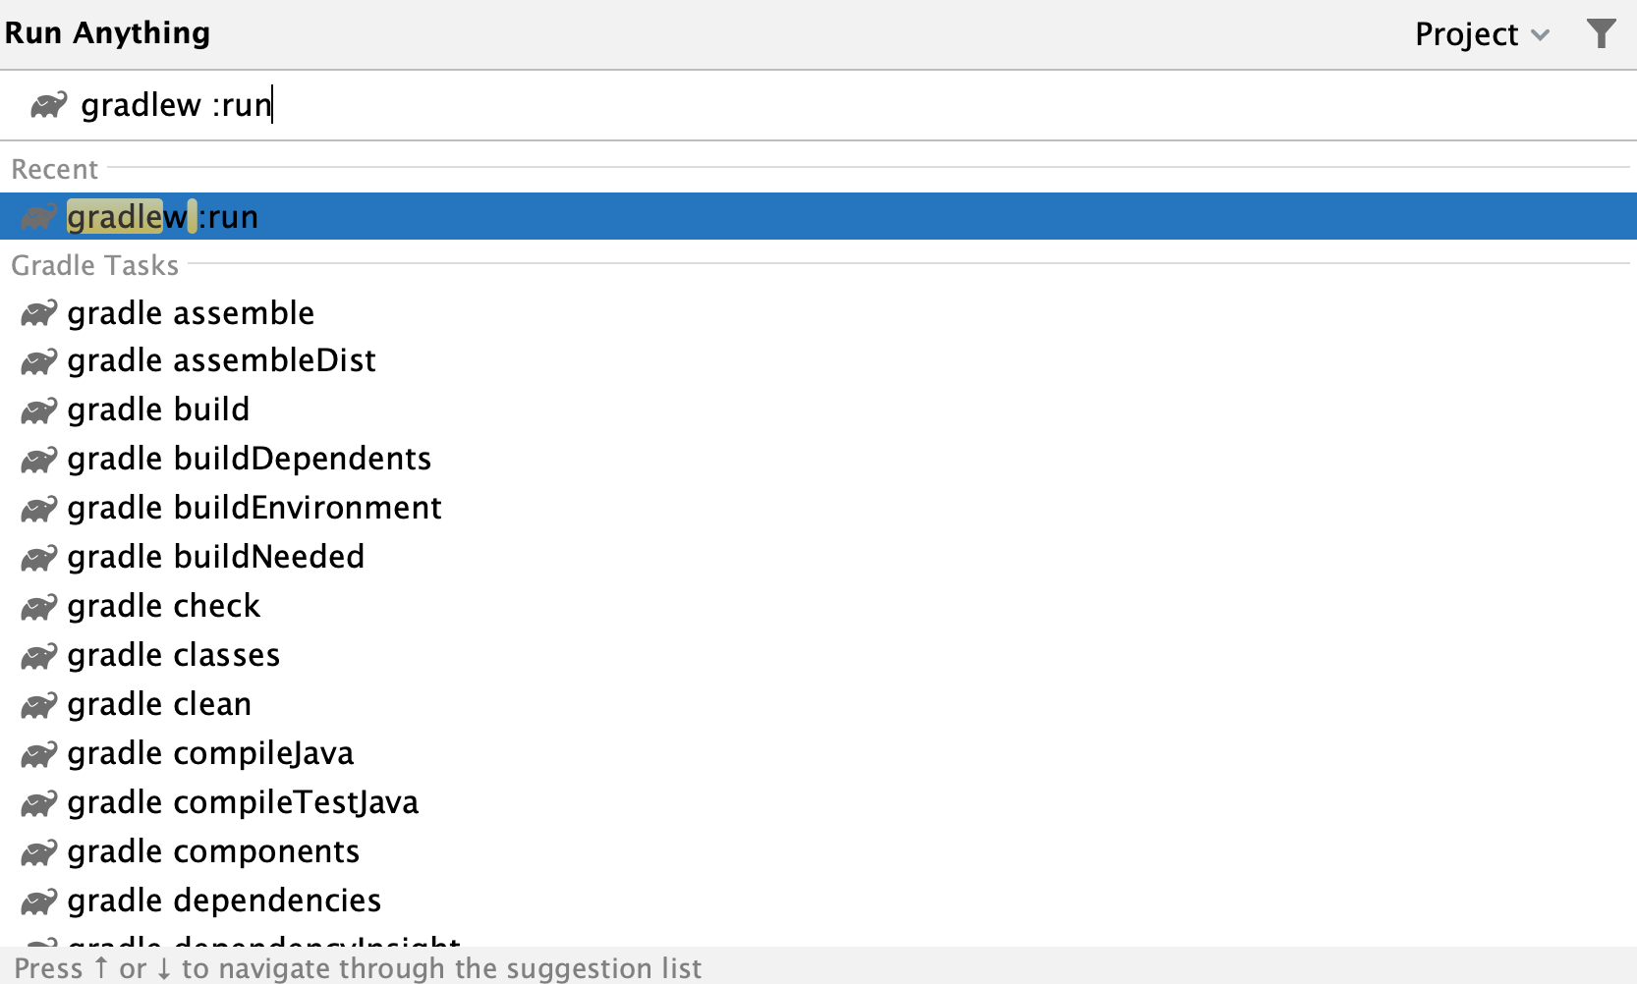
Run Gradle

Slide 22
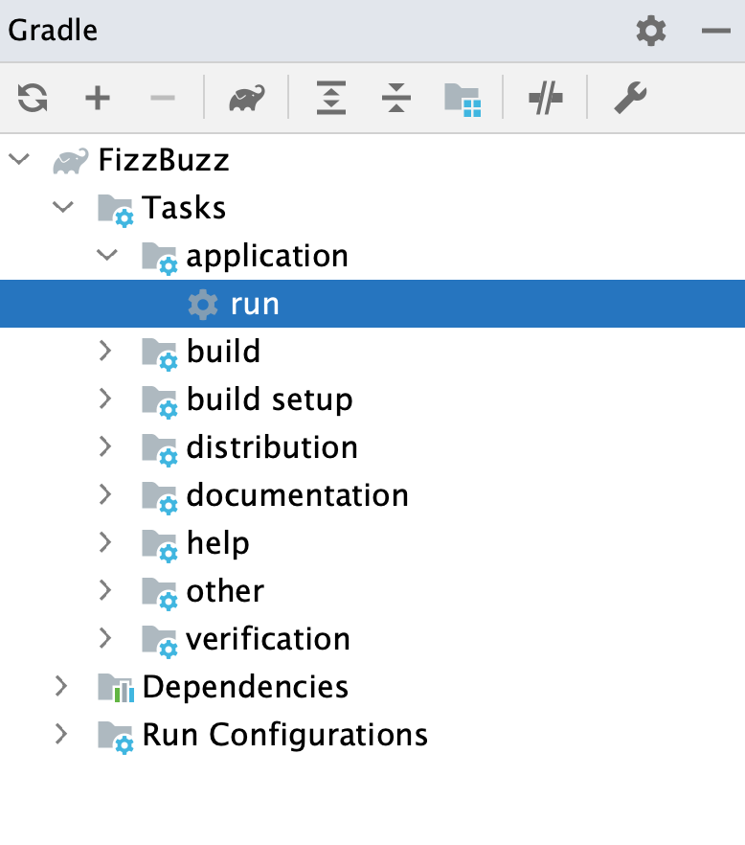
Run Gradle

Slide 23
Gradle - Plugins
Plugin does set of all useful tasks, such as compiling tasks, setting domain objects, setting up source files, etc. are handled by plugins.
Applying a plugin to a project means that it allows the plugin to extend the project’s capabilities.
The plugins can do the things such as −
Extend the basic Gradle model (e.g. add new DSL elements that can be configured).
Configure the project, according to conversions (e.g. add new tasks or configure sensible defaults).
Apply specific configuration (e.g. add organisational repositories or enforce standards).

Slide 24
Types of Plugins
Script plugins − Script plugins is an additional build script that gives a declarative approach to manipulating the build. This is typically used within a build.
Binary plugins − Binary plugins are the classes, that implements the plugin interface and adopt a programmatic approach to manipulating the build. Binary plugins can reside with a build script, with the project hierarchy or externally in a plugin JAR.

Slide 25
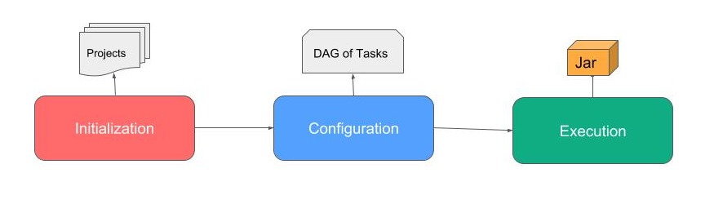
Lifecycle

Slide 26
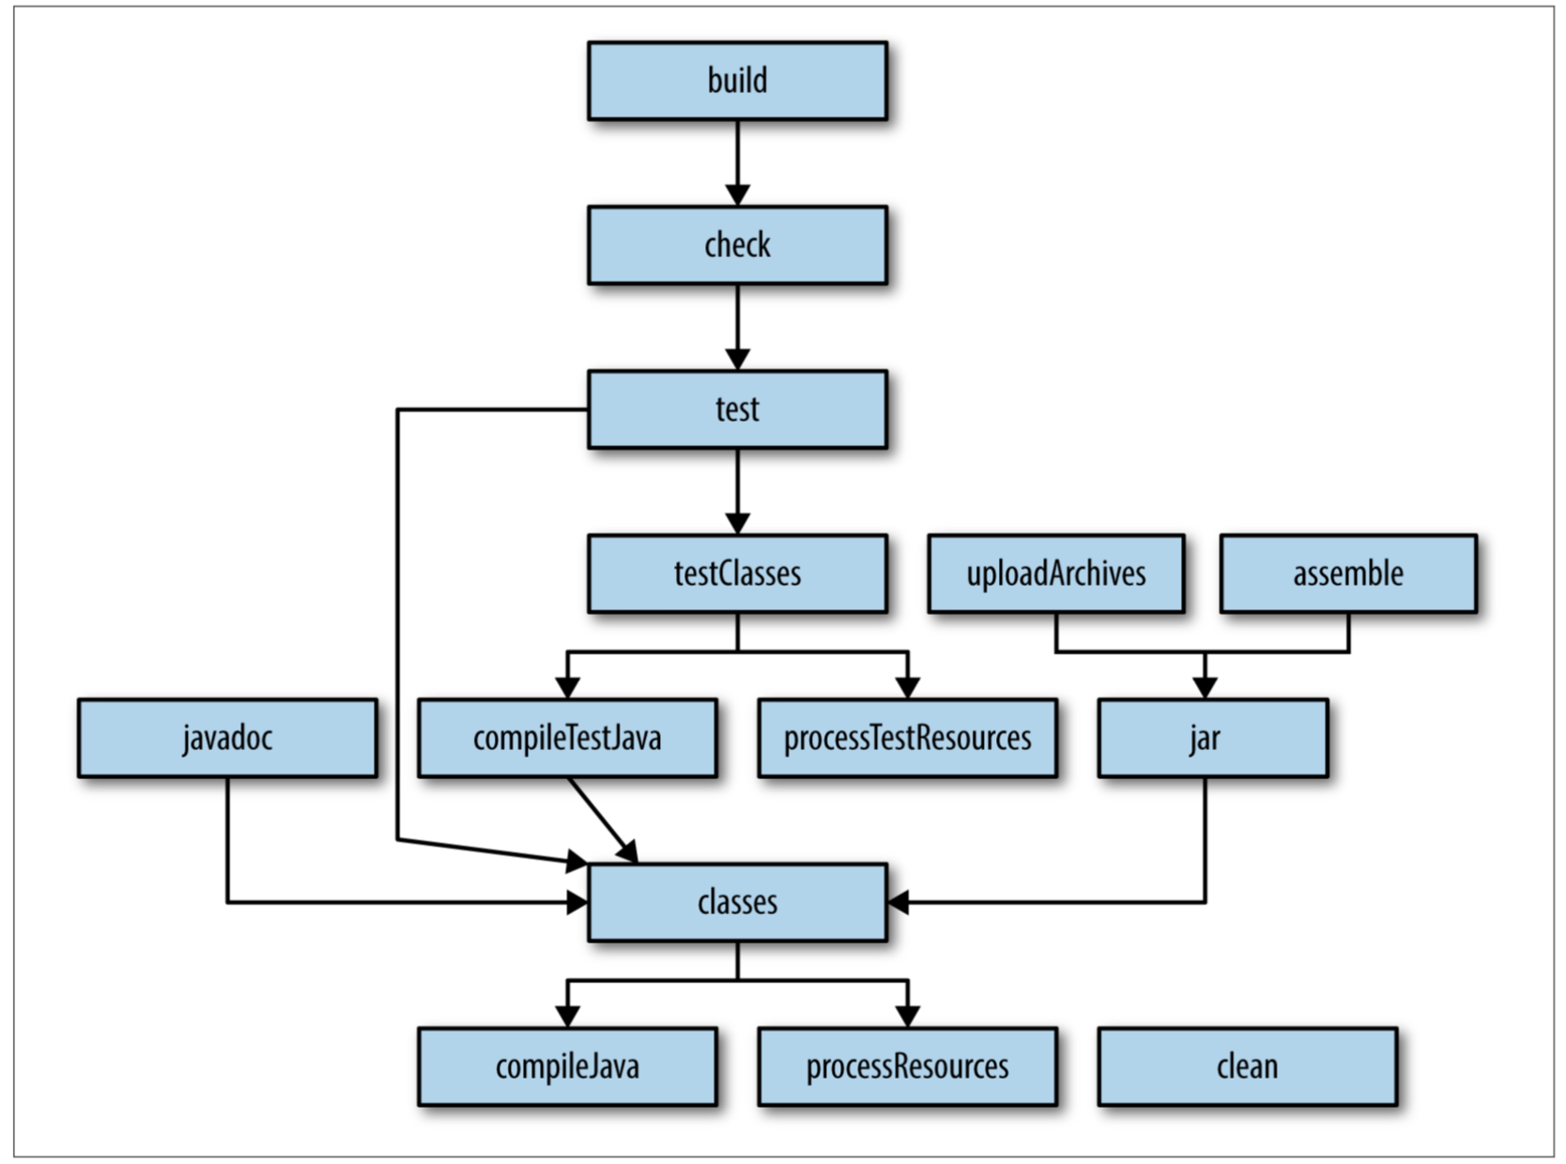

Slide 27
Questions

Slide 28
Module Summary
In this module we discussed
o Folder Structure
o The pom.xml
o Dependencies
o Goals
o Scopes
o The Compiler Plugin
o Source Plugin
o Jar Plugin

