Slide 1
Grafana Case Studies
Amazon Managed Grafana | Grafana Cloud | Self-hosted Grafana | Grafana for BI

Slide 2
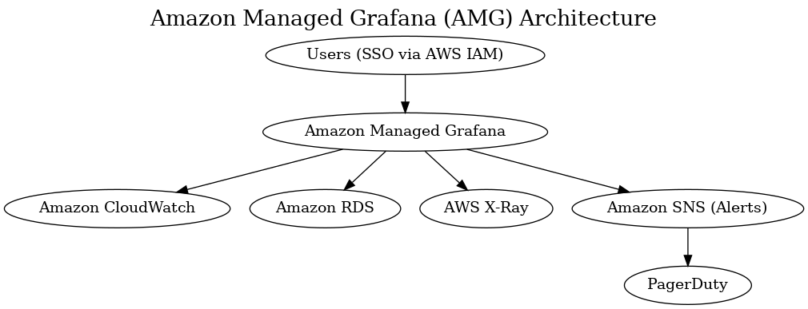
Case Study 1 – Amazon Managed Grafana (AMG)
Background: Financial services company with compliance needs. Challenges: Security, IAM, no self-hosting. Solution: Amazon Managed Grafana with CloudWatch, RDS, X-Ray. Outcome: 45% faster incident response, zero-maintenance, compliant.

Slide 3

Case Study 2 – Grafana Cloud
Background: SaaS startup needing observability. Challenges: Small team, multi-region data. Solution: Grafana Cloud with Prometheus, Loki, Tempo. Outcome: One-stop observability, 99.95% SLA, scaled 5x smoothly.

Slide 4

Case Study 3 – Self-hosted Grafana OSS
Background: Manufacturing company with hybrid infra. Challenges: Mix of on-prem + cloud, cost control, branding. Solution: Self-hosted Grafana with Prometheus, InfluxDB, Loki. Outcome: Unified dashboards, 30% savings, branding adoption.

Slide 5
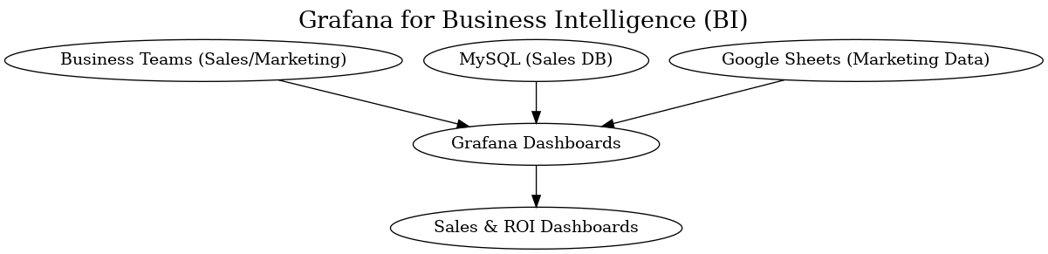
Case Study 4 – Grafana for Business Intelligence (BI)
Background: Retail chain needing BI dashboards. Challenges: Slow expensive legacy BI. Solution: Grafana with MySQL + Google Sheets. Outcome: 40% BI cost savings, real-time insights.

