Slide 1
Application Delivery Fundamentals 2.0
Spring AOP
Notes:
Faculty Notes:
Introduce yourself, if necessary.
Introduce the module and time frame, which is approximately 1.5 hours
Verify the students have the proper handouts for the module.
Ensure the students have access to the required software for the practice exercises.
Participant Notes:
N/A

Slide 2
Module Objectives
At the end of this module, participants will be able to:
Describe fundamentals of AOP and AOP concepts.
Describe how various cross-cutting concerns can be separated using Spring with AOP.
Define how to implement AOP concepts in Spring Framework.

Slide 3
AOP Fundamentals – Overview
Aspect-oriented programming:
Programming methodology that facilitates modularization of cross-cutting concerns
Based on identifying and creating aspects
Building block of AOP is “Aspect”
Complements object-oriented programming
Building block of OOP is “Object”
Notes:
Content:
AOP doesn’t replace object-oriented programming; it just complements it by separating the different concerns/tasks and modularizing the program/application.
An object is a building block for OOP, whereas an “aspect” is a building block for AOP.
Notes to Instructor: N/A

Slide 4
AOP Fundamentals – Frameworks
Aspect-oriented programming frameworks in Java:
AspectJ
Spring
JBossAOP
AspectWerkz
Java Aspect Components (JAC)
Notes:
Content:
There are several AOP frameworks to choose from, each having their own variations in terminology and implementations. Above are listed a few of the open-source AOP framework providers in Java. Details to be continued in the next few slides.
There are other open-source framework providers such as dynaop, Nanning, EAOP (Events-based Aspect-Oriented Programming), CAESER, CALI, DynamicAspects, etc.
Notes to Instructor: N/A

Slide 5
AOP Fundamentals (1 of 7)
Core concern:
Distinct feature or behavior of a program which is modular/independent of other features
Core Business Logic
Cross-cutting concerns:
Concerns that cannot be cleanly decomposed from the other concerns in the object-oriented programs
A concern that spans across multiple modules
Not core business logic/concern but something that is needed for other purposes
Notes:
Content:
Cross-cutting concern is common functionality that is needed/used in multiple places of the application.
It results in tangled, duplicated, and interspersed code.
Notes to Instructor: N/A

Slide 6
AOP Fundamentals (2 of 7)
Common cross-cutting concerns:
Logging
Security
Caching
Transaction management
Error handling
Performance monitoring
Notes:
Content: N/A
Notes to Instructor: N/A

Slide 7
AOP Fundamentals (3 of 7)
Problem area: interspersed code
Code scattering and code duplication
Same concern used in many places of the application
Example: Let’s consider a requirement for logging the entrance and exit of a method.
The same logger statements are repeated at the start and end of each method.
The same logger class and statements are used in all the methods across all modules in the application.
Notes:
Content: N/A
Notes to Instructor: N/A

Slide 8
AOP Fundamentals (4 of 7)
Sample for demonstrating interspersed code
public class CourseRegistrationService
{
// properties, constructors and other methods…..
Logger myLogger;
public int registerStudentIntoCourse(long studentId, String courseId) {
myLogger.log(“Before registering ”+ studentId +“into Course: ” + courseId);
// do some core business logic here…..
myLogger.log(“After registering ”+ studentId +“into Course: ” + courseId);
return 0;
}
Logger object declaration
Multiple logger statements – code duplication and scattering
Notes:
Content:
The core logic is registering a student into a course. Ideally, the developer should be concentrated on writing the business logic, but he still has to work on taking care of the cross-cutting concerns requirements such as logging, security, error handling, etc.
In the above listed example:
The requirement for logging is implemented using the object-oriented programming principles. But this leads to code duplication and scattering of the same code across all the methods in all the modules.
Notes to Instructor: N/A

Slide 9
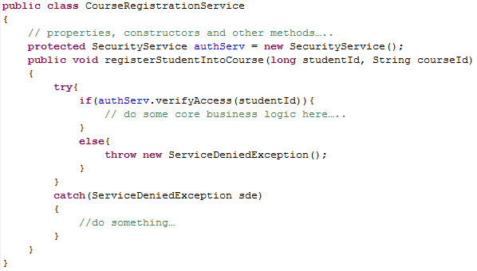
AOP Fundamentals (5 of 7)
Sample for demonstrating tangled code
SecurityService class provides methods for verifying access.
Encapsulates the “security” concern logic and shields the complexity of security implementation from the rest of the application code
Mixing of multiple concerns:
Core business logic
Security
Exception handling
ServiceDeniedException class provides exception handling functions.
Notes:
Content:
The core logic is registering a student into a course. Ideally, the developer should be concentrated on writing the business logic, but he still has to work on taking care of the cross-cutting concerns requirements such as logging, security, error handling, etc.
In the above listed example:
The requirement for access control is implemented using the object-oriented programming principles. But this leads to tangled code due to mixing up of multiple concerns into core business logic. This makes it complex to maintain and debug. Any changes in the interface or implementation of one of these concerns may require changes in multiple places of the program/system/project/application code.
Notes to Instructor: N/A

Slide 10
AOP Fundamentals (6 of 7)
Issues with these problem areas:
Intermixed cross-cutting concerns code with application logic code is:
Hard to maintain and debug
Prone to more errors
Increased dependency between modules – highly/tightly coupled
Changes in the interface or implementation of one of these concerns can lead to rewriting or changing code in multiple source files
Notes:
Content: N/A
Notes to Instructor: N/A

Slide 11
AOP Fundamentals (7 of 7)
Solution: Aspect-Oriented Programming
Aims to separate cross-cutting concerns
Reduces:
Duplicated code
Tangled code
Scattered code
Dependency between the concerns
Modularizes common code dealing with each of the concern which is applicable across multiple modules
Notes:
Content:
AOP links these aspects/concerns into the application.
AOP weaves these aspects into the core application code at compile time or runtime.
Notes to Instructor: N/A

Slide 12
AOP Fundamentals – Phases of AOP
Aspectual decomposition
Identifying the core concerns and cross-cutting concerns
Implementation of concerns
Implementing the identified core and cross-cutting concerns independently
Aspectual recomposition
Weaving the individual concerns into the core application code based on weaving rules
Aspectual Decomposition
Implementation of Concerns
Aspectual Recomposition
Notes:
Content: N/A
Notes to Instructor: N/A

Slide 13
Checkpoint Question 1
Which of the following does AOP enable? (Select all that apply.)
Separation of concerns
Interception
Addition of aspects to existing software
Dependency Injection
Notes:
Content: N/A
Notes to Instructor:
Have participants answer the questions.
Go to the next slide for the answers.

Slide 14
Checkpoint Answer 1
Which of the following does AOP enable? (Select all that apply.)
Separation of concerns
Interception
Addition of aspects to existing software
Dependency Injection
Notes:
Content: N/A
Notes to Instructor:
Answers:
A.
B.
C.

Slide 15
AOP Concepts (1 of 2)
Let’s say we have a class with a few methods
it is needed to log a message mentioning which parameter is passed
Should be done before a method is executed
also it is required to log the exit from the method
Should be done after a method is executed
Logging can either be added within the business service class or can be written separately in another class and then can be weaved using AOP
Using Spring AOP, we can create aspects (separate class for logging)
To weave it with business service class, we need to annotate methods using @Before and @After

Slide 16
AOP Concepts (2 of 2)
Spring aspect can be like the one below
public class SimpleAspect {
public void afterMethod() throws Throwable {
System.out.println("After the method call");
}
public void beforeMethod(String myName){
System.out.println("My name is "+myName);
}
}
The afterMethod() will log message after a method is called and beforeMethod() will log message before a method is called.

Slide 17
AOP Terminology
Spring AOP framework uses the existing common AOP terminology:
Aspect
Join Point
Pointcut
Advice
Introduction
Weaving
Target object
Proxy object
Notes:
Content: N/A
Notes to Instructor: N/A

Slide 18
AOP Terminology – Aspect
Well-modularized cross-cutting concern
A programming construct which enables cross-cutting concerns to be captured in modular units
Aspect can:
Have usage constraint specifications
Extend another aspect, class or implement an interface
Have abstract fields and methods; i.e., it can be abstract
Have Java methods, fields, etc.
Notes:
Content:
Usage constraint specifications indicate where and when this aspect can be used. More concrete examples and details will be covered in the upcoming sections.
Aspects are classes which can:
Have usage constraint specifications/rules
Extend another aspect, class or implement an interface
Have abstract fields and methods; i.e., it can be abstract
Have Java methods, fields, etc.
However, they can’t be instantiated like the normal classes.
Notes to Instructor: N/A

Slide 19
AOP Terminology – Join Point (1 of 3)
Fundamental concept of AOP
A well-defined location or a point in the execution of a program
A point where one or more aspects can be applied
Typically, Join Points can be of the following kinds:
Method and constructor call
Method and constructor execution
Exception handler execution
Field assignment: set and get
Class or object initialization: static and dynamic
In Spring AOP, a Join Point is always a method execution.
Notes:
Content: N/A
Notes to Instructor: N/A

Slide 20
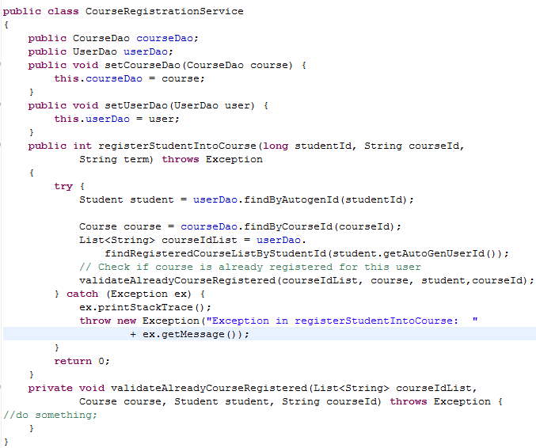
AOP Terminology – Join Point (2 of 3)
Field assignment Join Point
Method call Join Points
Exception handler execution Join Point
Method execution Join Point
Notes:
Content: N/A
Notes to Instructor: N/A

Slide 21
AOP Terminology – Join Point (3 of 3)
In Spring AOP framework, Join Point context information can be accessed by an advice during method execution:
Context | Join Point Method used to Obtain the Context | Description
this | getThis() | Returns the currently executing object that has been intercepted (AOP proxy)
target | getTarget() | Returns the target object of the execution (advised object)
args | getArgs() | Returns the method arguments passed at the Join Point
signature | getSignature() | Returns the method signature at the Join Point
Notes:
Content: Above is the list of Join Point methods to access the Join Point method by an advice during method execution.
Notes to Instructor: N/A

Slide 22
AOP Terminology – Pointcut
Selection or collection of Join Points defined to specify when/where an advice should be executed
Selects Join Points and matches values at those points (which can be an advice)
Can also collect context at the selected Join Points
Notes:
Content:
Note for second point: Selects the Join Point and matches the advice to be applied at that Join Point. Pointcut is a program construct that selects Join Points and collects context at those points.
Example of a pointcut can be: execute the logger statement at the entrance of all the methods in xyz package. More details to be covered in the upcoming sections.
Notes to Instructor: N/A

Slide 23
AOP Terminology – Advice (1 of 2)
The actual code to be executed when the pointcut is triggered
Consists of the action to be taken at Join Points in a pointcut
Can be marked before, after or around the Join Points in the pointcut
Can be modeled as an interceptor or chain of interceptors around the Join Point
Notes:
Content: N/A
Notes to Instructor: N/A

Slide 24
AOP Terminology – Advice (2 of 2)
Types of advice:
Type | Description
Before | Invoked and executed before a Join Point
After returning | Invoked and executed after Join Point is completed, without throwing any exceptions
After throwing | Invoked and executed after Join Point exits by throwing an exception
After (finally) | Invoked and executed after Join Point exits, no matter what the outcome is (either exception or completes successful) Typically used for releasing resources
Around | Surrounds a Join Point Can perform custom functionality/logic before and/or after the Join Point Decides whether to invoke a Join Point
Notes:
Content:
Around advice is a very intrusive way of advice programming.
It will have a lot of control over the Join Point.
It can have its own logic to run and depending upon that it will decide whether to invoke a Join Point or not.
Notes to Instructor: N/A

Slide 25
AOP Component Comparison
Component | Description | Semantics
Aspect | A programming construct which enables cross-cutting concerns to be captured in modular units | Combines what, when and where
Join Point | A well-defined location or a point in the execution of a program (method call, method execution, exception handler, etc.) | Where
Advice | Has a body (method definition) | What
 | Has a type (before, after, around, etc.) | When
Pointcut | Specifies a collection of Join Points | Where
Notes:
Content:
What, when and where….
“What” part is defined in the Advice body
“Where” to perform the defined action is defined in the joint point (collection of pointcuts)
“When” to perform the defined action is defined as the Advice type
Details with samples:
Sample Join Point in spring(always a method execution):
public int registerStudentIntoCourse(long studentId, String courseId, String term) throws Exception{…}
Pointcut is a selection or combination of Join Points
A pointcut can be defined as the collection of all the Join Points in a class.
pointcut expression: execution(“com.samples.Service.CourseRegistrationService.*(..)”)
Advice defines “what” action/code should be executed at a Join Point that has been selected by a pointcut
Like logging a message or checking/validating something, etc.
Notes to Instructor: N/A

Slide 26
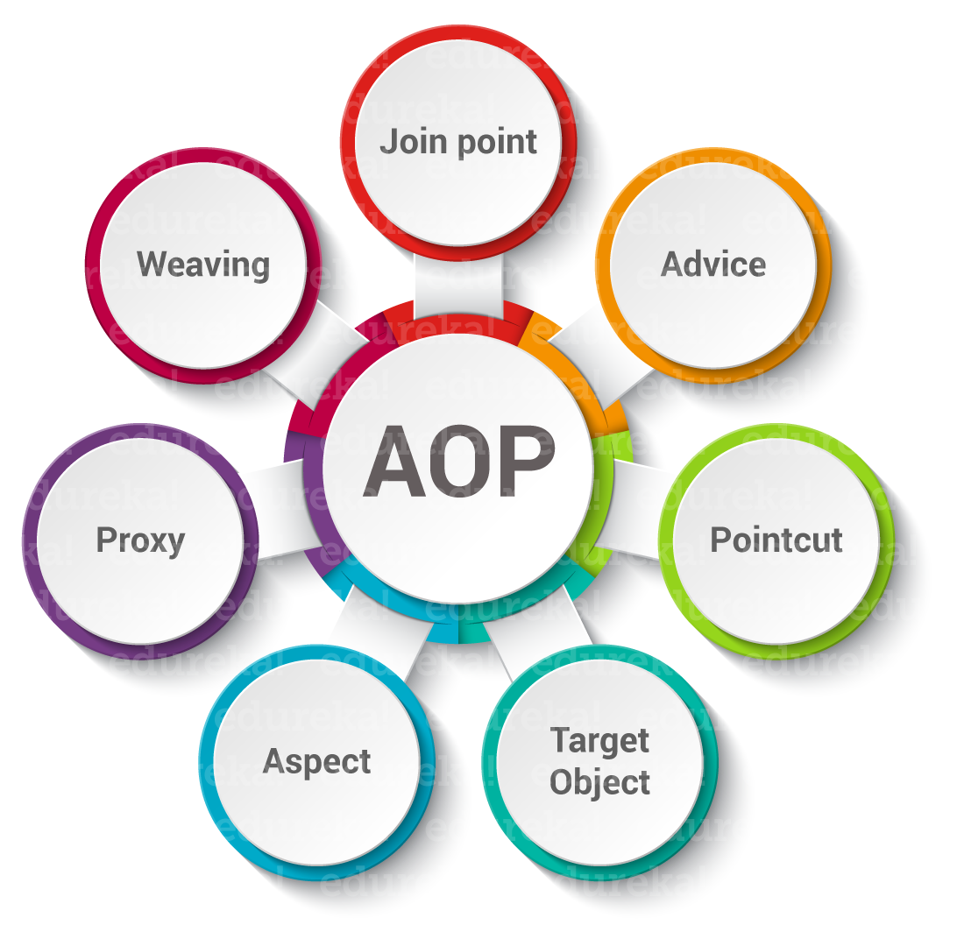

Slide 27
Checkpoint Question 2
Match the terms with their explanations.
Terms
Pointcut
Join Point
Advice
Aspect
Introduction
Explanations
Action to be taken at Join Points
Well-modularized cross-cutting concern
Adding methods or fields to an advised class
Set of Join Points
Well-defined point of execution in a program
Notes:
Content: N/A
Notes to Instructor:
Have participants match the terms and explanations.
Go to the next slide for the answers.

Slide 28
Checkpoint Answer 2
Match the terms with their explanations.
Terms
Pointcut
Join Point
Advice
Aspect
Introduction
Explanations
Action to be taken at Join Points
Well-modularized cross-cutting concern
Adding methods or fields to an advised class
Set of Join Points
Well-defined point of execution in a program
Notes:
Content: N/A
Notes to Instructor:
Slide animation: Click to reveal each answer.
Answers:
1 – D
2 – E
3 – A
4 – B
5 – C

Slide 29
AOP Terminology – Weaving
Links aspects/concerns into the application with other aspects/concerns
Assembles modules into final form
Can configure rules to combine different modules together
Weaving can occur during:
Compile time
Load time
Runtime
Spring AOP performs weaving at runtime.
Notes:
Content: AspectJ provides an aspect weaver.
Notes to Instructor: N/A

Slide 30
AOP Terminology – Target Object or Advised Object
The object on which an aspect or set of aspects can be applied
Object being advised
One or more aspects can advise the target object
In Spring Framework, this object will always be a proxied object.
Notes:
Content:
In Spring framework, AOP is implemented using runtime proxies. So, the target object or the advised object is always a proxied object.
CGLIB proxy usage examples:
To advise a method that is not declared on an interface
To pass a proxied object to a method as a concrete type
Notes to Instructor: N/A

Slide 31
Checkpoint Question 3
AOP provided by Spring is a type of which of the following? (Select all that apply.)
Static AOP
Simple AOP
Dynamic AOP
Compile-time AOP
Notes:
Content: N/A
Notes to Instructor:
Have participants answer the question.
Go to the next slide for the answer.

Slide 32
Checkpoint Answer 3
AOP provided by Spring is a type of which of the following? (Select all that apply.)
Static AOP
Simple AOP
Dynamic AOP
Compile-time AOP
Notes:
Content: N/A
Notes to Instructor:
Answer: C

Slide 33
Questions

Slide 34
Pointcut Additional Information
* and .. are used as wildcard tokens in defining pointcut expressions.
Pointcut expressions can be combined to create composite pointcut expressions:
For @AspectJ approach, use &&, || and ! Operators.
For schema-based approach, use and, or, and not keywords, respectively.
Spring AOP allows creating user-defined pointcut expressions which can be referenced by the pointcut expression name – called as named pointcuts.
Common pointcut expressions can be placed in a single aspect class and can be referred by multiple aspects.
Notes:
Content: The above information works for both @AspectJ and schema-based approaches.
Notes to Instructor: N/A

Slide 35
Checkpoint Question 4
Common pointcut expressions can be placed in a single aspect class
and can be referred by multiple aspects.
True
False
An aspect class can have one advice only.
True
False
Topic: Java EE Security
Notes:
Content: N/A
Notes to Instructor:
Have participants answer the questions.
Go to the next slide for the answers.

Slide 36
Checkpoint Answer 4
Common pointcut expressions can be placed in a single aspect class
and can be referred by multiple aspects.
True
False
An aspect class can have one advice only.
True
False
False
Topic: Java EE Security
Notes:
Content: N/A
Notes to Instructor:
Slide animation: Click to reveal the second answer.
Answers:
A. True
B. False

Slide 37
Checkpoint Question 5
Spring AOP supports AspectJ pointcut designators (set of operations)
for use in pointcut expressions.
True
False
Spring automatically identifies a class as an AspectJ aspect when it is annotated with @Annotation.
True
False
Topic: Java EE Security
Notes:
Content: N/A
Notes to Instructor:
Have participants answer the questions.
Go to the next slide for the answers.

Slide 38
Checkpoint Answer 5
Spring AOP supports AspectJ pointcut designators (set of operations)
for use in pointcut expressions.
True
False
Spring automatically identifies a class as an AspectJ aspect when it is annotated with @Annotation.
True
False
False
Topic: Java EE Security
Notes:
Content: N/A
Notes to Instructor:
Slide animation: Click to reveal the second answer.
Answers:
A. True
B. False

Slide 39
Questions

Slide 40
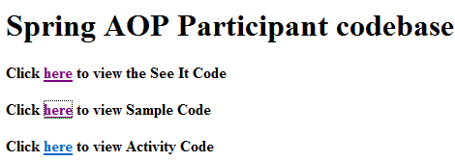
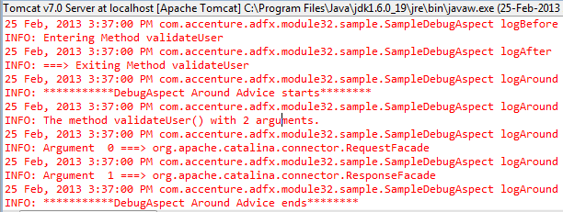
Spring AOP : See-It
Demonstration : Faculty will demonstrate how to implement AOP using Spring
Environment: Eclipse
Duration: 20 min
Steps:
Open the project ADFExtensionCodebaseM6AOP_participant in Eclipse
Run it on Tomcat server. Click the button
You should be able to see a click link for Home. Click on it. Refer the log
You should be able to see a click link for Sample. Click on it & refer the log
You should see a screen like the one below (see 2a below)
Click the link to view sample code
Click on Login button without any value in user name & password (see 2b below)
Try various combinations, refer the log and see how it behaves.
2a
2b

Slide 41
Spring AOP : Try It
Time Allocated : 30 minutes
Environment or File : ActivityController.java (complete) and ActivityDebugAspect.java (incomplete)
Steps :
Open the project ADFExtensionCodebaseM6AOP_participant in Eclipse
Open com.accenture.adfX.module5.activity.ActivityDebugAspect.java
Complete the TODO 1-TODO 12 mentioned in ActivityDebugAspect.java to enable the log in Controller using AOP.
Save and run the program & Click the link to run Activity code
Click Add Museum and refer the log.
Click on each link and verify the log.

Slide 42
Questions

Slide 43
Module 6 Summary (1 of 4)
AOP modularizes common code dealing with each of the concern which is applicable across multiple modules.
AOP reduces object-oriented programming problems like duplicated, tangled and scattered code.
The different cross-cutting concerns in software development which AOP addresses include logging, security, caching, profiling, transaction management, error handling, performance monitoring, etc.
The three phases of AOP are aspectual decomposition, implementation of concerns and aspectual recomposition.
Notes:
Content: N/A
Notes to Instructor: Briefly review the module’s key topics with participants.

Slide 44
Module 6 Summary (2 of 4)
Spring AOP framework uses the common AOP terminology such as aspect, Join Point, pointcut, advice, etc.
Spring AOP supports only method execution Join Points.
Spring AOP provide clean decoupling of “what” action to be performed from “when/where” that action should take place.
Spring AOP performs weaving at runtime.
Notes:
Content: N/A
Notes to Instructor: Briefly review the module’s key topics with participants.

Slide 45
Module 6 Summary (3 of 4)
Aspects in Spring can be implemented in two declarative ways: regular classes with either annotated AspectJ style or with XML schema-based approach.
Spring AOP is implemented in pure Java, eliminating the need for special compilation process and making it suitable for use in any Java EE web container or application server.
All the AOP-related configuration can be done in the Spring configuration file itself without the need for another AOP-specific configuration file.
Notes:
Content: N/A
Notes to Instructor: Briefly review the module’s key topics with participants.

Slide 46
Module 6 Summary (4 of 4)
Spring AOP supports AspectJ pointcut designators (set of operations) for use in pointcut expressions.
Pointcut expressions can be regular expressions, method pattern match, composite pointcuts, or user-defined pointcut expressions (which can be referenced by the pointcut expression name – also called named pointcuts).
Spring AOP’s @AspectJ and schema-based approaches use the same pointcut expressions and advice types.
Notes:
Content: N/A
Notes to Instructor: Briefly review the module’s key topics with participants.

Slide 47
Questions

