Slide 1
Useful Classes
Date, SimpleDateFormat ,Calendar, Math, Random, StringTokenizer

Slide 2
Date and Time
To work with date and time there are 3 important classes
  Date
  Calendar
  GregorianCalendar
All of these classes are in java.util
GregorianCalendar is subclass of Calendar
It is recommended that Calendar class be used whenever possible because most of the methods in Date class are deprecated.

Slide 3
java.util.Date
Date object is represented internally a single long number which represents the number of milliseconds since January 1, 1970, 00:00:00 GMT.
Most of its methods are deprecated because many of them are not amenable to internationalization.
Constructors
  Date() : Initializes to the nearest millisecond with system's current date and time measured with respect to January 1, 1970, 00:00:00 GMT
  Date(long) : initializes it to the specified milliseconds since the January 1, 1970, 00:00:00 GMT

Slide 4
Date methods
boolean after(Date when)
boolean before(Date when)
long getTime()
Returns the number of milliseconds since January 1, 1970, 00:00:00(Epoch) GMT represented by this Date object.
void setTime(long time)
Sets the time and date as specified by time, which represents an elapsed time in milliseconds from midnight, January 1, 1970, 00:00:00
Object clone( )
int compareTo(Object)
String toString( )

Slide 5
Example: Date
import java.util.Date;
public class DateEx{
public static void main(String[] args) {
  Date d= new Date();
  System.out.println(d);
  Date d1=new Date(d.getTime()+1000);
  System.out.println(d.after(d1));
  System.out.println(d.before(d1));
  System.out.println(d1.compareTo(d));
  System.out.println(d.compareTo(d1));}}
Fri Nov 18 14:14:36 IST 2011
false
true
1
-1

Slide 6
Formatting Dates
java.text.SimpleDateFormat class is used for formatting and parsing dates in a locale-sensitive manner.
In the constructor the date format can be specified using predefined letters that correspond to some meaning.
Constructors:
  SimpleDateFormat()
    uses the default pattern and date format symbols for the default locale.
  SimpleDateFormat(String pattern)
    uses the given pattern and the default date format symbols for the default locale.

Slide 7
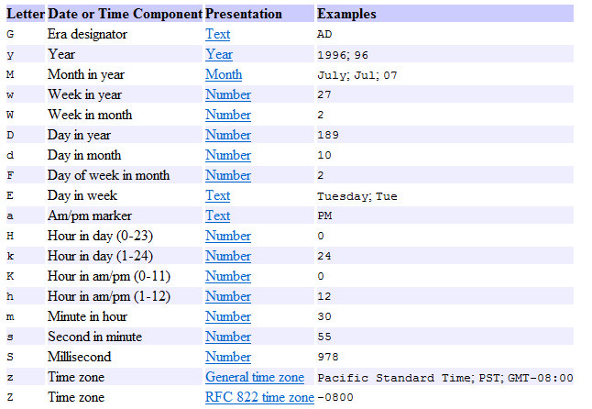
Pattern letters (JSE documentation)

Slide 8
SimpleDateFormat Methods
final String format(Date date)
  Formats a Date into a date/time string as per specification in the constructor.
Date parse(String source) throws ParseException
  Parses text from the beginning of the given string to produce a date based on the format specification in the constructor.
  java.text.ParseException is a checked exception which is thrown if the expected string is not matching specified format
Calendar getCalendar()
  Gets the calendar associated with this date/time formatter.

Slide 9
Example: SimpleDateFormat
import java.text.*;
import java.util.Date;
public class Palindrome {
public static void main(String[] args) throws ParseException {
Date now = new Date( );
SimpleDateFormat ft =
new SimpleDateFormat ("E dd MMM yyyy 'at' hh:mm:ss a zzz");
System.out.println(t.format(now));
SimpleDateFormat ft1 =
new SimpleDateFormat ("dd.mm.yyyy");
Date d= ft1.parse("10.7.1967");
System.out.println(t.format(d));
}}
Fri 18 Nov 2011 at 02:53:09 PM IST
Tue 10 Jan 1967 at 12:07:00 AM IST

Slide 10
Formatting character for Date in printf
We have seen how to format numbers and string using System.out.printf statement. Do you recall them?
System.out.printf statement can be used to display date in the desired format.
The format characters for time and date are in the next slides.
These characters must have prefix of 't' and 'T' conversions
Example:
  Date now = new Date( );
  System.out.printf(" %1$tA %1$tB %1$td, %1$tY %1$tH:%1$tM:%1$tS %1$tp %1$tZ ",now);
  This prints: Friday November 18, 2011 15:50:02 pm
  Calendar and its subclass can also be used in place of Date
Be careful when you use printf. Small error would cause UnknownFormatConversionException to be thrown at runtime

Slide 11
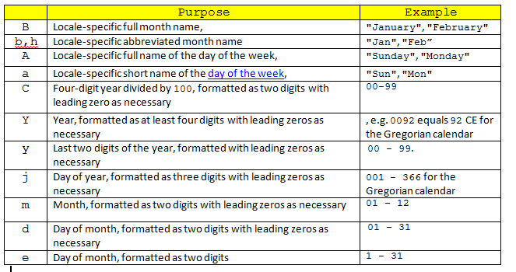
Date format characters (JSE)

Slide 12
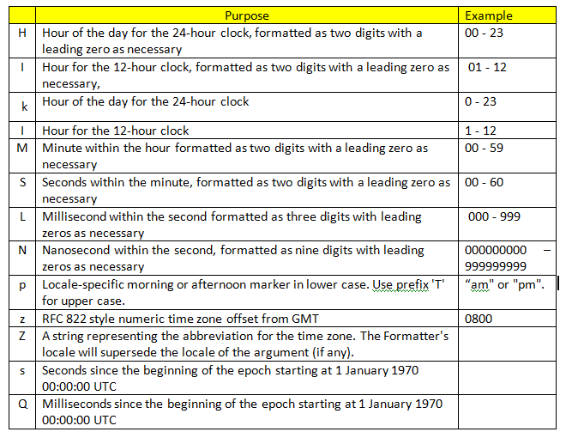
Time format characters (JSE)

Slide 13
Calendar and GregorianCalendar
Calendar is an abstract class.
GregorianCalendar is a concrete subclass of Calendar. This class provides the standard calendar system used by most of the world.
To create an instance of Calendar class getInstance() static method is used. This a Calendar object with the system’s date and time.
Gregorian Calendar internally the value is stored as time in millisecond represented by a value that is an offset from the Epoch, January 1, 1970 00:00:00.000 GMT.
Constructor:
  GregorianCalendar()
  GregorianCalendar(int year, int month, int dayOfMonth,[int hourOfDay, int minute, int second])

Slide 14
Calendar/ GregorianCalendar members
boolean after(Object when)
boolean before(Object when)
void clear()
Sets all the calendar field values and the time value to Epoch
final int get(int field)
final void set(int field, int value)
field is defined using static constants(next slide) used to get components of date like year, month etc.
void set(int year, int month, int date)
void set(int year, int month, int date, int hourOfDay, int minute)
Date getTime()
boolean equals(Object obj)
Object clone()
int compareTo(Calendar anotherCalendar) → same as Date
String toString()

Slide 15
GregorianCalendar members
void add(int field, int amount)
Adds or subtracts the specified amount of time to the given calendar field. This is an abstract method in Calendar.
void roll(int field, int amount)
Adds the specified (signed) amount to the specified calendar field without changing larger fields. A negative amount means to roll down.
Understanding the differences between the two methods by example
  Calendar cal = Calendar.getInstance();
  cal.set(2011,2,1);
  // line 1
  System.out.println(cal.getTime());
  cal.roll(Calendar.DATE, -1); at line 1 prints Thu Mar 31 10:19:55 IST 2011
  cal.add(Calendar.DATE, -1); at line 1 prints Mon Feb 28 10:23:05 IST 2011
  boolean isLeapYear(int year)

Slide 16
Static constants
  JANUARY to DECEMBER (values from 0 to 11)
  SUNDAY to SATURDAY ( values from 1 to 7)
  MONTH,YEAR,DATE
  HOUR,MINUTE,SECOND MILLISECOND
  DAY_OF_WEEK

Slide 17
Examples: using Calendar
/*cal value depends on the current system date and time.*/
Calendar cal =Calendar.getInstance();
System.out.println(cal instanceof GregorianCalendar); // true
System.out.println(cal.getTime());
//Fri Nov 18 16:13:12 IST 2011
cal.clear();
System.out.println(cal.getTime())
//Thu Jan 01 00:00:00 IST 1970

Slide 18
Example: Get date components
import java.util.*;
class Test{
  public static void main(String str[]){
  String month[]={"Jan","Feb","Mar","Apr","May","Jun","Jly","Aug","Sep","Oct","Nov","Dec"};
  Calendar c = Calendar.getInstance();
  String m=month[c.get(Calendar.MONTH)];
  System.out.println(m);
  System.out.println(c.get(Calendar.DATE));
  System.out.print(c.get(Calendar.HOUR)+":");
  System.out.print(c.get(Calendar.MINUTE)+":");
  System.out.println(c.get(Calendar.SECOND));
}
}
Nov
18
5:4:52

Slide 19
Example: Week computation
import java.util.*;
class Test{
public static void main(String str[]){
  String week[]={"Sun","Mon","Tue","Wed","Thu","Fri","Sat"};
  GregorianCalendar c = new GregorianCalendar();
  c.set(2011,10,11);
  int wk=c.get(c.DAY_OF_WEEK);
  System.out.println(wk);
  System.out.println(week[wk-1]);
  System.out.println(c.isLeapYear(2000));
}
}
6
Fri
true

Slide 20
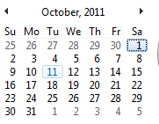
Tell me why?
c.set(2011,10,11) is a Tuesday but the code displays it as Friday. Why?
If you look at the static constants once again you will find that values for month begin from 0 and not from 1. So 0 indicates January. Therefore 10 here represents November and not October.
Also look at the week computation. Sun to Sat static constants range from 1 to 7. So the array’s 0th index position does not work for week computation as it worked for month computation in the example before this.

Slide 21
Example: Adding to dates
class Test{
public static void main(String str[]){
  String month[]=
  {"Jan","Feb","Mar","Apr","May","Jun","Jly","Aug","Sep","Oct","Nov","Dec"};
  GregorianCalendar c=new System.out.prinGregorianCalendar(2010,11,1);
  c.add(Calendar.MONTH,5);
  tln(month[c.get(Calendar.MONTH)]);
  c.add(Calendar.YEAR, 1);
  System.out.println(c.get(Calendar.YEAR));
}
May
2012

Slide 22
java.lang.Math
A final class containing methods to perform mathematical operation. All the methods are static.
XXX abs(XXX a) where XXX is int, long double, float
Trigonometric operations like
  double acos(double a)
  double asin(double a)
  double atan(double a)
  double cos(double a)
  double cosh(double x)
  double sin(double a)
  double sinh(double x)
  double tan(double a)
  double tanh(double x)
Static constants
E (2.718281828459045)
PI (3.141592653589793)

Slide 23
Power of a number
  double pow(double a, double b)
  double sqrt(double a)
  double cbrt(double a)
Round/truncation operations
  double ceil(double a)
  double floor(double a)
  long round(double a)
  int round(float a)
double random() returns a number between 0 and 1.
Log
  double log(double a)
  double log10(double a)

Slide 24
Example: using Math
double a = Math.PI;
System.out.println( Math.round(a));
System.out.println( Math.abs(a));
System.out.println( Math.ceil(a));
System.out.println(Math.exp(0));
System.out.println( Math.floor(a));
System.out.println( Math.max(11,4.5));
System.out.println( Math.min(11,4.5));
System.out.println("Power = " + Math.pow(10,3));
System.out.println( Math.sqrt(49));
3
3.141592653589793
4.0
1.0
3.0
11.0
4.5
Power = 1000.0
7.0

Slide 25
Test your understanding
Can you guess what will the code display ?
double a = 3.5;
System.out.println( Math.round(a));
System.out.println( Math.ceil(a));
System.out.println( Math.floor(a))
That should have been easy. What will it display if the number is negative?
double a = -3.5;

Slide 26
Recall
Do you remember that we used Math to generate random numbers?
How will you generate random numbers between 1 to 9?

Slide 27
java.util.Random
This class is used to generate a stream of pseudorandom numbers.
Constructor
  Random()
  Random(long seed)
  The seed is the initial value of the internal state of the pseudorandom number generator which is maintained by method next(int)
Methods
  xxx nextXxx() where xxx is boolean, int, long, double or float
  int nextInt(int n)
  void nextBytes(byte[] bytes):Generates random bytes and places them into a user-supplied byte array

Slide 28
Example 1 : using Random class
Random r2= new Random();
System.out.println( r2.nextInt(100));
System.out.println( r2.nextFloat());
byte b[]=new byte[5];
r2.nextBytes(b);
for(byte c:b)
System.out.print(c+ ",");
38
0.3184449
-13,0,-2,14,-90,

Slide 29
Example 2 : using Random class
If two instances of Random are created with the same seed, and the same sequence of method calls is made for each, they will generate and return same sequences of numbers.
Random r1= new Random(100);
Random r2= new Random(100);
System.out.print("1st instance: ");
System.out.print( r1.nextInt(10)+" ");
System.out.println( r1.nextInt(100));
System.out.print("2st instance: ");
System.out.print( r2.nextInt(10)+" ");
System.out.println( r2.nextInt(100));
1st instance: 5 50
2st instance: 5 50

Slide 30
java.util.StringTokenizer
Allows a string to be split into tokens based on delimiter. Default delimiter is space.
Constructor
  StringTokenizer(String s)
  StringTokenizer(String s, String d)
  StringTokenizer(String s, String d, boolean flag)
Methods
  String nextToken()
  String nextToken(String delim)
  int countTokens()
  boolean hasMoreTokens
  boolean equals(Object o)
  String toString()

Slide 31
Example 1 : using StringTokenizer
StringTokenizer st = new StringTokenizer("europe asia america");
while (st.hasMoreTokens()) {
System.out.println(st.nextToken());}
Prints
  europe
  asia
  america

Slide 32
Example 2 : using StringTokenizer
Example converts comma separated number into double
import java.util.*;
public class Test {
public static void main(String[] args) {
double number=0;
int pow=1;
StringTokenizer st =
new StringTokenizer("23,44,345.8", ",");
while (st.hasMoreTokens()) {
String str1="";
String str=st.nextToken();

Slide 33
if(str.contains("."))
str1=str.substring(0,str.indexOf("."));
else
str1=str;
pow=(int)Math.pow(10,str1.length());
number=number*pow+Double.parseDouble(str);
}
System.out.println(number);
}
}
Prints 2344345.8
Are you able to work out the logic for this by yourself?

Slide 34
Test your knowledge
Do you remember any other way in which strings can be split?

Slide 35
Performance issue
We saw two ways to split a string:
  Using StringTokenizer
  Using split() method of String
Between the two, split() method of String is believed to give better performance.
Java documentation states that
“StringTokenizer is a legacy class that is retained for compatibility reasons although its use is discouraged in new code. It is recommended that anyone seeking this functionality use the split method of String or the java.util.regex package instead.”

