Slide 1
Micro Service
Using .NET CORE
Parameswari

Slide 2
Command Query Responsibility Segregation (CQRS)
Database handling is split into two categories, the command part for handling data creation, update, deletion and the query part that uses materialized views to retrieve data.
The materialized view is updated by subscribing to data change events.
Event sourcing pattern is used along with CQRS to create immutable events.

Slide 3
Command Query Responsibility Segregation (CQRS)
Once we implement database-per-service, there is a requirement to query, which requires joint data from multiple services.
CQRS suggests splitting the application into two parts — the command side and the query side.
The command side handles the Create, Update, and Delete requests.
The query side handles the query part by using the materialized views.

Slide 4
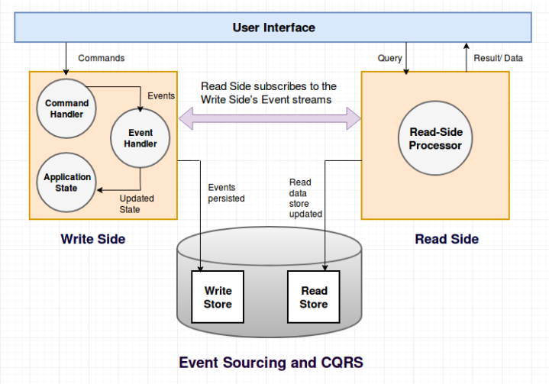
Command Query Responsibility Segregation (CQRS)

Slide 5
Command Query Responsibility Segregation (CQRS)
Commands represent user intent. They contain all the necessary information about actions that user would like to perform.
Command Bus is a type of queue that receives commands and passes them to Command Handlers.
Command Handlers contain actual business logic which validates and processes data received in commands. Command handlers are responsible for generation and propagation of domain events to Event Bus
Event Bus dispatches events to event handlers subscribed for specific event types. Event bus can propagate events both asynchronously or synchronously if consecutive events are dependent.
Event Handlers are responsible for handling specific incoming events. Their role is to save the new state of the application in read repository, and perform terminal actions like sending emails, storing files etc.

Slide 6
Command Query Responsibility Segregation (CQRS)
Queries are objects, which represent the actual state of application available for a user. Getting data for UI should be done through these objects.
We can distinguish many advantages of CQRS approach including the following:
We can split development tasks between people more experienced who will be working on the business logic and those ones who will be working on queries part.
We have to be careful because this advantage may hurt knowledge transfer.
We can achieve a great read/write performance by scaling commands and queries on multiple different servers.

Slide 7
Command Query Responsibility Segregation (CQRS)
Using two different repositories (read/write) which are synchronized gives us automatic backup without any additional effort.
Reads don’t hit write database, so they can go faster when using Event Sourcing.
We can structure read data directly for the views, without thinking about domain logic, which simplifies views and can improve performance.

Slide 8
Erlang
It was written in Erlang, the telco-grade, functional programming language designed at the Ericsson Computer Science Laboratory in the mid-to-late 1980s.
Erlang was designed to be a distributed, fault-tolerant, soft real-time system for applications that require 99.999% uptime.
As a language and runtime system, Erlang focuses on lightweight processes that pass messages between each other, providing a high level of concurrency with no shared state.

Slide 9
Erlang
Erlang’s design, which focused on concurrent processing and message passing, made it a natural choice for a message broker like RabbitMQ:
As an application, a message broker maintains concurrent connections, routes messages, and manages their states.
In addition, Erlang’s distributed communication architecture makes it a natural for RabbitMQ’s clustering mechanism.
Servers in a RabbitMQ cluster make use of Erlang’s inter-process communication (IPC) system, offloading the functionality that many competing message brokers must implement to add clustering capabilities

Slide 10
Erlang

Slide 11
Rabbitmq Foundation

Slide 12
Rabbitmq Foundation

Slide 13
Rabbitmq Foundation

Slide 14
Rabbitmq Foundation

Slide 15
AMQP Protocol
The Advanced Message Queuing Protocol (AMQP) creates interoperability between clients and brokers (i.e. messaging middleware).
Its goal of creation was to enable a wide range of different applications and systems to be able to work together, regardless of their internal designs, standardizing enterprise messaging on industrial scale.

Slide 16
AMQP Protocol
AMQP includes the definitions for both the way networking takes place and the way message broker applications work.
This means the specifications for:
Operations of routing and storage of messages with the message brokers and set of rules to define how components involved work
And a wire protocol to implement how communications between the clients and the brokers performing the above operations work

Slide 17
AMQP Capabilities
Monitoring and globally sharing updates
Connecting different systems to talks to each other
Allowing servers to respond to immediate requests quickly and delegate time consuming tasks for later processing
Distributing a message to multiple recipients for consumption
Enabling offline clients to fetch data later
Introducing fully asynchronous functionality for systems
Increasing reliability and uptime of application deployments

Slide 18
Main AMQP Components
The AMQP Model defining how messages are received, routed, stored, queued and how application parts handling these tasks work rely on the clear set definitions of the below components:
Exchange: A part of the broker (i.e. server) which receives messages and routes them to queues
Queue (message queue): A named entity which messages are associated with and from where consumers receive them
Bindings: Rules for distributing messages from exchanges to queues

Slide 19
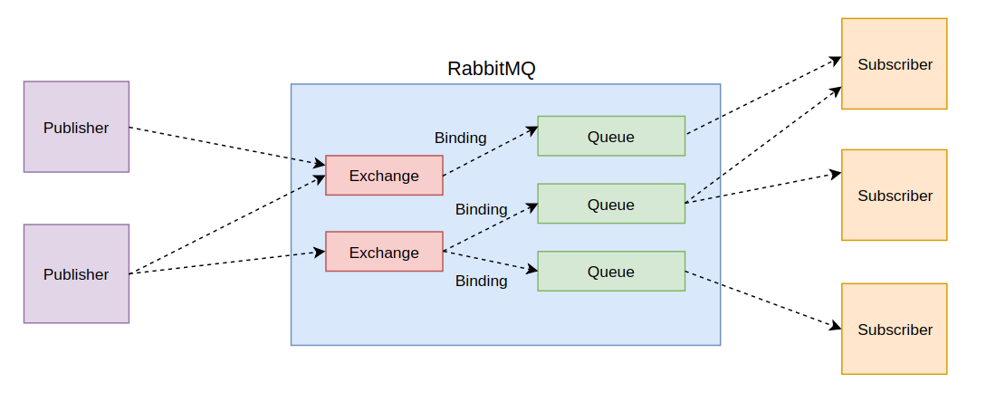
Rabbitmq Architectural Pattern

Slide 20
Rabbitmq Standard Exchange
The producer publishes a message to the exchange.
The exchange receives the message and is now responsible for the routing of the message.
Binding must be set up between the queue and the exchange. In this case, we have bindings to two different queues from the exchange. The exchange routes the message into the queues.
The messages stay in the queue until they are handled by a consumer.
The consumer handles the message.

Slide 21
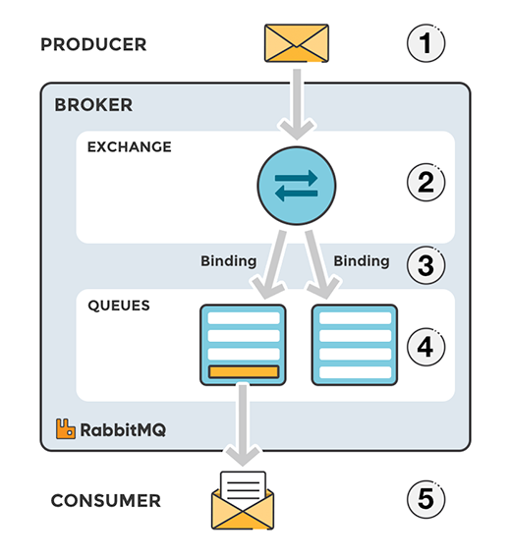
Rabbitmq Standard Exchange

Slide 22
Exchange types - Direct Exchange
A direct exchange delivers messages to queues based on a message routing key.
The routing key is a message attribute added to the message header by the producer.
Think of the routing key as an "address" that the exchange is using to decide how to route the message.
A message goes to the queue(s) with the binding key that exactly matches the routing key of the message.

Slide 23
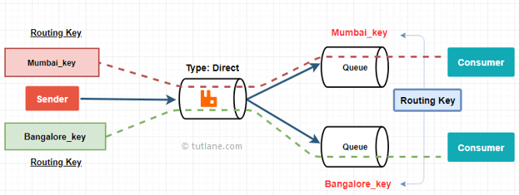
Exchange types - Direct Exchange

Slide 24
Exchange types - Default exchange
The default exchange is a pre-declared direct exchange with no name, usually referred by an empty string.
When you use default exchange, your message is delivered to the queue with a name equal to the routing key of the message.
Every queue is automatically bound to the default exchange with a routing key which is the same as the queue name.

Slide 25
Exchange types - Topic Exchange
Topic exchanges route messages to queues based on wildcard matches between the routing key and the routing pattern, which is specified by the queue binding.
Messages are routed to one or many queues based on a matching between a message routing key and this pattern.

Slide 26
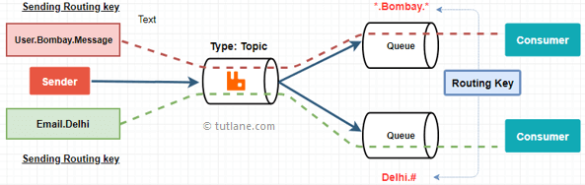
Exchange types - Topic Exchange

Slide 27
Exchange Types - Fanout Exchange
A fanout exchange copies and routes a received message to all queues that are bound to it regardless of routing keys or pattern matching as with direct and topic exchanges. The keys provided will simply be ignored.
Fanout exchanges can be useful when the same message needs to be sent to one or more queues with consumers who may process the same message in different ways.

Slide 28
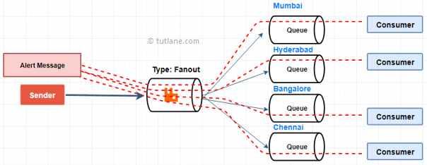
Exchange Types - Fanout Exchange

Slide 29
Exchange Types Headers Exchange
A headers exchange routes messages based on arguments containing headers and optional values.
Headers exchanges are very similar to topic exchanges, but route messages based on header values instead of routing keys.
A message matches if the value of the header equals the value specified upon binding.

Slide 30
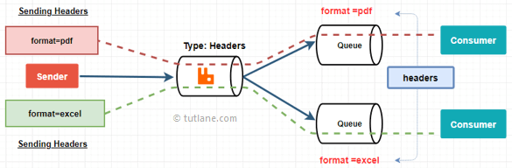
Rabbitmq – Headers Exchange

Slide 31
Exchange Type - DLQ
If no matching queue can be found for the message, the message is silently dropped. RabbitMQ provides an AMQP extension known as the "Dead Letter Exchange", which provides the functionality to capture messages that are not deliverable.

Slide 32
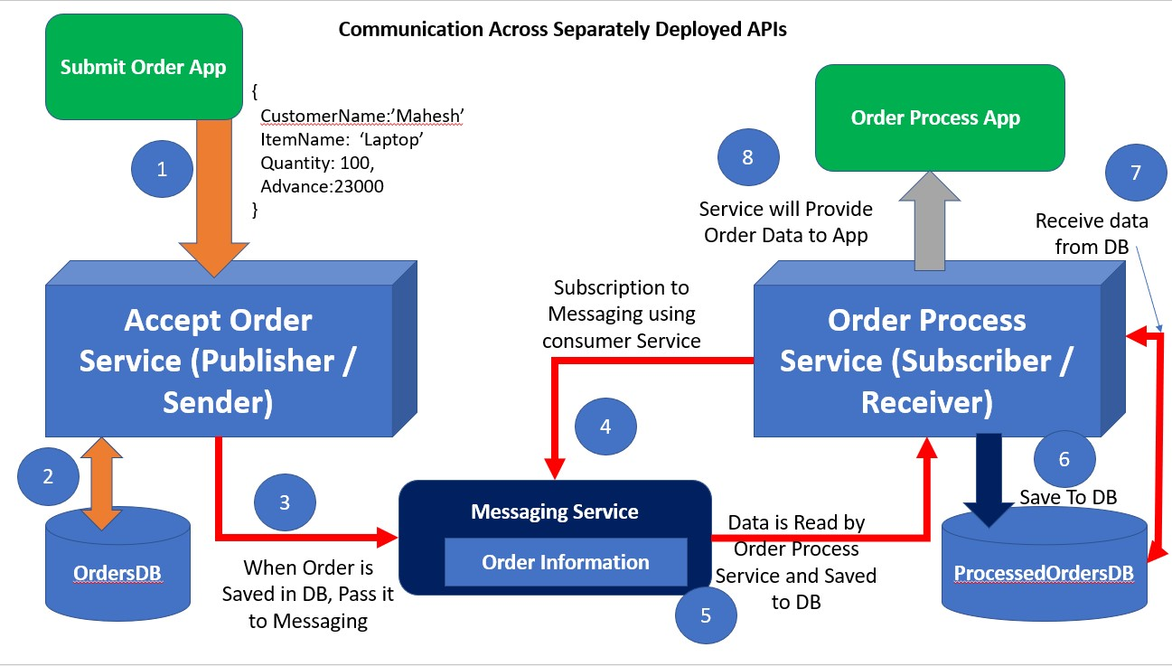
Communication across the API Applications using RabbitMQ and Background Service

Slide 33
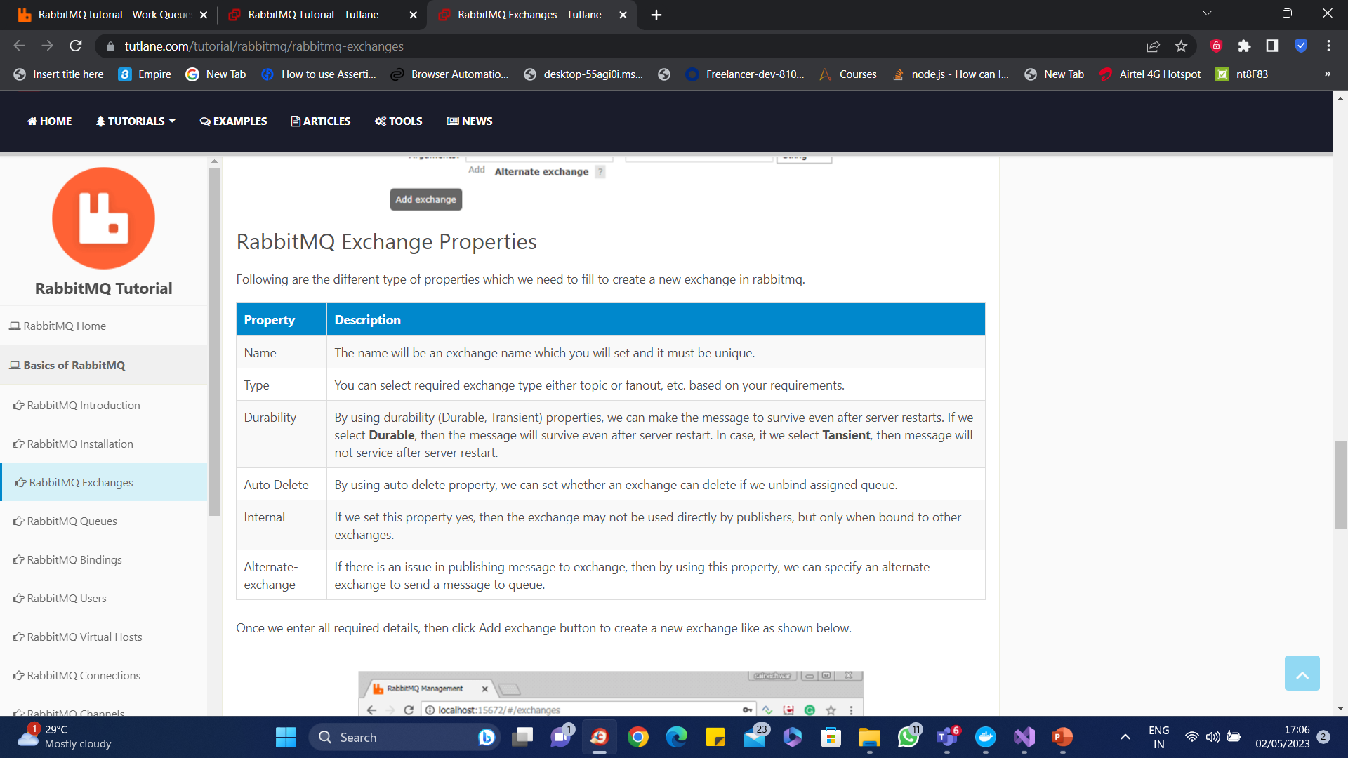
Exchange Properties

Slide 34
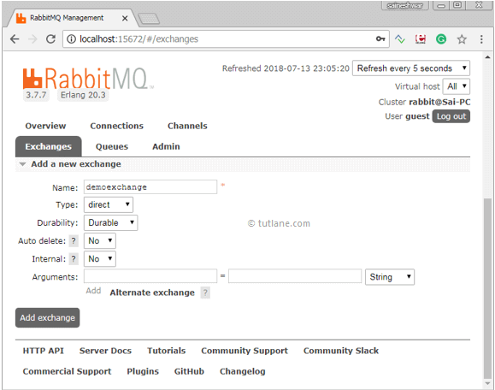
Exchange Properties

Slide 35
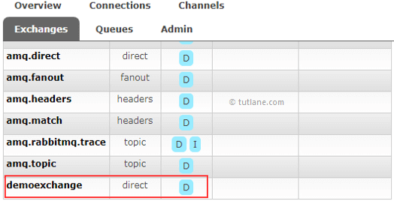
Exchange Properties

Slide 36
Queue Properties
Name – the name of the queue. If not defined, the broker will generate one
Durability – if enabled, the broker will not remove the queue in case of a restart
Exclusive – if enabled, the queue will only be used by one connection and will be removed when the connection is closed
Auto-delete – if enabled, the broker deletes the queue when the last consumer unsubscribes
Optional arguments

Slide 37
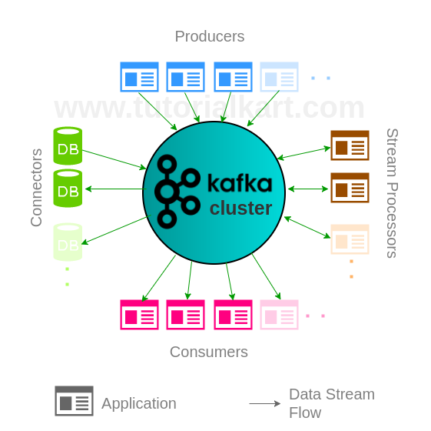
Kafka Cluster

Slide 38
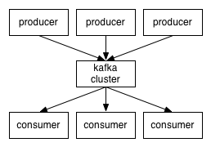
Kafka Cluster

Slide 39
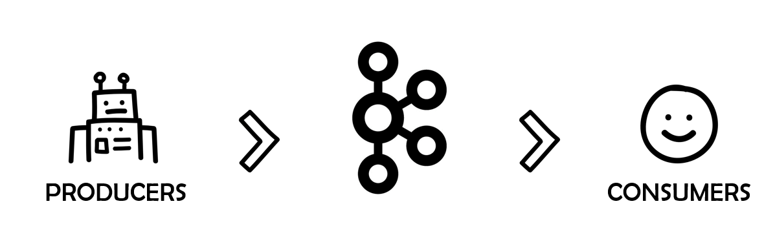
Kafka Cluster

Slide 40
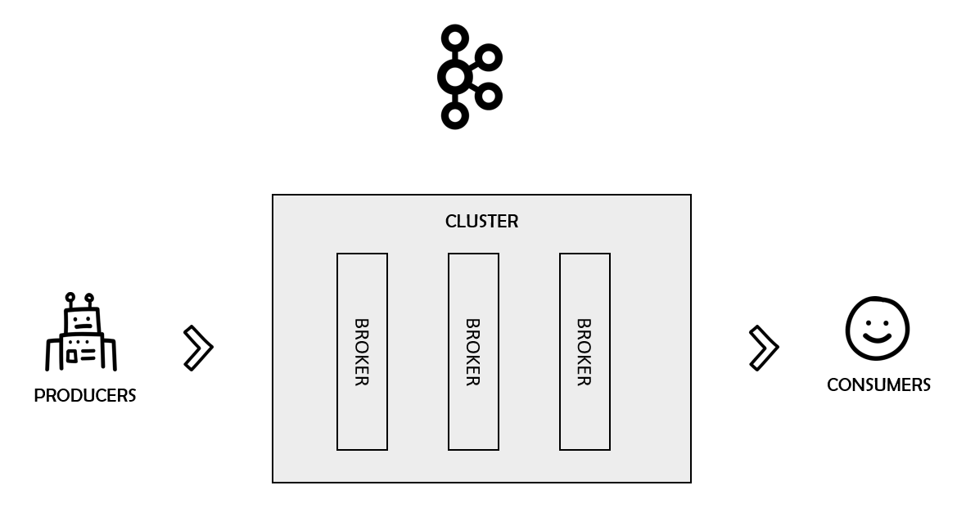
Kafka Cluster

Slide 41
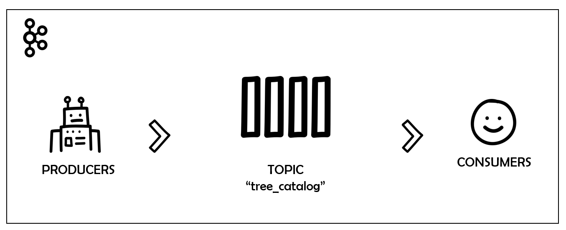
Kafka Topic

Slide 42
Kafka Topic
Kafka topics are the channels, the carriage that transport messages around.
Kafka records produced by producers are organized and stored into topics.
Imagine that you’re working on a new API project for a catalog of trees and plants.
You want to make sure that everybody in the company has access to each newly registered tree. And that is why you picked Kafka.

Slide 43
Kafka Offset
In this relationship, the topics work as a stack.
It keeps information in the same position as it arrived and guarantees no data loss.
Each data record that arrives is stored in a slot and registered with a unique position number called offset.
When a consumer consumes a message stored in offset 0, for example, it commits the message stating that everything was ok and moves on to the next offset, and so on.
The process usually happens linearly. However, since many consumers can “plug” into the same topic simultaneously, the responsibility of knowing which data positions were already consumed is left to the consumers.
That means that consumers can decide which order they will consume the messages, or even if they want to restart the processing from scratch (offset 0).

Slide 44
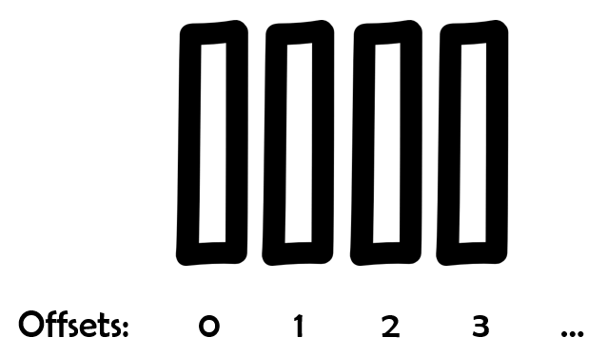
Kafka Offsets

Slide 45
Topic Partitions
One key feature of distributed systems is data replication.
It allows for a more secure architecture since the data is replicated somewhere else in case bad things happen.
Kafka deals with replication via partitions.
Kafka topics are configured to be spread among several partitions (configurable).
Each partition holds data records via unique offsets.
To achieve redundancy, Kafka creates replicas from the partitions (one or more) and spreads the data through the cluster.
This process follows the leader-followers model in which one leader replica always deals with the requests for a given partition while the followers replicate it.
Every time a producer pushes a message to a topic, it goes directly to that topic leader.

Slide 46
Kafka Consumer Groups
The most appropriate way to consume messages from a topic in Kafka is via consumer groups.
As the name suggests, these groups are formed by one or more consumers that aim to get all the messages from a specific topic.
To do this, the group must always have a unique id (set by the property group.id). Whenever a consumer wants to join that group, it will do so via group id.

Slide 47
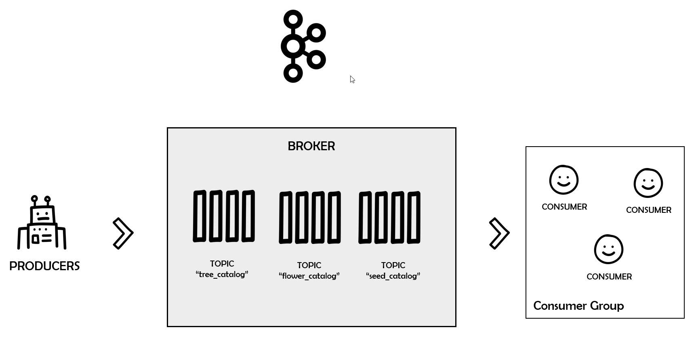
Kafka Consumer Groups

Slide 48
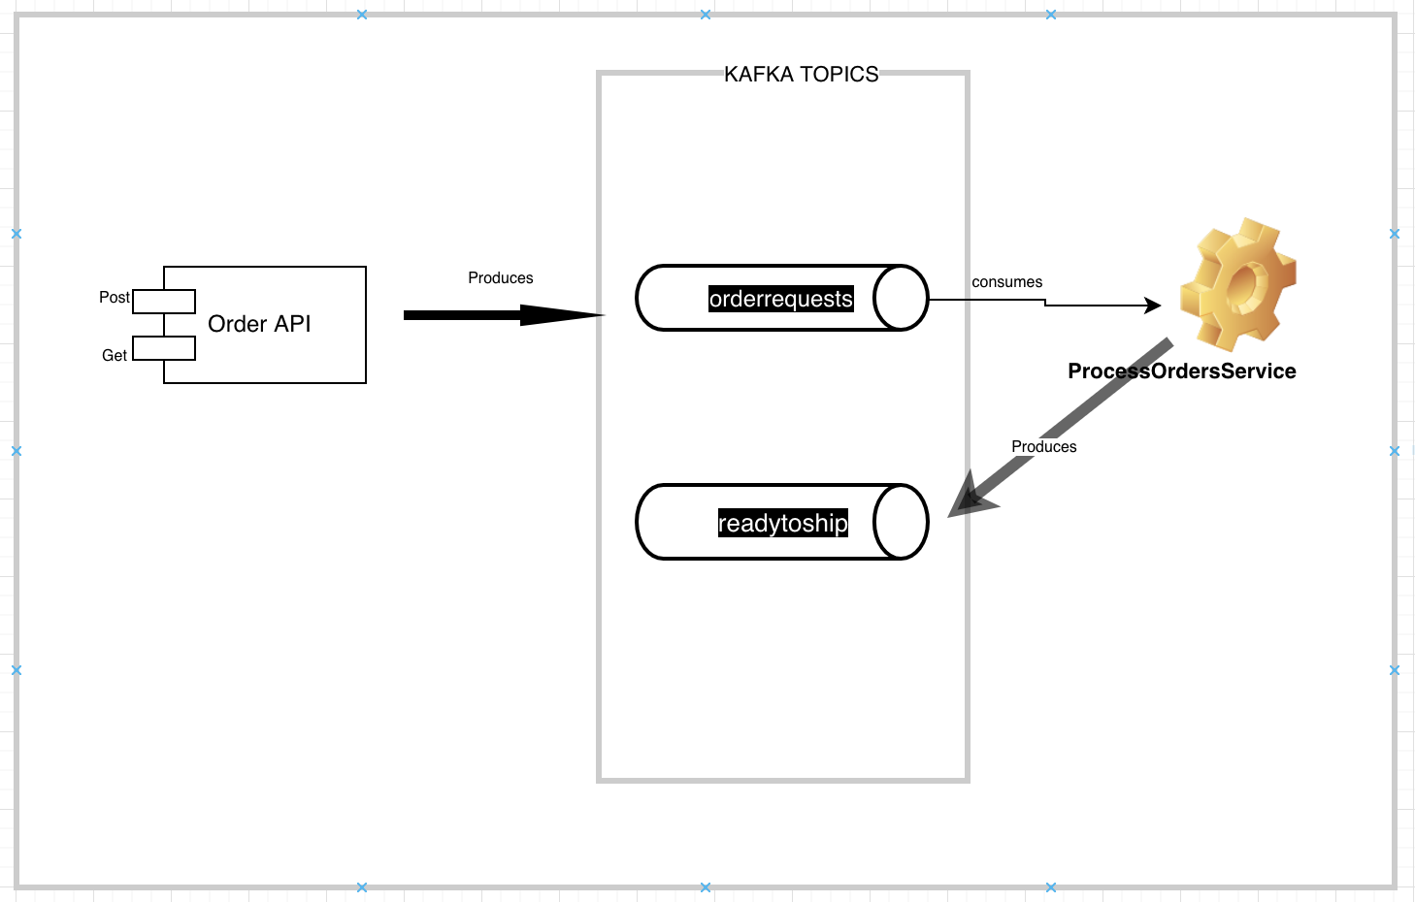
Kafka Case Study

Slide 49
Questions

Slide 50
Module Summary
Microservices using docker and Kubernets.
Message, Channel and Adapter
Understood the different Component Integration
Understood the Event-Driven Architecture

